Slide 1
the National Environmental Policy Act - NEPA
by Ralph Jesse
Environmental Protection Specialist
“Progress in every age results only from the fact that there are some men and women who refuse to believe that what they know to be right cannot be done.”
- Russell W. Davenport

Slide 2
NEPA
NEPA = National Environmental Policy Act
  Public Law 91-190, 42 U.S.C. 4321-4347, January 1, 1970
  EPA 40 CFR 1500
  Agriculture 7 CFR Part 520

Slide 3
NEPA Background
Enacted in 1970
  Applies only to Federal agencies
  Established the Council on Environmental Quality (CEQ)
CEQ regulations promulgated in 1977
  Allows agencies to prepare their own policies on NEPA

Slide 4
NEPA Background
40 CFR 1500 – 1508 -- Council on Environmental Quality
1500 - Purpose, Policy and Mandate
1501 - NEPA and Agency Planning
1502 - Environmental Impact Statement
1503 - Commenting
1504 - Precision Referrals to the Council of Proposed Federal Actions Determined to be Environmentally Unsatisfactory
1505 - NEPA and Agency Decision Making
1506 - Other Requirements of NEPA
1507 - Agency Compliance
1508 - Terminology and Index

Slide 5
NEPA Background
7 CFR 520 –
Procedures for ARS Implementing NEPA, 1986
520.1 General statement
520.2 Definition
520.3 Policy
520.4 Responsibilities
520.5 Categorical Exclusions (CATEX)
520.6 Preparation of an Environmental Assessment (EA)
520.7 Preparation of an Environmental Impact Statement (EIS)

Slide 6
NEPA’s Twin Objectives
Federal managers must make “informed decisions” and consider environmental effects along with mission, cost, schedule, etc.
Federal Agencies must diligently involve the public when making decisions having significant environmental impacts

Slide 7
NEPA
NEPA is PROCEDURAL statute
  Agencies must take a “HARD LOOK” at environmental consequences
NEPA does not drive decision
  Not required to select least environmentally damaging alternative
  Not required to elevate environmental concerns above other considerations
There is no “NEPA regulator” -- NEPA oversight is through the courts

Slide 8
NEPA Trigger
Compliance is required whenever an agency proposes to take “a major Federal action”
A “major Federal action” is any action that has the potential for significant impact on human environment
Typical actions:
  Constructing facilities
  Awarding grants
  Approving permits
  Research and Development
  Real Estate actions (leasing, disposal, acquisition)

Slide 9
“Significance”
Context – setting
Intensity – severity
  The degree to which the proposal:
    Has uncertain or scientifically controversial impacts
    Affects public health and safety
    Affects important natural resources (e.g. wetlands, listed species, Federal parks, wildlife refuges, cultural resources, marine sanctuaries, coral reefs, etc.)
    May establish a precedent for future actions with significant impacts
    Threatens violation of an environmental law

Slide 10
NEPA Documentation
Categorical Exclusion (CATEX) – routine actions with known insignificant impacts
Environmental Assessment (EA) – actions with unknown impacts
Environmental Impact Statement (EIS) – actions with significant impacts

Slide 11
Procedure
Is the planned operation a headquarters project? Determine if the NEPA review and documentation is already completed by SHEMB – FD.
Is the planned operation a research project? Determine if the NEPA review and documentation is already completed by National Program Staff.

Slide 12
Categorical Exclusion = CATEX
Used for actions having minimal impact
Most widely used for NEPA compliance
Not used where impacts
  Affect public health or safety
  Are uncertain / unknown
  Threaten violation of environmental law
  Would adversely affect important natural resources (endangered species, wetlands, cultural resources, etc.)

Slide 13
CATEX Examples
Routine procurements
Day-to-day administrative and management activities
Rehabilitation / modification of structures resulting in less than 20% increase in size and where land use does not change
Real estate acquisition, disposal or leasing where resulting land use does not change
Routine movement and use of hazardous materials when conducted in accordance with applicable environmental standards
Support services including health care, home ownership assistance, day care, rental assistance, etc.
Construction of facilities less than 10,000 SF and consistent with surrounding land use

Slide 14
Blanket CATEX for Routine Activities
General Repair and Maintenance Projects
  Plumbing (no asbestos abatement)
  HVAC (no insulation abatement)
  Painting (no lead abatement)
  Landscaping (no soil displacement)
  Carpentry (no landfill restrictions)
  Electrical (no PCB abatement)

Slide 15
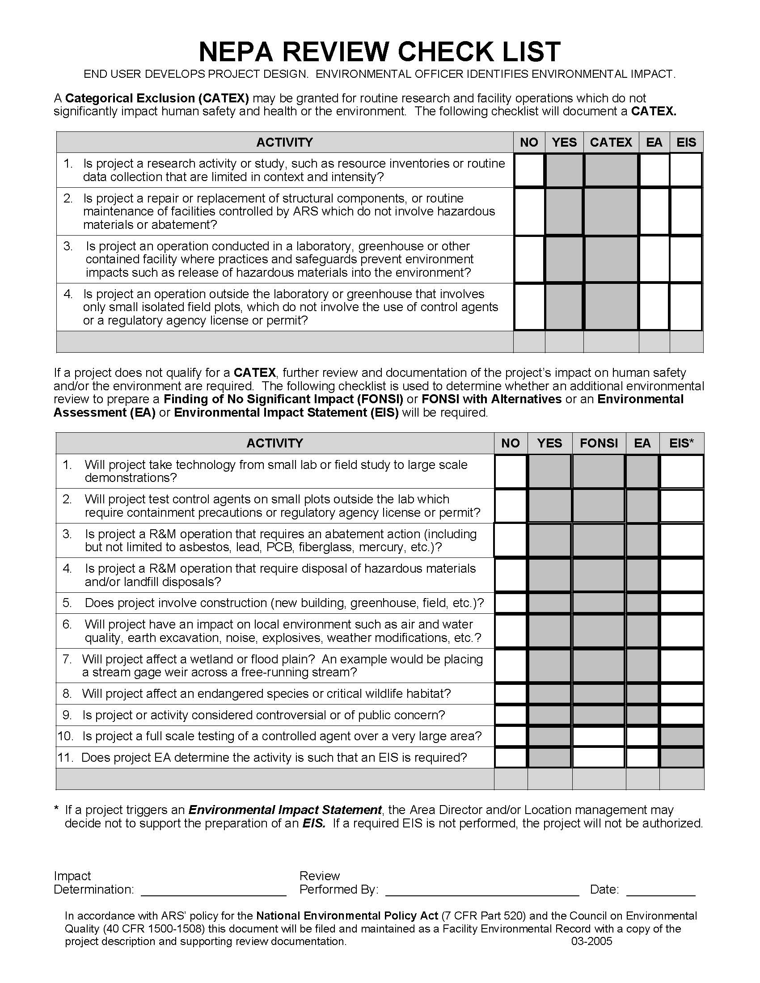
Link to NEPA PDF Fillable Checklist

Slide 16
CATEX Documentation
One-page memo to file
Memo:
  Describes proposed activity
  Explains why there are no extraordinary circumstances impacting the environment
  Cites 7 CFR 520.5, ARS Procedures for Implementing NEPA
  Must be signed by Area Director

Slide 17
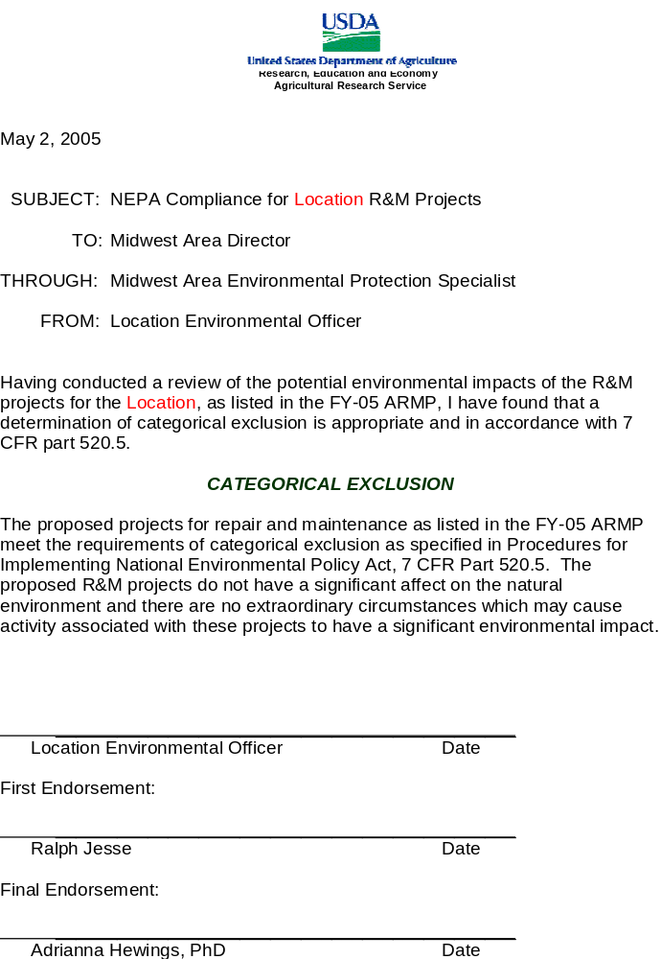
Link to Example Catex Memo

Slide 18
Environmental Assessment
Extensive Repair and Maintenance Projects
  Plumbing with asbestos abatement
  HVAC with insulation abatement
  Painting with lead abatement
  Landscaping with soil displacement
  Carpentry with abatement issues and landfill restrictions
  Electrical with PCB abatement
Requires a brief design review and project plan.

Slide 19
Link to NEPA PDF Fillable Checklist

Slide 20
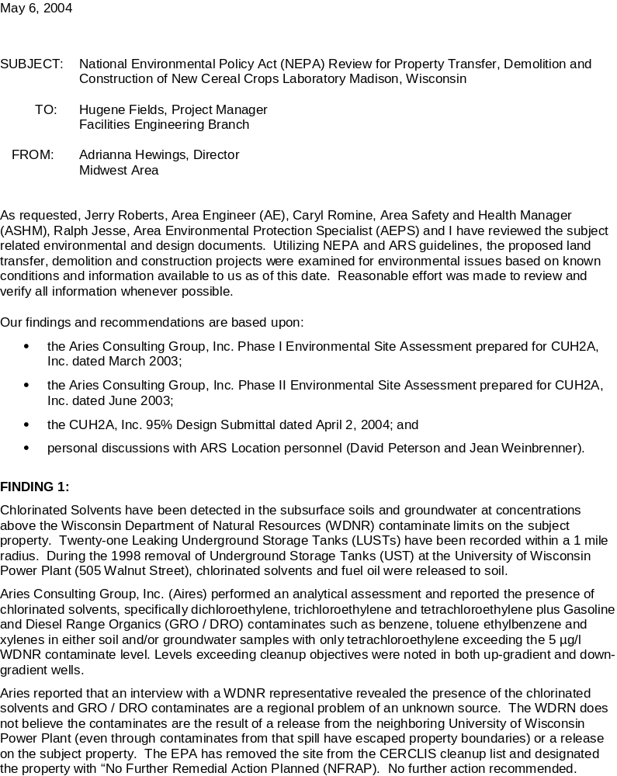
Link to FONSI Memo Example

Slide 21
Minor Environmental Assessment
Brief review document
  Demonstrates no significant impacts
Must
  Identify the proposed action
  State alternatives considered
  Discuss impacts
Process time – One week
EA Cost estimate - negligible

Slide 22

Link to FONSI Memo Example

Slide 23
Major Environmental Assessment
Detailed review document
  Demonstrates no significant impacts, or
  Facilitates preparation of EIS when one is necessary
Must
  Identify the proposed action
  State alternatives considered
  Discuss impacts
Process time = Three - six months+
EA Cost estimate = $20K - $80K

Slide 24
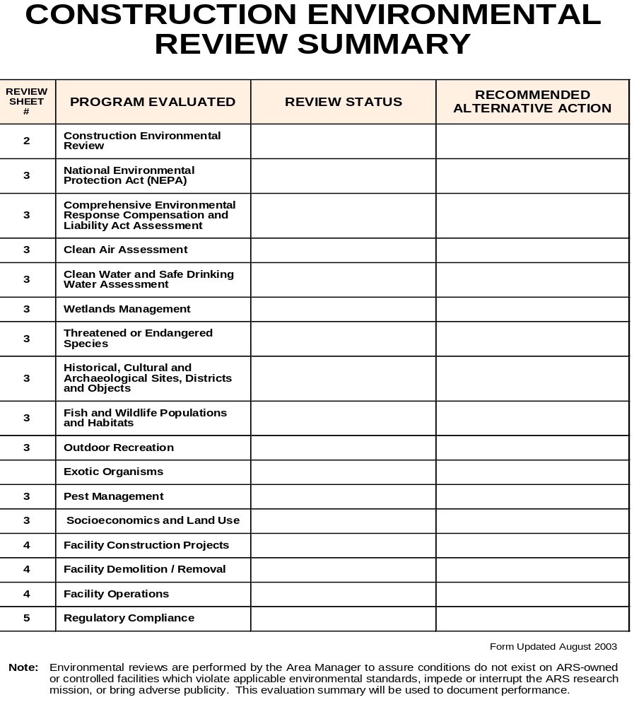
Link to Environmental Assessment Form

Slide 25
Link to FONSI Memo Example

Slide 26
Environmental Impact Statement
Required for actions with significant environmental impacts
Formal process – takes 18 months or more
Requires intensive interaction with “interested and affected parties”
Costly ~ $150K and up

Slide 27
EIS Content
Proposed activity
Purpose and need
Alternatives
Existing conditions
Projected impacts
Mitigation – alternative activities

Slide 28
NEPA Process
PROPOSED
ACTION
CATEGORICAL
EXCLUSION
?
YES
RECORD OF
CATEGORICAL
EXCLUSION
NO
IMPACTS
SIGNIFICANT
?
FINDING OF
NO
SIGNIFICANT
IMPACT
IMPLEMENT
ACTION
ENVIRONMENTAL
ASSESSMENT
NO
YES
ENVIRONMENTAL
IMPACT
STATEMENT
RECORD OF
DECISION

Slide 29
NEPA Timeframe
NEPA should occur at the earliest planning stage of a project or action – the “go” or “no go”
Repair and Maintenance
Construction
  NEPA is typically done at the planning stage (15% design)
  Grant applicants usually required to provide NEPA - like analysis for Federal review / adoption

Slide 30
SUMMARY
NEPA is PROCEDURAL statute
NEPA applies to most Federal actions
Agency decision makers must be informed about environmental impacts before taking an action
Agencies should develop procedures for determining the level of NEPA documentation for proposals
Agencies should promulgate a list of Categorical Exclusions
Plaintiffs and the courts regulate NEPA

Slide 31

Questions?

