Slide 1
Form 175 and Overview of Radio Service and Auction Rules
FM Broadcast Auction
(Auction No. 62)
Lisa Stover, Auctions Marketing Specialist, ASAD
Jim Bradshaw, Deputy Chief, Audio Division
Lisa Scanlan, Assistant Chief, Audio Division
Howard Davenport, Attorney Advisor, ASAD

Slide 2

Disclaimer
Nothing herein is intended to supersede any provision of the Commission's rules or public notices. These slides should not be used as a substitute for a prospective applicant's review of the Commission's relevant orders, rules, and public notices. Prospective applicants must familiarize themselves thoroughly and remain current with the Commission's rules relating to the FM Broadcast service, rules relating to application and auction procedures, and the procedures, terms and conditions contained in the Auction No. 62 public notices.

Slide 3
Questions?
If you are viewing this presentation live over the web, please feel free to email your questions to…
auction62@fcc.gov

Slide 4
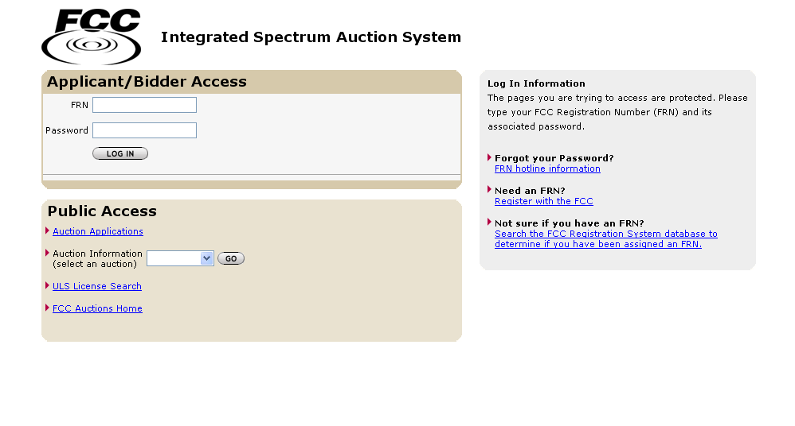

Slide 5
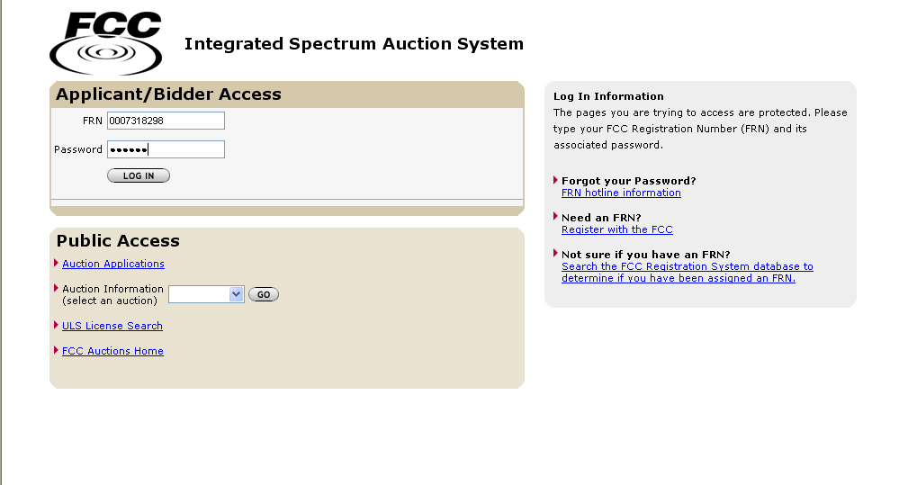

Slide 6
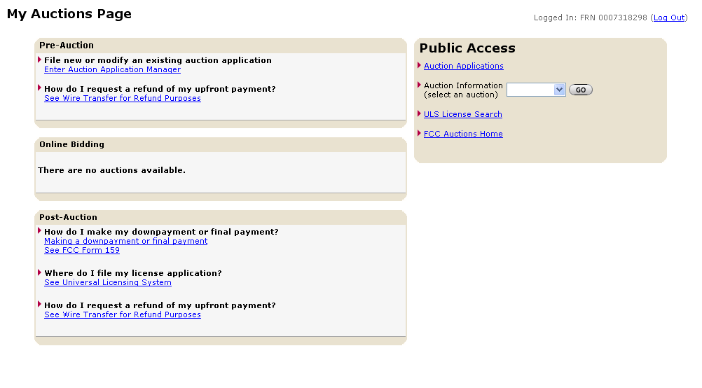

Slide 7
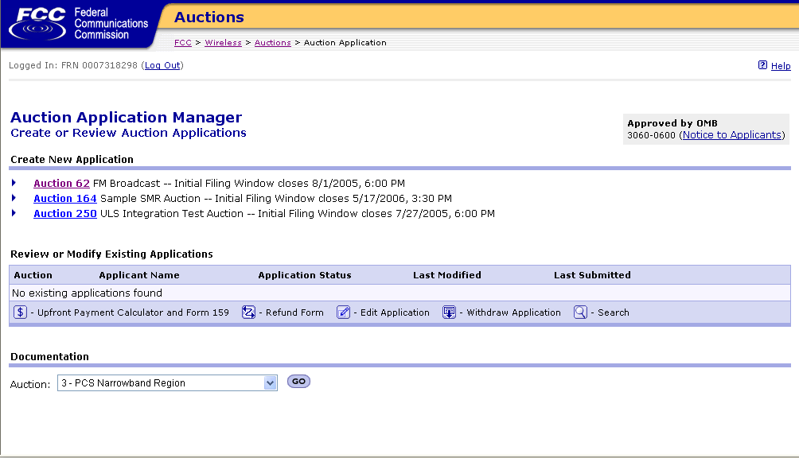

Slide 8
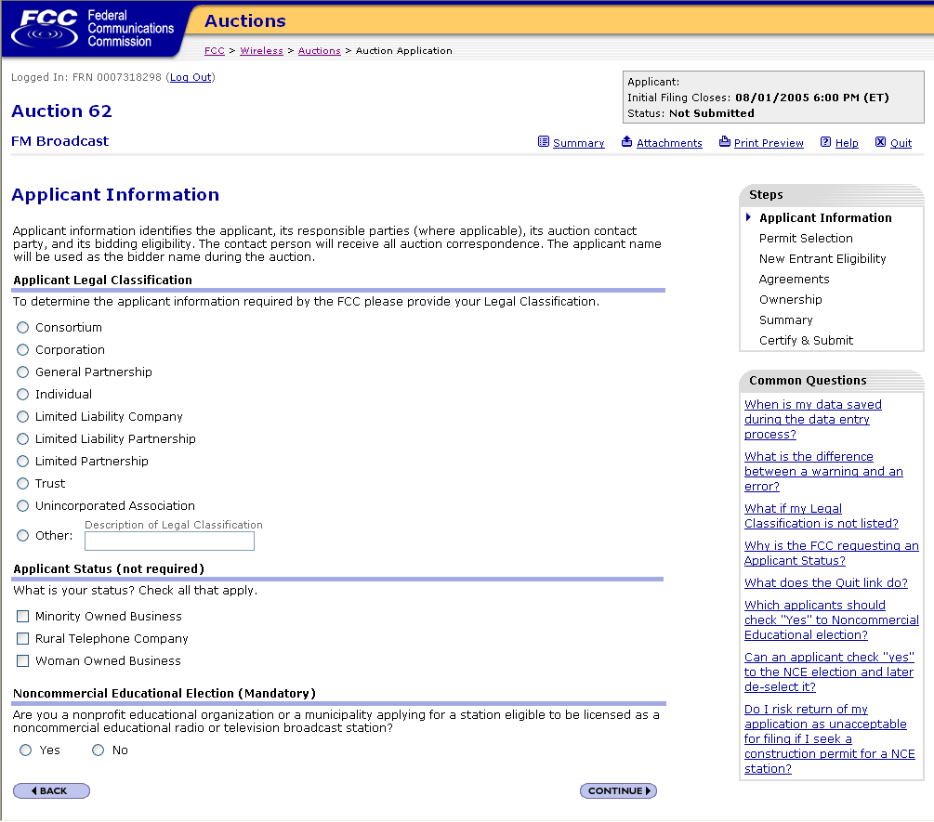

Slide 9

A legal Classification
must be selected
in order to proceed

Slide 10
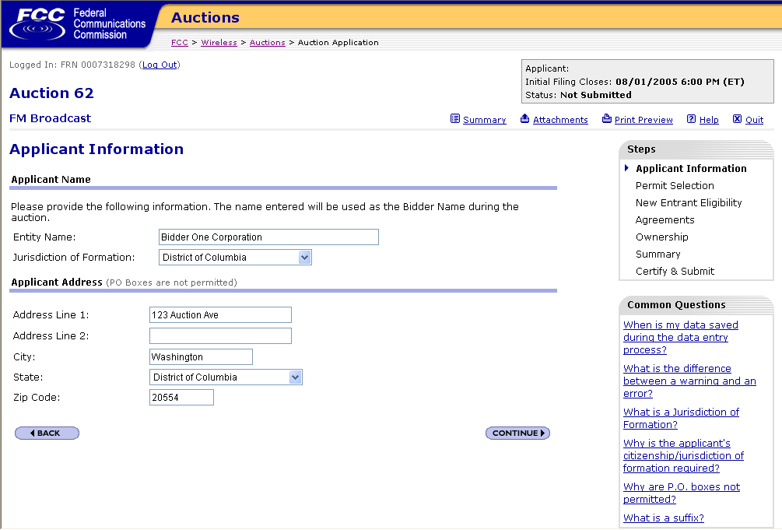

Slide 11
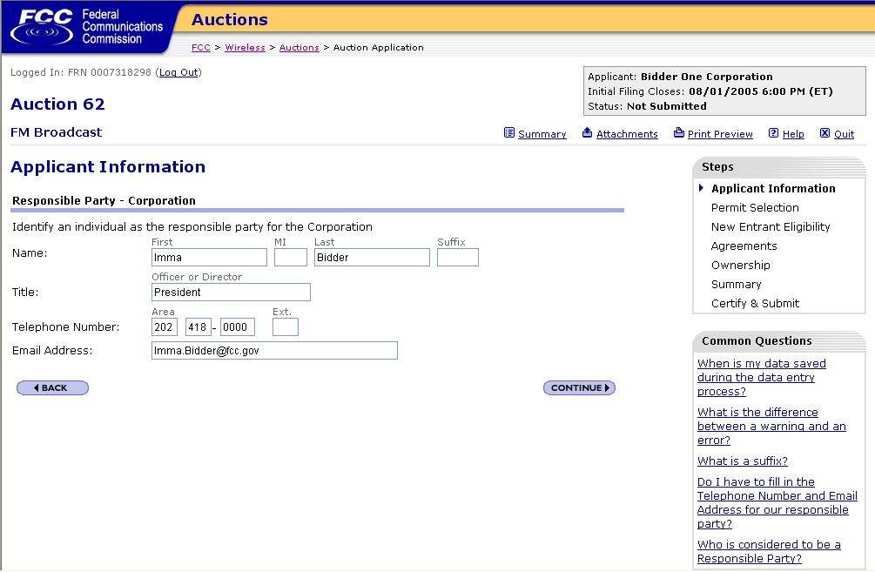

Slide 12
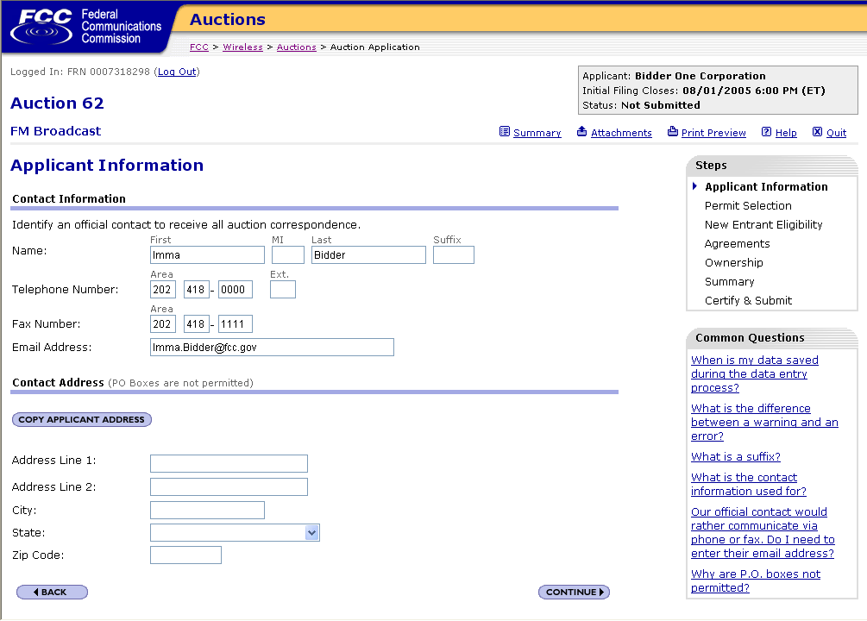
Copy Address If same
as Applicant

Slide 13


Slide 14
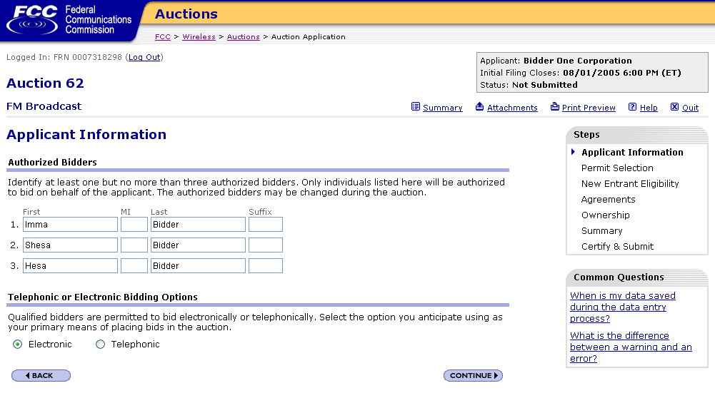

Slide 15
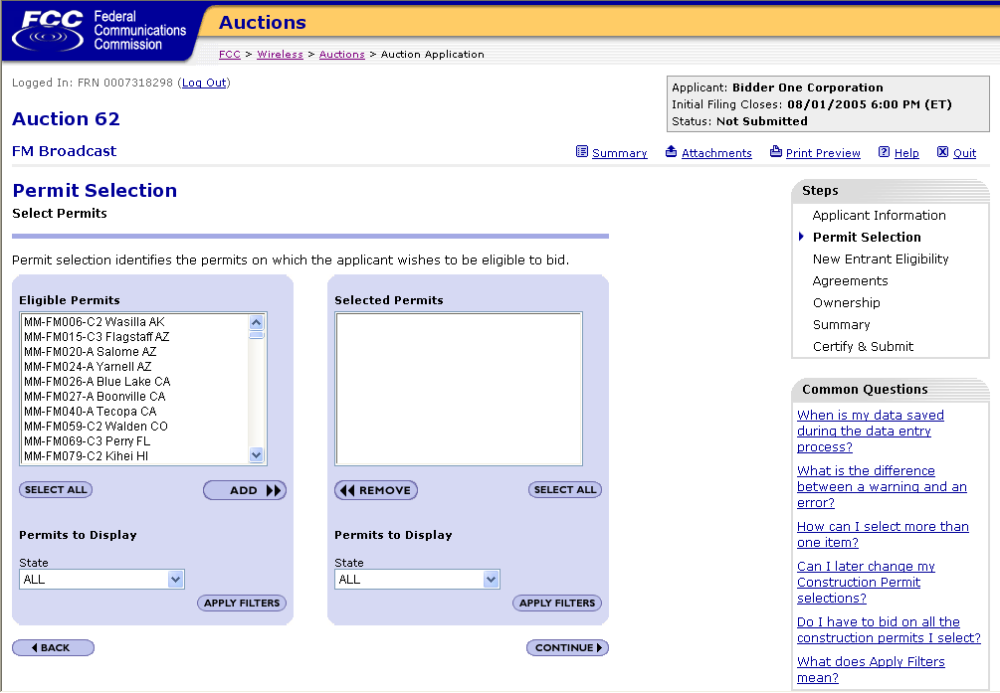
PA

Slide 16
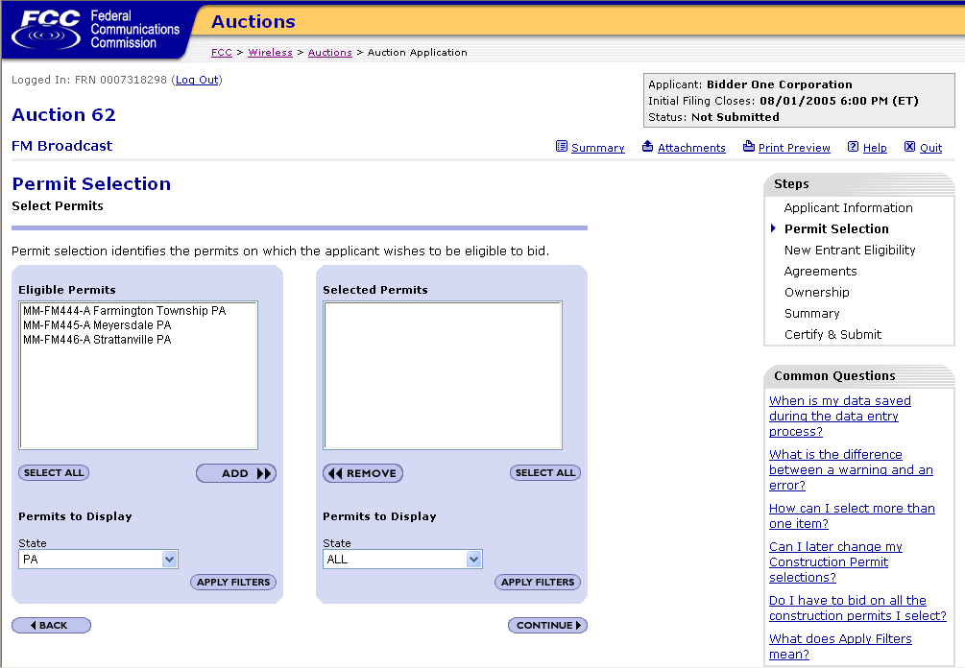

Slide 17
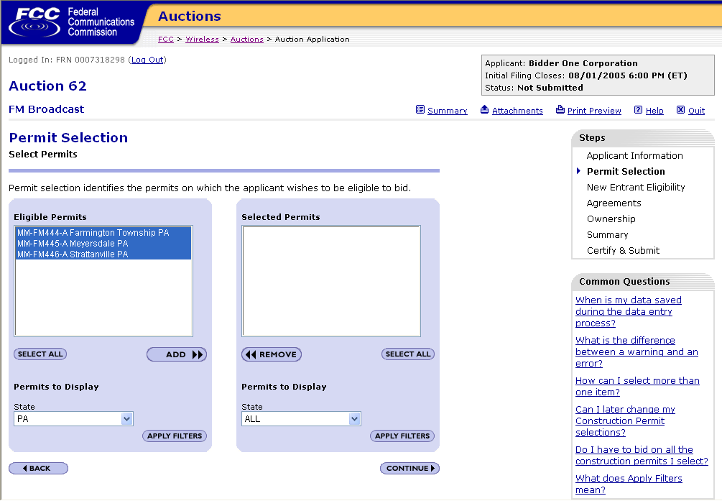

Slide 18
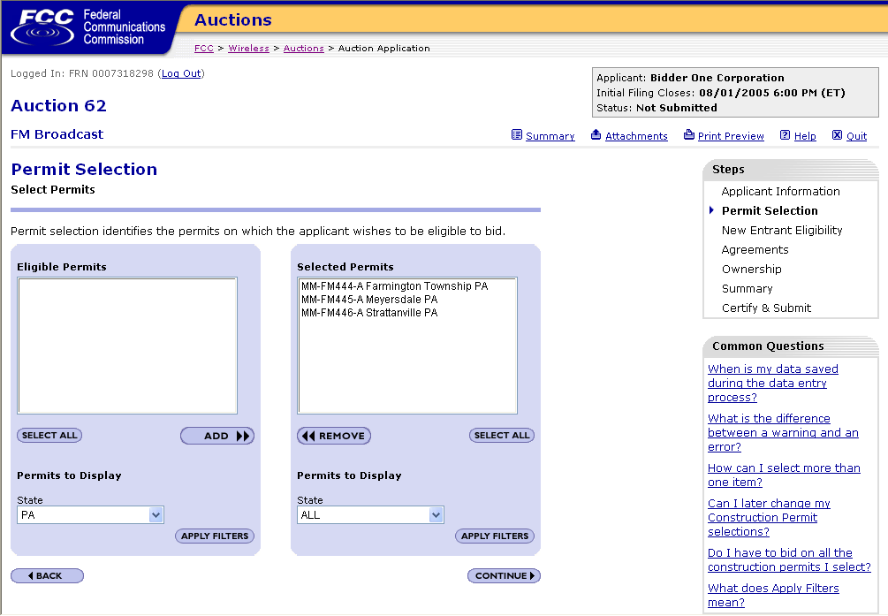

Slide 19
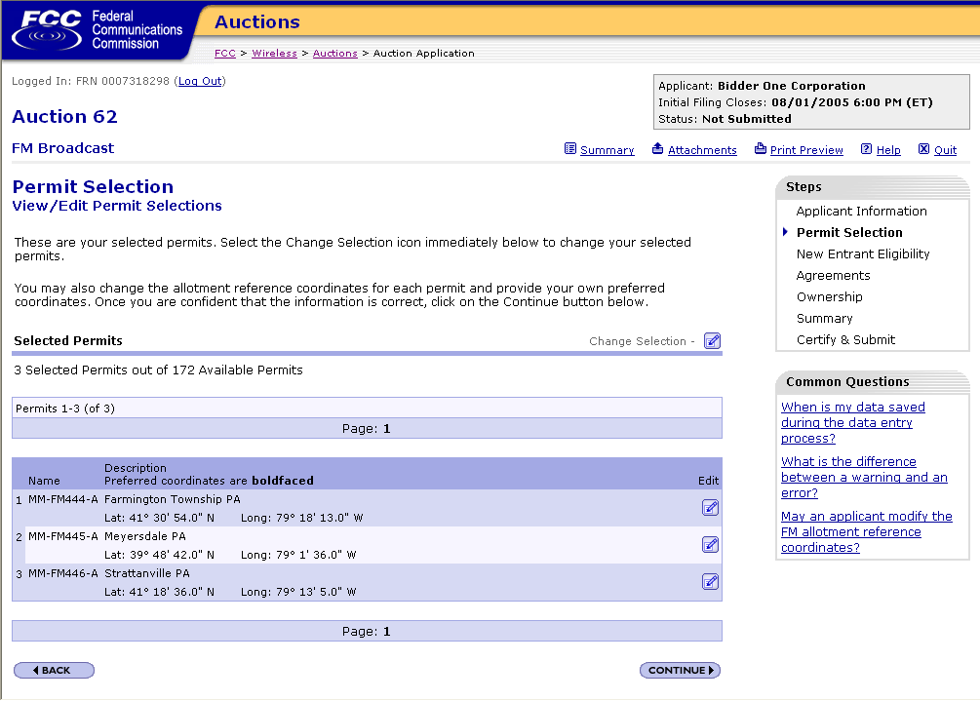

Slide 20
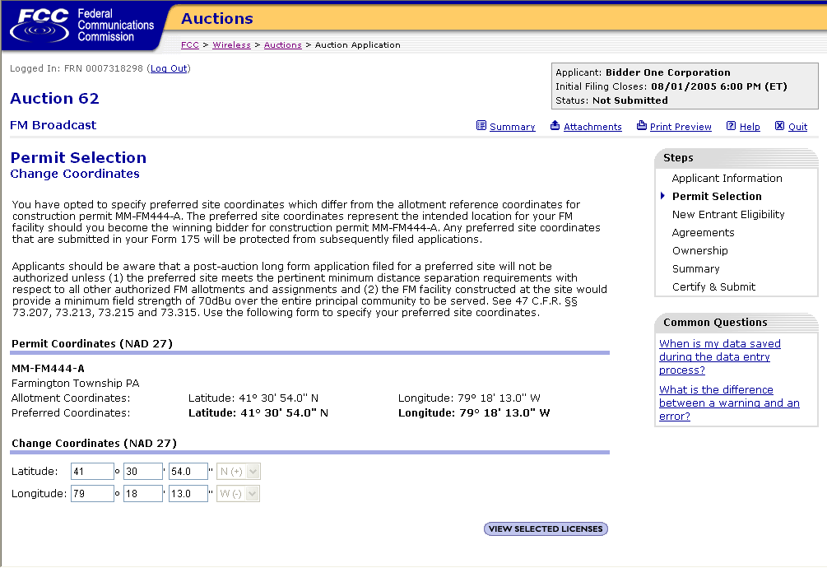

Slide 21


Slide 22


Slide 23
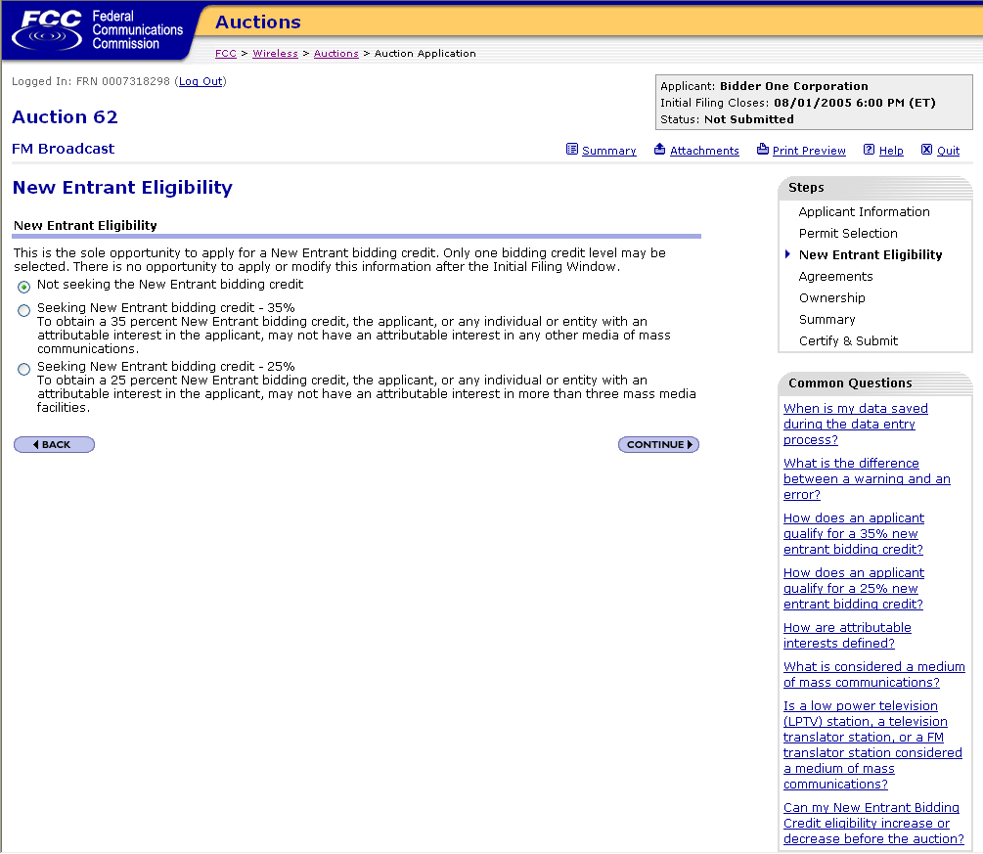

Slide 24
New Entrant Bidding Credit
Unique to broadcast auctions
Will be offered in FM Auction No. 62

Slide 25
History
Adopted August 6, 1998 in Broadcast First Report and Order (FCC 98-194) 13 FCC Rcd 15920 (1998)
  Fulfills 309(j) obligation
  promotes ownership diversification
Refined on reconsideration in April 15, 1999 Memorandum Opinion and Order (FCC 99-74) 14 FCC Rcd 8724 (1999)
Applied debt/equity attribution provisions in second Memorandum Opinion and Order August 4, 1999 (FCC 99-201) 14 FCC Rcd 12541 (1999)
Governed by the broadcast attribution rules

Slide 26
Mechanics
Bidding Credit: a percentage discount applied to high bid amount if bidder meets designated entity criteria established in broadcast auction rules
Two tiers: 25% and 35%
Apply on Form 175 - New Entrant Eligibility page
No opportunity to apply after initial filing window deadline

Slide 27
Rules
47 C.F.R. Section 73.5007 - Designated Entity Provisions
47 C.F.R. Section 73.5008 - Definitions
Applies general broadcast attribution provisions of rule 47 C.F.R. Section 73.3555, note 2

Slide 28
Eligibility
Whose other media interests are counted in establishing eligibility?
We consider other media interests held by winning bidder, and by any entity or individual with attributable interest in winning bidder
35% - no attributable interest in any other media of mass communication
25% - attributable interest in no more than 3 existing mass media facilities
  Existing interests may not be in “same area” as a proposed facility

Slide 29
Eligibility
“same area” – existing facility in “same area” as proposed if relevant defined service area of existing facility partially overlaps, or is partially overlapped by, proposed facility’s relevant contour
- relevant contours defined in 73.5007
What media interests are counted?
73.5008 defines a “medium of mass communications”: daily newspaper; cable television system; license or construction permit for television, AM or FM broadcast station; direct broadcast satellite transponder; or multipoint distribution service station

Slide 30
Eligibility
Which interests are counted?
Attributable interest – determined in accordance with 47 C.F.R. Section 73.3555 and note 2
Interests held by winning bidder in LPTV, TV translator, or FM translator facilities not counted as mass media interests in determining eligibility
Full service noncommercial educational stations, on both reserved and nonreserved channels, are included as mass media interests. Minnesota Christian Broadcasters, Inc., 18 FCC Rcd 614 (2003)

Slide 31
Unjust enrichment
If permittee used bidding credit and seeks to assign or transfer control to entity not meeting eligibility criteria
Must reimburse Government for bidding credit amount plus interest
Condition of Commission approval of assignment or transfer
5 year reimbursement period
  within first 2 years: 100%
  year 3: 75%
  year 4: 50%
  year 5: 25%. No reimbursement thereafter

Slide 32


Slide 33
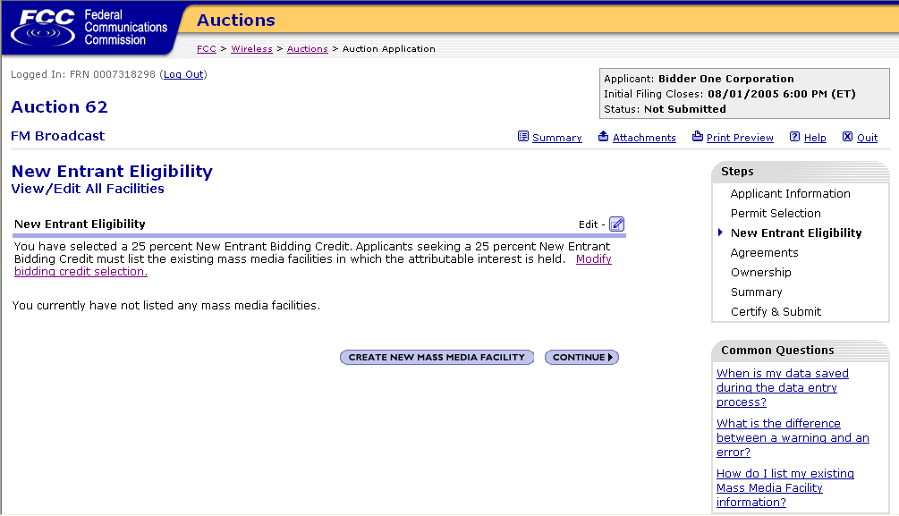

Slide 34
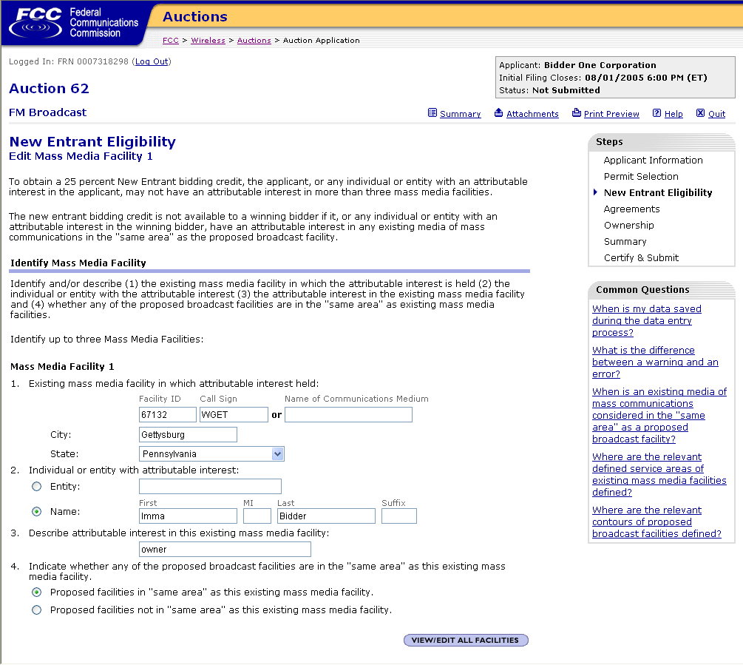

Slide 35
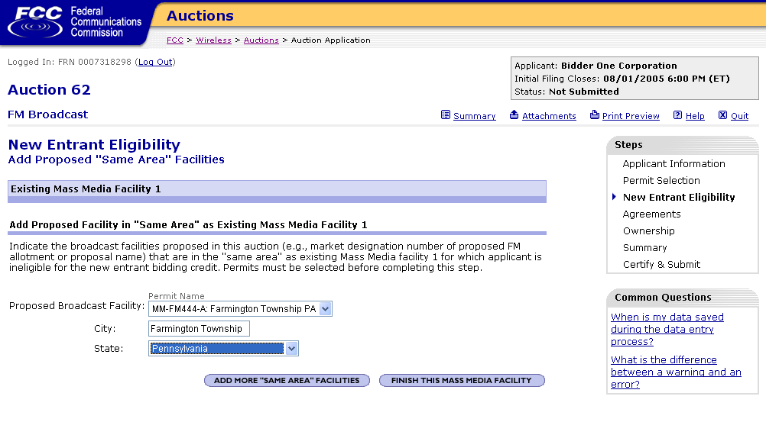
If additional
proposed
facilities
click here

Slide 36
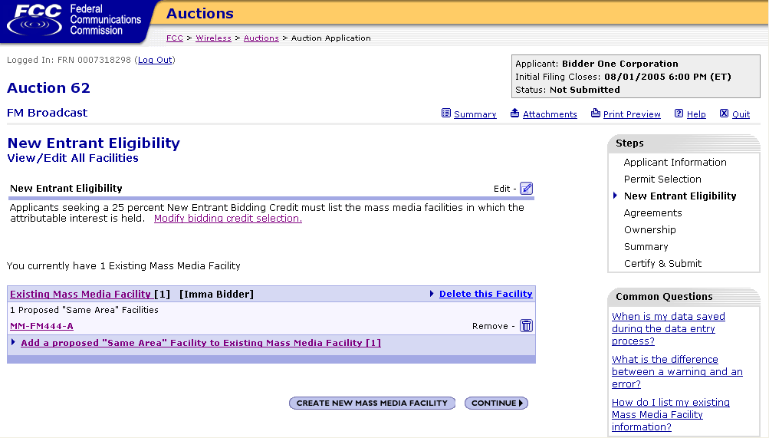
Click here to
identify
any additional
existing facilities

Slide 37
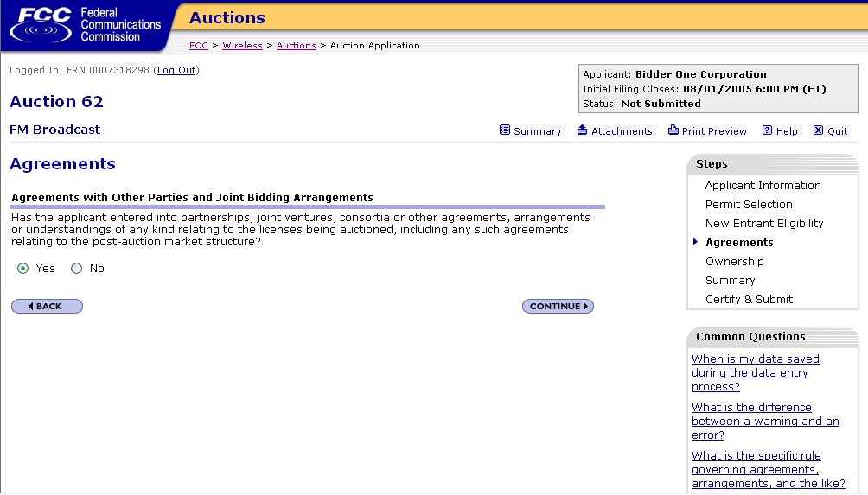

Slide 38
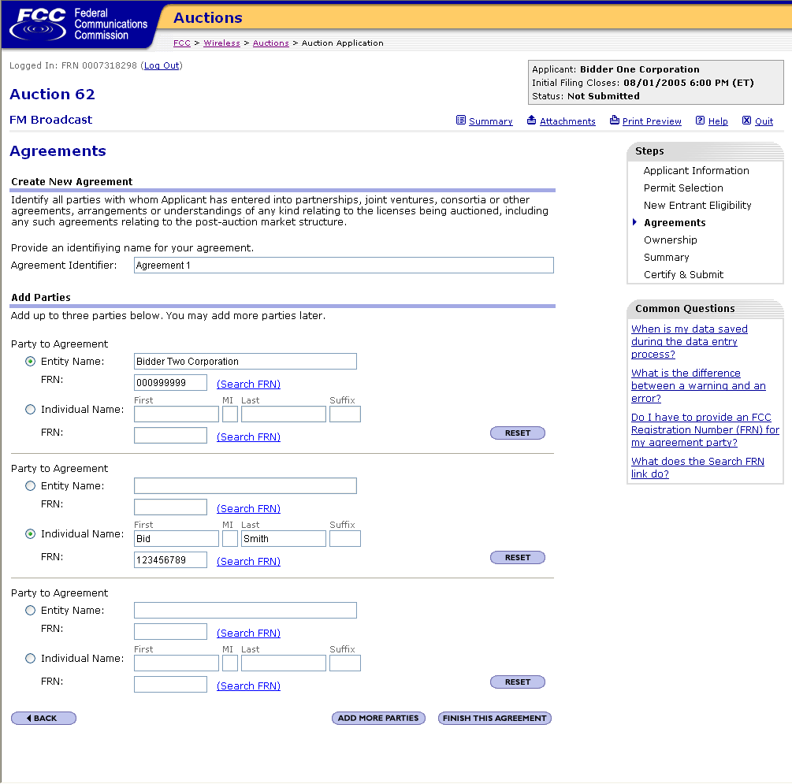
System allows
for more than
3 parties
to be
entered

Slide 39
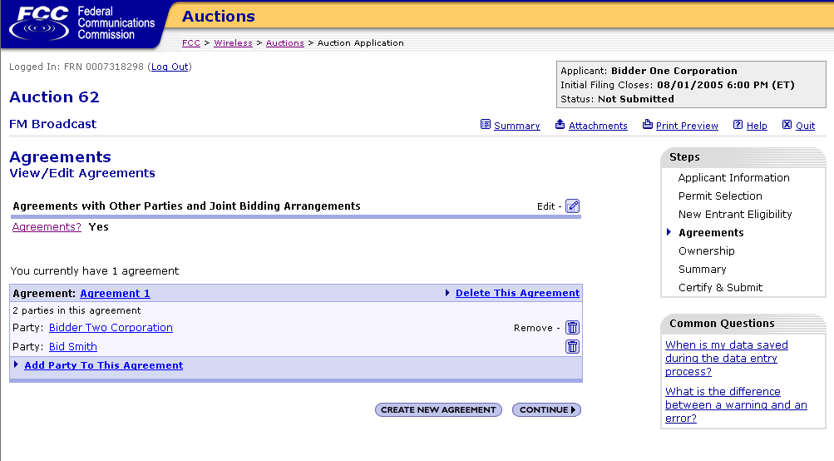

Slide 40
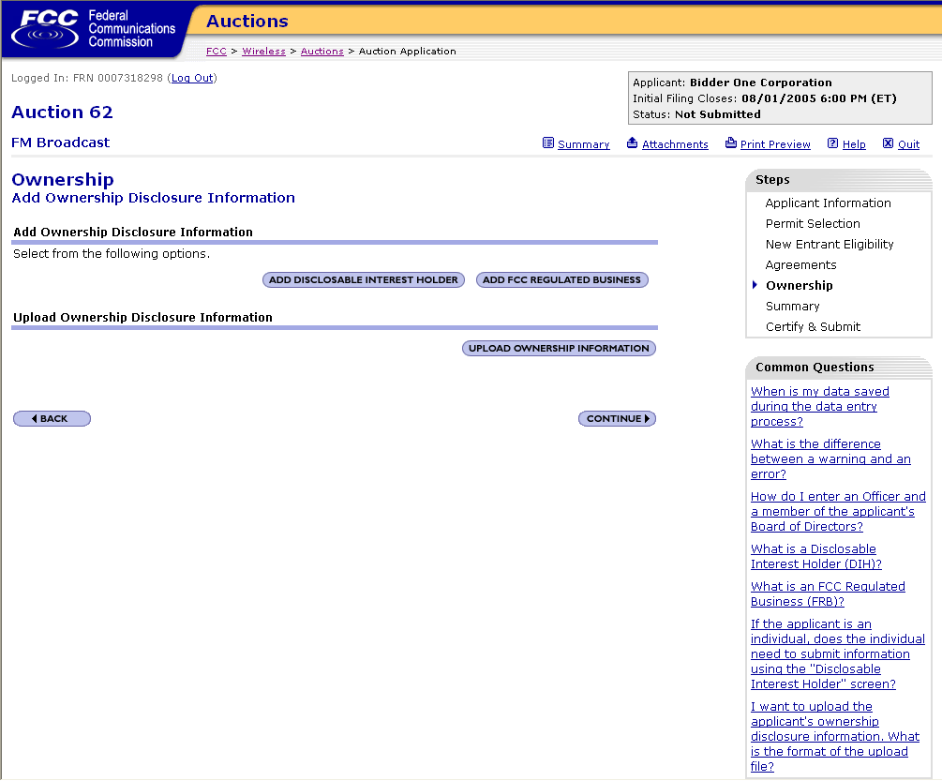
Notes:
Under Section 1.2105(a)(2)(ii), each applicant is required to disclose all real parties in interest.
Real parties in interest is defined in Section 1.2112.
YOU MUST INCLUDE INFORMATION ON all parties having a 10 percent or greater interest in the applicant
YOU MUST ALSO INCLUDE all FCC-regulated entities of which the applicant and entities with disclosable ownership interests in the applicant own 10 percent or more.
THE FOLLOWING SCREEN SHOTS SHOW WHAT THE SYSTEM WOULD DISPLAY IF AN APPLICANT SELECTED THE ‘ADD DISCLOSABLE INTEREST HOLDER’. [CLICK] [CLICK]

Slide 41
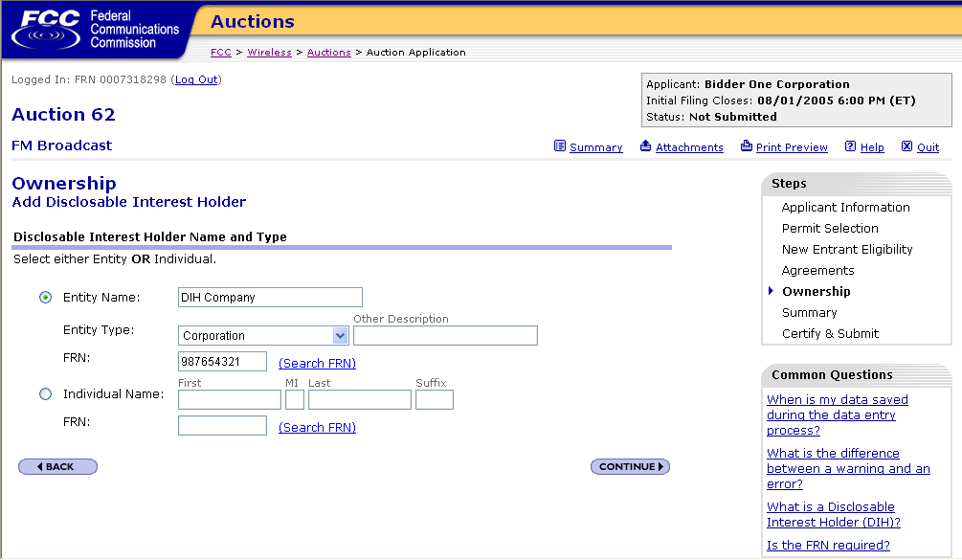

Slide 42
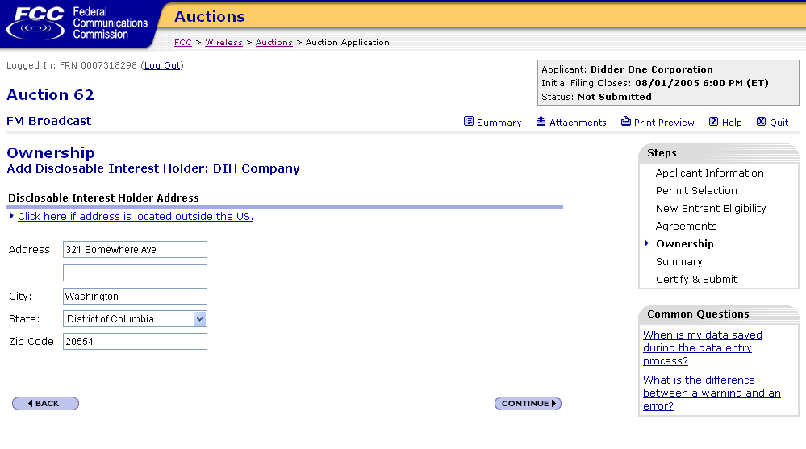
Link for Address
outside the U.S.

Slide 43
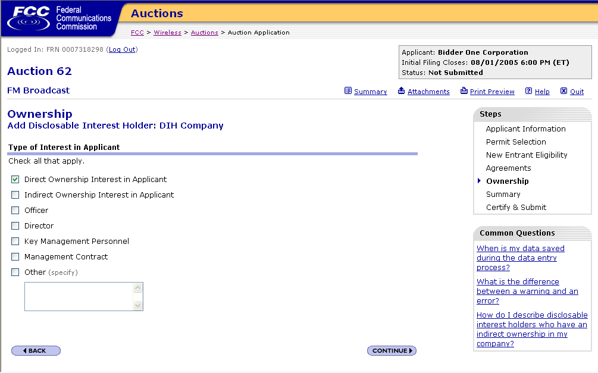

Slide 44
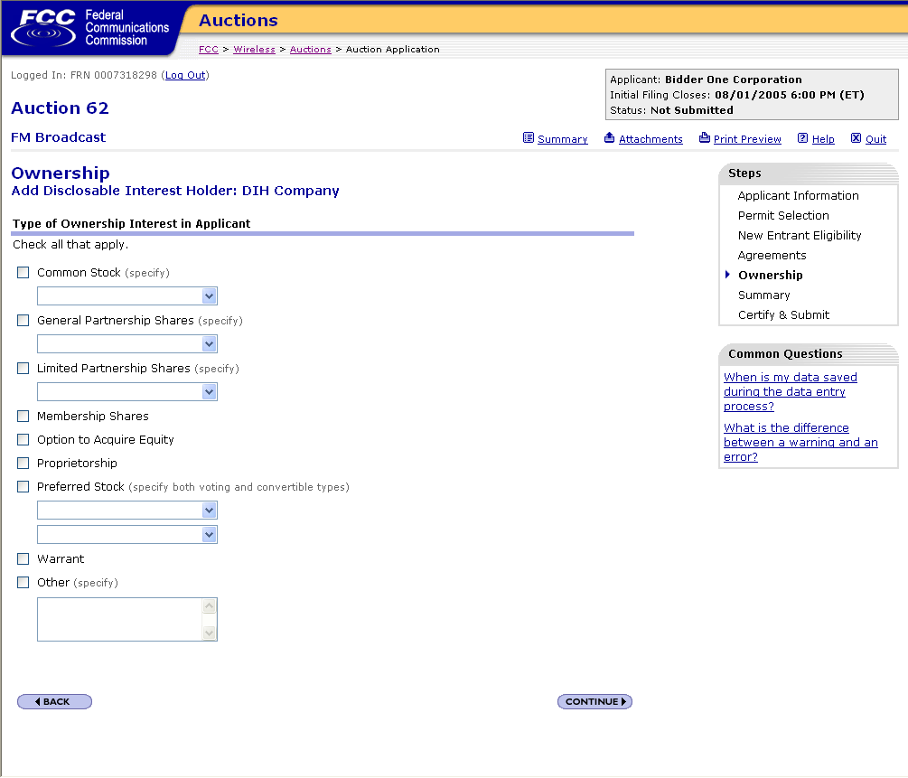

Slide 45
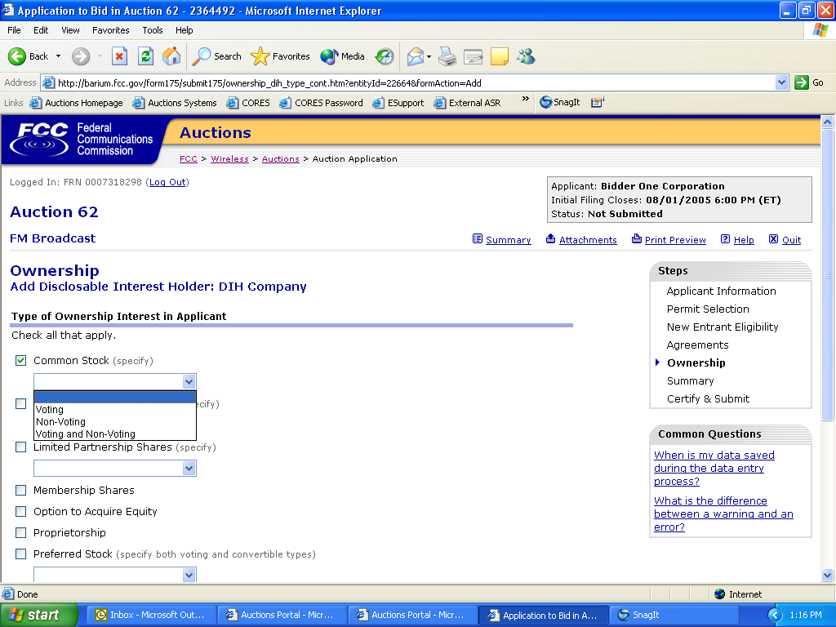

Slide 46
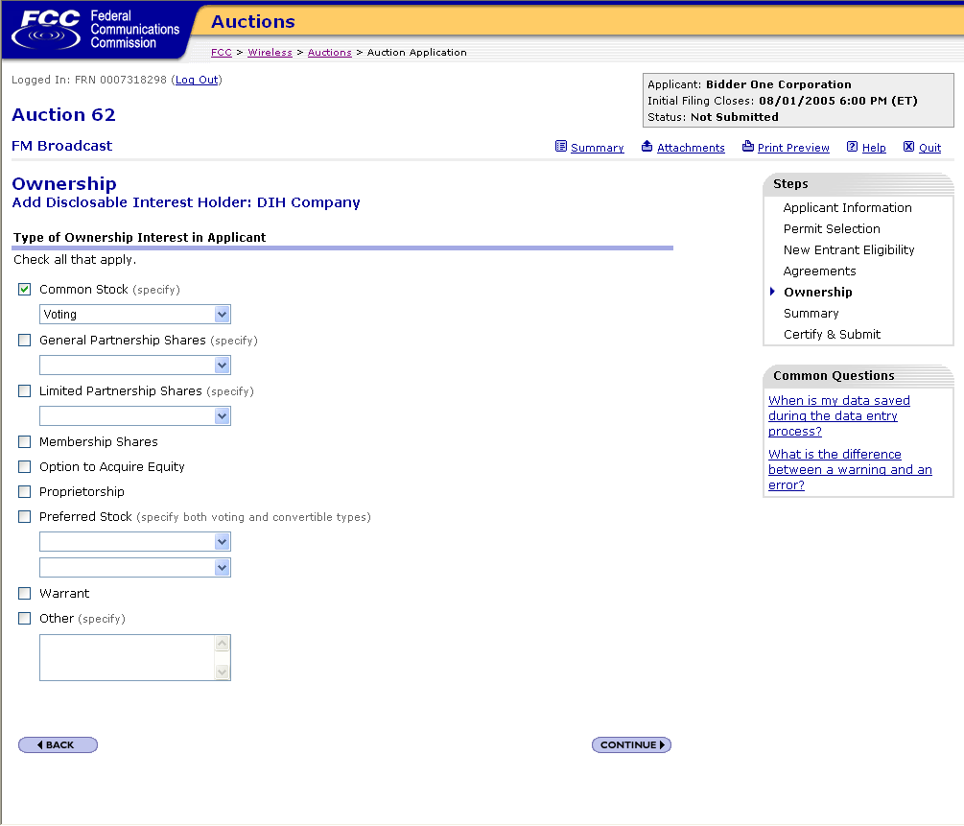

Slide 47
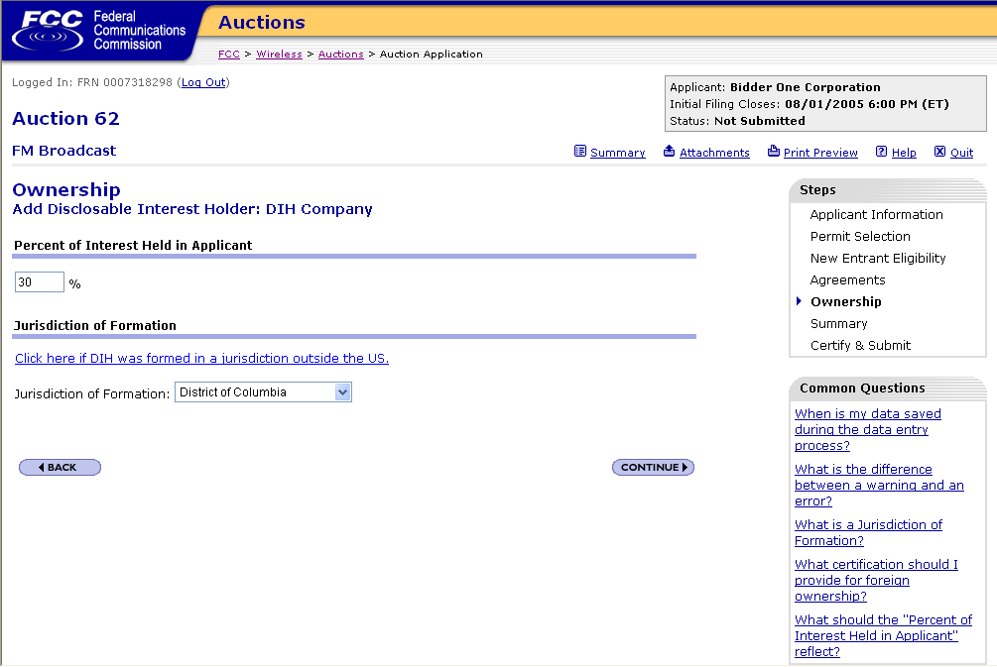
Link if jurisdiction
outside U.S.

Slide 48
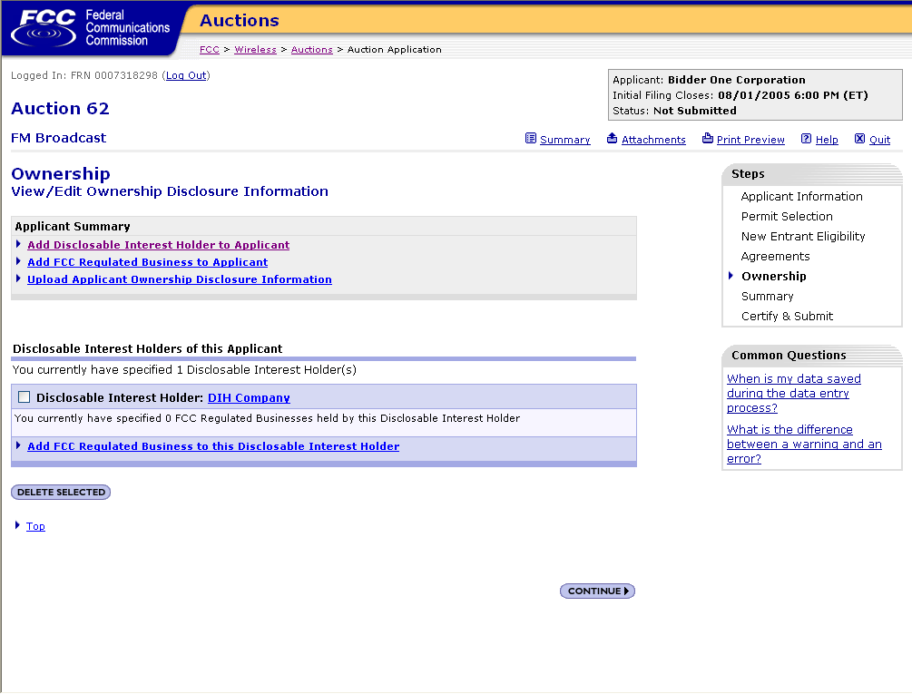
DIH information
previously
entered displays

Slide 49
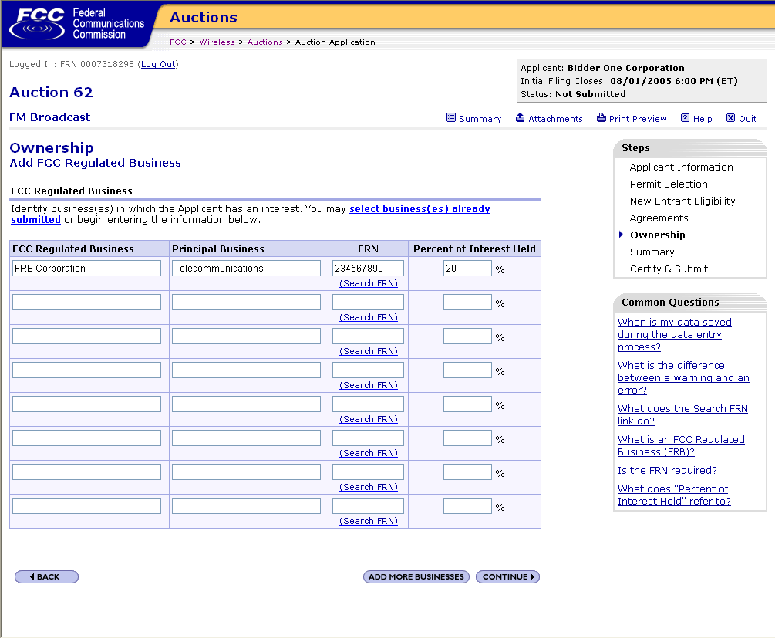

Slide 50
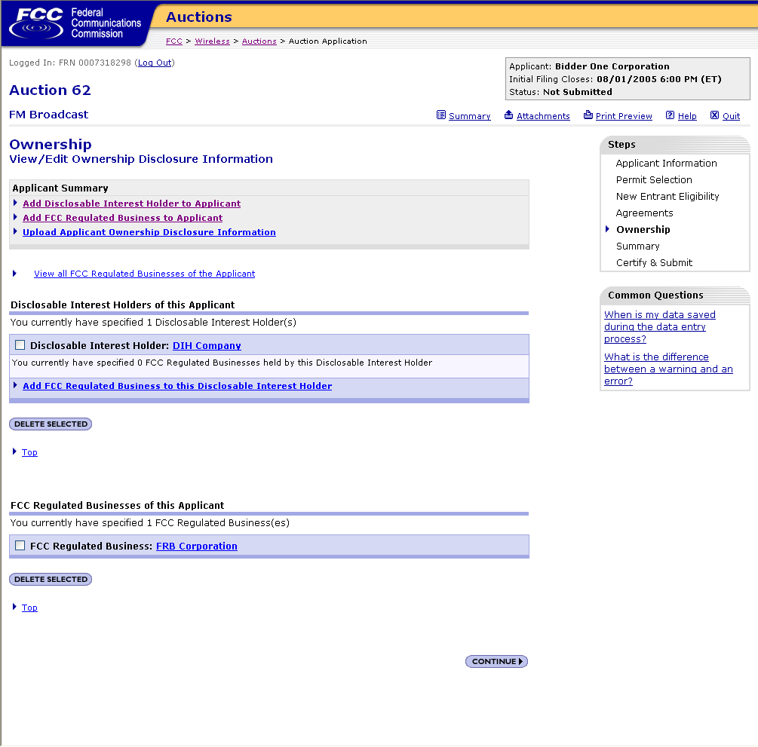
FRB
information previously
entered displays

Slide 51
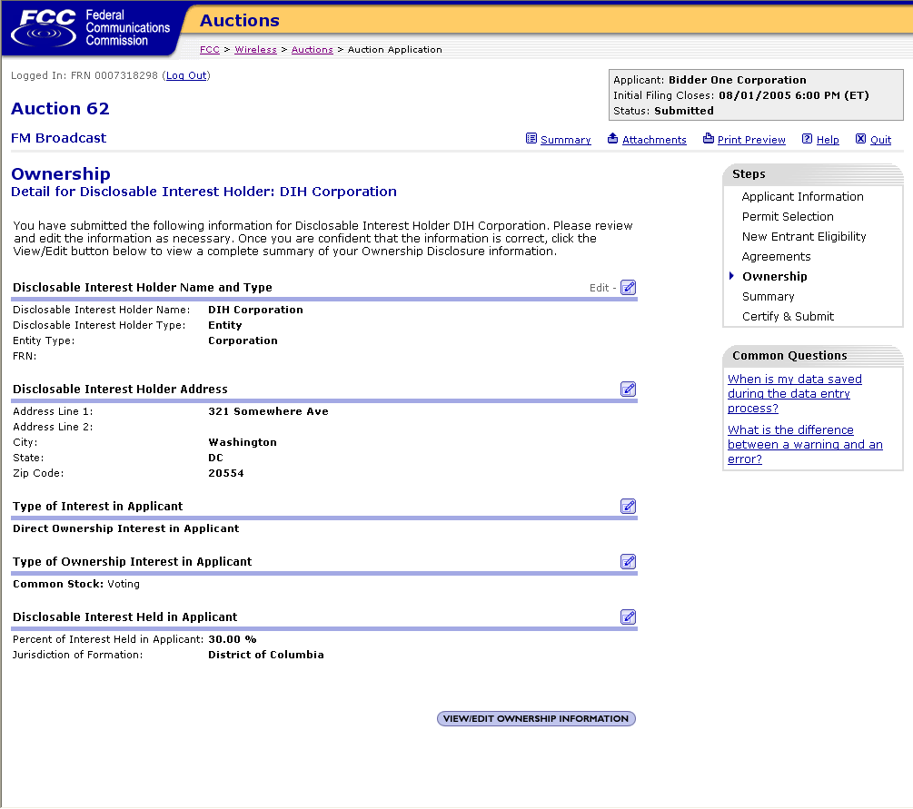

Slide 52
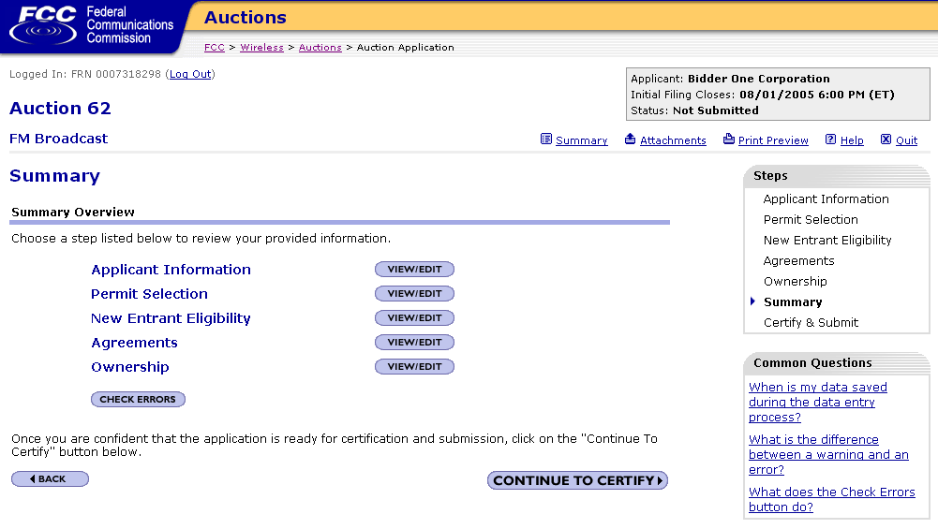
You can check for errors
before
certifying and submitting

Slide 53
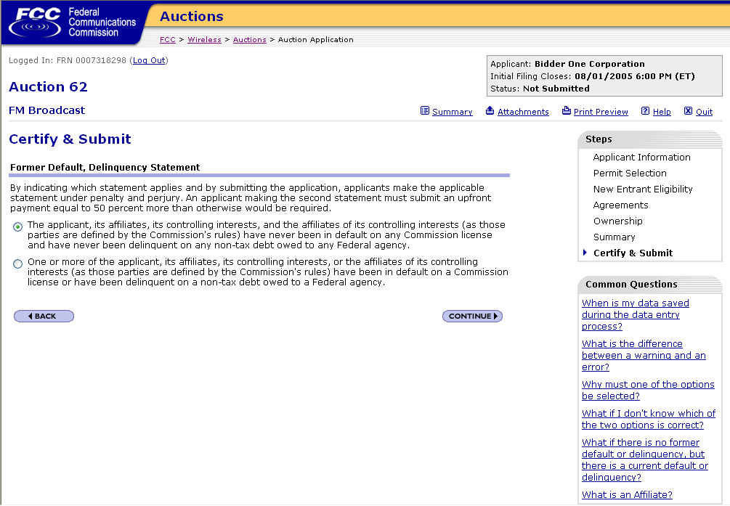

Slide 54
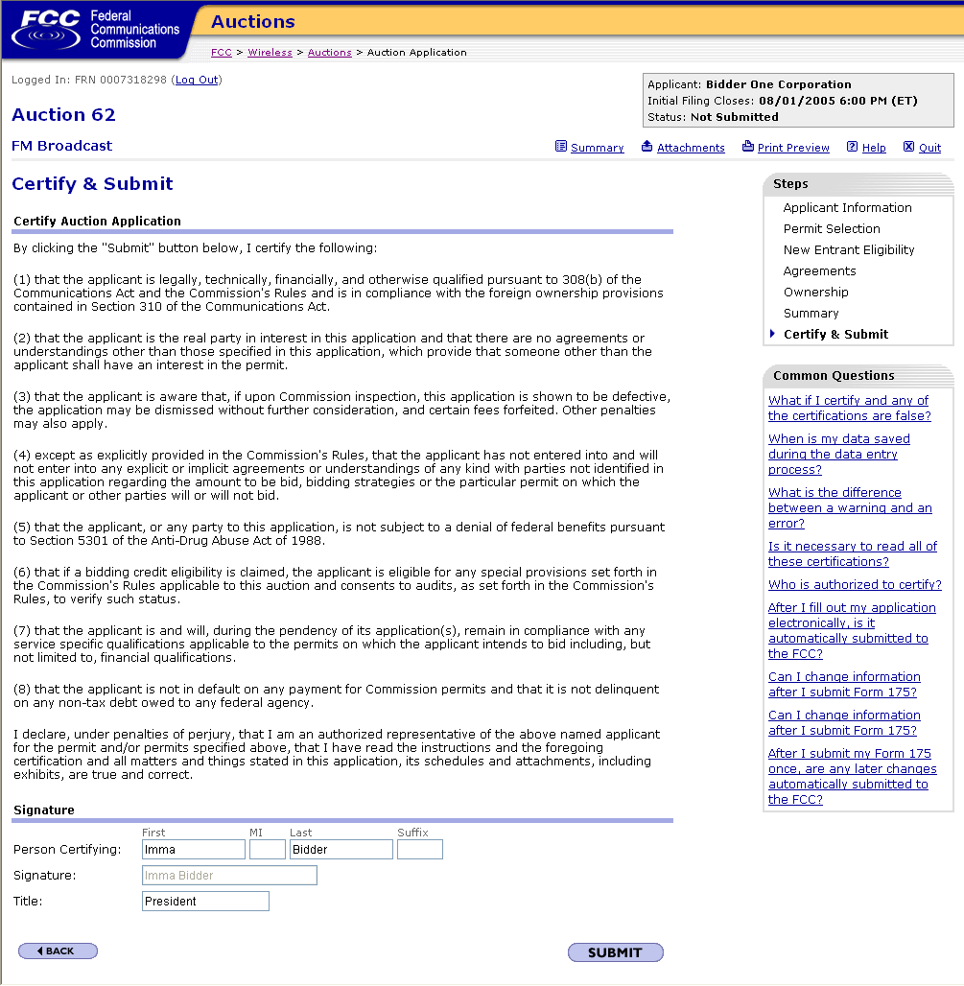

Slide 55
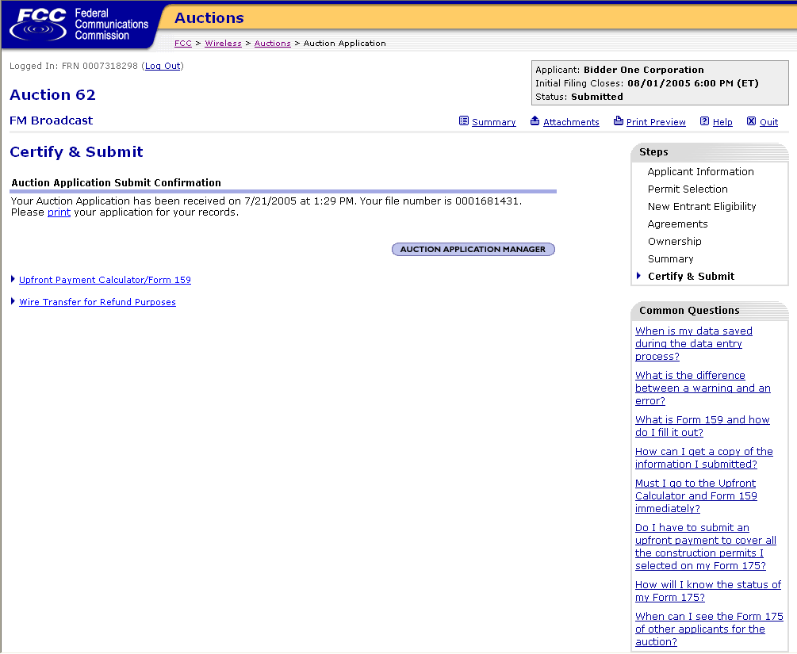

Slide 56
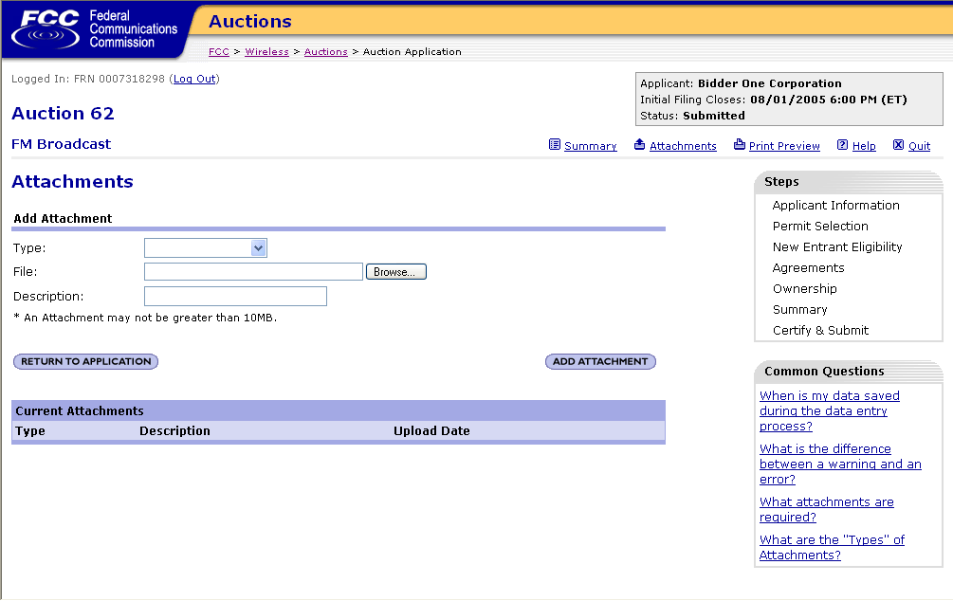

Slide 57
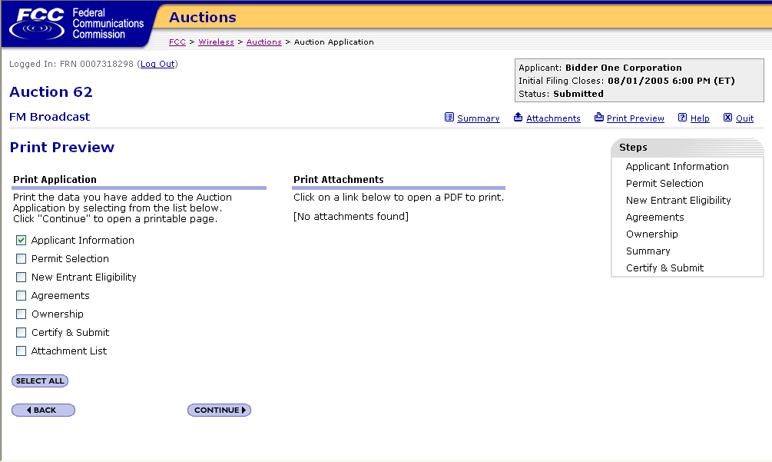

Slide 58
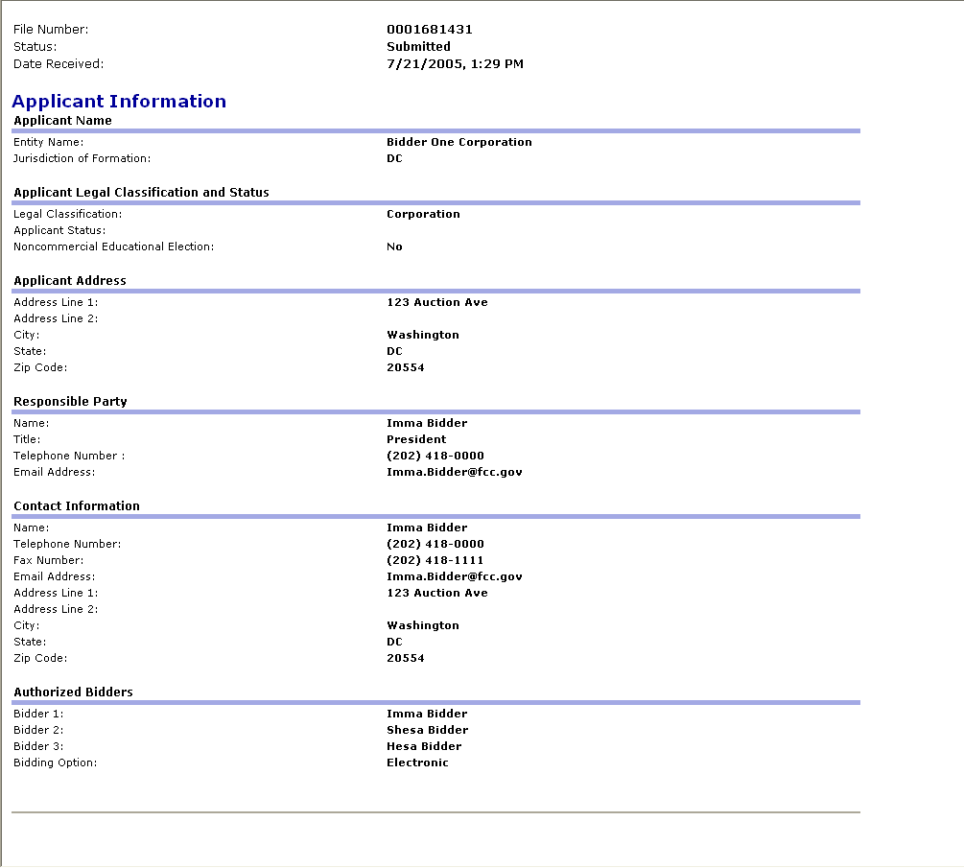

Slide 59
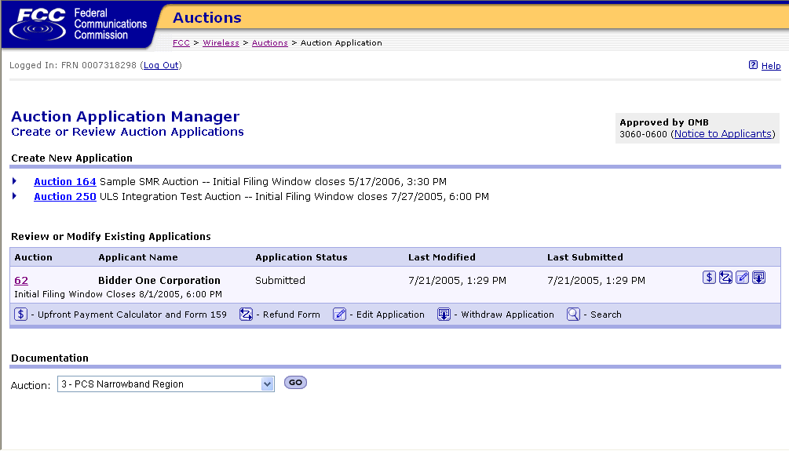

Slide 60
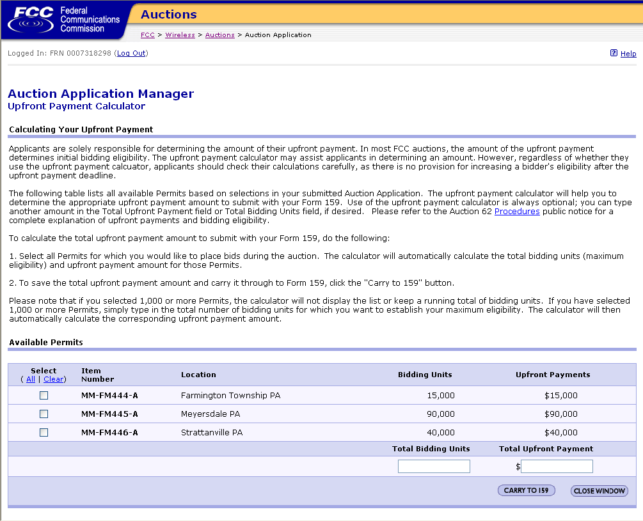

Slide 61


Slide 62
