Slide 1
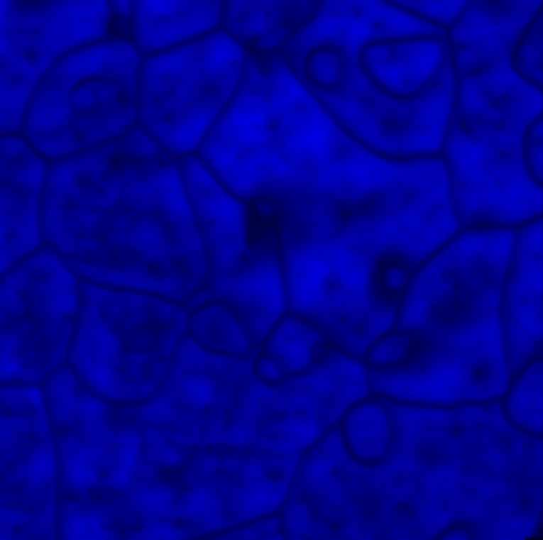

APS/CNM Joint Workshop
X-ray Microscopy & Imaging in Materials Science
May 2, 2006
The full-day Workshop aims to highlight most recent and exciting advances in areas of materials science using synchrotron x-ray microscopy and imaging. Topics to be discussed include both novel materials applications using well-established techniques, and emerging developments that may open up new areas of materials research. Eleven invited presentations are scheduled to provide authoritative overviews of the scientific fields and exciting outlooks into the future.
Organizers
Qun Shen (APS)
G. Brian Stephenson (MSD/CNM)
Invited Speakers
Samuel Bader (MSD, ANL)
Tonio Buonassisi (UC Berkeley)
Alison Davenport (Birmingham, UK)
Paul Evans (Wisconsin, Madison)
Paul Fenter (CHM, ANL)
Bennett Larson (ORNL)
Gabrielle Long (XSD, ANL)
Stefano Marchesini (LLNL)
John Miao (UCLA)
Michael Treacy (Arizona State)
Frank Tsui (North Carolina)
Rm. A1100, Bldg. 402
Argonne National Laboratory
9700 South Cass Avenue
Argonne, IL 60439, USA
http://www.aps.anl.gov/Users/Meeting/2006/

