Slide 1
Mississippi
Case Study

Slide 2
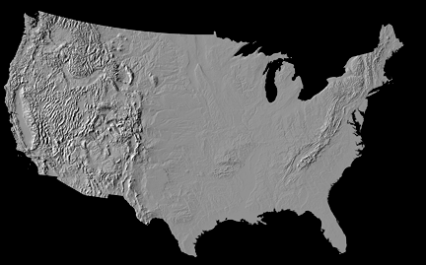
Mississippi Basin
Thelin and Pike 1991, USGS Map I-2206
Notes:
Recent relief map of the US illustrating the Mississippi River basin.

Slide 3
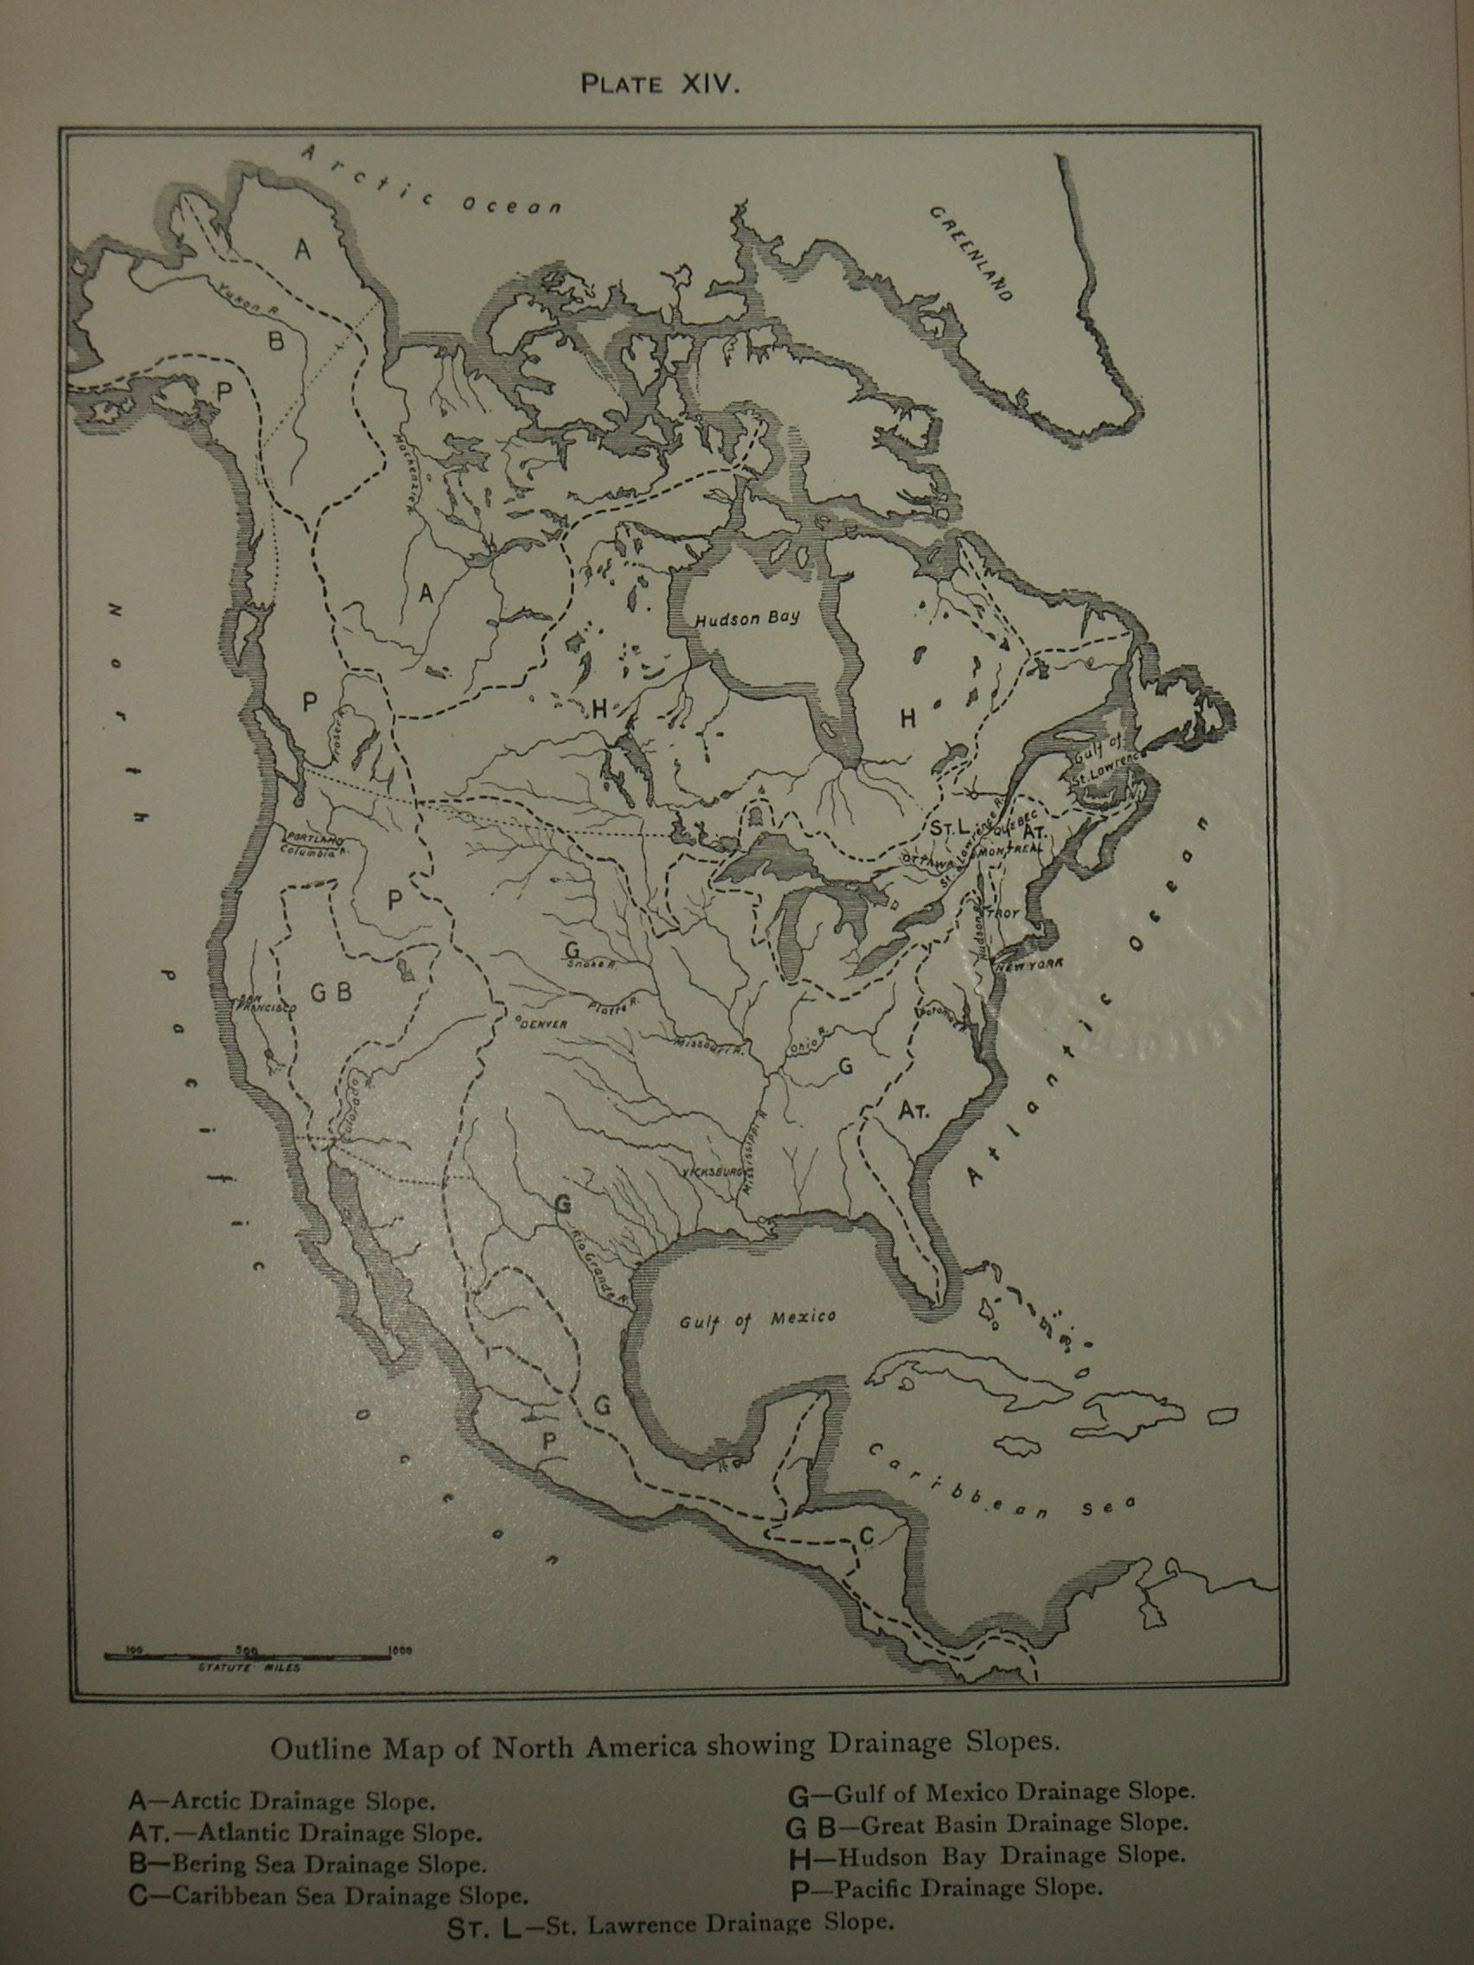
Mississippi River Basin – 1905 (before the reverse of the Chicago River)
Rivers of North America: A Reading Lesson for Students of Geography and Geology, by Israel C. Russell, New York, G.P.Putnam’s Sons London, John Murray 1905
Notes:
1905 map of the US illustrating the Mississippi River basin.

Slide 4
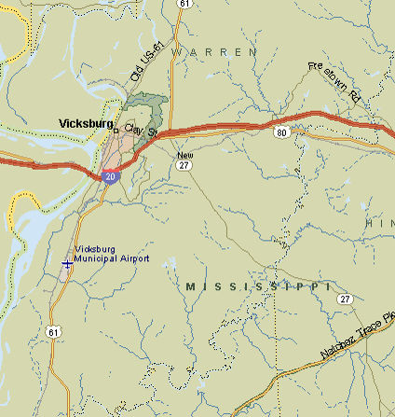
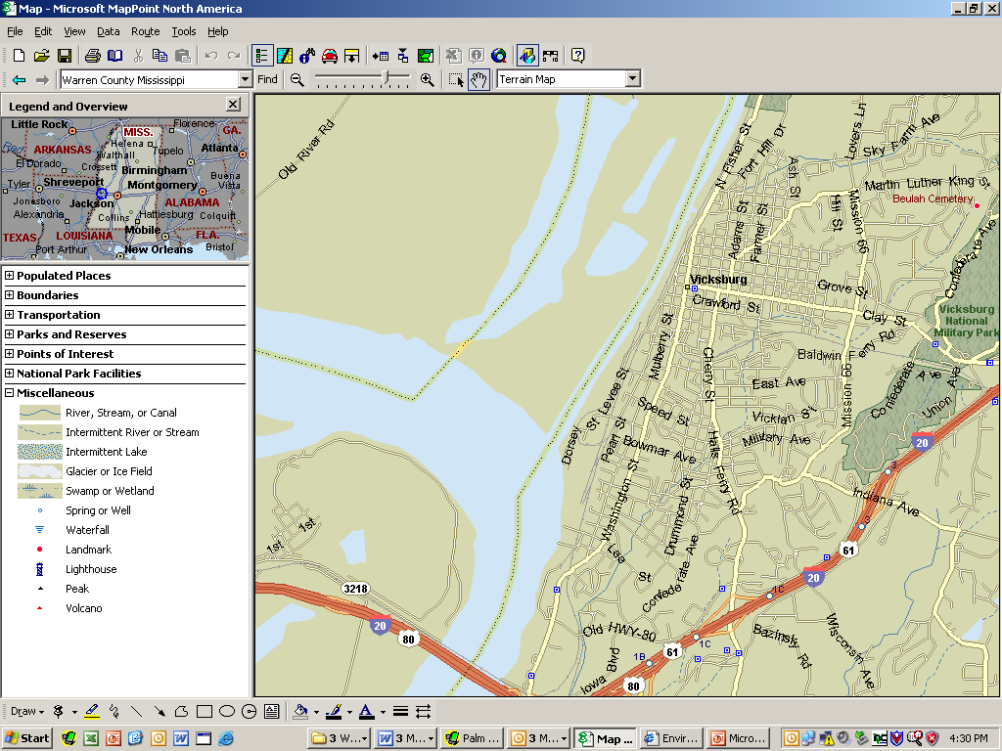
Warren County Mississippi and Vicksburg
Map – Microsoft MapPoint
Notes:
Street map of the floodprone communities within Warren County and Vicksburg.

Slide 5
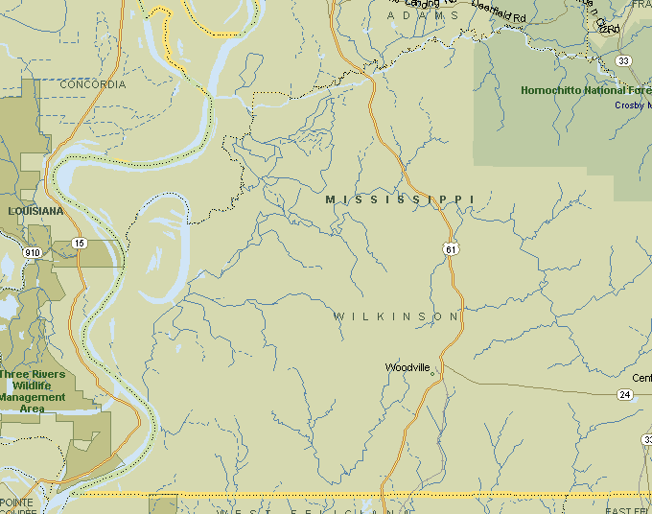
Wilkinson County, Mississippi
Map – Microsoft MapPoint
Notes:
Street map of the floodprone communities within Wilkinson County Mississippi.

Slide 6
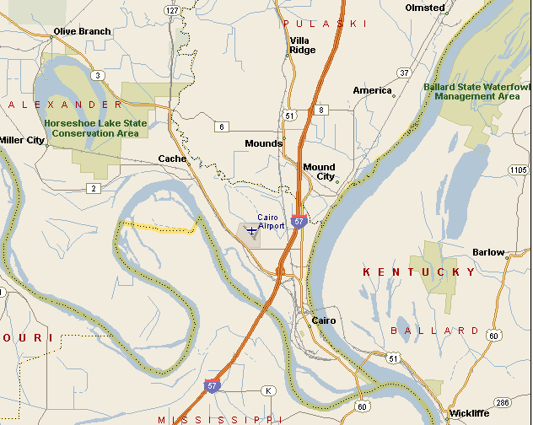
Alexander County IL
Map – Microsoft MapPoint
Notes:
Street map of the floodprone communities within Alexander County Ill.

Slide 7
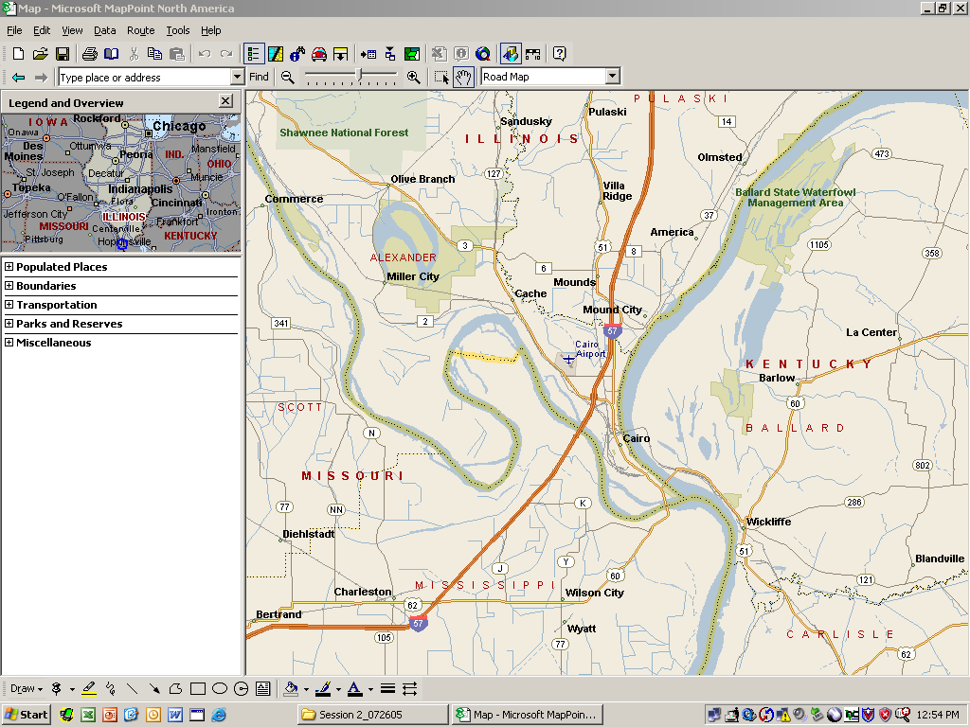
Cairo, Illinois
Map – Microsoft MapPoint

Slide 8
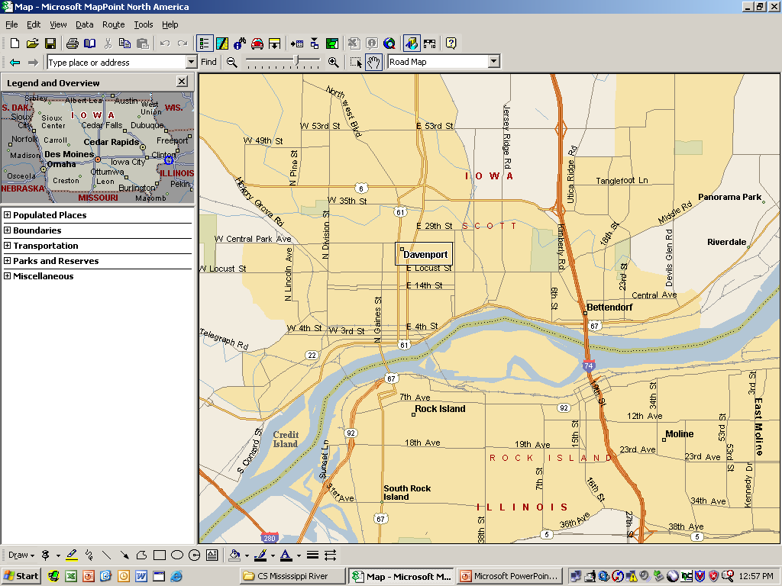
Davenport, Iowa
Map – Microsoft MapPoint

Slide 9
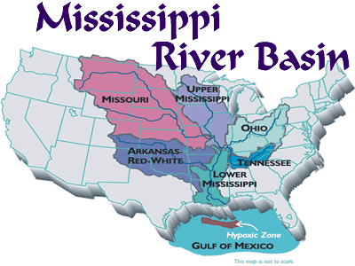
http://www.epa.gov/msbasin/
Notes:
Illustration of the Mississippi River basin.

Slide 10
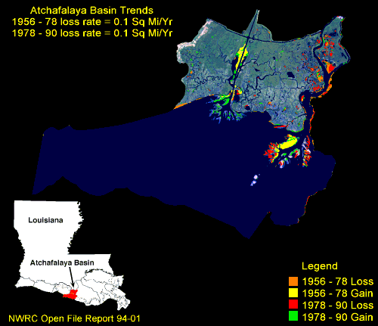
Atchafalaya Basin (Issues)
Notes:
Map of the lower Mississippi and the Atchafalaya basin.

Slide 11
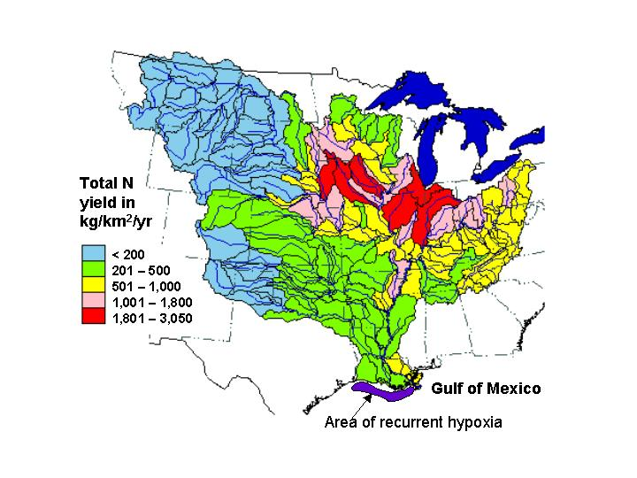
Basin Dead Zone (Issues)
Notes:
Map illustrating the dead zones within the Mississippi basin.

Slide 12
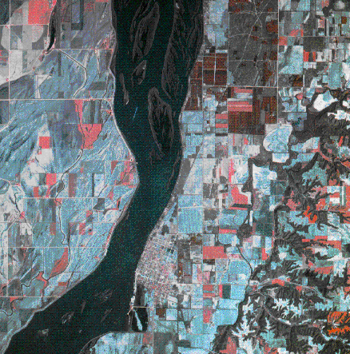
Channel Iowa
Notes:
Map of the Mississippi illustrating channelization.

Slide 13
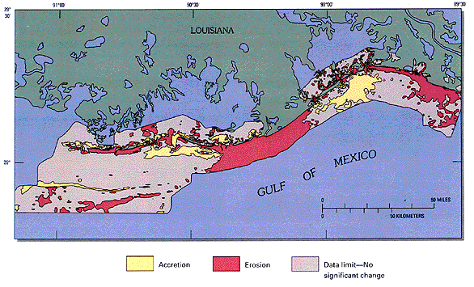
Delta Change (Issues)
Notes:
Map illustrating changes within the Mississippi Delta.

Slide 14
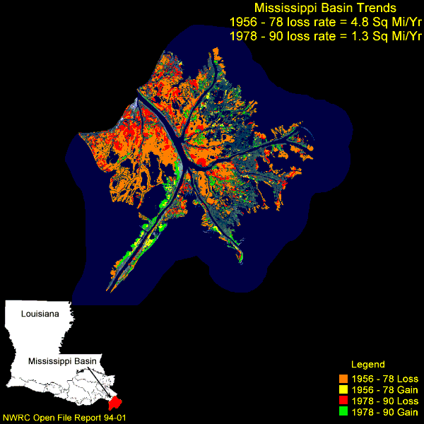
Delta (Issues)
Notes:
Map of Mississippi Delta illustrating changes in sediment deposits.

