Slide 1
Bank liability structure, FDIC loss, and time to failure: A quantile regression approach
6th Annual Bank Research Conference
September 13th – 15th, 2006
Arlington, Virginia
Klaus Schaeck
University of Southampton
This research was undertaken during my stay as a visiting scholar at the Department of Finance at the University of Illinois at Urbana-Champaign.

Slide 2
Bank liability structure, FDIC loss, and time to failure: A quantile regression approach
Outline
(1) Related work
(2) Rationale and contributions
(3) Preview of results
(4) Data
(5) Methodology and empirical analyses
(6) Conclusion and future research
Klaus Schaeck, September 2006

Slide 3
Bank liability structure, FDIC loss, and time to failure: A quantile regression approach
Related work
Studies of the deposit insurer’s loss
Loss as function of asset composition and asset quality (and other controls):
Bovenzi and Murton (1988); Barth et al. (1990); Blalock et al. (1991);
James (1991); Brown and Epstein (1992); Osterberg and Thomson (1994);
McDill (2004); Bennett et al. (2005); Hirschhorn and Zervos (1990);
Osterberg (1996); Marino and Bennett (1999)
Studies of market (depositor) discipline
Goldberg and Hudgins (1996, 2002); Jordan (2000); Billet et al. (1998);
Park and Peristiani (1998); Maechler and McDill (2006);
Davenport and McDill (2006)
Klaus Schaeck, September 2006

Slide 4
Bank liability structure, FDIC loss, and time to failure: A quantile regression approach
Rationale/Contributions
(1) Loss is usually modelled as a function of the failed banks’ asset composition and asset quality.
However, liability structure determines which depositors have to be compensated and also impacts a bank’s risk taking behaviour (Pennacchi, 2005; Shibut, 2002).
(2) Timing of failures can impact deposit insurer’s loss since ailing
institutions substitute uninsured funds with insured deposits (Billet et
al., 1998; Goldberg and Hudgins, 1996; 2002; Jordan, 2000)
Thus, depositor discipline plays a role for the deposit insurer’s loss.
(3) Existing work uses standard econometric techniques.
These techniques do not account for heterogeneity of the data and the
non-normal distribution of the losses. If the factors driving costly failures
differ systematically from the determinants of low cost failures, an
alternative way of estimation is required.
Klaus Schaeck, September 2006

Slide 5
Bank liability structure, FDIC loss, and time to failure: A quantile regression approach
Preview of results
The paper shows that
a) The loss rate varies considerably across the quantiles of the distribution
b) Loss rate exhibits varying sensitivity to the set of regressors
c) Liability structure is more important for high cost failures
d) Some explanatory variables change sign of the coefficient as we move up the distribution
e) Liability structure is important in explaining time to failure of troubled depositories
f) Depositors are a source of market discipline
Klaus Schaeck, September 2006

Slide 6
Bank liability structure, FDIC loss, and time to failure: A quantile regression approach
Data
Sample consists of 1,227 failed banks resolved in the US during 1984 – 1996.
Information regarding failure is taken from the list of failed banks provided on
the FDIC’s website.
Failure is defined as either assisted merger, P&A, transfer and assumption of
insured deposits, re-privatization, institution was closed and reopened, subject
to the management consignment programme, or a depositor pay-off took
place.
Explanatory variables are taken from Call Reports.
FDIC’s resolution cost calculated as the difference between net cash outlays
and the estimated discounted net recovery on any assets remaining in the
receivership’s books.
Cost are calculated as loss rates by dividing by total deposits, loss rates used
in previous studies, e.g. McDill (2004).
Klaus Schaeck, September 2006

Slide 7

Bank liability structure, FDIC loss, and time to failure: A quantile regression approach
Methodology (1)
Cost of failure are estimated using OLS and Tobit models
whereby y_{i} denotes the loss rate of bank i, α is the constant term and β
denotes the coefficients to be estimated for the explanatory variables x_{i}; u_{i} is
the error term.
However, the sample consists of different types of banks with different asset
size that operate in different lines of business.
To better account for these differences and take the skewed distribution of the
loss rate into account, quantile and censored quantile regression models are
estimated.
Quantile regression was developed by Koenker and Bassett (1978). Powell
(1984, 1986) introduced the adjustments for censored regression quantiles.
Klaus Schaeck, September 2006

Slide 8
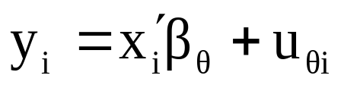
Bank liability structure, FDIC loss, and time to failure: A quantile regression approach
Methodology (2)
What are quantiles?
Quantiles divide the cumulative distribution function of a variable into a
given number of equally sized segments.
I estimate quantile regression models where θ is the θth quantile of a
conditional distribution and where x_{i} is a K x 1 vector of explanatory variables:
The expression β_{θ} is the vector of parameters to be estimated for different
quantiles θ, lying in the range (0;1); u_{i} is our error term.
The quantile estimators use linear programming techniques.
Klaus Schaeck, September 2006

Slide 9
Bank liability structure, FDIC loss, and time to failure:
A quantile regression approach
OLS and Tobit models Results (1)
Cost per dollar of total deposits
Ordinary least squares regression
Tobit Regression
Total assets (log)
-0.0129***
-0.0178***
-0.0208***
-0.0207***
-0.0136***
-0.0184***
-0.0214***
-0.0213***
Real estate owned/Total deposits
0.6742***
0.6851***
0.6923***
0.6971***
0.6754***
0.6873***
0.6956***
0.7006***
Loans past due (90 days+)/Total deposits
0.4515***
0.4207***
0.3292***
0.3194***
0.4511***
0.4213***
0.3294***
0.3193***
Income earned, not collected on loans/Total deposits
4.1055***
3.9046***
4.0823***
4.1162***
4.1169***
3.9022***
4.0688***
4.1031***
Total equity capital/Total deposits
-0.4498***
-0.3932***
-0.3665***
-0.3742***
-0.4562***
-0.3989***
-0.3724***
-0.3801***
Total asset growth, 4 quarters prior to failure
0.0486**
0.0406**
0.0434**
0.0428**
0.0496**
0.0412**
0.0439**
0.0432**
Fed Funds purchased/Total deposits
0.1708
0.1514
0.1568
0.1721
0.1506
0.1562
Brokered deposits < 100k/Total deposits
0.2397
0.1565
0.1474
0.2451*
0.1611
0.1518
Brokered deposits > 100k/Total deposits
0.2685
0.2289
0.2271
0.2593
0.2198
0.2179
Transactions deposits/Total deposits
-0.1573***
-0.1065*
-0.1032*
-0.1585***
-0.1080**
-0.1049**
Time and savings deposits/Total deposits
-0.0173
0.1167
0.1217
-0.0088
0.1279*
0.1335**
C&I Loans/Total deposits
0.2422***
0.2416***
0.2449***
0.2444***
Mortgages secured by 1-4 family residential mortgages/Total deposits
0.0056
0.0058
0.0055
0.0057
Loans to individuals/Total deposits
-0.0202
-0.0207
-0.0192
-0.0197
Agricultural loans/Total deposits
-0.0692
-0.0650
-0.0683
-0.0641
Depositor preference law
-0.0159*
-0.0162*

Slide 10
Bank liability structure, FDIC loss, and time to failure: A quantile regression approach
OLS and Tobit models Results (2)
Using OLS the results indicate that
(1) Transactions deposits tend to decrease FDIC loss significantly.
This finding can be explained with the charter value of the bank that such ‘core deposits’ constitute.
(2) The other funding variables do not enter significantly.
(3) Control variables confirm findings reported in previous studies.
(4) Results obtained with OLS are corroborated using Tobit model.
Klaus Schaeck, September 2006

Slide 11

Bank liability structure, FDIC loss, and time to failure:
A quantile regression approach
OLS and quantile regression models Results (2)
Klaus Schaeck, September 2006

Slide 12
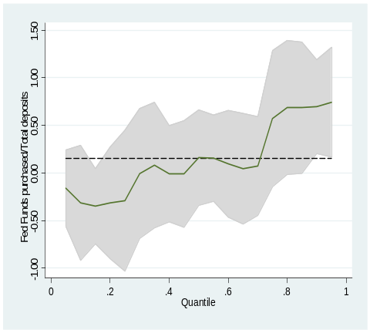
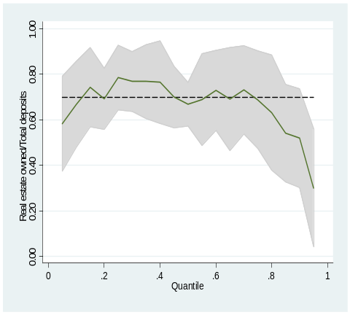
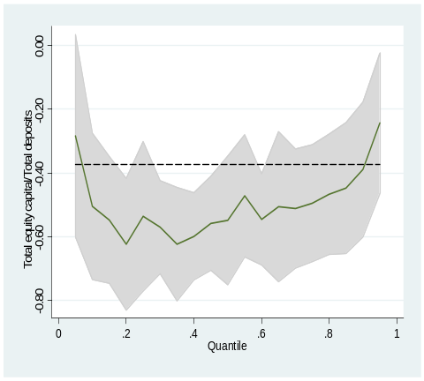
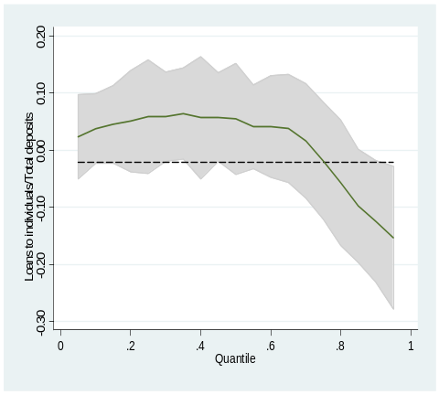
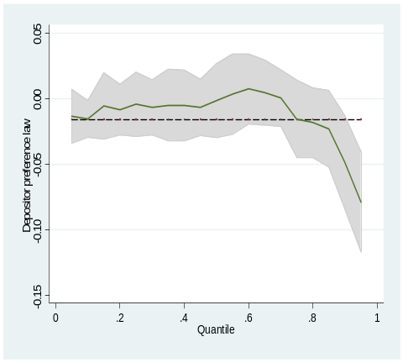
Bank liability structure, FDIC loss, and time to failure:
A quantile regression approach
OLS and quantile regression models Results (3)
Fed funds purchased/Total deposits
Real estate owned/Total deposits
Total equity capital/Total deposits
Loans to individuals/Total deposits
Depositor preference law

Slide 13
Bank liability structure, FDIC loss, and time to failure: A quantile regression approach
OLS and quantile regression models Results (4)
Quantile regression estimators underscore the impact of certain types of
deposits on FDIC loss; this is consistent with Shibut (2002).
Fed funds purchased significantly increase FDIC loss for high cost failures,
this result is robust to censoring.
Time and savings deposits, real estate owned, unearned income, C&I
loans, and asset growth increase loss rates for costly failures. By contrast,
bank size, capitalisation, loans to individuals and depositor preference laws
decrease loss rates for high cost failures.
Results suggest that relying on standard econometric techniques gives rise to misleading inferences.
Klaus Schaeck, September 2006

Slide 14
Bank liability structure, FDIC loss, and time to failure: A quantile regression approach
Bank funding structure and time to failure
Analysing the relationship between bank funding structure and time to failure
is an alternative way of assessing the role of market discipline.
Banks funded by uninsured deposits might fail faster due to their inability to
substitute such cash outflows with other types of funds.
Klaus Schaeck, September 2006

Slide 15
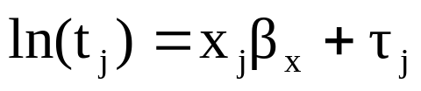
Bank liability structure, FDIC loss, and time to failure: A quantile regression approach
Methodology (3)
Modelling the timing of failure
An accelerated failure time model with time-varying covariates is estimated as
follows
where ln(t_{j}) is the log of time to failure, x_{j} denotes the explanatory variables
and β_{x} are the parameters to be estimated.
The term τ_{j} is a random variable that follows a distribution. To estimate the
model, we need to determine the distribution of τ_{j} and specify τ_{j} to follow the
log-logistic distribution.
The log-logistic distribution was utilized in previous work on bank failures and
bank exit (Cole and Gunther, 1995; DeYoung, 2003).
Klaus Schaeck, September 2006

Slide 16
Bank liability structure, FDIC loss, and time to failure: A quantile regression approach
Methodology (4)
Modelling the timing of failure (con’td)
I use the set of 1,227 failed institutions that underlies the loss equations and
sample those banks from 1983 onwards to have at least four quarters of
observations for the institutions that fail in the first quarter 1984
(23,986 bank-quarter observations).
Rationale for constraining the set to failed banks:
(1) Focus lies on the effect of liability structure on time to failure of ailing institutions.
(2) Policy considerations: knowledge of the factors that impact failure time of troubled institutions helps obtain better estimates of when losses occur to the deposit insurer
(3) Assumption that all banks fail in commonly used survival models in the banking literature does not hold in reality (Cole and Gunther, 1995)
Klaus Schaeck, September 2006

Slide 17

Bank liability structure, FDIC loss, and time to failure: A quantile regression approach
Bank funding structure and time to failure Results (5)
Klaus Schaeck, September 2006

Slide 18
Bank liability structure, FDIC loss, and time to failure: A quantile regression approach
Bank funding structure and time to failure Results (6)
The ratios of Fed funds purchased, brokered deposits below 100,000 USD,
time and savings and transactions deposits to total deposits are inversely
related to time to failure.
These results suggest the presence of depositor discipline (Goldberg and
Hudgins, 1996,2002). Seriously troubled banks may not be able to substitute
cash outflows of uninsured deposits (Maechler and McDill, 2006).
Klaus Schaeck, September 2006

Slide 19
Bank liability structure, FDIC loss, and time to failure: A quantile regression approach
Bank funding structure and time to failure Results (7)
The finding that brokered deposits below 100,000 and transactions
deposits are inversely related to time to failure appears counterintuitive
– at first glance.
Insured depositors may be reluctant to supply funds to ailing depositories.
They may be concerned about the insurer’s solvency or try to avoid other
indirect costs of arising from delay in deposit redemption after the failure
(Park and Peristiani, 1998).
Insured depositors also run (Davenport and McDill, 2006).
Time and savings deposits are also negatively associated with failure time.
Such deposits may consist of large uninsured CDs and money market deposit accounts and are therefore not insured.
Distressed banks engage in liability shifting!
Controlling for additional variables does not impact the inferences drawn.
Klaus Schaeck, September 2006

Slide 20
Bank liability structure, FDIC loss, and time to failure: A quantile regression approach
Policy implications (1)
The results highlight the presence of depositor discipline:
Liability structure deserves more attention by regulatory bodies!
Monitoring of certain types of liabilities can provide better insights into the
timing of failure of banks. Applying capital charges for deposits that tend to
leave the bank faster might curb risk taking behaviour of banks.
Pillar 3 of the New Basel Capital Accord currently neglects disclosure of insured and uninsured deposits.
In light of the findings of this study, disclosure of the levels of insured and
uninsured deposits might strengthen market discipline further.
Klaus Schaeck, September 2006

Slide 21
Bank liability structure, FDIC loss, and time to failure: A quantile regression approach
Policy implications (2)
Neither the Consultative Document Pillar 3 (Market Discipline), (BCBS, 2001a), nor the Working Paper on Pillar 3 – Market discipline, (BCBS, 2001b) mention disclosure rules with respect to financial institutions’ liability/deposit structure regarding their status of deposit insurance.
Liabilities/deposits are only mentioned in the context of interest rate risk and that “[…] a fully insured depositor […] has no motive to provide discipline.” (BCBS, 2001a, p.3)
This insufficient consideration of bank liability structure in the context of
market discipline and deposit insurance in particular is also documented in
Pennacchi (2005), who underscores that the Third Consultative Paper on the
New Basel Capital Accord (BCBS, 2003) contains no reference to deposit
insurance.
Klaus Schaeck, September 2006

Slide 22
Bank liability structure, FDIC loss, and time to failure: A quantile regression approach
Concluding remarks
The paper analyses the extent to which bank liability structure impacts on the
deposit insurer’s loss and how funding structure affects the timing of failure.
Using quantile and censored quantile regression estimators, I show:
(1) the sensitivity of the loss rate towards several explanatory variables across different quantiles.
(2) expensive failures are significantly influenced by Fed funds purchased, savings and time deposits, real estate owned, unearned income, and C&I loans
Examining the nexus between liability structure and time to failure:
I provide evidence for the presence of depositor discipline
I highlight that the New Basel Capital Accord insufficiently takes
account of bank liability structure.
Klaus Schaeck, September 2006

Slide 23
Bank liability structure, FDIC loss, and time to failure: A quantile regression approach
Limitations/ Additional tests
Limitations
Relying on Call Report data might yield misleading inferences when the failures
were caused by fraud.
Additional tests
(1) Additional fraud cases as reported in FDIC press releases can be incorporated in the next iteration to account for more recent fraud cases.
(2) Estimation with alternative dependent variable (dollar losses instead of loss rate).
(3) Normalisation by total assets instead of total deposits.
Klaus Schaeck, September 2006

Slide 24
Bank liability structure, FDIC loss, and time to failure: A quantile regression approach
Future research
Future research could focus on proposing detailed policy recommendations based on the findings regarding depositor discipline.
An analysis of the factors that impact failing depositories’ ability to substitute uninsured with insured funds could help better understand the behaviour of liabilities in the run-up to failure.
Klaus Schaeck, September 2006

Slide 25
Bank liability structure, FDIC loss, and time to failure: A quantile regression approach
Thank you for your attention!
Klaus Schaeck, September 2006

