Slide 1
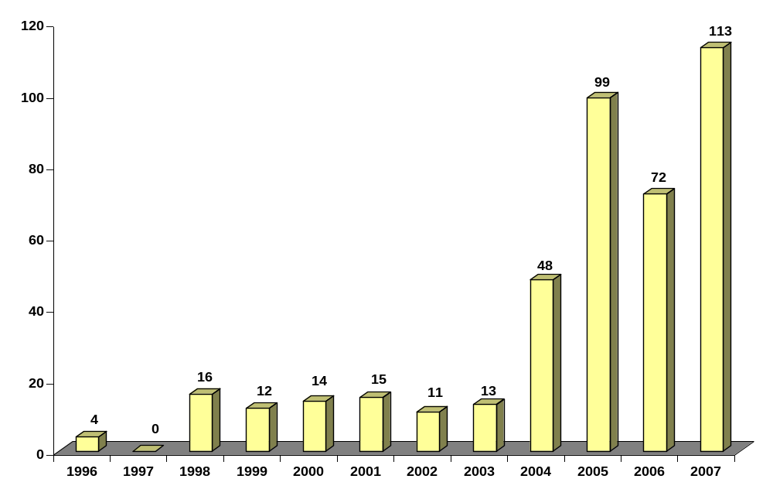
Suspicious Activity Report by Casinos & Card Clubs Filing Trend
State of Washington
For the Period August 1, 1996 through December 31, 2007
Total SARs: 417

Slide 2
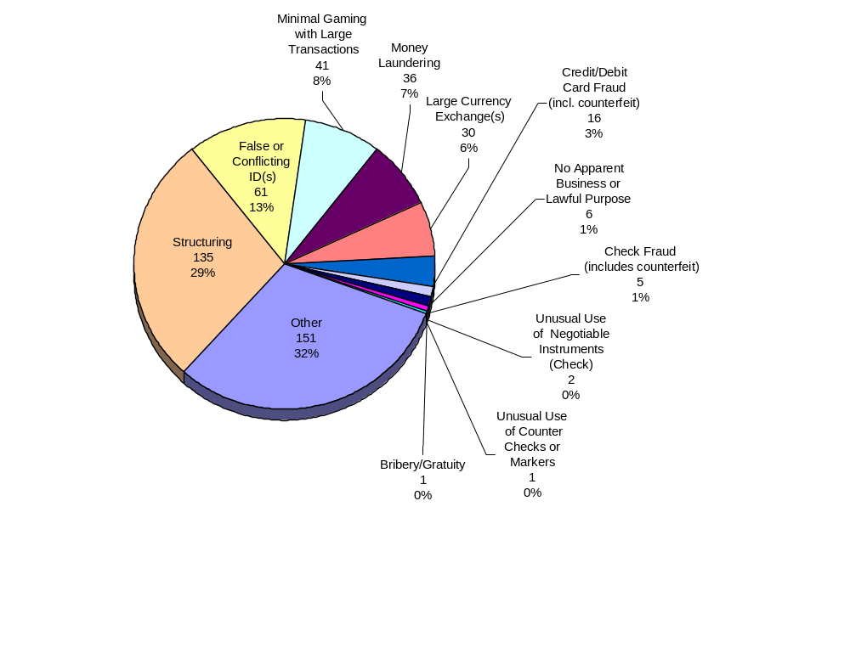
Suspicious Activities Reported by Casinos & Card Clubs Filing Trend
State of Washington
For the Period August 1, 1996 through December 31, 2007
Note: The pie chart does not include those categories of suspicious activity for which data queries returned no results (i.e., no filers reported these activities).
An individual SAR-C may cite more than one suspicious activity. Hence, the number of activities detailed here exceeds the total number of SARs.

Slide 3
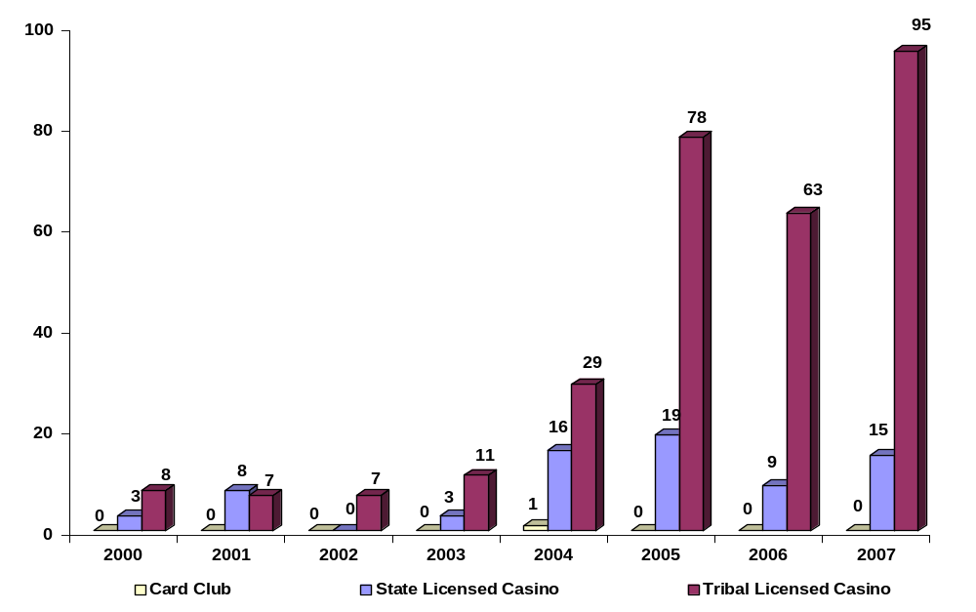
Suspicious Activity Report by Casinos & Card Clubs Filing Trend
by Type of Gaming Establishment
State of Washington
For the Period January 1, 2000 through December 31, 2007

Slide 4
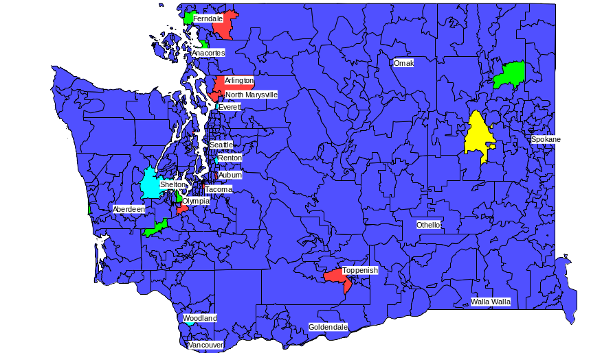
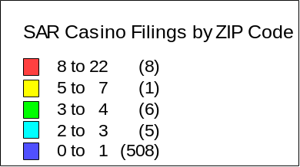
Suspicious Activity Report by Casinos & Card Clubs
Geographic Reporting Locations
State of Washington
For the Period January 1, 2007 through December 31, 2007
Deming
Chewelah
Davenport
Note: Statistics based on Casino Address

