Slide 1
Knowledge Management
eRA Project Team Briefing
April 9, 2002 at 9:00 a.m.
Notes:
I read in some of the literature for the upcoming meeting on May 10: “Each year, the NIH receives and processes approximately 45,000 biomedical research and research training applications, generating hundreds of millions of pieces of paper and countless manual activities.”
I am thrilled to be working for an organization that has as a primary agenda item “to reduce paper, improve access to information, and facilitate communications, and increase overall efficiency.”
Many organizations have similar ambitions and are addressing efficiency issues with computer applications.
But KM strives to go beyond simple efficiency gains, by treating the stored knowledge of an organization as a primary asset and then mining that asset for all it is worth.

Slide 2
to be discussed
working definition of KM
example: mediation
WIFM @ NIH: possible pilot projects
case: lessons learned at World Bank
next steps
Notes:
Here is what I hope to cover today:
I want to provide you with a working definition of knowledge management.
I’ll review examples of various software tools that are considered KM apps.
I’d like to discuss the central question: “What’s in it for NIH?”
Finally, I want to refer briefly to a case study from my own experience and mention the lessons learned in the KM exercise at the World Bank.

Slide 3
promise
PAPER-BASED
MACHINE-READABLE
COST
VALUE
VALUE
COST
τ
τ
Notes:
All of us know the promise of computers in the workplace.
In a paper-based world, the cost of maintaining stored information always on the increases, while the value of that information decreases the more data we accumulate.
Computers have always been expected to reverse this trend, by simplifying processes of handling data and documents.
Few of use can claim to be wholly satisfied that this promise has been fulfilled.
KM attempts to fulfill this promise in at least one way.
KM concentrates on extracting value from stored data.

Slide 4
what is knowledge management?
Knowledge management is . . .
systematic process by which knowledge is created, captured, shared, and leveraged
driven by:
  organizational objectives
  need to share and identify trends
IT tools
  search, analysis, and presentation
  serves one or many end-users
Notes:
Knowledge management is . . .
defined as “the systematic processes by which the knowledge needed for an organization to succeed is created, captured, shared, and leveraged”. The Idiot’s Guide to KM, Rumizen, 2002
driven by the need to share and identify trends in stored data across time and institutional boundaries.
a set of IT tools that enable the search, analysis, and presentation of archived information for one or many end-users.

Slide 5
what is value?
Qualities that make information valuable:
  accuracy
  timeliness
  accessibility
  engagement
  application
  rarity
  Source: Davenport & Prusak (1997)
Notes:
It is important to consider the qualities that make information valuable.
accuracy - inspires confidence
timeliness - appropriately current
accessibility - can be readily located when required
engagement - making an impact, influencing decisions
application - relevant and useful within the defined context
rarity - provides a hitherto unknown or confidential insight.
These provide the basis for KM applications that are now proliferating.

Slide 6

bi vs km
supplier
buyer
customer
SUPPLY CHAIN VS STORED DATA
STRATEGY
organization infrastructure
human resource management
research and/or technology development
WORKFLOW
procurement
DATA TREND
EFFICIENCY
inbound
logistics
operations
outbound
logistics
marketing
or liaison
service

Slide 7
KM focus
KNOWLEDGE
tacit view
synthesis
use
INFORMATION
analysis
manage
conversion
DATA
acquisition
Notes:
In any knowledge management exercise, the focus is on the value creation process:
What are we doing with data that makes it more or less useful to our organization?
What are we doing/not doing that transforms data into information and into useful knowledge.
The key is to understand
acquisition
conversion
analysis
management
synthesis, and the
use of data.
Workflow and tacit assumptions about the data are also key.

Slide 8
aligned w/ group & end-user needs
USER(s)
Notes:
It should never be forgotten that the value of any information is only as great as the extent to which it serves the needs of end-users and the mission critical objectives of the organization.

Slide 9


example: mediation
existing
content
relevance
existing
content
existing
content
existing
content
existing
content
preference
Notes:
At this point, I’d like to briefly discuss one example of a knowledge management application.
Whatever the organization – government, industry, science- or business based – we all have existing content that we’d like to learn from.
The first step in extracting new value from our databases is to clearly articulate what we want to learn. Frequently these knowledge preferences are complicated and they tend to vary from one person to another.
In knowledge management, computer applications are developed that assist with boiling down these preferences (what we want to know from one or more datasets) and giving us information that is tailored – made relevant -- to some specific task.
In this case, relevance refers to the process of giving us exactly the right information, when and where needed, in a readily usable form.

Slide 10
example: mediation
matching
engine
profile
catalogues
abstraction
engine
existing
content
relevance
existing
content
existing
content
existing
content
existing
content
preference
thesaurus
Notes:
The component parts of a KM application for mediated knowledge discovery might include:
profile catalogues
thesaurus
abstraction engine
matching engine.

Slide 11
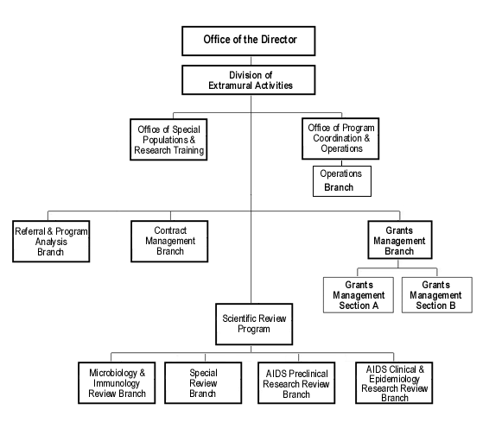
pilot A
VISION: reduce review workload
  reviewer selection
  conflict elimination
  proposal assignment
BARRIER: relevance
ACTION: mediated retrieval

Slide 12
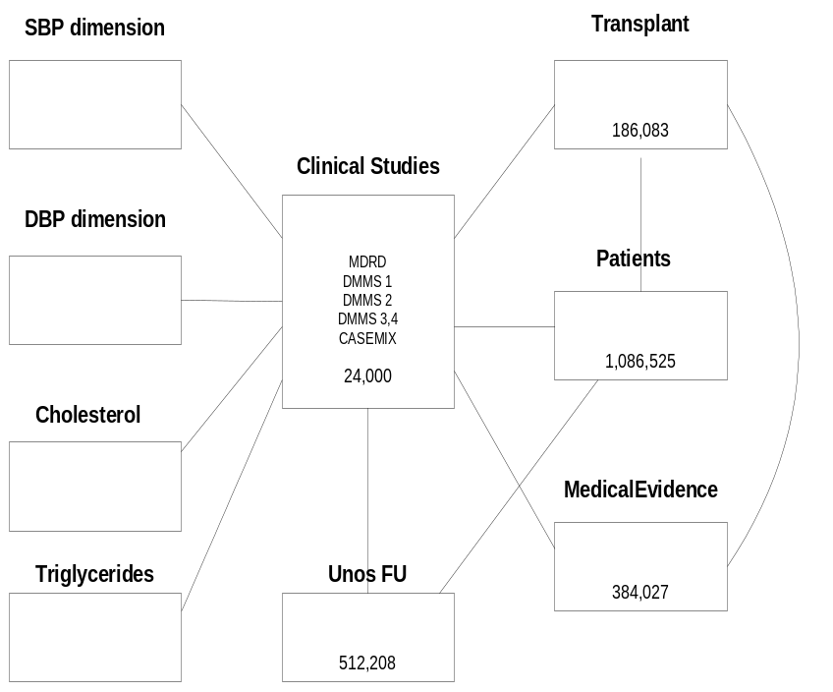
pilot B
VISION: better clinical decisions
  legacy data
  many, distributed projects
  multidisciplinary analysis
BARRIER: nomenclature diffs
ACTION: robust data models
Star Schema Data Model

Slide 13
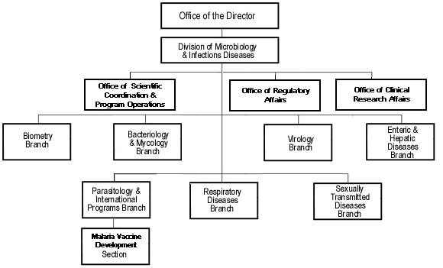
pilot C
VISION: timely program planning
  emerging research trends
  relation of novelty to score
BARRIER: discerning salience,
  signal-to-noise ratio
  e.g., “naked” DNA
ACTION: bibliometrics

Slide 14

lessons learned: world bank
World Bank Group Ranks 4th in Most Admired Knowledge Enterprises
Organization:
  multiple knowledge flows
  communities of practice
  redefine end-user relations (partners)
Budget for knowledge communities
Technologies for capture, dissemination, re-use
Build permanent capacity for knowledge brokering, e.g., advisory services, help desks
The KNOW Network is a group of leading knowledge-based organizations dedicated to benchmarking and sharing best knowledge practices leading to superior business performance. www.knowledgebusiness.com
Notes:
In closing, I’d like to leave you with the point that KM is not just about the computer software. It is also about organizational issues and managerial challenges that must be addressed in order for KM to be effective. The best example I can think of to illustrate this point is the World Bank.
On May 24, 2001 the Bank was the only public organization in the top 20 in this year's Most Admired Knowledge Enterprises (MAKE) study. The World Bank Group took 4th place in 2001, up from 10th place last year. The organizations in the study are recognized for their world-class efforts in managing knowledge, leading to superior performance. Others on the list include General Electric (1st), Hewlett-Packard (2nd), Buckman Laboratories (3rd), Microsoft (5th), BP Amoco (6th) and Siemens (7th).
Lessons learned from the WB experience are as follows:
Organizational dimension, necessitated multiple knowledge flows, new communities of practice, redefined relations with end users (e.g., as partnerships).
Budget allocated to knowledge communities on basis of clear work agreements.
Technologies are essential, e.g., for knowledge capture and dissemination and to enhance knowledge re-use.
Permanent capacity to facilitate the brokering of information and knowledge (Advisory Services/Help Desks).

Slide 15
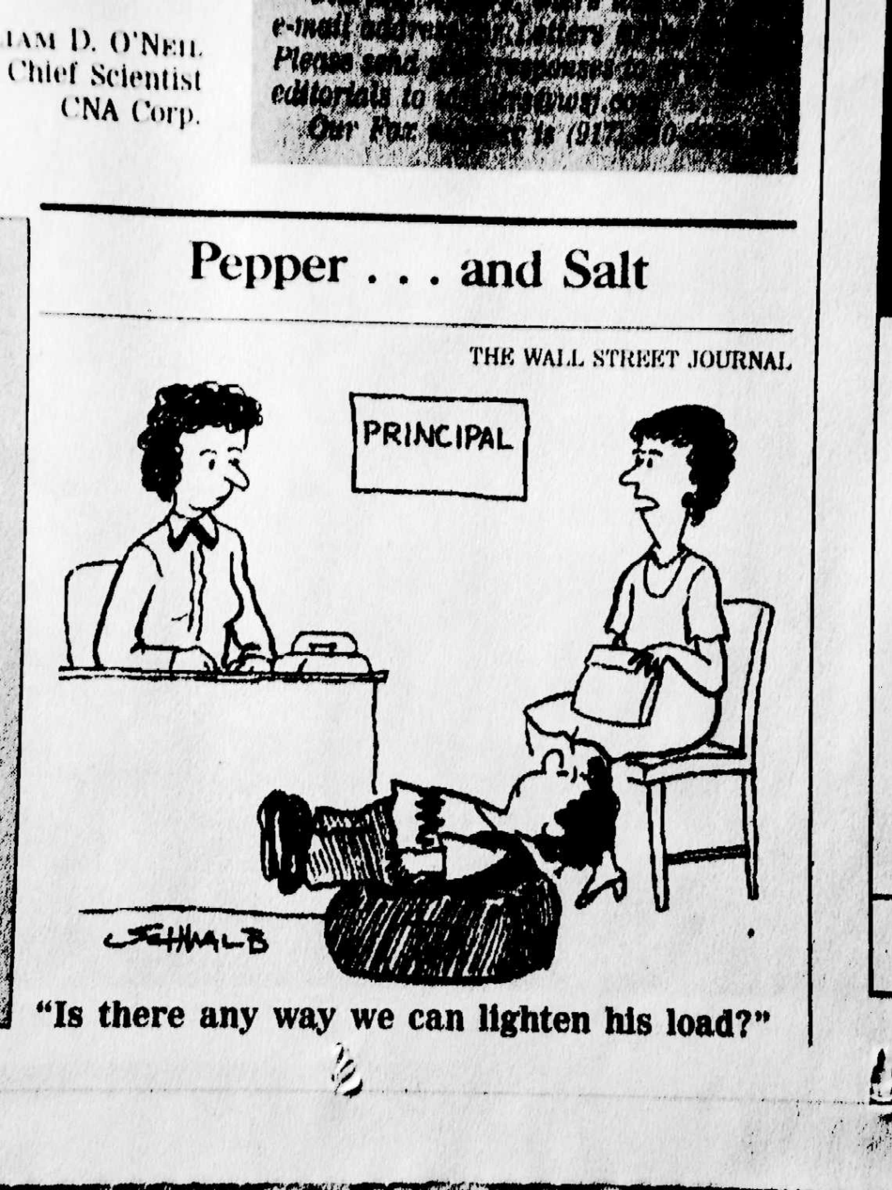
next steps
assess & develop a strategy
start pilot projects w/ key data
address organization (communities of practice)
commit to infrastructure
*********************
TODAY
    feedback
    pilot projects
    tiger-team volunteers

Slide 16
discussion

Slide 17
KM functions & apps
function | applications
Information Retrieval | search engines, intelligent agents , push technology
Knowledge Discovery | data mining, visualization
Knowledge Sharing | groupware, doc management, best practice DBs
Knowledge Development | pattern recognition, concept mapping
Intellectual Capital | measurement systems, bibio- or scientometrics
Integration | mediation, portals, KM suites, After Action Reviews
Notes:
Knowledge management software basically enables three computer-driven routines:
search databases
data analysis, and the
presentation of data or its analysis.
These computer-supported routines are also referred to as information retrieval, knowledge discovery, collaboration or knowledge sharing, knowledge development, intellectual capital systems, and integration systems.
Software applications within each of these functional families are
Info Retrieval - search engines, intelligent agents , push technology
Knowledge Discovery - data mining, visualisation
Knowledge Sharing - groupware, doc mngmt, best practice DBs
Knowledge Development – pattern recognition, concept mapping
Intellectual Capital - measurement systems, bibio- or sciento-metrics
Integration – mediation, portals, KM suites, After Action Reviews

Slide 18
further information on KM
Faculty of Information Studies, University of Toronto http://www.fis.utoronto.ca/Programs/kmi/index.htm
IT Toolbox http://www.ittoolbox.com
Upper Ontology http://ontology.teknowledge.com/
Health Services, Univ Washington, Module 38: Knowledge Management http://courses.washington.edu/~hs590a/hs590a.html
American Productivity and Qualty Center
KM Benchmarking Program, http://www.apqc.org/km
David Skyrme Associates http://www.skyrme.com/services/ktrends.htm#Tools
WARNING: BEWARE OF MARKET HYPE
& CONCEPTUAL INCONSISTENCIES!!!!
Notes:
Finally, let me leave you with some links to additional information.
Those who are really interested in KM are strongly encouraged to follow-up and learn more at these links.

Slide 19
getting started
develop a strategy
assess (people, organization, environment)
build infrastructure
start small (pilot projects w/ key data)
address organization
  communities of practice
  what’s in it for me (WIFM)

Slide 20
set strategy
requirements
business
rules
domain analysis
performance
measures
data design
data
acquisition
data
management
data
access
feedback
testing &
prototyping
implementation
scaling

Slide 21
assess
Environment
Firm
Workflow
& People

Slide 22
build infrastructure
inputs
capture
manage
release
outputs
decisions
decisions
data
data
docs
docs
disks
display
tasks
tasks

Slide 23
pilot to impact key data flows
inputs
capture
manage
release
outputs
decisions
decisions
data
data
process
store
process
docs
docs
prep/input
collate/sort
extract/merge
disks
display
tasks
tasks

Slide 24
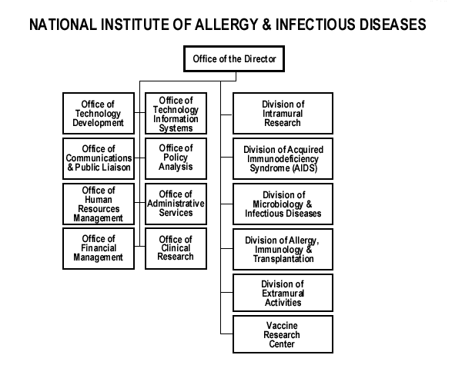
communities of practice

Slide 25
WIFM matrix
barriers
incentives
barriers
incentives
vision
action
Notes:
I thought it was very skillful that the upcoming workshop is organized around the theme “what’s in it for me”.
I’ve been taught to think of this in terms of the “WIFM matix”. That is the set of opposing forces – barriers and incentives -- that either deter or inspire a vision and concrete action towards a greater good (e.g., level of efficiency).

Slide 26
end

Slide 27
WIF-od
VISION: communicate & set policy w/ more detail on funded projects
BARRIER: nomenclature differences and dynamics
ACTION: smart(er) text search

