Slide 1


Knowledge Management…
and Beyond
Tom Davenport
Accenture Institute for Strategic Change
NASA
November 7, 2001

Slide 2
Outline
The Expanding World of Knowledge Management
Where Are We Now?
A Knowledge Management Framework
The Value of Knowledge Management
Implementing Knowledge Management over Time
New Frontiers in Knowledge Management

Slide 3
The Expanding World of
Knowledge Management
Business Intelligence
Knowledge — The most valuable form of information content, with a high level of human contribution and usability
Management — A concerted effort to improve the creation, distribution, or use of knowledge
Organizational Learning
Performance Support
Best Practices
Innovation and Reinvention
Notes:
Focus on the BENEFITS of Knowledge Management

Slide 4
Where Are We Now?
Finally getting some real KM technologies
  But the distinct KM technology is vanishing
Knowledge becoming an accepted business resource
  But how will it compare to profits?
Many small, function-specific projects
  But few transformational ones
Desperately seeking value
  But nobody really measures it well
How do we get to the next stage?

Slide 5
As We Mature...
Knowledge becomes too important to leave to the professionals
Maximizing knowledge becomes a preeminent corporate objective
General managers become knowledge managers
We move from knowledge inventory-building to supply chain management
Attention becomes the scarcest resource

Slide 6
What We Need...
To Begin
To Advance
Widely-available technologies
A place to get started
A few people to help out
A business problem or problem solver
Quick results
Knowledge strategy
Process change for knowledge workers
Cultural change
Integration across content types
Top management support

Slide 7
How Do We Manage Knowledge?
Knowledge management is more than the knowledge or the technology.
Context (Strategy)
Resources
Content
(Knowledge)
Technology
Process
People
Objectives
Metrics
Segments
Notes:
Discuss how having lotus notes doesn’t mean you have knowledge management.
Discuss what it is and what it isn’t.
Establish common lexicon.

Slide 8
The Most Important Resource
Includes organizational structure, culture and behavior, networks, roles and responsibilities
Creating knowledge and learning from it are highly volitional and largely invisible
Culture and behavior trumps all
People!

Slide 9
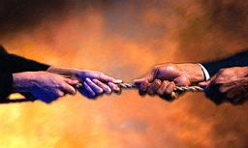
Knowledge Culture and Behavior
The fundamental belief that creating, sharing, and using knowledge are highly-valued activities
To begin, focus on a subculture
  Find one where knowledge matters
  No obvious cultural barriers
To advance, focus on
long-term cultural
change
  Big incentives
  Executive example
Notes:
D
Dow Chemical started with knowledge management in the R&D area
IBM started in consulting and services
Texas Instruments, Johnson & Johnson started with the sharing of best
practices, which was highly consistent with their quality-oriented cultures
Few organizations have changed their entire cultures, and perhaps none
have done so purely for reasons of knowledge management. The US Army
did have a culture change arising out of its Viet Nam experience, which
made it much more receptive to knowledge sharing and the management
of “lessons learned.”

Slide 10

Knowledge Works through Networks
To begin, identify/form communities
  Treat them as clubs
  Need to meet socially and facially
  on occasion
  Not by IT alone
To advance, manipulate network ties
  Strong vs. weak
  Physical vs. virtual
  Global vs. local
Notes:
Negative example - U.S. insurance company that started with knowledge
management by installing Notes, appointing a CKO in the “financial
knowledge” area - but no network in place, and financial workers had
little in common
Positive example - Daimler Chrysler - formed networks in the technical areas
of new vehicle engineering to address quality problems and knowledge
transfer across platform teams - worked well in the US, but can it be
extended to Germany?

Slide 11
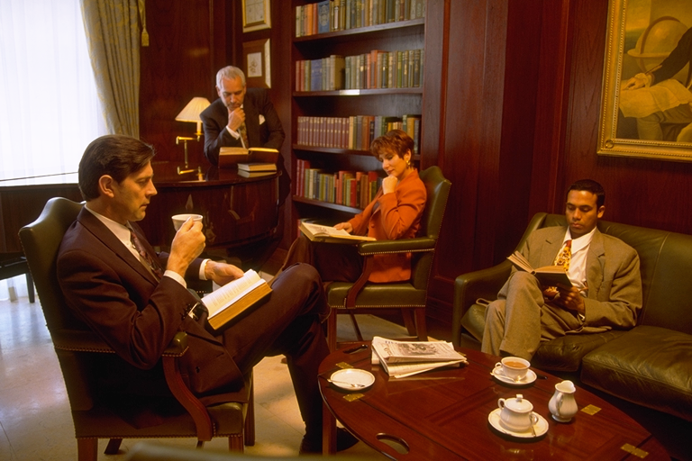
People and Knowledge Roles
To begin, focus on professionals
  Knowledge leaders
  Knowledge initiative managers
  Knowledge network
  facilitators, reporters, etc.
To advance, focus on amateurs
  How much division of
  knowledge labor?
  How much time learning vs. doing?
  Do we hire knowledge seekers in
  the first place?
Notes:
At Applied Materials, a leading semiconductor equipment firm,
identified project managers as the key “amateur” role that
needed to begin using knowledge more effectively
At Bechtel, question of whether design engineers would manage
their own knowledge, or whether a group of professional
knowledge managers would do most of the work - strategy was
to go with knowledge managers in the first few years, but begin
to change the behavior of the engineers and eliminate the need
for professionals

Slide 12
Knowledge Is a...
Knowledge work is a process
  Marketing, R&D, customer service, consulting, etc.
  Redesign to create some slack
Knowledge management is a process
  Create, capture, refine, distribute, use, monitor
Process!

Slide 13
To Begin, View KM as a Process
Create
Capture/ Store
Refine
Distribute
Use
Monitor
Which subprocesses do we do (well)?
Where do we need to focus?
Who owns or manages each one?
What human and technical enablers apply?
Notes:
At General Motors in marketing knowledge, conclusion was, “We’re
good at every aspect of knowledge management except use”
At Johnson and Johnson, how can we get better at two subprocesses:
creation and innovation, and distributing/sharing knowledge across
business unit boundaries

Slide 14

The Critical Role of
Knowledge Work Processes
Have to improve knowledge
work jobs
Participation is key
Some process orientation is
OK, but also explore...
  Where and with whom
  people work
  Changing the unit of knowledge
  Applying knowledge technology
Notes:
The key is to redesign key knowledge workers’ jobs so that they
are more effective
Examples: new car development at Chrysler
“Audit innovation” at Ernst & Young
oil exploration deals at BP Amoco

Slide 15

To Really Advance, Link Them
e.g., The Patient Care Process
History
Diagnose
Treat
Observe
Review
Track
Linking Mechanisms
People
Pilots and prototypes
Process designs
Programming
Knowledge Management Process
Create
Capture/ Store
Refine
Distribute
Use
Monitor
Notes:
Linking method examples:
“Knowledge champions” at Andersen Consulting, “knowledge stewards”
at Ernst & Young
The “knowledge-oriented drug development process” at J&J Pharma-
ceutical Research Institute
The “dialogue/decision process” at General Motors
“Knowledge horizons” at W.L. Gore

Slide 16
And Don’t Forget (as if) ...
Little standalone value
Lots of choices, but do the basics first (e.g., a portal)
Increasing blending with other technology types (e.g., e-learning)
For a broad solution, integration still required
Technology!

Slide 17

Technology to Start Playing
A basic set of knowledge tools
  Web portal
  Search and retrieval
  Document management
  Discussion databases
  Expertise directory
Infrastructure aids
  Common applications
  Dedicated databases

Slide 18
Advanced Knowledge Technologies
Role-specific portals
  Combining relevant transaction data and knowledge
AI tools for more structure
  Case-based reasoning, rule-based systems
Data-into-knowledge tools
  Neural nets, CHAID, data mining
Desktop video for the tacitly-minded
Tools that link e-commerce and KM (e.g., selling knowledge)
Tools that link knowledge and learning (simulations, performance support, web-based learning)
Notes:
Customer service applications frequently require higher levels of
structure, because they are real-time while the customer is waiting
At Hewlett-Packard, for example, had to move to case-based reasoning
in order to allow inexperienced people to work with customers on the
help line
BP Amoco decided that the most important knowledge in the E&P
business was tacit, so it implemented desktop video everywhere
There is an explosion of online learning tools, similar to the Siemens
financial management program, and in many cases these draw from
knowledge management repositories

Slide 19
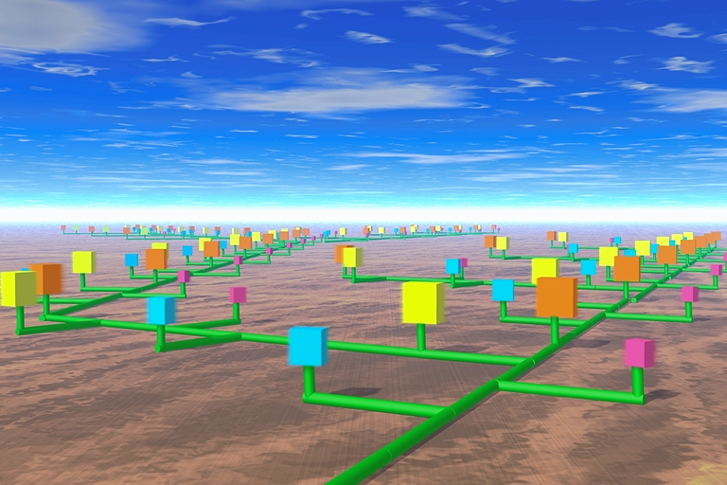
(Knowledge) Content Management
To begin, let a thousand
categories bloom
  Perhaps a map
Structure becomes critical as content proliferates
  Content architecture
  Taxonomies
  Thesauri
  Meta-knowledge
  Multiple levels
  Human pruning
Notes:
Chrysler’s “tech club” managers are focused heavily on what
makes content knowledge rather than data or information
IBM Global Services has three levels of knowledge in its
repositories; Arthur Andersen has two - convergent and divergent
Web companies are among the strongest in content management;
Yahoo, for example, has a staff of over 100 content specialists who
create and manage categories, check out sites, etc.

Slide 20
Strategies for the Strategic
To begin: choose a domain with business value
To advance: focus
  What knowledge content really
  matters?
  Where does our knowledge
  environment need improvement?
  How do we make money?
  What’s the work setting?
To really advance, link:
  Knowledge management with product/service strategy (World Bank, Ryder, Dow, DuPont, etc.)
Notes:
Sequent Computer - decided knowledge for sales was most strategic
when bringing out a new line of more powerful computers
The best example of embedding knowledge into product and service
strategy is at the World Bank, where James Wolfenson announced
in 1996 that the bank would become “the knowledge bank,”
dispensing knowledge to third-world countries as well as loans
Few companies have focused on customer knowledge, but it is the
primary focus at Procter & Gamble, one of the world’s best
marketers

Slide 21
KM and Alternative
Work Settings
Collaborative
Groups
Integration Model
Collaboration Model
Systematic, repeatable work
Highly reliant on formal processes, methodologies or standards
Dependent on tight integration across functional boundaries
Improvisational work
Highly reliant on deep expertise across multiple functions
Dependent on fluid deploy-ment of flexible teams
Level of
Interdependence
Transaction Model
Expert Model
Routine work
Highly reliant on formal rules, procedures and training
Dependent on low discretion workforce or automation.
Judgment-oriented work
Highly reliant on individual expertise and experience
Dependent on star performers
Individual Actors
Routine
Interpretation / Judgment
Complexity of Work
Notes:
Fast food chain in US - “all my workers are knowledge workers” - true
but in lower left category - how can knowledge improve transactions
Audit at E&Y - the Integration model - methodologies, but modularized
Microsoft software development - collaboration model, largely face to
face
Large New York law firm - expert model - very difficult to change their
behavior, so you supply knowledge managers to do it for them

Slide 22
Measures for Measurers
To start: knowledge activity
  Hits, users, items, etc.
To advance: business value
  At a minimum, anecdote management
  Build a chain of credibility: from activity measures to process measures to money (earned or saved)
Forget putting it on the balance sheet
In any case, faith still required
Notes:
Example: customer support knowledge management at HP
First test: are the knowledge bases being hit, are new
cases being added
Second test: is the time per call decreasing, is the number
of field dispatches or mailed-in computers decreasing
Third test: can we grow the business without adding headcount;
is customer service becoming a profit center

Slide 23
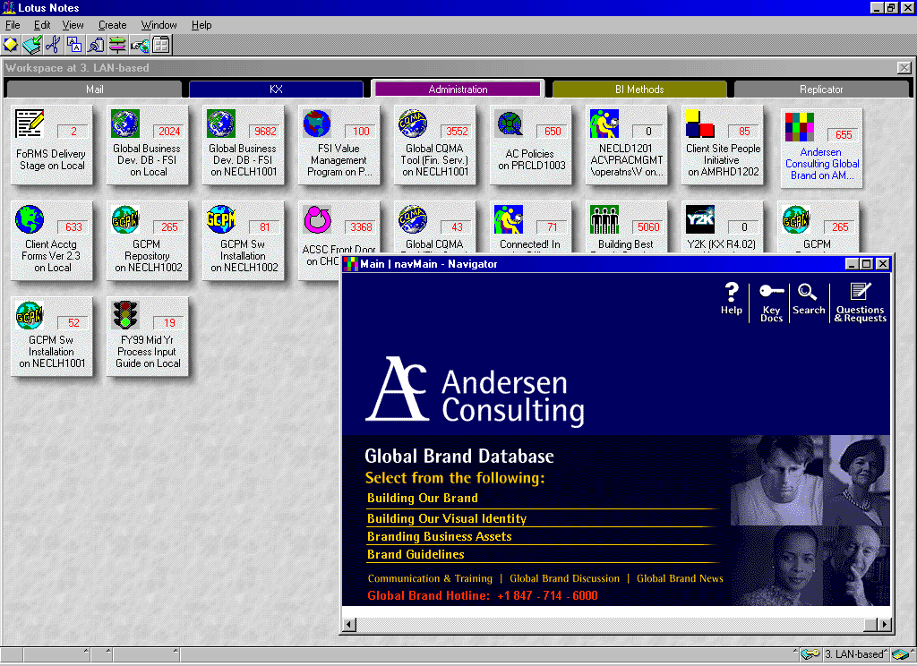
Implementing Knowledge
Management over Time
Step 1: hardware and software infrastructure
Step 2: human infrastructure
Step 3: content proliferation
Next steps:
  Integration with the front line
  Product/service integration
  Greater use of Web and Microsoft tools
Notes:
Discuss how the KX is successful by referencing the process elements.

Slide 24
Knowledge Management Frontiers -
Attention Management
Attention: the most important resource in business
  a finite resource
  a zero-sum game
Attention management is a two way street:
  seekers of attention try to capture it
  and givers of attention have to allocate and try to preserve it
Data, Information,
Knowledge
Information
Processing
Technology
Volume
Access
Network Bandwidth
Attention
Time

Slide 25
Knowledge Management Frontiers:
Turning Data into Knowledge and Results
Businesses have more and better quality data than ever before
The systems which deliver the greatest value are those that enable managers to steer the business more effectively, as well as reduce operational costs and process transactions efficiently
To date, relatively few businesses have been able to extract and use the full value of transaction data to:
  build stronger customer relationships
  design new and improved products and services
  enhance business and management processes
Successfully realizing the value of transaction data requires an knowledge management approach which looks at a combination of technical, organizational, people and cultural factors

Slide 26
A Model for Building Analytical Capability
Outcomes
Financial
Events that change as a result of the analysis and decision-making
Includes changes in behavior, processes and programs, and financial conditions
Process &
Program
Behavioral
Transformation
Decision
Making
Where the data is actually analyzed and used to support a business decision
Analysis
Context
May be viewed as the prerequisites of success for the capability
Strategy
Skills &
Experience
Organization
& Culture
Technology
& Data

