Slide 1
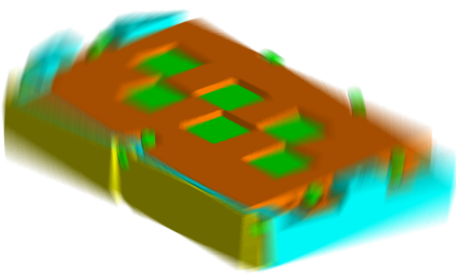
FEMCI Conference
A Multi-Disciplinary Approach to Calculate Displacement Due to Random Vibration For A Space Based Focal Plane
Anthony J. Davenport
Senior Mechanical Engineer
Northrop Grumman, ESSS

Slide 2
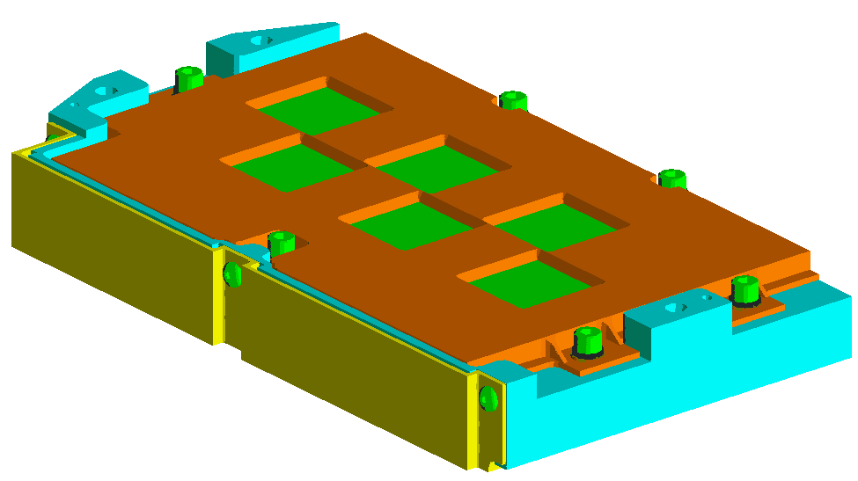
Focal Plane Geometry
Filter (x6)
Cover
Flex Cable Strain Relief
Housing

Slide 3

So What Is The Problem?
1. Out of Plane Bowing from Cryogenic Loading
2. Random Vibration Displacement of the Cover
3. Lack of Material Properties (Adhesives)
Cover
Filter
Housing
Gap of Concern
Sensors
Focal Plane Cross-Section

Slide 4
Design & Analysis Path for the Focal Plane
Phase I: Thermal Testing & Correlation
Define
Simplified
Simplified
Model
Define
Simplified
Simplified
Model
Problem
Model
Testing
Refinement
Problem
Model
Testing
Refinement
Phase II: Detailed Thermal Analysis & Results
Apply To
Housing
Bolt
Apply To
Housing
Bolt
Detailed Model
Deflection
Analysis
Detailed Model
Deflection
Analysis
Phase III: Random Vibration Testing & Correlation
Goals For
Pre-Qual
Testing
Model
Goals For
Pre-Qual
Testing
Model
Random
Vib
.
Testing
Results
Refinement
Random
Vib
.
Testing
Results
Refinement
Phase IV: Detailed Flight Hardware Analysis & Results
Displacement
Stress
Bolt
Proven
Displacement
Stress
Bolt
Proven
Analysis
Analysis
Analysis
Design
Analysis
Analysis
Analysis
Design

Slide 5
Thermal Expansion Analysis Method
Create a simplified model in PTC’s Mechanica using mechanical properties determined by the NG materials group.
  Run model between 295 ºK to 110 ºK (ΔT = 185 ºK)
  Examine relative displacement in the out-of-plane direction (Z)
Compare results to testing completed in laboratory and correlate model.
Apply what is learned to detailed model.

Slide 6
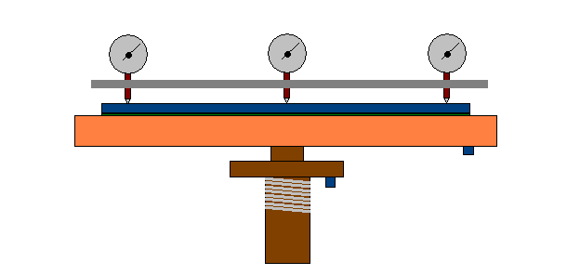
Simplified Test Model
Dial Gages (x3)
Substrate
Adhesive
Molybdenum
Cold Finger With
Heater Element
Temperature
Sensors

Slide 7
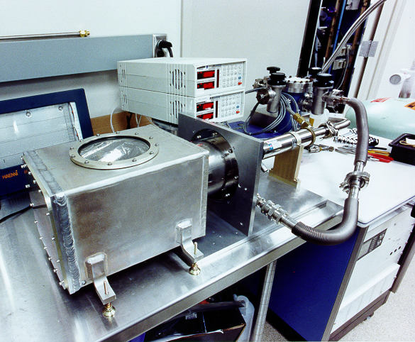
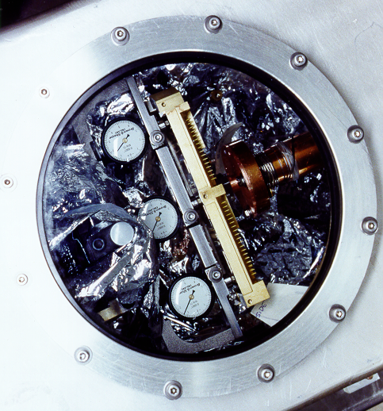
Laboratory Test Setup
Three Dial Gages Touch
The Focal Plane in
3 Locations to Measure
Bowing in Focal Plane
Measuring Dials (x3)
Cold Finger & Heater
Temperature Range 295 ºK - 110 ºK
Focal Plane

Slide 8
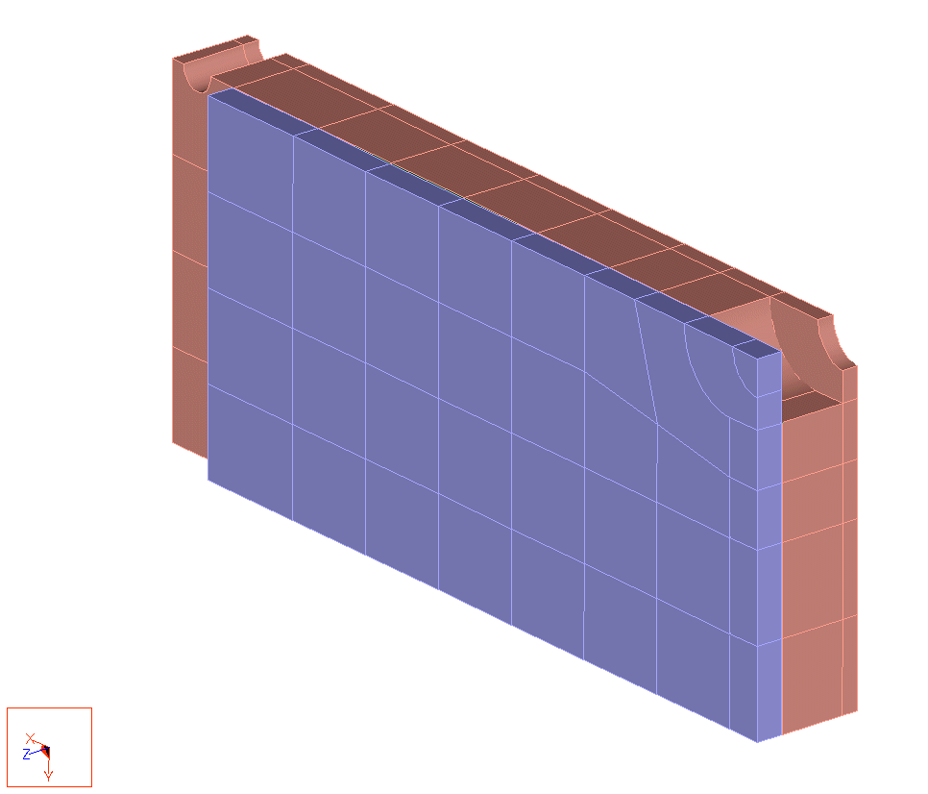
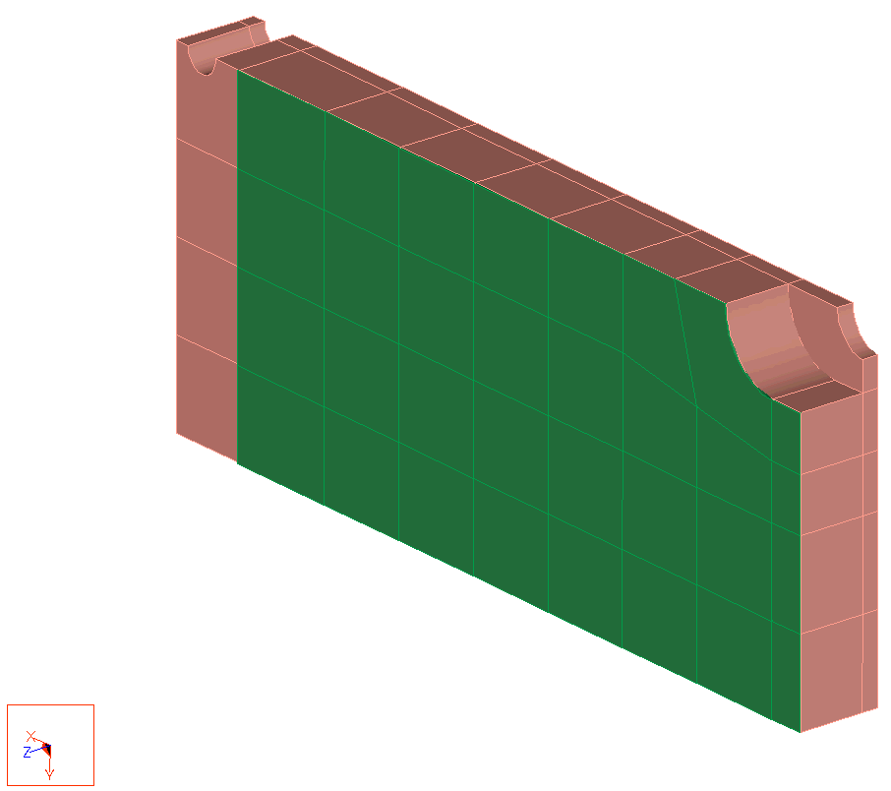
¹/₄ Simplified Analysis Model
Symmetry Constraint, Y
Molybdenum
Constraint, Z on Bottom Curve
Adhesive
Substrate
Substrate Removed
Substrate
Symmetry
Constraint, X

Slide 9
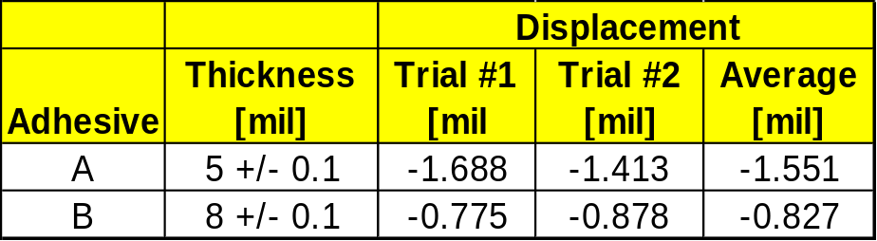
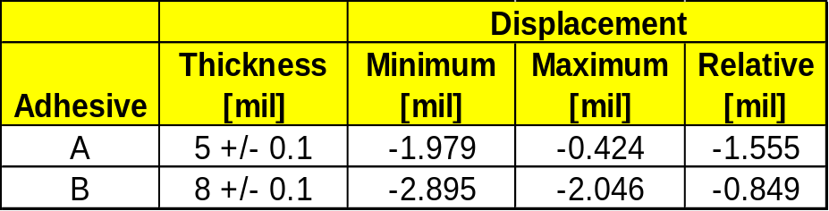
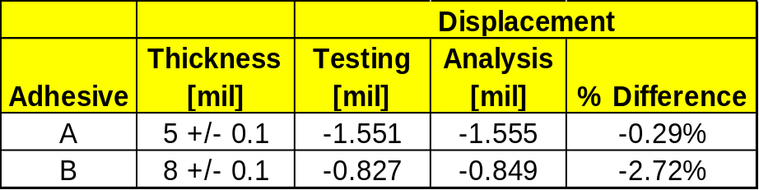
Relative Displacement Results From Testing & Analysis
Analysis Model
Testing
Comparison

Slide 10
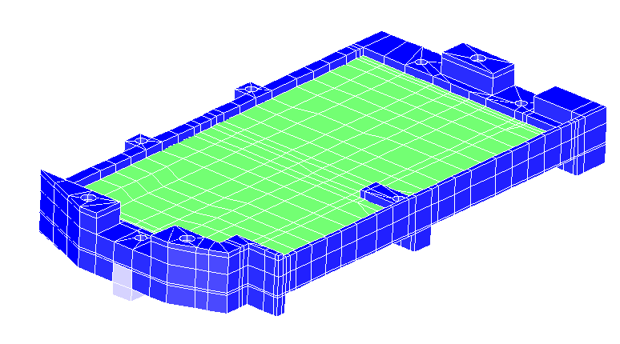
Detailed Analysis Model
Focal Plane Bows 5.3 μm, or +/- 2.6 μm Across a Mid-Plane
Mounting Surface Z Constraint
Ceramic Substrate
X,Y Constraint
Mounting Surface
Z Constraint
Molybdenum
Uniform Temperature Load: Cure to Cryogenic (295 ºK to 110 ºK)

Slide 11
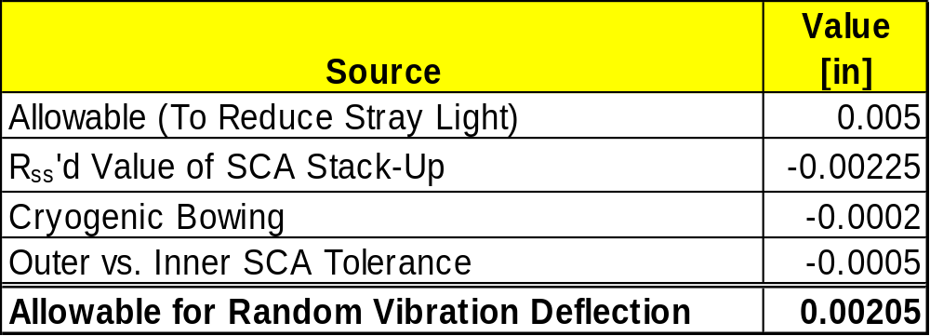
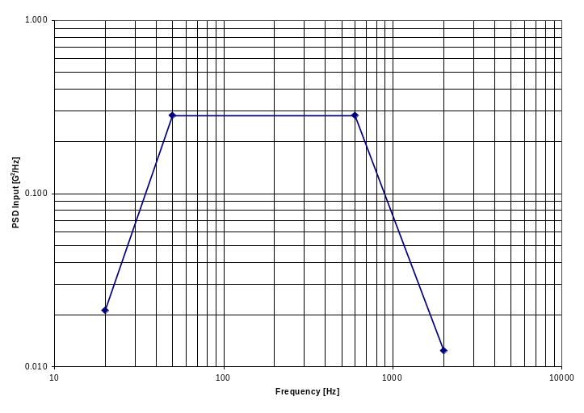
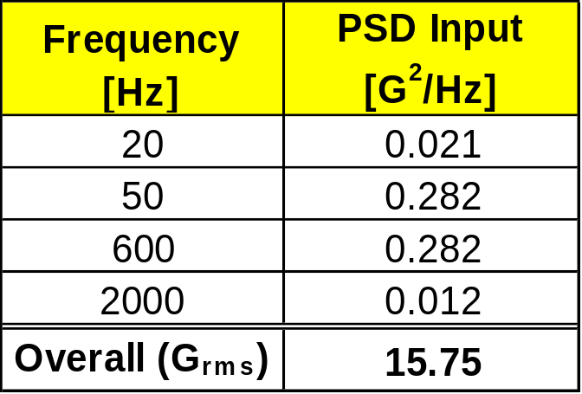
Random Vibration Derived Requirements
From Cryogenic Analysis

Slide 12
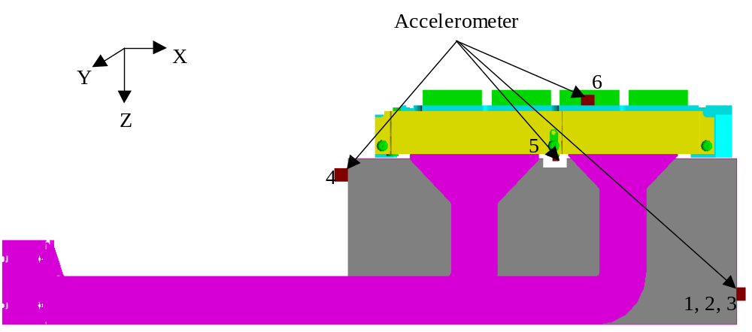
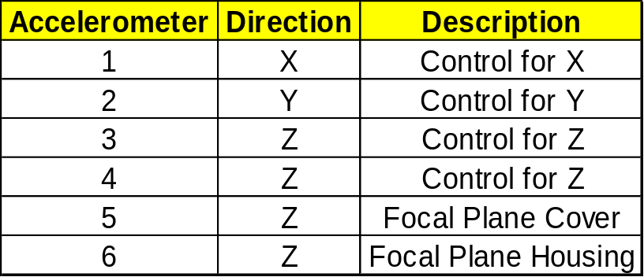
Random Vibration Test Setup

Slide 13
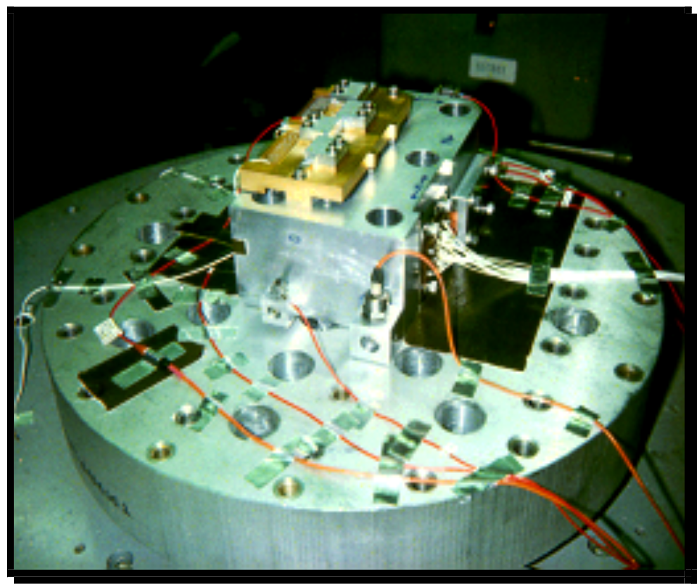
Test Setup
Focal Plane
Accelerometers

Slide 14
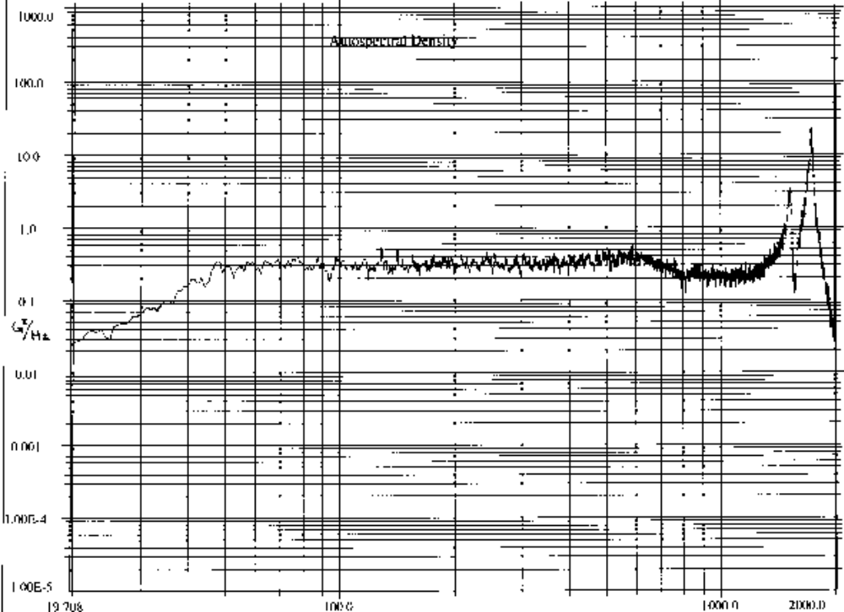
Test Results: Housing
Mode 2: 1717 Hz
Mode 1: 1513 Hz
39.3 G_{rms}

Slide 15
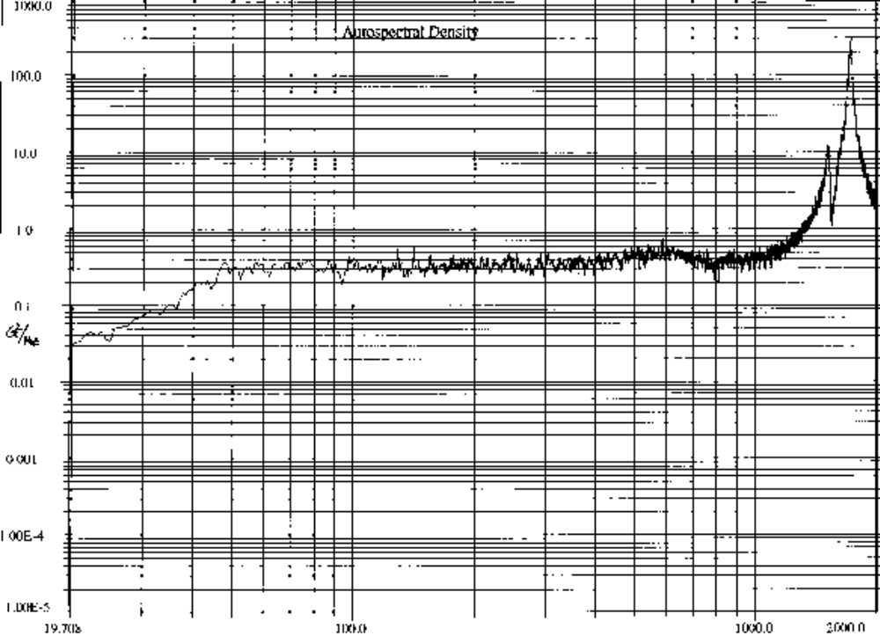
Testing Results: Cover
Mode 2: 1717 Hz
Mode 1: 1513 Hz
118.9 G_{rms}

Slide 16
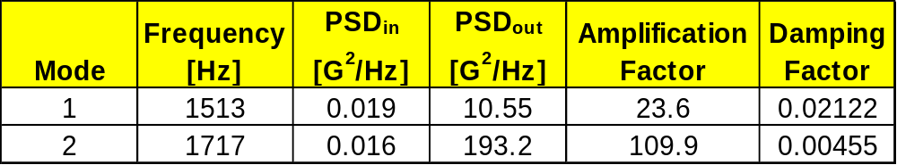
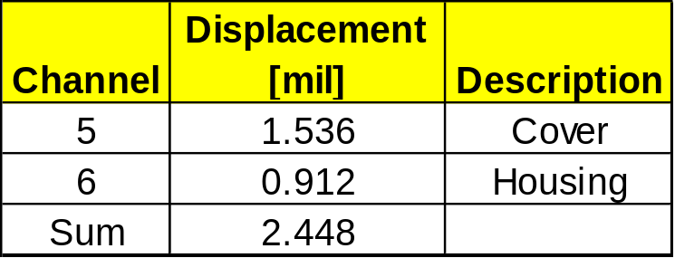
What Can Be Derived From Test?
Damping Factors
3σ Absolute Displacement
Relative Displacement (500 Hz - 2000 Hz): 2.379 +/- mil Using Method Discussed in Appendix B (3% Diff.)

Slide 17
Method of Correlation
Match the Frequency of the Test Model
  Boundary Conditions
  Mass of Components
  Stiffness
    Geometry
    Material Properties
Match the Displacement
  Acceleration PSD Input
  Damping Value: ζ = 1/(2Q)

Slide 18
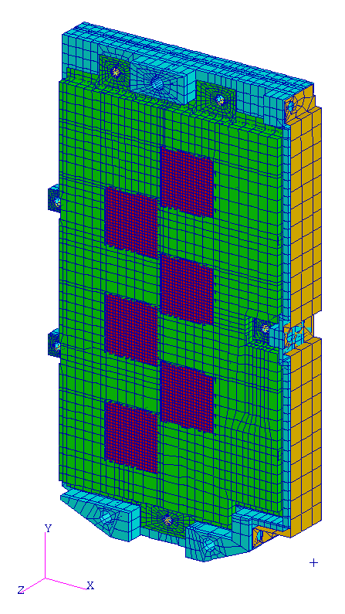
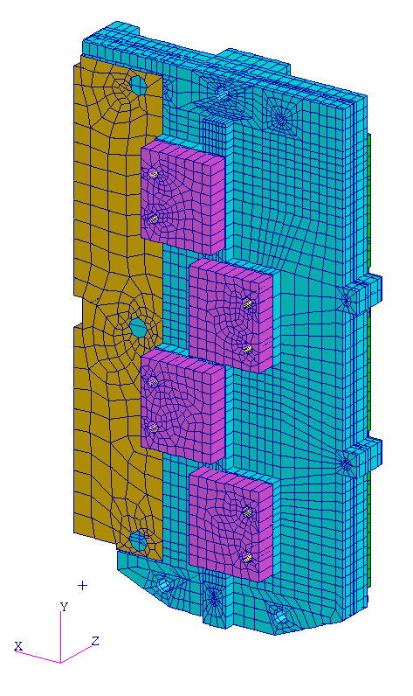
Matching Frequency
Geometry: Built from Unigraphics Model
Boundary Conditions: Bolt Stiffness Applied
Mass from Tested Components
Materials: Varied Young’s Modulus for Molybdenum within range found in multiple sources.
Iso - View
Aniso - View

Slide 19
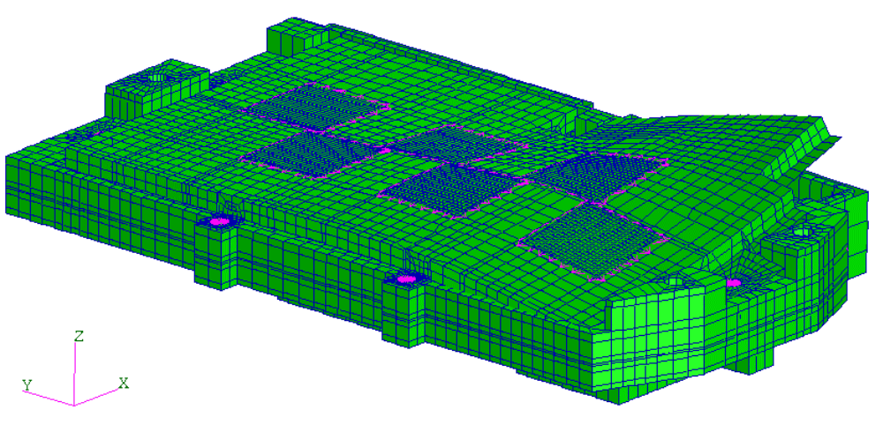
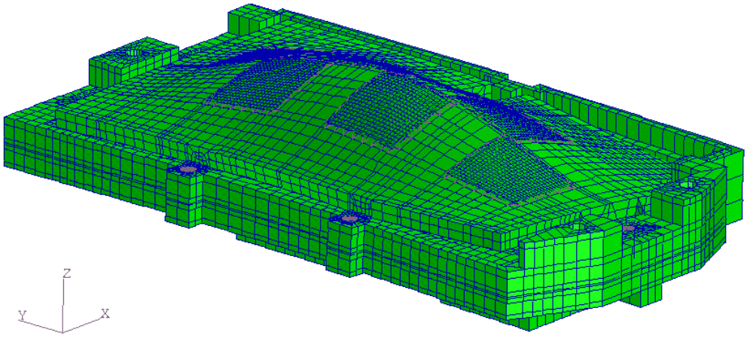
Matching Frequency Results
Mode 1: 1477 Hz (2.4% Diff)
Mode 1: 1717 Hz (0.0% Diff)

Slide 20
Matching Displacement
Adjust PSD Input to Match Testing.
  Tolerance allowed for a +1 dB overall variance.
  For a small response, this makes a large difference.
  It was found that the PSD input was +0.4 dB higher than Specification.
Adjust Damping to fine tune the model (ζ = 0.00351)
2.380 mil Deflection (0.042 % diff. from testing) for 500 - 2000 Hz.

Slide 21
Conclusions
Bowing due to Thermal Expansion is determined by defining material properties via testing, modeling, and correlation.
Cryogenic deflections help drive the random vibration allowable.
Random vibration correlation helps in examining future changes to the focal plane design and it’s inputs.

