Slide 1
NPOESS Cal Val Program
REVISED SLIDES
Brian Lottman
SSPR Contractor NPOESS Cal Val Lead
Karen St. Germain
IPO NPOESS Cal Val Lead
NASA NPP Science Team Kickoff
November 3, 2003
Annapolis, MD

Slide 2
Agenda
Teams, Objectives, Tasks, Coordination
Cal Val Plans Status
Cal Val Phase Status
Summary

Slide 3
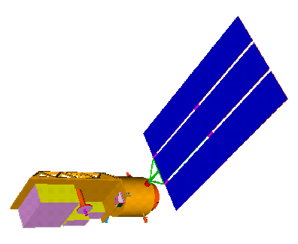

Philosophy of Calibration/Validation
Cal/Val
Calibration
Validation
Centrals
  NWP
Real-time tactical
Non-tactical
  JTWC
  NHC
  JIC
Science
Others
Mission Success
Users
Absolute Accuracy
Polarization Purity
Geolocation Accuracy
Instrument Stability
Signal-to-Noise
Antenna Pattern Correction
Environmental Data Products (EDRs)
Atmosphere
Ocean
Land
Ice
Space
Ensures
Meet Specification
Operational production of synoptic maps and profiles of critical atmospheric, oceanographic, land and space parameters
Known Accuracy
Quality Control
Calibration ensures that the Sensor Data (SDRs) are usable
Validation ensures that the Environmental Data (EDRs) are usable
St.Germain

Slide 4
NPOESS Calibration Verification
Validation Program Participants
Science
Activities
Operational
Activities
Engineering
Activities
Integrated Product Teams (IPTs)
Systems Engineering
(SE, SI, ST&E, Cal/Val)
Payloads
IDPS
Operations and Support
NPOESS Internal
Government Studies
NPOESS Operational
Algorithm Team (NOAT)
Government
NASA NPP
Science Team
Integrated Product Teams (IPTs)
Systems Engineering
(SE, SI, ST&E, Cal/Val)
Payloads
IDPS
Operations & Support
NGST Science
Advisory Team (SAT)
NGST
NGST Science Team
NPOESS Customer
Forum
Joint
Calibration/Validation Working Group (CVWG)
St.Germain

Slide 5
NPOESS
Internal Government Studies (IGS)
Lead and Managed by:
Dr. Stephen Mango, NPOESS IPO Chief Scientist
Teams of scientists and engineers from Government laboratories and centers, FFRDCs and universities
Tasked to identify technologies and techniques able to meet NPOESS requirements and objectives
Twelve (12) core study teams
Thirty-three institutions have participated
St.Germain

Slide 6
NPOESS Operational Algorithm Team
Lead and Managed by:
Dr. James Duda
Selected technical experts in the scientific specialties required for the success of the NPOESS program
Work as a team with the SSPR (and sensor vendors) to ensure that the sensors and algorithms satisfy IPO requirements
Focus on Algorithm and Sensor Science (EDR performance)
  Recommend Improvements, if applicable, to IPO
  Participate in Assessment of Instrument/EDR Performance Trades
  Provide independent validation of projected performance to ensure integrity of algorithm science
  Monitor conversion of science code to operational code
  Support integration of sensor onto spacecraft
  Participate in Configuration Control of ATBDs and operational code
St.Germain

Slide 7
NPOESS Cal/Val
Lead and Managed by:
Dr. Karen St.Germain
In process of refining roles and responsibilities for IPO technical experts in the engineering/ scientific specialties required for the success of the NPOESS program
Work as a team with the SSPR (and sensor vendors) across Integrated Product Teams (IPTs) to ensure that the sensors and algorithms satisfy IPO requirements
Focus on systems engineering approach to all three phases of Cal/Val
  Identify, manage, and document all functions, operations, and activities to adequately calibrate and validate NPOESS/NPP performance
  Identify, document and manage all parts of the system that interact with the Cal/Val function
  Jointly author the final Government/SSPR Cal/Val plans
  Identify/document/plan the inventory of Cal/Val resources and future availability
  Coordinate Cal/Val Operational Scenarios
  Oversee pre-launch sensor characterization
  Manage Cal/Val schedule, milestones, resources, personnel
  Partner in execution of Cal/Val
St.Germain

Slide 8
NPOESS Government - NASA
Cal Val Ver Program Participants
NASA NPP Project Science Group
Project Scientist: Dr Robert E Murphy
Deputy Project Scientist: Dr Jeffrey Privette
Dep Proj Scientist for Data: Sr Stephen Wharton
STE IPT
NPP Characterization Support Team
(NCST)
Lead: Dr Bruce Guenther
Dr. Joseph Lyu:CrIMS
Dr Hassan Ouaidrari:VIIRS
Dr Jack Xiong:VIIRS
Dr. Jeffrey Luybelczyk: Data Exchange
Prof Larrabee Strow:CrIS
In-House Science
Dr. Jim Shiue: ATMS Lead
Dr Joel Susskind:CrIS Lead
Ernest Hilsenrath:OMPS Lead
Dr. Jeffrey Privette: VIIRS Lead
Dr Alex Lyapustin: VIIRS
Dr Louis Kouvaris: CrIS
Dr. Mohan Nirala; VIIRS
Dr. Yujie Wang: VIIRS
CV WG
NPP Algorithm Implementation
Lead: Dr Peter Kealy
Seth Hoffman: Simulations
Dr John Qu; NGST Liaison
NPP Science Teams
Pre-Launch Team to be
Selected Summer 2003
At-Launch Team to be
Selected ~ 2006
SE IPT
IDPS IPT
St.Germain

Slide 9
NASA NPP Project Science Team
Bryan Baum ¹ | Alex Lyapustin ⁴ | Tom Pagano ² | Knut Stamnes ¹¹
Evan Fishbein ² | James Maslanik ⁶ | Jeff Privette ⁴ | Larrabee Strow ⁴
Qingyuan Han ³ | Chuck McClain ⁷ | Jon Ranson ⁴ | Omar Torres ⁴
Chris Justice ⁴ | Rich McPeters ⁴ | Hank Revercomb ¹ | Eric Vermote ⁴
Bjorn Lambrigtsen ² | Paul Menzel ¹ | Crystal Schaaf ⁹ | Menghua Wang ⁴
Thomas Loveland ⁵ | Peter Minnett ⁸ | Dave Staelin ¹⁰ | Robert Wolfe ⁴
1 University of Wisconsin 7 NASA GSFC
2 NASA JPL 8 Miami University
3 University of Alabama 9 Boston University
4 University of Maryland 10 Massachusetts Institute of Technology
5 USGS 11 Stevens Institute of Technology
6 University of Colorado
St.Germain

Slide 10
NPOESS SSPR Contractor
Cal Val Ver Program Participants
Vice President and NPOESS Program Director
Fred Ricker
Vice President and NPOESS Assistant Program Director
Mike Mader
Lottman
Vice President &
Deputy Program Director,
East Coast Operations
Jim Goodrich
Raytheon Deputy Program Manager: Gerard Wittman
Operations Manager: Bill Havens
Technical Director: Terry Larson
Supply Chain Manager: Brian Chappel
Chief Engineer: Ben James
Project Scientist: Michael Mussetto
Chief SW Engineer: Scott Yanke
QA Manager: Rick Ikemoto
Raytheon Subcontract Manager: Bill Rightmier
External Affairs
Steve Goralczyk
System
Engineering &
Integration
Roy Tsugawa
System
Test &
Evaluation
Steve Young
Payloads
Tom Kolesar
Space
Segment
Terry Larson
Ground
Segments
Keith Reinke
Operations
& Support
Ben James
System
Engineering
TBD
Spacecraft
Don Adkins
IDPS, FTS
Kerry Grant
Ground O&S
Tom Baugh
CAL VAL
PROGRAM
Brian Lottman
LSS
Rex Desilets
C3S
Mark Sargent
Flight O&S
Terry Watson
System
Integration
Gary Waldeck
Each IPT contributes to the Cal Val Program.
The Cal Val core team coordinates / integrates the effort across all phases of the NPOESS Program.
8/29/02

Slide 11
NPOESS SSPR Contractor
Cal Val Team
SSPR Contractor Cal Val Team
Lead: Brian Lottman
ST&E IPT
Lead: Steve Young
VIIRS TEAM
Lead: Lushalan Liao
Tim Dorman, Bill Byerly, Richard Sikorski
Test Infrastructure
Lead: Dr. Chunming Wang
Larry Harnett, Scott Shipley, Bonnie Reed
CrIMSS TEAM
Lead: Giovanni DeAmici
Art Dybdahl, Gene Kratz, Richard Buss, Daya Gilra
ALT TEAM
Lead: Ron Brooks
OMPS TEAM
Lead: Jack Larsen
Colin Seftor
TSIS TEAM
Lead: Tony Mallama
ERBS TEAM
Lead: Ama Ba
SESS TEAM
Lead: Sandy Pilipowskyj
Bob Prochaska, George Davenport
CMIS TEAM
Lead:Daya Gilra
Gene Kratz
GPSOS TEAM
Lead: Richard Sikorski
George Davenport
Note: This is a partial list of participants.
Other IPT’s participate as part of the normal course of work.
Lottman

Slide 12
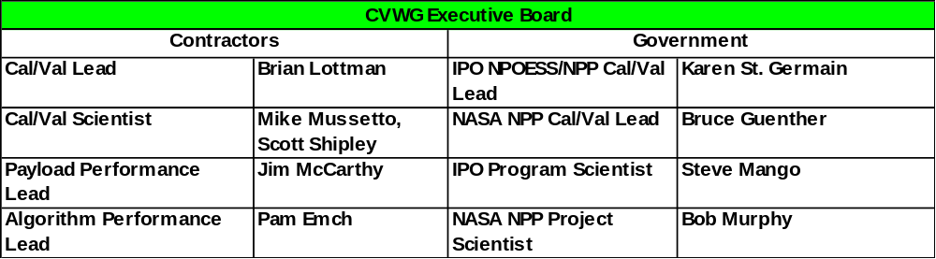
NPOESS Calibration Validation Working Group in Place
Joint Government SSPR contractor group.
Coordinate the planning of the calibration and validation of the NPOESS system beginning with NPP and continuing through the lifetime of all NPOESS satellites.
Support the execution of Cal/Val in alignment with project directives.
Membership includes stakeholders across program and community
CVWG Inaugural Plenary Symposium Meeting Held June 2003
NPP Prelaunch Sensor Specific Meetings – Nov/Dec 2003
NPP Post Launch Sensor Specific Meetings – Mar/Apr 2004
Complete CVWG Charter Posted on Erooms, see
https://collab1.trw.com/eRoom/NPOESS/SystemTestEvaluation/0_219eb
Lottman/St.Germain

Slide 13
CVWG Plenary Session June 12, 2003
Meeting Purpose / Objective
Describe the NPOESS Cal Val Program, SSPR approach, and planning and implementation strategy to key leadership representatives from stakeholder organizations. Leadership to disseminate information through their respective organizations.
Discuss the NPOESS Centrals and NASA higher order data products produced from NPOESS data.
Discuss splinter issues in breakout groups and summarize recommendations to team.
Set the framework for collaboration across “party” lines and begin building an effective government / contractor CVWG. Group to guide NPOESS Cal Val Program for the next ¼ century.
Support the Formulation of the
Joint Government-Contractor Cal Val Plan
Facilitate Participation in the Successful Execution of this Plan
Lottman/St.Germain

Slide 14
CVWG Prelaunch Sensor Characterization Calibration Meetings Nov / Dec 2003
Focus on NPP sensor characterization and calibration. Optimize sensor testing and calibration planned for instrument sell off for Cal Val.
Discuss what sensor testing and calibration is planned and what steps are required to produce calibrated radiances. Discuss how the test data is translated to produce SDR input parameters. Discuss options for optimizing this testing from a Cal Val perspective.
Outcome - list of proposed characterization and calibration strategies not currently under consideration that will optimize the Cal Val program and can be employed within the existing sensor subcontract.
OMPS – November 20-21 (Boulder)
VIIRS – November 24-25 (SBRS)
CrIS – December 9-10 (ITT)
Lottman/St.Germain

Slide 15
Calibration Verification &
Validation Program System Perspective
Prelaunch
Post-Launch
Long-Term Monitoring
Sensor Characterization and Calibration
Operations, Maintenance,
and Upgrades
Heritage sensor data, design analysis
Calibration and characterization ground tests
Calibration and characterization on-orbit
Sustaining calibration and validation
Algorithm tuning and upgrades
Verification of science algorithm quality and latency
Verification of
operational algorithm
quality
and latency
RDR/SDR validation
Validation of operational EDR quality and latency
Operational EDRs
RDR/SDR/EDR Verification
RDR/SDR/EDR Validation
Lottman

Slide 16
Cal Val Program Phase and Need Timeline
2003
2004
2005
2006
2007
Jan
Apr
Jul
Oct
Jan
Apr
Jul
Oct
Jan
Apr
Jul
Oct
Jan
Apr
Jul
Oct
Jan
Apr
Jul
Oct
Program
Milestones
NPP
M-CDR
NPOESS
DPDR
NPP
MTRR
NPP
Launch
NPP
OHR
NPP
DPC VR
Program Phases
Prelaunch Phase
Postlaunch
Phase
LTM
Phase
Needs
Sensor Data
Well Characterized EDU/FM Sensor
RDR, SDR, EDR
Truth Data
Science to Operational Code Conversion
Verif Op Alg
Ancillary Data
Offline Postlaunch Intensive Cal Val Tools
Science Algorithms from Vendors
Verification Tools
VerificationTools
Comprehensive Test Data Sets
Comprehensive Test Data Sets
Calibration Validation Data Base
Verified Science Algorithms
Validated Data Products
Test Infrastructure
Gov Provided
Joint SSPR Cont/Gov
Real Time DQM Tools
Lottman

Slide 17
Agenda
Teams, Objectives, Tasks, Coordination
Cal Val Plans Status
Cal Val Phase Status
Summary
Lottman

Slide 18
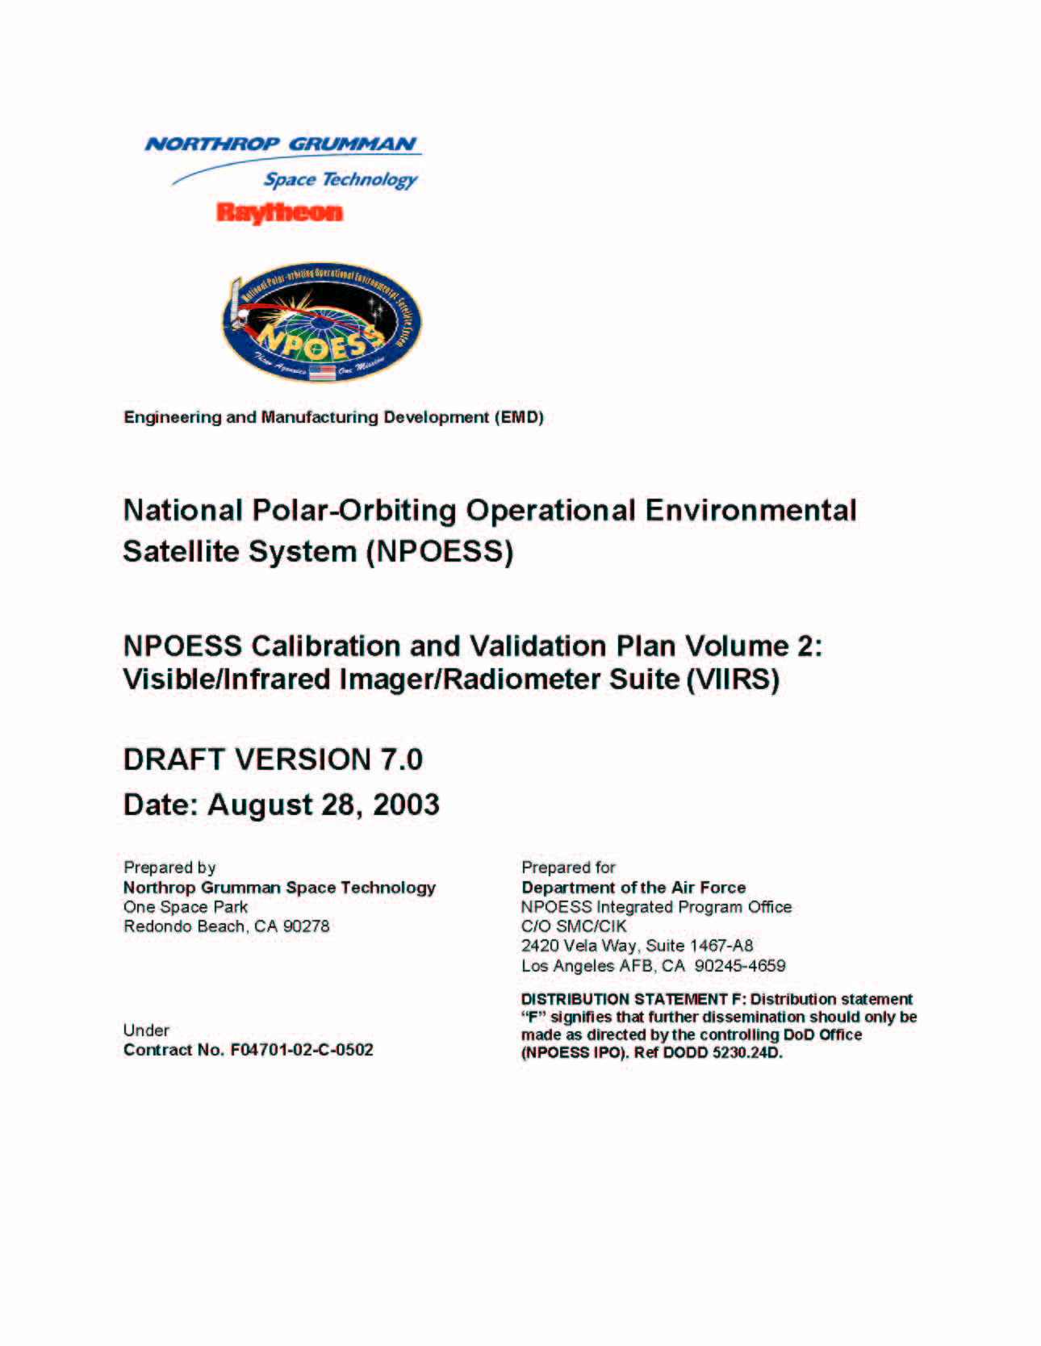
Sensor Specific Cal Val Plans Vol 2-10,
Draft REV-A Released November 3, 2003
- NPP Related Plans
*
+
*
*
*
Vol 9
TSIS
Vol 10
ERBS
Vol 1
Vol 8
ALT
Vol 6
GPSOS
Vol 7
SESS
Vol 4
CMIS
Vol 5
OMPS
Vol 2
VIIRS
Vol 3
CRIMSS
Joint Government SSPR contractor NPP Cal Val Plan developed over next year, with mature draft released October 2004.
Lottman/St. Germain

Slide 19
Sensor Specific Plans
6 Month Update Strategy
2003
2004
2005
Oct
Nov
Dec
Jan
Feb
Mar
Apr
May
Jun
Jul
Aug
Sep
Oct
Nov
Dec
Jan
Feb
VIIRS
Liao
REVA
REVB
REVC
CrIMSS
DeAmici
REV A
REV B
REV C
OMPS
Larsen
REVA
REVB
REVC
ERBS
Ba
REV A
REV B
REV C
ALT
Brooks
REVA
REVB
REVC
TSIS
Mallama
REV A
REV B
REV C
CMIS
Gilra
REVA
REVB
REVC
GPSOS
Davenport
REV A
REV B
REV C
SESS
Pilipowskyj
REV A
REV B
Sensor Specific leads to update during 6th month of each cycle.
SESS on special development cycle (Pilipowskyj/Davenport)
Changes documented in Rev X issues disposition list.
Lottman

Slide 20
Agenda
Teams, Objectives, Tasks, Coordination
Cal Val Plans Status
Cal Val Phase Status
Summary
Lottman

Slide 21
Prelaunch Sensor
Characterization and Calibration
Prelaunch
Post-Launch
Long-Term Monitoring
Sensor Characterization and Calibration
Operations, Maintenance,
and Upgrades
Heritage sensor data, design analysis
Calibration and characterization ground tests
Calibration and characterization on-orbit
Sustaining calibration and validation
Algorithm tuning and upgrades
Verification of science algorithm quality and latency
Verification of
operational algorithm
quality
and latency
RDR/SDR validation
Validation of operational EDR quality and latency
Operational EDRs
RDR/SDR/EDR Verification
RDR/SDR/EDR Validation
Sensor Testing Focus in Concert with Schedule Driver Milestones
Planned Sensor Testing in General Supports Needs for Cal Val
Sensor Testing Challenges Being Worked
Lottman

Slide 22
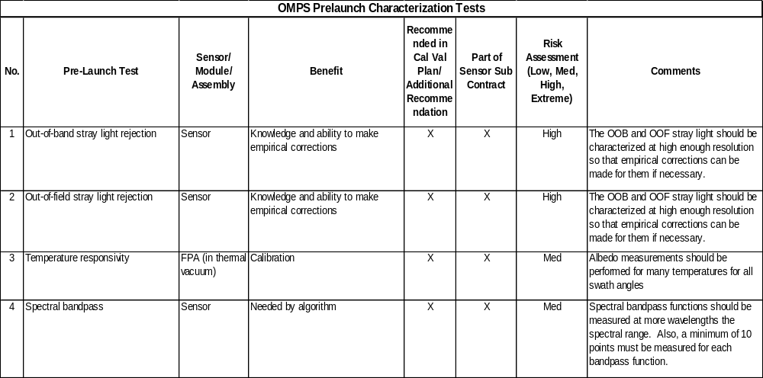
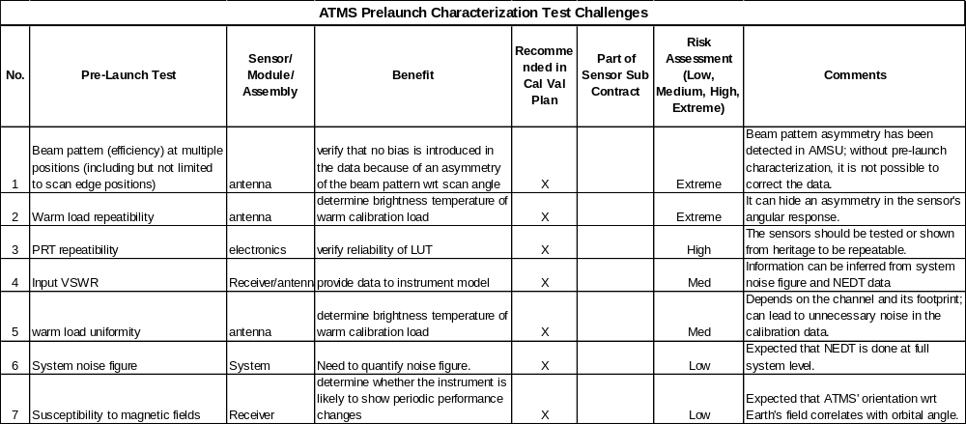
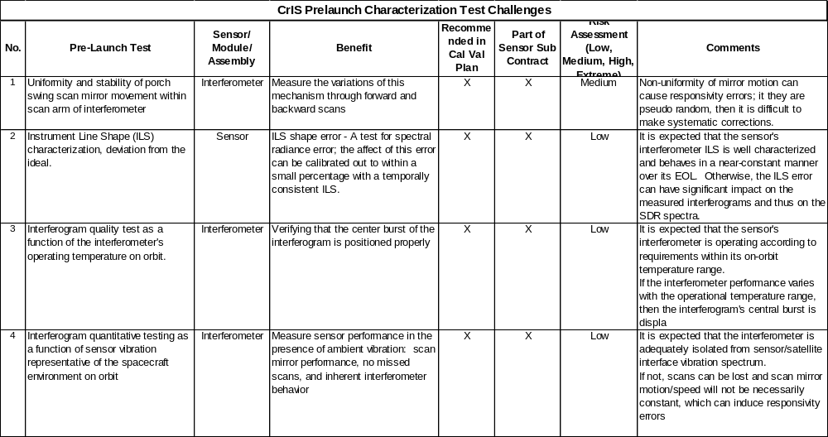
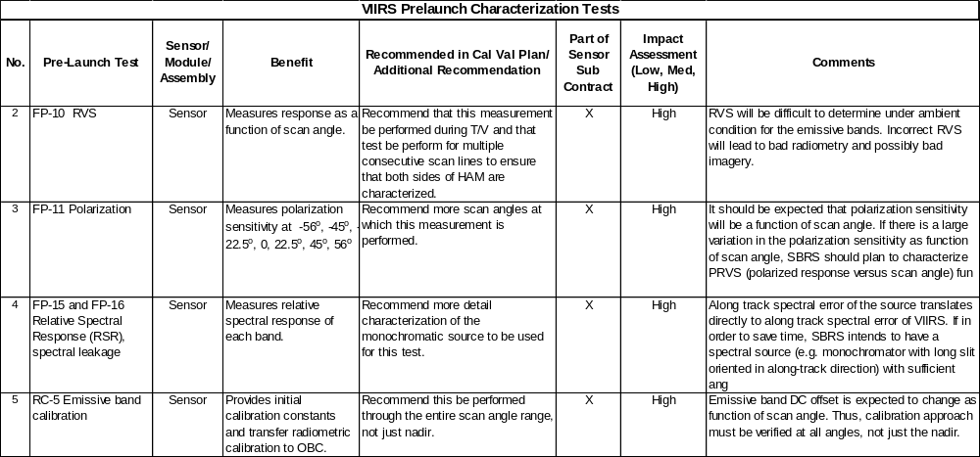
Sensor Testing Sample Challenges
ST&E/PL/SE have identified and are working the challenges in concert with the sensor subcontract testing schedules
For Complete Table See Draft Version 7.0 of Cal Val Plan
https://collab1.trw.com/eRoom/NPOESS/SystemTestEvaluation/0_24489
Lottman

Slide 23
Prelaunch Algorithm Performance Verification
Prelaunch
Post-Launch
Long-Term Monitoring
Sensor Characterization and Calibration
Operations, Maintenance,
and Upgrades
Heritage sensor data, design analysis
Calibration and characterization ground tests
Calibration and characterization on-orbit
Sustaining calibration and validation
Algorithm tuning and upgrades
Verification of science algorithm quality and latency
Verification of
operational algorithm
quality
and latency
RDR/SDR validation
Validation of operational EDR quality and latency
Operational EDRs
RDR/SDR/EDR Verification
RDR/SDR/EDR Validation
Work Scheduled in Concert with Schedule Driver Milestones
Algorithm Verification Activities Underway
Lottman

Slide 24
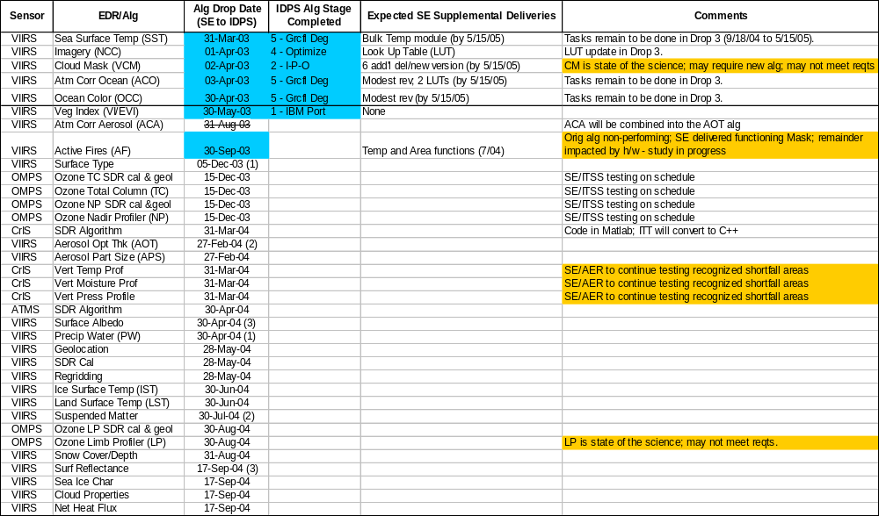
NPP Algorithm Status
Schedule Legend
On schedule
Not on schedule
Comment Legend
Watch Area
Issue
Drop 1
(up to 3-31-03)
Drop 2
(4-1-03 to 9-17-04)
(1), (2), (3) – Delivery dates to be swapped per SE/IDPS agreement; ECR in approval cycle
Note:Detailed Algorithm Discussion
in Separate Presentation
For science alg delivery details see: https://collab1.trw.com/eRoom/NPOESS/SystemEngineering/0_1b2b1
Lottman

Slide 25
Post Launch Sensor Performance Verification and Data Product Validation
Prelaunch
Post-Launch
Long-Term Monitoring
Sensor Characterization and Calibration
Operations, Maintenance,
and Upgrades
Heritage sensor data, design analysis
Calibration and characterization ground tests
Calibration and characterization on-orbit
Sustaining calibration and validation
Algorithm tuning and upgrades
Verification of science algorithm quality and latency
Verification of
operational algorithm
quality
and latency
RDR/SDR validation
Validation of operational EDR quality and latency
Operational EDRs
RDR/SDR/EDR Verification
RDR/SDR/EDR Validation
Planning Effort in Concert with Primary Schedule Driver Milestones
Postlaunch Strategies Identified For Sensor Performance Verification, SDR Radiance Calibration and Geolocation, EDR Validation. Draft Truth Data Prioritization Conducted
Working to uncover Requirements and Flow into System Design.
Lottman

Slide 26
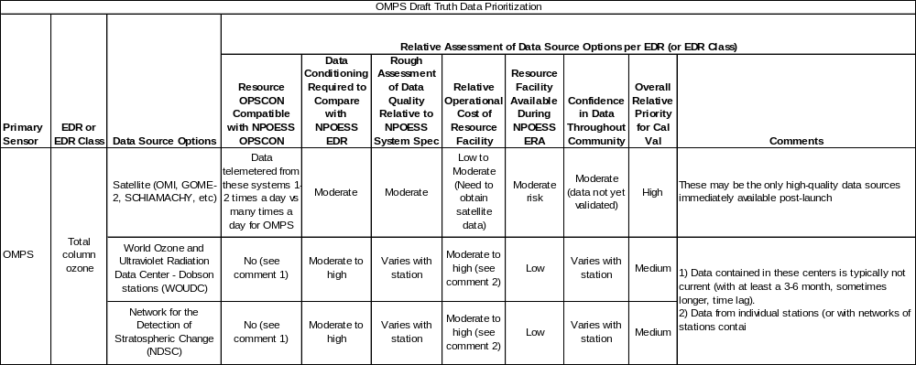
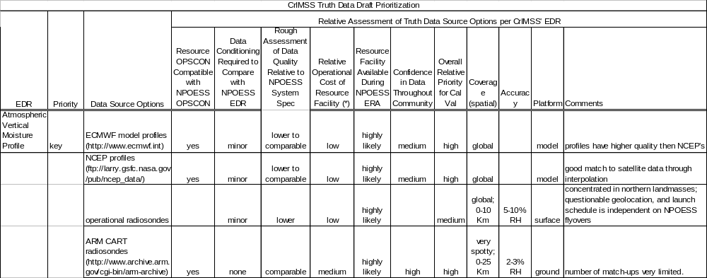
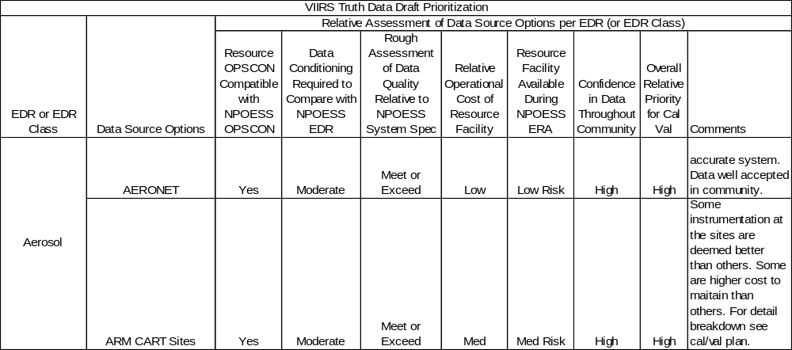
Draft Prioritization of Truth Resources
ST&E/SE/IPO/NASA joint effort July 2003.
Finalize prioritization by 10/2004.
Cal Val Working Group meeting scheduled for March 2004
See Section 7, Draft Version 7.0 of the Cal Val Plans
https://collab1.trw.com/eRoom/NPOESS/SystemTestEvaluation/0_24489
Lottman

Slide 27
Long Term Monitoring
Prelaunch
Post-Launch
Long-Term Monitoring
Sensor Characterization and Calibration
Operations, Maintenance,
and Upgrades
Heritage sensor data, design analysis
Calibration and characterization ground tests
Calibration and characterization on-orbit
Sustaining calibration and validation
Algorithm tuning and upgrades
Verification of science algorithm quality and latency
Verification of
operational algorithm
quality
and latency
RDR/SDR validation
Validation of operational EDR quality and latency
Operational EDRs
RDR/SDR/EDR Verification
RDR/SDR/EDR Validation
Work Identified and Scheduled in Concert with Primary Driver Milestones
Long Term Monitoring Supported by O&S Resources and Online IDPS CVS System and Offline Cal Val Tools. Development on Track.
Online IDPS CVS System Performs Basic Data Quality Monitoring
Lottman

Slide 28
Long Term Monitoring Highlights
Look at quality over time and make adjustments where needed to satisfy the long term monitoring requirements. Data quality monitoring function in real time allocated to the CVS within IDPS. Adjustments made using offline Cal Val test tools.
Developing long term monitoring strategy, documented in Section 8 of the Cal Val plans. Working to flow requirements commensurate with the IDPS Build 1.3 schedule.
Truth data requirements being worked.
LTM phase primarily supported by O&S resources using ST&E/IDPS developed tools.
Lottman

Slide 29
Agenda
Teams, Objectives, Tasks, Coordination
Cal Val Plans Status
Cal Val Phase Status
Summary
Lottman

Slide 30
Summary
Teams in Place and Well Coordinated
Work Scheduled in Concert with Program Drivers
Prelaunch Sensor Characterization and Calibration Focus
Algorithm Verification Activities Underway
Identifying Postlaunch Strategies
Identifying LTM Monitoring Strategies, Flowdown
Sensor Specific Plans in Mature Draft Form
Working as Joint Team and Leveraging Expertise
Proactive Approach Key to Success
Lottman

Slide 31
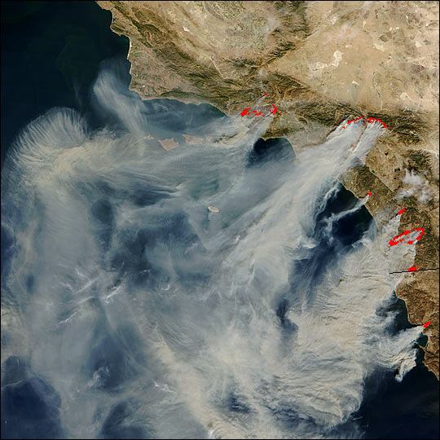
MODIS
10/27/03
Lottman

Slide 32
Backup Slides

Slide 33
Primary Schedule Driver Milestones
Sensor Characterization and Calibration
2003
2004
2005
Oct
Nov
Dec
Jan
Feb
Mar
Apr
May
Jun
Jul
Aug
Sep
Oct
Nov
Dec
Jan
Feb
Mar
Apr
Program Milestones
NPP
M-CDR
NPOESS
DPDR
Program Phases
Prelaunch Phase
EDU Test Procedures
EDU Ambient Testing
EDU Thermal Vac Testing
VIIRS
Drivers
FM Test Procedures
FM Ambient Testing
TV
CrIS Drivers
EDU 3 Test
Procedures
EDU 3 Testing
FM Testing
ATMS
Drivers
EDU Bench
Testing
EDU TV
FM Bench
Testing
FM TV
FM
Delivery
OMPS
Drivers
FM
Delivery
FM Test Procedures
Nadir, Limb, MEB FM Int & Test
ISS Int & Test
Critical Inputs
CVDB
ST&E
CVP
DV7.0
CVWG
MTG
Note:, CrIS FM Delivery 10/05, VIIR FM Delivery 11/05, NPP MTRR 12/05

Slide 34
Primary Schedule Driver Milestones
Science Algorithm Verification / Characterization
2003
2004
2005
2006
2007
Apr
Jul
Oct
Jan
Apr
Jul
Oct
Jan
Apr
Jul
Oct
Jan
Apr
Jul
Oct
Jan
Apr
Jul
Oct
Program
Milestones
Sci Alg
Activites
NPP
M-CDR
NPOESS
DPDR
NPP
MTRR
NPP
Launch
NPP
OHR
NPP
DPC
VR
Science Algorithm Verification / Characterization
Op Alg
Perf Verif
IDPS
Build 1.2
Build 1.3
Build 1.4
Science Algorithm
Verification
Science Code Verification
Drop 2
Science Code Verification Drop 3
Critical Inputs
Algorithm Delivery from Sensor Vendor
Test Data Sets
Test Data Sets
Test Data Sets
ST&E
CVP
D7.0
ST&E
CVP
Rev D
CVDB
CVWG
MTG
CVWG
MTG
CVWG
MTG
CVWG
MTG
CVWG
MTG

Slide 35
Primary Schedule Driver Milestones
Post Launch
2003
2004
2005
2006
2007
Apr
Jul
Oct
Jan
Apr
Jul
Oct
Jan
Apr
Jul
Oct
Jan
Apr
Jul
Oct
Jan
Apr
Jul
Oct
Program
Milestones
NPP
M-CDR
NPOESS
DPDR
NPP
MTRR
NPP
Launch
NPP
OHR
NPP
DPC VR
Program
Phases
Postlaunch
Phase
Build 1.2
ISF/OMS & CVS
in Use
IDPS
ISF/CVS
Drivers
Build 1.3
Build 1.4
Gov Drivers
Identify and Prioritize Truth Data
Secure Truth Data
Commitment
Collect
Truth Data
Critical Inputs
CVWG
MTG
CVWG
MTG
CVWG
MTG
CVWG
MTG
CVWG
MTG
CVDB
Test Data Sets
ST&E
CVP
DV7.0
ST&E
CVP
Rev C
Verification
Tools
ST&E Intensive Cal Val Toolset

Slide 36
Primary Schedule Driver Milestones
Long Term Monitoring
2003
2004
2005
2006
2007
Apr
Jul
Oct
Jan
Apr
Jul
Oct
Jan
Apr
Jul
Oct
Jan
Apr
Jul
Oct
Jan
Apr
Jul
Oct
Program
Milestones
NPP
M-CDR
NPOESS
DPDR
NPP
MTRR
NPP
Launch
NPP
OHR
NPP
DPC VR
Program
Phases
LTM
Phase
IDPS
ISF/OMS
CVS
Drivers
Build 1.2
ISF & CVS
in Use
Build 1.3
Build 1.4
Critical Inputs
System
Opscon
ST&E
CVP
DV7.0
ST&E
CVP
Rev D
CVDB
Req
ST&E Intensive Cal Val Toolset
CVWG
MTG
CVWG
MTG
CVWG
MTG
CVWG
MTG
CVWG
MTG

Slide 37
Operational Algorithm Teams (OATs) 7/28/03
MW Imagery/Radiometry
  Gene Poe/Karen StGermain NRL
  Jeff Haferman/Jeff Tesmer FNMOC
  Tom Kleespies NOAA
  Norm Grody/R.Ferraro NOAA
  Larry McMillin NOAA
  Peggy O’Neill NASA
  Roy Spencer/ Elena Lobl NASA
  Albin Gasiewski NOAA
  James Shiue/Ed Kim NASA
  Simon Yueh JPL
  Don Cavalieri NASA
  Fuzhong Weng NOAA
  Edward Measure ARL
  Dave Staelin MIT
  Tom Jackson USDA
  Mitch Goldberg NOAA
  Peter Gaiser NRL
  Michael Farrar USAF
  Narinder Chauhan, Dave Kunkee, Neal Baker, Don Boucher, and Bruce Thomas Aerospace
Ozone
  Larry Flynn NOAA
  John Hornstein NRL
  R. Bevilacqua NRL
  E. Hilsenrath NASA
  Bob Hudson UMD
  Irina Petropavlovskikh NOAA
  J. Gille UCAR
  Robert Loughman UAZ
  Fred Sanner Aerospace
  Dave Flittner NASA
  Eric Shettle NRL
  Ed Colon NRL
  Philippe Xu NOAA
Advisors in italics

Slide 38
Operational Algorithm Teams (OATs) 7/28/03
Soundings
  Allen Larar NASA
  Mitch Goldberg NOAA
  Joel Susskind NASA
  Mike Griffin MIT/LL
  Bill Smith LaRC
  Dave Staelin MIT/LL
  Jim Yoe NOAA
  Peter Schlüssel EuMetSat
  Paul Menzel NOAA
  Gail Bingham UU
  Dan Mooney MIT/LL
  Mike Kelly MIT/LL
  Advisors in italics
Vis/IR Imagery/Radiometry
  Paul Menzel/Andy Heidinger NOAA
  Thomas Kopp AFWA
  Jeff Privette NASA
  Dan Tarpley NOAA
  Robert Murphy NASA
  Eric Shettle NRL
  Doug May NAVO
  Alexei Lyapustin GSFC
  Richard Legeckis NOAA
  Wayne Esaias NASA
  Andy Harris NOAA
  Jeff Key NOAA
  Changyong Cao NOAA
  Several Aerospace

Slide 39
Operational Algorithm Teams (OATs) 7/28/03
Aerosols
  Eric Shettle NRL
  Lucia Tsaoussi NASA
  V. Ramaswamy NOAA
  R. Halthore NRL
  Tom Adang DoD
  Andrew Heidinger NOAA
  Phil DeCola/Don Anderson NASA HQ
  Larry Travis/Mike Mischenko NASA GISS
  Dan Murphy NOAA
  Brian Soden GFDL
  Mike Hardesty ETL
SESS
  Bill Denig AFRL
  Santi Basu AFRL
  Dave Evans NOAA
  Odile de la Beaujardiere AFRL
  Bob Hoffman NASA
  Markus Sorrells IPO
  Rodney Viereck NOAA
  Diane Buell Mitre
  Paul Strauss Aerospace
  Advisors in italics

Slide 40
Operational Algorithm Teams (OATs) 7/28/03
Ass’t OAT Manager (Alt, Solar, Earth Radiation): Jim McGuire/NASA
Altimetry
  Greg Jacobs NRL/NAVO
  Bob Cheney NOAA
  Bill Emery U. Colorado/NASA HQ IPA
  Don Chambers U. Texas
  Keith Raney APL
  Walter H. F.Smith NOAA
  David Sandwell UCSD
Solar Irradiation (TSIS)
  Rodney Viereck NOAA
  Judith Lean NRL
  Joe Rice NIST
  Kelly Doser USAF
  Gary Rottman U. Colorado
Earth Radiation Budget (ERBS)
  Jim Coakley U. Oregon
  Jim Miller NOAA/NWS
  Joe Rice NIST
  Istvan Laszlo NOAA/NESDIS
  Brian Soden NOAA/GFDL
  Bruce Wielicki NASA/LaRC
  Arnold Gruber NOAA

