Slide 1



A Computer Program to Model The Universe Surveyed by SNAP
Duane T. Doles, SIST Intern
Dr. Albert Stebbins, Supervisor
SIST 2004

Slide 2
Background
Background
Theory
Procedure
Results &
Discussion
Acknowledgements
Questions
Fermilab
  Tevatron
  Standard Model
Dark Energy
  Beyond Standard Model
  Energy in Empty Space
SNAP
  Int’l Mission to Study Dark Energy
  Characterize equation of state, density, time variation using dist-redshift

Slide 3
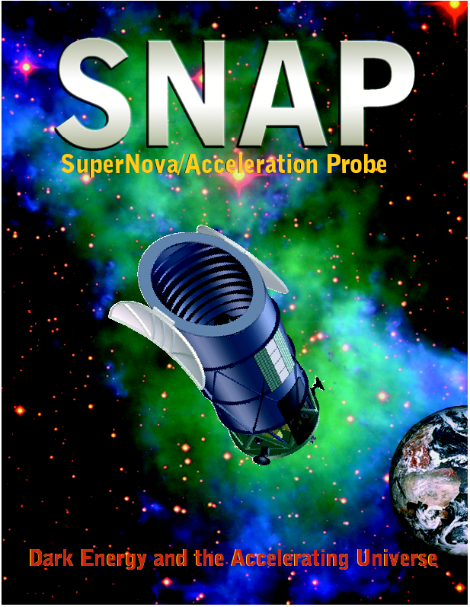

Slide 4
Theory
Background
Theory
Procedure
Results &
Discussion
Acknowledgements
Questions
Supernova
  Massive Star -> Explodes
  Type Ia: Uniform Luminosity
Redshift
  Rel. Motion Light Object and Observer
  Light Wavelength Shifted towards Red
Cosmological Principle
  Study Inhomogeneity in Early Universe
  Einstein: (1) homogeneous--no lumps (2) isotropic--same all directions

Slide 5
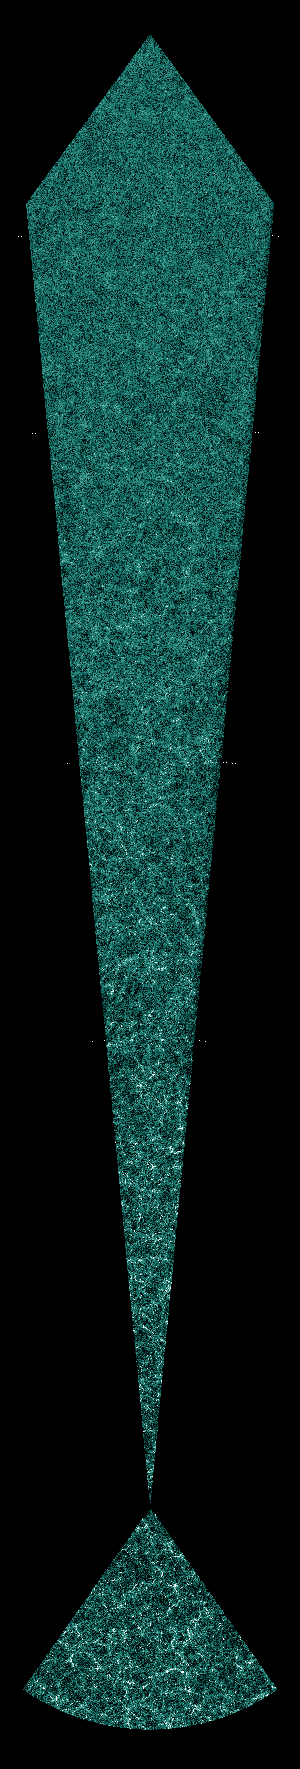

Slide 6
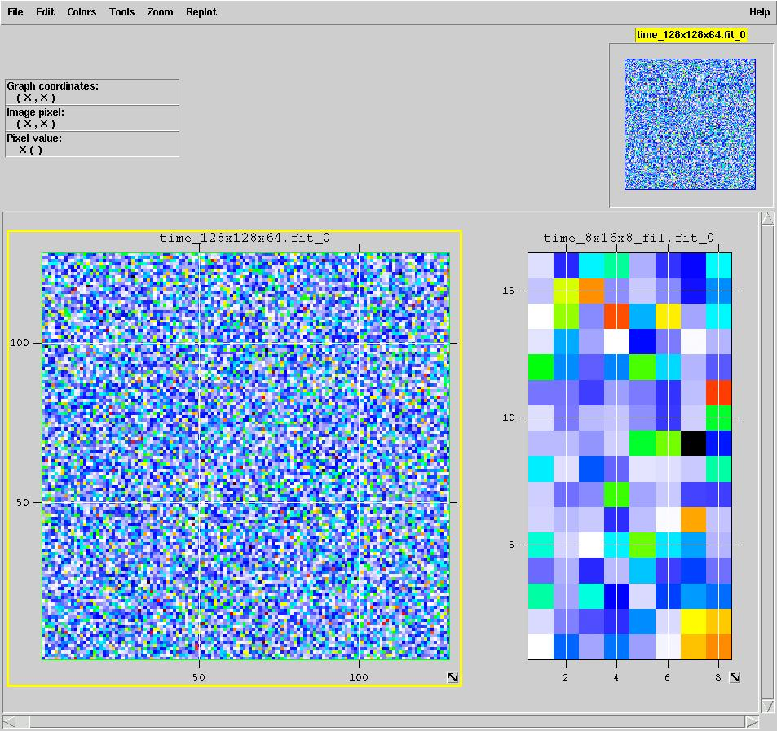
Procedure
Background
Theory
Procedure
Results &
Discussion
Acknowledgements
Questions
Create 3-D Matrix of Random Numbers
Fourier Transform & Inverse Fourier Transform
Copy Matrix to another Matrix in memory
Write Resultant Matrix to FITS file
Validate FITS file with fv software tool
Modify HugeFFT to WriteSubImg

Slide 7
Results & Discussion
Background
Theory
Procedure
Results &
Discussion
Acknowledgements
Questions
Success:
  FITS file
  Cube of FITS file
Performance:
  Memory
  Running Time

Slide 8
Acknowledgements
Background
Theory
Procedure
Results &
Discussion
Acknowledgements
Questions
Dr. Albert Stebbins
Huan Lin
Summer Interns
Mentors
C-USER@listserv.fnal.gov
Dr. William D. Pence, NASA’s HEASARC: Software
Dr. Davenport
SIST Program Staff

Slide 9

Questions
Background
Theory
Procedure
Results &
Discussion
Acknowledgements
Questions

