Slide 1



NCI ADVOCATE’S SUPPORT FOR THE NCI COMMUNITY CANCER CENTERS PROGRAM
Beverly L. Laird, Ph.D. Vice Chair
NCI Director’s Consumer Liaison Group
June 25-26, 2007

Slide 2
NCI OFFICE OF LIAISON ACTIVITIES
The Office of Liaison Activities contains programs and services for the cancer consumer advocate community:
  NCI Director’s Consumer Liaison Group (DCLG)
  Consumer Advocates in Research and Related Activities (CARRA) Program
  Professional Organization Leadership Meetings
  Digest of Federal Cancer News: E-Newsletter
  Understanding NCI Teleconference Series
  Advocacy Outreach

Slide 3
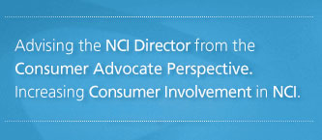
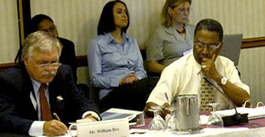
Director’s Consumer Liaison Group
Federal Advisory Committee of 16 consumer advocates
Advise the NCI Director from viewpoint of the cancer survivor
Recent initiatives:
    NCI Listens and Learns website
    Listening and Learning Together: Building a Bridge of Trust – first-ever patient advocacy summit held at NCI

Slide 4
NCI Director’ s Charge to the DCLG
Eliminating cancer health disparities – adding the consumer advocates’ perspective in planning for efforts of the NCI to address the issues of eliminating cancer health disparities. DCLG liaisons with NCI’s Center to Reduce Cancer Health Disparities and other health disparities research programs.
Minority recruitment and patient outreach – translating for NCI, and bringing to NCI, the perspective of the cancer advocacy community.
  The DCLG is represented on the Clinical Trials Advisory Committee (CTAC) by DCLG member Col. (Ret.) James E. Williams, Jr. USA.
Cancer care delivery – participating in the NCI Community Cancer Centers Program (NCCCP) pilot as part of the group who advises and directs the program and providing ongoing feedback to the Director about the community realities of this pilot program.
  The DCLG is represented on the NCI Program Advisory
  Committee (NPAC) to the NCCCP by DCLG Member
  Dr. Beverly Laird.

Slide 5
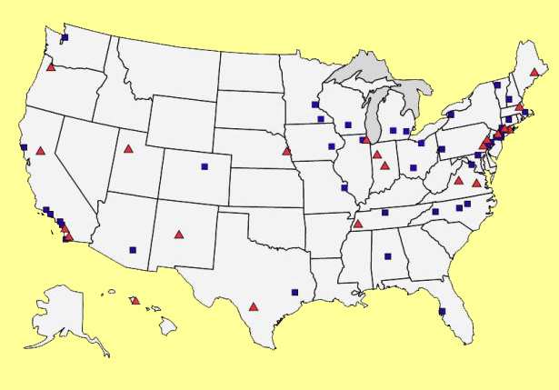
DCLG Members Across the U.S.
Four New Members will begin in July 2007

Slide 6
DCLG Member Organizations
American Cancer Society
American Pain Foundation
breastcancer.org
Curesearch National Childhood Cancer Foundation
Hope Through Grace, Inc.
In My Sister's Care
Kidney Cancer Association
Lance Armstrong Foundation
Leukemia & Lymphoma Society
National Breast Cancer Coalition
National Cervical Cancer Coalition
National Patient Advocate Foundation
Native People's Circle of Hope
Patient Advocate Foundation
Pennsylvania Prostate Cancer Coalition
Susan G. Komen for the Cure
Virginia Breast Cancer Foundation
Yul Brynner Head and Neck Cancer Foundation

Slide 7
DCLG Members
Ms. Margaret (Peg) Anthony, South Carolina, South Carolina, Clinical experience, Lung cancer (co-survivor), Head & neck cancer, Oncology Nursing Society
Mr. William (Bill) Bro, Illinois, Kidney cancer survivor, President & CEO, Kidney Cancer Foundation
Ms. Vernal Branch, Virginia, Breast cancer survivor, Health educator, Sister Study recruiter, NBCC & Komen
Dr. Yvette Colon, Michigan, Ovarian cancer survivor, Oncology social work, American Pain Association
Ms. Lourie Campos, California, Filipina cancer survivor, Community health partnerships, Young survivorship
Ms. Kelly L. Cotter, Illinois, Childhood leukemia survivor, Young survivorship, Attorney
Ms. Nancy Davenport-Ennis, Virginia, Breast cancer survivor, Head and neck cancer (co-survivor), Founder, Patient Advocate Foundation, Health Insurance Advocate Expertise
Dr. Grace Butler, Texas, Colon cancer survivor, Professor Emeritus, University of Houston, Founder, Hope Through Grace, Inc.,
CARRA member

Slide 8
DCLG Members
Mr. Alan Kaye, California, Founder, National Cervical Cancer Coalition, HPV education, Lung cancer (caregiver)
Ms. Mary Jackson-Scroggins, Washington, D.C., Ovarian cancer survivor, Co-founder, In My Sister’s Care, Writer and editor
Ms. Sue Sumpter, Oregon, Childhood cancer (parent), Candlelighter, Treatment side-effects
Dr. Marisa Weiss, Pennsylvania, Oncologist, Founder, breastcancer.org, Founder, Living Beyond Breast Cancer, Prof. Of Survivorship Award, Komen
Ms. Celeste Whitewolf, Oregon, Breast cancer survivor, Co-founder, Native People’s Circle of Hope, Medicine Bag Project, Native American Advisory Council, Komen
Col. (Ret.) James Williams, Jr., Pennsylvania, Prostate cancer survivor, Board/advisory member of several prostate cancer organizations, DCLG representative on CTAC
Mr. Doug Ulman, Texas, President, Lance Armstrong Foundation, Co-founder, Ulman Foundation, Cancer survivor, Young survivorship
Dr. Beverly Laird, Alabama, Breast & endometrial cancer survivor,
Public health, CARRA member, Advocates in peer review trainer
(Komen, LAF, CARRA)

Slide 9
What Advocates Can Do
Help educate patients, the public, and providers
Review communications
Help allay fears
Represent the voice of minorities and underserved populations
Community outreach and education
Assist with recruitment plans
Review protocols
Build collaborative capacity through our existing networks and organizations

Slide 10

NCI CARRA Program – Involving Advocates
Approximately 185 people from across the nation who have experience with cancer (i.e. patients, survivors, caregivers & family members)
  CARRA Members:
    Participate in a wide range of activities
    Represent the collective viewpoint of people affected by cancer
    Provide critical insights and analysis that help translate research advances more quickly and safely to patients
    and the broader public

Slide 11
Examples of How CARRA Members
Can Help You
CARRA members can help pioneer your consumer collaboration, enhance current community partnerships, or serve as a resource to the advocates that currently contribute to your Center
Participating on Institutional Review Boards and research committees
Participating on patient advisory boards
Promoting patient recruitment to clinical trials
Fostering patient and family support programs
Improving public image and consumer services (i.e., advertising, Web site design, facilities configuration, etc.)
Educating the public, media, and officials about your activities and research advancements
Reflecting, and providing outreach to, the diverse communities that you serve.

Slide 12
Issues That Are Important to Consumer Advocates
Clinical Trials
Health Care Disparities
Information Technology
Biospecimens
Quality of Care and Survivorship

Slide 13
Clinical Trials Issues
Consumer advocates would like to see
  Patient advocates on planning committees
  Advocate review of protocols and informed consent
  Expanded patient navigation support
  Increased outreach to community, especially minorities and those experiencing healthcare disparities – in a culturally sensitive manner
  Increased accruals (especially minorities)

Slide 14
Health Care Disparities Issues
Consumer advocates would like to see
  Increased access to more specialized services
  Advocates involved in teaching healthcare providers about cultural competency and sensitivity
  Well thought out plans to increase minority participation in research and health service
  Ways to address issues of the lack of health insurance

Slide 15
Information Technology Issues
Consumer advocates would like to see
  Careful implementation of Electronic Medical Records (EMR’s)
  Continued attention to issues of privacy and confidentiality

Slide 16
Biospecimens Issues
Consumer advocates would like to see
  Easy to understand communications about the importance of biospecimen collections
  Inclusion of advocates to help inform patients about the importance of biospecimen repositories

Slide 17
Quality of Care & Survivorship Issues
Consumer advocates would like to see
  Availability of risk assessment, including gene testing AND counseling and support
  Individualized survivorship plans
  Patient satisfaction surveys
  Increased referrals to hospice
  Inclusion of advocates to help promote hospice
  Increased attention to quality palliative care

Slide 18
Quality of Care and Survivorship Issues
Consumer advocates would like to see
  Free or low-cost transportation where needed
  Assistance with insurance claims and other paperwork issues
  Translators where needed
  Psychosocial services included as essential elements of quality of care
    Family support
    Nutritional counseling
    Relaxation/exercise classes
    Menopausal symptom support
    Fertility counseling
    Long-term sequelae followup support

Slide 19
Quality of care and survivorship initiatives
A multidisciplinary and integrated
“dream team” would include
[thanks to Madeline Harris, R.N., UAB Interdisciplinary Breast Clinic]
    Surgery
    Medicine
    Radiation oncology
    Radiology
    Pathology
    Nutrition
    Palliative care
    Social services
    Sports/rehab medicine
    Pastoral care
    Nursing
    Physical therapy
    Comfortable, adequate clinical space
    Sufficient staff with competitive salary support
    Navigation of patients through the system
    Cutting-edge treatments
    Patient-driven preferences
    Risk assessment

Slide 20
Advocates and the NCCCP
Our members and OLA staff will compile site-specific information for your hospitals, listing contact information and resources available from our organizations and our network of organizations.
We want to help reduce barriers to YOUR access to these resources that are provided at no cost to your patients or your hospitals.
We ask that you consider us to be part of your resource team.
We sincerely thank Dr. Niederhuber for inviting our participation in this exciting effort!
And we thank you for allowing us to be a part of your success.

Slide 21
Contacting DCLG and CARRA Staff
Office of Liaison Activities
Barbara Guest (Executive Secretary to DCLG)
  (301) 496-0307
  guestb@MAIL.NIH.GOV
Elizabeth Nielson (CARRA Program Manager)
  (301) 451-3321
  neilsone@mail.nih.gov
Website: http://dclg.cancer.gov
http://carra.cancer.gov
http://ola.cancer.gov

