Slide 1


A WEB BASED
ACCELERATOR CATALOGUE
Akuako Kalu
Benedict College, Columbia, SC
Junior Computer Science
Fermi National Accelerator Laboratory
Benedict College

Slide 2
Outline
Fermilab: ICFA Member
The Accelerator Catalogue Project
Specifications
Technical Challenge: Data Persistence
Conclusion
Acknowledgements

Slide 3
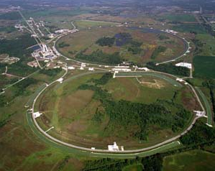
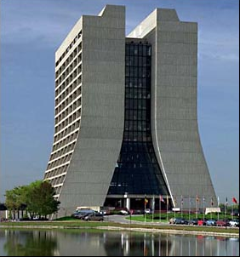


Fermilab – ICFA Member
Fermilab: research facility for Particle Physics and Astrophysics
ICFA: International Committee for Future Accelerators
Created in 1976
16 Members (e.g. KEK, CERN, INFN, SLAC)
Facilitate international collaboration
and exchanges (organizes Workshops and Schools)
6 Specialized Panels
The catalogue is an activity of the Beam Dynamics Panel.

Slide 4
Accelerator Catalogue
Existing Project
Means ?
Paper
Every 3 years
High Energy
1992
Database / Web
When needed
All
2005
Update ?
What ?
When ?

Slide 5
Advantages of a Web Catalogue
Data can be entered directly by authorized laboratory representatives. This minimizes the potential for errors
Use of a relational database makes possible interactive searches using user-defined criteria
Updates can be performed by institutional representatives on a continuous basis, allowing the catalogue to remain current

Slide 6
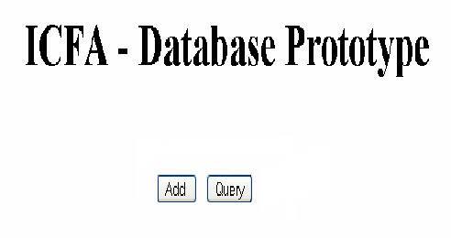
Prototype

Slide 7
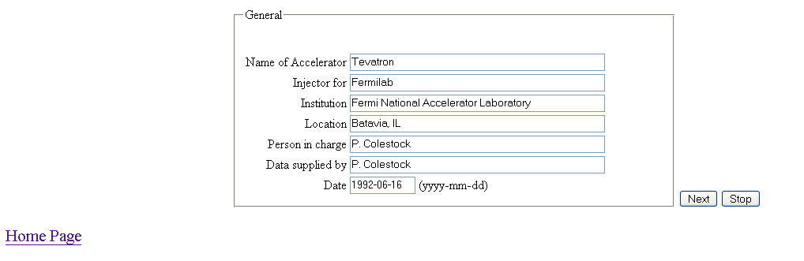
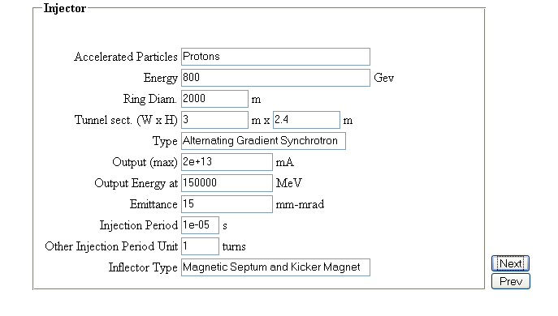
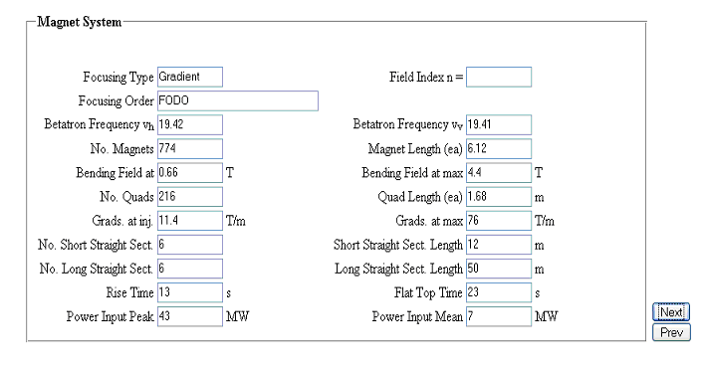
Web Interface

Slide 8
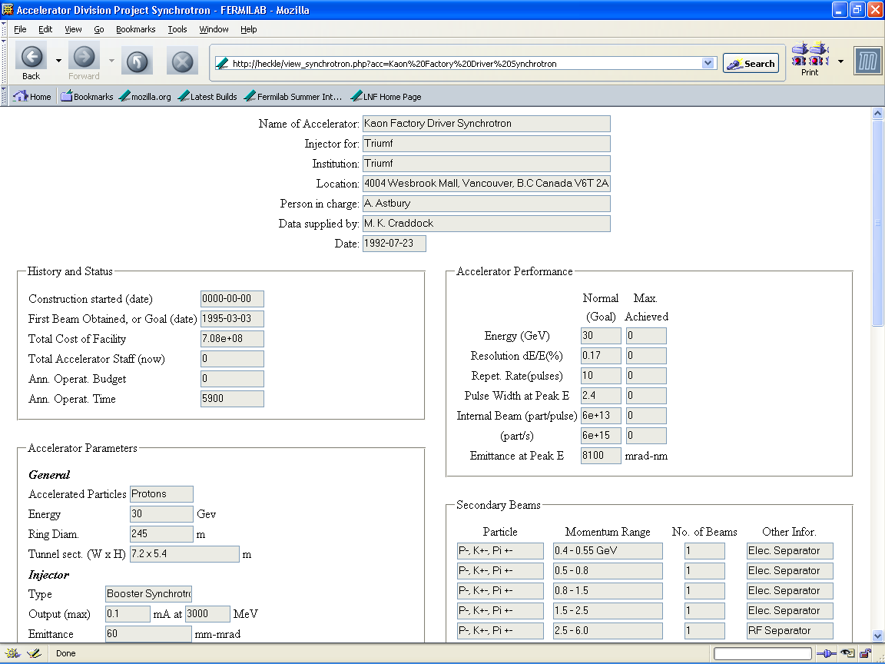
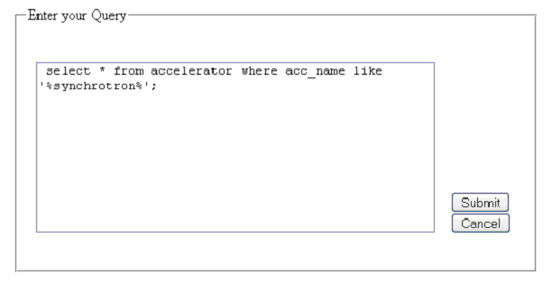
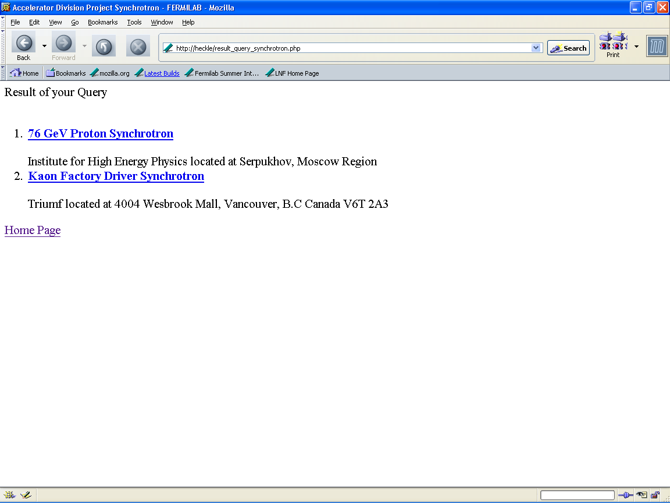
Query / Search Capability

Slide 9
Technical Challenge
Group of parameters (injector, magnet, performance, vacuum…)
One group = one web page
Data persistence
with
Statelessness of HTTP ?

Slide 10
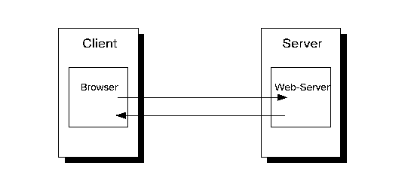
HTTP: A Stateless Protocol
Client identification not required
No persistent connection
Independent Transactions
HyperText Transfer Protocol
Machine Language
HTTP Request: .htm
HTTP Response: .htm

Slide 11
Data Persistence
GET and POST: no data storage
Cookies: Client-side data storage
Database Lookup: Server-side data storage
Advantage(s):
  Very simple to implement
Disadvantage(s):
  Maximum 100 characters passed through the URL
  Pass all the parameters on every web page
Advantage(s):
  No user session ambiguity
Disadvantage(s):
  User may disable cookies
  Browsers handle cookies differently
Advantage(s):
  Works with every browser
Disadvantage(s):
  Mechanism to uniquely identify a user and the data provided

Slide 12
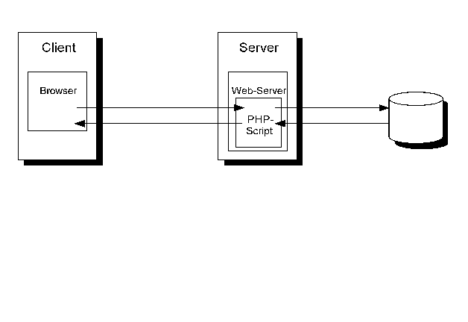
Session Management
HTTP Request: .php
Database
SQL Command
Web Site
Data
Web Server: Apache
Database: MySql
Scripting Language: PHP

Slide 13
Conclusion
Functional Web-application prototype developed
Search capability
Future Areas of Research / Improvement:
  Structure database tables
  Plan to migrate from prototype to production version
  User authentication / Security
  User Friendly queries

Slide 14
Acknowledgements
Special Thanks:
SIST Committee: McCrory, Engram, Arns
Acceleration Division: Ostiguy, Chou, Kriss
ICFA: Chou, Biscari, Mori, Kim
Mentor Session Group: McCrory, Vachon
Davenport
Fermilab

