Slide 1



Data Acquisition Graphs for DZero
Michael Carter, GEM Summer Intern
Supervisor: Stefan Gruenendahl
Tuesday, 7 August, 2007

Slide 2
Introduction
Purposes
  Performance monitoring of the trigger system.
  Provides big picture snapshot of overall performance.
  Storage of rate data for development of other tools.
  Diagnostic tool in case of problems.

Slide 3
How it works
  Via the ITC (Inter Task Communication) software package the DAQ Monitor Server provides data to the DAQ Recording tool.
  Our DAQ Recording tool places firing rate (Hz) in the database.
  Our DAQ Graphs tool renders the rate data, from the database, as CERN ROOT graphs.
  (ROOT is a particle physics data & graphical analysis software package)
  Experts perform their analysis of the health and performance of the detector.

Slide 4
D0 DAQ at Fermilab
Collision rate of 7.6 MHz
3 level trigger system
L1/L2 reduce rate to 1KHz into L3
250 MB/s average event data rate into L3
50 Hz and 12.5 MB/s output from L3
L1/L2
(Custom Hardware)
L3/DAQ
(Commodity HW/SW)
Data Tape
7.5 MHz
1 KHz
50 Hz

Slide 5
Trigger/DAQ Monitor System with DAQ Recording & DAQ Graphs
L1/
L2
TCC
L3
Collector/
Router
Data
Logger
Data
Distributor
EXAMINE
L3
Monitor
Trigger/DAQ
Monitor
Server
DATABASE
DAQ
Recording
DAQ
Graphs
Monitor
Display
T. Yasuda 4/26/99
Updated 5/18/01
M. Carter 8/7/07

Slide 6
Presenting DAQ Graphs
Over Five Years in Waiting

Slide 7
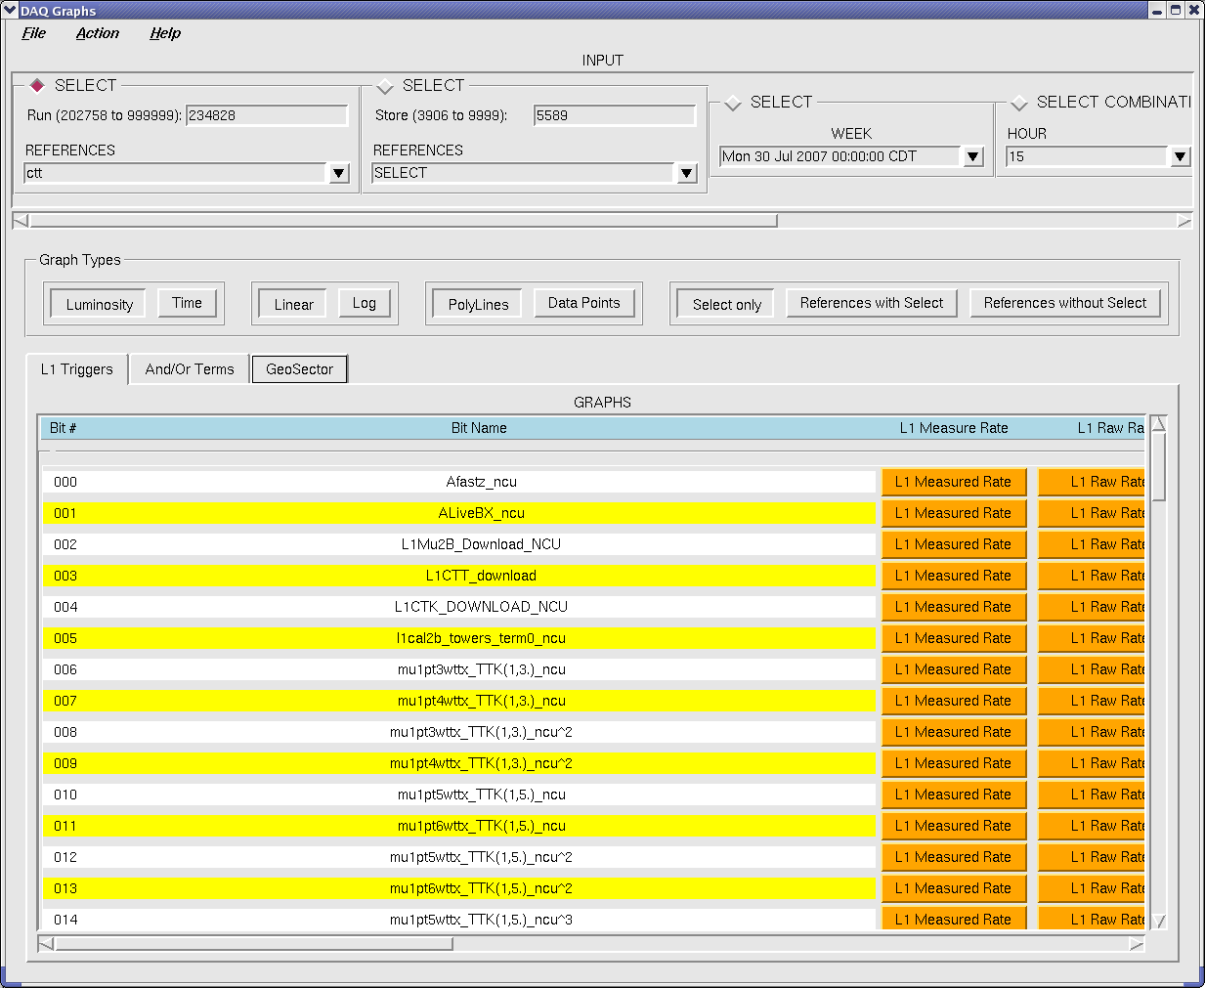
DAQ Graphs

Slide 8
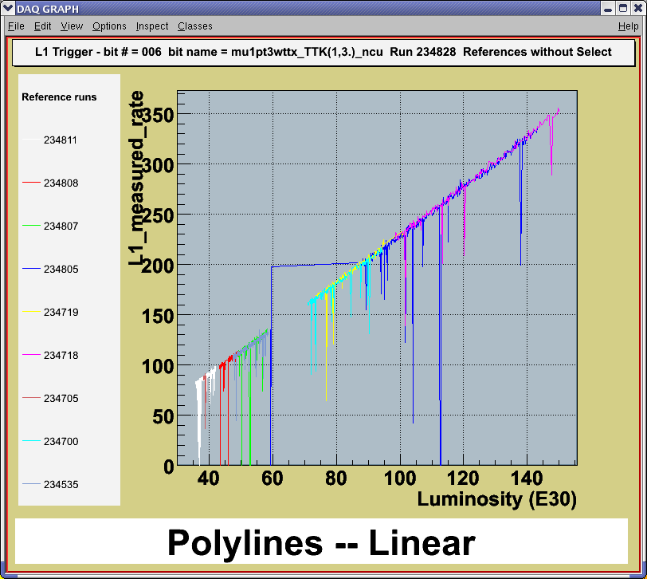
Reference Runs without Select

Slide 9
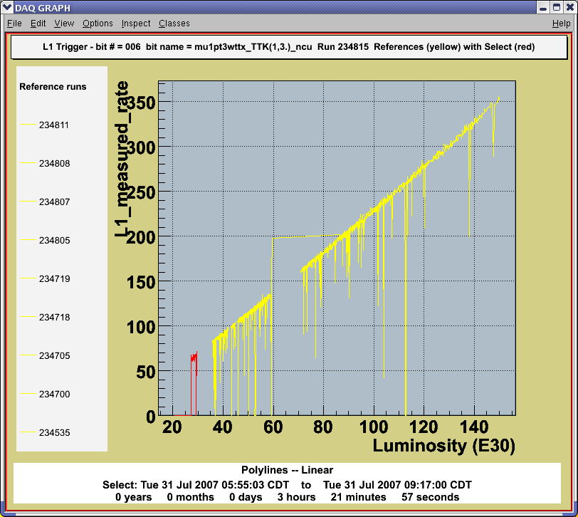
Reference Runs with Select

Slide 10
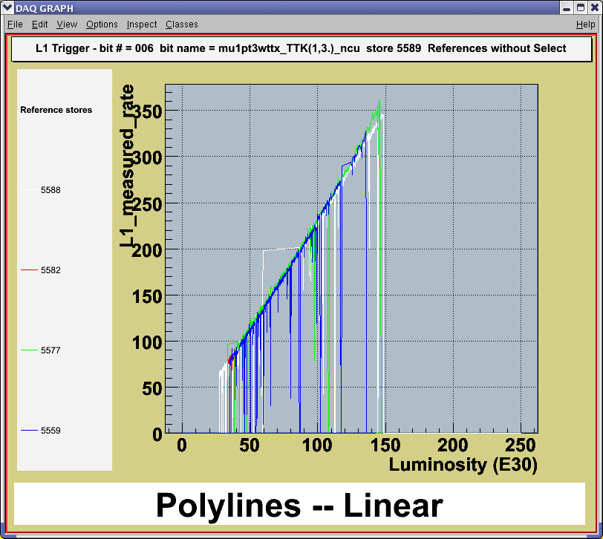
Reference Stores without Select

Slide 11
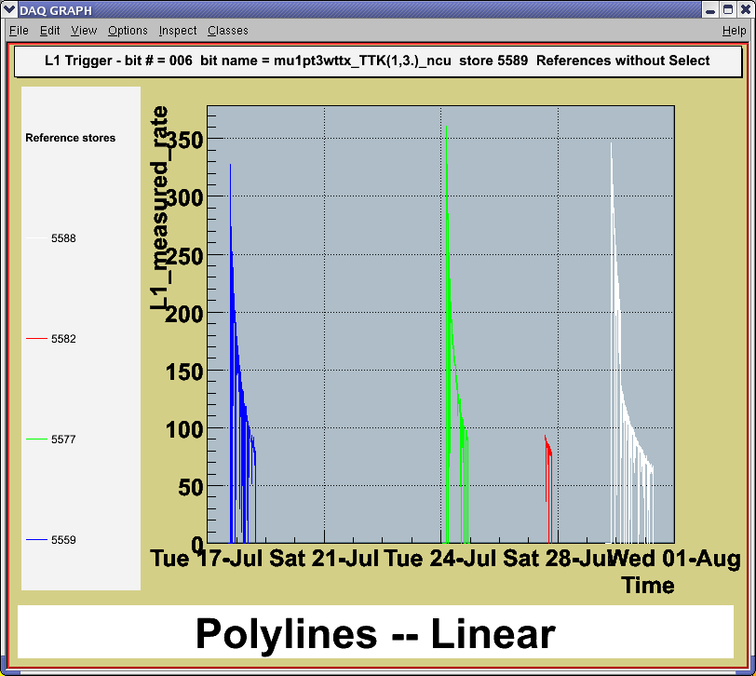
Same Reference Stores with Time Scale

Slide 12
Grand Total of Graphs = 1801 * 7 * 9 = 113,463
Buttons: ---------------------------------------------------------- L1 Triggers = 111 rows x 7 cols = 777 And/Or Terms = 256 rows x 2 cols = 512 GeoSectors = 128 rows x 4 cols = 512 ================================= Subtotal = 1801 -------------------------------- Graph Inputs: --------------------- Run = 1 Store = 1 Week = 1 Hour = 1 Day = 1 Month = 1 Year = 1 ============ Subtotal = 7 | Graphs Types: --------------------------- Luminosity = 1 Time = 1 Linear = 1 Log = 1 Poly Lines = 1 Data Points = 1 Select Only = 1 Ref w Select = 1 Ref w/o Select = 1 ================ Subtotal = 9

Slide 13
Acknowledgements
Stefan Grünendahl, Supervisor
Marco Verzocchi, Major Suggestions
Remigius Mommsen, Major Suggestions
Geoff Savage, Technical Advisor
Taka Yasuda, Technical Advisor
Marc Buehler, Minor Suggestions
Cynthia Knox, Minor Suggestions
Dr. Davenport, Direction & Inspiration
Dianne Engram, Director
Elliot McCrory, Director

Slide 14

Questions?

