Slide 1
FERMI NATIONAL ACCELERATOR LABORATORY
US DEPARTMENT OF ENERGY
f
FOFO Channel with Tilted Solenoids
Y.Alexahin
Muon Collider Design workshop, BNL, Upton NY December 3-7, 2007

Slide 2
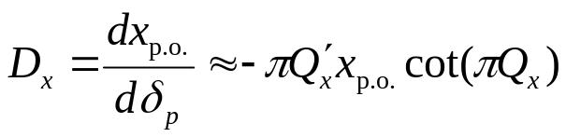
Motivation
6D cooling of both μ⁺ and μ⁻ in the same direction to allow for tapering→ straight channel
High pressurized RF cavities → avoid high beta !
Segmented structure to avoid difficulty inherent to HCC
Large dispersion → smaller wedge angles
Resonance dispersion generation:
In a periodic structure with alternating transverse field the periodic orbit resonantly depends on the tune: x_{p.o.}~1/sinπQ_{x},
if there is also large chromaticity we obtain dispersion
Since naturally the chromaticity is negative, Q_{x}′<0, we can obtain also large positive momentum compaction factor if the tune is just above an integer, Q_{x} ≥ n
FOFO Channel - Y. Alexahin MCD workshop, BNL December 6, 2007

Slide 3
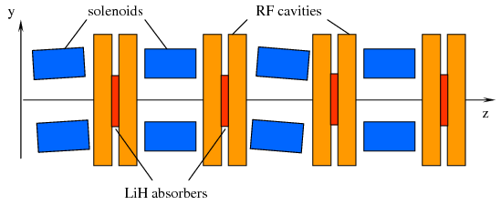
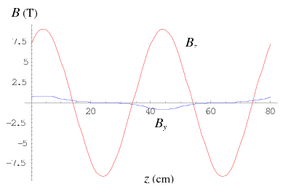
Double FOFO Cell
Cell with 800MHz RF :
Double cell of length 80cm consists of four 8cm long solenoids with inner and outer radii 10cm and 16cm respectively.
The first and third solenoids are tilted vertically by angle ±65mrad.
The maximum on-axis longitudinal field is 9.5T requires current density in solenoids ~450A/mm (well within the reach of high-temperature superconductors).
Two-cell pillbox RF cavities of length 2×4cm are placed between each pair of solenoids. It is assumed that filling with GH₂ of 19% density of LH₂ will allow to raise the amplitude field up to 50MV/m.
LiH wedge absorbers are placed between the cells of RF cavities (see discussion below).
On-axis tunes chosen rather far from the integer (Q_{I,II} ≈1.25) to obtain good momentum aceptance
FOFO Channel - Y. Alexahin MCD workshop, BNL December 6, 2007

Slide 4
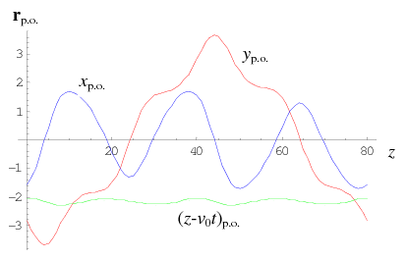
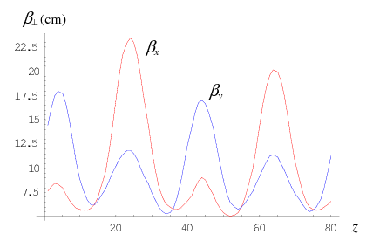

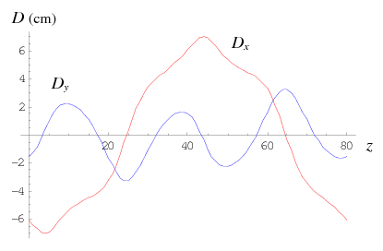
Linear optics functions
Complex tunes of the normal modes of oscillations w.r.t. the periodic orbit are: Q_{I,II,III} =1.4242+0.0084i, 1.505+0.0063i, 0.2105-0.0052i. The oscillation amplitudes are changed by exp(2πImQ_{i}) per cell → almost 10% emittance reduction/cell for transverse modes!
The third (longitudinal) mode is still antidamped wedges needed. Where to place them?
FOFO Channel - Y. Alexahin MCD workshop, BNL December 6, 2007

Slide 5
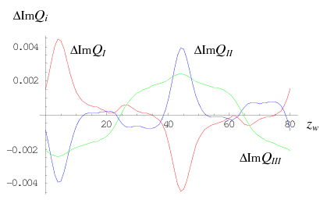

Effect of the wedges
Change in cooling decrements vs position of horizontal LiH wedge absorber with angle 0.1rad. Wedges inside tilted solenoids (where dispersion is the largest) are disastrous for the 1st mode. The best location is exactly between the solenoids (inside RF) at 14, 34, 54 and 74 cm.
To equalize the cooling decrements they should have different angle: 0.32 rad and 0.2 rad alternatingly.
FOFO Channel - Y. Alexahin MCD workshop, BNL December 6, 2007

Slide 6

Acceptance (damping aperture)
Using non-Hamiltonian perturbation theory it was possible to minimize nonlinear effects with the result:
Dependence of complex tunes on action variables of the normal modes.
Cooling of all three modes fails when their respective J_{i} are about 1cm. The corresponding Courant-Snyder invariants are 2cm so the cooling aperture is about 8σ (check!)
Presented results are obtained analytically, verification by tracking simulations is necessary (started by Bob and Katsuya but put on hold due to lack of time).
A helical channel with similar structure can be designed. For that even-numbered solenoids should be tilted on the horizontal plane.
FOFO Channel - Y. Alexahin MCD workshop, BNL December 6, 2007

