Slide 1
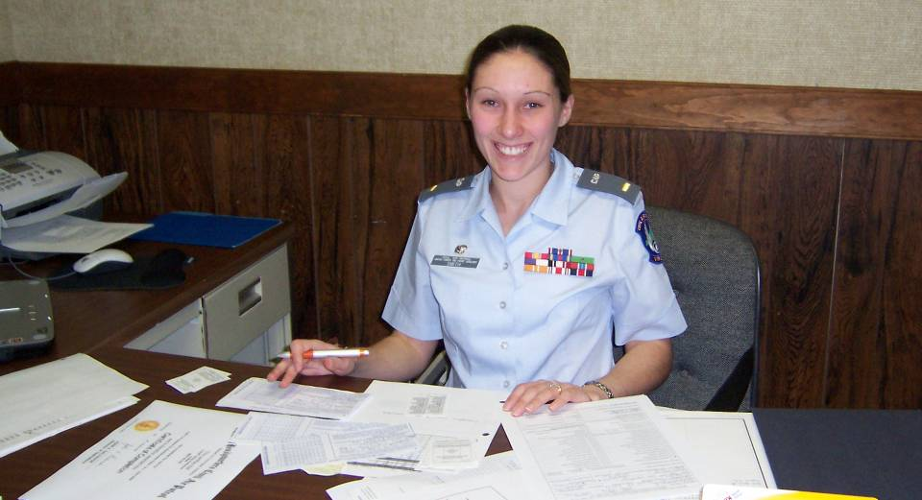

SQUADRON LEADERSHIP SCHOOL Seminar 3.2
Squadron Staff Officers

Slide 2
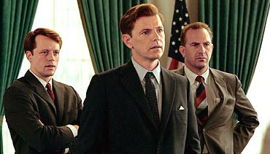
Does JFK have a good staff?
THIRTEEN DAYS © 2000 New Line Cinema

Slide 3
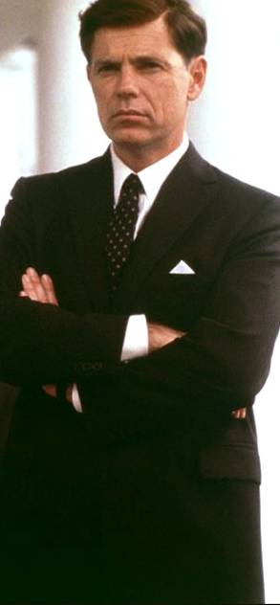
Thirteen Days
Positive Attributes of JFK’s Staff:
Technical expertise is a given
Presented the issue to the President; did not act on their own
Staff had talked-through the issue together; no one group locked-out another group
Staff had coordinated details of both options before seeing JFK
Staff did not simply state a problem, but offered JFK potential solutions
Staff spoke in clear, frank words; did not hide behind language

Slide 4
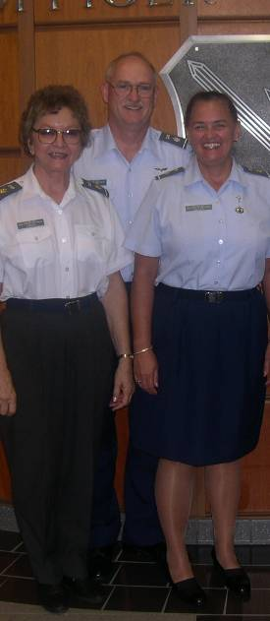
Objectives
Discuss the advantages and challenges associated with using a military-style organizational structure.
Describe basic attributes commanders want to see all staff officers demonstrate.
Diagram the anatomy of a squadron staff; list basic duties, programs, and regulations affecting each position.
Describe steps staff officers can take on their own to learn more about their job.

Slide 5
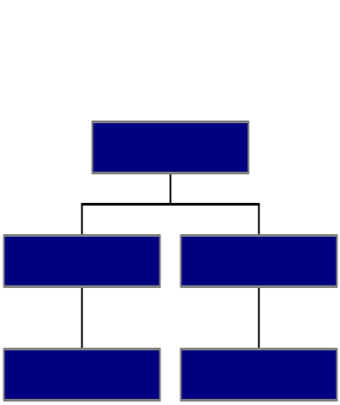
Advantages & challenges of our hierarchy
Advantages
Clear chain of command
Staff can specialize in one or two areas
Allows for a clear division of labor (in theory)
Shows our Air Force affiliation
Helps the commander monitor and allocate resources
Easy to tell where you need to go for help
Shows “who does what to who” and how your job fits in
Provides structure, logic, order, predictability
Challenges
Not very democratic
Cross-staff communications & coordination can be a burden
Potential turf battles
Potential “not my department” excuses
“Wide” trees need lots of staff & have span of control issues
“Tall” trees can be slow to act
Bureaucracy tends to create more bureaucracy

Slide 6
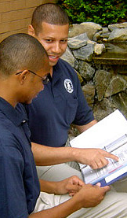
Commanders & Staff Officers
What do commanders expect
from staff officers?
What should the staff be doing in service to the commander’s leadership and decision-making process?

Slide 7
What Commanders Want from Staff Officers
Know your job
Do your job
Be a responsible volunteer
Don’t surprise the commander
Follow the “commander’s intent”
Make decisions on your own
Play well with others
Suggest solutions
Find and mentor your replacement.
Have fun

Slide 8
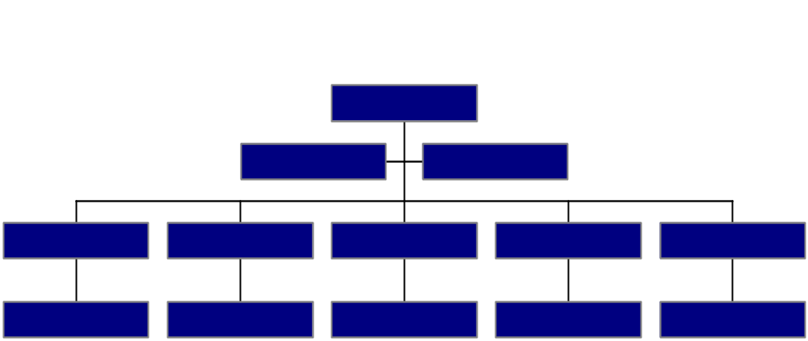
Anatomy of a Squadron
GROUP PROJECT: Create a squadron organization chart. For each “box” on your chart, include the following:
  Name of Position
  Summary of Duties
  Key Activities, Events, Programs
  Key Deadlines / Suspenses
  Key Regulations
  Note other staff positions that are closely related

Slide 9
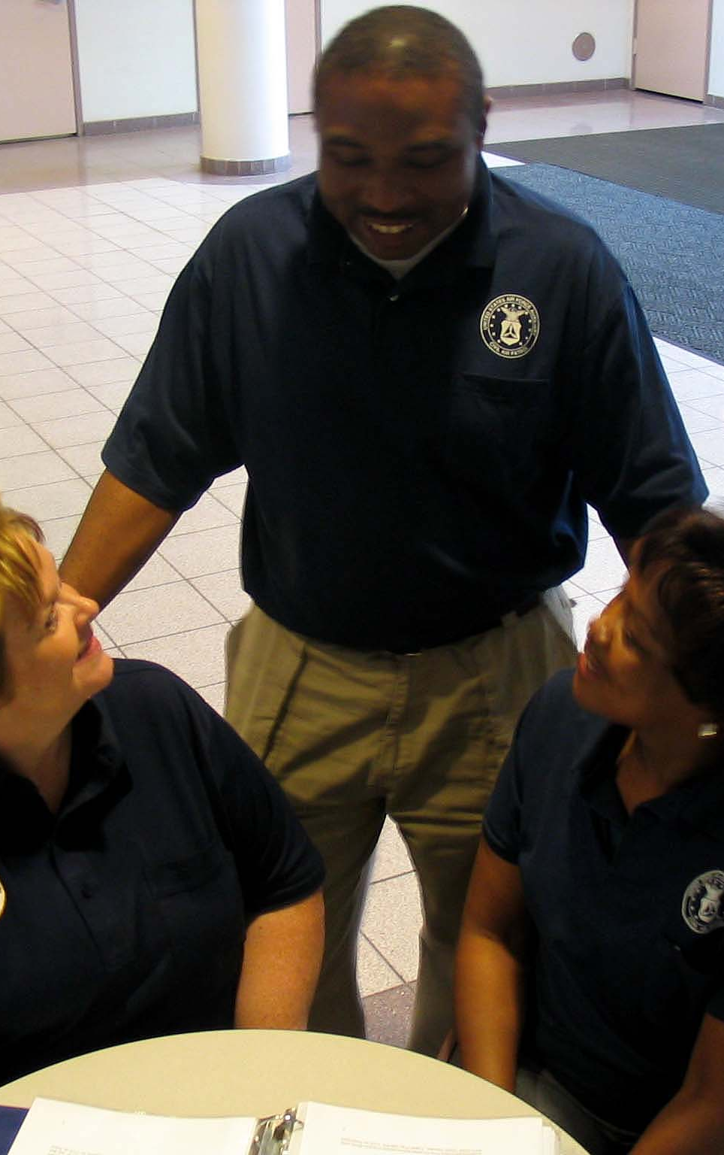
Help for Staff Officers
As a staff officer, what avenues are available to you for learning about your staff position?
Where can you go for help?

Slide 10
10 Ways to Get Help With a Staff Job
You are not alone. Help is available to staff officers:
1. Read your regulation
2. See if your predecessor left a “continuity book”
3. Use your Specialty Track Study Guide
4. Review the Subordinate Unit Inspection Guide
5. Ask your commander to assign you a mentor
6. Ask your wing staff counterpart to share their expertise
7. Partner with a neighboring squadron
8. Get input from CAP-USAF Reservists
9. Use the CAP Knowledgebase (cap.gov/answers)
10. Browse your section’s web pages at cap.gov

Slide 11
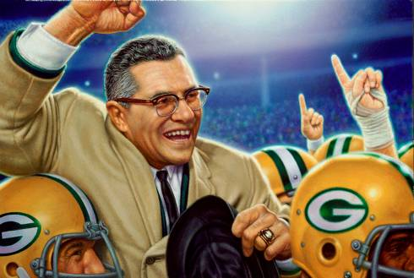
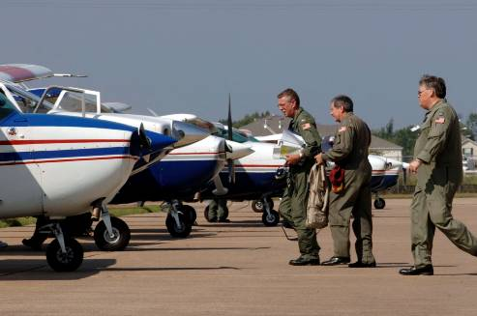
Final Thought
Individual commitment to a group effort -
that is what makes a team work, a company work, a society work, a civilization work.
- VINCE LOMBARDI
Artwork: USPS

