Slide 1


Commercial Service Eastern Africa

Slide 2
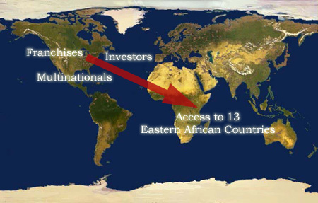
Commercial Service Eastern Africa
CS Kenya provides access to THIRTEEN Eastern African countries

Slide 3
Commercial Service Eastern Africa
Most economies enjoying significant growth!
Easily accessible by air or sea
Strategically placed to access all of Africa
Population: 314,283,948 (cumulative)
Enjoys three of Africa’s major ports
> Mombasa
> Dar Es Salaam
> Djibouti

Slide 4
Commercial Service Eastern Africa
Best Prospect sectors in Eastern Africa
Telecommunications equipment/services
Educational services
Construction equipment
Electric power systems
Commercial aircraft

Slide 5
Commercial Service Eastern Africa
Best Prospects (con’t)
Agricultural machinery and equipment
Agricultural chemicals
New and used medical equipment
Used clothing

Slide 6
Commercial Service Eastern Africa
Regional Potential
Great opportunities with formalization and evolution of the East African Community
Addition of Rwanda and Burundi to the EAC
Increased political stability and growing economies (e.g., Rwanda)
Access to Common Markets for East and Southern Africa (COMESA) through Eastern Africa

Slide 7
Commercial Service Eastern Africa
Infrastructure (Kenya-specific)
Expansion of Jomo Kenyatta International Airport in Nairobi -- upgrade to Category A (direct flights)
Expansion of the Port of Mombasa
Revival/privatization of regional railroads
Increased funding for road construction (e.g., Northern Corridor Highway) (long term: Sudan)
Housing construction boom with demand estimated at 150,000 houses per year

Slide 8
Commercial Service Eastern Africa
Infrastructure (Kenya-specific) con’t
Rapid growth of communications sector; especially mobile telephony
Multiple licenses offered to internet gateway and communication network providers (8 licensed, 4 operational)
Over 6 million mobile phone subscribers since 2000
Government push for transition to digital television broadcasting

Slide 9
Commercial Service Eastern Africa
Infrastructure (Kenya-specific) con’t
Anticipated connection of fiber optic cable off coastline, connecting Eastern Africa to the world using broadband (three proposed projects)
Major telecom companies competing to lay fiber countrywide by the end of 2008 (19 licensed, 4 operational)
Government push for ICT growth and e-government implementation

Slide 10
Commercial Service Eastern Africa
Commercial Service Kenya
Helped created the American Chamber of Commerce of Kenya in 2005
A pioneer in regional co-ordination, allowing for more results in more countries (including Southern Sudan)
Experts in facilitating feasibility study grants,
Ex-Im Bank and OPIC projects, and working with private finance partners

Slide 11
Commercial Service Eastern Africa
Contact us:
U.S. Commercial Service - Eastern Africa
U.S. Embassy, Nairobi, Kenya
P.O. Box 606-00621
Tel: +254 (20) 363-6000/6424
Fax: +254 (20) 363-6722/6065
Email: Nairobi.Office.Box@mail.doc.gov
Web: www.BuyUSA.gov/eastafrica

Slide 12
Commercial Service Eastern Africa
The Lion’s Share of Opportunity
When you’re in Africa, half the time all you can think of is getting away
But when you’re away from Africa, the only thing you can think of is getting back

