Slide 1

T A D S
Treatment for Adolescents with Depression Study
Stage 1 ITT Outcomes
John S. March, MD, MPH
TADS Team (2004). JAMA 292: 807-820

Slide 2
Acknowledgements
National Institute of Mental Health
Coordinating Center
  DUMC Department of Psychiatry
  Duke Clinical Research Institute
Consultants / SAB / DSMB
Thirteen sites from around the county
Lilly provided fluoxetine
Children and families who participate
T A D S

Slide 3
Objectives
To examine the effectiveness of medication and cognitive-behavioral psychotherapy, alone and in combination, for the acute and long-term treatment of adolescents with DSM-IV Major Depression
T A D S

Slide 4
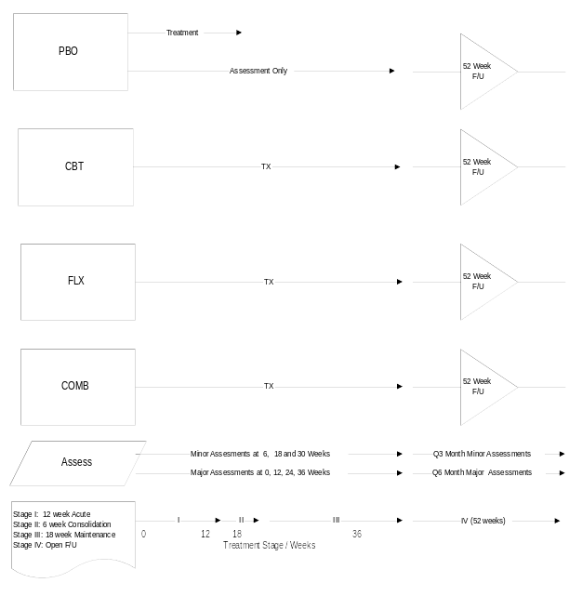
T A D S

Slide 5
T A D S
Treatment for Adolescents with Depression Study
Sample

Slide 6
Who Is Eligible
Outpatient
Boys and girls
Age 12 through 17
DSM-IV MDD
IQ > 80
T A D S

Slide 7
Who Isn’t Eligible
Severe conduct disorder
Substance abuse (other than nicotine)
Pervasive developmental disorder(s)
Thought disorder
Bipolar disorder
Suicidality or homicidality
T A D S

Slide 8
Exclusion for Suicidality
Hospitalization within 3 months
“High risk”
  Suicidal action within 6 months
  Intent or active plan
  Suicidal ideation with disorganized family
T A D S
Notes:
19
19

Slide 9
Baseline Depression on the CDRS
Score | COMB | CBT | FLX | PBO | Total
CDRS Raw Score
Number (N) | 107 | 111 | 109 | 112 | 439
Mean ± SD | 60.75 ± 11.58 | 59.58 ± 9.21 | 58.96 ± 10.16 | 61.11 ± 10.50 | 60.10 ± 10.39
Median | 60.00 | 58.00 | 57.00 | 59.50 | 59.00
Range | 45.00- 95.00 | 45.00- 83.00 | 45.00- 84.00 | 45.00- 98.00 | 45.00- 98.00
CDRS T-Score
Number (N) | 107 | 111 | 109 | 112 | 439
Mean ± SD | 75.67 ± 6.53 | 75.37 ± 6.32 | 74.73 ± 6.74 | 76.14 ± 6.11 | 75.48 ± 6.43
Median | 76.00 | 75.00 | 74.00 | 76.00 | 76.00
Range | 66.00- 85.00 | 66.00- 85.00 | 66.00- 85.00 | 66.00- 85.00 | 66.00- 85.00
Children's Depression Rating Scale-Revised (CDRS): clinician score
T A D S

Slide 10
Baseline Clinical Characteristics
Current Dx | COMB | CBT | FLX | PBO | Total
MDD
First MDE | 93 ( 90.29% ) | 92 ( 84.40% ) | 91 ( 85.05% ) | 93 ( 84.55% ) | 369 ( 86.01% )
Comorbidity
Dysthymia | 11 ( 10.28% ) | 17 ( 15.45% ) | 6 ( 5.50% ) | 12 ( 10.71% ) | 46 ( 10.50% )
Anxiety | 30 ( 28.04% ) | 36 ( 32.43% ) | 26 ( 23.85% ) | 28 ( 25.23% ) | 120 ( 27.40% )
DBD | 23 ( 21.50% ) | 27 ( 24.32% ) | 25 ( 22.94% ) | 28 ( 25.00% ) | 103 ( 23.46% )
OCD/Tic | 4 ( 3.74% ) | 2 ( 1.80% ) | 2 ( 1.83% ) | 4 ( 3.57% ) | 12 ( 2.73% )
SUD | 3 ( 2.80% ) | 1 ( 0.90% ) | 3 ( 2.75% ) | 0 ( 0.00% ) | 7 ( 1.59% )
ADHD
ADHD | 14 ( 13.08% ) | 14 ( 12.61% ) | 13 ( 11.93% ) | 19 ( 16.96% ) | 60 ( 13.67% )
On Medication | 4 ( 3.74% ) | 4 ( 3.60% ) | 3 ( 2.75% ) | 10 ( 8.93% ) | 21 ( 4.78% )
Current DSM-IV diagnosis. MDD=Major Depressive Disorder; MDE=Major Depressive Episode;
Anxiety=Anxiety Disorder; DBD=Disruptive Behavior Disorder; SUD=Substance Use Disorder;
OCD/Tic=OCD/Tic Disorder; ADHD=Attention Deficit-Hyperactivity Disorder;
On Medication=Current use of a non-prohibited psychostimulant for ADHD.
T A D S

Slide 11
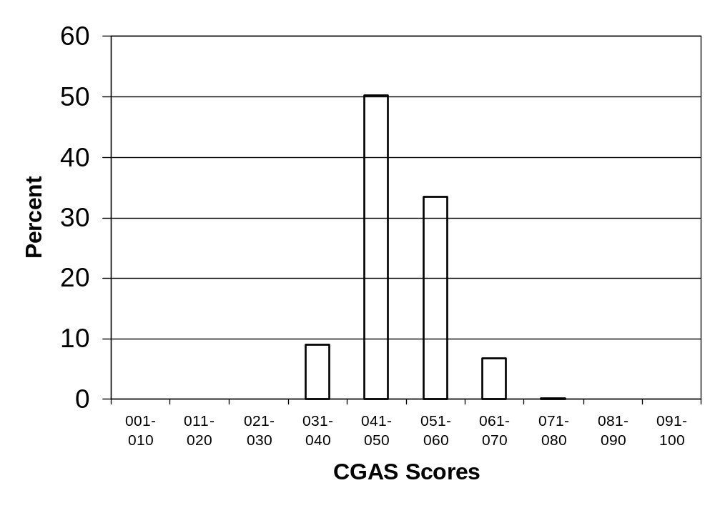
CGAS Ratings
T A D S

Slide 12
T A D S
Treatment for Adolescents with Depression Study
Effectiveness Outcomes

Slide 13
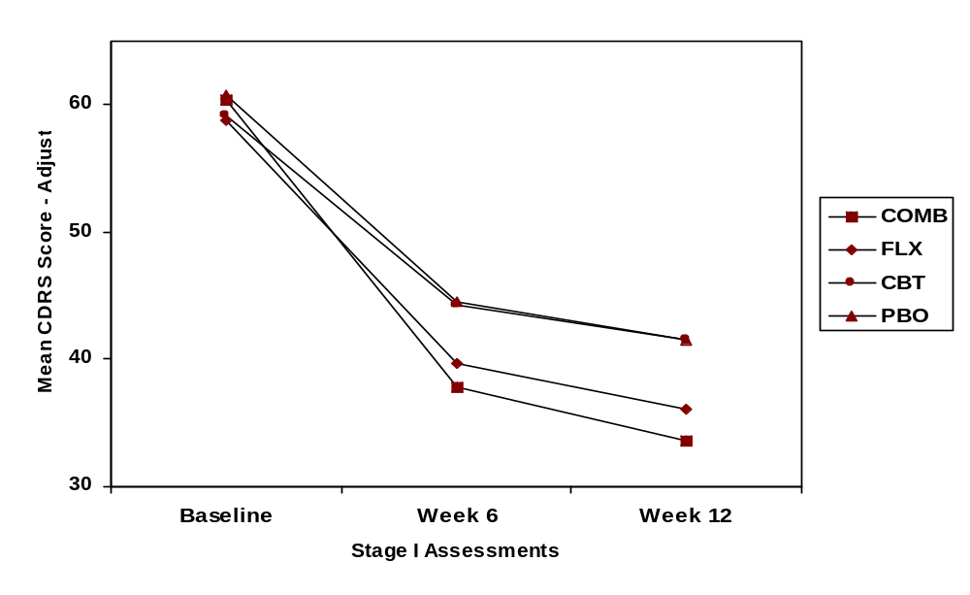
CDRS: Adjusted Means (ITT)
entry
response
T A D S

Slide 14
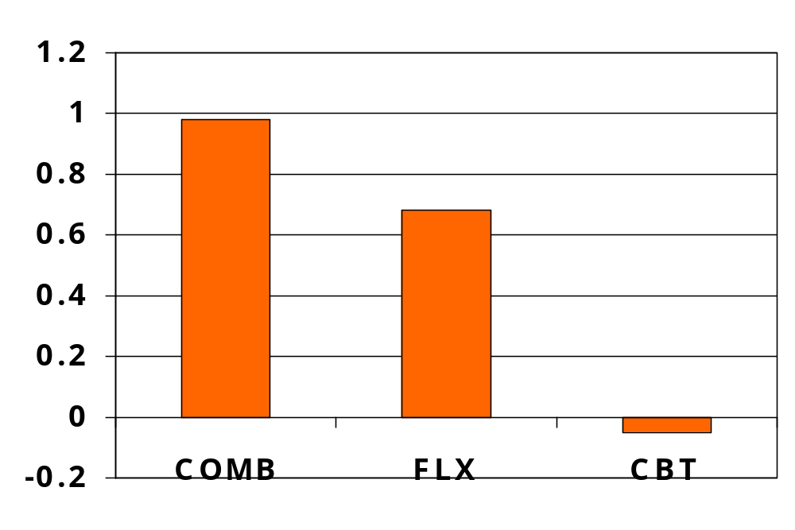
Effect Size for CDRS (ITT)
T A D S

Slide 15
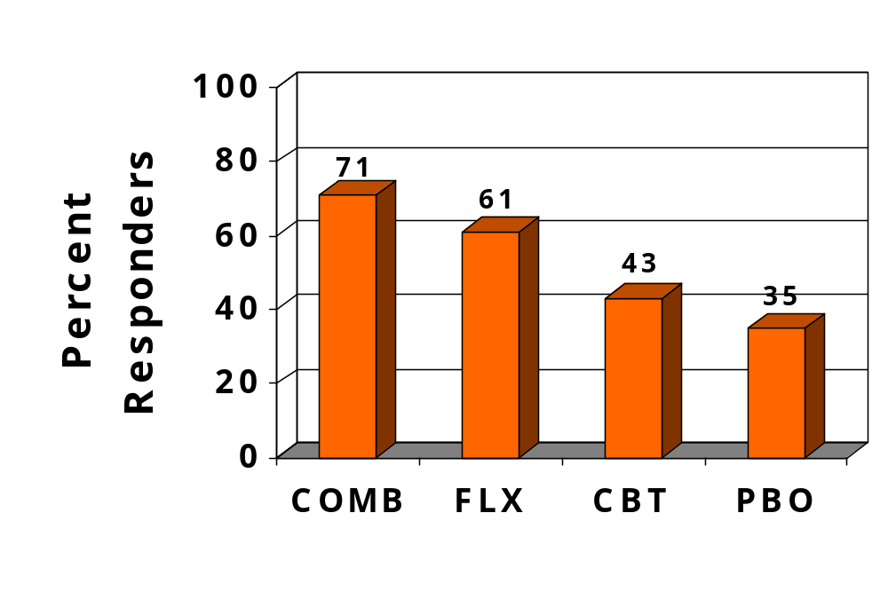
Treatment Response: Week 12
T A D S

Slide 16
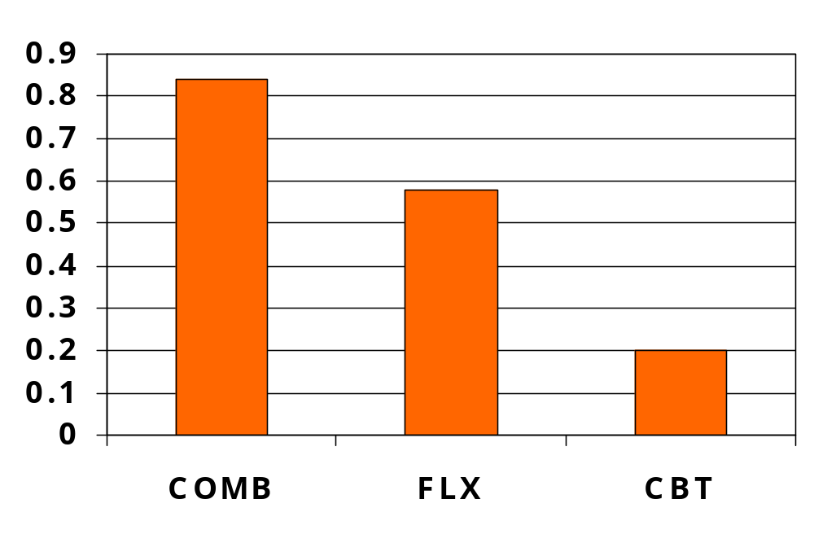
Effect Size for CGI-I (ITT)
T A D S

Slide 17
T A D S
Treatment for Adolescents with Depression Study
Safety Outcomes

Slide 18
Suicidal Ideation
T A D S

Slide 19
Suicidality at Baseline
Scale Items | Criterion | N | # | %
RADS
Item 14 | Score of 4 | 429 | 32 | 7.5%
CDRS-R
Item 13 | Score of 6 | 439 | 8 | 1.8%
SIQ-Jr
SIQ-Flag | Score > = 31 | 439 | 125 | 29.2%
Items 2, 3, 4, 7, 8, 9 | Score of 5 or 6 on two or more of the six items | 428 | 43 | 10.1%
T A D S

Slide 20
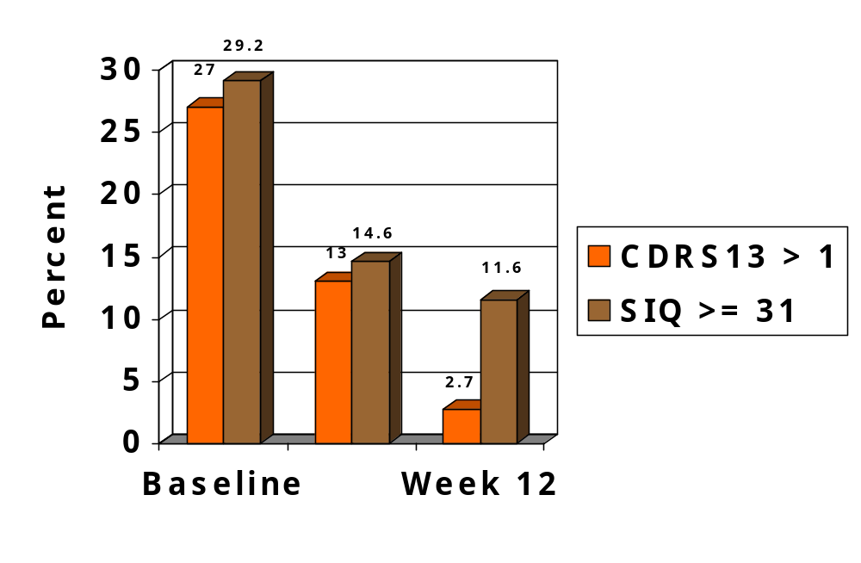
Suicidality Improves Overall (ITT)
T A D S

Slide 21
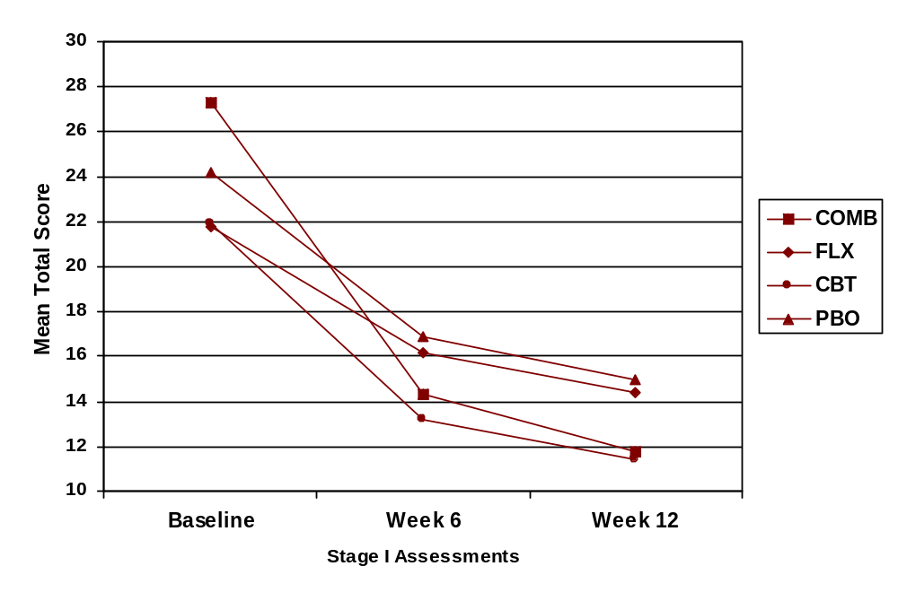
SIQ : ITT Adjusted Means
T A D S

Slide 22
Adverse Events
T A D S

Slide 23
Harm Related Adverse Events
Harm-related event defined as one or both of the following:
  harm to self (non-suicidal, ideation, or attempt)
  harm to others (requires ideation or attempt)
Suicide-related event defined as:
  harm to self (requires ideation or attempt)
Suicide attempt defined as:
  harm to self (attempt)
TADS analyses are ITT; FDA analyses exclude patients after premature termination, slightly changing OR
T A D S

Slide 24
Rates of Adverse Events (ITT)
Treatment | N | Harm-Related | Suicide-Related
FLX | 109 | 11.9% (13) | 8.3% (9)
COMB | 107 | 8.4% (9) | 5.6% (6)
CBT | 111 | 4.5% (5) | 4.5% (5)
PBO | 112 | 5.4% (6) | 3.6% (4)
SSRI | 216 | 10.2% (22) | 6.9% (15)
No-SSRI | 223 | 4.9% (11) | 4.0% (9)
Total Sample | 439 | 7.5% (33)* | 5.5% (24)
29 SAEs; 4 AEs
T A D S

Slide 25
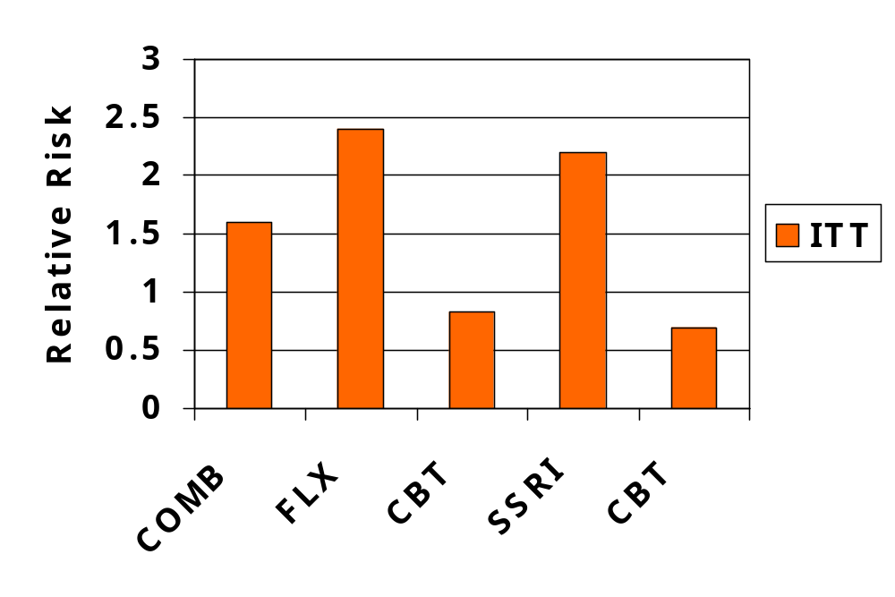
Harm-Related Events
*
* = uncorrected P < .05
T A D S

Slide 26
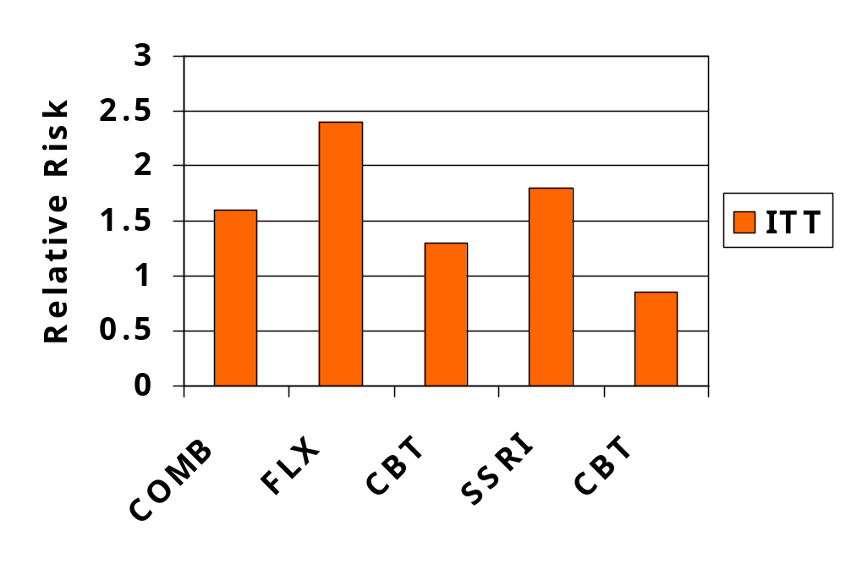
Suicide-Related Events
* = uncorrected P > .05
T A D S

Slide 27
Very Few Suicide Attempts
Treatment | N | Suicide Attempt | SIQ Flag*
FLX | 109 | 1.8% (2) | 2
COMB | 107 | 3.7% (4) | 3
CBT | 111 | 0.9% (1) | 1
PBO | 112 | 0.0% (0) | 0
Total Sample | 439 | 1.6% (7) | 6
*at baseline
T A D S

Slide 28
Benefit to Risk Ratio
Treatment | ABI | NNT | ARI | NNH | Ratio
FLX : PBO | 27% | 4 | 4.7% | 21 | 5.3
COMB: PBO | 37% | 3 | 2% | 50 | 16.7
SSRI : no SSRI | 31% | 3 | 3% | 34 | 11.7
ABI = absolute benefit increase and ARI = absolute risk increase calculated as EER – CER
NNT = number needed to treat and NNH = number needed to harm calculated as 1/ ABI or 1/ARI
T A D S

Slide 29
T A D S
Treatment for Adolescents with Depression Study
Conclusions

Slide 30
Conclusion
The combination of FLX and CBT (COMB) is the most effective treatment for adolescents with MDD
Fluoxetine alone is effective, but not as effective as COMB
CBT alone is less effective than FLX and not significantly more effective than placebo
Placebo is acceptable in RCTs for adolescent MDD
T A D S

Slide 31
Conclusion
Suicidality decreases substantially with treatment
Improvement in suicidality is greatest for COMB and least for fluoxetine alone
Fluoxetine does not increase suicidal ideation
Suicide-related AEs, which are uncommon, may occur more often in FLX treated patients
CBT may protect against suicide related AEs in fluoxetine treated patients
T A D S

Slide 32
Summary
Taking both risk and benefit into account, the combination of fluoxetine and CBT appears superior as a short-term treatment for MDD in adolescents
Conclusive findings regarding relative benefit and risk of SSRIs in pediatric MDD will require a placebo-controlled practical clinical trial (PCT) comparing fluoxetine versus another SSRI
T A D S

Slide 33

The Child and Adolescent Psychiatry Trials Network
Web site: www.captn.org
Notes:
6
6
6

