Slide 1
Regenstrief
SPIN Query Tool
Clem McDonald, M.D.
September 15, 2003
© 2003 Regenstrief Institute, Inc.

Slide 2
Overview of what we have in SPIN today
Five (5) hospital systems
  Clarian
    IU/Riley
    Methodist
  Community
  St. Francis
  St. Vincent
  Wishard
Total of thirteen (13) hospitals
  Tumor registry data for some
© 2003 Regenstrief Institute, Inc.

Slide 3
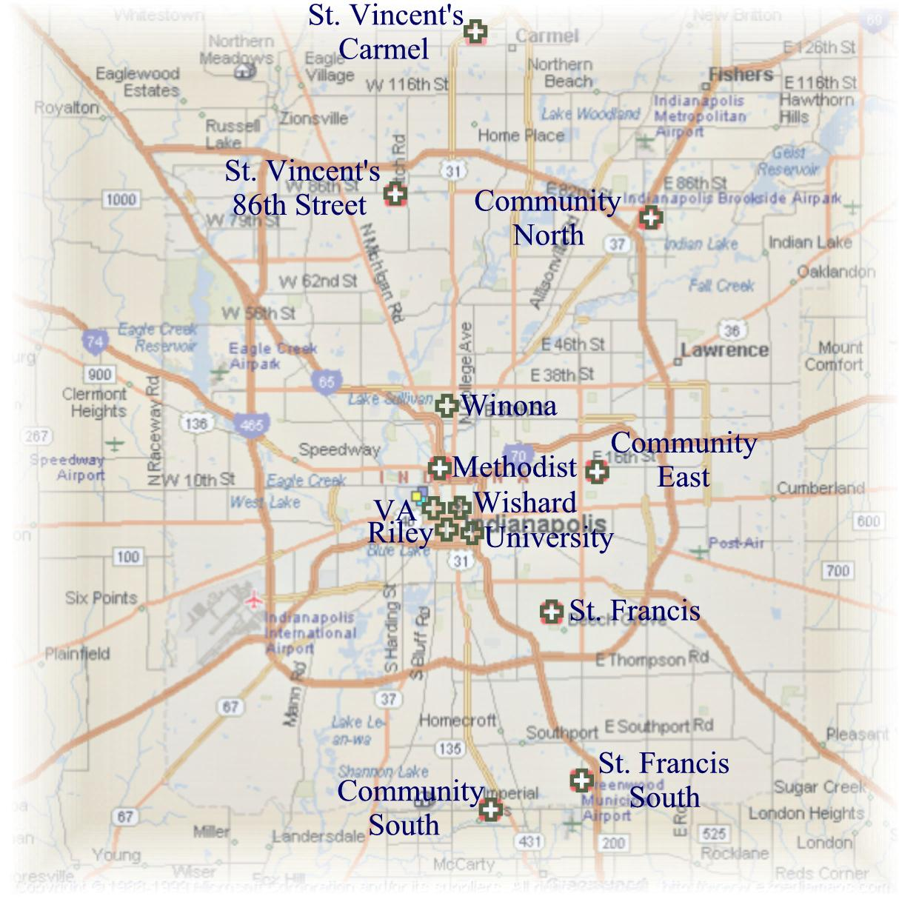
County Health Department
Quest
State Board of Health
LabCorp
© 2003 Regenstrief Institute, Inc.

Slide 4
Pathology data in hand
Institution | Years | Comment
Hosp A | 1989-2003 | Waiting for 200-300K more
Ameripath hosp B | 1980-2003
Hosp C | 2003 (now) | 15 year archive coming
Ameripath Hosp D | 1990-2003
Hosp E | 1975-2003
Confidential data – not for distribution
© 2003 Regenstrief Institute, Inc.

Slide 5
Surg Path Report Parsing / Coding
TOTAL ELIGIBLE REPORTS
855,639
100.0%
Successfully CODED
550,650
64.4%
Could not code (yet)
304,989
35.6%
100.0%
NAKED DIAGNOSES ++
156,248
18.3%
51.2%
NORMAL FINDINGS *
91,792
10.7%
30.1%
FIXABLE BUGS
21,252
2.5%
7.0%
NO CONTENT*
12,749
1.5%
4.2%
HARD PARSER ISSUES*
8,924
1.0%
2.9%
NEGATED FINDINGS*
7,649
0.9%
2.5%
CODER MISS*
6,374
0.7%
2.1%
Estimated from sample
Sure we can get to 82% (naked DX and Successful)- prob better
© 2003 Regenstrief Institute, Inc.

Slide 6
NAACCR Tumor registry data
From Indiana State for:
  Tumor DX
  Survival
  Organ site of primary
  Etc.
State query restricted to same 5 hospital systems
Date range 1997 - 2003
# records = 136 K/up from 129 K
# patients = 128 K/up from 112 K
  Based on current 850K surg path reports, we find path reports in 50% of tumor registry patients. With the additional 400K path reports we have been promised, we could expect path reports in 75% of them
© 2003 Regenstrief Institute, Inc.

Slide 7
Table 2 Distribution of NAACCR Tumor registry case by Institution
Institution | # Tumor Registry Records | # of Patients
Hosp A | 68,528 | 64,710
Pub Health Hosp B | 20,418 | 18,991
Pub Health Hosp D | 12,520 | 11,821
Pub Health Hosp C | 28,697 | 26,685
Hosp E | 6,563 | 6,256
TOTAL | 136,726 | 128,463
© 2003 Regenstrief Institute, Inc.

Slide 8
Lab data included in database
So for have included tumor related labs ONLY for patients with either a surg path report OR a tumor registry record and included only 2 hospitals
This represents 320K patients (about 1/3 of patients with TR or Surg Path reports. Time frames differ from hospital to hospital:
  Wishard 1975-2003
  Clarian IU 1989-2003
  Clarian Methodist 1995-2003
© 2003 Regenstrief Institute, Inc.

Slide 9
Patient linking
We have HIPAA business associate agreements and IRB approval to link within the Indianapolis consortium
We have software that does the linking within our city wide project
Have not implemented any linking yet
So, patient numbers are not de-duplicated – YET
© 2003 Regenstrief Institute, Inc.

Slide 10
The data hierarchy
Each patient has
  Many distinct different observations
    Each observation can be repeated on different dates/times
      Some observations have many results, e.g. one pathology report can have many specimens – a specimen can have more than one finding
Currently
  Query tool returns cohorts by patient
  Returns only one result per data and one finding per result
© 2003 Regenstrief Institute, Inc.

Slide 11
1
1
Patient
1
Report
1
0..*
serviceCode : CV
0..*
0..*
physiologicTime : TS
0..*
text : TEXT
1
ClinicalVariable
1
0..*
1
0..*
1
serviceCode : CV
0..*
0..*
physiologicTime : TS
Specimen
0..*
originalText : TEXT
0..*
tissueType : CV
0..1
interpretationCode : CV
0..1
siteModifier : SET<CV>
collectionMethod : CV
CodedClinVar
NumericClinVar
value : CV
value : PQ
normalRange : SET<CV>
normalRange : IVL<PQ>
© 2003 Regenstrief Institute, Inc.

Slide 12
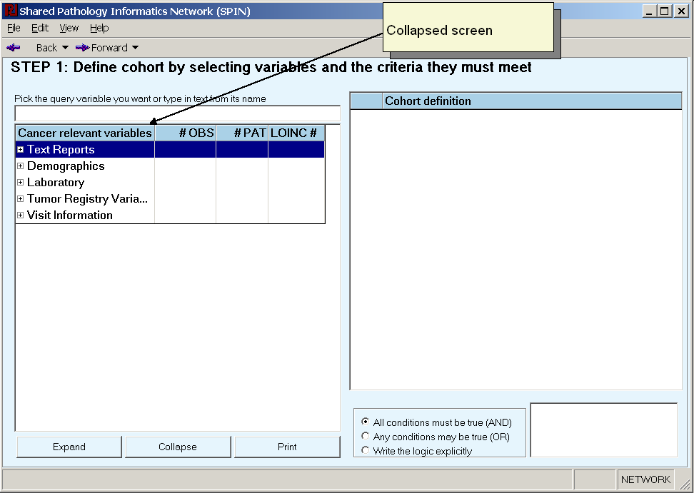
Variable selection tree collapsed
You can expand and collapse nodes one at a time or enmass. Or enmass by pressing the Expand / collapse button at the bottom of the screen)
© 2003 Regenstrief Institute, Inc.

Slide 13
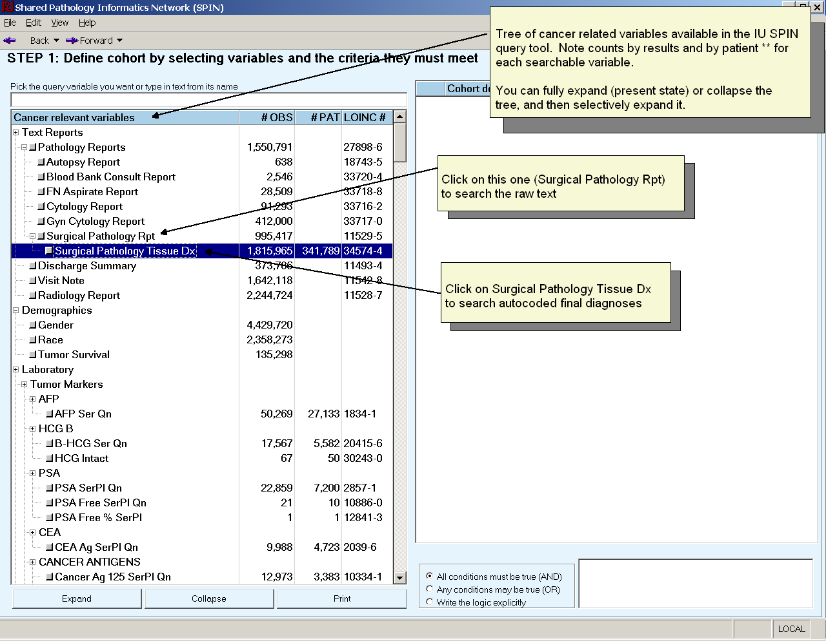
Variable selection tree (expanded)
© 2003 Regenstrief Institute, Inc.

Slide 14
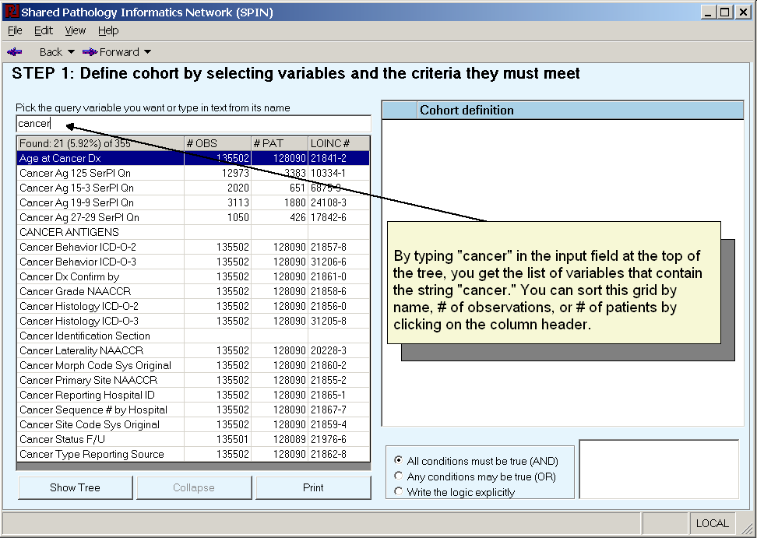
Search for variable by word in variable name
© 2003 Regenstrief Institute, Inc.

Slide 15
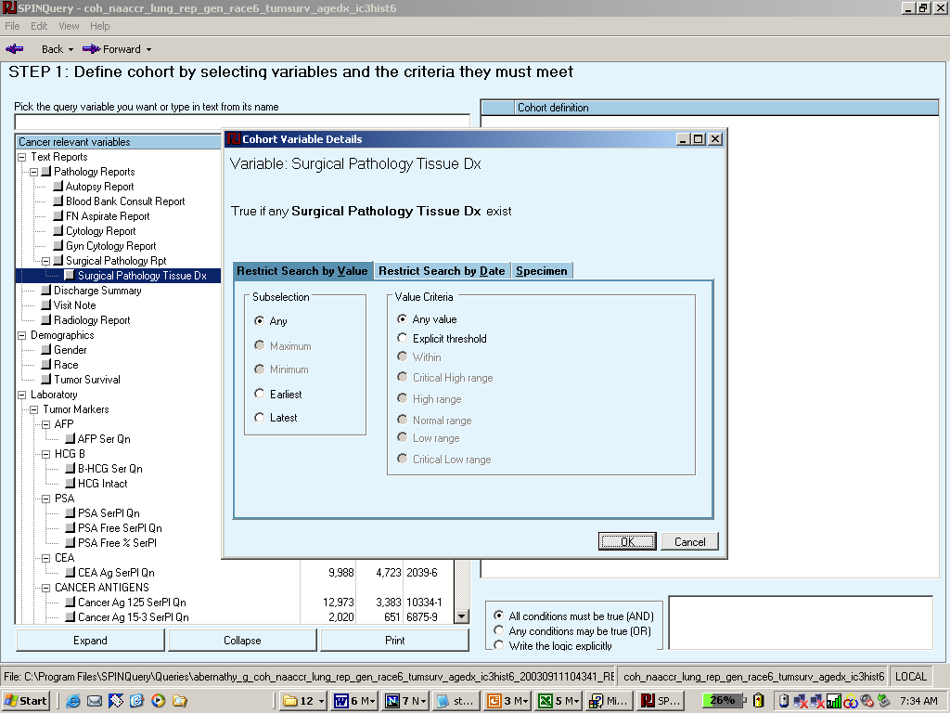
Tab for selecting auto coded surg path findings is clicking on explicit threshold produces next pop up d
Click to open tab that allows setting of date constraints
Click to open tab to set search criteria on specimen type, site and procedure.
© 2003 Regenstrief Institute, Inc.

Slide 16
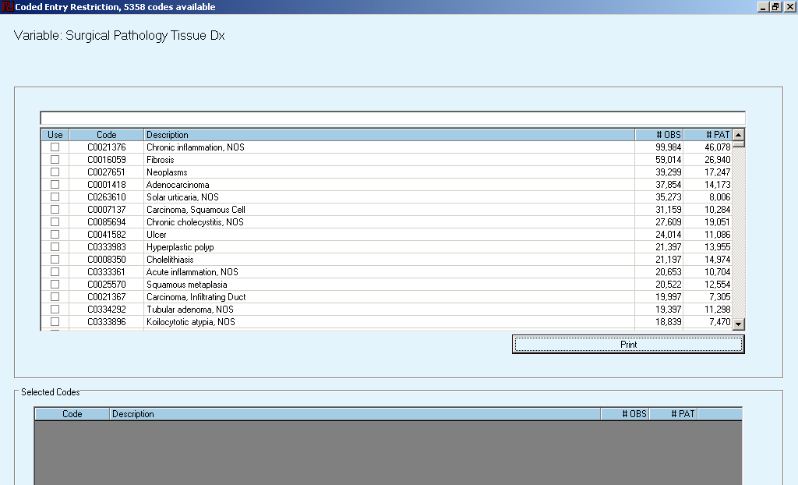
Pop up showing Auto coded surg path findings Click on #obs or #patients to sort by counts
© 2003 Regenstrief Institute, Inc.

Slide 17
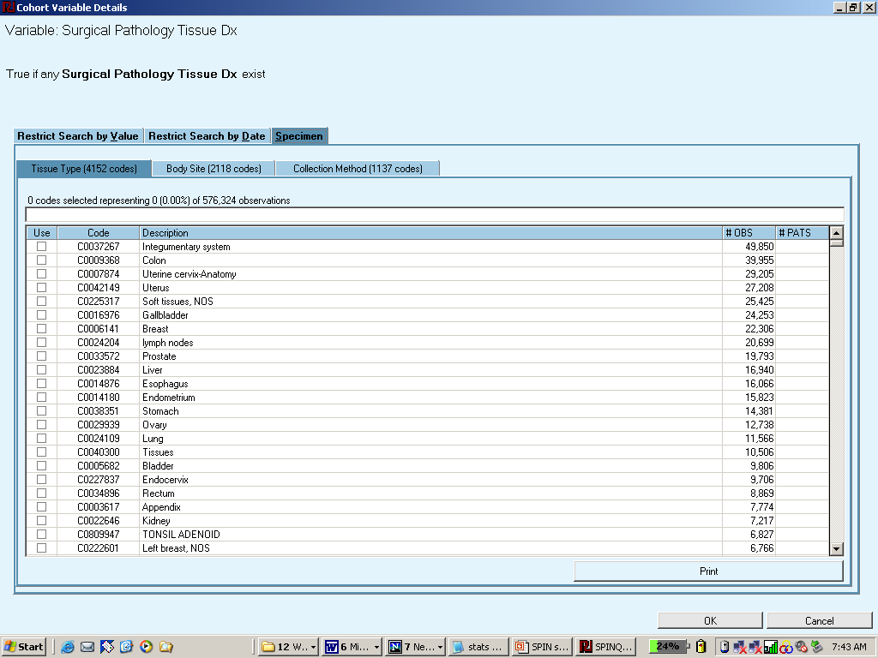
User clicked on Specimen tab. Note three tabs: Tissue Type, Body Site, Collection Method. Screen offers same options for search by word and sorting.
© 2003 Regenstrief Institute, Inc.

Slide 18
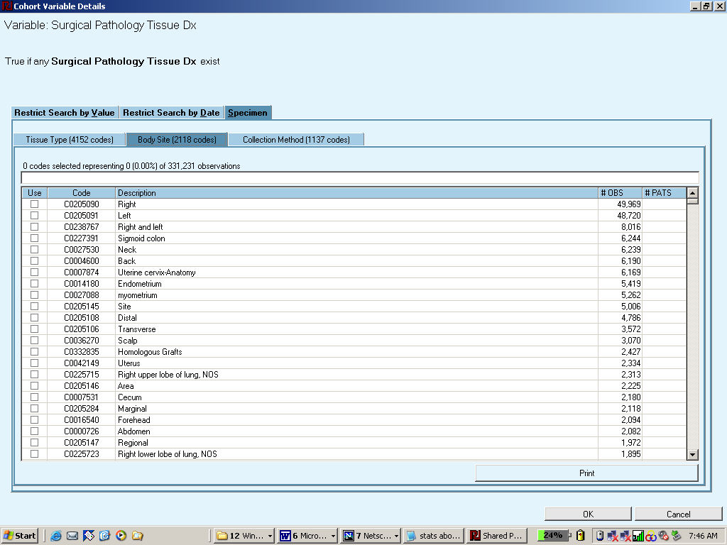
User clicked Body Site tab. Same options for searching, sorting and selecting.
© 2003 Regenstrief Institute, Inc.

Slide 19
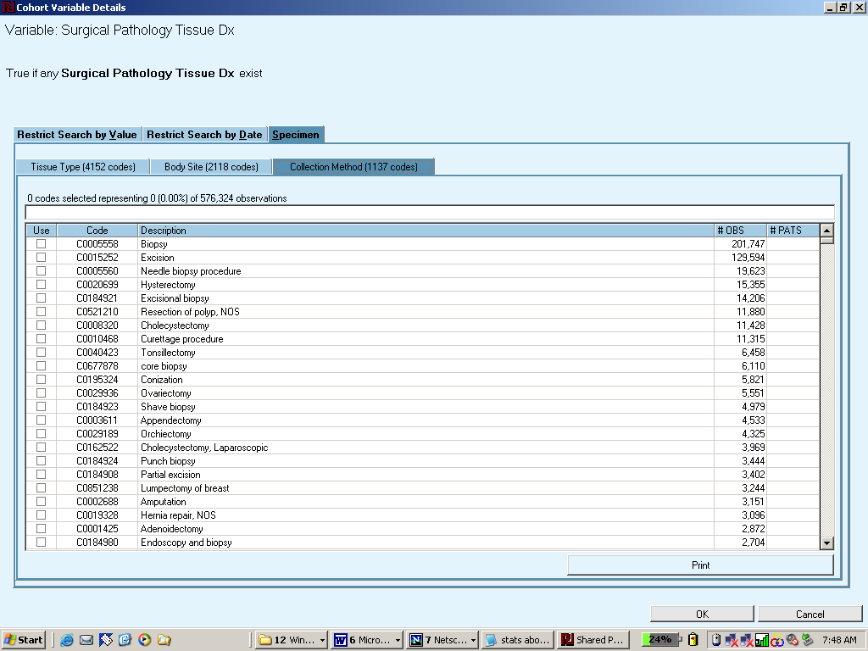
User clicked on collection method tab. Same options for searching, sorting and selecting.
Reports total number of available codes
© 2003 Regenstrief Institute, Inc.

Slide 20
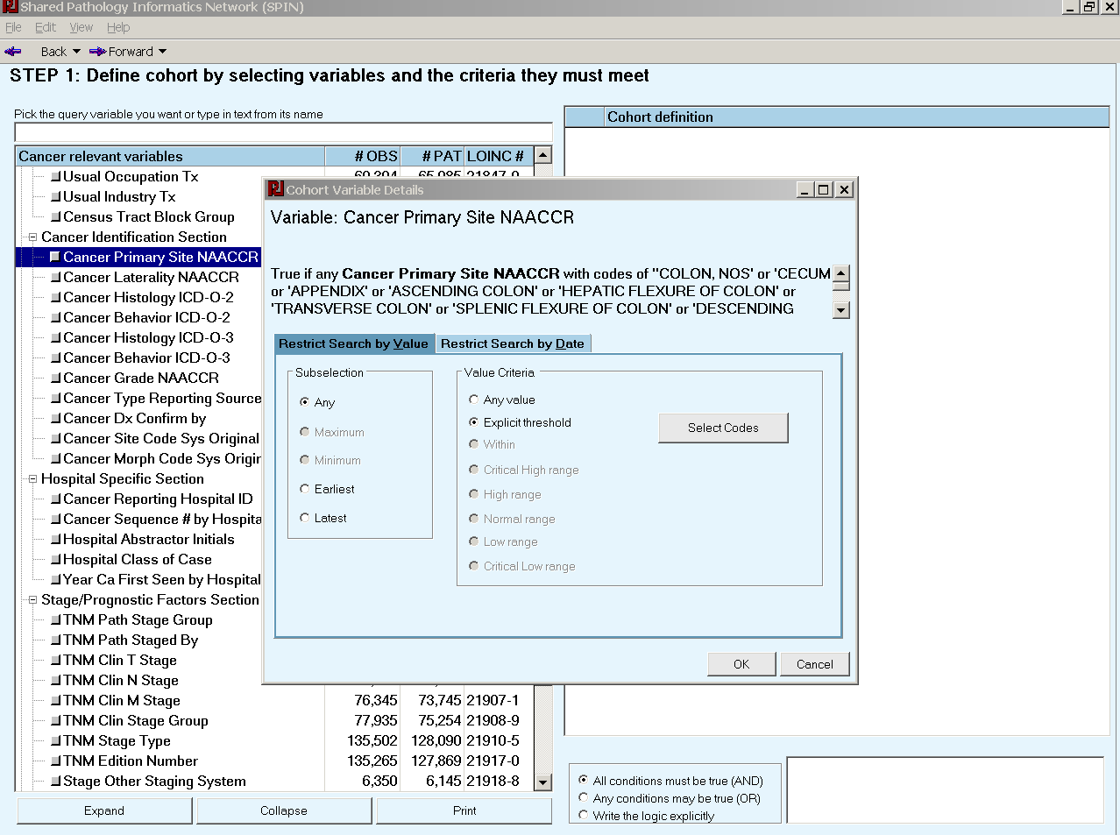
© 2003 Regenstrief Institute, Inc.

Slide 21
Data Types
Variables can have values that are
  Numeric
  Text
  Codes
  Dates (rare – other values also have dates)
© 2003 Regenstrief Institute, Inc.

Slide 22
Variable with numeric values
Some tumor registry variables (e.g., # years of survival)
Laboratory results (e.g., %blasts, PSA)
Eventually, variables such as Gleason score parsed out of the pathology text
© 2003 Regenstrief Institute, Inc.

Slide 23
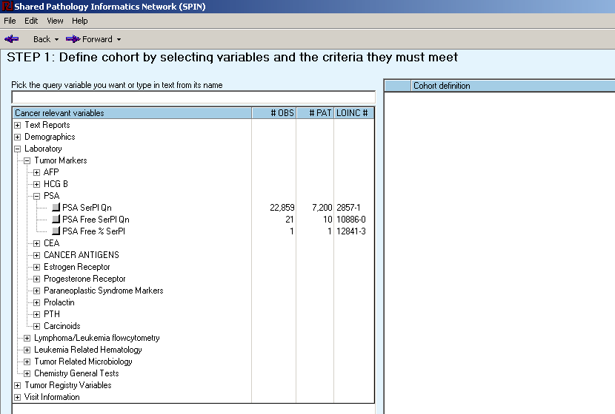
Select PSA variable. Note the count of number of observations available to help the searching process.
© 2003 Regenstrief Institute, Inc.

Slide 24
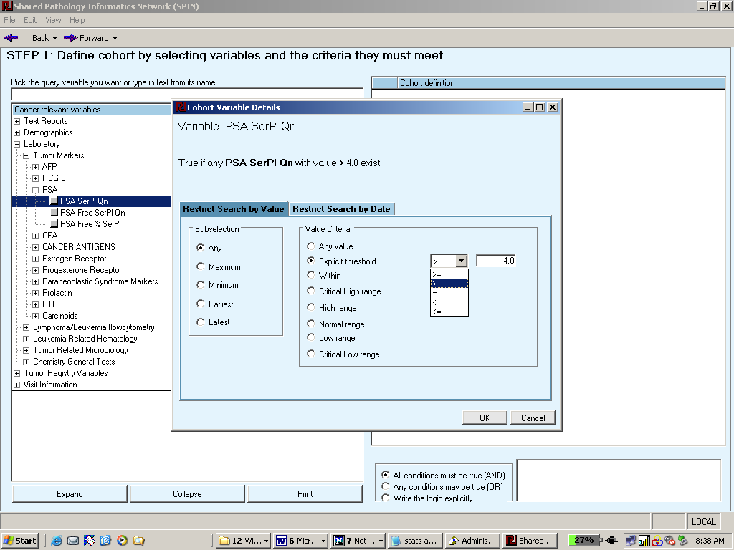
Search options when variable is numeric – e.g., PSA
© 2003 Regenstrief Institute, Inc.

Slide 25
Variables with text “values”
Surg path reports (en toto) (the only one that is operational now)
Other kinds of reports
Clinical variables that have text as values
© 2003 Regenstrief Institute, Inc.

Slide 26
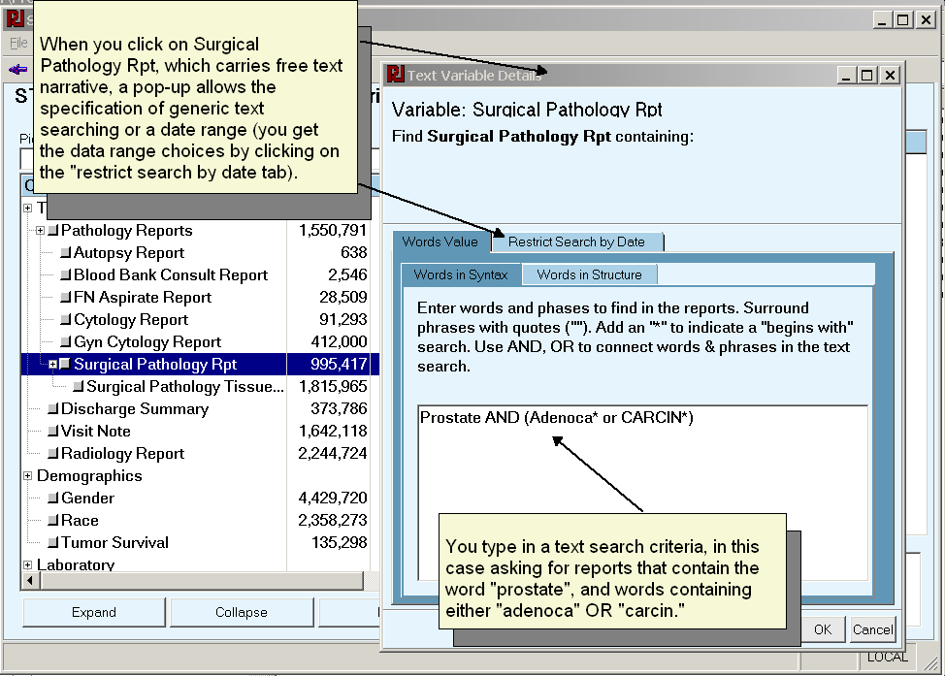
Select a variable on which to define a search criteria (text data type)
© 2003 Regenstrief Institute, Inc.

Slide 27
Variables with coded values
Auto coded surg path findings
Most tumor registry variables
Many laboratory reports (e.g., Hep B Surface Ag)
DRG and diagnoses
© 2003 Regenstrief Institute, Inc.

Slide 28
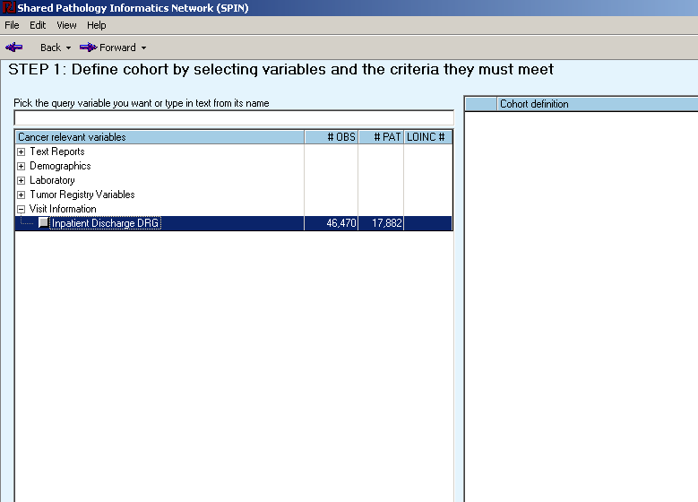
Selecting Inpatient DRG codes
© 2003 Regenstrief Institute, Inc.

Slide 29
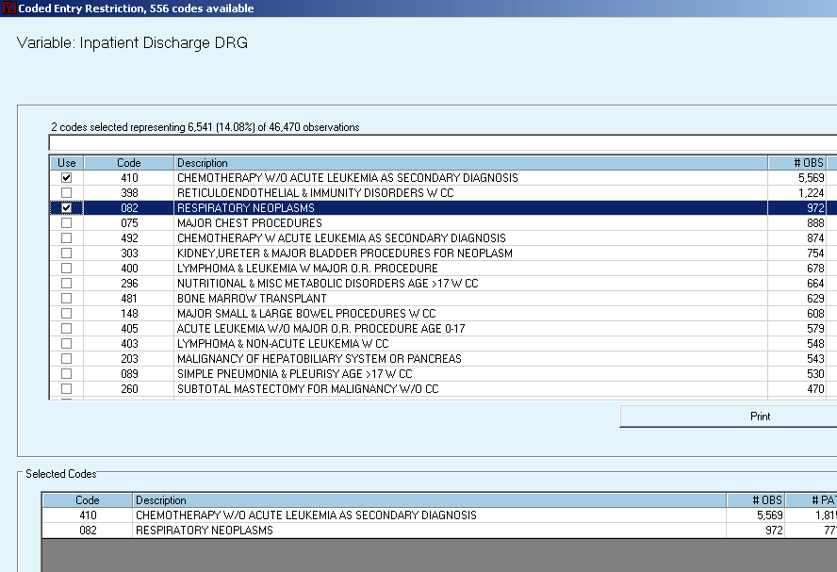
Inpatient DRG choices (only have Wishard and some Clarian values stored so far.
© 2003 Regenstrief Institute, Inc.

Slide 30
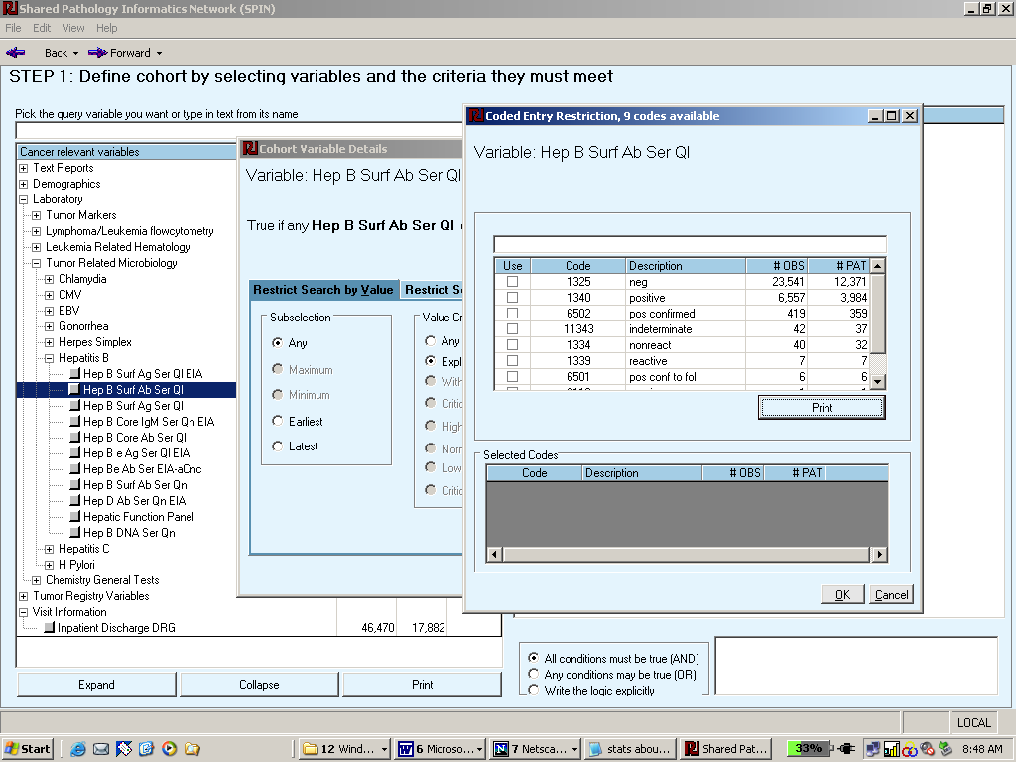
Select Hepatitis H surface ab – click on explicit, get list of answers that may be of interest.
© 2003 Regenstrief Institute, Inc.

Slide 31
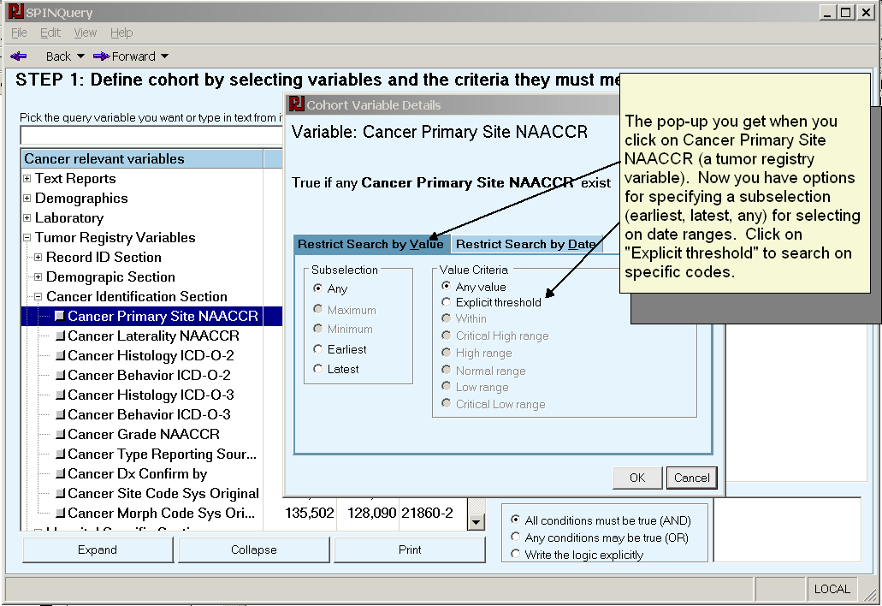
Pop-up for entering search criteria
© 2003 Regenstrief Institute, Inc.

Slide 32
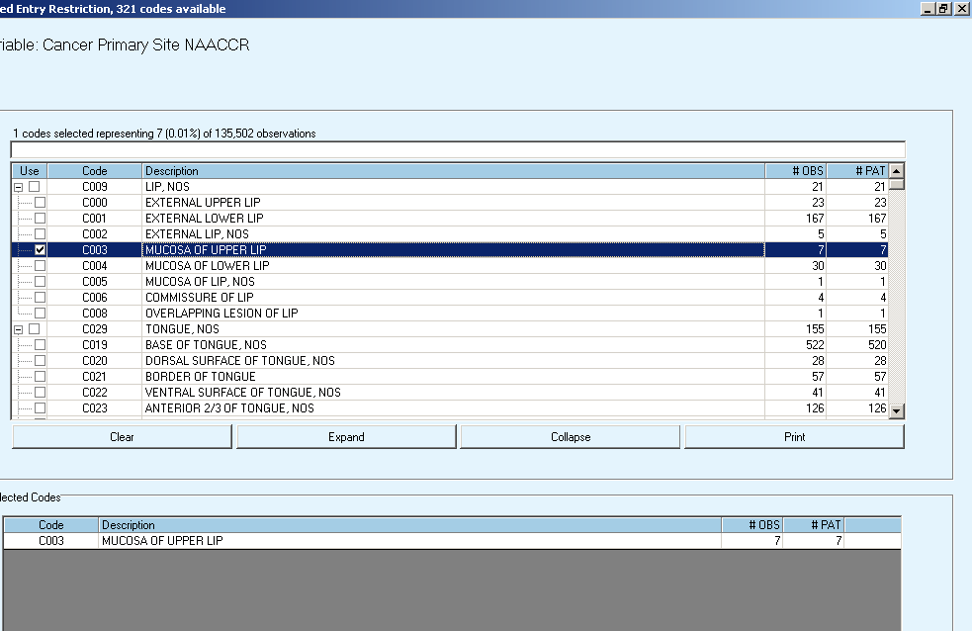
Choice of tumor registry ICD0-3 codes on which to search for (tumor registry primary site). User search and sort-like other screens
Note that the ICD0-3 codes have a hierarchical structure that is represented by a tree.
© 2003 Regenstrief Institute, Inc.

Slide 33
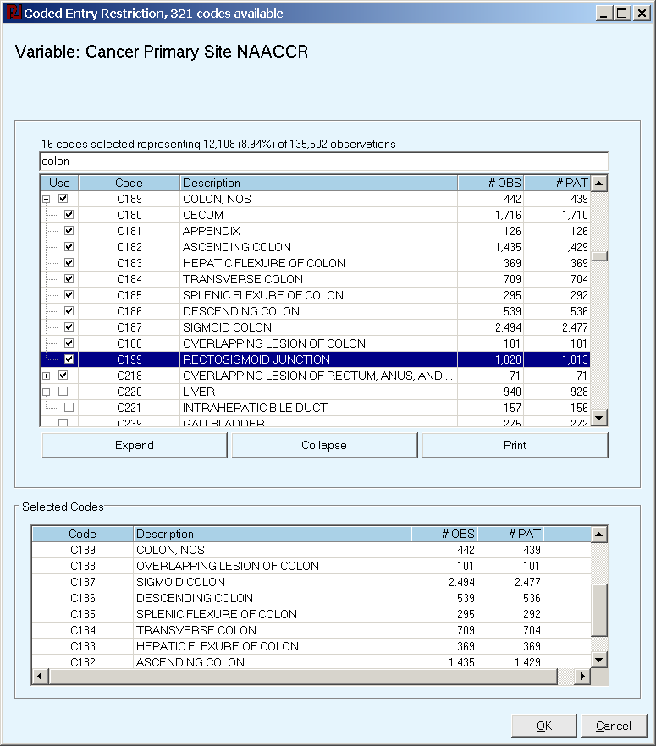
© 2003 Regenstrief Institute, Inc.

Slide 34
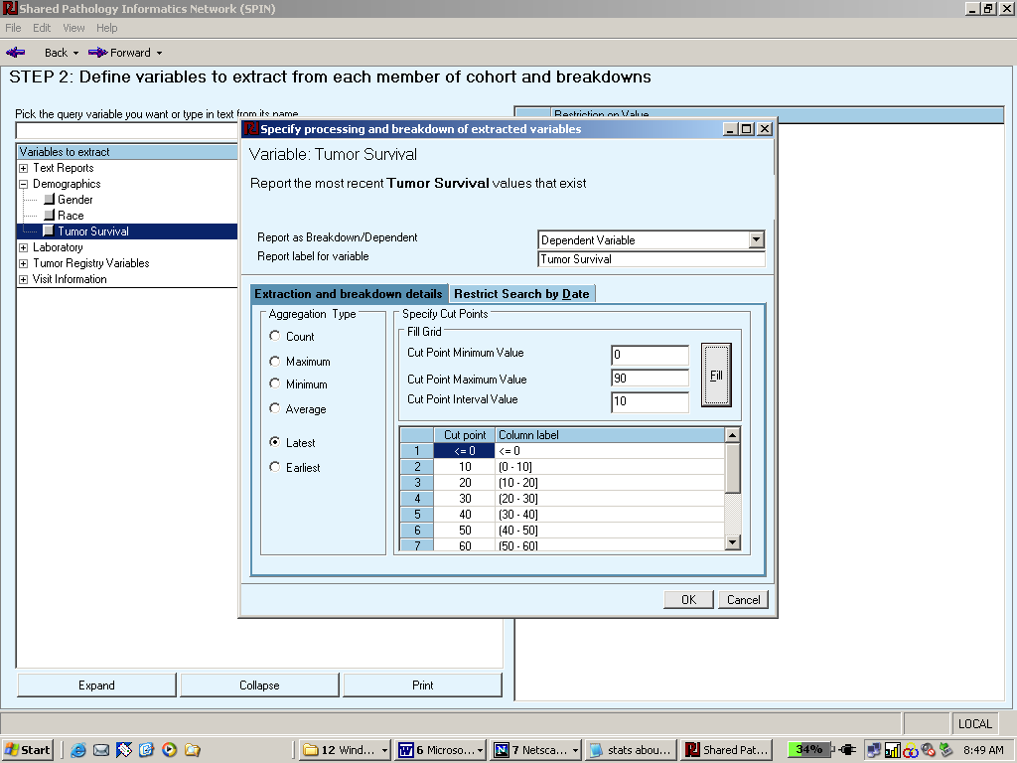
Setting cut points on numeric data in breakdown screen
Users enter the range and the increment and computer generates the cut points.
© 2003 Regenstrief Institute, Inc.

Slide 35
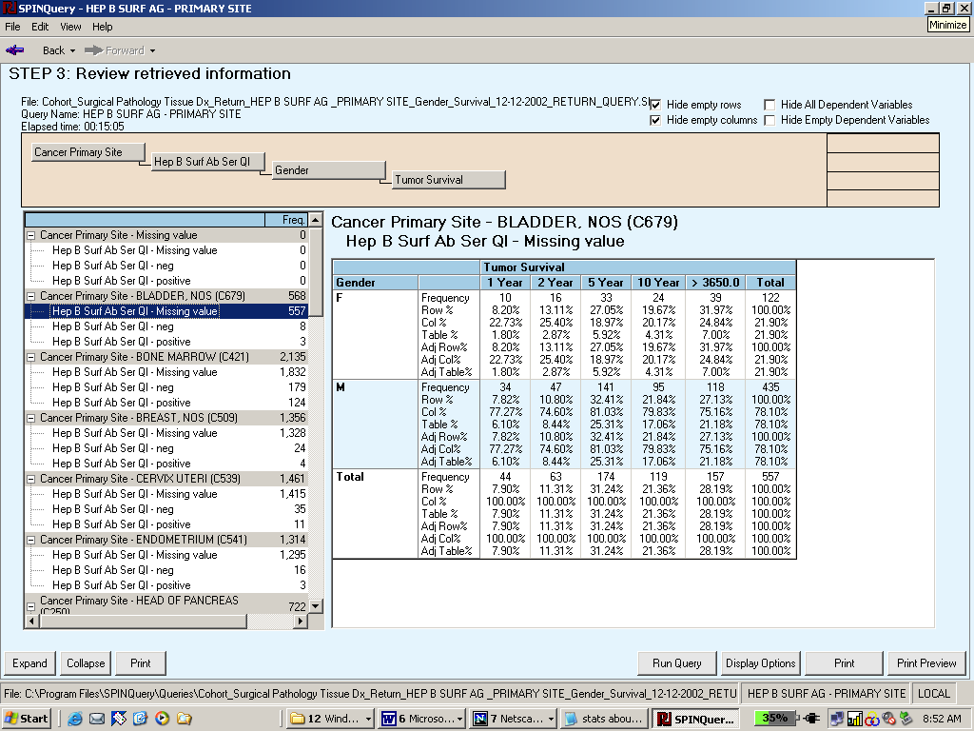
Review of query response for breakdown of cancer primary site, Hep B surf AB results, gender and tumor survival.
© 2003 Regenstrief Institute, Inc.

Slide 36
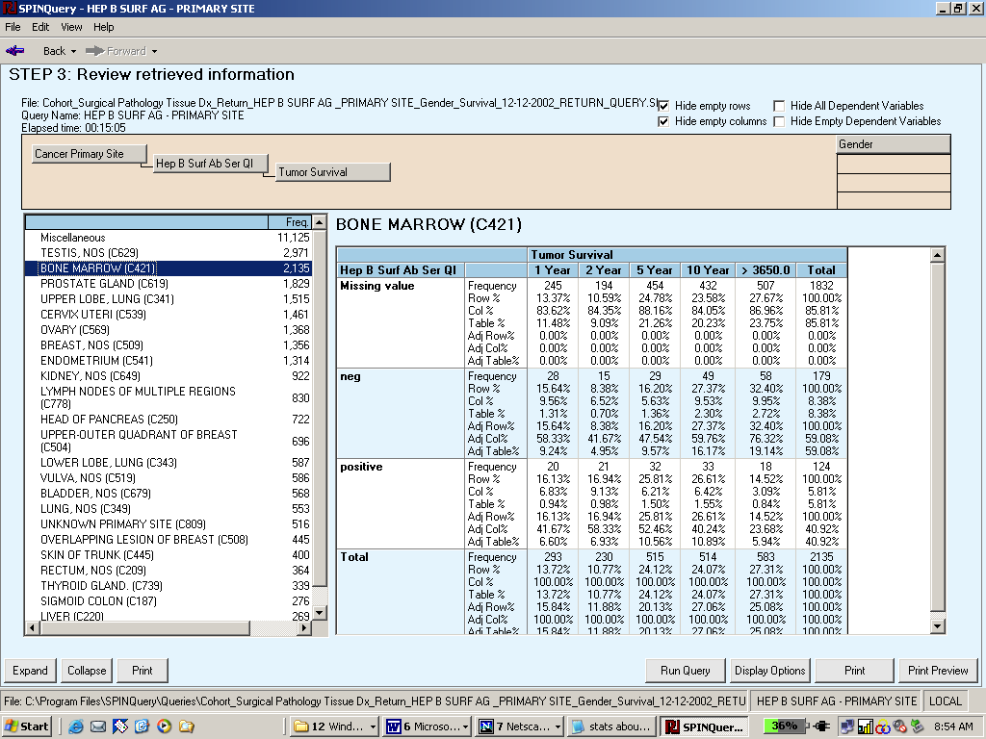
Drag the gender dimension to the holding pen and change the cross tab look
© 2003 Regenstrief Institute, Inc.

Slide 37
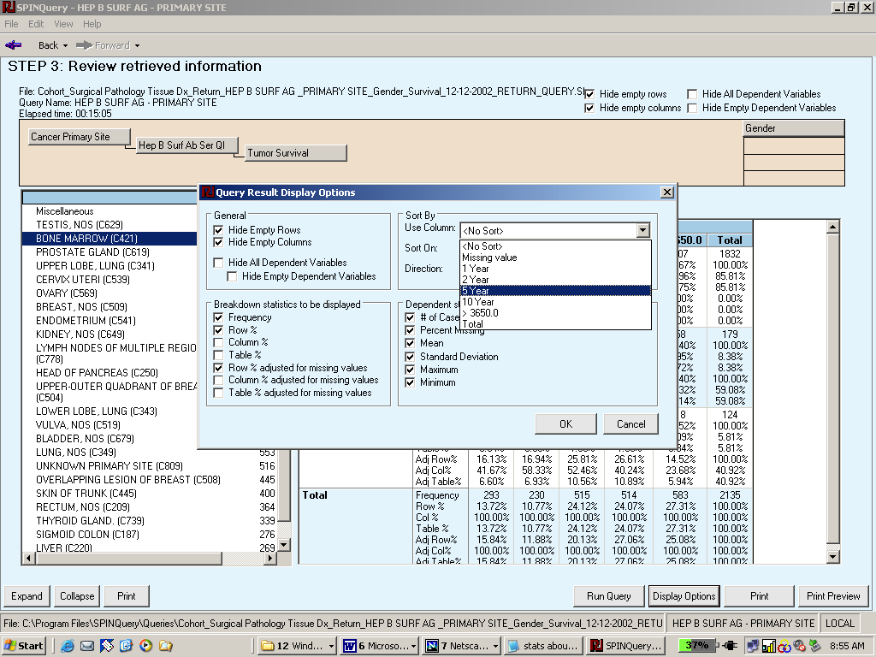
Re-arrange the display options
© 2003 Regenstrief Institute, Inc.

Slide 38
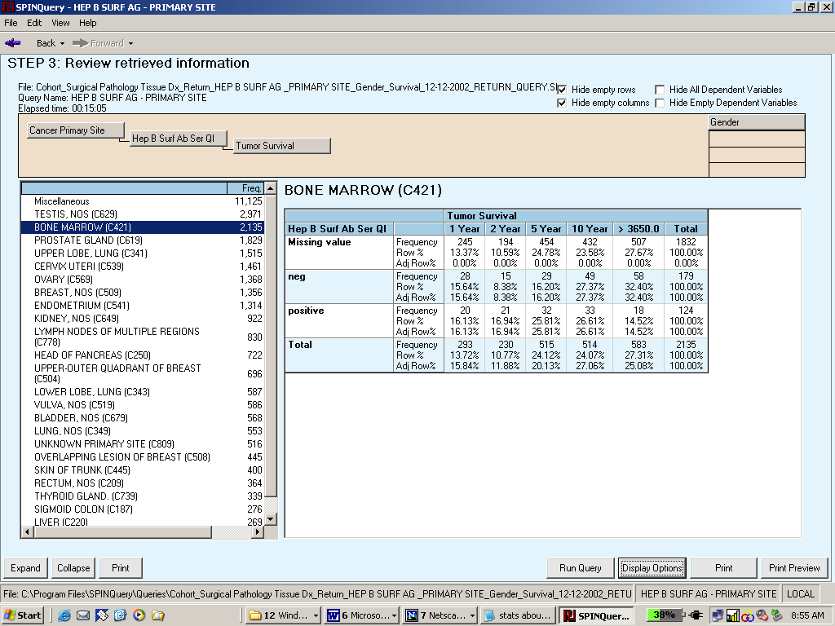
Results of turning off some of the display options
© 2003 Regenstrief Institute, Inc.

Slide 39
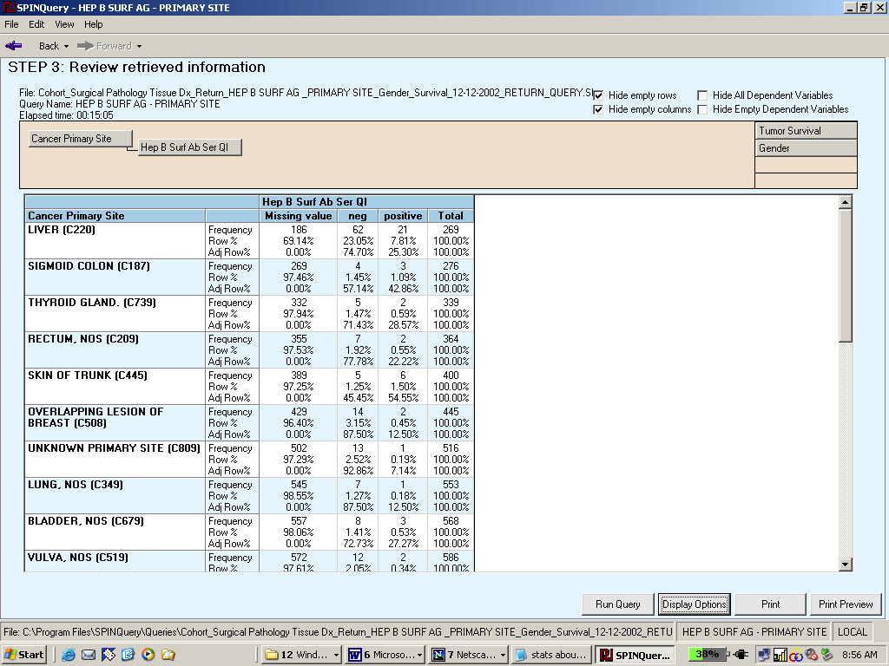
Put another dimension in the holding pin and sort the bins by total number of cases
© 2003 Regenstrief Institute, Inc.

