Slide 1


Update
BOSTON SUMMIT
August 2002

Slide 2
What’s New
Electronic Submissions
Online GA Loan Updating Guaranty
Agency Reports on Web Site
GAFR Reasonability
Edit Changes
Enrollment Enhancements
Electronic Cohort Default Rates
NSLDS II

Slide 3
Electronic Submissions
Conversion from tape to SAIG
  EDConnect for PC
  Easy Access for mainframe/midrange
Thirteen agencies live
Four agencies submitting weekly or bimonthly
Loan submittals, Error file, and Enrollment Notification file
Contact NSLDS Customer Service
1-800-999-8219

Slide 4
Electronic Submissions
Weekly
Higher Education Assistance Authority – Kentucky
Bi-Monthly
American Student Assistance – Massachusetts
Colorado Student Loan Program
Education Assistance Corporation – South Dakota
Monthly
California Student Aid Commission
Connecticut Student Loan Foundation
Educational Credit Management Corporation
Pennsylvania Higher Education Assistance Agency
New Hampshire Higher Education Assistance Foundation
Higher Education Student Assistance Authority – New Jersey
Student Loans of North Dakota
Utah Higher Education Assistance Authority
Vermont Student Assistance Corporation

Slide 5
Online GA Loan Updating
This powerful customer service tool gives your agency direct update access to NSLDS. This enhancement will improve your ability to respond quickly to schools and students when corrections or updates are needed that affect a student’s eligibility.
For security reasons, only two users from each GA will be granted this authority at one time.
Current and future users must complete/update the SAIG enrollment document after October 1, 2002.

Slide 6
Online GA Loan Updating
Online Updates
  Identifiers
  Loan Details
  Loan Amounts
  Loan Activities
  Loan Status
  Claim detail
  Collection detail
  Holder

Slide 7
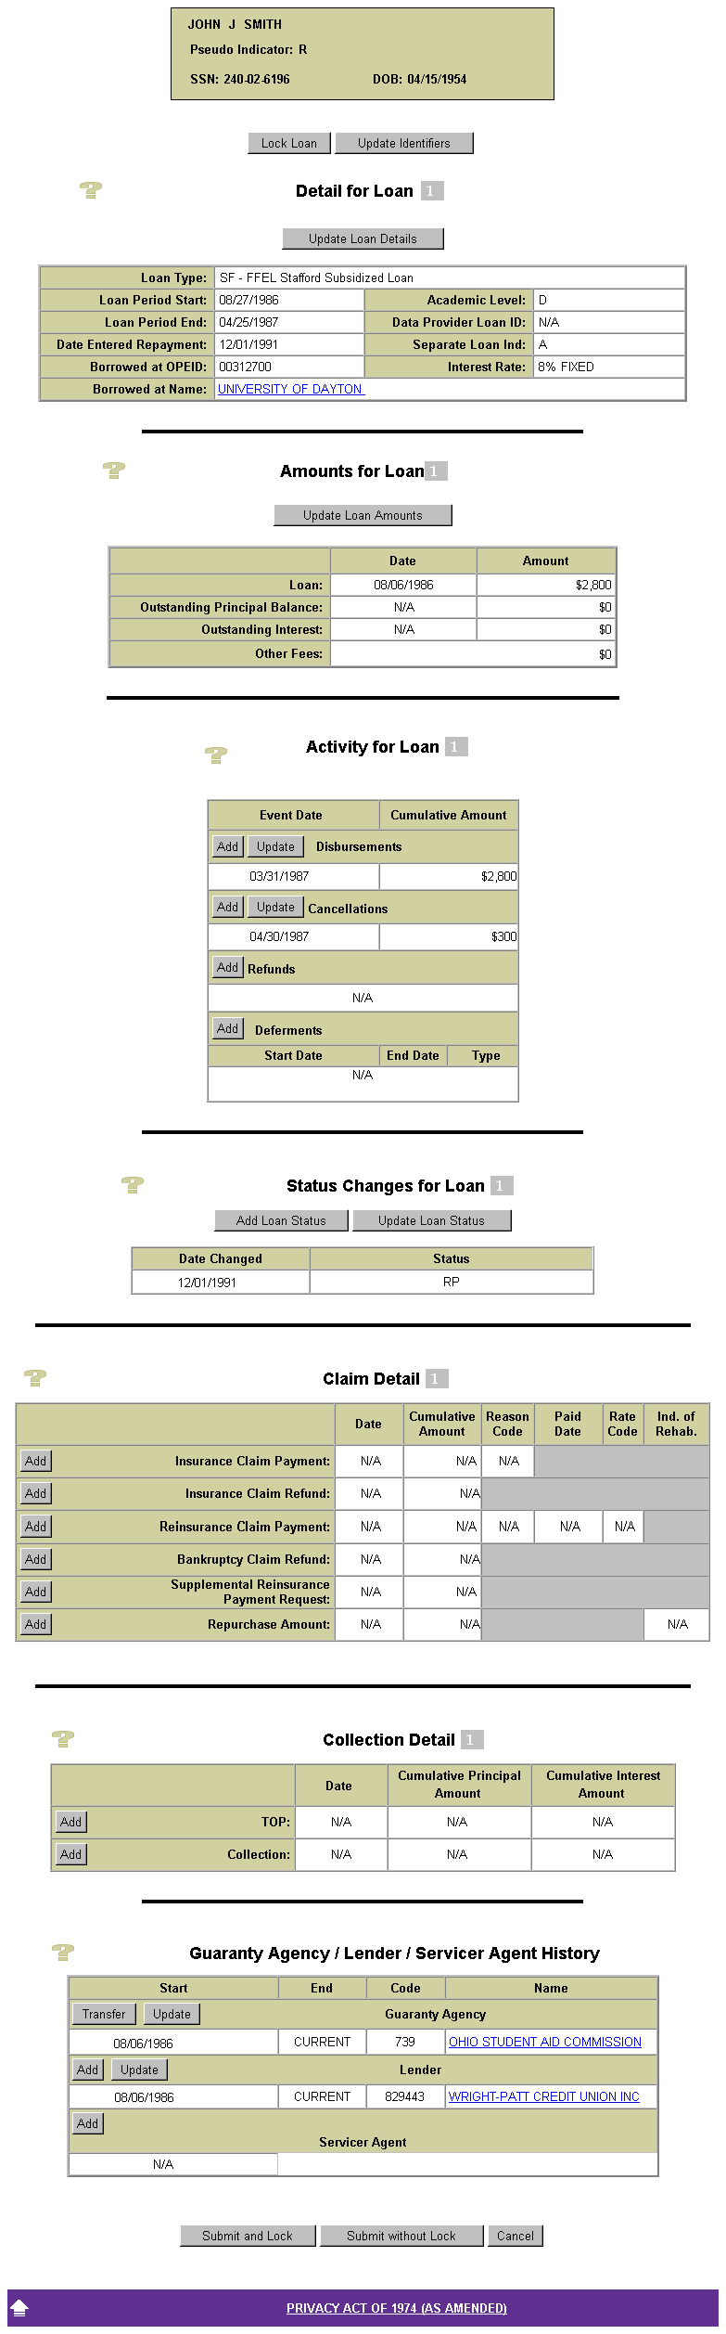
Loan Detail
Update Page:

Slide 8
Guaranty Agency Reports
Available on the Web Site
GA005A – Loan Profile Data by SSN
  Request complete loan history for up to 50 borrowers
GAERR2 – GA Top Ten Error Report
  Request agency’s error rates and top ten errors
GA___ - Future report for on-line updates

Slide 9
GAFR Reasonability
Began with FY 1998 ED Form 1130
As of April 2002 back-up detail available
  Technical Update GA-2002-02
  FY 2001 and FY 2000 Annual Comparisons
Quarterly and Annual Calculations

Slide 10
Attachment C
2000 AMOUNT PERCENT
LINE FROM GAFR AMOUNT AMOUNT PERCENT DIFF.
ITEM AS PER ED FROM NSLDS DIFFERENCE DIFF. ALL GA
----- ---------------- ---------------- ---------------- --------- ---------
LOANS GUARANTEED TOTAL W/O CONSOLIDATION AR-1 6869006639 6858305815 10700824 0.16% 1.33%
SLS(SL) 9575 -1059 10634 111.06% 97.31%
PLUS(PL) 829868243 829539511 328732 0.04% -0.35%
STAFFORD(SF) 3105468156 3096451091 9017065 0.29% 2.65%
UNSUBSIDIZED STAFFORD (SU) 2933660665 2932316272 1344393 0.05% 0.10%
REFINANCED(RF) 0 0 0 0.00% 0.00%
LOANS CANCELLED TOTAL W/O CONSOLIDATION AR-2 818362378 865486245 -47123867 -5.76% -6.12%
SLS(SL) -71818 142881 -214699 298.95% 159.66%
PLUS(PL) 102990478 109030581 -6040103 -5.86% -7.29%
STAFFORD(SF) 348701947 365632925 -16930978 -4.86% -6.61%
UNSUBSIDIZED STAFFORD (SU) 366741771 390679858 -23938087 -6.53% -4.80%
REFINANCED(RF) 0 0 0 0.00% 0.00%
LOANS GUARANTEED CONSOLIDATION (CL) AR-3 2134715194 2157121635 -22406441 -1.05% -9.13%
LOANS CANCELLED CONSOLIDATION (CL) AR-4 6906529 3425847 3480682 50.40% -0.32%
LOANS TRANSFERRED IN AR-6 192161 1198776 -1006615 -523.84% -422.68%
CONSOLIDATION (CL) 0 1166510 -1166510 N/A -126.31%
SLS(SL) 0 -1000 1000 N/A -375.10%
PLUS(PL) 74569 5641 68928 92.44% -80.82%
STAFFORD(SF) 109635 24968 84667 77.23% -1273.96%
UNSUBSIDIZED STAFFORD (SU) 7957 2657 5300 66.61% -14.74%
REFINANCED(RF) 0 0 0 0.00% 0.00%
LOANS TRANSFERRED OUT AR-7 66740 260848 -194108 -290.84% -730.29%
CONSOLIDATION (CL) 0 72837 -72837 N/A -3445.17%
SLS(SL) 11476 11476 0 0.00% 1605.06%
PLUS(PL) 0 78121 -78121 N/A -1218.67%
STAFFORD(SF) 44418 86046 -41628 -93.72% -497.25%
UNSUBSIDIZED STAFFORD (SU) 10846 12368 -1522 -14.03% -343.01%
REFINANCED(RF) 0 0 0 0.00% 0.00%
DEFAULT CLAIMS PAID AR-8 572880303 566684158 6196145 1.08% 6.93%
CONSOLIDATION (CL) 126178488 125219684 958804 0.76% 7.71%
SLS(SL) 31860060 31289086 570974 1.79% -32.56%
PLUS(PL) 23235343 23020763 214580 0.92% 6.88%
STAFFORD(SF) 270325021 267006367 3318654 1.23% 5.20%
UNSUBSIDIZED STAFFORD (SU) 121281391 120148258 1133133 0.93% 14.74%
REFINANCED(RF) 0 0 0 0.00% 0.00%

Slide 11
Edit Changes
File tolerance edits reduced on collections to 30% and TOP reduced to 10%.
Edit for loan status IA changed to allow a later effective date than the guaranty date.
Revised edit on academic-level aggregate limit to edit against net guaranty amount instead of guaranty amount.

Slide 12
Enrollment Enhancements
Effective January 1, 2002
Enrollment History
Summary/Detail/Timeline
Enrollment Reporting
Update/Add capability
Enrollment Reporting Schedule
Create new/modify a current schedule
All under a new Enrollment Tab

Slide 13
Purpose of the Changes
For Schools:
To make enrollment reporting easier on the Web.
To put schools in control of when they report.
To enable a school to have online access to the complete roster of students that NSLDS has associated with the school (their portfolio).
To enable a school to quickly and simply add a student to their portfolio.

Slide 14
Purpose of the Changes
For GAs and Lenders:
To provide a complete history of enrollment data reported to NSLDS.
To provide that history on the Web in a format to make research easy.
To allow scheduling the receipt of enrollment status updates in notification files on specific days and as frequently as needed.

Slide 15
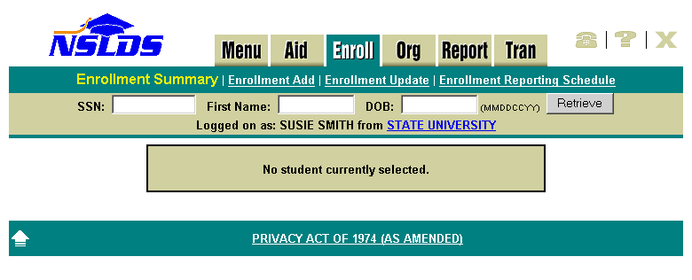
Menu Options:
Enrollment Summary
Enrollment Add
Enrollment Update
Enrollment Reporting Schedule
New Enroll Tab
Notes:
A new tab was added to the website for access to all enrollment activity in one place.

Slide 16
GA Preferences for Notification
Output file format:
  Current SSCR output format
  CAM format
Notification style:
  All data since last report (each record sent)
  Changes only (only records that are a change in Status Code, Effective Date, or Anticipated Completion Date)

Slide 17
New For GAs
Now available, a new option of viewing school reporting schedules.
Selection of Enrollment Reporting will show your agencies schedule and give you a line in which to select a school by code or name.
You will only be able to change your own schedule if you have that authority, but may view the schedule currently in place for a school.

Slide 18
Online Reporting Statistics
Since January 1, 2002, online updating has been very popular.
As of July 1:
Total online updates – 274,267
Total number of schools making online updates – 1,719
Average updates monthly - 45,711

Slide 19
School Portfolios in NSLDS
Of the almost 7,000 schools signed up for Enrollment Reporting:
Around 1,600 have 30 or less students
Around 2,500 have 100 or less students
Around 4,300 have 500 or less students
Notes:
With online reporting it is appropriate to encourage schools to immediately notify NSLDS of status changes rather than waiting for the next roster.

Slide 20
Electronic Cohort Default Rates
Replaces school paper process beginning with FY 2001 Draft Cohort Default Rates
Schools will receive CDR package via SAIG
Dates will be announced each cycle via IFAP
All domestic schools will be required to sign up

Slide 21
NSLDS Reengineering
Major Objectives
Improve financial integrity.
Simplify and unify the management of federal data about Title IV aid.
Reduce FSA costs associated with NSLDS and related operations.
Improve quality and usability of NSLDS information, benefiting the Department and other NSLDS users in the financial aid community .
Balance FSA’s data needs with burdens placed on financial aid community.
Improve usability of NSLDS data repository through new tools.

Slide 22
NSLDS Reengineering
NSLDS II – Internal Modernization
The primary focus of NSLDS II reengineering will be to support existing business requirements through a reengineered system, or other modernized systems, PLUS modernizing internal processing capabilities.
Establish a modernized technical platform that includes:
  Program-wide data warehousing capabilities.
  Powerful analytical tools.
  Near real-time access to FSA-maintained aid.
Refine existing data feeds and edits – with minimal disruption to the community – to provide for the continuous improvement of data.
With the above improvements, reduce NSLDS operational costs by 25 – 50%.
  Consider cost impact on interfacing systems – both internal and external.
EAI “Bus”
NSLDS II
GAs
FSA
Source
Systems
Servicers
Schools
Data Marts

