Slide 1
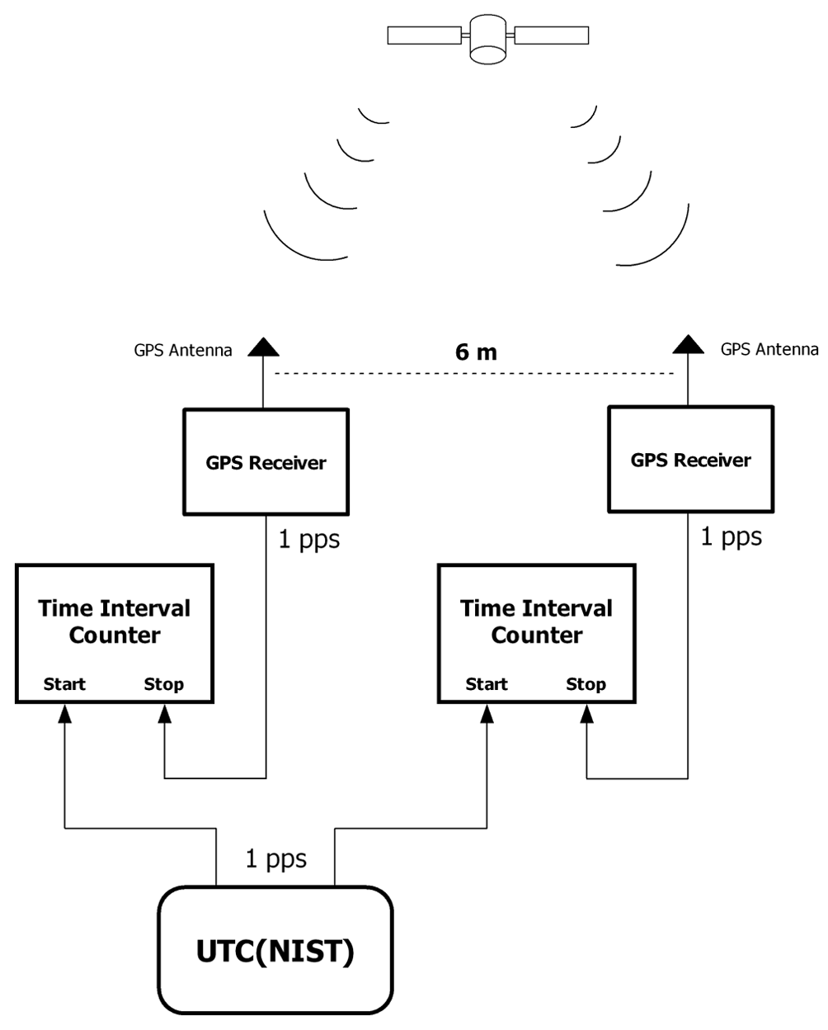
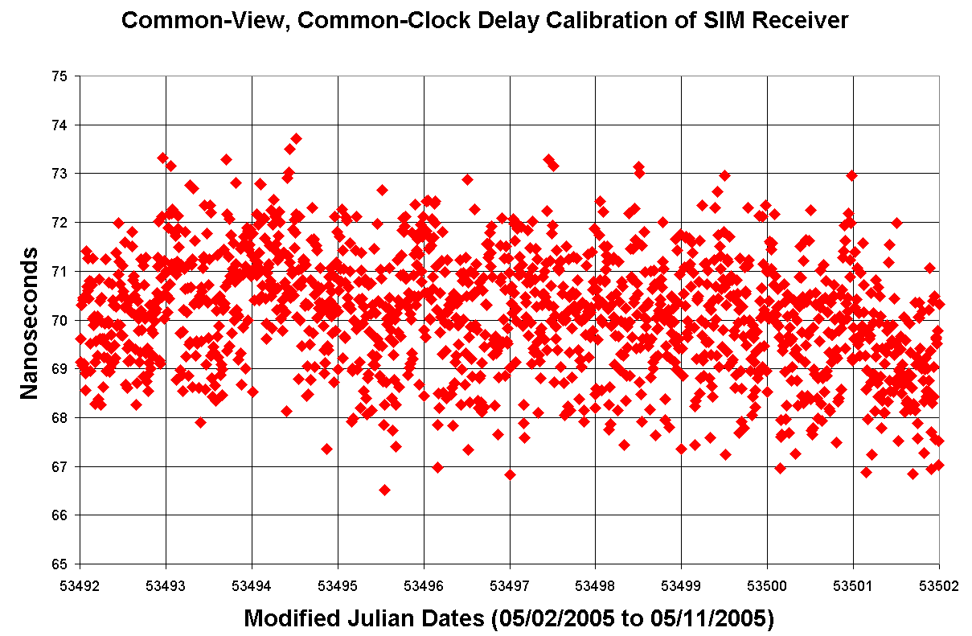
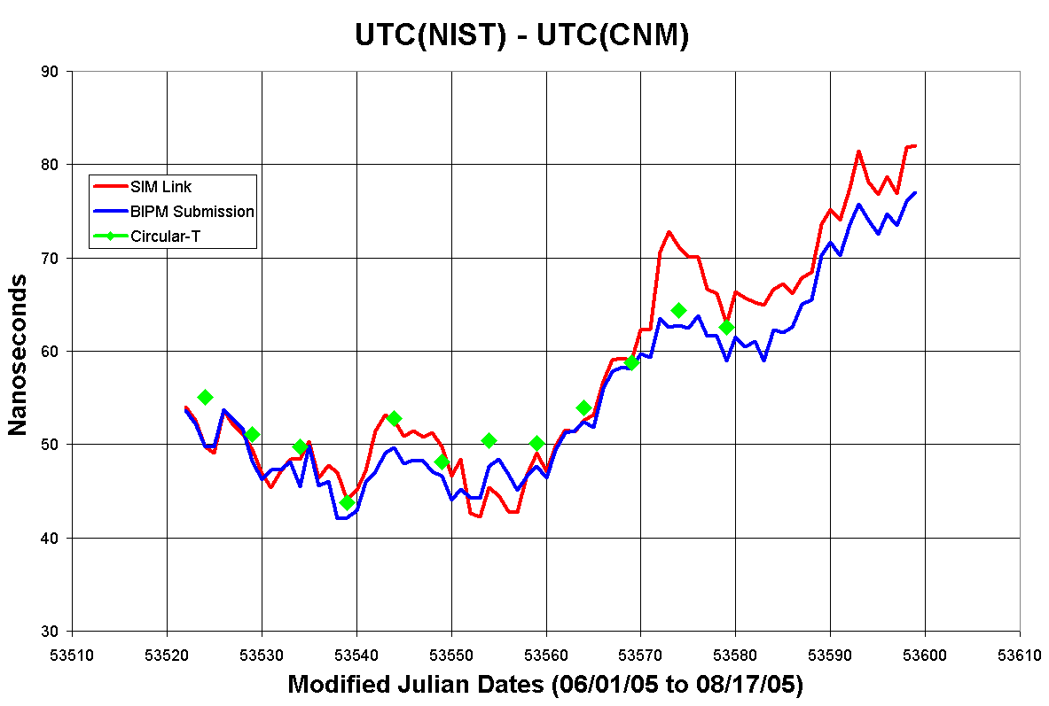
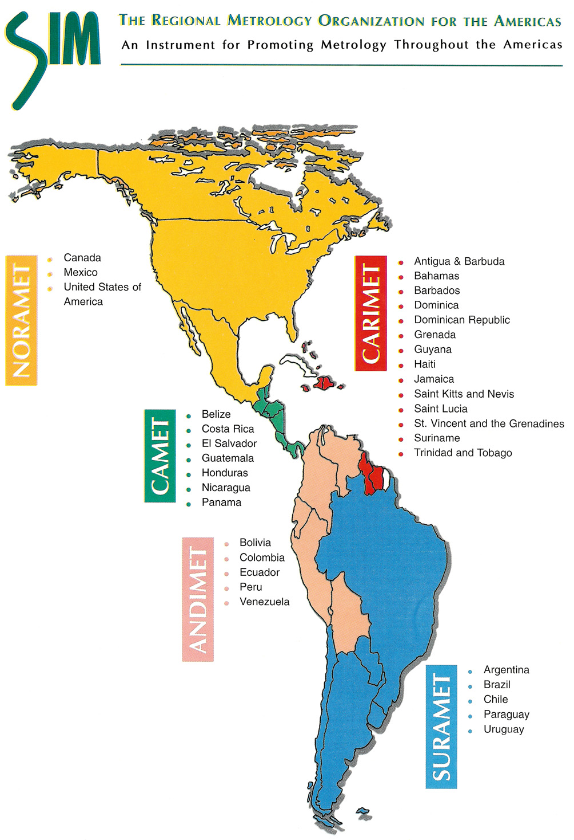
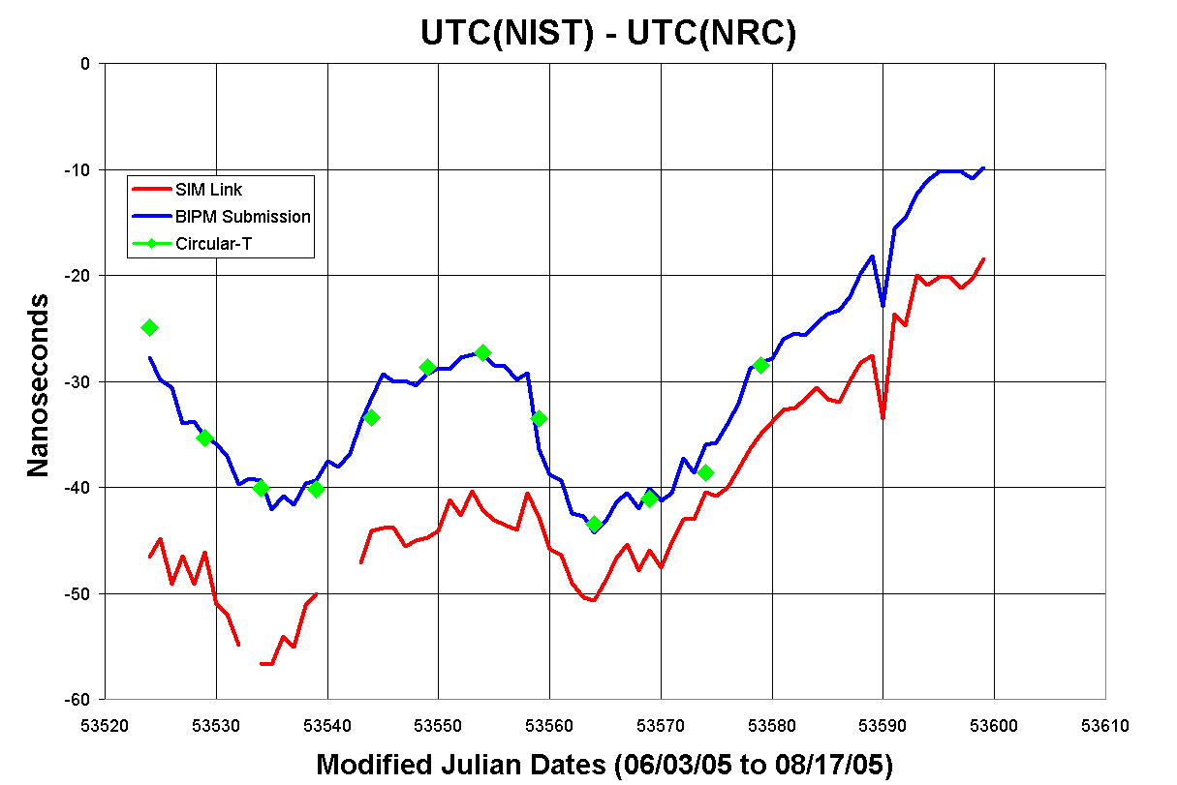
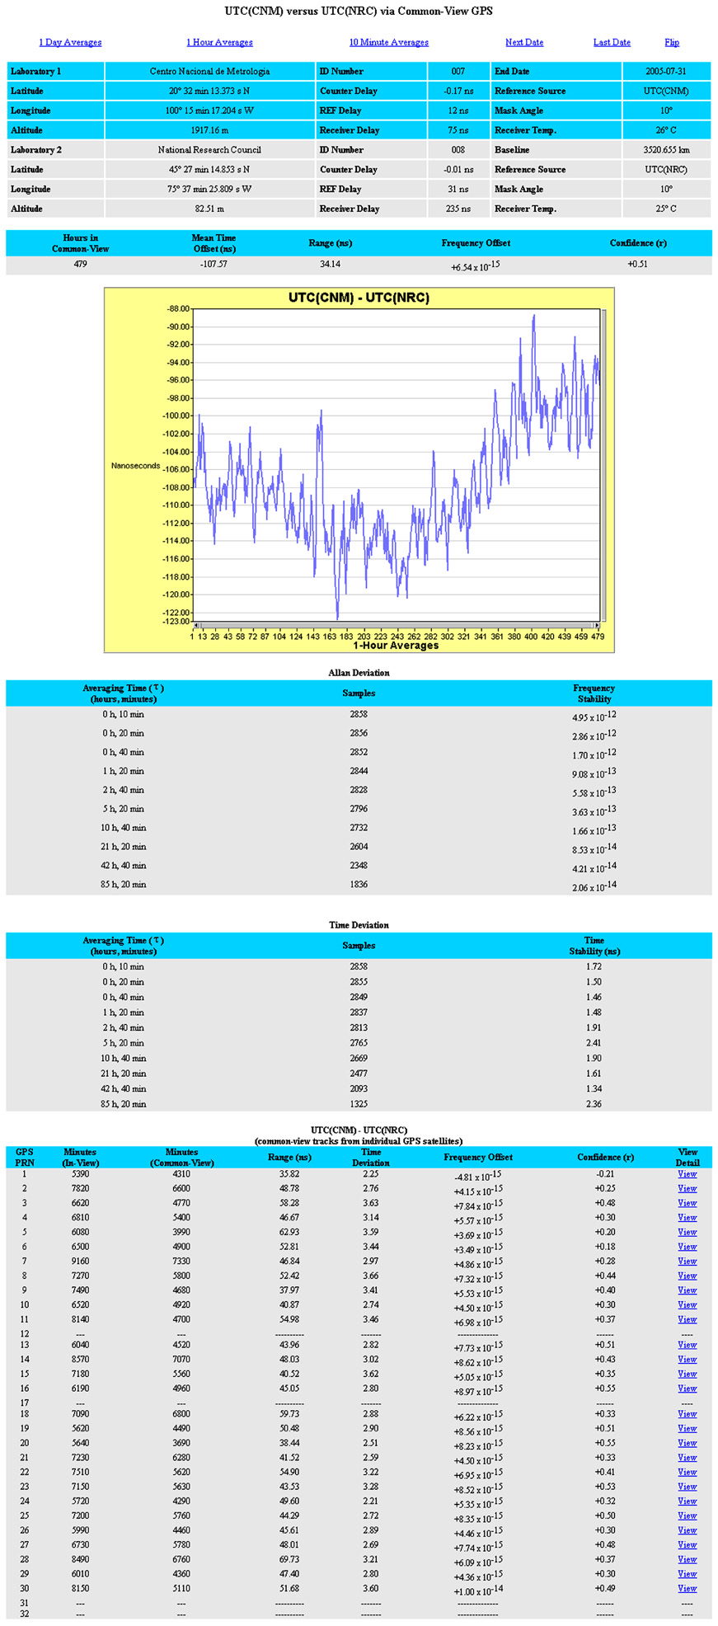
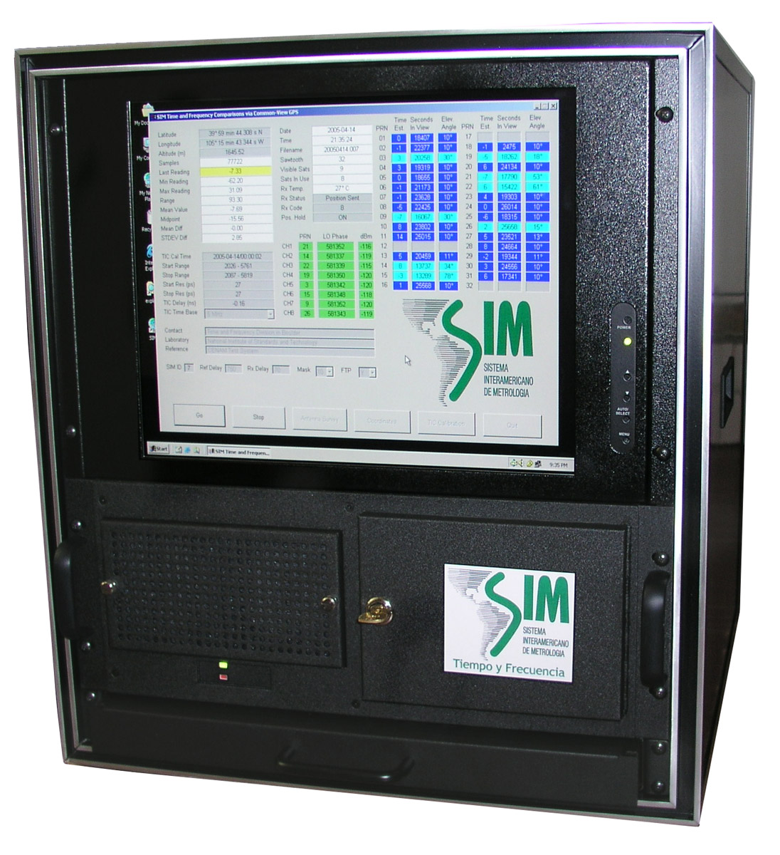
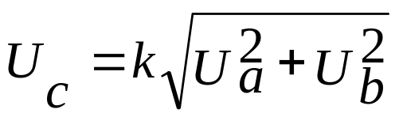
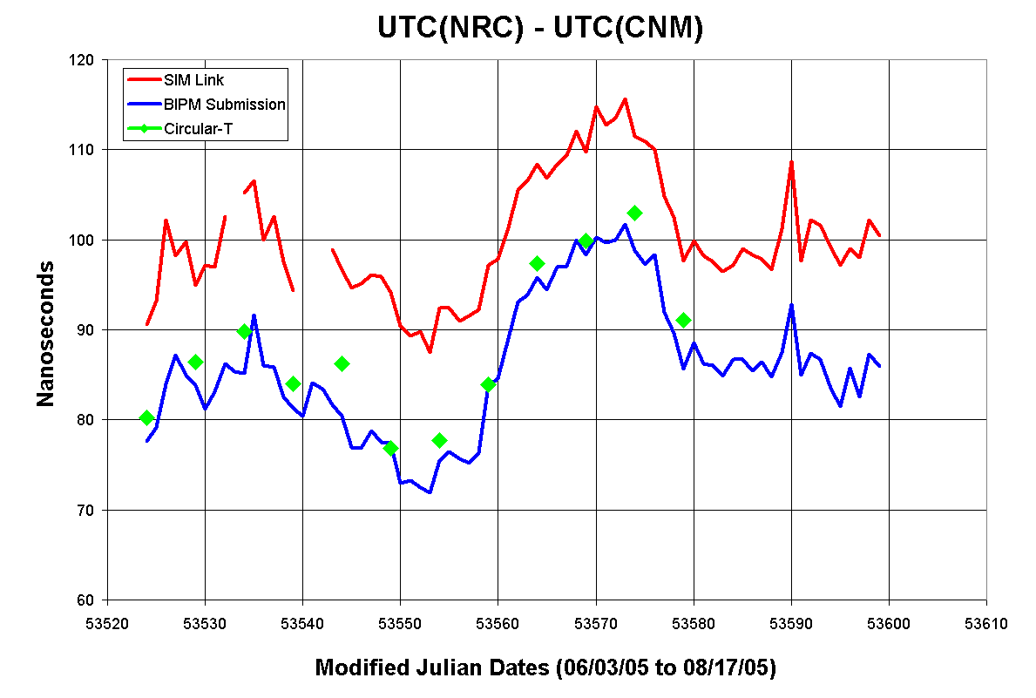
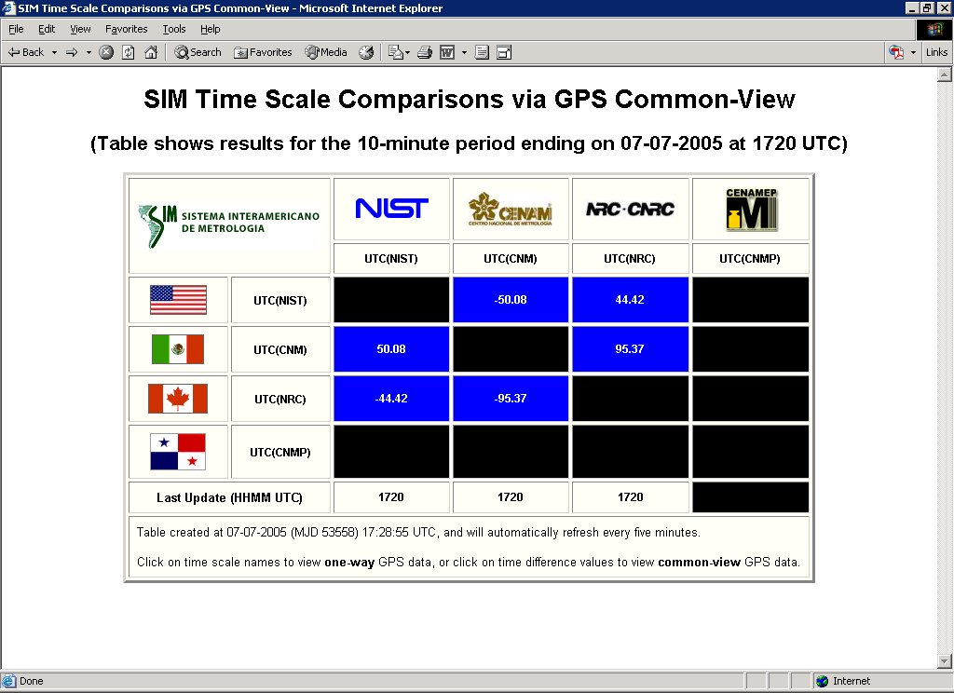
The Inter-American Metrology System (SIM) Common-View GPS Comparison Network
Michael A. Lombardi and Andrew N. Novick • National Institute of Standards and Technology (NIST) • Boulder, Colorado, United States • lombardi@nist.gov
Jose Mauricio Lopez • Centro Nacional de Metrología (CENAM) • Querétaro, Mexico • mauricio.lopez@cenam.mx
Jean-Simon Boulanger and Raymond Pelletier • National Research Council (NRC) • Ottawa, Canada • jean-simon.boulanger@nrc-cnrc.gc.ca
I. Introduction
III. System Calibration
V. Measurement Results
SIM is the Sistema Interamericano de Metrologia, or the Inter-American Metrology System. It consists of national metrology institutes (NMIs) located in 34 countries in North, Central, and South America. At present, thirteen SIM nations are members of the BIPM’s Metre Convention, and at least ten operate national laboratories that maintain time and frequency standards.
To advance the state of metrology throughout the SIM region, we have developed a common-view GPS comparison network that is capable of automating continuous, near real-time comparisons between the national time and frequency standards located at SIM NMIs. This paper describes the common-view network, and presents the results of comparisons between the national time scales located at the Centro Nacional de Metrologia (CENAM) in Queretaro, Mexico, the National Research Council (NRC) in Ottawa, and Canada, and the National Institute of Standards and Technology (NIST) in Boulder, Colorado, in the United States.
Systems are calibrated for 10 d at NIST using the same antenna and cable that will be shipped to the SIM laboratory.
Method of calibration is short-baseline common-view, using UTC(NIST) as a common-clock.
Baseline length is 6 meters, coordinates are surveyed to an estimated uncertainty of 20 cm.
The time stability, σ_{x}(τ), is typically near 0.2 ns at τ = 1 day.
Continuous measurements between CENAM, NRC, and NIST began in early June 2005.
Results below compare SIM links to links between common-view receivers that submit data to the BIPM.
Green diamonds show results from the BIPM Circular-T, calculated at 5 d intervals.
The Phase and stability of the SIM links agree well with corresponding BIPM links.
Time offset between SIM and BIPM links falls within the coverage area of estimated measurement uncertainties as discussed in Section VI.
SIM system collects about 10 400 min of data per day at each site with no dead time or gaps between measurements, as compared to 624 min collected by single-channel BIPM submission receivers.
SIM data and BIPM submission data apply modeled ionospheric corrections (MDIO), Circular-T data has the measured ionospheric (MSIO) corrections applied. As expected, BIPM submission data correlates very strongly to the Circular-T data.
SIM Baselines in the NORAMET Region
Results from NORAMET Baselines
Baseline | Length | Usable Data | Data Lost
Calibration | 6 m | 10 400 min | None
CNM/NIST | 2198.9 km | 8 100 min | 22 %
NRC/NIST | 2471.3 km | 8 200 min | 21 %
NRC/CNM | 3520.7 km | 7 600 min | 27 %
Baseline | Mean Offset Between Links | σ_{x}(τ) at 1 d |  | σ_{y}(τ) at 1 d
 |  | SIM | BIPM | SIM | BIPM
CNM/NIST | 2.3 ns | 1.2 ns | 1.2 ns | 2.4E-14 | 2.5E-14
NRC/NIST | 7.2 ns | 1.5 ns | 1.1 ns | 3.1E-14 | 2.2E-14
NRC/CNM | 13.0 ns | 2.1 ns | 1.9 ns | 4.3E-14 | 3.8E-14
SIM Nations Belonging to the
Metre Convention
Country | Member or Associate? | Maintains Time and Frequency Standards? | Contributes to UTC?
Argentina | Member | Yes | Yes
Brazil | Member | Yes | Yes
Canada | Member | Yes | Yes
Chile | Member | Yes | Yes
Costa Rica | Associate | Yes | No
Dominican Republic | Member | Unknown | No
Ecuador | Associate | Yes | No
Jamaica | Associate | Yes | No
Mexico | Member | Yes | Yes
Panama | Associate | Yes | Yes
United States | Member | Yes | Yes
Uruguay | Member | Unknown | No
Venezuela | Member | Unknown | No
VI. Uncertainty Analysis
Type A and B uncertainties have been evaluated as prescribed in the ISO GUM.
The time deviation, σ_{x}(τ), is used as the Type A uncertainty U_{a}.
Type B uncertainties are summarized in the table and combined using the square root of the sum of the squares method to produce U_{b}.
The combined expanded uncertainty U_{c} is estimated (where k is the coverage area) as
Type B Time Uncertainties
IV. Common-View Data Reduction
Component | Explanation | Estimated Uncertainty
Delay calibration errors | Short-baseline common-clock calibrations are not exactly repeatable and can introduce systematic errors due to seasonal delay variations and differences between the multipath environment at the calibration site and the measurement site. | 5 ns
Ionospheric Delay Errors | SIM common-view system does not apply MSIO corrections. | 3 ns
Antenna Coordinates Error | Assumes that antenna position (x, y, z) is known to within 1 m. | 3 ns
Time interval counter | The absolute accuracy of the SIM system counter is near 2 ns. | 2 ns
Environmental variations | Receiver delays can change due to temperature or voltage fluctuations from power supplies, antenna cable delays can change due to temperature. | 2 ns
Estimate of D_{REF} | This is generally done with time interval counter and is subject to errors near 2 ns. | 2 ns
Resolution Uncertainty | SIM software allows delay values to only be entered with 1 ns resolution. | 0.5 ns
Common-view data reduction is done “on-the-fly” in near real-time.
Requests for measurement data are processed instantly from any Java-enabled web browser.
The “pure” common-view method is now supported, but support for the “all-in-view” method can be easily added to the web software.
Web-based software produces:
  10 min, 1 hour, and 1 d averages for intervals as long as 200 days.
  Graphs of 1 hour or 1 day data.
  Fast calculations of Allan deviation and time deviation.
  Near real-time grid that shows results from the most recent 10 minute comparison.
For k = 2 coverage, U_{c} is nearly identical for all three baselines:
  15.0 ns for CNM/NIST comparison.
  15.1 ns for NRC/NIST comparison.
  15.4 ns for CNM/NRC comparison.
The differences between the SIM and BIPM submission links fall well within the coverage areas of these uncertainties.
II. Description of Measurement System
VII. Summary
8-channel GPS receiver with standard L1 carrier frequency antenna.
Time interval counter with 30 ps resolution that accepts a 5 or 10 MHz external time base.
Stores 10 min and 1 min averages from all satellites in view.
Does not follow any tracking schedule, but 1 min data can be converted to the BIPM format.
Uploads data via Internet FTP every 10 min to a web server.
Software records measurements and other system parameters including temperature.
The SIM common-view GPS comparison network began operation at three NORAMET NMIs in June 2005.
Measurement results agree well with BIPM submission links, but the SIM results have the distinct advantage of being available in near real-time.
Future work will focus on increasing the number of participating labs, reducing the measurement uncertainties, exploring the use of the “all-in-view” method, and perhaps the eventual creation of a UTC(SIM) time scale.

