Slide 1
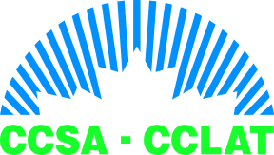

What the Data Tells Us About Youth Volatile Solvent Abuse (VSA) in Canada
Inhalant Abuse Among Children and Adolescents: Building and International Research Agenda
Colleen Anne Dell, Ph.D.
Canadian Centre on Substance Abuse & Carleton University, Department of Sociology and Anthropology
Ottawa, Ontario
November 7-9, 2005

Slide 2
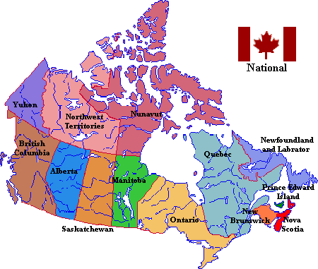
Where’s the “data”?
Canadian data on youth VSA are scarce

Slide 3
CCENDU Indicators
  Prevalence
  Treatment
  Law Enforcement
  Morbidity
  Mortality

Slide 4
PREVALENCE
2004 Canadian Addiction Survey [1]
  1.9% of males and 0.7% of females reported lifetime volatile solvent use (glue, gasoline, other solvents).
  67% reported to have first used solvents between 12 and 16 years of age. Thirteen percent tried solvents before the age of 12, and 19% tried them when they were 17 or older.
1998-99 National Longitudinal Survey of Children and Youth [2]
  Ten percent of 12 and 13 year olds reported that their friends had tried glue or solvents.

Slide 5
Provincial and Territorial School Surveys [3]
PROVINCE/ TERRITORY | YEAR DATA COLLECTED | GRADES SURVEYED | PAST YEAR USE
BC | 2003 | 7-12 | 4.0%
Alberta | 2002 | 7-12 | 5.6%
Manitoba | 2004 | 7-12 | 2.4%
Ontario | 2003 | 7-12 | 7.0%
Quebec | 2002 | 7-12 | 2.2%
Nova Scotia | 2002 | 7, 9, 10, 12 | 4.9%
New Brunswick | 2002 | 7, 9, 10, 12 | 5.3%
PEI | 2002 | 7, 9, 10, 12 | 5.8%
Newfoundland | 2003 | 7, 9, 10, 12 | 5.6%
Yukon | 2001 | 8-12 | 3.0%

Slide 6
Provincial and Territorial School Surveys: General Observations
Not a large difference in rates of VSA between males and females.
VSA declines with grade among secondary school students.
Majority of youth are experimental and not habitual abusers.
Variation across Canada in trends by year.

Slide 7
Studies of Youth Experiencing Poorer Life Conditions
Documented among street youth, inner city youth, and some First Nations and Inuit youth living in select rural and remote areas of the country.
  2004 study of street youth in Toronto found that 10% had inhaled solvents within the past month. [4]
  2003 report from Pauingassi First Nation in Manitoba revealed that half of the children on reserve who were under 18 years abused solvents. [5]

Slide 8
1997 study of First Nations youth living on reserve in Nova Scotia and Ontario found more than half had tried drugs at least once, and these drugs were usually marijuana or inhalants. [6]
1993 survey of all reserves in Canada reported that more than half of all solvent abusing youth respondents began to abuse solvents at 11 years or younger. 43.3% reported being experimental users, 37.5% social users, 19.2% chronic users. [7]
1998 General Review Report of the National Native Alcohol and Drug Abuse Program concluded solvent abuse is an important issue that must be addressed at the Aboriginal community level. [8]

Slide 9
TREATMENT
1999/2000 → 0.5% of males and 0.5% of females (youth and adults) who presented for treatment at Ontario’s 211 provincially funded addictions programs included glue and other inhalant abuse as a problem substance. Highest number of clients were under 16 years of age (1.2%), followed by 16-17 (0.8%) and 18-24 (0.7%). [9]
2002/03 → less than 1% of adolescents admitted to AADAC treatment centres in Calgary, AB presented for solvents. [10] This rate was higher among youth in Edmonton, AB (1.7%). [11]
2003/04 → over 5% of AFM youth clients reported using solvents at some time. This has increased from previous years.

Slide 10


…prevention…

Slide 11
LAW ENFORCEMENT
Possession and use of volatile solvents is not prohibited under Canadian federal law, and provincial and municipal laws are rare.
  The Alberta Public Health Act
  The Saskatchewan Safer Communities and Neighborhoods Act
  The Manitoba Minors Intoxicating Substance Control Act
2005 meeting of Federal, Provincial and Territorial (FPT) Ministers addressed issues regarding the protection of vulnerable persons.
Informal responses

Slide 12
MORBIDITY & MORTALITY
2003/04 → in the Qu’Appelle Health Region of Regina 83 solvent related diagnoses were recorded. This is an increase from 77 in 2002/03.
Since 1990 → between 2 and 14 solvent-related deaths annually.
Age range → 1999 (26-68), 2000 (26-61), 2001 (18-77).

Slide 13
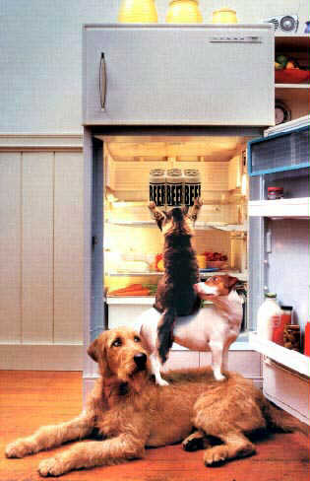
PARTNERING
Thank you!

Slide 14
Sources
[1] Adlaf, E. Begin, P. & Sawka, E. (2005). Canadian Addiction Survey (CAS): A National Survey of Canadians’ Use of Alcohol and Other Drugs. Prevalence of Use and Related Harms. Detailed Report. Ottawa: Canadian Centre on Substance Abuse – specialized data run.
[2] Dell, C. & Garabedian, K. (2003). CCENDU 2002 National Report. Drug Trends and the CCENDU Network. Ottawa: Canadian Centre on Substance Abuse.
[3] The McCreary Centre Society (2004). Healthy Youth Development. Highlights from the 2003 Adolescent Health Survey III. Vancouver: The McCreary Centre Society; Alberta Alcohol and Drug Abuse Commission (2003). The Alberta Youth Experience Survey 2002. The Use and Abuse of Illicit Drugs Among Alberta Youth. Edmonton: AADAC; Patton, D., MacKay, T. & Broszeit, B. (2005). Alcohol and Other Drug Use by Manitoba Students. Winnipeg: AFM; Adlaf, E. & Paglia, A. (2003). Drug Use Among Ontario Students 1977-2003. Detailed OSDUS Findings. Toronto: Centre for Addiction and Mental Health;

Slide 15
Perron, B. & Loiselle, J. (2003). Enquete quebecoise sur le tabagisme chez lese eleves du secondaire (2002). Ou en sont les juenes face au tabac, a l’alcool, aux drogues et au jeu? Montreal: Institute de la Statistique du Quebec; Van Til, L. & Poulin, C. (2002). P.E.I. Student Drug Use Survey 2002. Highlights Report. P.E.I.: Department of Health and Social Services; Poulin, C. (2002). Nova Scotia Student Drug Use Survey 2002. Highlights Report. Nova Scotia: Department of Health, Addictions Services; Liu, J., Jones, B., Grobe, C., Balrom, C. & Poulin, C. (2002). New Brunswick Student Drug Use Survey 2002. Highlights Report. New Brunswick: Department of Health and Wellness; Barcelo, A., Jones, B. & Grobe, C. (1998). Provincial Student Drug Use Survey. Highlights 1998. New Brunswick: New Brunswick Department of Health and Community Services; Yukon Women’s Directorate (2001). A Cappella North 2 Survey, 2001 Bulletin 5 – Alcohol and Drugs. Whitehorse: Yukon Women’s Directorate; Poulin, C., Martin, D. & Murray, M. (2005). Newfoundland and Labrador Student Drug Use 2003. (Island Portion Only). Summary Report. Nova Scotia: Dalhousie University.

Slide 16
[4] Goodman, D. (2004). “Youthlink Inner City. Hepatitis C Support program”. Final report. Toronto: 2004 Toronto CAS , in Research Group on Drug Use (2004). Drug Use in Toronto. Ontario: Toronto Public Health.
[5] 2003 Pauingassi First Nation report on solvent abuse. (Manitoba Office of the Children’s Advocate). Sourced in Winnipeg Free Press, Wednesday, August 24.., 2005. “Manitoba’s sniff crisis has given birth to a tragic trend…Babies that smell like gas”. D. O’Brien. pp. A1-A2.
[6] First Nations and Inuit Regional Health Survey (1997). The Health of Youth. Ontario: National Aboriginal Health Organization.
[7] Kaweionnehta Human Resource Group (1993). First Nations and Inuit Community Youth Solvent Abuse Survey and Study. Ottawa: National Native Alcohol and Drug Abuse Program/Addictions and Community-Funded Programs.
[8] National Native Alcohol and Drug Abuse Program (200?). National Native Alcohol and Drug Abuse Program. General Review. 1988. Final Report. Ottawa: First Nations and Inuit Health Branch.

Slide 17
[9] Rush, B. (2002). Client Characteristics & Patterns of Service Utilization within Ontario’s Specialized Addiction Treatment Agencies: A Provincial Report from DATIS. Ontario: Centre for Addiction and Mental Health.
[10] James, D. (2003). Canadian Community Epidemiology Network on Drug Use: Calgary Summary. Alberta: Alberta Alcohol and Drug Abuse Commission.
[11] Wild, C., Curtis, M. & Pazderka-Robinson, H. (2003). Drug Use in Edmonton: 2001-2002. A CCENDU Report. Alberta: University of Alberta, Addiction and Mental Health Research Laboratory.
[12] Stevens, K. (2005). Winnipeg 2004 CCENDU Report. Manitoba: Addictions Foundation of Manitoba.
[13] Addictions Services, Qu’Appelle Health Region (2005). Regina 2003 Report. Regina: Addictions Services.

