Slide 1

Communicating with Parents/Guardians
During a School Emergency
Virginia Beach City Public Schools
Virginia Beach, Virginia
Presented by:
Richard Ponti, Director, Safe Schools and Risk Management
Nancy Soscia, Public Relations Coordinator, Media and Communications Development

Slide 2
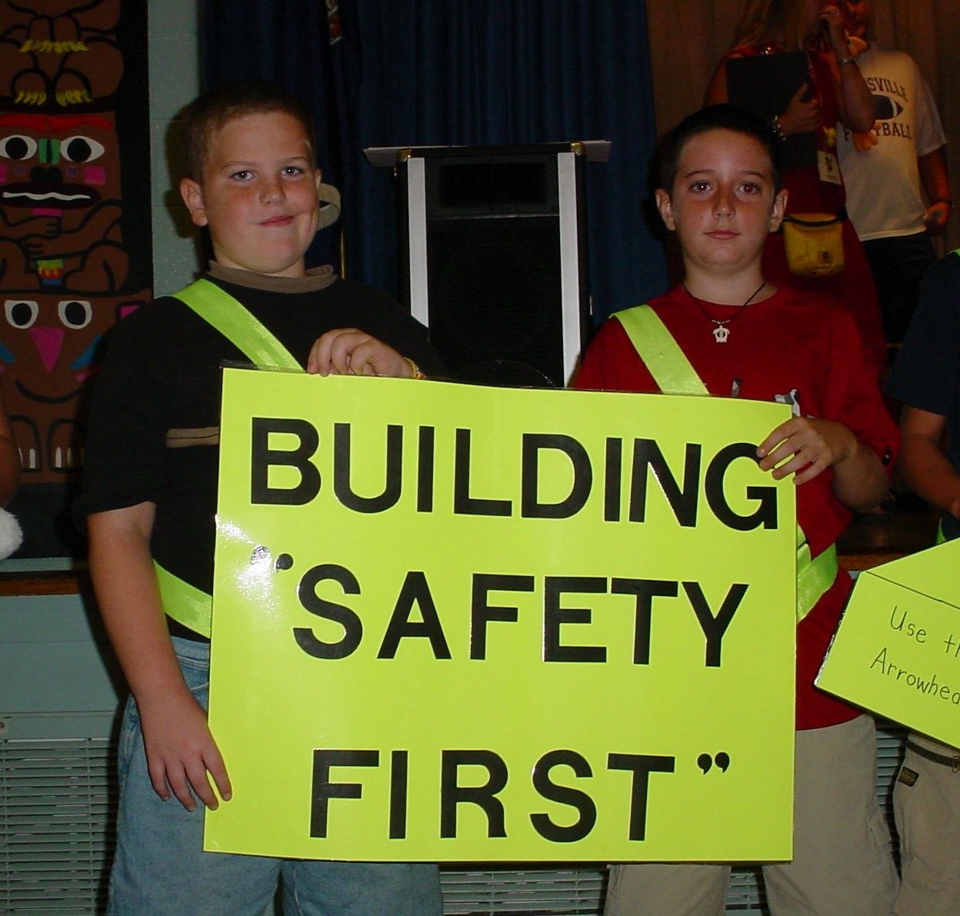
Background Information
Virginia Beach City Public Schools
2ND largest school
division in Virginia
87 schools/centers
75,000 students
11,000 employees
68,000 students
transported daily
600 school buses

Slide 3
__ __ I T Happens
March 25, 2005 Bank Executive Shot to Death. Three Schools in Lockdown as Police Search for Suspect.
May 2, 2005 Shots Near Beach Library Prompts Lockdown in Five Schools. Two Suspects Taken into Custody at Virginia Beach Alternative School.
October 20, 2005 Three School Buses Struck by Bullets Prompts Lockdown of Middle School.
October 24, 2005 Head on Collision With School Bus Leaves One Dead and One Critically Injured.
October 31, 2005 Seven Injured in Virginia Beach School Bus Accident- Thirteen Students Transported to Hospital.
November 8, 2005 Child Dies After Being Struck By School Bus.
December 1, 2005 Jogger Dies After Being Struck by School Bus.

Slide 4
In order to communicate effectively
during a school emergency you must
have a plan for the three phases.
Before an emergency
During an emergency
After the emergency

Slide 5
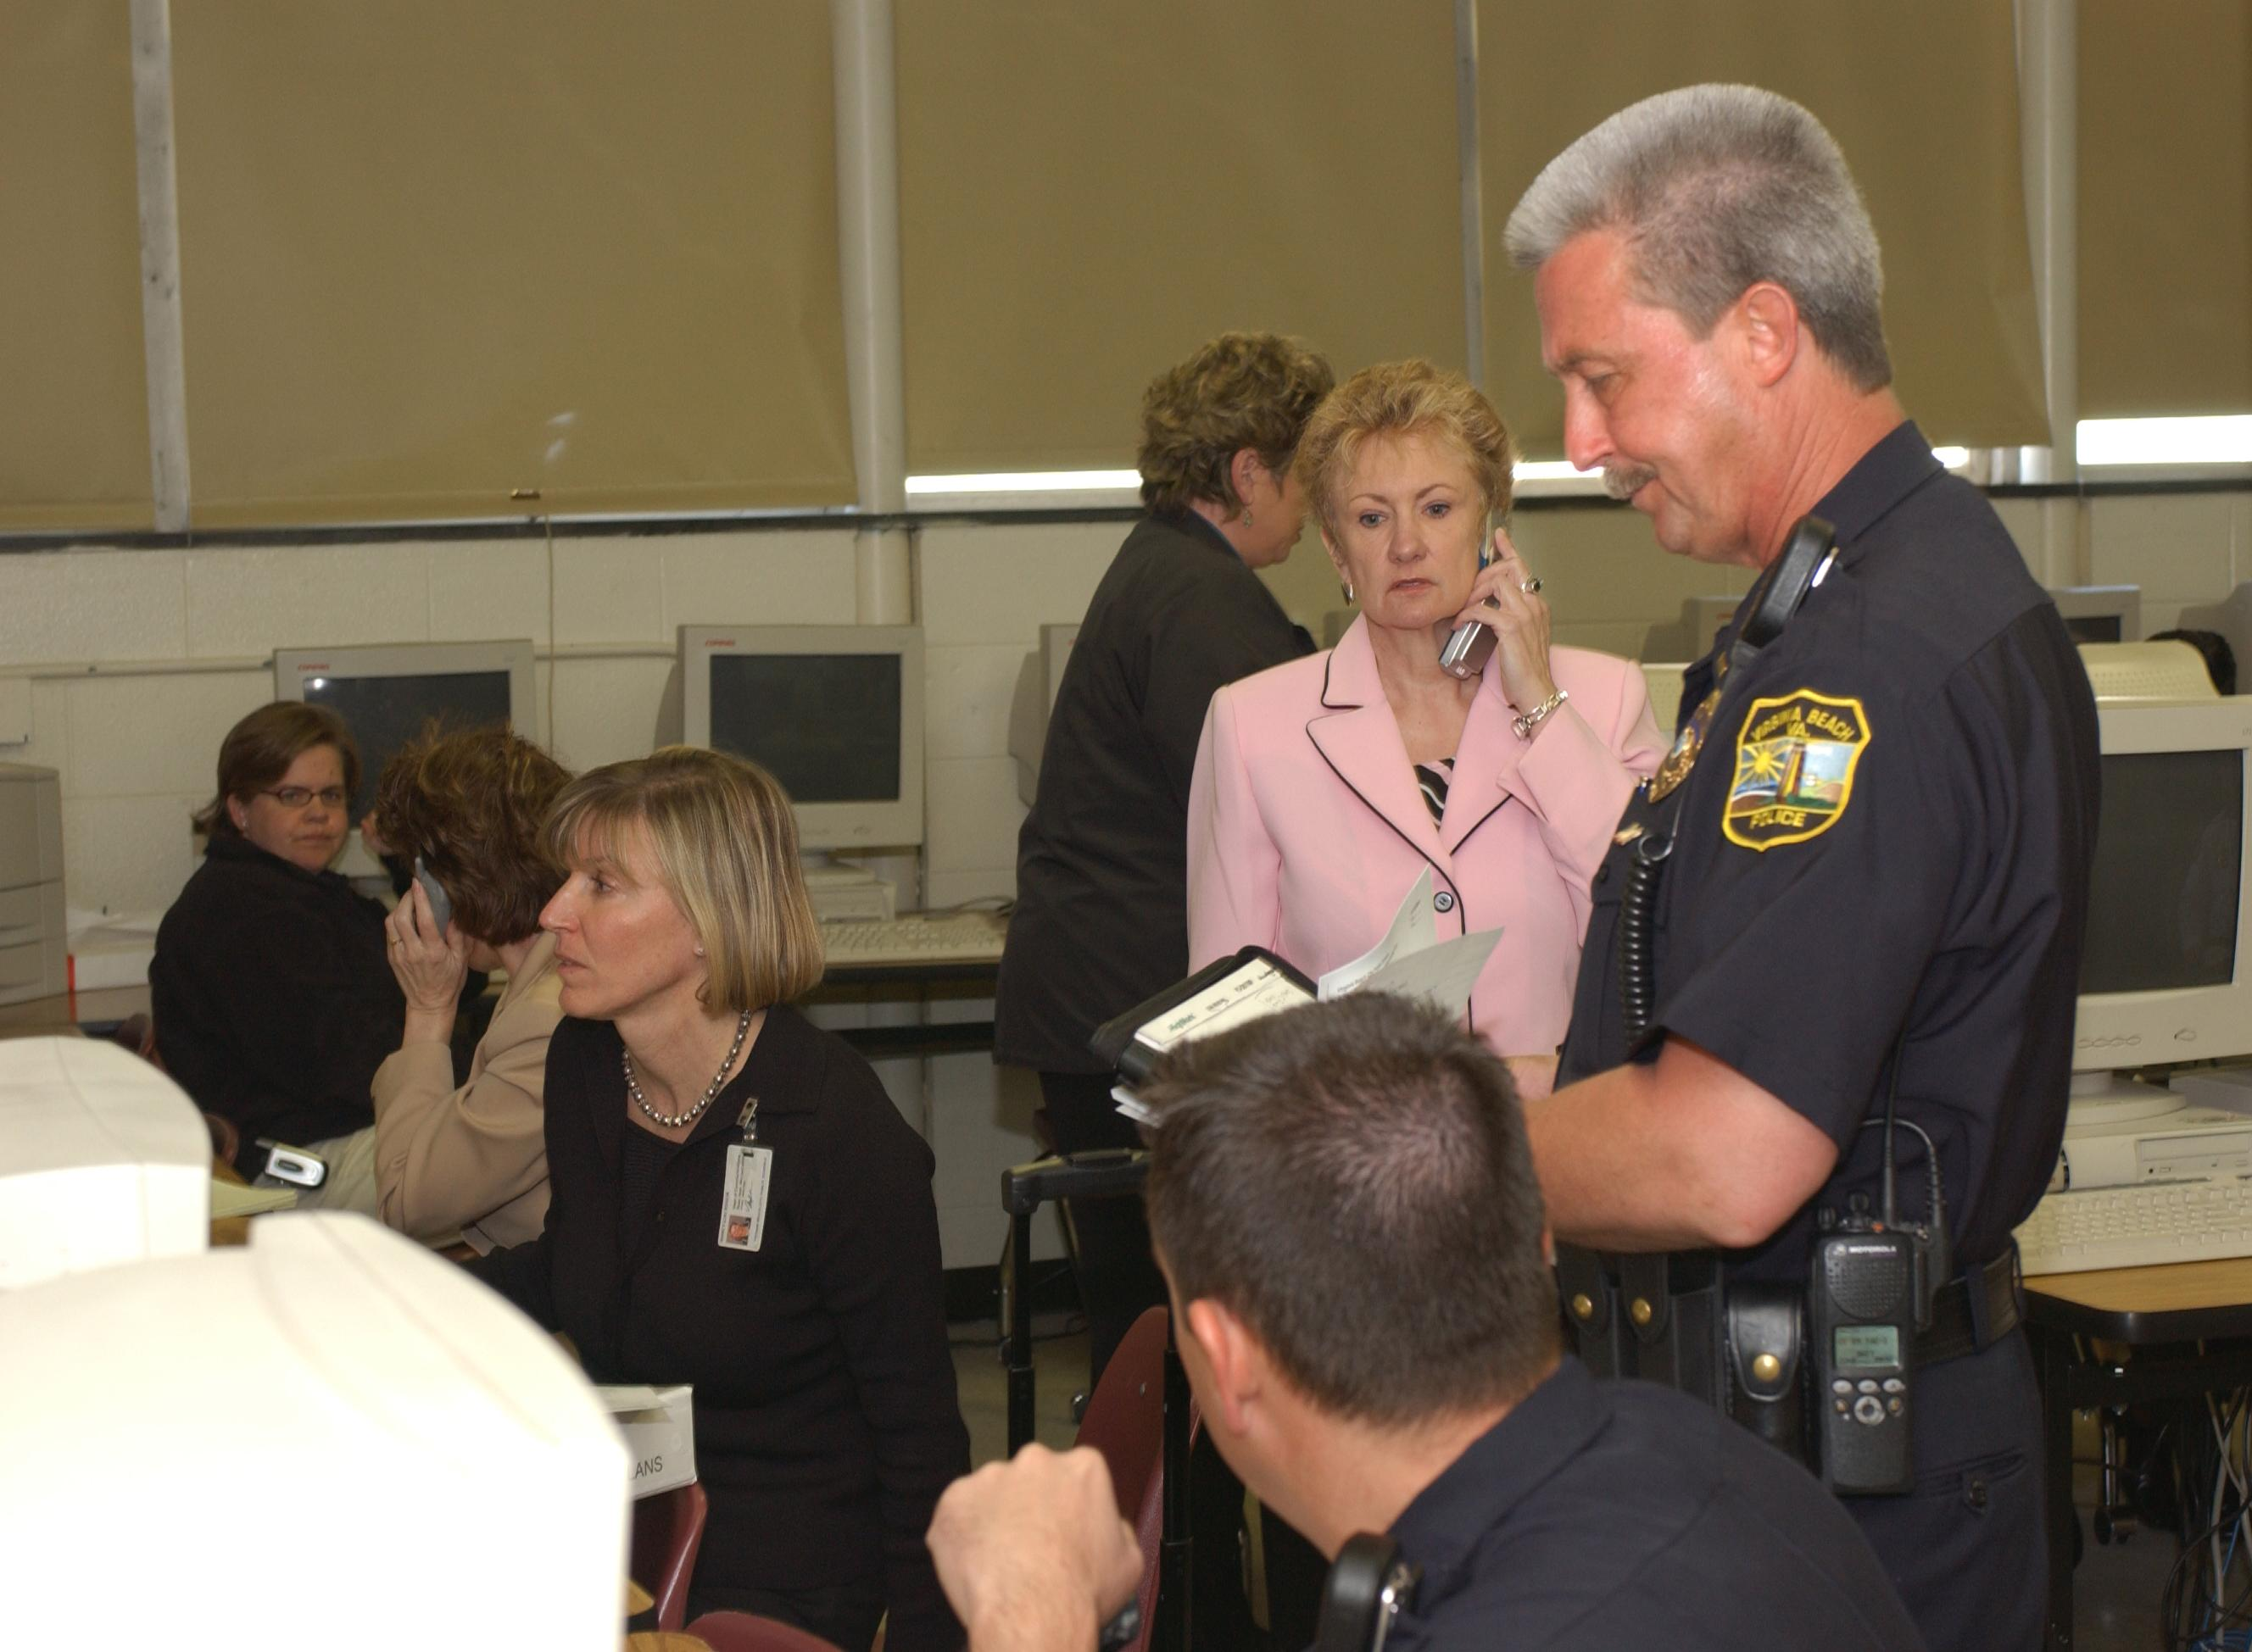
The Best Crisis Communications Plan Starts with Being Prepared.

Slide 6
Crisis Communications
Joint Crisis Communications Plan
In a large-scale crisis, the message communicated to parents requires inter-agency coordination. Due to the complexity of the event, multiple agencies will be involved in crafting the message.
• Police
• Fire
• Emergency Medical Services
        • City Communications
        • School Communications

Slide 7
Joint City/Schools
Crisis Communications Plan
Reviewed and updated during school year.
Tested through an interagency tabletop disaster (Fall 2002).
Field tested on April 11, 2005.

Slide 8
Joint Information Center (JIC)
During a School Emergency/Crisis
The lead PIO will be from the lead agency, responding to the emergency, or a designee of that agency's choosing.
The JIC, under the supervision of incident command, will handle all release of information to the media.
JIC responsibilities will include: staffing of center, identifying a media holding center, identifying appropriate spokespersons, setting up media briefing schedules, writing/approving news releases, and approving message points, release of video footage, and other related material.

Slide 9
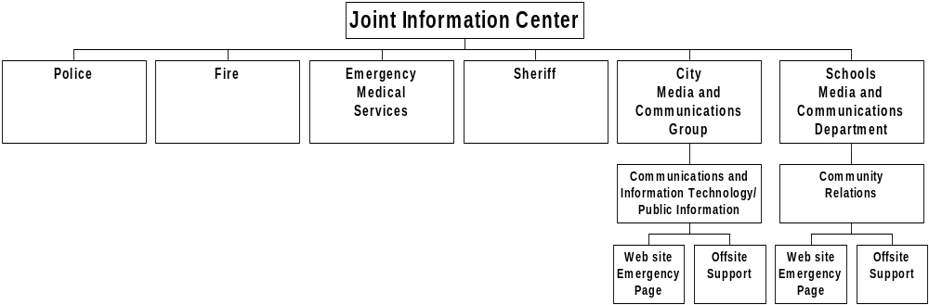
Virginia Beach City Public Schools
EMERGENCY COMMUNICATIONS COMMAND STRUCTURE

Slide 10
One Critical Target Audience: Parents
Why did we target parents/guardians?
Application process for the Emergency Response and Crisis Management grant revealed a gap and inconsistencies in the notification process for parents/guardians during a large-scale school emergency.
In other words, we did not have a division-wide plan!

Slide 11
What is our message for parents?
1. To assure parents that the school division is prepared to
respond to a school emergency.
2. To advise parents how they can be prepared for a school
emergency.
3. To inform parents how they can get important information
during a school emergency.
4. To educate parents about key terms that will be used during
a school emergency (e.g., internal/external lockdowns,
shelter-in-place).
5. To provide parents with guidelines on what will be needed to
pick up their child in the school or at an alternate location
should the school be evacuated.

Slide 12
Parent School Emergency Guide
As a parent how can you
be prepared for a
school emergency?

Slide 13
Parent School Emergency Guide
Focus is on Educating Parents
Internal Lockdown: All school interior doors are locked and students are confined to their classrooms and no entry or exit of the school is allowed. This takes place if there is a threat or possible threat inside the school.
External lockdown: All school exterior doors are locked. This takes place if the threat is outside of the school.
Shelter-in-Place: Selecting small, interior rooms in the school, with no or few windows, and taking refuge there until it is safe to release students.
Reunification of parents/students: Each school has a procedure for helping parents locate their child. Parents will be directed to a specific location where they will be required to show proper identification.

Slide 14
How did we distribute the brochure?
• At the start of the 2005-2006 school year, each school received one brochure per student. 83,100 brochures were printed along with 10,000 emergency wallet size cards.

Slide 15
How did we market the brochure?
• Parent Newsletter- Apple A Day
• Employee Newsletter - Kaleidoscope
• Municipal cable television station (VBTV)
• Message on Hold (MOH)
• Training (School Staff)
• School division Web site www.vbschools.com
• Electronic subscription service via e-mail
(vbschools x-tra)
• Online Survey

Slide 16


Slide 17


Slide 18
Online Parent Safe Schools Survey
October 24 - November 23, 2005
Three Questions
1. As a parent, are you aware that should there be an emergency in your child's school that you would call 263.1000 to obtain important/updated information?
Yes 18.87% No 81.13%
2. Do you believe your child's school is prepared to respond appropriately
should there be an emergency?
Yes 73.58% No 26.42%
3. Are you a subscriber to vbschools-xtra's School Closings and
Cancellations list?
Yes 64.15% No 35.85%

Slide 19
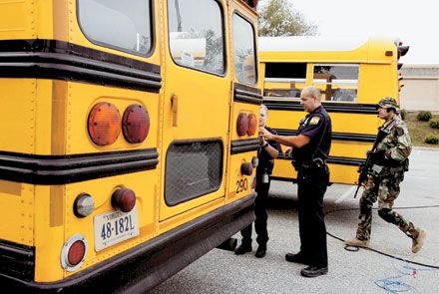
Real Life School Emergency
October 20, 2005
Lynnhaven Middle School - 1400 Students

Slide 20
What happened and how we responded.
• Two bus drivers during their elementary school runs reported that their buses had been hit by an object at 2:50 p.m. Middle school dismissal time is 3:40 p.m.
• A third bus transporting 2 high school students from school reported having a window shot out.
• Police immediately respond and placed the school on an external lockdown.
• At the same time, the police department receives calls about numerous gun shots that were heard in a
neighborhood near the middle school.
• Swat Team and K-9 Unit responds.

Slide 21
What happened and how we responded.
• Emergency Hotline (off-site) activated at 4:00 p.m.
• Police determine school should remain in an external lockdown until wooded area west of the school grounds is searched.
• Department of Media and Communications releases message to television stations that building is in a lockdown and states that the buses will not be transporting students home. However, students will be
released to their parents.
• Television stations report a "shooter" and encourage parents to pick up students from school.

Slide 22
What happened and how we responded.
• Approximately 200 parents report to school to pick up students.
• Emergency hot line handled approximately 400 incoming phone calls from 4:00 - 7:00 p.m.
• At 5:45 p.m. police advise releasing one bus at a time with a police escort for each bus.
• 6:30 p.m. last school bus is released.
• Last students leave the school at 7:15 p.m.

Slide 23
Communication After an Emergency
Critical information must be delivered to parents.
• Determine how best to communicate: letter, Web site, meeting
• Issue facts regarding incident, to include:
• Correct any inaccurate information released by the media
• Share actions taken by school administration
• Provide additional safety precautions in place
• Stress the importance of student safety
• Ensure that staff members receive the same accurate information that will be provided to parents.
• Communicate to parents signs of post-traumatic stress, services and resources that schools can provide for students and parents, and other resources within the community.

Slide 24
Lessons Learned
As incident unfolds, commander (Police Sergeant-Police Lieutenant-SWAT Lieutenant) can change making it difficult to get a timely message to parents.
TV reporters can omit important parts of message.
TV reporters can create unnecessary panic and hysteria.
Schools need a prearranged staging area for parents and have signage directing parents to area.
Parents were patient, and appreciative of the efforts of school administration and police.
Parents used the hotline (263-1000).
The emergency hotline relieved pressure for school staff.

Slide 25
Lessons Learned
• Police assistance is needed to keep media away from school grounds during the incident and upon return to school.
• Incident at one school can impact multiple schools.
• Should have activated the school's answering service with a message directing them to the hotline and provided general information about the incident.
• Should have used our school division's Web site to post the same information we were releasing to the media. This would have reduced confusion on the particulars of the incident.

Slide 26


Slide 27
Virginia Beach City Public Schools
Committed to providing a safe
environment for students, staff, and
visitors.
Questions?

Slide 28
Virginia Beach City Public Schools
www.vbschools.com
Richard Ponti richardm.ponti@vbschools.com
Nancy Soscia nancyl.soscia@vbschools.com

