Slide 1

STIP Meeting
Berkeley, April 20-21, 2005
The Four “Ps”
of Information Management
at Lawrence Livermore National Laboratory
This work was performed under the auspices of the U.S. Department of Energy
by University of California, Lawrence Livermore National Laboratory under Contract W-7405-Eng-48.
UCRL-PRES-211526

Slide 2
The Four Ps of Information Management
Process
Protect
Publish/Disseminate
Points of Contact (POCs)

Slide 3

Process – A new system was upgraded after 20 years
LLNL deploys electronic review and release
system in October 2003
Web-based system is accessed through an employee’s desktop computer 24/7
Documents are routed as a PDF
for appropriate approvals
The review process was streamlined from 10 days to three days
Authors

Slide 4
Process – A new system was upgraded after 20 years continued
IM Team reduced from 12 to 3 persons
Cost per review was reduced from $300 to $76
New graded approach allows flexibility to the directorates
Tracking numbers are assigned to documents and followed with a UCRL number for approved release

Slide 5
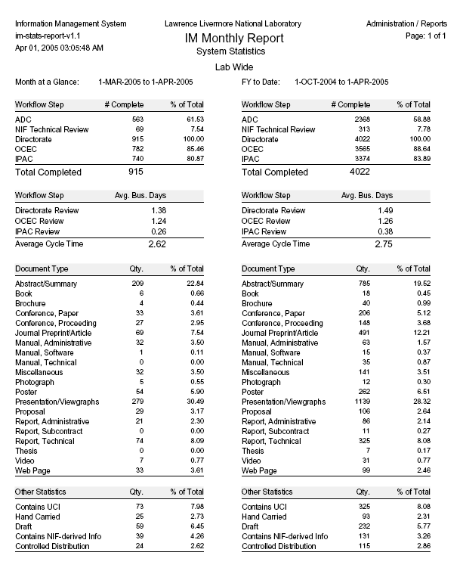
Process – Awareness and ease of use reflect increasing statistics

Slide 6
Protect – System controls and training protect sensitive information
Thirteen directorates select key personnel to be well trained in the subject being reviewed and released
System work flow is driven by audience, document type, STI or administrative, and/or Unclassified Controlled Information (UCI)
UCI awareness is important and there are many resources available to guide authors

Slide 7
Publish and Disseminate – LLNL has made improvements in this area
IM portal contains helpful tools for authors to create their own document templates for publications
Journal preprints are now being released in new system
Harvesting project streamlines OSTI announcements
Increased reviews Lab wide = increase release of STI documents

Slide 8
Publish and Disseminate – LLNL has made improvements in this area continued
Continue awareness of OSTI and DOE Order 241.1 through quarterly meetings with directorate representatives
Provide OSTI links and search tools for LLNL authored research
LLNL Library promotes OSTI link on their Web site

Slide 9
Points of Contact (POCs) - Communicate and disseminate information
Eighteen individuals have been selected to serve as directorate POCs
POCs meet quarterly to discuss the IM process and review and release issues
Monthly statistics provided to each directorate and management
Self-assessment program implemented to better understand our systemic problems

Slide 10

How do you make STI more visible within the Lab?
Increased Training = Increased Awareness
Increased Awareness = Increased Reviews
Increased Reviews = Increased Releases/Publications
Increased Releases = Increased STI Research Available

Slide 11

Build a system and they will come!

