Slide 1
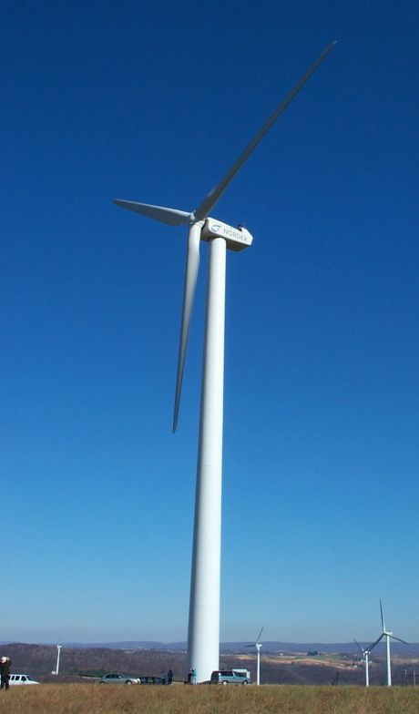
Montgomery
County, MD
Regional Wind Power Purchase
Ann Elsen
Energy Planner
Notes:
Contact Information:
Ann Elsen
Energy Planner
Montgomery County Department of Environmental Protection
255 Rockville Pike, Suite 120
Rockville, MD 20850
240.777.7754
Ann.Elsen@montgomerycountymd.gov

Slide 2

. It’s not easy being green .
Notes:
State and local governments are a key market for renewable energy.
Renewable Energy has never before been approved as a pollution control measure under a SIP.
We needed:
New EPA Guidance
Integration with State NOx allowance allocations

Slide 3
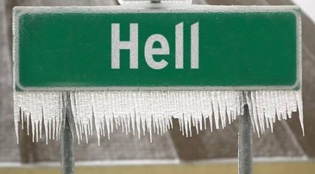
We’ll pay more for power when…
Notes:
Montgomery County is a member of the International Council for Local Environmental Initiatives’ Cities for Climate Protection (CCP) campaign. As a member, we have made a commitment to reduce our local greenhouse gas emissions. A large wind energy purchase represents a significant step towards meeting our goal under the CCP program.
Montgomery County is also a member of EPA’s Green Power Partnership.
Recently, our County Council and County Executive passed a joint resolution that commits the County’s electricity buying group to purchase a minimum of 5% of its electricity supply from new zero-emissions renewable energy sources.
Even so, purchasing “green” power at a price premium is a difficult undertaking during a particularly tight budget year.

Slide 4

State Implementation Plans
State Environmental Department
SIP Requirements
Notes:
Renewable energy becomes cost-effective when considered as an air quality improvement measure. Incorporating a renewable energy purchase in a SIP provides:
Compliance with Clean Air Act
Reduce ground-level ozone by reducing precursors: NOx and VOC
Safeguard of federal transportation dollars

Slide 5

So, this improves our air quality?
Notes:
Quantifying local air quality improvements from renewable energy is a challenge. However, many of the perceived complexities of the electricity grid have been exaggerated to mythic proportions. Publicly available information provides most or all of the data needed to conduct a detailed analysis of power plant dispatch and emissions offsets produced by renewable generation.

Slide 6
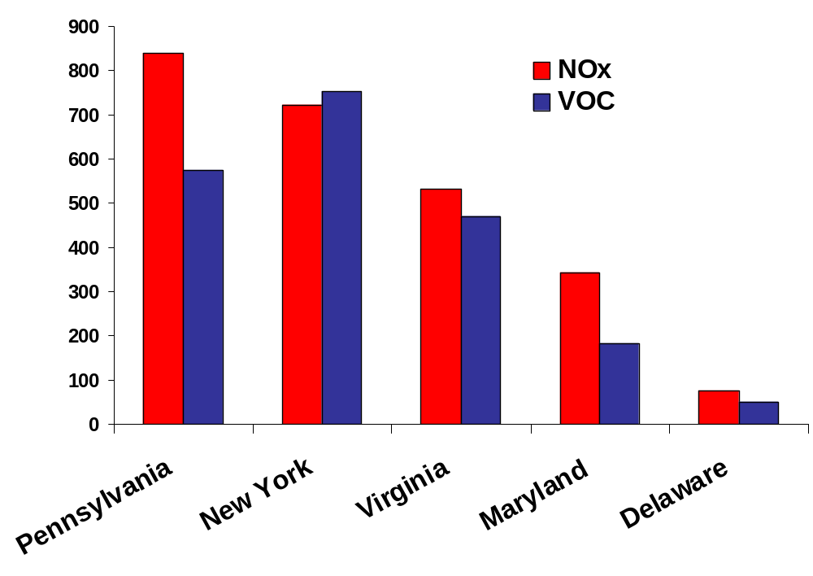
Emissions
tons per year
Source: MDE, 1999 U.S. EPA data
Notes:
Environmental benefits of renewable energy can be demonstrated in terms of local air quality improvements.
This graph shows levels of emissions of ozone precursors in Maryland and neighboring states.

Slide 7
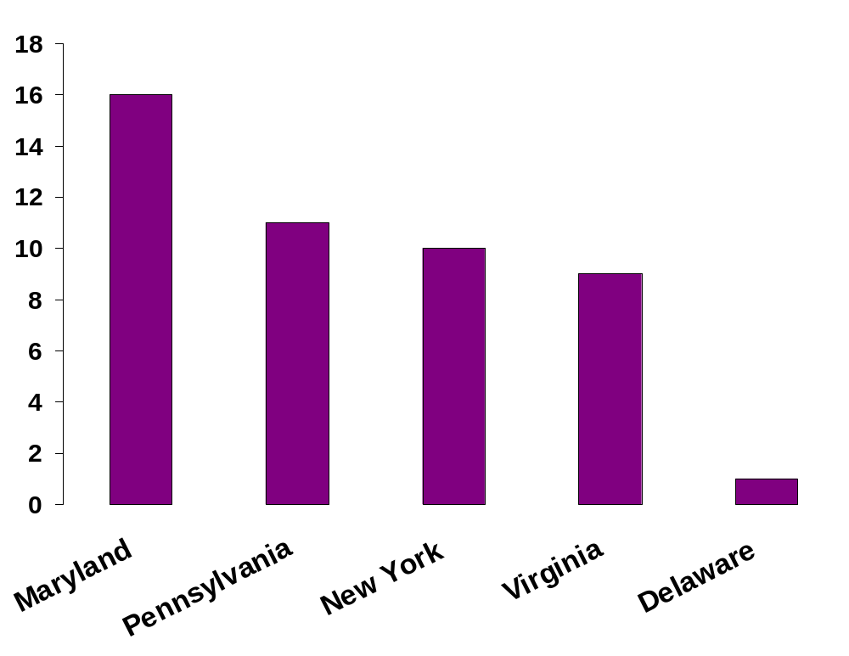
Ground-Level Ozone
# Days above 1-hour standard
Source: MDE, 2002 (MD data from Baltimore monitor)
Notes:
Ground-level ozone measurements in Maryland are higher than would be suggested by local emissions of precursors.
The Washington DC Metropolitan area is in severe non-attainment for ozone.

Slide 8
So, where does the ozone come from?
“Ozone Transport”
Notes:
Emissions from sources out-of-state make compliance difficult or impossible.
Emissions reductions from traditional control measures largely exhausted in many areas.
MDE works in partnership with the University of Maryland – College Park to measure and analyze pollution being transported into Maryland.
On our worst days we measure ozone at 110 parts per billion (ppb) floating into the state from the West. [The 1-hour standard is 125 ppb]

Slide 9
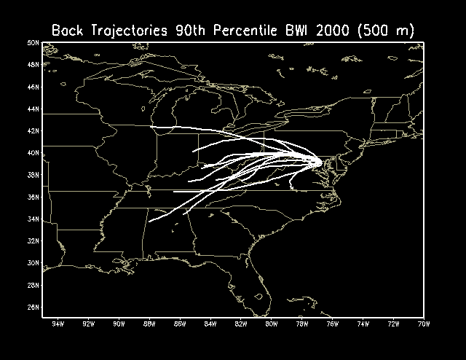
Maryland Department of Environment
Notes:
Research conducted by the University of Maryland provides insight into the sources of NOx emissions in Maryland.
Maryland’s location places us at the “air pollution crossroads” when if comes to transport.
Air pollution floats to us from the west and the south.
Sometimes the air pollution we transport to the north actually “re-circulates” back to us.
Power plants, cars and area sources are all involved in the transport process

Slide 10
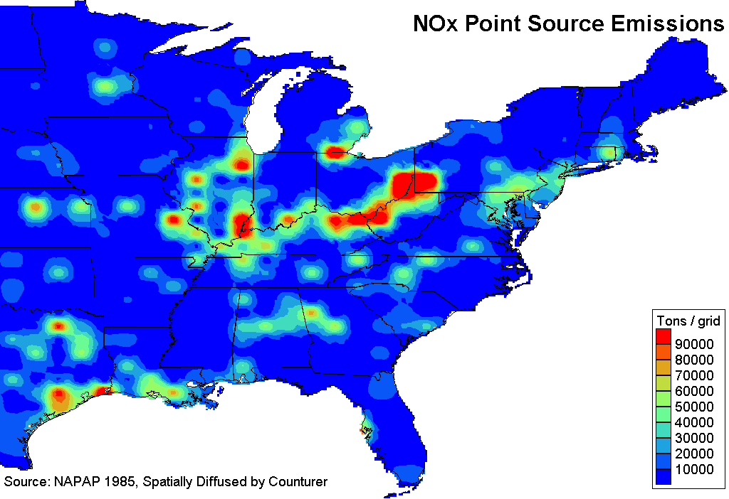
Maryland Department of Environment
Notes:
Major NOx point sources lie to the West of the Washington Metropolitan region.
In Maryland, our technical analyses show that local reductions are not very good at reducing local ozone.
In other areas, like Atlanta, local reductions seem to be much more effective
Local versus regional benefits are a function of each areas weather

Slide 11
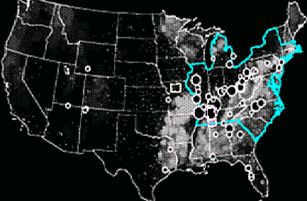
Locations of 50 Largest Power Plants in US
Source: NOAA
Notes:
Primary point sources for NOx affecting Maryland are coal fired electricity generating plants.
The elevated ozone reservoir above Maryland is a complex mix of pollution that originates in the west (primarily power plants) and the south (cars, area sources and stationary sources)

Slide 12
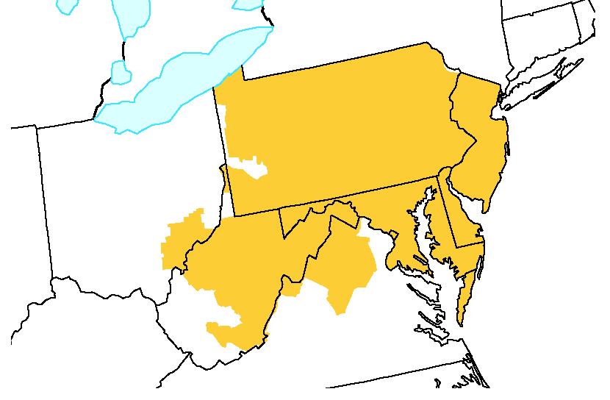

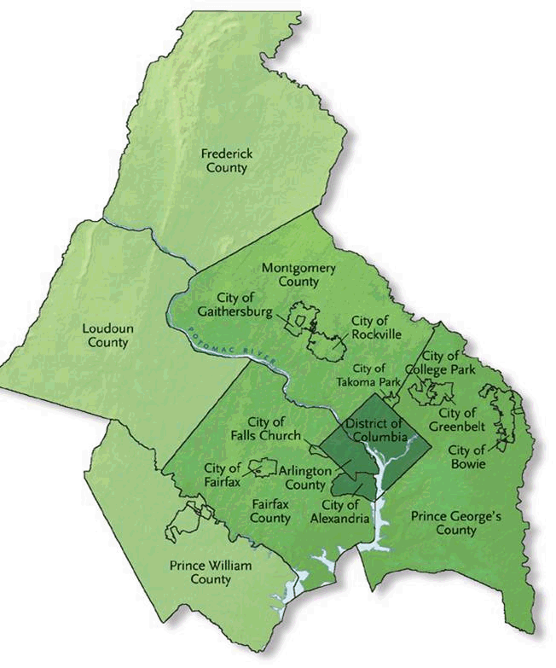
PJM Control Area
NY
NJ
PA
OH
MD
DE
WV
VA
Notes:
The Metropolitan Washington Council of Governments (COG) is shown in green. COG is the organization that coordinates a regional approach to SIPs.
PJM Interconnection is the Independent System Operator and Regional Transmission Organization that coordinates the movement of electricity in all or parts of Delaware, Illinois, Maryland, New Jersey, Ohio, Pennsylvania, Virginia, West Virginia and the District of Columbia.

Slide 13
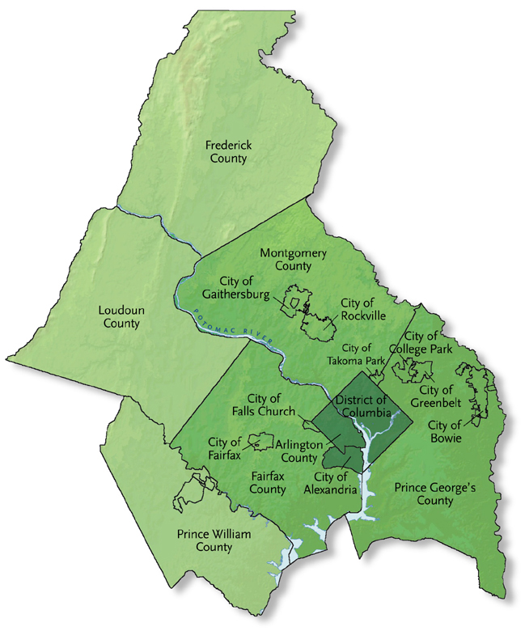
Partners in Buying Group
“Big Six” Montgomery County Agencies:
32.8 million kWh/year
Plus thirteen other jurisdictions:
5.6 million kWh/year
Total purchase of
38.4 million kWh/year
Notes:
Agency Yearly kWh Cost / year Total Annual
wind power Wind only Consumption
Housing Opportunities Commission 1,226,649 $18,375.20 24,532,980
Montgomery College 1,286,259 $19,268.16 25,725,180
Montgomery County Government 7,397,796 $110,818.98 147,955,920
Montgomery County Public Schools 9,818,022 $147,073.97 196,360,440
Park & Planning Commission 2,542,190 $38,082.01 50,843,800
Water & Sewer Authority 10,500,000 $157,290.00 210,000,000
Chevy Chase Village 14,344 $214.87 286,880
Chevy Chase Sect. 5 1,979 $29.65 39,580
City of Rockville 760,272 $11,388.87 15,205,440
College Park 74,041 $1,109.13 1,480,820
Gaithersburg 351,349 $5,263.21 7,026,980
Glenn Echo 4,088 $61.24 81,760
Prince George's 4,270,276 $63,968.73 85,405,520
Rockville Housing Authority 51,411 $770.14 1,028,220
Somerset 8,753 $131.12 175,060
Takoma Park 83,490 $1,250.68 1,669,800
Town of Kensington 19,114 $286.33 382,280
Town of Laytonsville 1,747 $26.17 34,940
Total 38,411,780 $575,408.46 768,235,600

Slide 14

Big dogs eat first.
Notes:
Montgomery County is the leader of an electricity buying group, consisting of thirteen jurisdictions. Membership in the buying group is conditional upon joining the renewable energy procurement. All member of the group have purchased wind power in an amount equal to 5% of their annual electricity usage.
The size of the buying group enabled Montgomery County to obtain a premium environmental product at a reasonable price. The purchase also helps to drive the renewable energy market and promote additional wind projects in the region.

Slide 15

A Closer Look at RECs
Notes:
“Designer” RECs (Renewable Energy Credits):
We buy wind attributes from area where NOx emissions occur (ozone transport) – requires definition of geographic area.
Wind power “offsets” some coal power generation – requires knowledge of power plant dispatch and emissions.
MDE (or equivalent) awards NOx “allowances” – requires existence of “set-aside” pool.
Allowances are retired
Credit for “allowances” taken in SIP
0.05 tpd ~ 5.75 allowances
Contract language must be very specific, and provide transfer of ownership of all environmental attributes that exist or might come into existence during the term of the contract.

Slide 16
Total Purchase
Two year contract began July 1
At a price of $0.01498 per kWh
Total aggregate cost of $575,408/yr
Equivalent to about 15 MW capacity
Largest local government purchase of wind in the US.
Notes:
NOx Allowances:
From Maryland “set-aside” pool (5% = 726 allowances)
SIP proposed “dispatch methodology” for calculating amount of allowances.
New MD regulations incorporate methodology using average for base-load plants in MD.
MW capacity during ozone season x 1.7 (factor representing average allowance per MW) = number of allowances.
~ 5 x 1.7 = 8.5 allowances

Slide 17
Cost-Effective NOx Reduction Measure
(not to be confused with the cost of a NOx Allowance)
Control Measure | Cost (ton/year)
Wind Energy | $32,000
CNG Refueling Stations | $54,701
55 CNG Busses | $103,063
1967 Bike Lockers | $247,111
Notes:
Many of the control measures included in the Maryland SIP are expensive and difficult to verify. Wind energy compares very favorably both in terms of economics and quantifiable emissions reductions.

Slide 18
New EPA Guidance
Encourages the use of renewable energy as a control measure
Sites the Montgomery County wind energy purchase as an example (see Maryland example).
Provides an explanation of dispatch-based methodology for calculating emissions reductions.
Is easier to apply in states with NOx set-aside, but can be applied in any location where power plant emissions are a significant contributor to ground-level ozone.
Notes:
Summarizes from Guidance:
The calculation method begins by estimating which power plants would reduce their operations when the wind farm comes online. The estimated electricity generation at the wind energy power plant was based on an estimated schedule of the wind power production for the summer ozone season (by time of day, week, and month), actual wind anemometer measurements and actual meteorological data. The annual capacity factor for this analysis is estimated at 37 percent and the summer season capacity factor of the wind facility is estimated at 20 percent.
The prospective calculation used actual dispatch information and actual and real renewable plant specifications. Dispatch information from plants located in the PJM West power control area were used to estimate which plants would be affected by the wind power generation. The analysis resulted in energy displacement occurring at 10 facilities (3 facilities in Maryland, 6 facilities in West Virginia, and one facility in Pennsylvania). Generation data was taken from the most recent U.S. Energy Information Administration data from these plants. The emission rate information was taken from the most recent continuous emission monitors information reported to the U.S. Environmental Protection Agency. The estimated generation-weighed emission rate of the displaced electricity was 5.72 pounds of NOx per MWh.
Taking a conservative approach, the amount of proposed SIP credit was one half of the calculated emission reductions, with a projected reduction (to be used as SIP credit) of 0.05 tons per day of NOx during the ozone season. Additionally, a retrospective analysis of power plant activities after the new wind energy plants come online will be performed.

Slide 19

The End
Notes:
For information of the Montgomery County Wind Purchase, contact:
Ann Elsen
Energy Planner
Montgomery County Department of Environmental Protection
240.777.7754
Ann.Elsen@montgomerycountymd.gov
For information on the Maryland NOx set aside, contact:
Tad Aburn
Maryland Department of Environment
gaburn@mde.state.md.us
For information on the dispatch based methodology for calculating emissions reductions, contact:
Colin Haller
ICMA
(292) 962-3616
challer@ICMA.org
For information on incorporation of renewable energy programs into State Implementation Plans, contact:
Debra Jacobson
George Washington University Law School
(703) 356-7448
Deb1703@aol.com

