Slide 1
Personal Health Records: Overview of Patient Identity Proofing Practices
Presentation to the AHIC
Confidentiality, Privacy and Security Workgroup
February 20, 2007

Slide 2
Agenda
Introduction
Analysis of IDP Practices
Examples of Non-Healthcare IDP Practices
IDP Considerations for the CPS WG
Other Research Findings:
  Privacy Policies
  Authentication Credentials
  SSL Site Certificates

Slide 3
Introduction
Initial research:
  50 companies providing PHRs that have no prior relationship with consumers
  Publicly available information from company web sites
Types of PHR providers:
  Off-line: PHR products and applications operated by a consumer in a non-networked environment
  On-line: PHRs hosted by a provider and managed on-line by a consumer (i.e., via the Internet), or PHRs locally managed by the consumer and can also be network connected to obtain additional on-line services

Slide 4
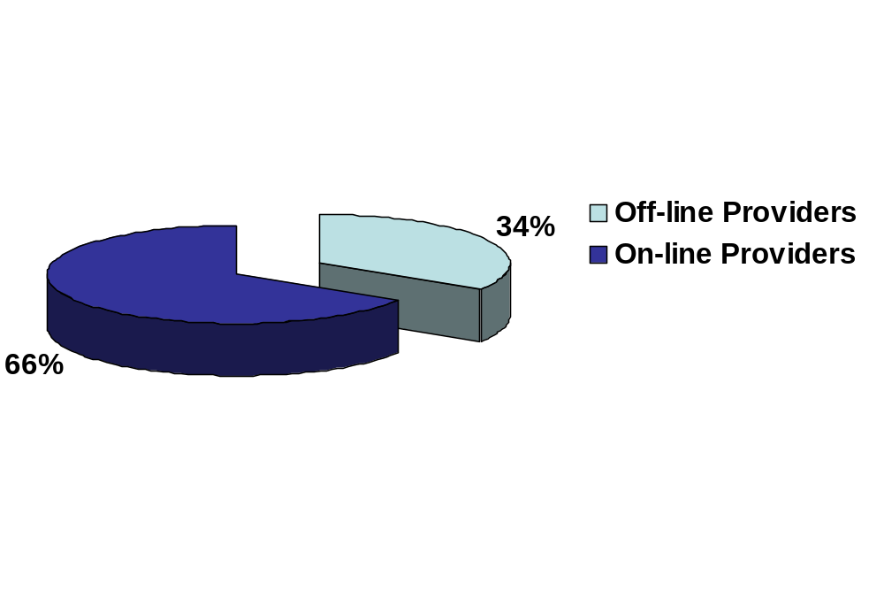
Introduction (cont.)
Types of PHR Providers
17 total off-line providers
33 total on-line providers

Slide 5
Introduction (cont.)
Research extended to identify PHR providers offering value-added services, where these services:
  Are in addition to medical journal services
  Require network connectivity to a third party (e.g., care provider)
  Consist of services such as secure messaging, prescription refill, and lab results reporting
Off-line PHR providers did not offer any value-added services

Slide 6
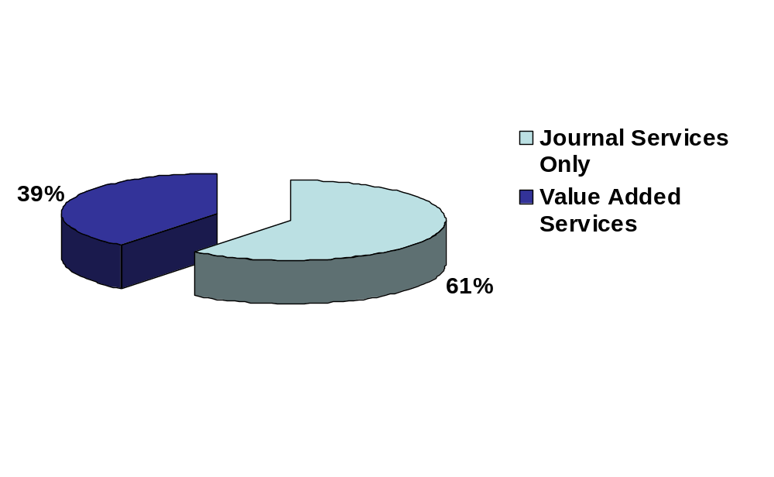
Introduction (cont.)
Services Offered by On-line PHR Providers
13 total value-added service providers
20 total journal only service providers

Slide 7
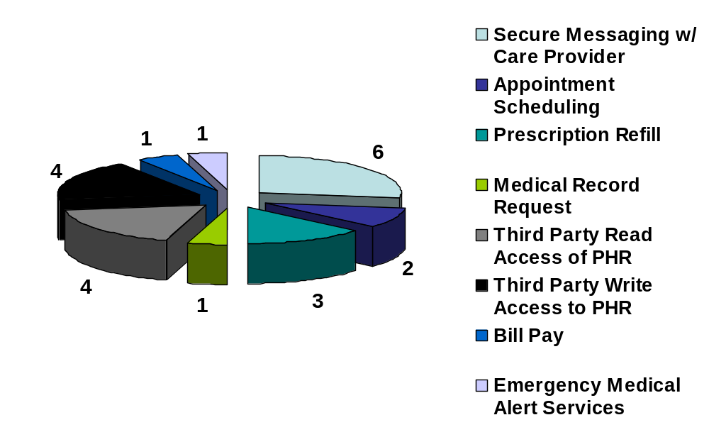
Introduction (cont.)
Value-Added Services Provided by On-line PHR Providers
Note: Some service providers offer multiple value-added services

Slide 8
Introduction (cont.)
Remaining research focused on the thirteen (13) PHR providers offering on-line, value-added services
  IDP practices
  Non-healthcare IDP practices
  Privacy policies (appendix A of research paper)
  Authentication credentials (appendix B of research paper)
  Miscellaneous findings (appendix C of research paper)

Slide 9
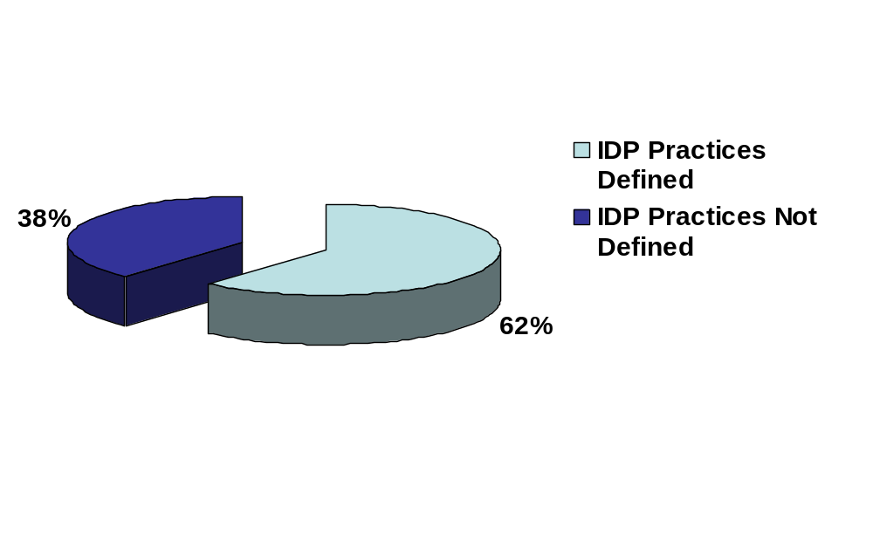
PHR IDP Practices
IDP Processes for Value-Added PHR Services
8 total with IDP practices defined
5 total with no IDP practices defined

Slide 10
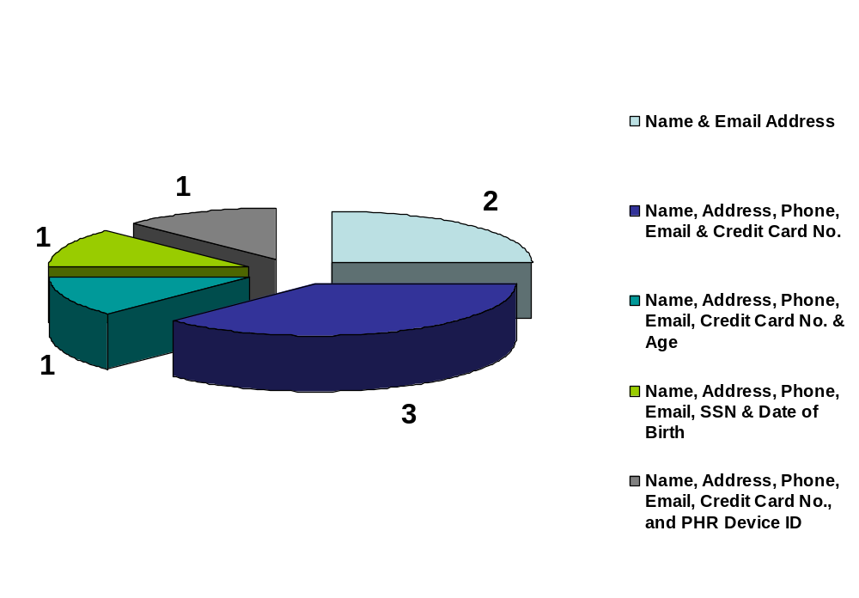
PHR IDP Practices (cont.)
Identity Data Verified by PHR Providers Offering Value-Added Services
Device purchase required before establishing on-line PHR service
Free PHRs
Not clear if purchase required to establish PHR service

Slide 11
PHR IDP Practices (cont.)
Mapping of IDP Practices to Value-Added Services
Value-added Service | Name & Email Address | Name, Address, Phone, Email & Credit Card No. | Name, Address, Phone, Email, Credit Card No., & Age | Name, Address, Phone, Email, SSN & DoB | Name, Address, Phone, Email, Credit Card No., & PHR Device ID
Secure Messaging w/ Care Provider | X | X |  | X
Appointment Scheduling | Information on identity proofing practices not found.
Prescription Refill | Information on identity proofing practices not found.
Medical Record Request by Consumer | Information on identity proofing practices not found.
3rd Party Read Access to PHR |  | X | X |  | X
3rd Party Write Access to PHR | X
Consumer Bill Pay | Information on identity proofing practices not found.
EMT Alert Services |  | X

Slide 12
PHR IDP Practices – Summary
Minimal consumer IDP being performed
  Four of the value-added services had no IDP practices defined
  Four of the value-added services leveraged a successful credit card transaction to prove identity
  One case allowed write access based on name and email address identity data
Little to no information on IDP for authorized 3rd parties accessing PHR services
  Consumers need to trust PHR provider to correctly establish authorized 3rd party relationships (e.g., care provider, pharmacy)
  3rd parties need to trust the minimal consumer IDP practices of the PHR provider to ensure information is obtained from, or transferred to the correct the PHR

Slide 13
PHR IDP Practices – Summary
No use of technologies such as Knowledge Based Authentication (KBA)
  Real-time, on-line identity proofing of consumers with no prior relationship
  Based on access to trusted third party sources and proprietary algorithms to develop personal questions to be answered by the consumer
    Requires initial identity data to be provided by consumer
    Questions are then tailored to the user’s personal history (e.g., loans, residence, credit history)
  Additional information on KBA can be found at http://csrc.nist.gov/kba

Slide 14
Non-Healthcare IDP Examples
 | Annual Credit Report | Capital One | HSBC Direct
Initial Set of Identity Information Collected | Legal Name SSN Date of Birth Mailing Address Residency More than 2 Years? | Legal Name Citizenship SSN Date of Birth Driver’s License/State ID # Email Address Mailing Address Phone Number Residency More than 2 Years? | Legal Name Citizenship SSN Date of Birth Driver’s License/State ID # Email Address Mailing Address Phone Number Residency More than 2 Years?
Additional Set of Identity Information Collected | Personal Questions* Mortgage provider? Mortgage amount? Car loan provider? Car loan amount? | Personal Questions* Car loan provider? Car loan term? Personal loan provider? Personal loan amount? Credit card provider? | Personal Questions* Student loan provider? Student loan amount? Car loan provider? Car loan amount? Credit card provider?
Method Used to Verify Identity Information | Third Party Source Verification and Knowledge Based Authentication | Third Party Source Verification and Knowledge Based Authentication | Third Party Source Verification and Knowledge Based Authentication
Account Activation Method | Immediate | Log back in with account information, SSN and email address to establish on-line account access; also required to provide 3 security answers for customer support. | Log back in with account information and SSN to establish on-line account access.
Authentication Credential | Credit report number provided by credit agency, along with State, Zip Code and SSN | Username/password | Username/password
* Personal questions are geared toward the applicant based on their verified credit information. Verified credit information is determined from the initial set of identity information collected from the applicant.

Slide 15
Non-Healthcare IDP Examples (cont.)
IDP practices more stringent than researched PHR IDP practices
  More base identity data collected
  Use of KBA technology and on-line trusted third party resources
Assuming PHR information is as sensitive as credit report and banking information, then current practices show PHR IDP is lacking to adequately identify consumers

Slide 16
Considerations for the CPS WG
Should PHR providers offering value-added services be required to explicitly describe their identity proofing practices on their provider sites?
Are technologies such as KBA, along with utilization of on-line trusted third party sources adequate to perform identity proofing of a PHR consumer where the consumer has no prior relationship with the PHR provider?
Should third parties who have access to a PHR be identity proofed separately from the consumer? Further, should the identity proofing be more stringent for those third parties that have write access into a PHR?
Should the degree of identity proofing be commensurate with the type of value-added services being provided by the PHR provider (e.g., is appointment scheduling less sensitive than communicating with a care provider, and therefore requires less identity proofing to be performed)?

Slide 17
Additional Research
Appendices in the Research Paper

Slide 18
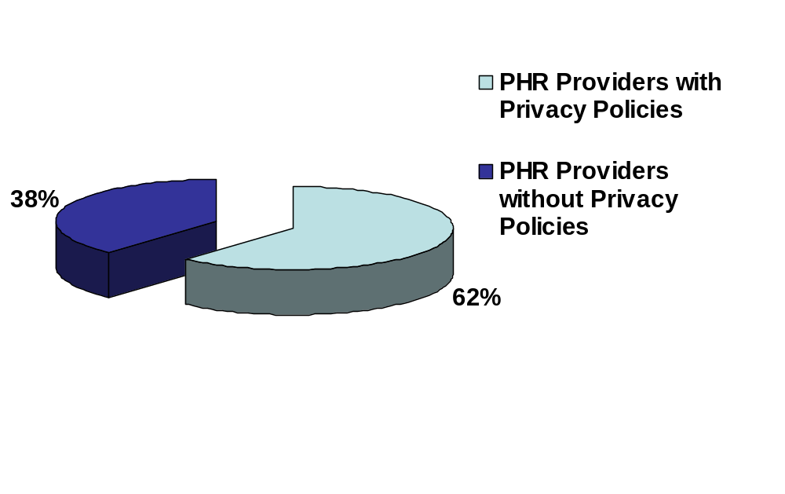
Privacy Policies
Published Privacy Policies by Value-Added PHR Service Providers
Only one had their policy validated by Trust-e.
Note: Privacy policies include how personal information is collected, used, managed, distributed and protected.

Slide 19
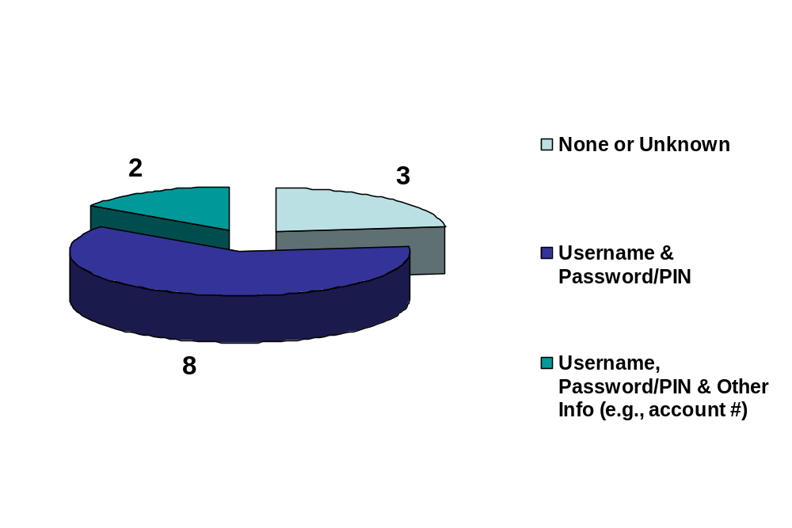
Authentication Credentials
Types of Authentication Credentials Used by Value-Added PHR Service Providers
Single Factor Authentication
Note: The financial industry, based on guidance issued by the Federal Financial Institutions Examination Council, is moving toward the use of multi-factor authentication credentials for on-line banking solutions.

Slide 20
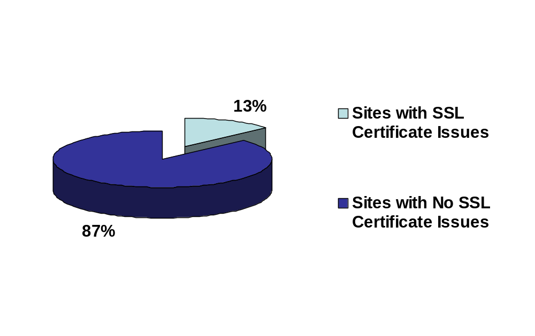
Secure Socket Layer (SSL) Site Certificate Issues
PHR Provider Web Sites with SSL Site Certificate Issues
Note: SSL site certificates are used to authenticate the provider site to the consumer as being a valid and trusted site.

Slide 21
Secure Socket Layer (SSL) Site Certificate Issues (cont.)
When an issue occurs during verification of an SSL site certificate…
  Certificate is expired
  Not trusted by the web browser (i.e., does not verify to one of the trusted root authorities in the browser)
  Name in certificate does not match URL of web site
…then a message such as this appears:
“The is a problem with this website’s certificate.
We recommend that you close this webpage and do not continue to this website.”
SSL site certificate issues can create a lack of trust between on-line PHR providers and the consumer community

