Slide 1
NSF Nugget for FY06
Computational thermodynamics of the Mg-B-C ternary system
Sept. 2006
FRG on Two Gap Superconductivity
Wisconsin-Penn State- Arizona State-Puerto Rico-Mayaguez collaboration
DMR-0514592
PI David Larbalestier, Eric Hellstrom and Paul Voyles (UW), Zi-Kui Liu (Penn State), Nate Newman and John Rowell (Arizona State), and Oswald Uwakweh (U. Puerto Rico Mayaguez)

Slide 2
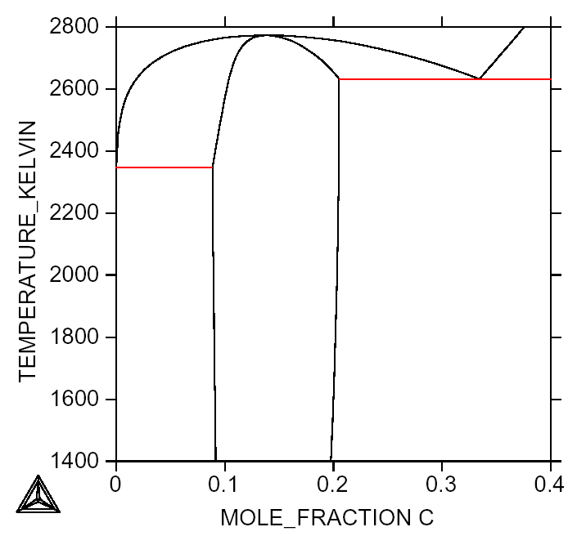
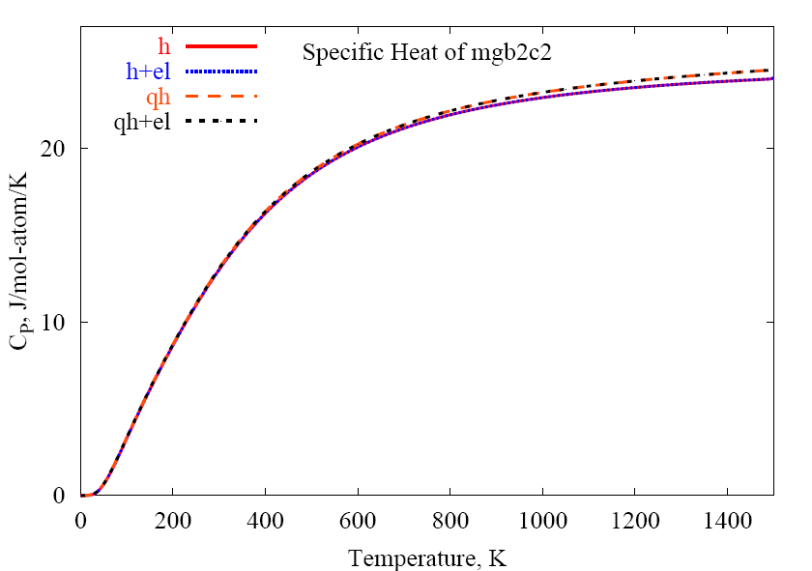
Computational thermodynamics of Mg-B-C ternary system
Work done in the group of Z.K. Liu, Penn State DMR-0514592
Our project is trying to understand the phase stability of the Mg-B-C system so as to guide Hybrid Physical Chemical Vapor Deposition (HPCVD) processing of C-doped MgB₂ thin films. Using the CALculation of PHAse Diagrams (CALPHAD) approach, we can calculate the phase diagram of the Mg-B-C ternary system. To develop a thermodynamic database for use in CALPHAD, we need thermochemical and phase equilibria data. First-principles calculations can be use to obtain thermochemical properties such as enthalpy and entropy of formation and heat capacity. In such calculations, the electronic interaction of atoms is simulated at the quantum level without need for experimental input. We use the Vienna Ab-initio Simulation Package (VASP) to perform these calculations.
Liq
Preliminary B-C binary phase diagram generated by “ThermoCalcTM” from our thermodynamic database.
The specific heat of the MgB₂C₂ ternary compound in the Mg-B-C system calculated from first-principles
B4C
+
B-Boron
B4C
B4C
+
Graphite
Notes:
Computational thermodynamics is interdisciplinary as thermodynamics is involved in many applied sciences. It makes use of computer software and assessed thermodynamic databases to perform realistic calculations of thermodynamic properties of binary, ternary and multicomponent systems under various experimental conditions.
The 39K MgB₂ superconductor shows tremendous potential in high magnetic-field application. Many researchers try to improve this property by adding some element such as Al, Ca, Na, C, O and N. Carbon doping cause dramatically increase in upper critical field.
To understanding and guiding HPCVD, we need a ternary phase diagram of Mg-B-C system. To thermodynamically model a materials system, the Gibbs energy of each phase must be explicitly defined. The CALPHAD, the calculation of phase diagram, approach is to implement thermochemical and phase equilibria data from either experiments or first-principle calculations. The parameters of the Gibbs energy equations are evaluated from this input to produce accurate data. Once deemed “accurate”, lower order models, in our case the binary systems Mg-B Mg-C and B-C, can combined to produce models for higher order systems, such as Mg-B-C.

Slide 3
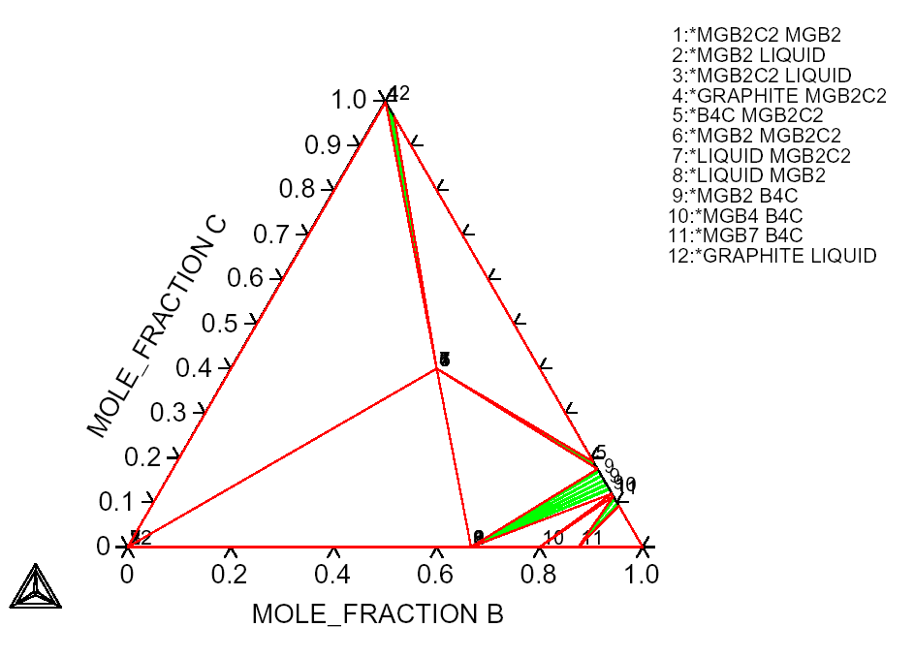
Computational thermodynamics of Mg-B-C ternary system
Future work:
When the thermodynamic modeling is complete, we will be able to predict carbon solubility in MgB₂, a crucial item fro understanding its high upper critical field (H_{c2}).
Other dopants will be studied to predict potential contributions to H_{c2}(T) to guide new experiment.
B₄C +
Graphite +
MgB₂C₂
Liquid +
Graphite +
MgB₂C₂
B₄C + MgB₂ +
MgB₂C₂
Beta Boron +
B₄C + MgB₇
Liquid + MgB₂ +
MgB₂C₂
Phases Research Lab:
We have thirteen graduate students and three research fellows working on various projects such as magnesium alloys, aluminum alloys, boride, Ni-based superalloys and diffusion in intermetallics.
The FRG is supporting two graduate students.
B₄C + MgB₂ + MgB₄
B₄C + MgB₄ + MgB₇
A preliminary isothermal section of the Mg-B-C ternary phase diagram at 1000K from combining the Mg-B, Mg-C and B-C binary phase diagrams
Notes:
Main research of our group are involved in thermodynamics, kinetics and system design of metal and ceramic materials. Currently our group consists of thirteen graduate students and three research fellows working on various projects. The web site of the Phase Research Lab is http://phases.psu.edu.

