Slide 1


The HEASARC
Established December 1990
The HEASARC Charter:
Maintain and disseminate data from previous and concurrent high-energy astrophysics missions
Provide software and data analysis support for these data sets
Maintain and provide the necessary scientific and technical expertise for the processing and interpretation of the data holding
Develop and maintain multi-mission analysis and support tools
Provide catalogs of observations and ancillary information for the data holdings
Coordinate data, software, and media standards with other astrophysics sites.

Slide 2
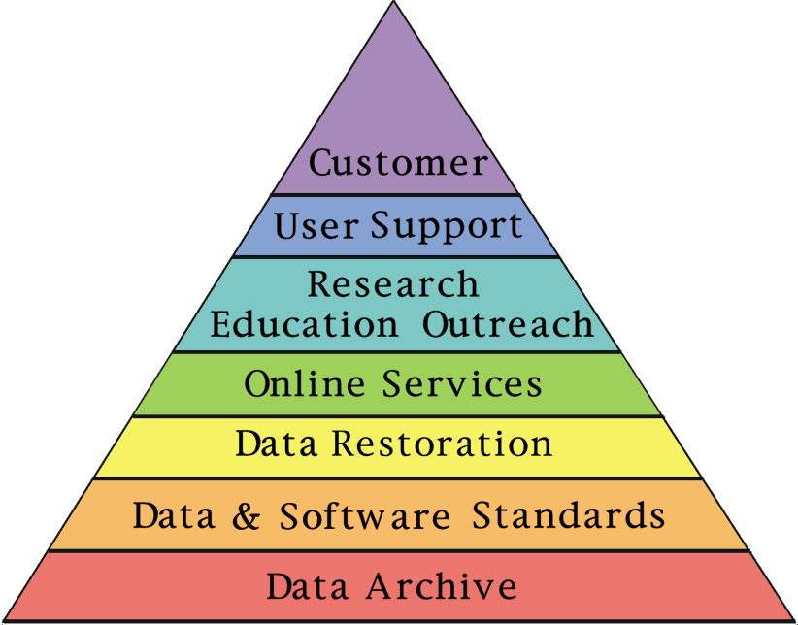
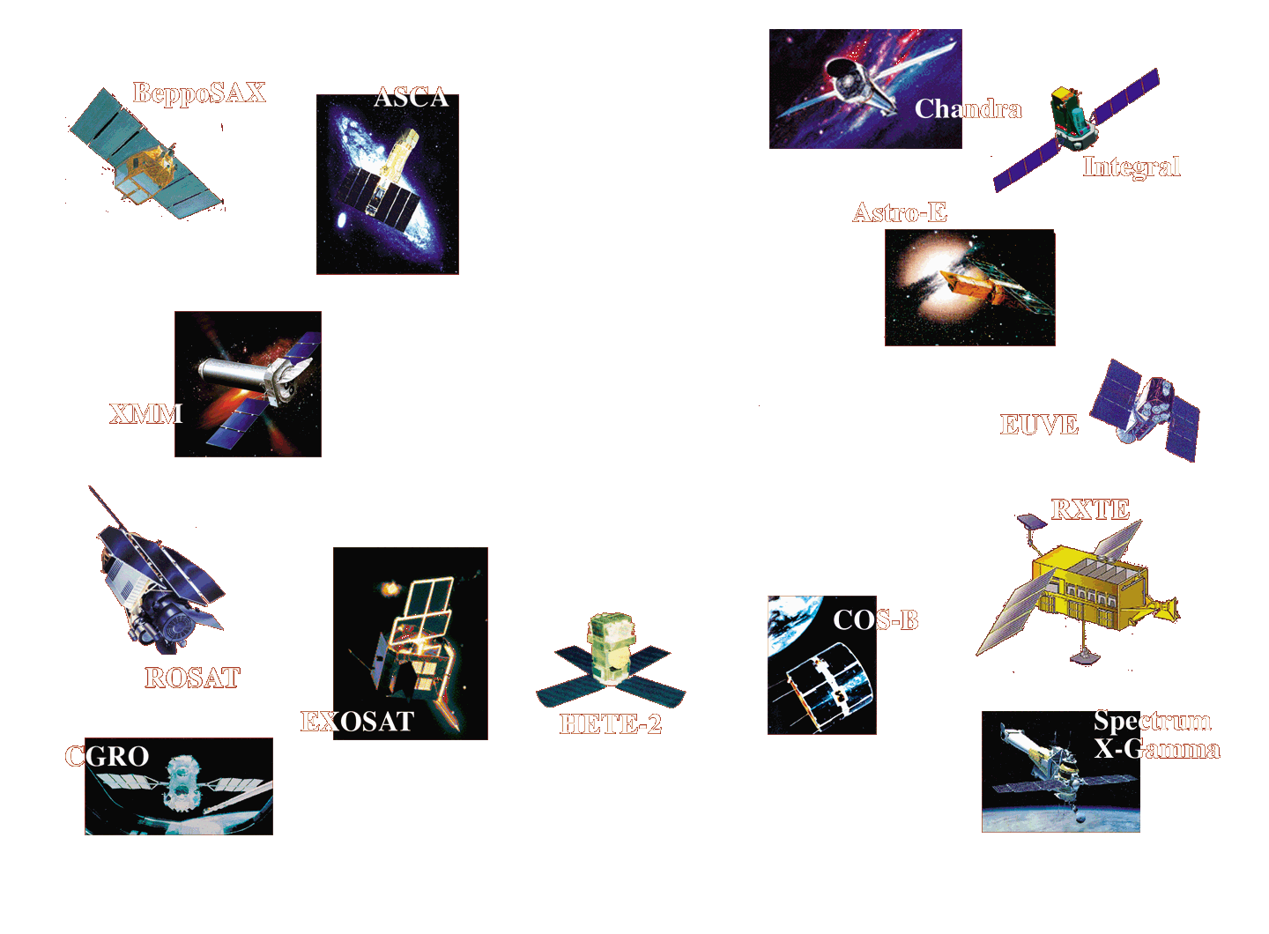
Active Mission Support

Slide 3
The Physical Archive
Past Missions
Ariel 5 EXOSAT
ASCA Ginga
BBXRT HEAO 1
CGRO HEAO 3
Copernicus OSO 8
COS B ROSAT
DXS SAS 2
Einstein SAS 3
EUVE Vela 5B
Active Missions
RXTE (1995- )
BeppoSAX (1997- )
Chandra (1999- ) [data at CXC]
XMM-Newton (1999- )
HETE-II (2000- )
Upcoming Missions
Integral (2002 Launch)
Swift (2003 Launch)
GLAST (2006 Launch)
• Data from 25 missions currently in the archive
• About 280 astronomical catalogs & mission tables
• The archive volume was
2500 Gigabytes as of the end
of 2001

Slide 4
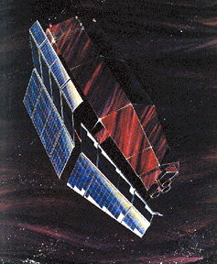
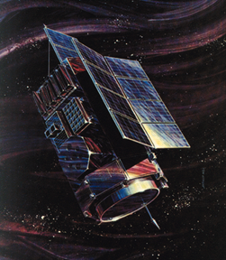
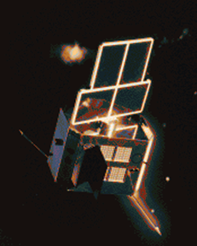
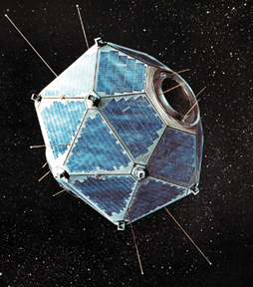
Data Restoration

Slide 5
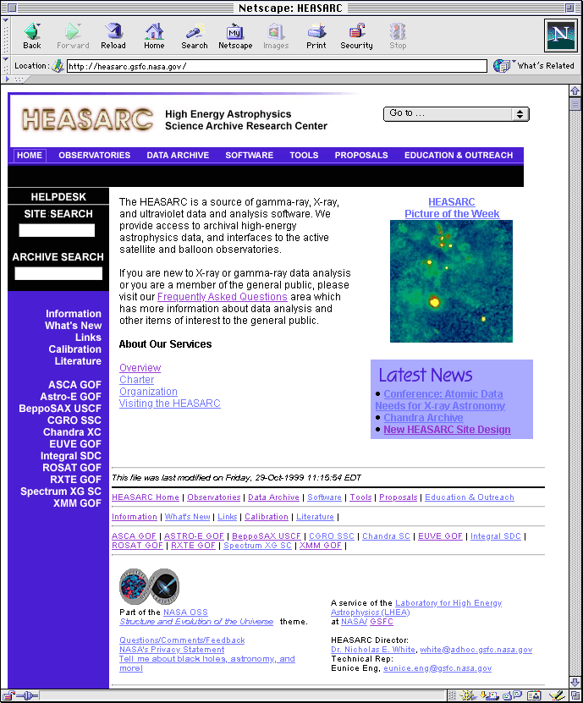
The HEASARC Web
Assist astrophysicists in all stages
of their archival research:
Information and latest news about HEASARC Catalogs
• Mission information
• Search catalogs & retrieve data
• Download analysis software
• Access documentation
• Astronomical Web site links
• Public outreach & education

Slide 6
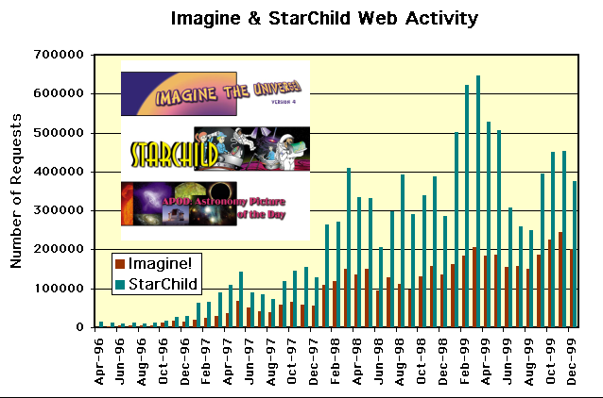


Education & Public Outreach
A service of the High Energy Astrophysics Learning Center
http://imagine.gsfc.nasa.gov/
Multi-level discussion of astronomy
Lesson plans using actual satellite data
CD-ROM’s, posters, support teacher conferences
Created by HEASARC scientists and programmers collaborating with teachers
NCTM and NSTS standards listed
Ask A High Energy Astronomer service

Slide 7
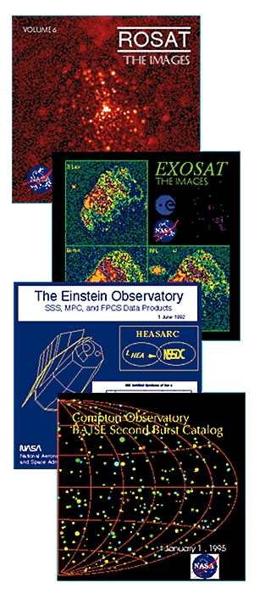
HEASARC CD-ROM’s
The HEASARC publishes CD-ROM’s containing
selections of important data products (images,
spectra, and light curves).
Thirteen CDs have been published for a variety
of high-energy astrophysics missions (CGRO,
ROSAT, EXOSAT, and Einstein.
CD-ROM’s contain URL links directly back to
the data archives at the HEASARC.
CD-ROM’s are distributed by the HEASARC at
AAS and other astronomical meetings, and are
also available free of charge on request.

Slide 8


Software: Ftools & Xanadu
FTOOLS is a general software package which can manipulate any type of FITS files, and can do selection, analysis, and other scientifically useful tasks on FITS files from high-energy astrophysics missions. Currently supported missions include ASCA, ASTRO-E, CGRO, Einstein, EXOSAT, OSO-8, ROSAT, RXTE, and Vela 5B.
XANADU is a software package comprising high-level programs for spectral (XSPEC), timing (XRONOS), and imaging (XIMAGE) analysis of X-ray and gamma-ray astronomy data files.
In early 2000, FTOOLS and XANADU will work in an integrated common environment and be distributed (either together or separately, according to the user’s requirement) on a common release schedule.

Slide 9
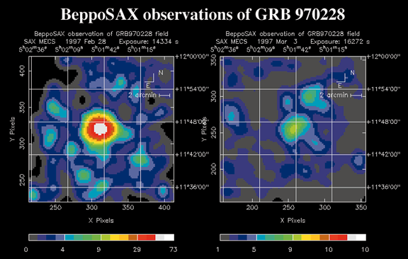
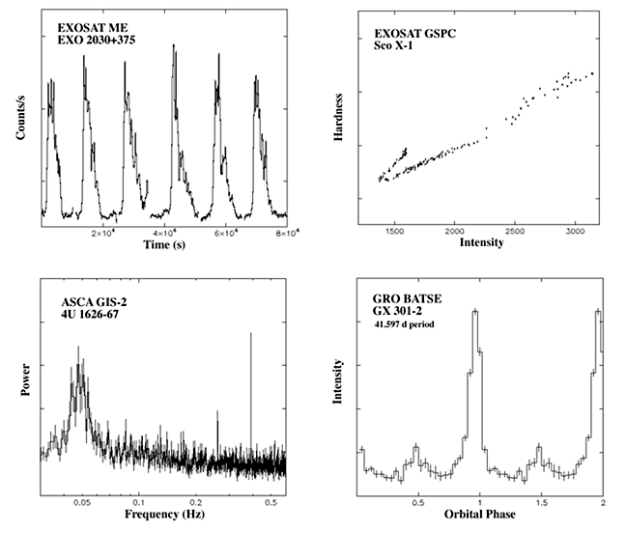
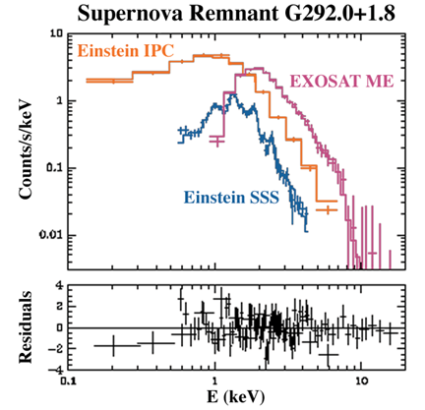
Software: Xanadu
Multi-mission analysis software
Spectral analysis: XSPEC
Timing analysis: XRONOS
• Image analysis: XIMAGE

Slide 10
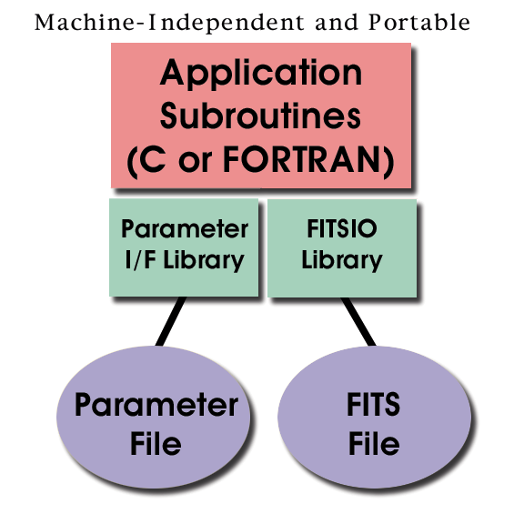
Software: Ftools
All code written in ANSI standard C or FORTRAN. Machine-independent and portable.
All data input/output is in the form of FITS files via the CFITSIO subroutine interface, or occasionally, ASCII files.
All user input to the task is done via a parameter file.

Slide 11
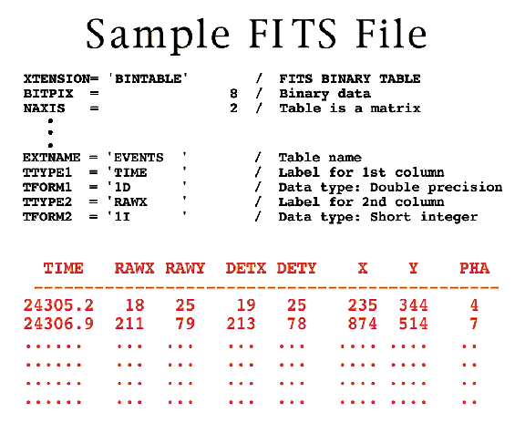
Data Format Standards
The HEASARC develops, coordinates and promotes standardized FITS formats for use within the High-Energy Astrophysics community.
These standards allow multi-mission analysis packages and encourage recycling of software at considerable cost savings.
The HEASARC publishes these standards on the Web and in its journal, Legacy. It also collaborates with new missions to ensure that their data products conform to these standards.

Slide 12
The HEASARC Customers
The HEASARC has 4 groups of users:
Investigators selected to use the ASCA, ASTRO-E, BeppoSAX, CGRO, ROSAT, and RXTE observatories which include scientists
- at US universities
- at NASA’s GSFC and other government labs
- from around the world
Archival researchers
The general public, who are interested in what NASA is doing
Teachers, parents, and school children for education and outreach

Slide 13
Usage & Data Statistics
Gigabytes (GB) transferred by ftp per year:
1998 1999 2000 2001
842 GB 1391 GB 1846 GB 2251 GB
Gigabytes (GB) transferred by the www (http) per year:
1998 1999 2000 2001
424 GB 603 GB 1083 GB 1428 GB
Gigabytes retrieved per quarter

