Slide 1
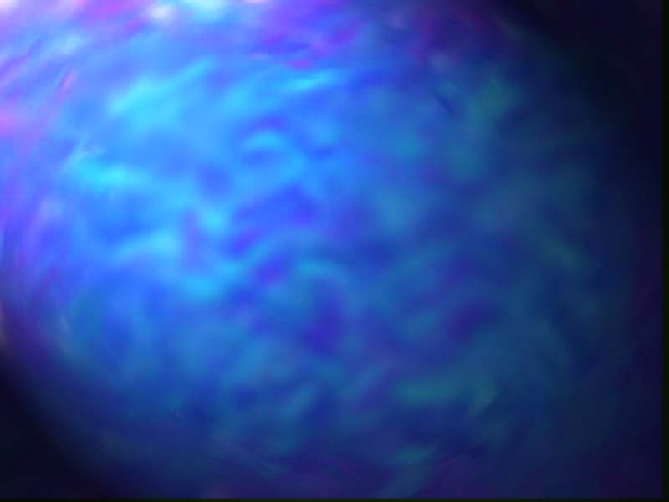
Iron Deficiency Anemia
Reema Batra, MD
George Washington University

Slide 2
Essential Nutrients for Erythropoiesis
Folic Acid
Cobalamin
Iron

Slide 3
Essential Nutrients for Erythropoiesis
Folic Acid Cobalamin Iron
Enzyme
Thymidylate
synthetase
Methionine
synthetase
Ferro-chelatase
Function
DNA synth.
DNA synth.
Hb synth.
Source
Vegetables,
fruit, liver
Meats, milk,
eggs
Meats,
fortification
Absorp.
Prox. Intest.
Term. Ileum
Prox. Intest.
Storage
Liver
Liver, kidney
Macrophages

Slide 4
Essential Nutrients, cont’d
Folic Acid Cobalamin Iron
Dietary
content
1.0 mg
0.01 mg
20 mg
Daily
absorption
0.2 mg
0.002 mg
1.0-1.5 mg
Stores
5-10 mg
1-10 mg
500-1000 mg

Slide 5
Iron- essential nutrient
  Reversible binding O₂:
  hemoglobin
  myoglobin
  Enzymes: heme (cytochromes)
  iron sulfur cluster (aconitase)
  other (ribonucleotide reductase)
  Immunity: free radicals to destroy microbes

Slide 6
Iron- potentially toxic
Highly reactive with O₂; can cause fatal toxicity.
  Cardiomyopathy
  Liver cirrhosis
  Endocrine abnormalities

Slide 7
Iron Metabolism: Broad Themes
Absorption of iron is highly regulated to prevent excess iron from being absorbed.
No physiologic pathway for excreting excess iron exists.

Slide 8
Body Iron Compartments
 | 60 kg F | 70 kg M
Functional compounds
Hemoglobin | 1750 mg | 2300 mg
Myoglobin | 290 mg | 320 mg
Enzymes | 160 mg | 180 mg
Transferrin | 2.5 mg | 3 mg
Storage compounds
Ferritin & hemosiderin | 300 mg | 1000 mg
Total | 2500 mg | 3800 mg

Slide 9
Iron Requirements
Men Women
Obligatory losses 1.0 mg/d 1.0 mg/d
Menstruation 0 mg/d 0.5 mg/d
Total losses 1.0 mg/d 1.5 mg/d
Iron absorbed 1.0 mg/d 1.5 mg/d

Slide 10
Iron Absorption
1. Heme iron (meats) absorbed better than non-heme iron (grains).
2. Gastric acid keeps Fe reduced to Fe⁺⁺ form that is absorbed.
3. Occurs in proximal small bowel
4. Increases with: - high erythropoiesis
  - low iron stores
5. Inhibited by inflammation, tea

Slide 11
Fe from
intestine
(1 mg/day)
Erythroid precursors
in bone marrow
produce hemoglobin
(18 mg Fe/day)
Transferrin in plasma carries Fe back to bone marrow
(17 mg/day)
Macrophages in spleen
remove and break down
senescent RBCs
(18 mg Fe/day)
Losses (1 mg Fe/day)

Slide 12
Iron Metabolism
Fe circulates in plasma bound to transferrin (approx 0.1% of body Fe)
Fe stored intracellularly as ferritin.
3. Serum Fe concentration and transferrin saturation reflect Fe delivery to erythroid precursors.
4. Serum ferritin concentration reflects stores in macrophages.

Slide 13
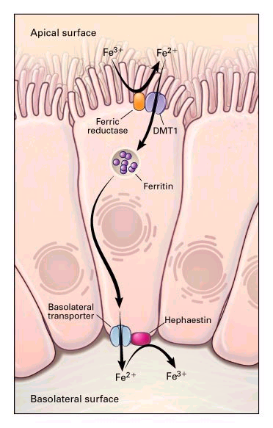

Iron Transport
into Plasma
Duodenal
Duodenal
cytochrome
cytochrome
b
b
Senescent
RBC
Macrophages
Macrophage
Hb
Fe
Ferro-
portin 1
Cerulo-
plasmin
Ferroportin
1
Tf
Ferroportin
Ferroportin
1
1
Fe
+2
Fe
+2
Fe⁺³
Adapted frlm Andrews,
NEJM 1999;341:1986

Slide 14
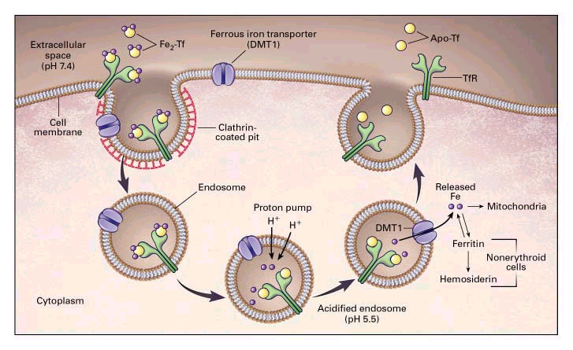
Receptor-Mediated Endocytosis
Andrews N, NEJM 1999;341:1986

Slide 15
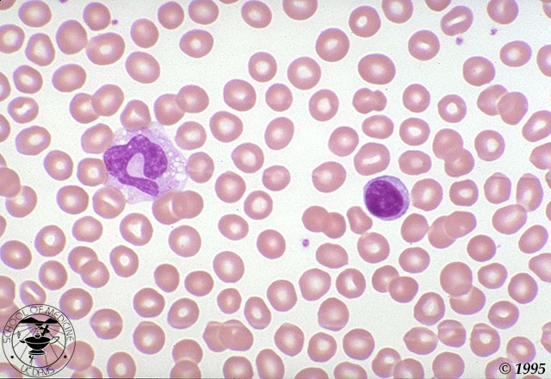
Normal Peripheral Smear

Slide 16
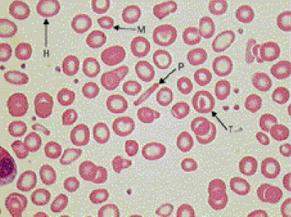
Iron Deficiency Anemia
H=hypochromic RBC; p=pencil RBC; T=target RBC; M=microcytic RBC
The Lancet 2000;355:1260

Slide 17
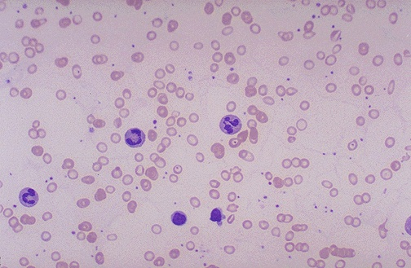
Iron Deficiency Anemia

Slide 18
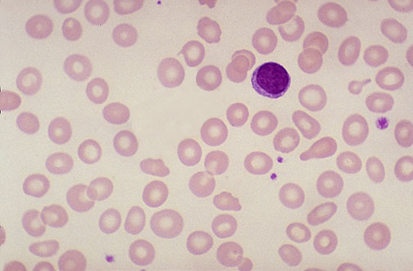
Iron Deficiency Anemia

Slide 19
Causes of Iron Deficiency
1. Chronic blood loss
  gastrointestinal (carcinoma, ulcers, diverticuli, a-v malformations, hookworm)
  genitourinary (menorrhagia, bladder ca)
  pulmonary (hemoptysis, pulmonary hemosiderosis)
  frequent blood donors (220 mg Fe lost with each blood donation

Slide 20
Causes of Iron Deficiency
2. Dietary insufficiency
  rapidly growing children
  women of child-bearing age.
Malabsorption
  s/p gastrectomy
  s/p resection proximal small bowel
  Crohns disease
  Celiac disease

Slide 21
Causes of Iron Deficiency
4. Pregnancy and lactation
Hemoglobinuria
  secondary to intravascular hemolysis:
    paroxysmal nocturnal hemoglobinuria
    runner’s anemia

Slide 22
Fe Deficiency: Clinical Manifestations
Impaired growth, psychomotor development
Fatigue, irritable, ↓ work productivity
Pica
Dysphagia, esophageal web (Plummer-Vinson or Patterson-Kelly Sx)
Koilonychiae, glossitis, angular stomatitis

Slide 23
Fe Deficiency: Lab Findings
CBC
  ↑ RDW, platelets
  ↓ MCV, MCH, MCHC, RBC, Hb, Hct
Retic count not ↑
Serum tests
  ↓ Fe , Tf Sat, Ferritin (< 12 μg/L)
  ↑TIBC, transferrin, transferrin receptor

Slide 24
Fe Deficiency: Lab Findings-II
Bone marrow aspirate
  - Absent macrophage Fe
  - ↓ sideroblasts
  - Erythroid hyperplasia

Slide 25
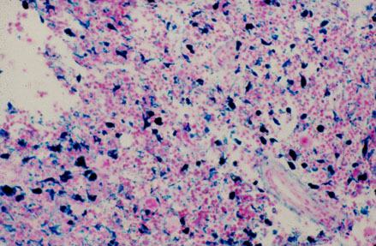
BM aspirate: iron stain, increased macrophage iron

Slide 26
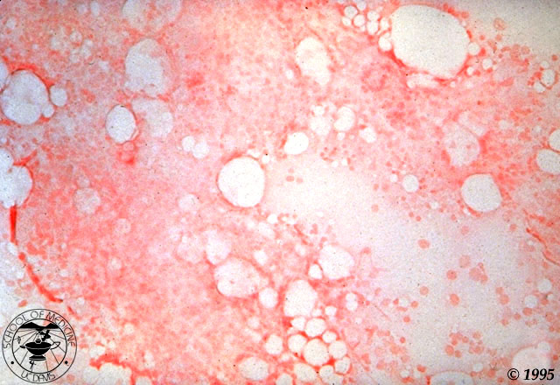
BM aspirate: iron stain, absent macrophage iron

Slide 27
Fe Deficiency: Management
First, look for source of blood loss. Rule out malignancy. Test stools for occult blood.
Gastrointestinal Genitourinary
  Colorectal - Endometrial
  Gastric - Cervical
  Esophageal - Bladder
  Hepatoma
Second, correct cause of blood loss.

Slide 28
Treatment
General principles
  Iron absorption occurs at the duodenum and proximal jejunum
    Extended release capsules or enteric coated capsules get absorbed lower parts of the GI tract and are not very effective
  Iron salts should not be given with food because the salts bind the iron and impair absorption

Slide 29
Treatment
Iron should be given two hours before or four hours after the ingestion of antacids
Iron is best absorbed as the ferrous salt in a mildly acidic medium
  Can give with tablet of Vitamin C
Iron preparation used should be based upon cost and effectiveness with minimal side effects
  Cheapest is iron sulfate (65 mg of elemental iron)

Slide 30
Treatment
GI tract symptoms is directly related to the amount of elemental iron ingested
  These symptoms may be less in the iron elixir preparation.

Slide 31
Oral Iron Therapy
Most appropriate oral iron therapy is use of a tablet containing ferrous salts
  Ferrous fumarate, 106 mg elemental iron/tab
  Ferrous sulfate, 65 mg elemental iron/tab
  Ferrous gluconate, 28-36 mg iron/tab
Recommended daily dose= 150-200 mg/day of elemental iron
  No evidence that one preparation is better than another

Slide 32
Side effects
10-20% patients nausea, constipation, epigastric distress and/or vomiting
  Treatment
    Smaller dose of elemental iron, or switch to elixir form
    Slow increase in dose from 1 tablet to 3 tablets per day
    Take tablet with meals (may decrease absorption)

Slide 33
Duration of Treatment
Depends on physician
  May discontinue when hgb level is normal
  Some continue for six months after the hgb is normal

Slide 34
Treatment Failures
Incorrect diagnosis
Pressure of coexisting disease (ACD)
Noncompliance
Difficulty with absorption (antacids, enteric-coated tablets)
Iron loss > amount ingested
Iron malabsorption (Celiac disease, H. Pylori)

Slide 35
Parenteral Iron Therapy
Indications
  Rarely given when patients cannot tolerate oral form
  If iron loss exceeds oral iron replacement
  Inflammatory bowel disease
  Dialysis patients
  Anemic cancer patients

Slide 36
Available Preparations
Iron dextran (INFeD, Dexferrum)
  50 mg elemental iron/mL, given either IM or IV
    INFeD is low molecular weight, Dexferrum is high molecular weight
  Side effects: Usually in ~ 5% patients
    Local rxns: Pain, muscle necrosis, phlebitis
    Systemic: Anaphylaxis seen in 1%, fever, urticaria, arthritic flares
    Side effects seen more with high molecular weight preparations.

Slide 37
Available Preparations
Ferric Gluconate (Ferrlecit, 12.5 mg iron/mL)
Iron sucrose (Venofer, 20 mg iron/mL)
  Both can only be used in IV formulation
  Ferric gluconate has less allergic reactions as compared to Iron dextran (3.3 vs. 8.7 allergic events per 1 million doses per year)
  Iron sucrose also has less side effects, even if there is a prior history of rxn to Iron dextran
Faich, G. Am J Kidney Dis 1999; 33:464

Slide 38
IM Iron
Usually slow iron mobilization and occasionally incomplete
  Therefore usually not used, even though available in the Iron dextran form

Slide 39
IV Iron
Most commonly used in dialysis setting
If Ferric gluconate used, test dose not recommended anymore
  2 mL of ferrlecit, diluted in 50 mL of NS and infused over 60 min.
    If no reaction seen, up to 10 mL is given in any setting, diluted in 100 mL of NS and given over 60 minutes

Slide 40
Calculation of IV Iron Dose
Calculate iron defecit
  1 gram of hemoglobin = 3.3 mg of elemental iron
60 kg woman with hgb of 8 g/dL needs IV iron in the form of iron sucrose (20 mg/mL)
  Normal blood vol 65 mL/kg, thus her blood volume is 3900 mL
  Normal hgb is 14 g/dL, therefore hgb deficit is 6 g dL, with a total of 234 grams (6 x 39 dL)

Slide 41
Calculation of IV iron Dose
Each gram of hemoglobin = 3.3 mg of iron
  Total RBC iron deficit is 772 mg (234 g x 3.3)
Iron sucrose has 20 mg/mL, therefore, this would require a total of 38.6 mL

Slide 42
Oral Iron Therapy
Dose
  100-200 mg elemental Fe/d (adults)
  5.0 mg elemental Fe/kg per day (children)
  administer on empty stomach if tolerated
Duration
  1-2 months to correct anemia
  2-4 additional months to replenish stores
Side effects- diarrhea, constipation, cramps

Slide 43
Oral Iron Therapy
4. Preparations
  FeSO₄ (325 mg FeSO₄ = 65 mg Fe)
    one tab tid
    GI side effects
    risk of poisoning in small children
  Carbonyl iron
    elemental Fe powder- 150 mg/d
    Similar side effects; safer

Slide 44
Parenteral Iron Therapy
Indications (rare)
  Unable to absorb oral iron
  Intractable non-compliance to oral iron
Preparations
  Fe dextran (risk of anaphylaxis)
    50 mg/ml, 100 mg/d im/iv
  Sodium ferric gluconate complex
    Given with EPO in hemodialysis pts.

