Slide 1
Looking sharp today in a CAP uniform
Susie Parker
Deputy Director, Membership Services
sparker@capnhq.gov

Slide 2
CAP Uniforms
CAPM 39-1 covers uniform wear policy
  Revision ratified by Feb 04 NB
  Permission for nametag received Apr 04
  Revised draft awaiting USAF approval
Air Force retains control over the grade insignia and any devices on the AF-style uniforms

Slide 3
CAP Uniforms
How Changes come about
  Member submits thru chain of command
  Staffed at National Headquarters (Development Committee)
  NB considers once a year
Changes to CAP distinguishing differences go thru AF chain to AU & AETC

Slide 4
Uniforms
Most Common Infractions
Weight, Weight, Weight!
  CAP weight standards are AF standards plus 10%
    10% is 10%
  There is no body fat equivalent for CAP
  Members who do not meet the standards must not wear AF style uniforms
Hair and Grooming
  No waivers for beards
  Jewelry
Extremely critical to CAP relationship with the Air Force
  CAPM 39-1, Atch 2

Slide 5
Service Uniforms
Fit is especially important
Service Coat
  Fit easily over chest and shoulders
    Bottom edge extends 3 to 3 ½ inches below top of thigh
    Should not pull or bunch in back above waist
  Sleeves end ¼ inch from heel of thumb
  Collar shows at least ¼ to ½ inch above coat collar and center back

Slide 6
Uniform Fit
Trousers/Slacks
  Worn at natural waist with no bunching at waist or sagging in seat
    Horizontal wrinkles at waist, tightness in crotch and bulging in side pockets indicate too small
  Rest on front of shoe or boot with slight break in crease
  Back edge approximately 7/8 inch longer than front
Skirts
  Hang naturally over hips
    Horizontal wrinkles at waist or bulging in side pockets indicate too small
  No shorter than top of kneecap nor longer than bottom of kneecap

Slide 7
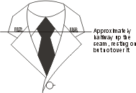
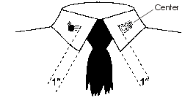

Accouterments
Proper placement is key
  U.S. and C.A.P. Cutouts
  Grade insignia
    No metal grade for senior members

Slide 8
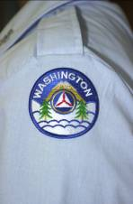
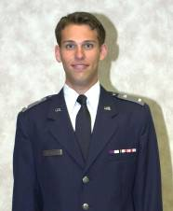
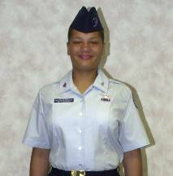
Placement
Wing/region patch
  ½ inch from shoulder seam
  Centered on epaulet
  To crease or not to crease
Nametag
  Shirts
    Females even with to 1 ½ higher or lower than first button
  Service coat
    Cadets vs Seniors
    Mandatory wear date 1 Aug 2004

Slide 9

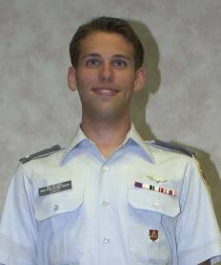


Placement
Aviation Badges
  ½ inch above ribbons
Specialty Insignia
  ½ inch above ribbons, below aviation badge
Specialty Badges
  Men – Pocket
  Women
    Service Coat
    Blouse
Command Badge
  Sitting Unit and Group commanders
  ½ above nametag

Slide 10
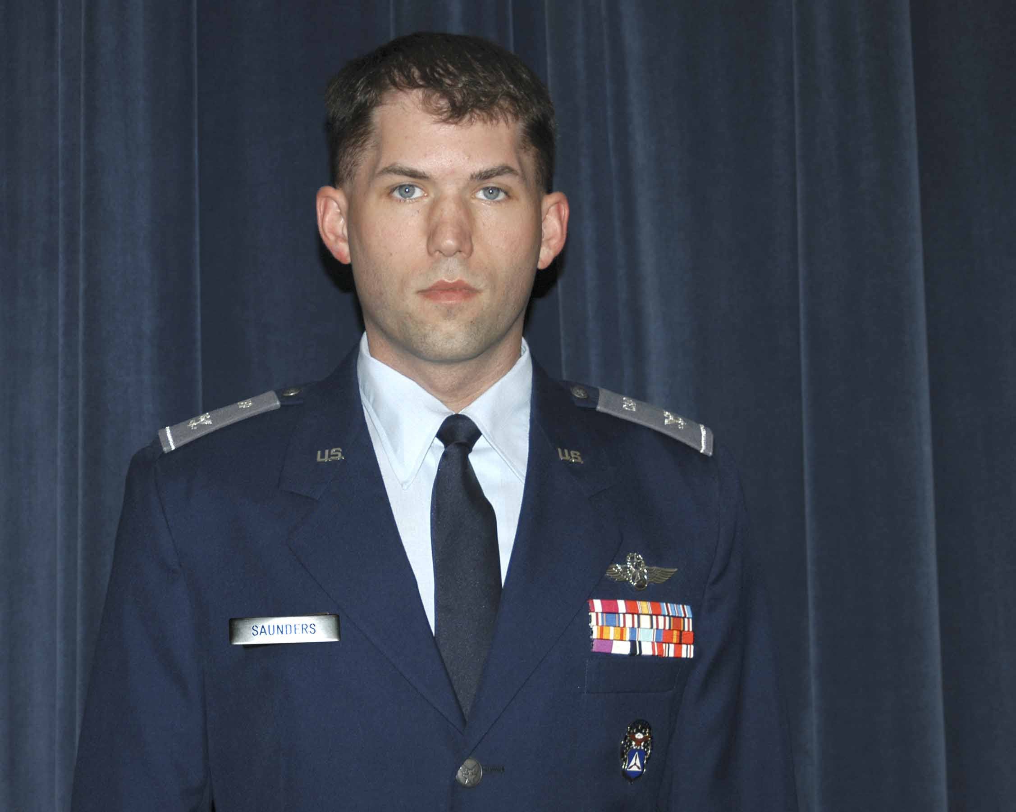
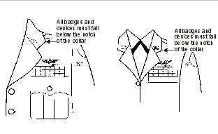
Ribbons
Mandatory on Service Coat
  Military and CAP
Optional on blue AF-shirt
  Military and CAP
Optional on aviator shirt
  CAP ribbons only
Excellent tool for order of precedence
http://www.bobbythomas.net/CAPcode/CAPRibbons.htm
  Link on Cadet Programs web page

Slide 11
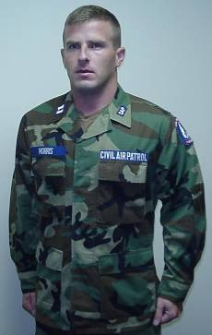
Battle Dress Uniform
Only woodland green authorized
Must meet weight and grooming standards
1/8 inch of blue shows around embroidered devices
Headgear
CAP not authorized subdued badges/devices

Slide 12
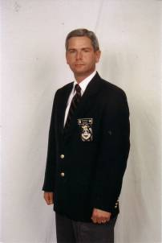
CAP Distinctive Uniforms
Blazer uniform or aviator shirt equivalent to AF-style blue uniform
Blazer uniform with regimental tie/floppy bow
  Blue CAP tie/bow still authorized but regimental preferred
  Grade on black nametag
  CAP crest
  Gray slacks
    Commercial dress slacks, not casual slacks/skirts
Semi-formal blazer combination
  Remove nametag
  One miniature medal

Slide 13
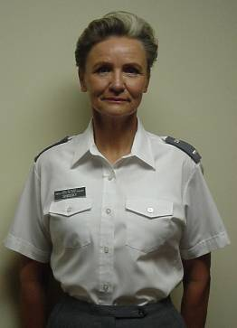
Aviator Shirt
Aviator shirt – Senior Members only
  Worn with gray epaulets
  Black nametag option phased out Feb 01
  CAP aviation badge, one additional CAP badge
  CAP ribbons only
  No military devices
  Long sleeves = tie (blue AF or blue CAP)

Slide 14
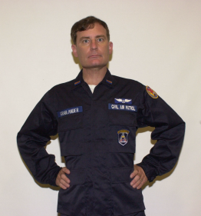
CAP Field Uniform
Worn same as AF BDUs
  CAP tape and nametape
  No military badges/patches
  Trousers may be bloused
  Headgear not required
  Blue flight jacket authorized
    If worn same devices as shirt
    Blue BDU hat
  Civilian outergarments

Slide 15
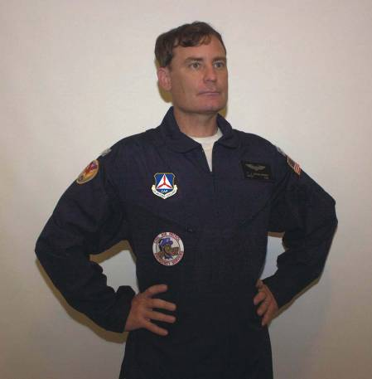
CAP Utility Uniform
One-piece, flightsuit style
  Replaces CAP jumpsuit
    Phase out 31 Dec 03
  Worn as CAP or AF-style flightsuit
  No military patches
  No headgear required
  Any civilian outergarment
  Not nomex!

Slide 16
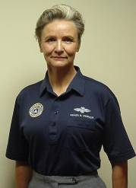

CAP Summer Uniform/
Golf Shirt
Three shirts currently authorized
  All are dark blue
    White golf shirt phased out 1 Jan 02
    Ultramarine blue golf shirt phased out 1 Jan 03
  Two have embroidered seal
    One has name and aviation badge
  One has white screen printed seal

Slide 17
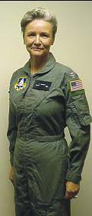
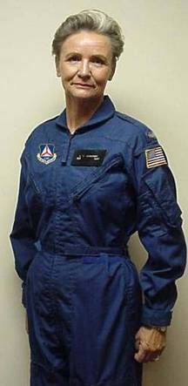
Flight suits
AF-style flight suit
  Must meet weight and
  grooming standards
  White, black or brown t-shirts
  Leather namepatch
  Optional Right shoulder patches
  Flight cap or CAP baseball cap
CAP flight suit
  White t-shirt
  Leather namepatch
  Optional right shoulder patches
  No military badges
  Flight cap or CAP baseball cap

Slide 18
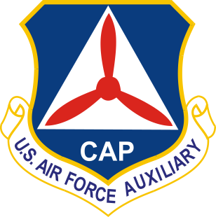
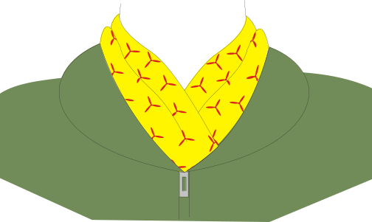
New Items
CAP Command Patch
  Replaces CAP seal on:
    CAP and AF-style flightsuits
    Green flight jacket
    CAP utility uniform
  Mandatory wear date 31 March 2004
Command scarf for aircrew members with AF flightsuit only

Slide 19
Uniform Phase Out Dates
  Aviator shirt w/blazer nametag – Feb 01
  White golf shirt – 1 Jan 02
  Ultramarine blue golf shirt – 1 Jan 03
  BDUs and Flight suits without grade insignia – 1 Jan 2003
  Jumpsuit –31 Dec 03
  CAP seal patch on flightsuits and utility uniform – 31 March 2004

