Slide 1

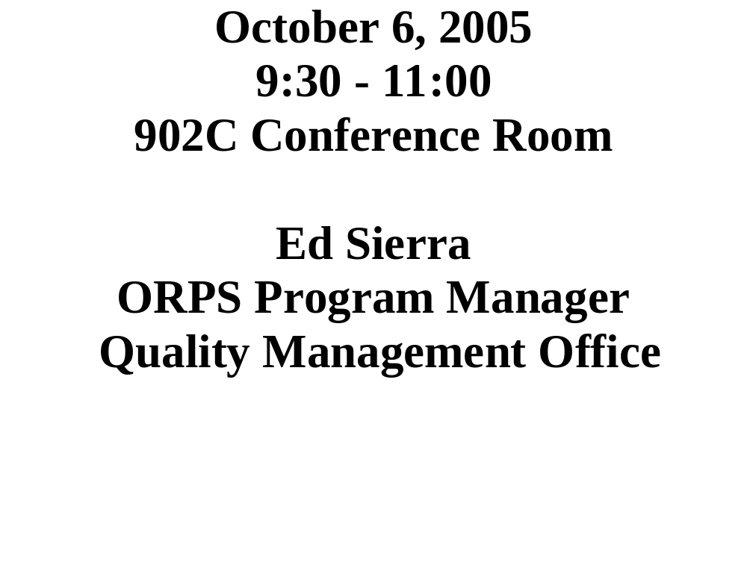
Categorizers (CAT) Team Workshop #2005-03

Slide 2

OUR AGENDA!
Workshop Goals
Point to Ponder
ORPS Trending
CAT Form Entries
Programmatic Bins
Cat Chat
  BNL “R” Report Process
  “R” Reports in the Complex
Meeting Evaluation and Wrap-up

Slide 3

CAT Team Workshop
Workshop Goals:
  To EVALUATE and CONTINUOSLY IMPROVE the BNL Occurrence Reporting Program.
  To MAINTAIN a baseline categorization process such that reportability decisions are both VALID and CONSISTENT.
  To PROMPT (via categorization) deep and lasting value-added CHANGE, which results in new ways of thinking and acting.
    CAT

Slide 4
Point to Ponder
“GREAT MINDS discuss ideas,
Average minds discuss events,
Small minds discuss people.”
- Admiral Hyman G. Rickover

Slide 5
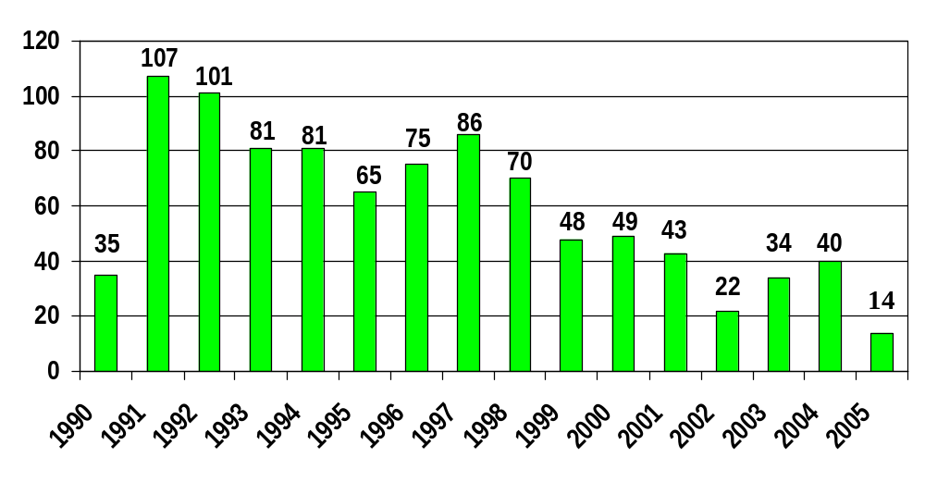
BNL ORPS by Calendar Year Report Submitted
As of 09/30

Slide 6
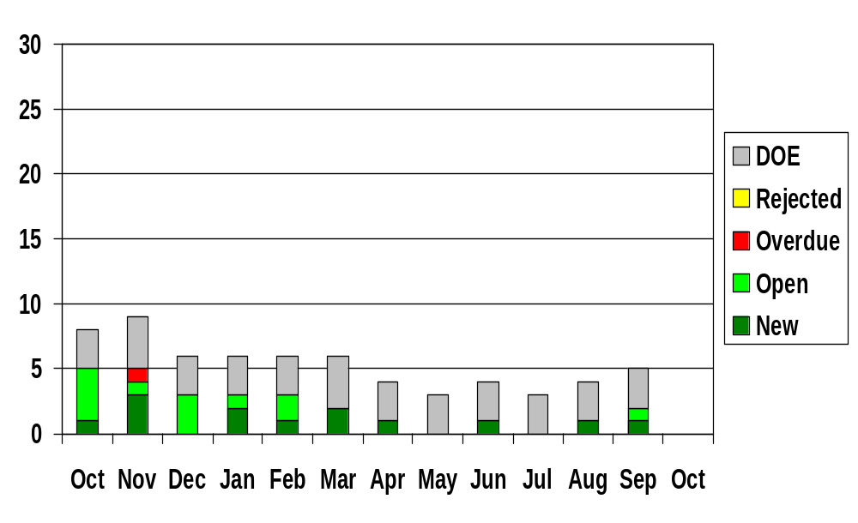
BNL ORPS Report Status
FY 2005 (End of Month)

Slide 7
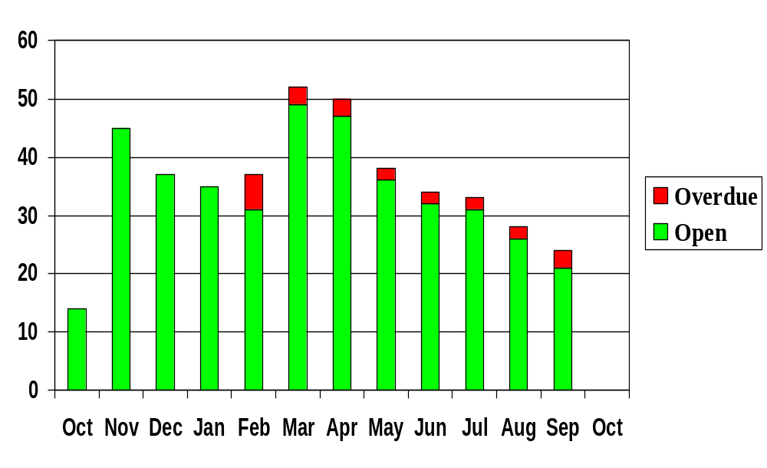
ORPS Corrective Action Status
FY 2005 (End of Month)

Slide 8
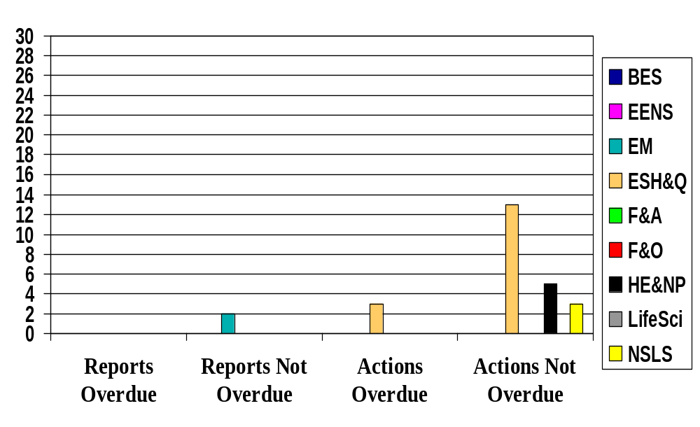
ORPS Reports and Actions
September 30, 2005
ALD

Slide 9

CAT Electronic Entries
07/07 – KK, < 1 gal hyd oil spill from PE line truck
07/07 – KK, Chemistry student passes out, taken to hosp, not work related
07/12 – AL, EOC opened to track hazardous waste shipment
07/13 – AL, Chemical Hole contract worker ill, not work related
07/14 – AL, Momentary loss of LIPA power, no fault of BNL
07/18 – KS, LIPA Power Dips Cause Unplanned Shutdown of Cyclotron
07/21 – KS, Minor Occupational Injury (wood splinter) at Building 1005R
07/26 – AL, Safety Notice - Faulty Pressure Relief Valve (SC4)
08/01 – PB, Simple Fracture of Pinky Finger while working on dump truck
08/05 – MB, NSLS User trans from BNL Dorm to Hospital, non-work related
08/06 – MB, Discovery of fixed Rad Cont @ Bldg 527
08/08 – MB, Rail Car (Gondola) Derailment at BNL (SC3)
08/10 – MB, BNL Fire Department extinguishes small brush fire
08/15 – RK, <1Cup oil spilled at railroad track by south firebreak

Slide 10
CAT Electronic Entries
08/15 – RK, BNL Initiated “time out” at New Research Building site
08/16 – RK, <1-gallon hydraulic fluid on pavement in rear of B326
08/17 – RK, Rail jitney radiator cracks, ~ 7 gals of anti-freeze spill
08/17 – RK, Hg laden soil temp stored at Old HWMF
08/18 – MB, Fire Rescue responds to smoke detector false alarm at NSLS
08/21 – RK, Phones/fire alarm trans to BNL Firehouse oos for ~ 1 hour
08/24 – PB, Contractor - 4K dpm skin cont on neck @ B650
08/26 – RK, (Update) Hg/Cs-137 laden soil stored at Old HWMF
08/29 – SM, P/U truck damages wall at B1002B
09/06 – MD, (Update) Contractor - 4K dpm skin cont on neck @ B650 (SC4)
09/06 – MD, GW treatment system (Sr-90) fitting leak, to sump @ B855
09/07 – ES, (Update) Contractor - 4K dpm skin cont on neck @ B650 (SC3)
09/08 – MD, 09/08 - PE truck hung up on berm behind B912
09/13 – KS, Tritiated water (2200 pCi/L) leak (30-50 gal) to soil near B930A

Slide 11
CAT Electronic Entries
09/16 – KS, 500 dpm alpha (Americium 241) skin cont on hand @ B650
09/19 – AL, Non-occupational illness results in trans to hospital
09/23 – AL, Worker has allergic reaction to chigger bites around B257 &258
09/26 – AL/PB, Custodian cuts hand on window pane during fall @ B815
09/29 – PB, Inert gas removed from HFBR vessel without written approval
09/29 – ES, (Update of 8/8 entry) Recurring Railcar Events (SC“R”)

Slide 12
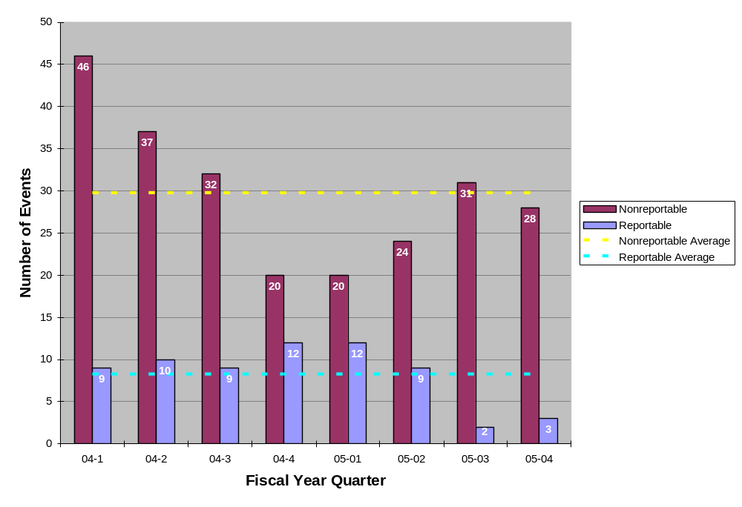
ORPS Reportable and Nonreportable Cat Entries

Slide 13

Programmatic Bins
Personnel Contamination
Medical Department
NSLS
Physics
CA-D
BGRR Project
Plant Engineering (New Bin)
Utilities Struck
Material Transportation
Electrical Shock Hazards
Material Handling Issues
Waste Management
Chemistry
Environmental Restoration
Railroad Tracks

Slide 14

Programmatic Review
Personnel Contamination – 2004
  04/14 – 5,000 dpm on top of worker’s shoe at BGRR (RAR)
  05/21 – <50,000 dpm cont on experimenters at AGS
  08/31 – ~ 200 dpm/100cm2 on experimenter at PET
Personnel Contamination – 2005
  02/02 – Personnel Contamination at Cyclotron
  02/08 – Radioisotope Production Lab Cont Identified @ 901
  03/30 – 14,000 dpm of beta/gamma on sneaker at PET
  09/07 – Contractor - 4K dpm skin cont on neck @ B650 (SC3)
  09/16 – KS, 500 dpm alpha cont on hand @ B650

Slide 15

Programmatic Review
Medical department, 2004
  01/27 – MEL hot cell filters not replaced at age of 66 months
  02/03 – Water leak floods 490 with 150 gallons
  02/03 – Slip and fall on slick floor
  03/10 – Failed HEPA filter efficiency test at B-801
  03/12 – 20ml leak from D-waste storage tank in B-801
  04/08 – Chill water spill at 801 during seasonal flushing
  04/28 – BLIP target shaft leaks water to secondary containment
  05/09 – New target window at BLIP leaking
  05/25 – Herpes-B Virus Precautions in Animal Facility (SC3)
  07/30 – Minor leak from “D” waste valve in B-801
  08/10 – Minor I-135 spill in B-490 (RAR)
  08/16 – Carpenter drills into water line in B-490
  10/29 – RWP and Trans Safety Violations in B-490 (SC3)

Slide 16
Programmatic Review
Medical department, 2005
  01/17 – Steam Leak in Basement of Building 490
  01/26 – Meth Chloride Spill and Overexposure @ 490 (SC3)
  04/21 – Post-doc faints when taking blood samples @ 490
  06/07 – Researcher transport Rad experiment in private vehicle

Slide 17

Programmatic Review
NSLS, 2004
  01/16 – Pre-action SS spurious trip
  02/07 – Unapproved work in laser hutch (Bldg. 729)
  04/18 – Unauthorized SDL operation
  05/13 – Window pane falls from second floor
  06/03 – Improper cable connection on exp floor
  07/12 – Worker feels mild electrical tingling in his finger
  07/22 – Hydrofluoric Acid Contamination of Technician
  08/07 – Trace amts. of H-sulfide leaked from gas cylinder
  08/10 – Worker experiences electric shock (SC3)
  09/22 – Voltage leakage through hook on crane at NSLS

Slide 18
Programmatic Review
NSLS, 2005
  03/03 – Suspect Bolts Found in Crane During Inspection @ NSLS (SC4)
  04/20 – Haz concerns associated with energized magnet
  06/28 – SC, Syringes (w/needles) found in Research Laboratory
  Trash Receptacles @ Bldg 725A

Slide 19

Programmatic Review
Physics, 2004
  07/01 – Laser interlock check overdue by 3 weeks @ ATF
  10/21 – Trimmed tree branch breaks window at physics
Physics, 2005
  04/25 – Smoke alarm from overheated plastic tubing @ Bldg 832

Slide 20

Programmatic Review
CA-D, 2004
  01/13 - Worker breaks ankle while preparing for cable pull (SC3)
  03/22 - Welder’s helper receives minor eye irritation
  05/17 - Damaged detector at STAR after 10 foot drop
  05/21 - <50,000 dpm cont on experimenters at AGS
  07/14 - Fire in a RHIC RF cavity power supply in Bldg 1004A
  08/11 - Heating element inside cold box causes burn to hand (SC 3)
  10/15 - Potential fire hazard in AGS cable tray (SC4)
  10/15 - Low voltage leakage through hook on crane at bldg 930
  11/08 - Fire Inside Power Supply Cabinet (SC4)
  12/02 - Unauthorized access into the STAR hall

Slide 21
Programmatic Review
CA-D, 2005
  01/07 – Employee falls while walking (Reason Unknown, SC3)
  02/09 – Slip and Fall Results in Hairline Fracture of Kneecap (SC3)
  03/14 – Cooling Water Leak at LINAC due to stuck open relief valve
  02/22 – High pH detected at recharge basin HTW, Bldg 930
  04/19 – Worker breaks finger while climbing ladder @ AGS
  05/04 – Sparking From ATR Main Magnet Cooling Water Pump
  07/21 – Minor occupational injury (wood splinter) at Bldg 1005R
  08/29 – P/U truck damages wall at B1002B
  09/13 – Tritiated water (2200 pCi/L) leak (30-50 gal) to soil near B930A

Slide 22

Programmatic Review
BGRR Project, 2004
  04/14 - 5,000 dpm on top of worker’s shoe (RAR)
  05/03 - Leakage of cont water from Sea-Land Container (SC4)
  05/11 - Filter cart sep from resp during work in rad/cont area (SC3)
  09/03 - DSB work performed outside of procedure (SC4)
  10/05 - Injury due to steel plate falling at bldg 701 (SC3)
BGRR Project, 2005

Slide 23

Programmatic Review
Plant Engineering, 2005
  08/01 – Simple Fracture of Pinky while working on dump truck
  09/08 – PE truck hung up on berm behind B912

Slide 24

Programmatic Review
Utilities struck, 2004:
  04/19 – Electrical utility conduit strike (SC3)
  07/07 – Domestic water main strike
  09/07 – Comm. cable severed during excavation work
  12/09 – Unexpected discovery of 2.4K deenergized cables during excavation
Utilities struck, 2005:

Slide 25

Programmatic Review
Material Transportation, 2004
- 06/25 - B-52 waste cont support chnl rain water accumulation (SC4)
- 07/26 - Transportation of Solidified Liquid Low-Level Waste (SC1)
Note: “suspected radioactive contamination occurs involving shipment of radioactive materials” = SC1
Material Transportation, 2005
  03/17 – Excessive Drainage from BNL Rail Cars arriving at Envirocare (SC3)

Slide 26

Programmatic Review
Electrical Shock Hazards, 2004
  07/12 - Worker feels mild electrical tingling in his finger @ NSLS
  08/10 - Worker experiences electric shock @ NSLS (SC3)
Electrical Shock Hazards, 2005
  04/01 - Unexpected Discovery of Hazardous Energy Source @ Magnet Division (SC3)

Slide 27

Programmatic Review
Material Handling Issues, 2004
  03/05, Load Falls off Flatbed Truck, (SC3)
  03/24, Recurring Material Handling Problems, (SCR)
  05/17, Damaged detector at STAR after 10 foot drop
  06/11, 500 # steel block falls (3 – 4 feet) from forklift
  10/05, Injury due to steel plate falling at bldg 701 (SC3)
Material Handling Issues, 2005

Slide 28

Programmatic Review
Waste Management, 2005
  01/07 – WMD Worker Enters Controlled Area with Expired Training
  06/30 – ~2 inches (150 -200 gallons) of water flooded the equipment level at the BMRR
  04/21 – Worker injures back while moving drum
  09/16 – KS, 500 dpm alpha cont on hand @ B650

Slide 29

Programmatic Review
Chemistry, 2005
  02/02 – Personnel Contamination at Cyclotron
  02/08 – Radioisotope Production Lab Cont Identified @ 901
  03/30 – 14,000 dpm of beta/gamma on sneaker at PET
  05/11 – R.A. Cuts Hand/Requires Stitches @ Bldg 555

Slide 30

Programmatic Review
Environmental Restoration Projects, 2005
  05/26 – Technician Cuts Thumb During Cable Repair @ Bldg 811
  06/07 – Personnel Exposure to Excessive Noise (SC-3)
  06/21 – White Powder Substance Found Behind Bldg 657
  08/26 – Hg/Cs-137 laden soil stored at Old HWMF
  09/07 – Contractor - 4K dpm skin cont on neck @ B650 (SC3)
  09/06 – GW treatment system (Sr-90) fitting leak, to sump @ B855
  09/29 – Inert gas removed from HFBR vessel without written approval

Slide 31

Programmatic Review
Railroad Tracks, 2003
  08/27 - Rail Car movement while loading (ON)
Railroad Tracks, 2004
  09/03 - Empty railroad car derailed at BNL track switch
  09/04 - Off-site train car derailment (SC4)
  09/14 - Inadequate rail safety procedures (SC4)
Railroad Tracks, 2005
  01/05 - Empty Railroad Car Derailed
  08/08 - Rail Car (Gondola) Derailment (SC3)
  09/29 - (Update of 8/8 entry) Recurring Railcar Events (SCR)

Slide 32

Proposed BNL “R” Report Process
On going data collection
Tracking and Trending of data – ongoing
Identification of potential “R” recurring issue
Determine issue ownership
Inform DOE/BHSO ORPS Coordinator
Present potential recurring issue to owner for discussion/insight
Owner decision - Is this issue “R” reportable to DOE? Y/N?
    Yes – Issue “R” report
    No – Is BNL ORPS Coordinator in agreement? Y/N? Yes, Stop – No, continue to step 8
Presentation made to categorizers for “R” reportability vote
    Yes – Issue “R” report
    No – Stop
NOTE: All data/determinations captured in Quarterly Performance Analysis Report

Slide 33

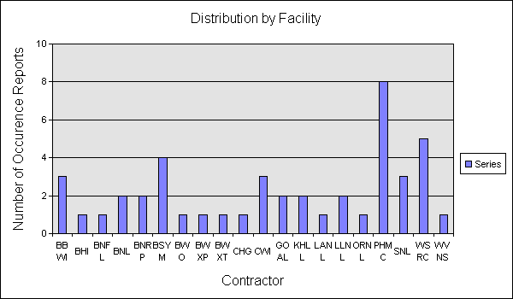
“R” Reports in the Complex
45 as of 10/05/2005
BBWI Bechtel BWXT Idaho, LLC.
BHI Bechtel Hanford Incorporated BNFL BNFL INC.
BNL Brookhaven National Laboratory BNRP Bechtel National River Project BSYM Bechtel SAIC Company LLC. BWO Babcock and Wilcox of Ohio, Inc. BWXP BWXT PANTEX
BWXT BWXT Y12
CHG CH2M HILL Hanford Group, Inc. CWI CH2M*WG Idaho, LLC
GOAL Albuquerque Operations
KHLL Kaiser-Hill Company, L.L.C. LANL Los Alamos National Laboratory LLNL Lawrence Livermore National Lab. ORNL Oak Ridge National Laboratory PHMC PROJECT HANFORD MANAGEMENT CONTRACTO
SNL Sandia National Laboratories WSRC Westinghouse Savannah River WVNS West Valley Nuclear Services

Slide 34
“R” Reports in the Complex
45 as of 10/05/2005
Procedure Non-Compliance during a Nuclear Explosive Operation that was determined to be of recurring nature.
RCRA Compliance Order resulting from 2001 Annual Inspection
Recurring Material Handling Problems (BNL)
Repetitive Issue on Noncompliance with Facility Operational Mode Requirements
Failure to apply Lockout/Tagout (LOTO) while working on an electrical system removing a light fixture
Recurring Events Involving Degradation Of Hydrogen Monitors/LFL Analyzers
Performance Analysis Identifies "Inadvertent Transfers/Siphons" As A Recurring Event
Performance Analysis Identifies "WSRC TSR Violations" As A Recurring Event
Management Concern of Lock and Tag Issues
Repetitive Issue with Subcontractor Performance
Recurring - Discovery of Beryllium Contamination in a non-Beryllium Use Facility
Five Technical Safety Requirement (TSR) violations occurred at the Plutonium Finishing Plant during the period from Sept. 2003 to July 2004
Recurring CAAS/PRDI Events
Temporary Suspension of ESF Underground Activities
Evacuation Alarm System Malfunction (Recurring)
Permit Exceedance for Copper, September and October 2004
Repetitive Issue Related to Management of Waste Transport Tankers
Management Concern With Recurring Radiological Control Events
Recurring Events Involving Subcontractor Performance

Slide 35
“R” Reports in the Complex
45 as of 10/05/2005
20. Recurring Event Report involving Tools or Materials Dropped from Heights
21. Quarterly Perfomance Evaluation Reveals Reportable Trend in ISM Program Implementation
22. Repetitive Issue with Electrical Safety
23. Management Concern - Conduct of Operations at the 100 K Area.
24. Recurring Events at the INTEC Spent Nuclear Fuel Facilities
25. Under-Reporting of Radiation Contamination Events
26. Repetitive Issue Related to Spacing of Containers in Accordance with Criticality Safety Postings
27. Performance Analysis Identifies "Multiple PISA/USQ Events in the SWMF" As A Recurring Event
28. Occurrence Reports Associated with Facilities Construction Operations
29. Evacuation of Shandiin Child Development Center (SCDC) Due to Broken Natural Gas Pipe
30. Repetitive Issue with Heavy Equipment Operations
31. Performance Analysis Identifies Deficiencies in Facility Hazard Categorization as a Recurring Event
32. Recurring Issues Associated With Hazardous Energy Control
33. Recurring Issues Associated with Radiological Control
34. Performance Analysis Identifies WSRC Electrical Safety Performance As A Recurring Problem
35. Inadequate Work Control Process
36. Evacuation of Shandiin Child Development Center (SCDC) Due to Natural Gas Leak
37. Multiple Criticality Working Requirement Violations Cause Management Concern
38. CO Monitors Alarm Causing Tunnel Precautionary Evacuations
39. Survey Activities Extended Outside Radiologically Cleared Area

Slide 36
“R” Reports in the Complex
45 as of 10/05/2005
40. Delay in Placing SCW Packet Assay into Suspension Vilolates Limiting Condition for Operation and Recurring TSR Implementation Events
41. Recurring Issues Associated With Respiratory Equipment
42. Recurring Occurrence on Work Control Issues
43. Management Concern - Procedural Compliance Issues
44. Recurring Railcar Events (BNL)
45. Near Miss [Electrical] Incidents at the WTP (Recurring)

Slide 37


CAT Team Workshop
CAT Team Action Item Review
Meeting Evaluation and Wrap-Up

