Slide 1

Professional Image
Page 21 in Guide
50 minutes
Instructor: See Notes View of this Overhead.
U.S. AIR FORCE
AUXILIARY
Notes:
This is the only file (e-mail attachment) you will need to do a great presentation! Use the overheads as your briefing notes. Overheads appear in the same sequence as they will appear in the Student Guide. The overhead above shows the students what page to turn to.
The overhead also tells you how many minutes your entire presentation should take, including time for questions and comments. If the overhead has “Includes Case Study” you will need to budget that time to complete the case study as well. Case studies are required, and appear (with textbook answers) as the last of these overheads. This is because case studies build on lecture and get learners actively involved in personalizing the information. They make it interesting and fun, too!
Your primary job in preparation is to make sure the information on the overheads is correct, complete, and current. You may need to check the CAP regulations and forms; and you may need to consult key CAP members for more information. Their e-mail addresses are usually found in the Wing web page.
If you add, delete, or change any overhead, need audio-visual devices (other than an overhead projector) and/or copies of your handouts, please contact the Activity Director no later than one week before the first class day of the activity. This allows time to make changes, run copies (including overheads) and put them in binders. After that date, if you choose to print your own handout materials, you may do so, but at your own expense.
Please wear either the blue military-style uniform with service jacket and ribbons OR aviator shirt-gray pants/skirt combination with tie and blazer, during your presentation.
Arrive at least 30 minutes early so time schedules run smoothly.
Stick to your time schedule so we can avoid dead time or over time. Remember time for questions and comments, and your Case Study. It is better to end early than run over.
We welcome you to stay with us before and after your presentation. It is a good chance to discover new material and ideas from other talented people!

Slide 2
Purpose and Rationale
Purpose and rationale
  How first impressions relate to the CAP professional image
Wear of the CAP uniform
The “who” “what” “when” “how” and “where” of saluting
Respecting the American Flag
Other Situations
Receiving your certificate or award

Slide 3
Wear of the CAP Uniform
Type
  Blue-shirt combination
  Aviator Shirt & CAP blazer combination
  BDUs
  Flight Suit
  Mess Dress
Device
  Name plate
  Grade insignia
  Ribbons
The above is helpful for My Uniform Rules and Regulations, page 22 in Guide

Slide 4
Wear of the CAP Uniform
Quick Guide for Uniform Inspection & Uniform Inspection Checklist
polished shoes
not wrinkled
all buttons done up
straight gig line
tie tack/clip centered
break of trouser crease or skirt above/below knee cap

Slide 5
Wear of the CAP Uniform
Common Blue Uniform Mistakes
Epaulets over collar of service jacket
Ribbon order
Items protruding from pockets
Crooked knot on necktie

Slide 6
Wear of the CAP Uniform
Common BDU Mistakes
Blousing boots
T-shirt black or brown
Rolling up sleeves
1/10-inch blue margin on some patches
Proper belt and proper belt buckle

Slide 7
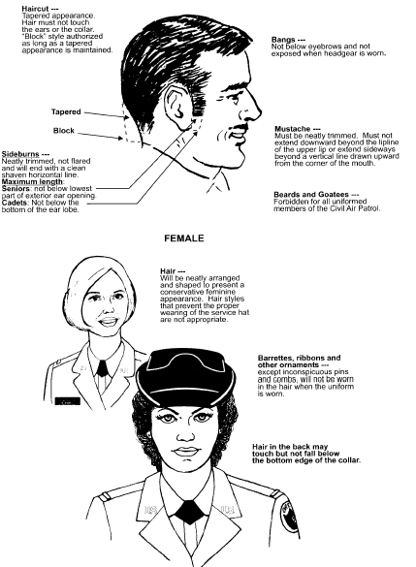
Wear of the CAP Uniform
Grooming standards required in order to wear the blue Air Force style uniform combinations.

Slide 8
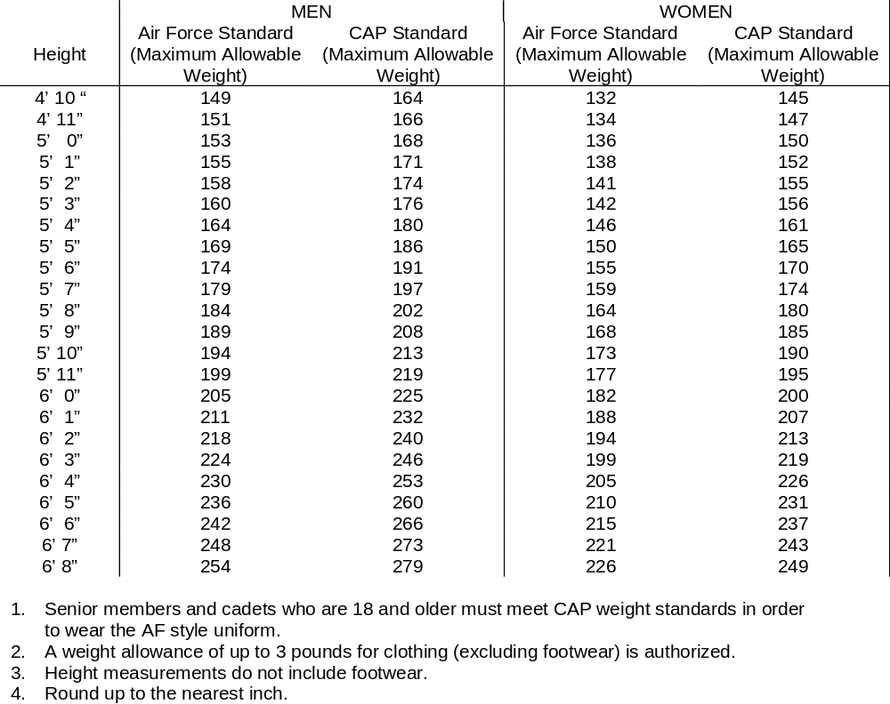
Wear of the CAP Uniform
Weight standards required in order to wear the blue Air Force style uniform combinations.

Slide 9
Saluting
Who and What
When and Where
How
When Not to Salute

Slide 10
Saluting
Who and What
The United States Flag
The President of the United States
Officers in the U.S. Armed Forces
Officers of Civil Air Patrol
Officers of friendly foreign nations
Medal of Honor recipients

Slide 11
Saluting
When and Where
Indoors
  When reporting in or out
  During an award ceremony

Slide 12
Saluting
When and Where
Outdoors (any area outside of a building, including open porches, covered sidewalks, bus stops, covered or open entryways, and reviewing stands)
  When approaching a senior officer
  When in charge of a formation
  When approached by a vehicle with a flag or medal standard with the rank of an officer
  In respect to the American flag
  After a conversation with a senior officer

Slide 13
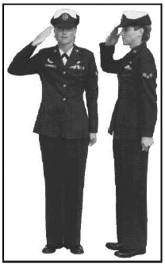
Saluting
How
Raise right hand smartly in most direct manner
Extend and join the forefingers
Place the thumb along the forefinger, keeping the palm flat
Face the palm slightly toward the face
Tilt the palm slightly toward the face Hold the upper arm horizontal, slightly forward of the body and parallel to the ground
Ensure the tip of the middle finger touches the outside corner of the right eyebrow or the front corner of the glasses
Keep the rest of the body at attention
Bring the arm smoothly downward
Return to the position of attention

Slide 14
Saluting
When Not to Salute
In formation (only the officer in charge salutes)
When encumbered by items in hands (a verbal greeting is appropriate)
In emergency situations
When judgment and common sense determine

Slide 15
Respecting the American Flag
The National Anthem
Military-style uniform
  Indoors
    Remain silent
    Stand at attention
    Face the Flag
  Outdoors
    Remain silent
    Stand at attention
    Face the Flag (or music, if Flag is not visible)
    Salute

Slide 16
Respecting the American Flag
The National Anthem
Civilian clothes, non-military-style uniform
  Indoors and Outdoors
    Remain silent
    Stand at attention
    Face the Flag (or music)
    Place hand over heart (remove headdress with right hand and hold it at the left shoulder with the right hand over the heart)

Slide 17
Respecting the American Flag
The Pledge of Allegiance
Military-style uniform
  Indoors
    Come to attention
    Face the Flag
    Remain silent
  Outdoors
    Come to attention
    Face the Flag
    Remain silent
    Salute

Slide 18
Respecting the American Flag
The Pledge of Allegiance
Civilian clothes, non-military-style uniform
  Indoors and Outdoors
    Come to attention
    Face the Flag
      If wearing a hat, remove it with the right hand and place at left shoulder with right hand over heart
      If not wearing a hat, place right hand over heart
    Recite pledge

Slide 19
Respecting the American Flag
Retreat
(lowering of the Flag on a military institution at the end of the day)
Military uniform
  Remain silent
  Face the Flag (or music if no flag is visible)
  Stand at Parade Rest during sounding of Retreat
  Come to attention and salute when National Anthem begins

Slide 20
Respecting the American Flag
Retreat
(lowering of the Flag on a military institution at the end of the day)
Civilian clothes, non-military-style uniform
  Remain silent
  Stand at Parade Rest during the sounding of Retreat
  Come to Attention
    If wearing a hat, remove it with the right hand and place at left shoulder with right hand over heart
    If not wearing a hat, place right hand over heart

Slide 21
Other Situations
In a car
  driver stops at To The Colors
  driver and passengers remain silent during National Anthem
When U.S. Flag passes in a parade or flag ceremony
  military style uniform
    salute when Flag within 6 paces, hold salute until Flag passes six paces (outdoors only)
  non-military clothing
    place right hand over heart when Flag within 6 paces, hold until Flag passes six paces (indoors and outdoors)

Slide 22
Receiving Your Certificate or Award
Salute (right hand)
Take (left hand)
Shake (right hand)
Salute (right hand)
Picture (optional)

