Slide 1
Overview of EPA’s Regulatory Program on Endocrine Disruptors

Slide 2
US Approach to Endocrine Disruptors
Two Part Approach
Research:
  Understand the basic science and mechanisms of action, and
  Develop measurement methods and risk assessment models
Screening, Testing and Risk Management:
  Identify potential endocrine disruptors
  Determine adverse effects and dose-response
  Assess risk
  Manage risk under current laws

Slide 3
ED Regulatory Program Activities
Next 4 years:
Development of priority setting mechanism
Development and validation of screens and tests
Development of procedures and policies for the EDSP
Develop standard evaluation procedures and risk assessment guidelines
Require screening and testing

Slide 4
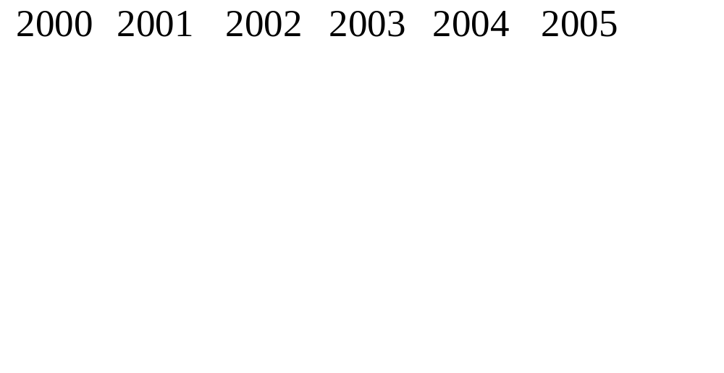
US Timeline
Priority Setting
Tier I Validation
Tier II Validation
Screening 1st
Chemicals

Slide 5
ED Regulatory Program Activities
Long term:
Review test data
Conduct hazard/risk assessments
Take appropriate risk management

Slide 6
U.S. Endocrine Disruptor
Screening Program
Required by the Food Quality Protection Act of 1996
  - Screen pesticides for estrogenic effects that may affect human health
  Develop a screening and testing program by August 1998
  Implement the screening and testing program by August 1999
  Report to Congress by August 2000

Slide 7
U.S. Endocrine Disruptor
Screening Program
EPA must use appropriate validated test systems or other scientifically relevant information
EPA can require screening and testing of:
  - Certain drinking water contaminants
  Other endocrine effects
  Certain other substances that have an effect cumulative to that of a pesticide chemical
Notes:
2

Slide 8
EDSTAC RECOMMENDATIONS
EDSTAC made 71 recommendations. The overarching ones are:
  EPA should use a High Throughput Pre-Screen to help prioritize chemicals
  EPA should develop a data base to help prioritize chemicals
  Use 3 in vitro and 5 in vivo assays in the tier 1 screen to cover all known modes of E,A,T action
  Use 5 tests in tier 2 to cover mammals, birds, fish, invertebrates and amphibians
  EPA should validate the screens and tests prior to regulatory implementation

Slide 9
SCOPE OF EPA’S ENDOCRINE DISRUPTOR SCREENING PROGRAM
Based on current science, the scope of the screening program includes:
  Estrogen, Androgen and Thyroid hormones
  Human health and ecological effects
  Broad range of chemicals and mixtures
Notes:
6

Slide 10
THE UNIVERSE OF CHEMICALS
Chemicals Under EPA’s Purview
  950 pesticide active ingredients
  2500 “inerts” in 20,500 products
  75,500 industrial chemicals on the TSCA inventory
  environmental contaminants (?)
Chemicals Under Other’s Purview
  cosmetics
  food additives
  nutritional supplements
Notes:
7

Slide 11
Framework
Initial Sorting
Priority Setting
Screening (Tier 1)
  Identifies substances for further testing
Testing (Tier 2)
  Identifies adverse effects and establishes dose-response relationship for hazard assessment
Notes:
8

Slide 12
Screening, Testing and Assessment Strategy
Current efforts focused on:
  Pesticide active ingredients (~950)
  Chemicals which are both “inert” formulation ingredients and HPV commercial (~600) chemicals
  Chemicals positive on QSAR
Meets statutory mandate for screening pesticides
Reasonable number of chemical candidates

Slide 13
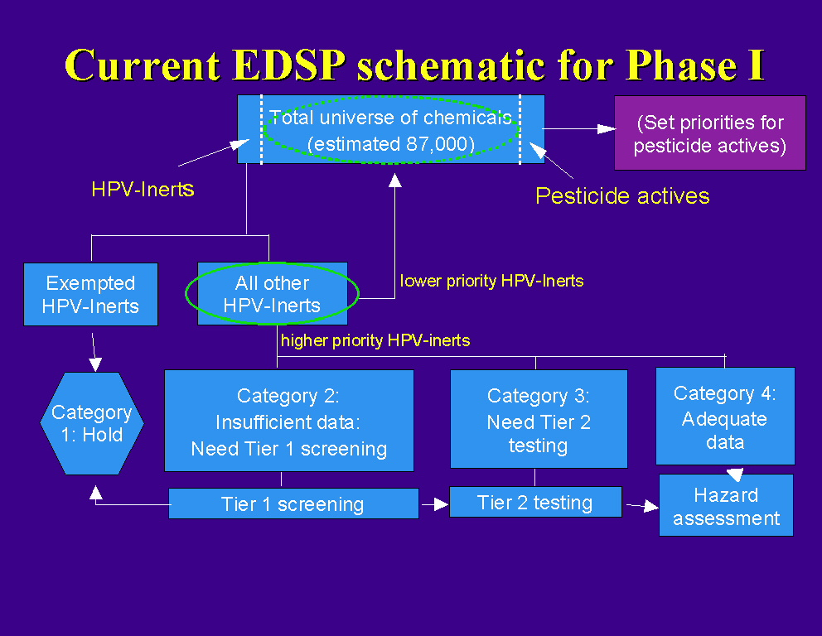
+ QSAR

Slide 14
Implementation Strategy:
Commercial Chemicals
Goal: Set priorities for chemicals according to potential exposure and potential endocrine effects
How:
  Develop Priority Setting Database
  Group chemicals based on common effects and exposure information
  Compare chemicals within groups and establish priorities within groups
  Pick highest priority chemicals in each group
Notes:
12

Slide 15
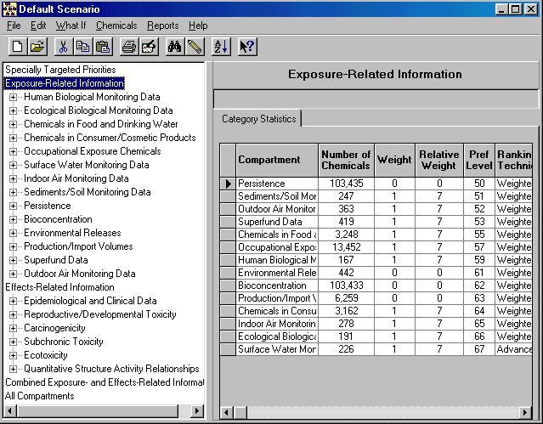
EDPSD v.2 Exposure Data Screen

Slide 16
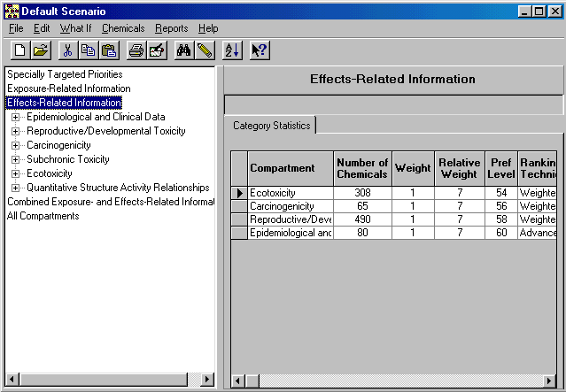
EDPSD v.2 Effects Data Screen

Slide 17
PROBLEM: LACK OF EFFECTS INFORMATION FOR PRIORITY SETTING
PROPOSED SOLUTION # 1
Use High Throughput Screening Technology (HTPS)
EPA to run ER, AR assays (Tier 1) assays before priority setting on 15,000 chemicals
Use data to help set priorities for remainder of Tier 1 screen
PROPOSED SOLUTION # 2
Develop and validate QSAR models based on receptor binding data
Notes:
14

Slide 18
USING MODELS FOR PRIORITY SETTING
Explore the use of QSAR models rather than HTPS for priority setting for 1st group of screening candidates
Building a QSAR model involves two steps:
  Generation of descriptors to encode chemical information
  Correlation of descriptors with biological activity
QSAR will be validated and peer reviewed

Slide 19
NCTR Stepwise Approach for ER Binding
Step 1 Simple filters
  Molecular weight: 94-1000
  HC with at least one ring
Step 2 Qualitative Activity Prediction
  3-D Pharmacophore Atomic distance and bond angles like E2 or DES
  Classification models
Step 3 CoMFA
  3D correlation of steric-electrostatic interactions between ligand and receptor

Slide 20
COmmon REactivity PAttern (COREPA)
3-D Approach
High computational intensity
Computations performed once
Provides conformational flexibility
Uses descriptors based on published data
Screens large sets of structurally-diverse chemicals based on stereo-electronic properties of each chemical

Slide 21
Proposed Implementation Strategy:
Registered Active Ingredients
Conduct Pilot Program with 25-50 “potentially high EAT hazard concern” substances
Pilot will be used to develop criteria for evaluating existing information and sorting pesticides and chemicals into Categories 2, 3 and 4.
Contractor will conduct literature search and assessment using developed criteria
Obtain screening or testing data by periodic issuance of testing orders for additional substances

Slide 22
TIER 1 SCREENING
Interaction with endocrine system
Screens should be
  inexpensive, quick, simple
  standardized and validated
  more sensitive than specific
  able to detect multiple endpoints
  readily interpretable
Use information to
  make initial judgments
  direct and focus tier 2 tests

Slide 23
Modes of Action
Hormone synthesis and clearance
Hormone storage and release
Hormone transport
Receptor binding
Altered post-receptor activation

Slide 24
PROPOSED SCREENING BATTERY (Tier 1)
In vitro Screens
  ER Binding / Reporter Gene Assay
  AR Binding / Reporter Gene Assay
  Steroidogenesis Assay with minced testis
In vivo Screens
  Rodent 3-day Uterotrophic Assay (sc)
  Rodent 20-day Pubertal Female Assay with Thyroid
  Rodent 5-7 day Hershberger Assay
  Frog Metamorphosis Assay
  Fish Reproduction Screening Assay

Slide 25
ALTERNATE SCREENING ASSAYS
Rodent 20-day Pubertal Male Assay with Thyroid
Placental aromatase
Rodent in utero through Lactation Assay

Slide 26
TIER 2 TESTING
Confirm and characterize endocrine effects
Tests should
  if found, determine if effects are a primary or secondary disturbance of endocrine function
  establish exposure/concentrations/timing and effects relationships
  be sensitive and specific
  assess relevant endpoints
  include life cycle of live-bearing and egg-laying species
  include a dose range for full characterization of effects
  be conducted in accordance with GLP
  be validated

Slide 27
PROPOSED TIER 2
TESTING BATTERY
Multigeneration reproduction and development studies
  Rodents
  Birds
  Frogs
  Fish
  Shrimp

Slide 28
Development of Policies and Procedures
EPA proposed policy in Dec 1998
Re-propose statement of EPA policy 2002
Final statement of policy 2003

Slide 29
Development of Policies and Procedures
Statement of Policy may address:
  Authorities EPA will use to require testing
  Data compensation issues
  Data development and submission requirements
  Program mechanics
  Other legal and policy issues

Slide 30
EPA REGULATORY IMPLEMENTATION
Use Order (FIFRA, FQPA, SDWA) and /or Test Rule authority (TSCA) to require industry to develop screening and testing data
EPA conducts hazard/risk assessment

Slide 31
Endocrine Disruptors Will Be Regulated Under Existing Laws
Insecticide, Fungicide, Rodenticide Act
Food Drug and Cosmetics Act
Toxic Substances Control Act
Clean Water Act
Safe Drinking Water Act
Clean Air Act

Slide 32
RESEARCH
Risk Assessment Guidelines
Assay
Development
Standardization
Validation
Standard Evaluation
Procedures
TEST
DATA
EVALUATE STUDIES
ASSESS HAZARD
EXPOSURE
ASSESS RISK

Slide 33
US Timeline
Priority Setting
Tier I Validation
Tier II Validation
Screening 1st
Chemicals

