Slide 1

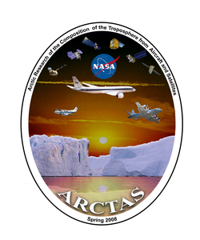
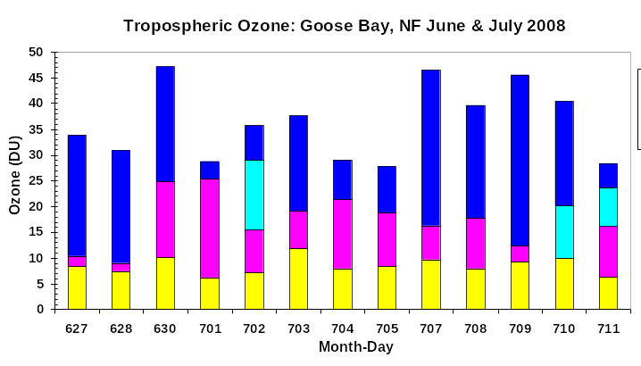
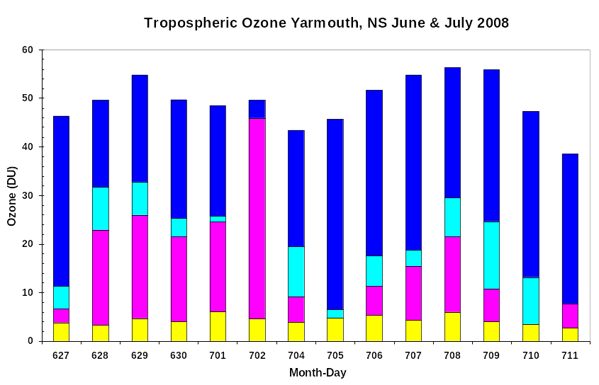
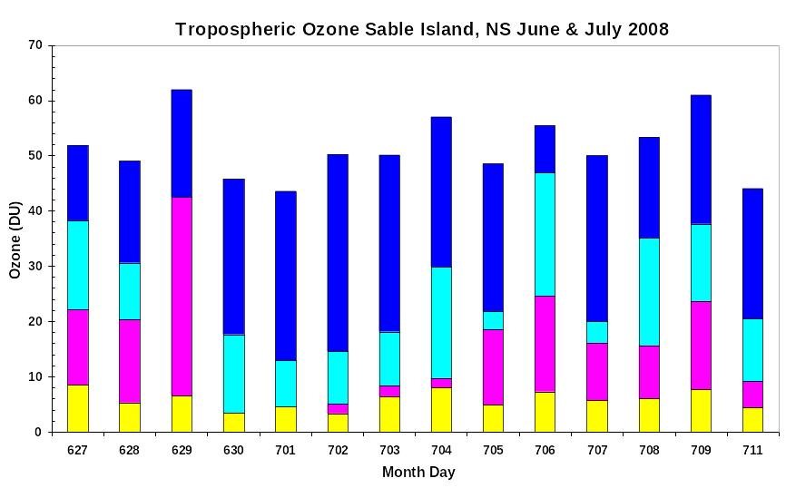

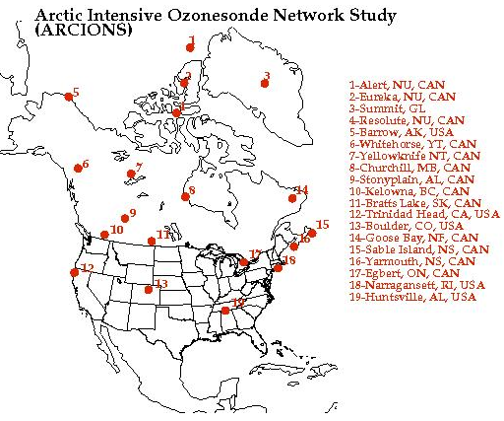
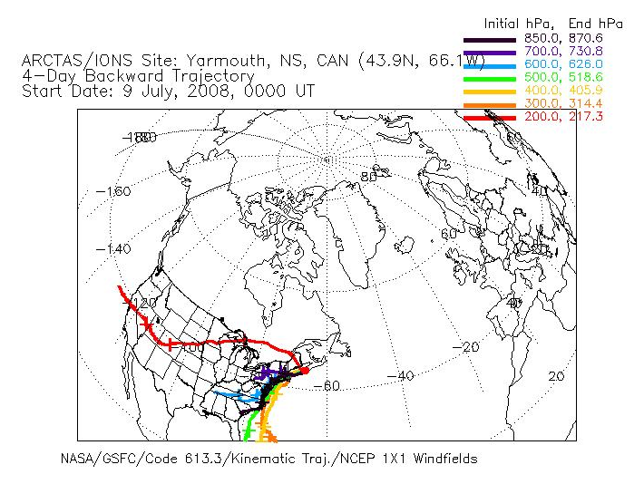
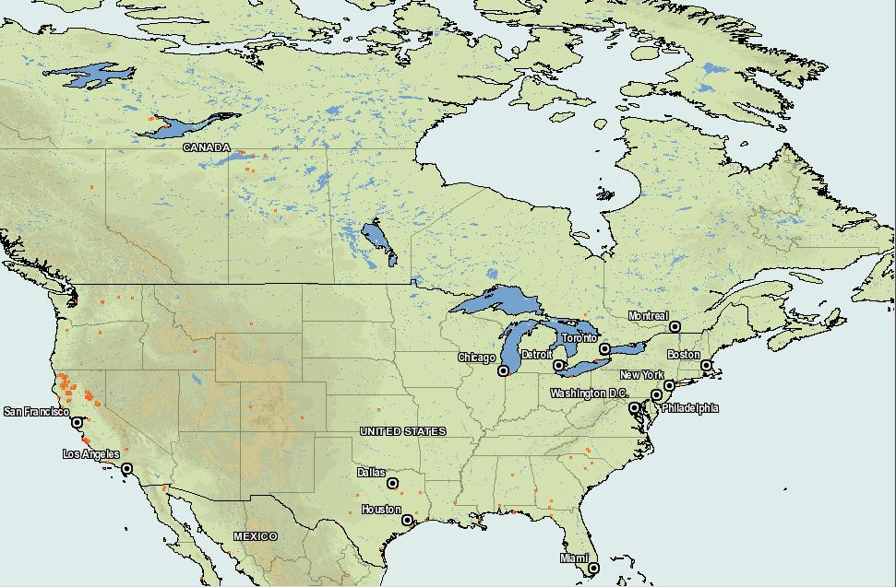
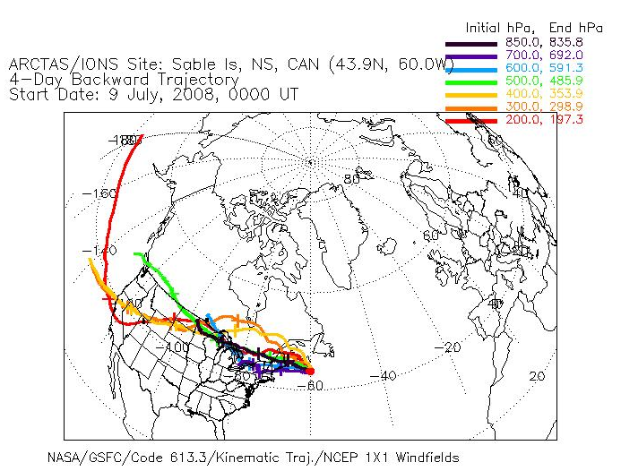
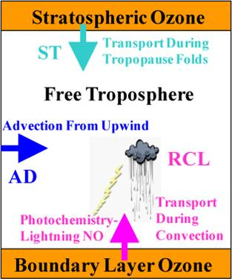
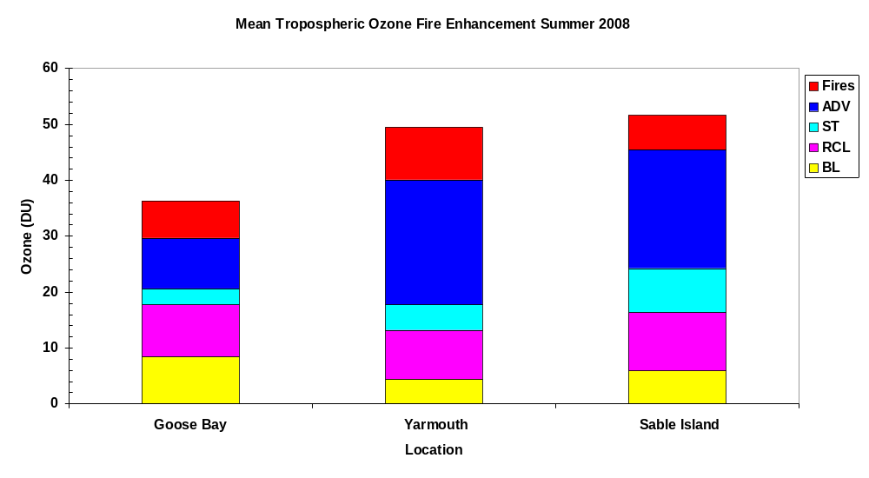
Arctic Tropospheric Ozone Structure during the Summer 2008 ARCTAS/ARC-IONS Campaign
Alaina M Luzik¹, Anne M Thompson¹, Stephan D Gallagher¹, Sonya K Miller¹, Jacquelyn C Witte², David Tarasick³
¹The Pennsylvania State University, Department of Meteorology; ² SSAI of Lanham, MD 20706 USA; also at NASA/Goddard Space Flight Center; ⁵ Environment Canada, MSC
Introduction
NASA’s two-part Arctic Research of the Composition of the Troposphere from Aircraft and Satellites (ARCTAS) mission was developed for two reasons. First, the Arctic is a haven for pollution from the mid-latitudes and summer boreal fires. Second, it is a beacon of climate change. During June and July 2008, satellites, airplanes and ground-based instruments were used to study air pollution as a result of boreal fires.
Ozonesonde launches, which comprised the Arctic Intensive Ozonesonde Network Study (ARC-IONS), were coordinated with the Aura satellite overpass during the spring (1-20 April) and the summer (27 June – 11 July). The influence of forest fires at three ARC-IONS sites, Goose Bay, NF, Sable Island, NS and Yarmouth, NS, will be discussed. These sites were chosen because of their close proximity to each other and each site had several days with forest fire influence.
Results & Discussion
LID budgets show an increase in TTOC towards the end of the campaign, when forest fires influenced the ozonesonde profile.
Forest fire influence on the ozonesonde profile was determined by comparing the GMAO back trajectories from the croc website (http://croc.gsfc.nasa.gov/arcions/) to MODIS detected forest fire hot spots.
Mean TTOC profiles were calculated for days when forest fires influenced the ozonesonde profile. These budgets differ from Figure 3 because the ADV term has been divided into ozone due to forest fire influence and the remaining ADV term.
Conclusion
Forest fire plumes influenced the ozonesonde profiles 5 days at Goose Bay, 7 days at Yarmouth and 6 days at Sable Island during the 2008 ARC-IONS campaign. The increased ozone amounts ranged from 6 DU at Sable Island to 9 DU at Yarmouth.
Variations in fire enhancement ozone may have been caused by the smoke plume mixing with other air masses or deposition as the plume passed from Goose bay to Yarmouth and then to Sable Island.
Meteorological surface maps (not shown) illustrate two low pressure systems were north of the study region on July 6-7 and July 8-9. The low pressure systems caused sinking air and shorter total column heights. These meteorology conditions allowed the plume to mix with tropospheric air over a shorter column height thus increasing the TTOC amount on those days.
The TTOC decrease on July 10 and 11 can be contributed to the low pressure system moving to the east and allowing high pressure to build over the region.
Future work for this data will include comparisons with the satellite and aircraft data used during ARCTAS. Some comparisons may also be made between model results and the actual observations.
Figure 3: Tropospheric ozone budgets calculated using the LID method for Goose Bay (top left), Yarmouth (above) and Sable Island (left).
a)
c)
Figure 1: Locations of the ARCIONS ozonesonde launch sites. Courtesy of Jacquie Witte.
Methods
Ozone profiles are analyzed using the Laminar Identification (LID) method [Thompson et al., 2008; Yorks et al., 2008] to determine if the free tropospheric ozone is generated by vertical motions (ie, convection or waves - RCL), transported from the stratosphere (ST) or if it was advected from upwind (ADV). Ozone below 1-2 km is classified as boundary layer (BL) ozone.
The ozone column origins are determined for each day for one particular site. Mean tropospheric ozone columns (TTOC) were calculated to allow intercomparisons among the sites.
Forest fire influence was calculated by analyzing GMAO back trajectories (http://croc.gsfc.nasa.gov/arcions/) and MODIS detected forest fire hot spots. A meteorological analysis was also completed for fire days to observe how weather patterns influenced the plume’s behavior at a location.
Ozonesonde budgets on days with forest fire influence were then reanalyzed to determine how much ADV ozone was due to the forest fire influence.
b)
Figure 4: Forest fire influence on the ozonesonde profile was calculated using NOAA HYSPLIT Back Trajectories for (a) Yarmouth and (b) Sable Island. Forest fire locations (c) as identified by the MODIS Rapid Response were mapped using the UMD’s Information for Resource Management System (FIRMS) (http://firefly.geog.umd.edu/firemap/). The fires on this day were in the South East U.S. and in Southern Canada
References
A. M. Thompson, J. E. Yorks, S. K. Miller, J. C. Witte, K. M. Dougherty, G. A. Morris, D. Baumgardner, L. Ladino, and B. Rappenglueck (2008), Tropopsheric ozone sources and wave activity over Mexico City and Houston during Milagro/Intercontinental Transport Experiment (INTEX-B) Ozonesonde Network Study, 2006 (IONS-06), Atmos. Chem. Phys. Disc. 8, 5979-6007.
J. E. Yorks, A. M. Thompson, E. Joseph, and S. K. Miller. The Variability of Free Tropospheric Ozone over Beltsville, Maryland (39N, 77W) in the Summers 2004-2007, Atmospheric Environment, Submitted 2008.
Figure 2: Diagram showing the four different origins of tropospheric ozone.
Acknowledgements
Thanks to NASA, Aura Validation (MJ Kurylo, KW Jucks), and Tropospheric Chemistry Programs (JH Crawford).
Thanks also to David Doughty and Greg Garner for their valuable input and assistance.
Figure 5: Mean TTOC budgets for days when forest fires influenced the ozonesonde profile. The amount of ozone enhancement due to the forest fires is shown in red. The TTOC amount increased by 7 DU at Goose Bay (~18%), 9 DU at Yarmouth (~18%) and 6 DU at Sable Island (~12%).

