Slide 1
Sweetpotato Pilot Insurance Program
Pilot Program Overview
2005 Version

Slide 2
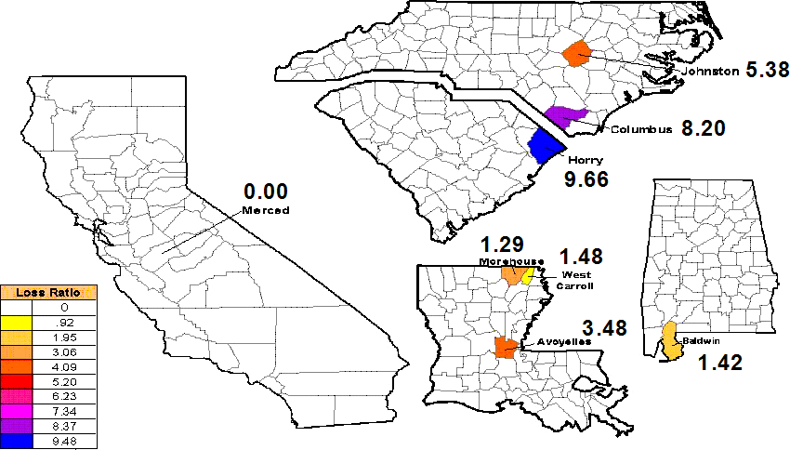
Sweetpotato Risk
Management History
The original Sweetpotato Pilot Program was implemented in 1998 in eight pilot counties.
The program offered generous price elections and lenient requirements for insured production.

Slide 3
Sweetpotato Risk
Management History
Substantial financial losses were incurred between the years of 1998 and 2002.
Although improvements were made to the program for the 2003 and 2004 crop years, RMA found the original pilot to be an inviable policy.
The FCIC Board authorized RMA to begin development of a new sweetpotato crop insurance program.

Slide 4
Sweetpotato Risk
Management History
RMA awarded the contract for development of a two-part Sweetpotato New Pilot Program.
  Stage 1 – Development of an improved “turnrow” (harvest) pilot insurance product. (Completed)
  Stage 2 – Development of coverage for sweetpotatoes from planting through storage
The Turnrow Component for the new pilot was approved by the FCIC Board in October 2004.

Slide 5
Overview of Changes
Crop provisions rewritten to incorporate some existing underwriting rules, modify others, and add new ones:
  Improve definition of insured crop;
  Producer must submit production records to establish APH;
  Possible scouting of crop after planting by an agricultural expert;
  Require an initial planting density (population);
  Representative samples (“test strips”) made mandatory after report of loss.

Slide 6
Overview of Changes (cont.)
Crop provisions rewritten to modify gatekeeping procedures and incorporate the following:
  FCI-33 maps will be developed to identify and exclude high risk land poorly suited for sweetpotato production; and
  A requirement that a producer must have grown sweetpotatoes in 3 out of 5 previous years to be eligible.

Slide 7
Overview of Changes (cont.)
Loss Adjustment Standards Handbook rewritten to:
  Incorporate new crop provisions;
  Provide better forms to capture information;
  Improve differentiation of insured and uninsured causes of loss;
  Appraisal procedures more detailed and specific;
  Pre-maturity appraisal method included (not found in existing handbook); and
  Production to count is from all planted acres. Guarantee is based on insurable acres.

Slide 8
Turnrow Component
Overview
Price Election:
  Based on November average harvest-time price (AMS market news), not season average; and
  Reduced when acres are not harvested.
Three risk regions established after analyzing relative variability of yields.

Slide 9
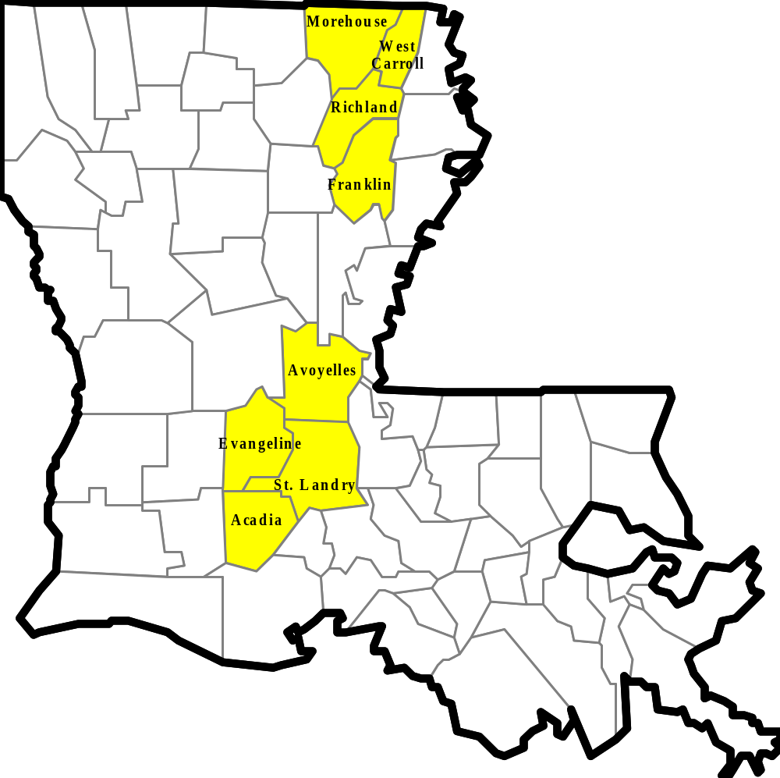
Louisiana Risk Region
Counties:
Acadia
Aroyelles
Evangeline
Franklin
Morehouse
Richland
St. Landry
West Carroll

Slide 10
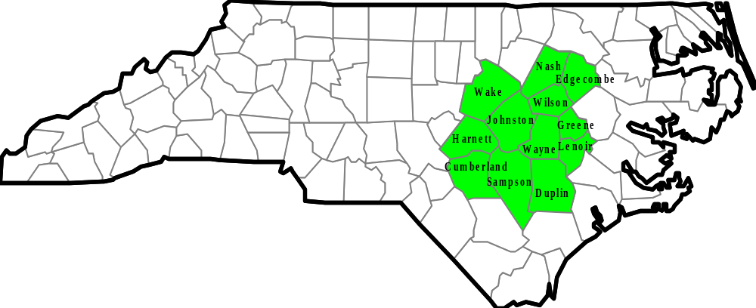
Central North Carolina
Risk Region
Counties:
Duplin
Cumberland
Edgecombe
Greene
Harnett
Johnston
Lenoir
Nash
Sampson
Wake
Wayne
Wilson

Slide 11
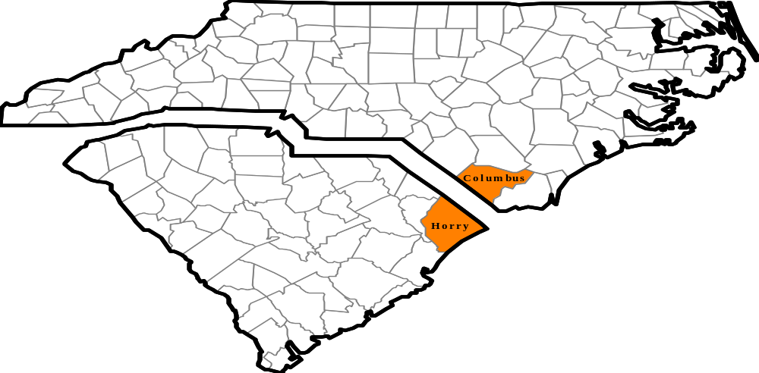
Columbus/Horry Risk Region
Counties:
Columbus
Horry

