Slide 1
Case Management, CDSS and the Mental Health and Wellness Program
Valerie R. Cherry, Ph.D.
Principal Mental Health Consultant

Slide 2
Introduction To A Case
Management Approach
First, do not kill the messenger!
We are on the same team
Doubled or tripled workload—same hours
Protect your license
Protect your clients – our students

Slide 3
CDSS
Partner in employability
MHC contributions to each phase—a new model for mental health care
Many already implementing CDSS informally—need to formalize
Use of PCDP
PCDP
OAP
JOB
CPP
CDP
CTP
JOB
JOB

Slide 4
You Are A Consultant and Administrator
Your program—CDSS, Disability, Meetings, TEAP, Education/Training, Wellness, Counseling and Direct Care
Must develop TEAM Approach with case management

Slide 5
Job Corps Case Management
Nuts and Bolts
Documentation-”if it isn’t written, it didn’t happen.”
Most centers do more than documented
Health record is a legal document and central to ROCA review
Decreases liability
Document your thought process—why you did NOT do something

Slide 6
Job Corps Case Management
Referral and Feedback System
The PRH requires a written referral and feedback system for mental health treatment. You will need to develop a two part form in which a referral for mental health treatment can be written by other disciplines on center, such as counseling or residential life. On the second portion of the form, you would write a response that goes back to the referral source. You can be somewhat general to protect confidentiality but provide enough BEHAVIORAL INFORMATION so that referral sources believe there is follow-up to referrals; otherwise, referrals may stop.

Slide 7
Job Corps Case Management
Intake Notes
  , reason for referral, presenting problem, history of presenting problem, mental status exam, diagnostic impression, and a clear management plan. The management plan will be multidisciplinary and describe various modes of treatment, including groups, TEAP counseling, medication evaluation, as well as off-center referrals

Slide 8
Job Corps Case Management
Progress Notes
  assessment, progress, and update on the management plan. The notes should be written in the chronological portion of the health record so staff can track referrals and providers, treatment, and progress over time.
  SOAP

Slide 9
Job Corps Case Management
Management Plan
  After evaluation of the student's mental health problems, the CMHC should make a confidential entry in the health record and prepare a management plan. The management plan should be tied to Job Corps program elements and specific staff members. A career counselor is the ideal case manager for an individual with academic or social problems

Slide 10
Job Corps Case Management
Management Plan
  The management plan should be designed to improve the student's mental health and to strengthen his/her performance in the vocational and educational programs; it should be very specific and realistically tied to the center program.
  Concise and Specific–Less than one page

Slide 11

Job Corps Case Management
Management Plan- Who is responsible?
  CMHC, TEAP Specialist,Counseling staff, and in some cases, selected health and/or academic/vocational instructors, are usually responsible for some aspects of the management plan. The case manager monitors nonhealth staff involvement in the plan and may work with a teacher to monitor the student on performance goals.

Slide 12

Job Corps Case Management
Management Plan’s Best Friend-
Personal Career Development Plan (PCDP)
Throughout all periods of CDSS

Slide 13
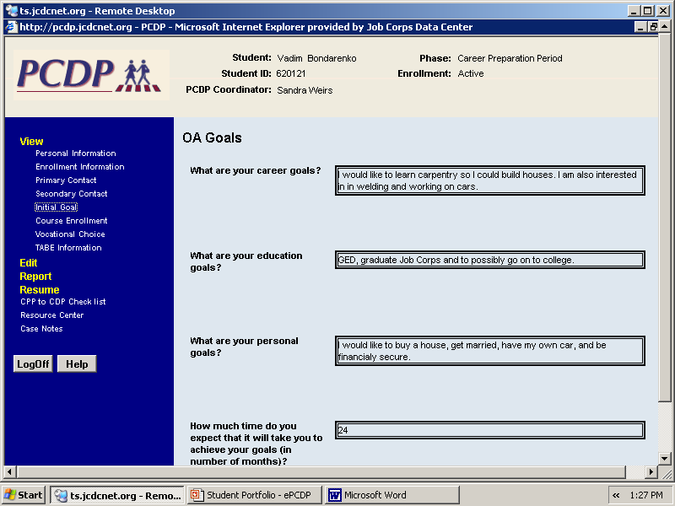

Slide 14
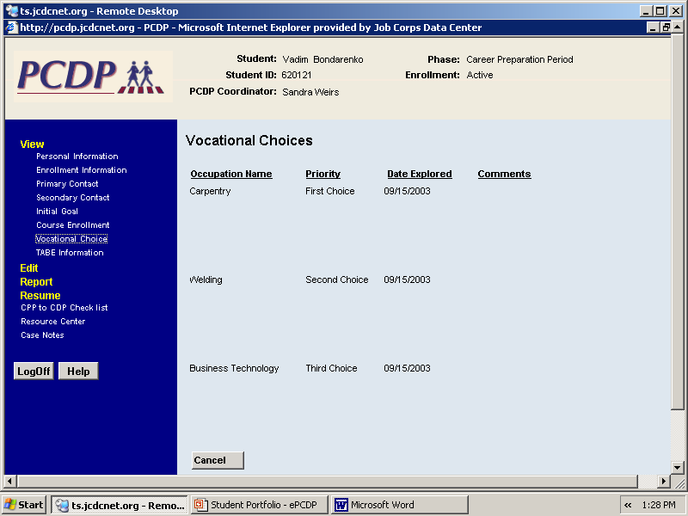

Slide 15
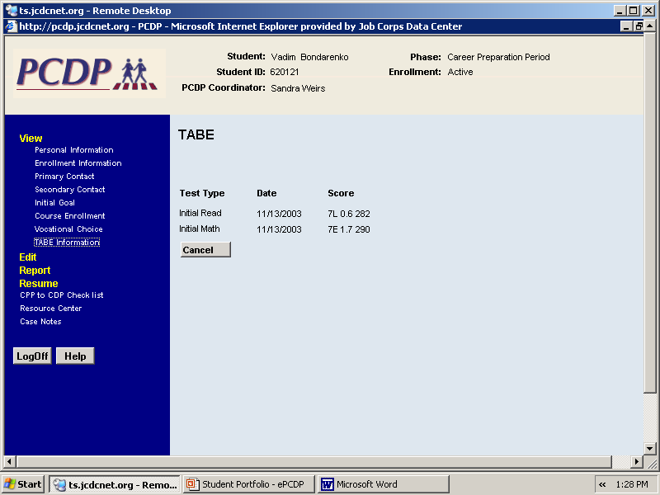

Slide 16
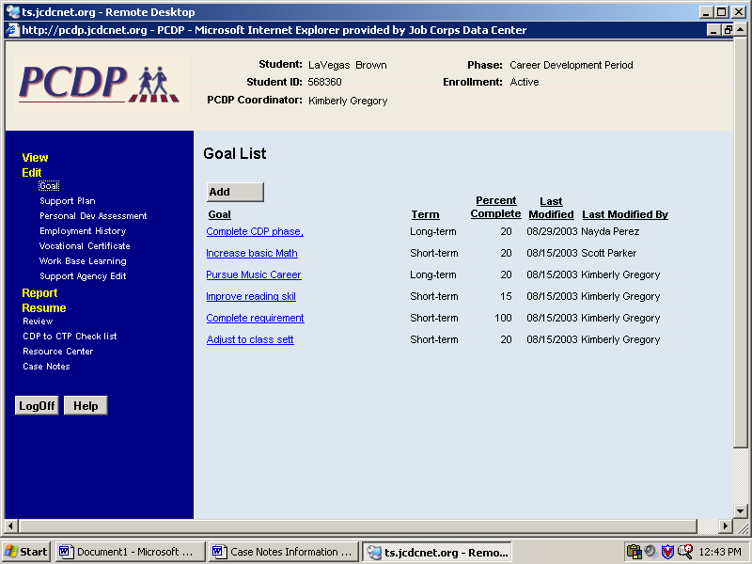

Slide 17
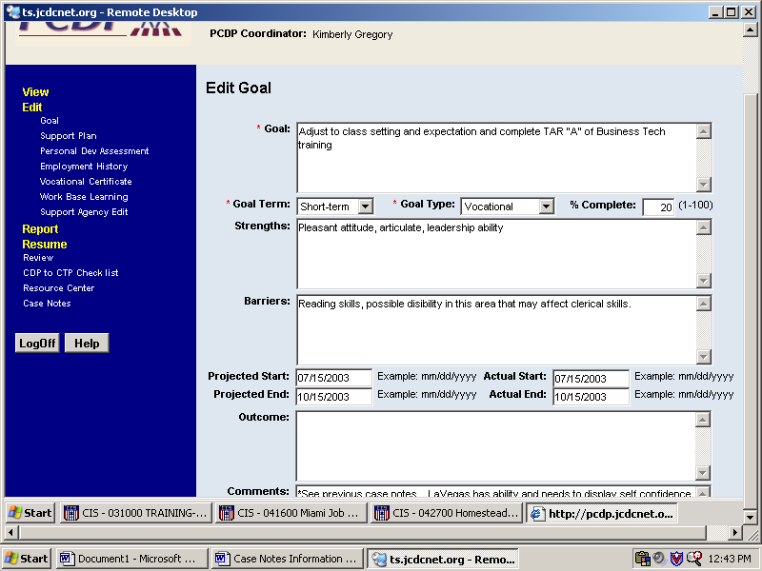

Slide 18
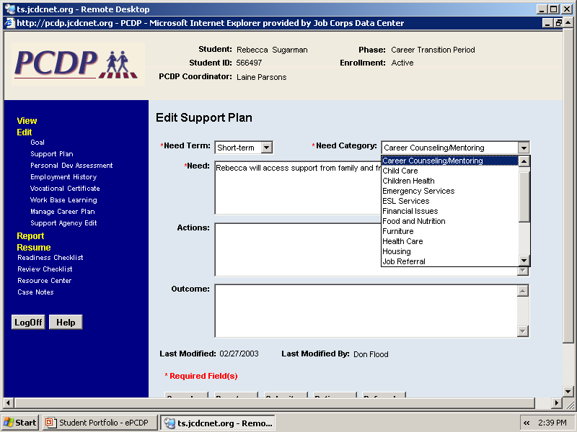

Slide 19
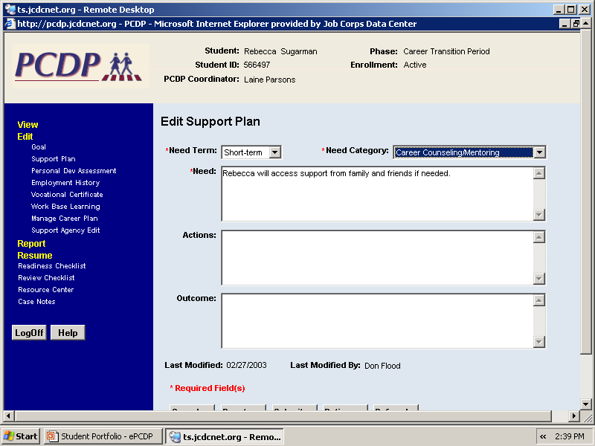

Slide 20
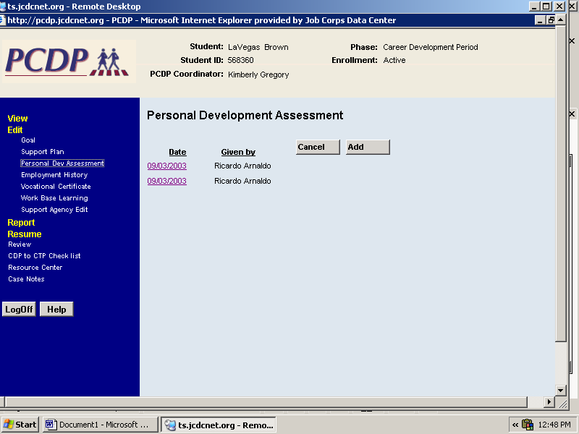

Slide 21
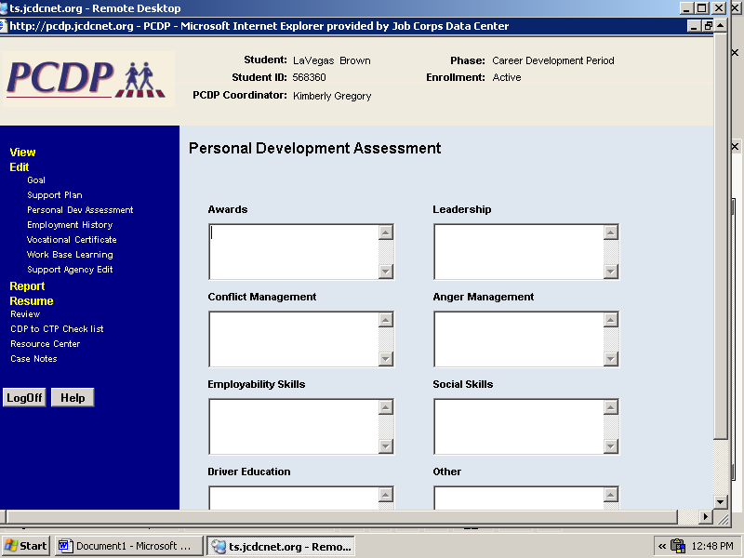

Slide 22
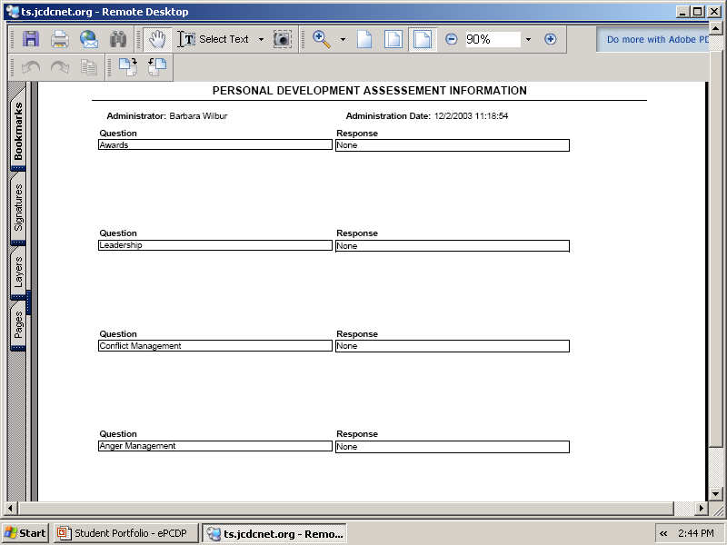

Slide 23
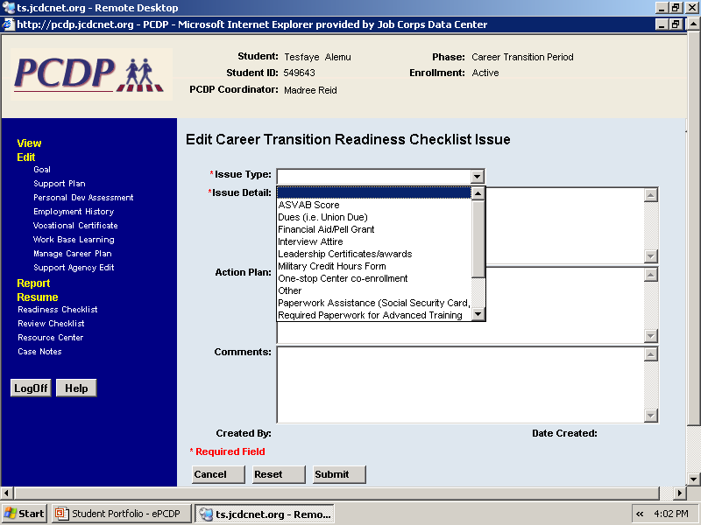

Slide 24
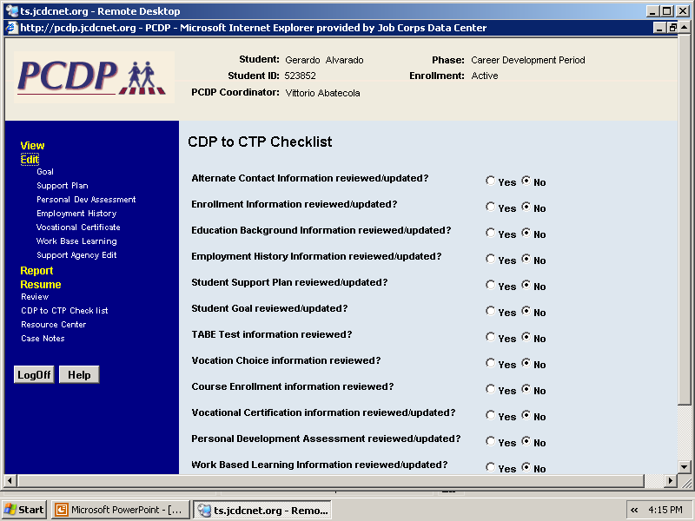

Slide 25
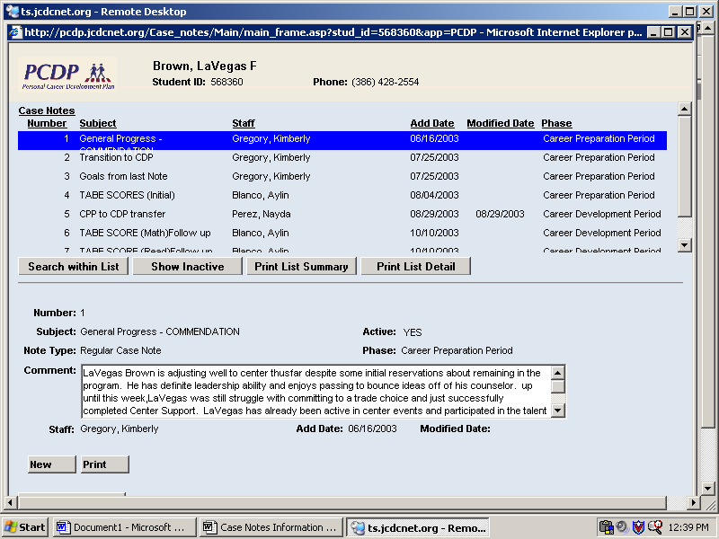

Slide 27
Behavioral Descriptors
Student may have difficulty concentrating and is easily distractible
Student may need assistance with anger management
Student may be impulsive (acts before thinking)
Student may look for a lot of attention through behavior and appearance
Student may have difficulty with information presented orally
Student may have inappropriate provocative behavior
Student may have difficulty in social situations
Student may need assistance with developing positive leisure activities

Slide 28
WHY
Job Corps Case Management ?
At risk population
Limited time on center
Standard practice
Expands the umbrella for the mental health and wellness program

Slide 29
Off Center Treatment
Documentation of compliance—no details
Develop tickler system to monitor at least monthly
If non-compliant, follow-up and document

Slide 30
Medical Separations
Majority should be medical separation with reinstatement (MSWR)
  Most conditions clear within 6 months
  Cannot predict course of illness—ADA issues
Document specific symptoms and behaviors
Do not do a medical for behavioral problems

Slide 31
Psychotropic Medications
Psychotropic medication monitoring
Memo of understanding with psychiatrist
Documented follow-up on center or off center

Slide 32
Case Conferences and
Core Meetings
Document meetings
Document phone consults with other disciplines on center-very
Document phone consults with off center providers

Slide 33
Suicidal Students
No suicide watches or hourly bed checks
  Too much liability—no harm contracts
  No resources for high level of care
  Consider MSWR—be conservative
  No releasing suicidal students to family members INSTEAD of evaluation at a hospital

Slide 34
More Suicide Issues
The myth of suicide contract
All threats taken seriously
Poetry or prose taken seriously
Be conservative—do MSWR’s
  Better to be in court with civil rights for unlawful separation than with family of dead student for malpractice
  Suicide SOP and document all casework

Slide 35
Summary of Suicidal
Behavior in PY03*
Type of Incident | Number Reported | Percentage of Philadelphia’s Incidents
Suicide Threat | 18 | 4.4%
Suicide Attempt | 14 | 3.4%
Suicides | 0 | 0%
Total Incidents Reported by Region | 409 | 100%
*Includes incidents occurring on July 1st, 2003 through April 23rd, 2004

Slide 36
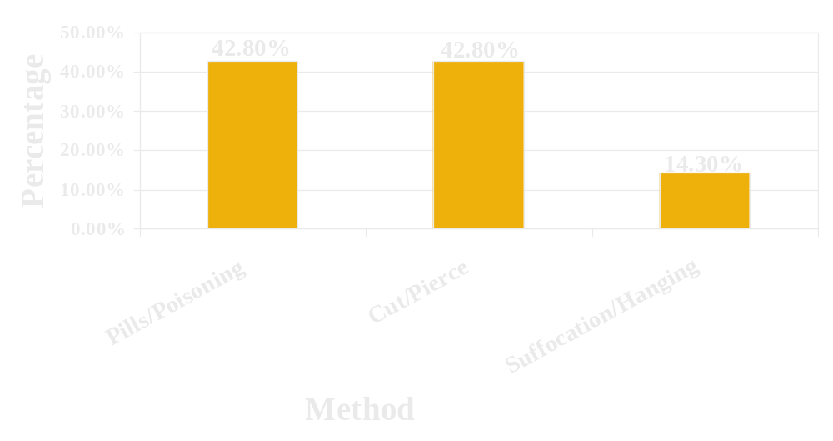
Percentage Breakdown by Method of Suicide Attempt in PY03*
*Includes incidents occurring on July 1st, 2003 through April 23rd, 2004

Slide 37
Summary of Suicidal
Behavior in PY02*
Type of Incident | Number Reported | Percentage of Philadelphia’s Incidents
Suicide Threat | 21 | 4.8%
Suicide Attempt | 10 | 2.3%
Suicides | 0 | 0%
Total Incidents Reported by Region | 437 | 100%
*Includes incidents occurring on July 1st, 2002 through April 23rd, 2003

Slide 38
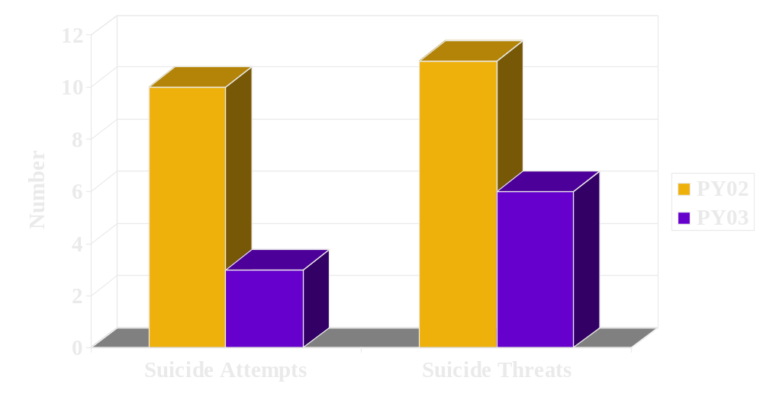
Summary of Suicidal Behavior: Comparison Between PY02 and PY03*
*Data only includes incidents occurring between July 1st and April 23rd of each program year

Slide 39
Personality Disorders
Increase on center and more empowered with civil rights laws
More difficult to separate medically
More likely to refuse treatment and manipulate
May create feelings of helplessness in staff

Slide 40
Create Links with Behavioral or Disciplinary System
Refusal of medication and treatment—students must still abide by rules and regulations on center.
No behavioral consequences for refusing medications—but consequences to students behavior as a result of refusing meds
CSO must support health and wellness compliance

Slide 41
Behavioral Consequences Influence Compliance
Fail to keep appointments—consequences increase compliance
Personality disorders—after refusal of treatment (documented) and continued behavioral problems, disciplinary separation
CSO and behavioral contracts

Slide 42
Standard Operating Procedures
Your COP or SOP should reflect your actual procedures—decreases liability
  Centers in which the SOP looks great but actual procedures documented are very different
  Centers in which documentation great but no SOP’s that reflect this

Slide 43
Informed Consent and Confidentiality
Your role can be perceived as a therapy relationship, as defined by ethics and laws
You are not exempt because you do “assessments”
You are not exempt because you work for Job Corps
As a licensed mental health professional, you are not construed as a “counselor”

Slide 44
More Informed Consent
Just Released–Mental Health and Wellness Informed Consent Form added to OASIS
  JCDC Notice 03-186 New Release of OASIS - April 12, 2004
  PRH Change Notice
    Chapter 1, Exhibit 1-1
    Chapter 6 - 6.12 , Authorizations

Slide 45
Mental Health Program and CDSS
CDSS—The new evaluation model
Think of your duties as it relates to each phase of CDSS and write COP
Implement “Transition Group” into and out of Job Corps
You must formally implement the mental health and wellness program in the structure of CDSS or your role and program will be unclear
Handout with examples

Slide 46
Regional Office Help
We are here to help provide support
Possibility of quarterly teleconferences with RMHC
Share information with regional office—avoid “keep them out of the loop”

Slide 47
Resources
http://www.jobcorpshealth.com
http://www.jobcorpsdisability.com
TAG-D Mental Health and Wellness Program
Release Date: March 24, 2003
TAG-F Disability Resource Manual
Release Date: June 2002
TAG-G Learning Disabilities and Attention Deficit Hyperactive Disorder
Release Date: June 2003
TAG-H Mental Health Disabilities
Release Date: October 29, 2003
TAG-L Trainee Employee Assistance Program (TEAP)
Release Date: July 22, 2002

