Slide 1
Condyloma acuminata
HPV

Slide 2
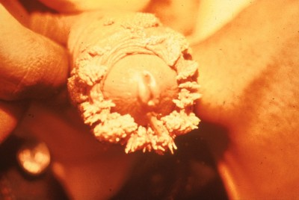
Condyloma acuminata, penile

Slide 3
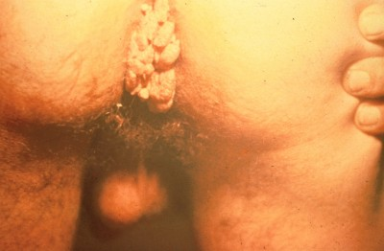
Condyloma acuminata, anal

Slide 4
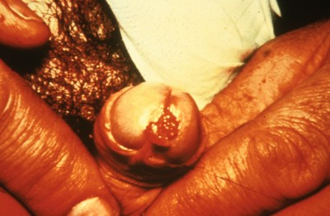
Condyloma acuminata, meatal

Slide 5
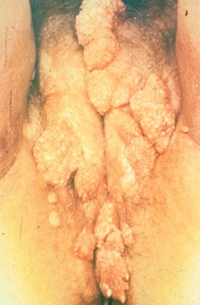
Condyloma acuminata, vulva

Slide 6
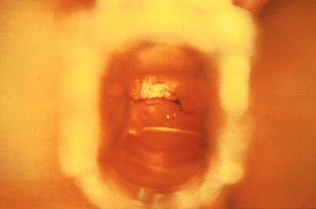
Condyloma acuminata, vaginal wall

