Slide 1

Quadrivalent HPV Vaccine
Efficacy and
Provisional Recommendations
Lauri Markowitz, MD
DSTDP, NCHHSTP, CDC

Slide 2
Licensed & Candidate Prophylactic
HPV Vaccines
Vaccine/ Manufacturer | HPV Types | FDA Filing | FDA Decision | ACIP Vote
Quadrivalent Merck | 6/11/16/18 | Dec 2005 | June 2006 | June 2006
Bivalent GSK | 16/18 | Dec 2006? | 2007? | 2007?

Slide 3
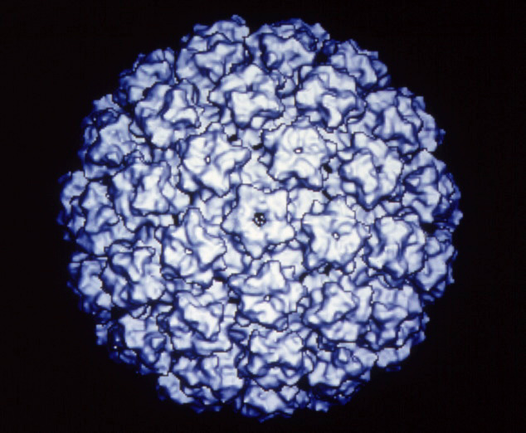
Quadrivalent HPV Vaccine
HPV L1 major capsid protein of the virus is antigen used for immunization
Expression of L1 protein uses recombinant technology
L1 proteins self-assemble into virus-like particles (VLP)
HPV VLP

Slide 4
Quadrivalent HPV Vaccine
Clinical Development Program
Efficacy Trials* | “Bridging” Immunogenicity Safety Trials
females 16-26 yrs | females 9-15 yrs

Slide 5
Quadrivalent HPV Vaccine
FDA Licensure – June 8, 2006
Indicated in girls and women 9-26 years of age for the prevention of the following diseases caused by HPV types 6, 11, 16, and 18:
  Cervical cancer
  Genital warts (condyloma acuminata)
  Cervical, vaginal and vulvar precancerous or dysplastic lesions

Slide 6
Quadrivalent HPV Vaccine
Additional Clinical Development: results expected in next few years
Efficacy trials in males
Efficacy in females older than 26 years
Long term follow-up

Slide 7
Efficacy for Prevention of Clinical HPV Disease Due to HPV 6/11/16/18*
Endpoint | Vaccine N Cases | Placebo N Cases | Efficacy | (95% CI)
HPV 16/18 related CIN2/3 or AIS | 8487 0 | 53 | 100 | (93,100)
HPV 6/11/16/18 related CIN | 7858 4 | 83 | 95 | (87, 99)
HPV 6/11/16/18 related Genital warts | 7897 1 | 7899 91 | 99 | (94,100)
*Integrated dataset; results in the Per-Protocol Populations

Slide 8
Populations in Quadrivalent HPV Vaccine Trials among
Females 16-26 years of age
 | Seronegative | Seropositive
PCR (-) | Prophylactic efficacy in HPV-naïve women (Per protocol population) | Low recurrence rate High efficacy
PCR (+) | No evidence of efficacy | No evidence of efficacy

Slide 9
Time to Detection of HPV 16/18 CIN 2/3 or AIS, All Participants 16-26 years of age
Phase II and III Database for GARDASIL® and HPV 16 Vaccine
6
Placebo and 95% CI
5
4
Cumulative Incidence (%)
39% ↓
3
2
1
HPV L1 VLP Vaccine
0
0
6
12
18
24
30
36
42
48
Time Since Month 1 (in Months)
v501p5p7p13p15c2w Apr. 28, 2006

Slide 10
Antibody Titers by Age at Enrollment
Anti-HPV 6 GMTs (Quadrivalent HPV vaccine)
1600
Immunogenicity Bridge
Efficacy Program
1500
1300
1100
900
Serum GMT with 95% CI, mMU/mL
700
500
9
10
11
12
13
14
15
16
17
18
19
20
21
22
23
Age at Enrollment (Years)
Merck, unpublished data, ACIP presentation by Eliav Barr, February 2006

Slide 11
Anti-HPV 16 GMTs Through 5 Years
Protocol 007
10000
GARDASIL
®
1000
GMT
(Log Scale)
100
10
Placebo (Sero (+) and PCR (-)
*
*
*
Vaccination
to HPV 16 at Day 1)
0
7
12
18
24
30
36
54
60
Time Since Vaccination 1 (Months)
Notes:
To supplement the efficacy results of the study that I just showed, I present a graphic of anti-HPV 16 GMTs over time. The X-axis provides time, and the stars denote vaccination. The white line represents the subset of placebo recipients who were anti-HPV 16 seropositive at Day 1. So this line provides a reference for the durability of natural anti-HPV 16 over a 5 year period. As you can see, the levels are generally stable.
Now, lets look at vaccine induced anti-HPV 16. We see that after an initial decline of about 1-log-fold early in the follow-up, anti-HPV levels are stable for the next 3.5 years.

Slide 12
Quadrivalent HPV Vaccine
Summary
High efficacy in 16 to 26 year-old females who are naïve to the HPV vaccine type
  HPV 16,18 related CIN 2/3
  HPV 6,11,16,18 related CIN
  HPV 6,11,16,18 related external genital lesions
No evidence of efficacy against disease in persons already infected with relevant type
Efficacy data available through 5; duration of protection and need for booster unknown
Safe; side effects mainly local reactions

Slide 13
Quadrivalent HPV Vaccine
Summary
>99% seroconversion rates in 9-26 year-olds
Antibody titers substantially higher than after natural infection; highest in those vaccinated at younger ages
Antibody titers decline over time after 3rd injection, but plateau by 24 months

Slide 14
Recommendations
Routine vaccination
Catch-up vaccination
Special situations
Precautions and contraindications

Slide 15
Routine Vaccination
Provisional Recommendation
ACIP recommends routine vaccination of females 11-12 years of age with three doses of quadrivalent HPV vaccine
The vaccination series can be started as young as 9 years of age

Slide 16
Rationale: Routine Vaccination
Females at 11-12 Years
Routine
  Prevalent infection, targeting ‘high risk’ groups not possible
  Modeling shows greater impact
11-12 years
  Vaccination prior to sexual debut
  Implementation advantages; consistent with young adolescent health care visit
  High antibody titers after vaccination at this age
  Data through 5 years show no evidence of waning immunity; ongoing studies will monitor duration of protection

Slide 17
Females 13-26 Years
Provisional Recommendation
Vaccination is recommended for females 13-26 years of age who have not been previously vaccinated
Ideally vaccine should be administered before onset of sexual activity, but females who are sexually active should still be vaccinated

Slide 18
Rationale: Vaccination of
Females 13-26 Years
Females not yet sexually active can be expected to have the full benefit of vaccination
Sexually active females may not have full benefit of vaccine because they may have been infected with vaccine HPV types, however:
  Only a small percentage are likely to have been infected with all four vaccine HPV types
  For those already infected with >1 vaccine HPV types, vaccine would provide protection against disease caused by the other vaccine HPV types
  Therefore, although overall vaccine effectiveness would be lower, most females will still derive benefit from
  vaccination

Slide 19
Special Situations
Equivocal or abnormal Pap test
Positive HPV test
Genital warts
Immunosuppression
Lactating women

Slide 20
Vaccination during Pregnancy Provisional Recommendation
Initiation of the vaccine series should be delayed until after completion of the pregnancy
If a woman is found to be pregnant after initiating the vaccination series, completion should be delayed until after the pregnancy
If a vaccine dose has been administered during pregnancy, there is no indication for intervention

Slide 21
Precautions and Contraindications
Moderate or severe acute illnesses: should be deferred until after the illness improves
History of immediate hypersensitivity or severe allergic reaction to yeast or to any vaccine component: contraindication

Slide 22
Cervical Cancer Screening
Cervical cancer screening – no change
  30% of cervical cancers caused by HPV types not in the quadrivalent HPV vaccine
  Vaccinated females could subsequently be infected with non-vaccine HPV types
  Sexually active females could have been infected prior to vaccination
Decision to vaccinate should not be based on Pap testing, HPV DNA testing or HPV serologic testing
Providers should education women about the importance of cervical cancer screening

