Slide 1
GARDASIL®
Quadrivalent HPV (Types 6, 11, 16, 18)
L1 VLP Vaccine
Vaccines and Related Biological Products
Advisory Committee Meeting
May 18, 2006
Merck Research Laboratories

Slide 2
GARDASIL® Agenda
Patrick Brill-Edwards, MD
  Introduction and Overview (5 min)
Eliav Barr, MD
  Clinical Significance of HPV Disease
  Design of the Clinical Trials Program for GARDASIL®
  Clinical Trial Results for GARDASIL®
  Overall Benefit/Risk Profile

Slide 3
Proposed Indication
GARDASIL® is a vaccine indicated for the prevention of cancer, precancerous or dysplastic lesions, genital warts, and infection caused by the HPV types targeted by the vaccine.

Slide 4
There Is an Unmet Medical Need
Cervical cancer is caused by the Human Papillomavirus (HPV)
HPV infection is common
  Lifetime risk of HPV infection – >50%
  In US, lifetime risk for Cervical Intraepithelial Neoplasia (CIN) diagnosis – 25%
  >10% of adults will develop genital warts
Cervical cancer is the 2nd most common cancer in women worldwide
  ~500,000 new cases and ~290,000 deaths annually
Despite Pap testing, American women remain at risk for cervical cancer
  10,370 new cases and 3,710 deaths in 2005

Slide 5
GARDASIL® Meets the Unmet Need
Currently no approved vaccine for prevention of cervical cancer
Therefore VRBPAC in 2001 considered the endpoints for the basis of licensure
Merck proposed:
  Not feasible to use cancer as endpoint
  Most infections/low grade precancer regress, therefore need to recommend endpoint that links to cancer
  Success of screening programs is due to detection of and definitive therapy for CIN 2/3
VRBPAC recommendation: CIN 2/3 as basis for licensure

Slide 6
GARDASIL®
Quadrivalent HPV (Types 6, 11, 16, 18) L1 Virus-like Particle (VLP) Vaccine
Merck’s
Aluminum
Adjuvant
L1 VLP
Constituent
HPV 6
HPV 11
HPV 16
HPV 18
Dose (mcg)
20
40
40
20
225
VLPs manufactured in Saccharomyces cerevisiae (yeast)
Given as 0.5-mL i.m. injection at 0, 2, 6 (months)
Must be stored at 2 to 8°C
Vaccine cannot cause infection or disease

Slide 7
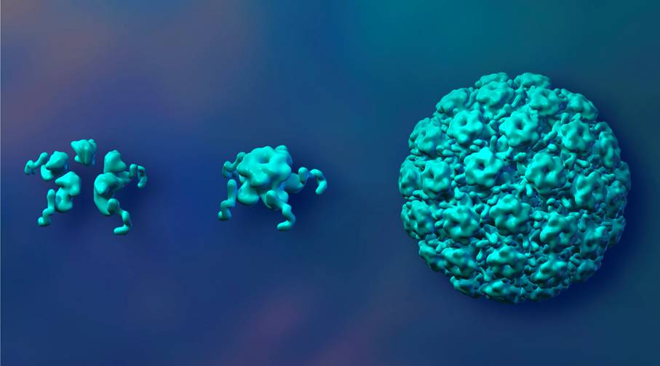
Structural Model of HPV VLP
Bioengineered
L1 Proteins (5)
Self-Assembled
Virus-Like Particle
L1 Pentamer

Slide 8
GARDASIL® Phase III Results
Comprehensive clinical program
  Randomized, placebo-controlled studies enrolling over 27,000 subjects in 33 countries
GARDASIL® efficacy:
  Vaccines are most effective when given before exposure to infection
  GARDASIL® is efficacious; it is this high efficacy that is the basis for a Priority Review
Is immunogenic
Has an excellent safety profile

Slide 9
Proposed Indications
GARDASIL® is a vaccine indicated for the prevention of cancer, precancerous or dysplastic lesions, genital warts, and infection caused by the HPV types targeted by the vaccine.
GARDASIL® is indicated for the prevention of the following caused by HPV 16 and 18:
  Cervical cancer
  Cervical Adenocarcinoma in situ (AIS)
  Cervical Intraepithelial Neoplasia (CIN) grade 2 and grade 3
  Vulvar and vaginal cancer
  Vulvar Intraepithelial Neoplasia (VIN) grade 2 and grade 3
  Vaginal Intraepithelial Neoplasia (VaIN) grade 2 and grade 3

Slide 10
Proposed Indications (Cont.)
GARDASIL® is indicated for the prevention of the following caused by HPV 6, 11, 16, and 18:
  Cervical Intraepithelial Neoplasia (CIN) grade 1
  Genital warts (condyloma acuminata)
  VIN grade 1 and VaIN grade 1
  HPV infection

Slide 11
Overview
Cervical cancer is caused by the Human Papillomavirus (HPV)
GARDASIL® prevents disease caused by the most common HPV types
GARDASIL® has the potential to meet an unmet medical need as the first vaccine to prevent cervical cancer

Slide 12
GARDASIL® Consultants
Laura Koutsky, PhD University of Washington
Seattle, WA
Michael Cunningham, MD University of Washington
Seattle, WA
Mark Stoler, MD University of Virginia
Charlottesville, VA
Myron Levin, MD University of Colorado Denver, CO
Janet Wittes, PhD Statistics Collaborative, Inc.
Washington, DC

Slide 13
GARDASIL® Agenda
Patrick Brill-Edwards, MD
  Introduction and Overview
Eliav Barr, MD
  Clinical Significance of HPV Disease
  Design of the Clinical Trials Program for GARDASIL®
  Clinical Trial Results for GARDASIL®
  Overall Benefit/Risk Profile

Slide 14
GARDASIL® (Merck & Co., Inc.)
Eliav Barr, MD
Merck Research Laboratories

Slide 15
Presentation Outline
Clinical Significance of HPV Disease
Design of the Clinical Trials Program for GARDASIL®
Clinical Trial Results for GARDASIL®
Overall Benefit/Risk Profile

Slide 16
HPV Infection Causes Benign and Malignant Epithelial Dysplasia
HPV is a potent carcinogen
  Cervix
  Vagina, vulva, anal canal
  Penis
  Tonsil, pharynx, larynx
HPV causes benign tumors
  Low grade cervical, vulvar, vaginal dysplasia
  Genital warts
  Recurrent Respiratory Papillomatosis

Slide 17
Lifetime Risk of HPV-Related Pathology
Event
Risk (Ratio)
Risk of HPV Infection
CIN 1
CIN 2/3 or AIS
Cervical Cancer
Without Pap Testing
With Pap Testing
Risk of Genital Warts
(Men and Women)
1 in 2
1 in 6
1 in 25
1 in 31
1 in 123
1 in 8
CDC Fact Sheet, May-2004.
Ho et al. NEJM 1998.
American Cancer Society: Cancer Facts and Figures 2005.
CIN = Cervical Intraepithelial Neoplasia; AIS = Adenocarcinoma in situ.

Slide 18
Cervical Cancer
Every day, 800 women die from cervical cancer worldwide
  500,000 new cases and 290,000 deaths annually
  Peak in 30s to 50s – peak productivity, family lives
Two variants, both HPV related
  Squamous cell cancer (~80%)
    Preceded by Cervical Intraepithelial Neoplasia (CIN)
  Adenocarcinoma (~20%)
    Preceded by Adenocarcinoma in situ (AIS)
World Health Organization. 2003:1-74.
American Cancer Society: Cancer Facts and Figures 2005.

Slide 19
Cervical Cancer Screening
In the US, Pap testing has reduced cervical cancer rates by 75%, but at high costs
  50 Million Pap tests annually to yield…
  3.5 Million Pap test abnormalities which result in…
  1.4 Million cases of CIN 1, and
  330,000 cases of CIN 2/3
  And the total cost is $4 to $6 Billion (per year)
Despite availability of screening, over 10,000 American women develop cervical cancer annually
World Health Organization. 2003:1-74.
American Cancer Society: Cancer Facts and Figures 2005.
National Cancer Institute Fact Sheet. The Pap Test: Questions and Answers.
Schiffman M, et al. Findings to date from the ALTS. Arch Pathol Lab Med. 2003;127: 946-9.
American Cancer Society: Cancer Facts and Figures 2006.

Slide 20
Vulvar and Vaginal Cancer
In the US, over 3,500 cases annually
40 to 50% of cases are caused by HPV
  Strong associations with cervical cancers and dysplasia
  Incidence of vulvar cancer in the US has increased in women below age 50 due to higher rates of HPV infection
American Cancer Society. Cancer Facts and Figures 2005.

Slide 21
Annual Number of New Cases of HPV-Related Cancers in American Men
% Cancers With
Detectable
HPV
New
HPV-Related
Cases
Anatomic
Area
Oral Cavity
Oropharynx
Larynx
Anal Canal
Penis
Total
23%
36%
24%
88%
80%
--
2600
2455
1850
1680
1225
9,810
American Cancer Society: Cancer Facts and Figures 2006.
Kreimer AR, et al. Canc Epidemiol Biomarkers Prev. 5002;14(2):467-75.
Ryan DP, et al. N Engl J Med. 2000;342:792-800.
Daling JR, et al. Int J Cancer. 2005;116:606-616.

Slide 22
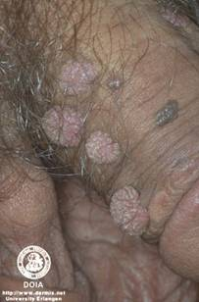
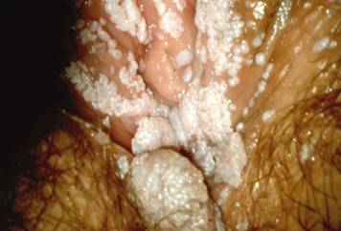
HPV Infection Causes Genital Warts
>10% of men and women will be diagnosed with genital warts during their lives
Clinical manifestations
  Painful, unsightly genital lesions
  Depression, disruption of primary relationship
Treatment options
  Treated by ablation
  On average, 3 rounds of therapy required
  30% recurrence
Munk C, et al. Sex Transm Dis. 1997;24(10):567-72.
Maw RD et al. Int J STD AIDS. 1998;9:571-8.
Conaglen MH et al. Int J STD AIDS. 2001;12:651-8.
Insinga RP et al. Clin Infect Dis. 2003;36:1397-403.
von Krogh G et al. Sex Transm Inf. 2000;76:162-8.

Slide 23
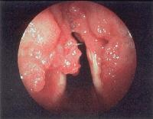
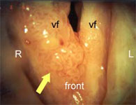
Recurrent Respiratory Papillomatosis (RRP)
Clinical description
  Warty tumors of the larynx
  Hoarseness, airway obstruction
Juvenile RRP – 2,300 cases annually (US)
  Typically diagnosed at age 3 to 4
  On average, 4 surgeries per year due
  to airway obstruction
Adult RRP – 3,600 cases annually (US)
  Typically diagnosed in 20’s or 30’s
Ref: www.emedicine.com
Ref: www.voiceproblems.org
Derkay CS et al. Otolaryngol Clin North Am. 2000;33(5):1127-41.

Slide 24
Immunologic Basis for GARDASIL®
L1 HPV major capsid protein self-assembles into virus-like particles (VLPs)
In animal models of papillomavirus infection using species-specific VLPs
  Vaccination results in protection from infection/disease
  Neutralizing antibodies induced
  Transfer of sera from vaccinated animals to unvaccinated animals results in transfer of protection

Slide 25
GARDASIL® Covers the HPV Types Responsible for the Majority of Clinical HPV Disease in the US
Type
Women
Men
16/18
70% Cervical Cancer
70% Other HPV-related Cancers
65% High-grade Precancer
25% CIN 1
70% Anal Cancer
70% Other HPV-related Cancers
65% High-grade Precancer
Transmission to Women
6/11
90% Genital Warts
90% RRP Lesions
10% CIN 1
90% Genital Warts
90% RRP Lesions
Transmission to Women
RRP = Recurrent Respiratory Papillomatosis.

Slide 26
Presentation Outline
Clinical Significance of HPV Disease
Design of the Clinical Trials Program for GARDASIL®
  Objectives
  Study Populations
  Consistent study infrastructure
Clinical Trial Results for GARDASIL®
Overall Benefit/Risk Profile

Slide 27
Primary Efficacy Objectives
Clinical Program for GARDASIL®
Primary endpoints (application for licensure)
Define the magnitude of prophylactic efficacy of GARDASIL® with respect to the incidence of HPV 6/11/16/18-related:
  Cervical cancer
  Vulvar, and vaginal cancers
  CIN, VIN, VaIN
  Genital warts
  Persistent infection
Supplemental (subsequent filings)
Assess the impact of GARDASIL® on the overall burden of clinical HPV disease
CIN = Cervical Intraepithelial Neoplasia.
AIS = Adenocarcinoma in situ.
VIN = Vulvar Intraepithelial Neoplasia.
VaIN = Vaginal Intraepithelial Neoplasia.

Slide 28
Natural History of HPV Infection Guides Definition of Cervical Cancer Surrogates
Definitive Efficacy
0 to 1 Year
0 to 3 Years
Up to 20 Years
Initial
HPV Infection
Continuing
Infection
CIN 2/3 or AIS
Cervical Cancer
CIN 1
Cleared HPV Infection

Slide 29
CIN 2/3 and AIS ― Established Surrogate Markers for Cervical Cancer
Definitive Efficacy
0 to 1 Year
0 to 3 Years
Up to 20 Years
Initial
HPV Infection
Continuing
Infection
CIN 2/3 or AIS
Cervical Cancer
1° Efficacy Objective of Clinical Program for GARDASIL® – Demonstrate Prevention of HPV 16/18-CIN 2/3 and AIS
CIN 1
Cleared HPV Infection

Slide 30
Vulvar and Vaginal Intraepithelial Neoplasia Grade 2/3 (VIN 2/3, VaIN 2/3)
Natural history of HPV-related vulvar and vaginal cancer closely mimics that of cervical cancer
Cancer arises from VIN 2/3 or VaIN 2/3 lesions
  In a series of untreated VIN 2/3, 16% progressed to invasive cancer at a mean interval of 3.9 years
  In a series of treated VaIN 2/3, 2% progressed to invasive cancer at a median follow-up of 2 years
VIN = Vulvar Intraepithelial Neoplasia.
VaIN = Vaginal Intraepithelial Neoplasia.

Slide 31
Primary Immunogenicity and
Safety Objectives
Immunogenicity:
  Bridge efficacy findings in 16- to 26-year-olds to 9- to 15-year-olds
  Define the duration of immune responses to GARDASIL®
  Concomitant administration with Hepatitis B vaccine
Safety:
  Describe the safety profile of GARDASIL® in all populations for which the vaccine will be indicated
  Describe pregnancy outcomes in subjects who received GARDASIL®

Slide 32

Studies Conducted in Age Ranges at Risk for HPV Disease
Incidence of New Genital Warts by Age in US
Rate of New Genital Warts
per 1000 Person-Years
Age (years)
Insinga RP. Clin Inf Dis. 2003;36:1397-1403.

Slide 33
Studies Conducted in Age Ranges at Risk for HPV Disease
Incidence of New Genital Warts by Age in US
Main Efficacy
Rate of New Genital Warts
per 1000 Person-Years
Age (years)
Insinga RP. Clin Inf Dis. 2003;36:1397-1403.

Slide 34
Studies Conducted in Age Ranges at Risk for HPV Disease
Incidence of New Genital Warts by Age in US
Adolescent
Bridging
Main Efficacy
Rate of New Genital Warts
per 1000 Person-Years
Age (years)
Insinga RP. Clin Inf Dis. 2003;36:1397-1403.

Slide 35
Consistent Study Infrastructure
It was anticipated that the efficacy trials would span several years, and that they would be combined to provide higher precision for efficacy
Consistent study infrastructure:
  Standardized collection of specimens
  Central pathology laboratory for cytology, histology
  Central HPV detection laboratory
  Validated pathology panel (endpoint diagnosis)
  Data and Safety Monitoring Board

Slide 36
Presentation Outline
Clinical Significance of HPV Disease
Design of the Clinical Trials Program for GARDASIL®
Clinical Trial Results for GARDASIL®
  Overall Study Population
  Efficacy and Immunogenicity
    Prophylactic Efficacy (the impact of administration of GARDASIL® to HPV-naïve subjects on the incidence of HPV 6/11/16/18-related disease)
    Population Impact (the impact of administration of GARDASIL® on the overall incidence of HPV disease, regardless of the causal HPV type)
    Bridging Efficacy Findings from Women to Adolescents
    Duration of Efficacy
  Safety
Overall Benefit/Risk Profile

Slide 37
Clinical Program in >27,000 Subjects
Diversity to Allow Generalization to Real World
Ethnicity/region/economic status
  27,004 subjects
  33 countries on 5 continents
Age/gender
  16- to 26-year-old adolescent and young adult women
  9- to 15-year-old girls
  9- to 15-year-old boys
HPV disease
  Enrollment regardless of baseline HPV status
  Endpoints spanning range of severity
  Cervical, vaginal, vulvar disease
  Patterns of management of Pap test findings

Slide 38
Presentation Outline
Clinical Significance of HPV Disease
Design of the Clinical Trials Program for GARDASIL®
Clinical Trial Results for GARDASIL®
  Overall Study Population
  Efficacy and Immunogenicity
    Prophylactic Efficacy
    Population Impact
    Bridging Efficacy Findings from Women to Adolescents
    Duration of Efficacy
  Safety
Overall Benefit/Risk Profile

Slide 39
Phase II/III Efficacy Program
Mean
Follow-Up
(Years)
Vaccine
Tested
Primary
Endpoint
Protocol
N
005
007
013
015
007, 013,
015
005, 007,
013, 015
2391
551
5442
12,157
18,150
20,541
HPV 16 Vaccine
GARDASIL®
GARDASIL®
GARDASIL®
GARDASIL®
HPV 16 Vaccine
GARDASIL®
HPV 16 Infection/CIN
HPV 6/11/16/18
Infection/CIN/EGL
HPV 6/11/16/18-CIN
HPV 6/11/16/18-EGL
HPV 16/18-CIN 2/3
or AIS
HPV 6/11/16/18-CIN
HPV 6/11/16/18-EGL
HPV 16/18-CIN 2/3
or AIS
3.5
2.6
2.1
1.9
2.0
2.1
EGL = External Genital Lesion.

Slide 40
Phase II/III Efficacy Population
Asia
Pacific
N=748
Latin
America
N=5666
North
America
N=5292
Total
N=20,887
Europe
N=9181
Day 1 Parameter
Percent of Total
Mean Age (Years)
Non-Virgin
Chlamydia (+)
ASC-US or Worse
HPV 6,11,16, or 18 (+)†
Naïve to All 4 Types†
100%
20
94%
4%
12%
27%
73%
4%
21
96%
3%
7%
16%
84%
44%
20
92%
3%
11%
25%
75%
27%
21
99%
7%
12%
32%
68%
25%
20
93%
3%
14%
25%
75%
† Evaluated for Protocols 007, 013 and 015 only.
ASC-US = Atypical Squamous Cells of Undetermined Significance.

Slide 41
Principal Efficacy Endpoints
HPV 16/18-related CIN 2/3 and AIS
  Surrogate for cervical cancer
HPV 16/18-related VIN 2/3 and VaIN 2/3
  Surrogate for vulvar and vaginal cancer
HPV 6/11/16/18-related CIN (any grade) and AIS
HPV 6/11/16/18-related External Genital Lesions (EGLs)

Slide 42
Defining Disease Endpoints
Fixation, Processing &
Paraffin Embedding
13
Prepare
Consecutive
Sections
12
Biopsy
11
10
9
8
7
6
5
4
3
2
1
Extraction of DNA for
HPV Multiplex PCR
3
4
5
1
2
12
13
H&E Staining and Histology
Vaccine Type
PCR Negative
Vaccine Type
PCR Positive
Diagnosis (Wart/CIN)
No Case
Case

Slide 43
Prophylactic Efficacy Populations
GARDASIL® is intended to be a prophylactic vaccine
Efficacy trials allowed enrollment of subjects regardless of baseline HPV status
Subjects already infected with a vaccine HPV type were not eligible for prophylactic efficacy evaluations for that type

Slide 44
Role of Baseline HPV Status in Endpoint Counting for Prophylactic Efficacy
Clinical Endpoint
HPV 6-
Related
HPV 11-
Related
HPV 16-
Related
HPV 18-
Related
Baseline HPV Status
Naïve to all 4 Types
Positive to HPV 6 or 11
Naïve to HPV 16 and 18
Positive to HPV 16
Naïve to HPV 6, 11, and 18
Positive to HPV 18
Naïve to HPV 6, 11, 16
Yes
No
Yes
Yes
Yes
No
Yes
Yes
Yes
Yes
No
Yes
Yes
Yes
Yes
No

Slide 45
Prophylactic Efficacy Population
Per-Protocol Efficacy (PPE)
  Primary analysis population
  Approximates adolescents or adults who receive a full course of GARDASIL® prior to exposure to vaccine types
HPV-Naïve Modified Intention-to-Treat (HN-MITT)
  Supportive analyses
  Approximates adolescents or adults who receive ≥1 dose of GARDASIL® prior to exposure to vaccine types

Slide 46
Prophylactic Efficacy Populations
Per-Protocol Efficacy (PPE)
(~87% of Enrolled Subjects)
Additional Subjects
(~8% of Overall Population)
HPV-naïve at Day 1
Remain free of HPV infection during the course of vaccination
Had follow-up visits
No protocol violation
Received all 3 doses
Endpoint counting starting after Month 7
Infected during the course of vaccination
Protocol violator
Received <3 doses
Had no follow-up visits post Month 7
Endpoints between Month 1 and Month 7
+
=
HPV-Naïve MITT (HN-MITT)†
(~95% of Enrolled Subjects)
Naïve to relevant HPV types at Day 1
Had follow-up visits
Case counting starting at Month 1
† In Clinical Study Reports, termed MITT-2.

Slide 47
Timing of Analyses
Primary efficacy analyses were case driven
  Analyses triggered when a requisite number of endpoint cases were observed in the PPE population of the relevant studies
After the primary analyses, studies continued
  Efficacy over longer duration of follow-up
  Population impact analyses
PPE = Per-Protocol Efficacy.

Slide 48
HPV 16- and 18-Related Cervical Cancer, Vulvar Cancer, and Vaginal Cancer

Slide 49
HPV 16/18-Related Cervical Cancer Prevention
Primary endpoint - HPV 16/18-related CIN 2/3 and AIS
  Immediate/obligate precursor to cervical cancer caused by high risk HPV types in GARDASIL®
  Endpoint recommended by VRBPAC
Primary studies
  Protocol 015 CIN 2/3 efficacy study (N=12,157)
  Combined Efficacy Population to increase precision
    Protocol 005, 007, 013, 015 (N=20,887)
VRBPAC = Vaccines and Related Biologic Products Advisory Committee.

Slide 50
HPV 16/18-Related Cervical Cancer Prevention
Statistical Considerations
Primary Analysis Population
  Per-Protocol Efficacy (PPE) Population
Statistical criteria for success
  P015: Lower bound of CI>0%
  [005, 007, 013, 015]: Lower Bound of CI>25%
Supplemental analyses in HPV-Naïve MITT population
  HPV 16/18-related CIN 2/3 and AIS
  HPV 16/18-related CIN 3 and AIS
CI = Confidence Interval.
MITT = Modified Intention-to-Treat.

Slide 51
HPV 16/18-Related Cervical Cancer
Protocol 015
GARDASIL®
Cases
Placebo
Cases
%
Efficacy
Pop.
Endpoint
% CI
p-Value
PPE
HN-
MITT
HPV 16/18-related
CIN 2/3 or AIS
HPV 16/18-related
CIN 2/3 or AIS
0
0
0
1
21
16
8
36
100
100
100
97
76, 100
75, 100
42, 100
83, 100
<0.001
HPV 16-related
CIN 2/3 or AIS
HPV 18-related
CIN 2/3 or AIS
Subjects are counted once per applicable row.
CI = Confidence interval (for PPE composite endpoint, 97.96% CI – multiplicity adjusted for interim analysis; for remaining rows, 95% CI).
HN-MITT = HPV-naïve Modified Intention-to-Treat.

Slide 52
HPV 16/18-Related Cervical Cancer
[Protocols 005, 007, 013, 015]
HPV Vaccine
Cases
Placebo
Cases
%
Efficacy
Pop.
Endpoint
95% CI
p-Value
PPE
HN-
MITT
HPV 16/18-related
CIN 2/3 or AIS
HPV 16/18-related
CIN 2/3 or AIS
0
0
0
1
53
44
14
81
100
100
100
99
93, 100
92, 100
70, 100
93, 100
<0.001
HPV 16-related
CIN 2/3 or AIS
HPV 18-related
CIN 2/3 or AIS
Subjects are counted once per applicable row.
CI = Confidence interval.
HN-MITT = HPV-naïve Modified Intention-to-Treat.

Slide 53
HPV 16/18-Related Cervical Cancer
[Protocols 005, 007, 013, 015]
HPV-Naïve MITT Population
HPV Vaccine
Cases
(N=9342)
Placebo
Cases
(N=9400)
%
Efficacy
Endpoint
95% CI
HPV 16/18-related
CIN 3 or AIS
HPV 16/18-related CIN3
HPV 16/18-related AIS
0
0
0
52
47
9
100
100
100
93, 100
92, 100
49, 100
Subjects are counted once per applicable row.

Slide 54
HPV 16/18-Related Vulvar and Vaginal Cancer Prevention
Endpoint - HPV 16/18-related VIN 2/3 and VaIN 2/3
  Immediate precursors for vulvar and vaginal cancer caused by high risk HPV types in GARDASIL®
VIN 2/3 and VaIN 2/3 are uncommon
  Analyze integrated efficacy trial data set for GARDASIL® (P007, P013, P015)
    P005 (HPV 16 vaccine) did not include detailed genital evaluation, so was not included
VIN = Vulvar Intraepithelial Neoplasia.
VaIN = Vaginal Intraepithelial Neoplasia.

Slide 55
HPV 16/18-Related Vulvar and Vaginal Cancer Prevention
Statistical Considerations
Primary Analysis Population
  HPV-naïve MITT: Largest prophylactic efficacy population
Statistical criteria for success
  Prespecified exploratory evaluation

Slide 56
HPV 16/18-Related Vulvar and Vaginal Cancer in [P007, P013, P015]
HPV-Naïve MITT Population
GARDASIL®
Cases
(N=8641)
Placebo
Cases
(N=8667)
%
Efficacy
Endpoint
95% CI
HPV 16/18-related
VIN 2/3 or VaIN 2/3
0
24
100
83,100

Slide 57
Summary – Cancer Prevention
Prophylactic administration of GARDASIL® was highly efficacious in preventing
  HPV 16/18-related Cervical Cancer (via CIN 2/3 and AIS)
  HPV 16/18-related Vulvar Cancer (via VIN 2/3)
  HPV 16/18-related Vaginal Cancer (via VaIN 2/3)
Universal administration of GARDASIL® has the potential to impact 350,000 cases of cervical cancer annually worldwide

Slide 58
HPV 6-, 11-, 16-, and 18-Related
CIN (Any Grade) and AIS

Slide 59
HPV 6/11/16/18-Related CIN or AIS
Primary Endpoint
Primary endpoint - HPV 6/11/16/18-related CIN (any grade), AIS
  HPV 6/11/16/18 cause ~700,000 CIN cases every year in the US
Primary evaluation in Protocol 013
  Study designed for detection of CIN of any grade
Supplemental analyses in combined dataset of efficacy trials that evaluated GARDASIL®

Slide 60
HPV 6/11/16/18-Related
CIN (Any Grade) or AIS Prevention
Statistical Considerations
Primary analysis population
  Per-protocol efficacy (PPE) population
Statistical criteria for success
  P013: Lower bound of CI>20%
Supplemental analyses in HPV-Naïve MITT population
  Protocol 013
  Combined efficacy studies of GARDASIL® [007, 013, 015]

Slide 61
HPV 6/11/16/18-Related CIN or AIS in Protocol 013
GARDASIL®
Cases
Placebo
Cases
%
Efficacy
Pop.
Endpoint
% CI
p-Value
PPE
HN-
MITT
HPV 6/11/16/18-
CIN or AIS
HPV 6-CIN/AIS
HPV 11-CIN/AIS
HPV 16-CIN/AIS
HPV 18-CIN/AIS
HPV 6/11/16/18-
CIN or AIS
0
0
0
0
0
2
37
7
3
22
8
57
100
100
100
100
100
97
87, 100
30, 100
<0, 100
82, 100
41, 100
87, 100
<0.001
Subjects are counted once per applicable row.
CI = Confidence interval (for PPE composite endpoint, 97.5% CI multiplicity adjusted for 2 primary endpoints;
for remaining rows, 95% CI).

Slide 62
HPV 6/11/16/18-Related CIN or AIS in [P007, P013, P015]
GARDASIL®
Cases
Placebo
Cases
%
Efficacy
Pop.
Endpoint
95% CI
PPE
HN-
MITT
HPV 6/11/16/18-
CIN or AIS
HPV 6/11-CIN/AIS
HPV 16-CIN/AIS
HPV 18-CIN/AIS
HPV 6/11/16/18-
CIN or AIS
4
0
4
0
9
83
23
49
20
143
95
100
92
100
94
87, 99
83, 100
78, 98
80, 100
88, 97
Cases in subjects who received GARDASIL® were CIN 1 detected early
in the follow-up period – not due to waning immunity
Subjects are counted once per applicable row.

Slide 63
HPV 6/11/16/18-Related
External Genital Lesions (EGL)

Slide 64
HPV 6/11/16/18-Related EGLs
Primary Endpoint
Primary endpoint - HPV 6/11/16/18-related genital warts, VIN (any grade), VaIN (any grade)
  Overall burden of vulvar and vaginal disease caused by new HPV 6/11/16/18 infections
Primary evaluation in Protocol 013
  Study designed to focus on EGL detection
Supplemental analyses in combined efficacy studies for GARDASIL® (Protocol 007, 013, 015)
  Protocol 005 did not systematically evaluate genital lesions
EGL = External Genital Lesions.
VIN = Vulvar Intraepithelial Neoplasia.
VaIN = Vaginal Intraepithelial Neoplasia.

Slide 65
HPV 6/11/16/18-Related EGL Prevention
Statistical Considerations
Primary analysis population
  Per-protocol efficacy (PPE) population
Statistical criterion for success
  P013: Lower bound of CI>20%
Supplemental analyses in HPV-naïve MITT population
  Protocol 013
  Combined efficacy studies of GARDASIL® [007, 013, 015]

Slide 66
HPV 6/11/16/18-Related EGL
Protocol 013
GARDASIL®
Cases
Placebo
Cases
%
Efficacy
Pop.
Endpoint
% CI
p-Value
PPE
HN-
MITT
HPV 6/11/16/18-EGL
HPV 6-related EGL
HPV 11-related EGL
HPV 16-related EGL
HPV 18-related EGL
HPV 6/11/16/18-EGL
0
0
0
0
0
3
40
23
10
10
3
59
100
100
100
100
100
95
88, 100
83, 100
55, 100
56, 100
<0, 100
84, 99
<0.001
Subjects are counted once per applicable row.
CI = Confidence interval (for composite endpoint, 97.5% CI multiplicity adjusted for 2 primary endpoints;
for remaining rows, 95% CI).

Slide 67
HPV 6/11/16/18-Related EGL
[P007, P013, P015]
GARDASIL®
Cases
Placebo
Cases
%
Efficacy
Pop.
Endpoint
95% CI
PPE
HN-
MITT
HPV 6/11/16/18-related EGL
HPV 6/11-related EGL
HPV 16-related EGL
HPV 18-related EGL
HPV 6/11/16/18-related EGL
1
1
0
0
9
113
97
26
9
174
99
99
100
100
95
95, 100
94, 100
85, 100
50, 100
90, 98
Subjects are counted once per applicable row.

Slide 68
Other Prophylactic Efficacy Findings
In subjects who are already infected with one vaccine HPV type, high efficacy in preventing CIN or EGL caused by the remaining 3 vaccine HPV types
Efficacy uniformly high across
  Ethnic groups
  Sexual behavior patterns
  Co-infection with other common pathogens
Variations in dosing regimen did not impact efficacy
  Only dosing requirement for inclusion in PPE population was receipt of 3 doses of vaccine/placebo within a 1 year period

Slide 69
Conclusions – Prophylactic Efficacy
Prophylactic administration of GARDASIL® to 16- to 26-Year-old women is highly effective in preventing:
HPV 16/18-related cervical cancer (via CIN 2/3 and AIS)
HPV 16/18-related vulvar and vaginal cancer (via VIN 2/3 and VaIN 2/3)
HPV 6/11/16/18-related CIN (any grade) and AIS
HPV 6/11/16/18-related EGL

Slide 70
Presentation Outline
Clinical Significance of HPV Disease
Design of the Clinical Trials Program for GARDASIL®
Clinical Trial Results for GARDASIL®
  Overall Study Population
  Efficacy and Immunogenicity
    Prophylactic Efficacy
    Population Impact
    Bridging Efficacy Findings from Women to Adolescents
    Duration of Efficacy
  Safety
Overall Benefit/Risk Profile

Slide 71
Prophylactic Population Impact
Approximating HPV-Naïve Adolescents
Research question:
  If GARDASIL® is given prior to sexual debut, what is the magnitude of reduction in the overall risk for cervical cancer?
Overall risk for cervical cancer due to:
  Vaccine HPV types (~70%)
  Non-vaccine HPV types (~30%)
Requirement to answer this question:
  Efficacy study starting in young adolescents – not feasible
  Modeling the impact in a population of young women that is naïve to HPV types causing ~95% of cervical cancer
    HPV 6, 11, 16, 18, 31, 33, 35, 39, 45, 51, 52, 56, 58, 59
Definitive evaluation at end of the Phase III studies (2007)

Slide 72
Prophylactic Population Impact
Preliminary Analysis
Current (preliminary) evaluation
  Negative to 4 vaccine HPV types
  Unknown status for 10 other HPV types
    Instead: Negative Pap test
Negative Pap test
  Excludes ~65% of CIN 2/3 and AIS present at Day 1 caused by non-vaccine HPV types
  Unable to exclude subjects infected with non-vaccine HPV types at Day 1 who later develop CIN 2/3 or AIS
Result – efficacy analysis includes CIN 2/3 or AIS cases in subjects who are HPV-infected at Day 1
  Impacts efficacy findings, especially early in the study

Slide 73
Prophylactic Population Impact
Partially HPV-Naïve Population
(Protocols 007, 013 and 015)
Efficacy (Truly HPV-Naïve Population)
  (Efficacy for HPV 16/18-related CIN 2/3 and AIS) x (Proportion of overall CIN 2/3 and AIS caused by HPV 16/18)
  Expected Efficacy = 99% x 0.55 = 54.5%
Efficacy (Partially HPV-Naïve Population) should be lower
GARDASIL®
Cases
Placebo
Cases
%
Efficacy
Endpoint
95% CI
CIN 2/3 or AIS
CIN 2
CIN 3
AIS
59
42
28
0
96
74
50
5
38
43
43
100
13, 56
15, 62
8, 66
<0, 100

Slide 74
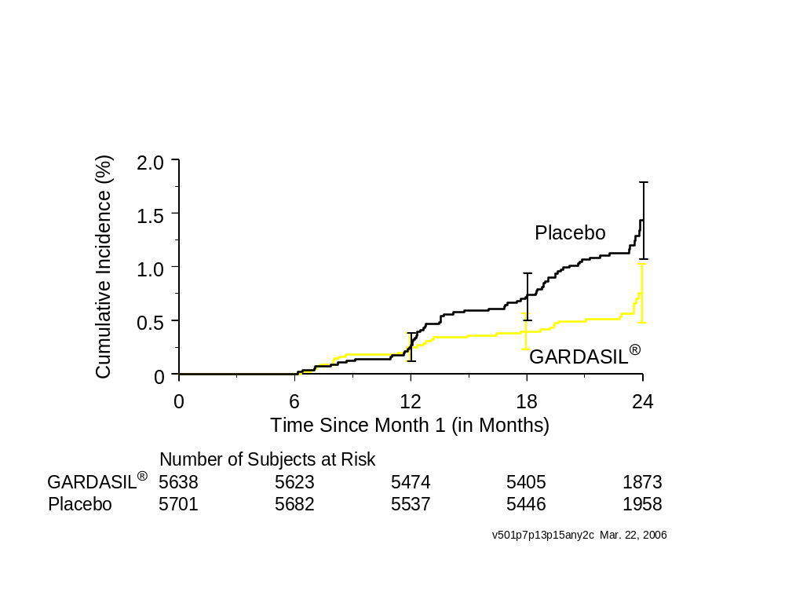
Time to Detection of CIN 2/3 or AIS
(Regardless of Causal HPV Type)
Partially HPV-Naïve Population [P007, P013, P015]
CIN 2/3 in Subjects Presumably HPV-Infected at Day 1
CIN 2/3 in Subjects Presumably HPV-
Naïve at Day 1

Slide 75
Presentation Outline
Clinical Significance of HPV Disease
Design of the Clinical Trials Program for GARDASIL®
Clinical Trial Results for GARDASIL®
  Overall Study Population
  Efficacy and Immunogenicity
    Prophylactic Efficacy
    Population Impact
    Bridging Efficacy Findings from Women to Adolescents
    Duration of Efficacy
  Safety
Overall Benefit/Risk Profile

Slide 76
Bridging Efficacy Results in Adults to Adolescents
Studies in sexually-naïve young adolescents are not feasible
FDA and Merck agreed that efficacy findings in 16- to 26-year-olds can be applied to adolescents using immunogenicity bridging
  Demonstrate that immune responses to GARDASIL® in
  9- to 15-year-olds are non-inferior to those in 16- to 26-year-olds

Slide 77
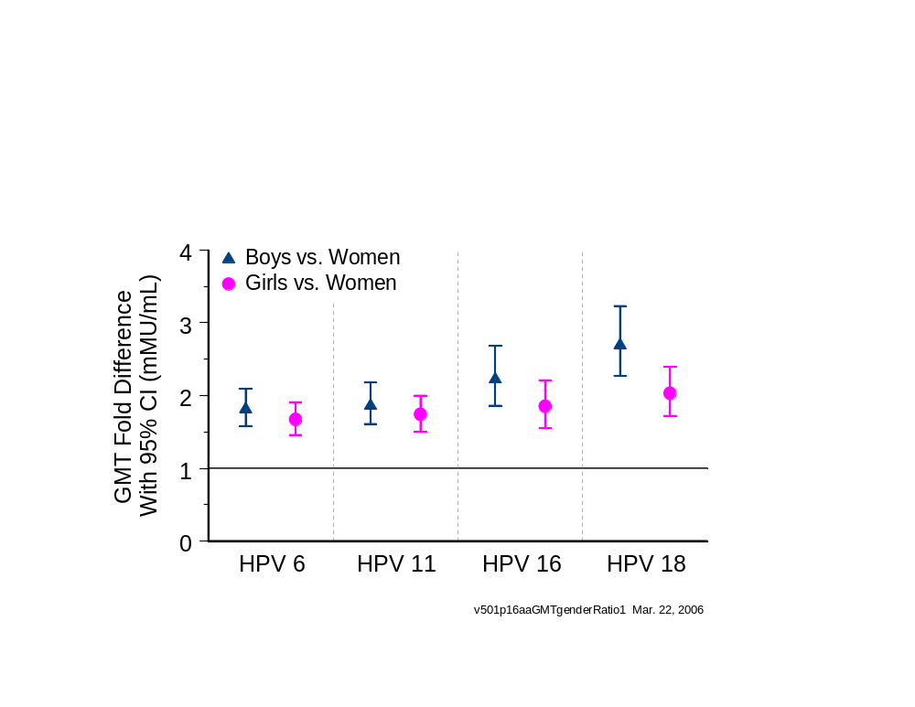
Fold-Difference in Month 7 Anti-HPV GMTs Between Adolescents vs. Adults
Protocol 016 Adolescent/Adult Bridging Study

Slide 78
Presentation Outline
Clinical Significance of HPV Disease
Design of the Clinical Trials Program for GARDASIL®
Clinical Trial Results for GARDASIL®
  Overall Study Population
  Efficacy and Immunogenicity
    Prophylactic Efficacy
    Population Impact
    Bridging Efficacy Findings from Women to Adolescents
    Duration of Efficacy
  Safety
Overall Benefit/Risk Profile

Slide 79
Immune Correlates of Efficacy
High prophylactic efficacy
No documented breakthroughs due to waning immunity
Precludes defining a minimal protective anti-HPV level

Slide 80
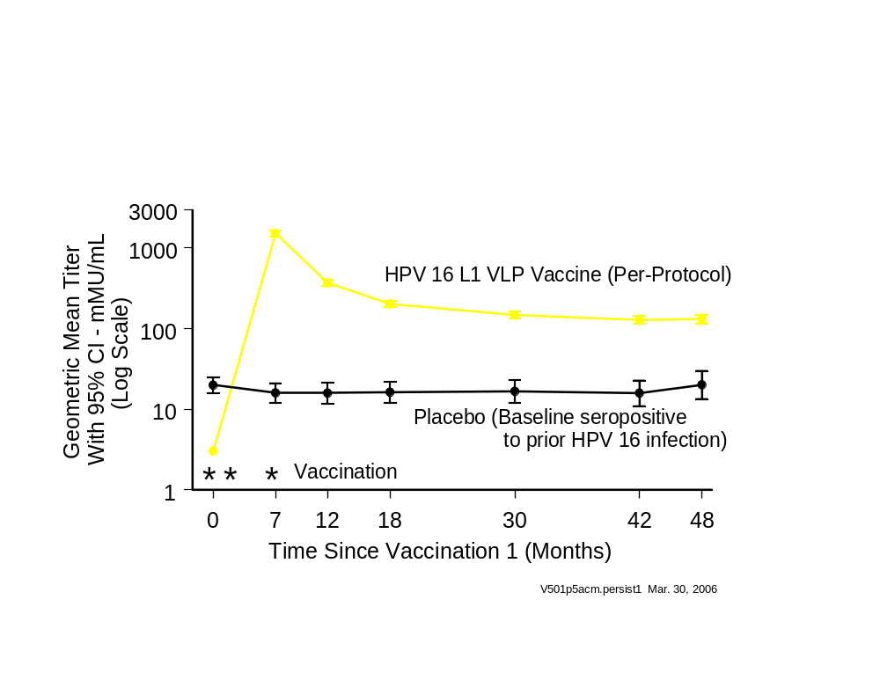
Persistence of Anti-HPV 16 Immunogenicity HPV 16 Vaccine Efficacy Study (Protocol 005)
due

Slide 81
Sentinel Cohort to Evaluate
Duration of Efficacy
The Nordic Region requires reporting of Pap test and biopsy results by national ID number to centralized registries
In 5498 CIN 2/3 study subjects enrolled in the region, these registries will be used to define long-term duration of efficacy
Vaccination
Protocol 015
Registry-Based Follow-Up
Efficacy Reports
3 yr
5 yr
7 yr
9 yr
Launch in US
(Assuming Approval)
2 yr
4 yr
6 yr
2003
2004
2005
2006
2007
2008
2009
2010
2011
2012
2013

Slide 82
Efficacy Summary
Prophylactic administration of GARDASIL® is highly effective in preventing cervical and genital disease caused by HPV 6, 11, 16, and 18
GARDASIL® reduces overall burden of HPV disease
Protective efficacy demonstrated for at least 3.5 years Postdose 3 (HPV 16) and at least 2.5 years postdose 3
(HPV 6, 11, 18)
Robust immunogenicity bridging from adults to 16- to 26-year-olds to 9- to 15-year-olds
Sentinel cohort has been set up to evaluate long-term efficacy well in advance of the general population

Slide 83
Presentation Outline
Clinical Significance of HPV Disease
Design of the Clinical Trials Program for GARDASIL®
Clinical Trial Results for GARDASIL®
  Program Design
  Efficacy and Immunogenicity
  Safety
    General Safety (9- to 26-Year-Olds)
    Pregnancy Outcomes
Overall Benefit/Risk Profile

Slide 84
Adverse Experience Reporting
Non-serious AEs collected Day 1 through Day 15 Post-vaccination on Vaccination Report Card (VRC) in all studies
Serious AEs collected Day 1 through Day 15 Postvaccination and at any time during the study if the event was:
  Death of a study subject
  Was determined by the investigator to be possibly, probably, or definitely vaccine related
  Was determined by the investigator to be possibly, probably, or definitely related to a study procedure
Mandatory worksheet completed to ensure no Serious AEs went unreported
Also collected new medical history at every visit
Data and Safety Monitoring Board supervision of Phase III studies

Slide 85
Safety Populations
All Subjects in All Studies (N=27,004)
Monovalent HPV Vaccines or Placebo (N=3464)
Safety Population
GARDASIL® or Placebo (N=21,464)
Serious Adverse Experiences
Pregnancy Outcomes
New Medical History
Quadrivalent HPV Vaccine With Higher VLP or Alum Doses than GARDASIL® (N=552)
Detailed Safety Population
(N=10,224)
Vaccination Report Card (VRC) (Nonserious AEs)
Quadrivalent HPV Vaccine With Lower VLP Doses than
GARDASIL® (N=1524)
Protocol 015 Selected Sites
(N=11,240)
Spontaneous Reporting (Nonserious AEs)

Slide 86
Summary of SAEs, Deaths, Discontinuations
Safety Population
Days 1 to 15 Following Any Vaccination
GARDASIL®
(N=11,778)
Placebo
(N=9686)
Result
n
(%)
n
(%)
Subjects With Follow-up
Number of Subjects
With Serious AEs
With Serious VR AEs
Who Died
Discontinued Due to AE
Discontinued Due to SAE
Discontinued Due to VR SAE
11,641
59
5
3
15
4
0
(0.51)
(0.04)
(0.03)
(0.13)
(0.03)
(0.00)
9578
43
2
1
10
3
1
(0.45)
(0.02)
(0.01)
(0.10)
(0.03)
(0.01)
 One subjects who received GARDASIL® reported a serious VR AE beyond Day 15 after vaccination.
 Seven subjects who received GARDASIL® and 6 subjects in the placebo group died beyond Day 15
after vaccination.

Slide 87
Serious Adverse Experiences Judged to Vaccine-Related in the Safety Population
Day 1 to 15 Following Any Vaccination
GARDASIL®
(N=11,778)
Placebo
(N=9686)
Subjects With Follow-up
Subjects With at Least 1 Vaccine-related Serious AE
Bronchospasm (Possibly Related)
Gastroenteritis (Possibly Related)
Headache/Hypertension (Definitely Related)
Injection Site Pain/Movement Impairment (Probably Related)
Vaginal Hemorrhage (Probably Related)
Hypersensitivity (Possibly Related)
Chills/Headache/Fever (Possibly Related)
11,641
5
1
1
1
1
1
0
0
9578
2
0
0
0
0
0
1
1

Slide 88
Overall Adverse Experience (AE) Summary
Detailed Safety Population
Days 1 to 15 Following Any Vaccination
GARDASIL®
(N=6160)
Placebo
(N=4064)
Result
n
(%)
n
(%)
Subjects With Follow-up
Number of Subjects
With 1 or More AEs
Injection-site AEs
Systemic AEs
With Serious AEs
With Serious VR AEs
Who Died
Discontinued Due to AE
Discontinued Due to SAE
Discontinued Due to VR SAE
6069
5455
5035
3591
37
1
1
11
2
0
(89.9)
(83.0)
(59.2)
(0.61)
(0.02)
(0.02)
(0.18)
(0.03)
(0.00)
3994
3416
2932
2413
26
0
1
6
2
0
(85.5)
(73.4)
(60.4)
(0.67)
(0.00)
(0.03)
(0.15)
(0.05)
(0.00)

Slide 89
Maximum Temperatures
Detailed Safety Population
Days 1 to 5 Following Any Vaccination
GARDASIL®
(N=6160)
Placebo
(N=4064)
Result
Subjects With Follow-up
Subjects With a Fever (≥37.8°C)
≥37.8°C and <38.9°C
≥38.9°C and <39.9 C
≥39.9°C
6040
11.4%
9.9%
1.3%
0.2%
3981
9.6%
8.6%
0.9%
0.2%
All temperatures were oral or oral equivalent

Slide 90
Clinical Adverse Experience (AE) Summary
Days 1 to 15 Following Any Vaccination Visit
Subjects Given GARDASIL®
(Detailed Safety Population) by Gender + Age
18- to 26-Year
Old Women
N=3697
9- to 17-Year
Old Girls
N=1391
9- to 15-Year
Old Boys
N=1071
No. of Subjects
n
(%)
n
(%)
n
(%)
With Follow-up
With 1 or More AEs
Injection-site AEs
Systemic AEs
With Serious AEs
With Serious VR AEs
Died
Discon. Due to AE
3640
3370
3166
2346
26
1
1
5
(92.6)
(87.0)
(64.5)
(0.7)
(0.0)
(0.0)
(0.1)
1372
1214
1111
742
7
0
0
2
(88.5)
(81.0)
(54.1)
(0.5)
(0.0)
(0.0)
(0.1)
1056
870
757
503
4
0
0
4
(82.4)
(71.7)
(47.6)
(0.4)
(0.0)
(0.0)
(0.4)

Slide 91
Presentation Outline
Clinical Significance of HPV Disease
Design of the Clinical Trials Program for GARDASIL®
Clinical Trial Results for GARDASIL®
  Program Design
  Efficacy and Immunogenicity
  Safety
    General Safety (9- to 26-Year-Olds)
    Pregnancy Outcomes
Overall Benefit/Risk Profile

Slide 92
Pregnancy Outcomes Reporting in Phase III Studies
All pregnancies followed for outcome
  Medical history during pregnancy
  Outcomes (mother and child) in neonatal period
  Follow-up in infants until end of study
  Cause of spontaneous abortion
  Reason for elective termination
Outcome
Background Rate
Spontaneous Abortion (Pregnancy
detected by periodic β-hCG testing)
Congenital Anomalies
28 to 33%¹
3 to 4%²
¹ Scott JR et al. Early Pregnancy Loss. 8th Ed. Philadelphia: 1999:143-53.; Wilcox AJ et al. Time of Implantation of the Conceptus and Loss of Pregnancy. N Engl J Med. 1999;340(23):1796-9; Wang X et al. Conception, early pregnancy loss, and time to clinical pregnancy: a population-based prospective study. Fertil Steril. 2003;79(3):577-84.
² Quick Reference: Birth Defects (http://www.marchofdimes.com/printableArticles/14332_1206.asp).

Slide 93
Pregnancy Outcomes in the Phase III Program
Database as of 11-Nov-2005
GARDASIL®
(N=10,418)
Placebo
(N=9120)
Result
Subjects With Pregnancies
Number of Pregnancies
Fetuses/Infants
Ongoing Pregnancy/Unknown
Known Outcome
Live Births
Fetal Loss
1115
1244
258
996
621 (62%)
375 (38%)
1151
1272
263
1018
611 (60%)
407 (40%)

Slide 94
Pregnancy Outcomes in the Phase III Program Database as of 11-Nov-2005
GARDASIL®
Placebo
n
(%)
n
(%)
Fetuses/Infants With Known Outcomes
EOP Within 30 Days of a Vaccination
Spontaneous Loss
Elective Termination
Live Birth
Fetuses/Infants With Known Outcomes
EOP Beyond 30 Days of a Vaccination
Spontaneous Loss
Elective Termination
Live Birth
112
21
21
70
879†
236
93
549
(18.8)
(18.8)
(62.5)
(26.8)
(10.6)
(62.5)
115
26
23
66
898
237
117
544
(22.6)
(20.0)
(57.4)
(26.4)
(13.0)
(60.6)
† Type of fetal loss not reported for one fetus.

Slide 95
Pregnancy Outcomes in the Phase III Program Database as of 11-Nov-2005
GARDASIL®
n
Placebo
n
Infant/Fetus Congenital Anomalies
EOP Within 30 Days of a Vaccination
Anomaly in Live-Born Infant
EOP Beyond 30 Days of a Vaccination
Anomaly in Live-Born Infant
Anomaly in Fetal Loss
Intrauterine Observation
15
5
5
10
9
0
1
16
0
0
16
13
2
1

Slide 96
Congenital Anomalies in 5 Pregnancies With EOP Within 30 Days of a Vaccination
Case
Number
Timing of
Conception
Gestational
Critical Period
Background Rate
(% of Live Births)
Diagnosis
1
2
3
4
5
Pyloric
Stenosis
Congenital
Megacolon
Congenital
Hydronephrosis
Hip Dysplasia
Club Foot
19 Days
After Dose 1
7 Days
After Dose 3
2 Days
Prior to Dose 2
1 Day
After Dose 1
9 Day
After Dose 1
8th Week
7th Week
5th Week
2nd-3rd
Trimester
2nd-3rd
Trimester
0.17
0.02
0.02
0.1 to 0.15
0.06 to 0.6

Slide 97
Pharmacovigilance Program (Proposed)
Postlicensure study of 35,000 subjects to evaluate general safety and pregnancy outcomes
A pregnancy registry to further monitor for pregnancy outcomes in women who receive GARDASIL®
An evaluation of the long-term safety of GARDASIL® as part of the Nordic Cancer Registry program
A population-based evaluation of the safety (and effectiveness) of GARDASIL® in Nordic countries planning to implement a mandatory HPV vaccine registry

Slide 98
Safety Conclusions
GARDASIL® is generally well tolerated in 9- to 26-year-olds
GARDASIL® is associated with:
  An increase in injection-site AEs, compared with placebo
  Higher incidence of low-grade fevers, compared with placebo
Individuals 9 to 26 years of age who receive GARDASIL® rarely discontinue vaccination due to an AE
GARDASIL® is generally well tolerated in 9- to 26-year-old subjects who are positive to ≥1 vaccine HPV type
Overall pregnancy outcomes are comparable between women who receive GARDASIL® or placebo
Large pharmacovigilance monitoring program will be launched at licensure

Slide 99
Presentation Outline
Clinical Significance of HPV Disease
Design of the Clinical Trials Program for GARDASIL®
Clinical Trial Results for GARDASIL®
  Program Design
  Efficacy and Immunogenicity
  Safety
    Overall
    Special Populations (Children, Baseline HPV infected)
    Pregnancy Outcomes
Overall Benefit/Risk Profile

Slide 100
Burden of HPV Infection/Disease in American Men and Women Is High
~35,000 cancers annually
  HPV 16 and 18 cause ~25,000 of these cases
~1.4 Million CIN lesions annually
  HPV 16 and 18 cause ~530,000 of these cases
  HPV 6 and 11 cause ~175,000 of these cases
~1 Million cases of genital warts annually
  HPV 6 and 11 cause ~900,000 of these cases
~6,000 cases of RRP annually
  HPV 6 and 11 cause ~5400 of these cases

Slide 101
GARDASIL® Definitively Shown to Prevent Clinical HPV Disease Due to HPV 6/11/16/18
Integrated Phase II/Phase III Data Set
HPV-Naïve
Modified
Intention-to-Treat
(With CIs)
Per-Protocol
Efficacy (With CIs)
Endpoint
HPV 16/18-related:
Cervical Cancer
(via CIN 2/3 + AIS)
Vulvar + Vaginal Cancer
(via VIN 2/3 + VaIN 2/3)
HPV 6/11/16/18-related:
CIN or AIS
HPV 6/11/16/18-related EGL
100% (93%, 100%)
--
95% (87%, 99%)
99% (95%, 100%)
99% (93%, 100%)
100% (83%, 100%)
94% (88%, 97%)
95% (90%, 98%)

Slide 102
Population Impact and Duration of Follow-Up Being Evaluated
Population Impact
  Reductions in the overall burden of CIN, CIN 2/3 + AIS, EGL already observed
  Complete analysis to be provided in Spring 2007
Long-term Duration of Efficacy
  Efficacy through up 3.5 years Postdose 3 shown
  No breakthroughs due to waning immunity
  Sentinel cohorts with follow-up >3 years ahead of general population will evaluate longer-term duration of efficacy
  Similar sentinel cohort set up in adolescents

Slide 103
GARDASIL® Has a Favorable Safety Profile
GARDASIL® is generally well tolerated in 9- to 26-year-old subjects
Individuals 9 to 26 years of age who receive GARDASIL® rarely discontinue vaccination due to an AE
Overall pregnancy outcomes are comparable between women who receive GARDASIL® or placebo
Further pharmacovigilance monitoring is planned

Slide 104
Positive Benefit/Risk Ratio for
Vaccination of 9- to 15-Year-Old Boys
In boys, GARDASIL® was immunogenic and well-tolerated
  Trial to confirm efficacy of GARDASIL® in 16- to 26-year-old men is ongoing and will continue post-licensure
Strong public health rationale for vaccinating boys:
  Vaccine coverage in girls will be incomplete
  Males transmit HPV to females
  Previous experience with female-only vaccination showed that this approach failed to control female-only morbidity
  Gender-neutral vaccination will result in more rapid and complete reduction in the burden of HPV disease in women
Propose labeling to allow flexibility in decision about optimal vaccination policy by public health authorities
  Indication to prevent diseases against which efficacy was shown
  Inclusion of all data in girls, women, boys

Slide 105
Benefit/Risk Profile for GARDASIL®
Is Favorable
Cervical, vulvar, vaginal cancer prevention
Reduction in the burden of cervical precancers and external genital lesions
Excellent safety profile
Large positive public health impact

