Slide 1

LNG
PAT WOOD III
Federal Energy Regulatory Commission
December 17, 2003

Slide 2
FERC
Existing and Proposed
Lower-48 LNG Terminals
Existing Terminals with Expansions
A. Everett, MA : 1.035 Bcfd (Tractebel)
B. Cove Point, MD : 1.0 Bcfd (Dominion)
C. Elba Island, GA : 1.2 Bcfd (El Paso)
D. Lake Charles, LA : 1.2 Bcfd (Southern Union)
Approved Terminals
1. Hackberry, LA : 1.5 Bcfd, (Sempra Energy)
2. Port Pelican: 1.0 Bcfd, (Chevron Texaco)
Proposed Terminals – FERC
3. Bahamas : 0.84 Bcfd, (AES Ocean Express)
4. Bahamas : 0.83 Bcfd, (Calypso Tractebel)
5. Freeport, TX : 1.5 Bcfd, (Cheniere / Freeport LNG Dev.)
6. Fall River, MA : 0.4 Bcfd, (Weaver's Cove Energy)
7. Long Beach, CA : 0.7 Bcfd, (SES/Mitsubishi)
Proposed Terminals – Coast Guard
8. Gulf of Mexico: 0.5 Bcfd, (El Paso Global)
9. California Offshore: 1.5 Bcfd, (BHP Billiton)
10. Louisiana Offshore : 1.0 Bcfd (Gulf Landing – Shell)
Planned Terminals
11. Brownsville, TX : n/a, (Cheniere LNG Partners)
12. Corpus Christi, TX : 2.7 Bcfd, (Cheniere LNG Partners)
13. Sabine, LA : 2.7 Bcfd (Cheniere LNG)
14. Humboldt Bay, CA : 0.5 Bcfd, (Calpine)
15. Mobile Bay, AL: 1.0 Bcfd, (ExxonMobil)
16. Somerset, MA : 0.65 Bcfd (Somerset LNG)
17. Louisiana Offshore : 1.0 Bcfd (McMoRan Exp.)
18. Belmar, NJ Offshore : n/a (El Paso Global)
19. So. California Offshore : 0.5 Bcfd, (Crystal Energy)
20. Bahamas : 0.5 Bcfd, (El Paso Sea Fare)
21. Altamira, Tamulipas : 1.12 Bcfd, (Shell)
22. Baja California, MX : 1.3 Bcfd, (Sempra)
23. Baja California : 0.6 Bcfd (Conoco-Phillips)
24. Baja California - Offshore : 1.4 Bcfd, (Chevron Texaco)
25. Baja California : 0.85 Bcfd, (Marathon)
26. Baja California : 1.3 Bcfd, (Shell)
27. St. John, NB : 0.75 Bcfd, (Irving Oil & Chevron Canada)
28. Point Tupper, NS 0.75 Bcf/d (Access Northeast Energy)
29. Harpswell, ME : 0.5 Bcf/d (Fairwinds LNG – CP & TCPL)
30. St. Lawrence, QC : n/a (TCPL and/or Gaz Met)
31. Lázaro Cárdenas, MX : 0.5 Bcfd (Tractebel)
32. Corpus Christi, TX : 1.0 Bcfd (ExxonMobil)
33. Gulf of Mexico : 1.0 Bcfd (ExxonMobil)
34. Sabine, LA : 1.0 Bcfd (ExxonMobil)
35. Providence, RI ; 0.5 Bcfd (Keyspan & BG LNG)
30
28
27
29
35
A
6
16
B
18
14
19
7
9
22
C
23
34
1
D
15
20
24
25
5
13
3
4
26
12
31
2
33
17
11
8
10
21
31
December 2003

Slide 3
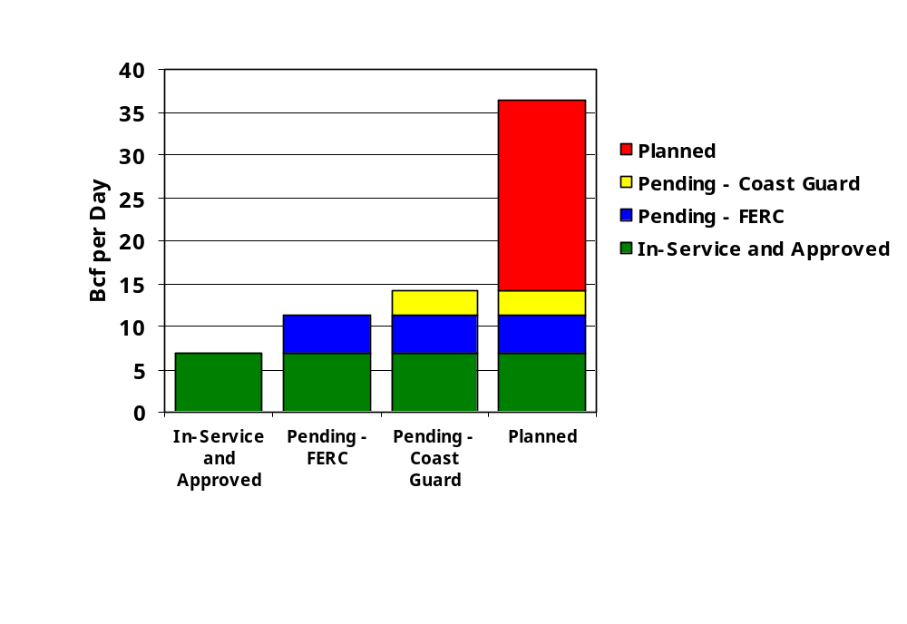
Maximum LNG
Deliverability Growth

Slide 4

FERC
December 2002 FERC Policy Change
Liquid to Vapor Flow
LNG
Buyers
A
LNG
Suppliers
B
B
Open Access At Delivery of Vapor into Interstate Pipeline System
A
Open Access At Delivery of Liquid to Terminal

Slide 5
LNG Terminal
Siting Issues
Safety
Take Away Capacity
Local acceptance
Federal and State approvals

Slide 6
Safety
Proximity to residential and commercial areas raises public safety concerns.
  Exclusion zones
DOT/OPS enforces security.
FERC performs pre- and post-certificate reviews of LNG terminals.
  Biennial reviews continue for life of terminal.
Coast Guard enforces offshore ship safety.

Slide 7
Takeaway Capacity
Is there an existing pipeline with takeaway capacity?
Does the project require new pipeline construction?
NEPA requires an analysis of the cumulative effects.
  Can not have an LNG terminal without takeaway capacity.

Slide 8
Federal and State
Approvals
Must get approvals:
  FERC – NGA Approval
  DOT/OPS – Exclusion Zones
  Coast Guard – Vessel Operating Plan
  Corps of Engineers – Dredging, Wetland Filling, Alternative Sites
  NMFS, FWS – Endangered Species Act
  Coastal Zone Consistency Determination
  State Agency Requirements

Slide 9
Traditional vs. NEPA Pre-Filing Process
Announce
Open
Season
Develop
Study
Corridor
File
At
FERC
Prepare Resource
Reports
Traditional - Applicant
Traditional - FERC
Conduct
Scoping
Issue
Draft
EIS
Issue
Final
EIS
Issue
Order
Announce
Open
Season
Develop
Study
Corridor
File
At
FERC
Prepare Resource
Reports
NEPA Pre-Filing - Applicant
Conduct
Scoping
Review Draft
Resource Reports
& Prepare DEIS
Issue
Draft
EIS
Issue
Final
EIS
Issue
Order
NEPA Pre-Filing - FERC
0 1 2 3 4 5 6 7 8 9 10 11 12 13 14 15 16 17 18 19 20 21 22 23 24 25 26 27 28
(months)

Slide 10
Making the NEPA
Pre-Filing Process Work
Projects Can Be Expedited Only If
  The company follows the NEPA Pre-Filing guidelines;
  Public involvement is made an integral part of the project planning process;
  The company works in partnership with the agencies; and
  The project is READY to move forward.

Slide 11
NEPA Pre-Filing
Lessons Learned
Management support needed for project teams’ work with stakeholders.
Participating agencies early involvement is needed.
Stakeholder involvement needs to be planned.

Slide 12
Benefits of NEPA Pre-Filing
More interactive NEPA process, no shortcuts
Earlier, more direct involvement by FERC, other agencies, landowners
Goal of “no surprises”
Time savings realized only if we are working together with stakeholders
FERC staff is an advocate of the Process, not the Project!

Slide 13
Companies Need a Plan for Public Participation
A Plan is required for NEPA Pre-filing, strongly encouraged otherwise
Must be an intentional component
It won’t happen by accident

