Slide 1
SNLS & Type II-P Supernovae
A Hubble Diagram for Today
and the Future
Peter Nugent (LBNL)

Slide 2
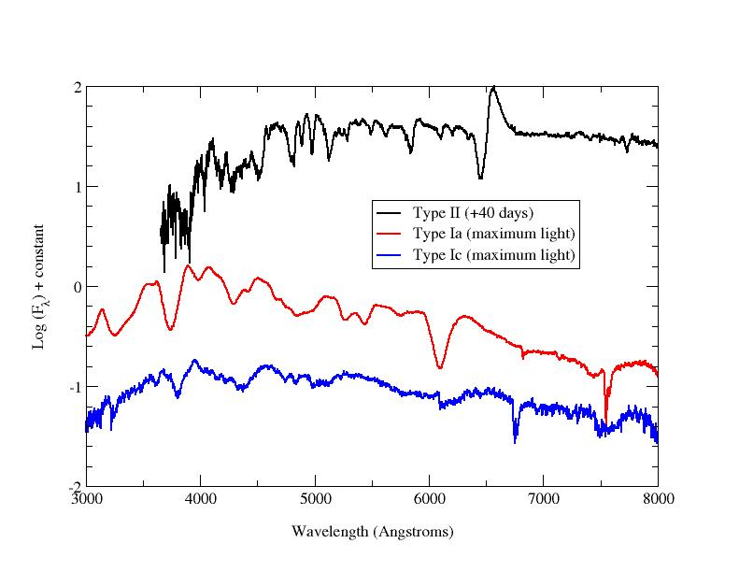
Type II’s
A Type II means we see hydrogen in the spectrum.
II-P = Plateau-like lightcurve in the optical.
II-L = Linearly declining lightcurve in the optical.
II-n = Narrow Balmer lines seen in optical spectrum.

Slide 3
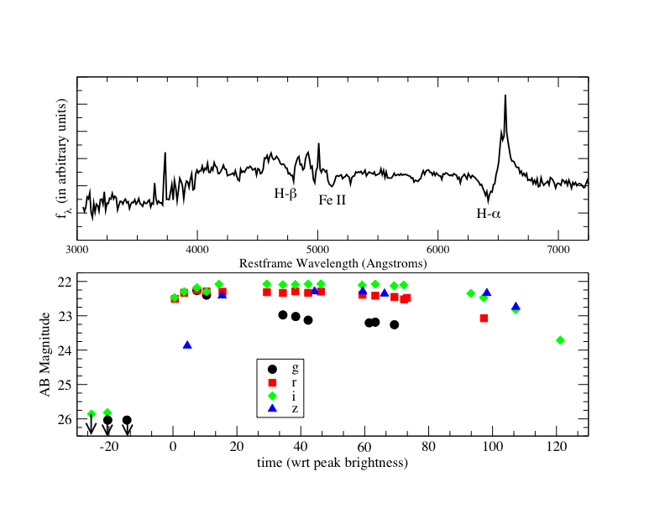
Type II-P’s
A Type II-P is most likely a 8-15 M_{solar} star that undergoes core-collapse.
Unlike the II-n’s and II-L’s it is probably not in a binary systemand is not experiencing an interaction with the circumstellar material around it.

Slide 4
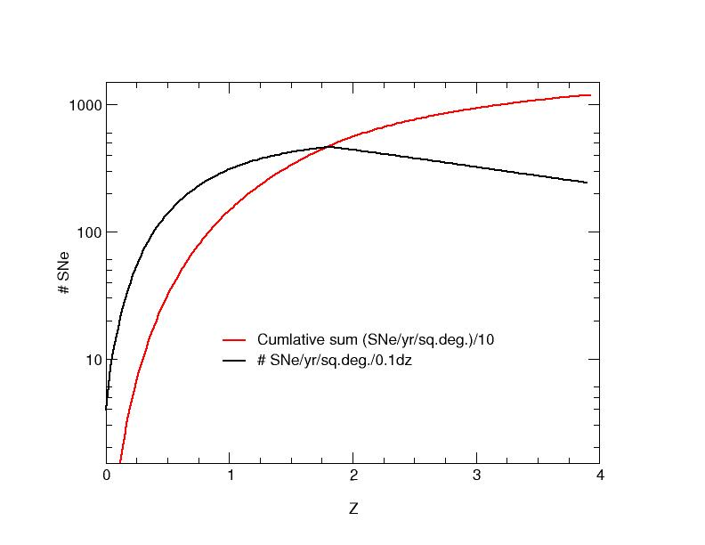
What about Type II’s
At low z (< 0.1) they are 5 times more abundant than Ia’s.
They directly follow the SFR, thus increasing by several fold at high-z.
But they are much fainter…

Slide 5
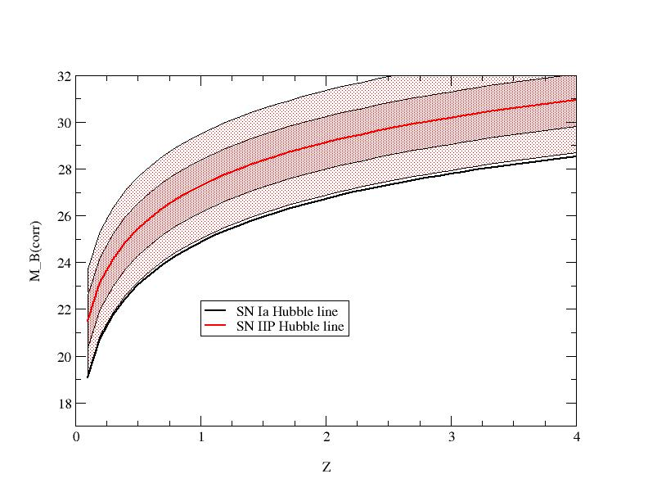
What about Type II’s
Based on this we expect about 8
SNe-IIP per SNLS pointing over the entire observing period brighter than 24th magnitude.

Slide 6
EPM
Measuring Distances to Type II’s - Think:
EPM, the Expanding Photosphere Method (Baade –Wesselink Method)
Type II Supernovae (made mostly of Hydrogen) are like hot,
diffuse blackbodies that expand homologously.
Velocity is measured from spectra, time is from the explosion date.
Zeta is the dilution factor - calculated from models.

Slide 7
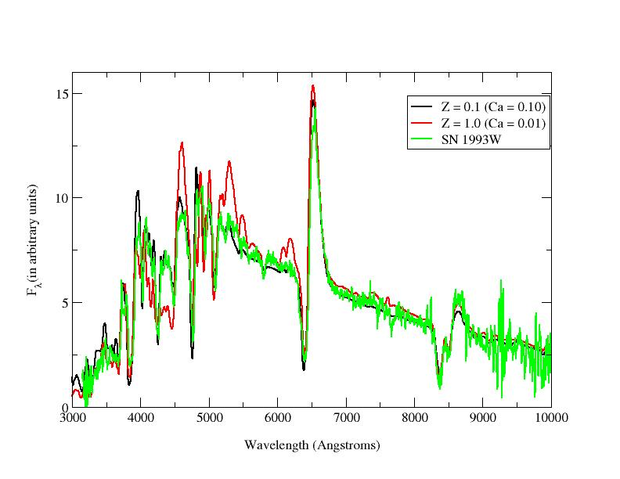
Type II models
Distances to Type II's:
Spectral Expanding Atmosphere Method
or SEAM
The physics is dominated by hydrogen, thus in principle they are much easier to understand than Ia’s.

Slide 8
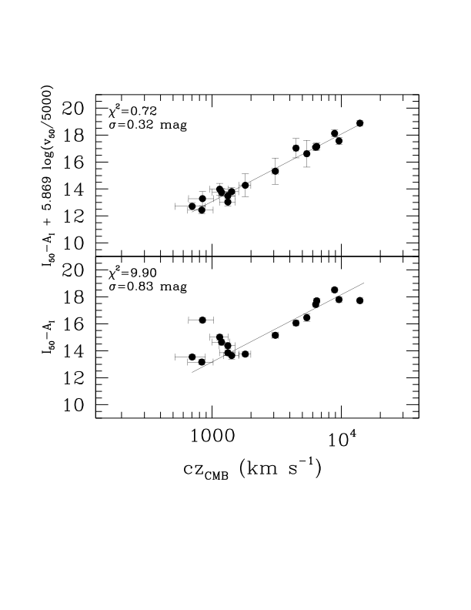
Hamuy’s Method
Mario Hamuy’s Technique:
Basically velocity
is proportional to brightness at t = 50 days
Why should this work?

Slide 9
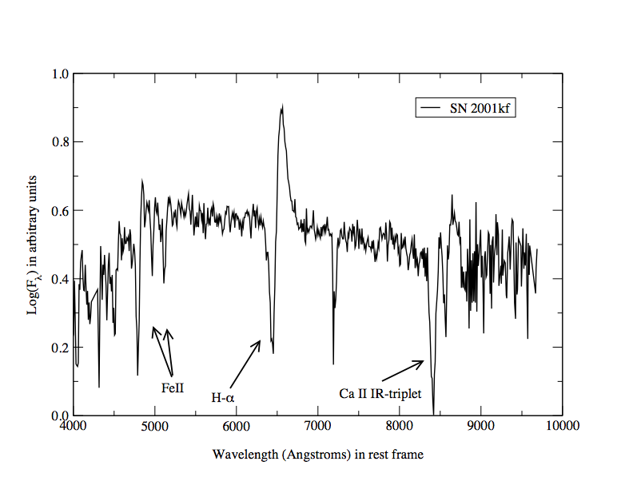
Measurements
Lightcurves from SNLS.
Spectra from Keck.
Measure the velocity from weak FeII lines that best represent where the photosphere is located.
Problems:
Fainter
Buried in host
Lines are weak
Aspherical

Slide 10
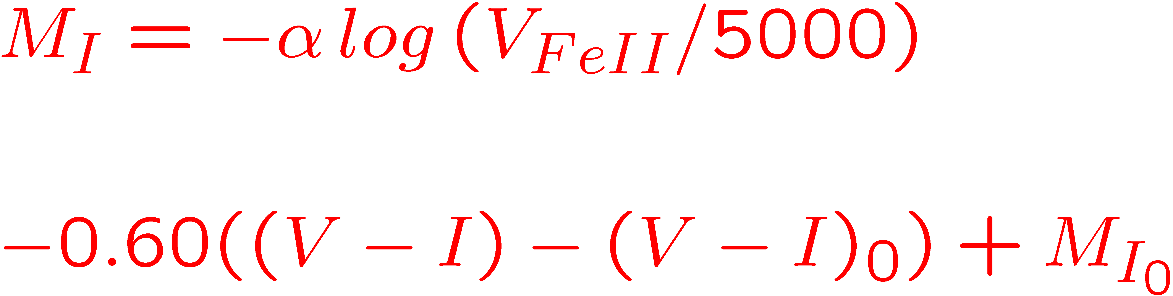
Improving Hamuy’s Method
Old HP02 term
New term relating observed 50 day color to extinction
Two major fixes:
Color Corrections
Velocity measurements

Slide 11
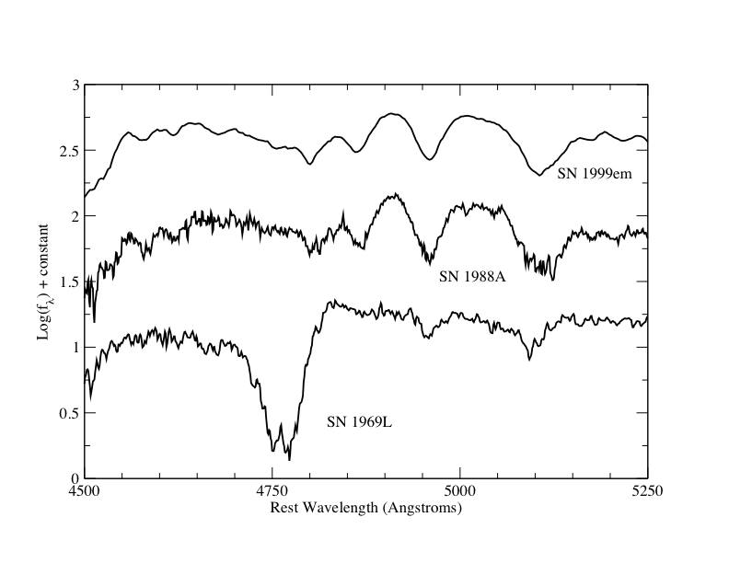
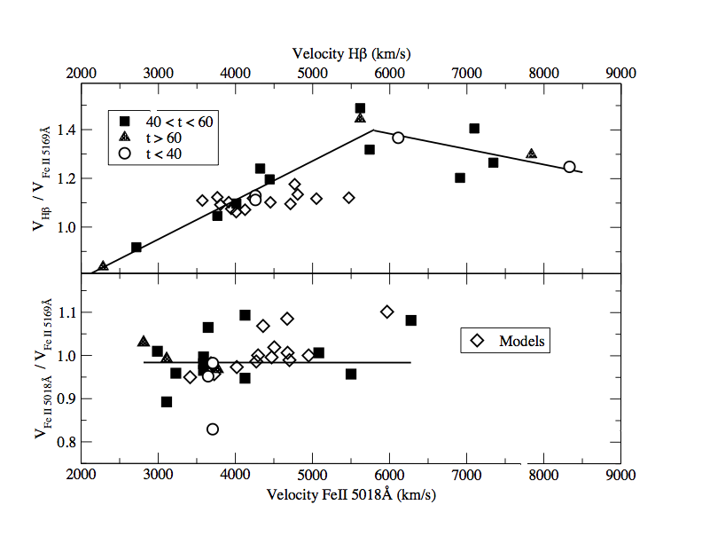
Improving Hamuy’s Method
Fe II (5169) isn’t always the easiest line to measure.
Therefore we came up with correlations to use H-beta and FeII (5018). Cross-correlation measurements.

Slide 12
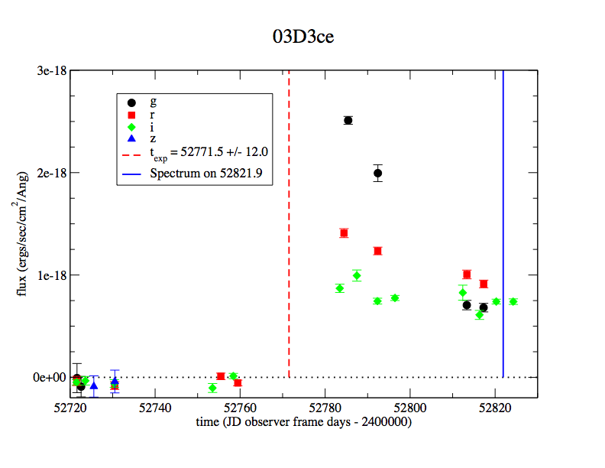
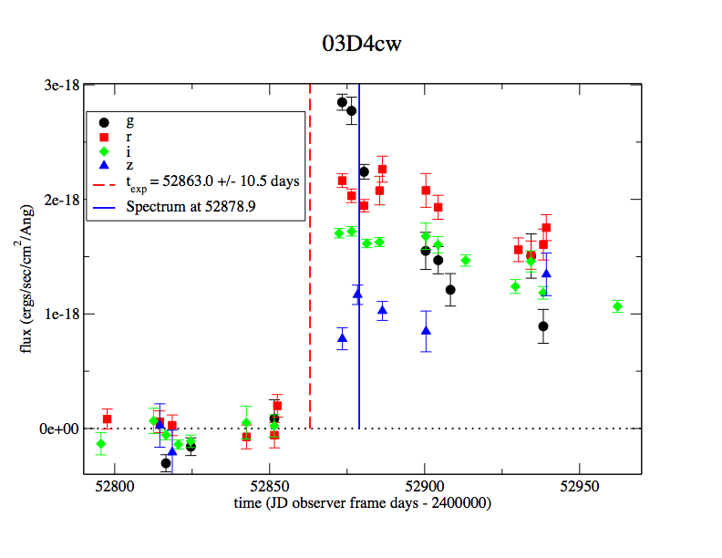
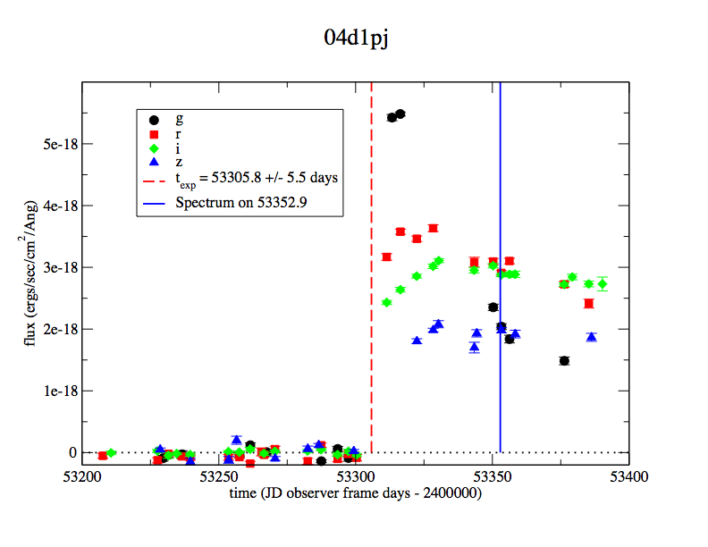
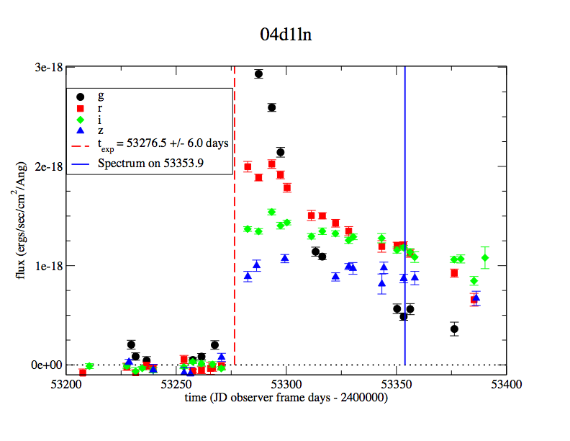
SNLS Type-IIP

Slide 13
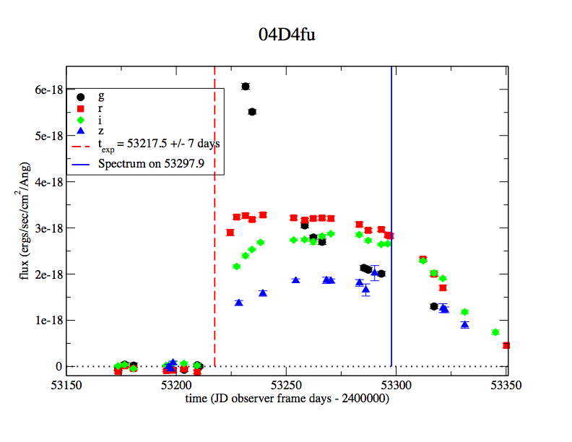
SNLS Type-IIP
The lightcurves are so nice that we often catch the shock breakout. We clearly have a lot of information that we are not exploiting…

Slide 14
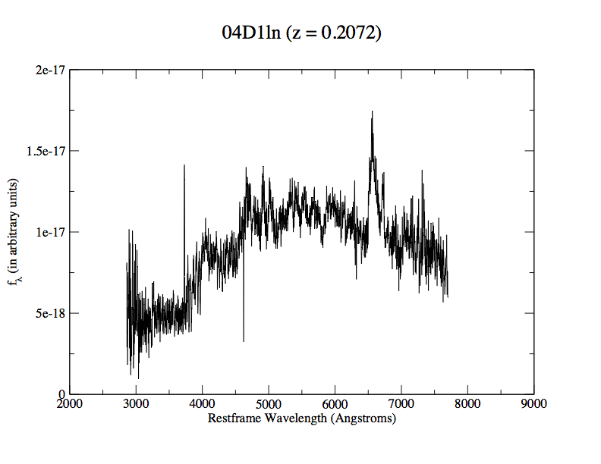
Keck Obs. of Type-IIP
These are incredibly demanding observations, ~2hr for this spectrum, to get enough S/N in the weak FeII lines.

Slide 15
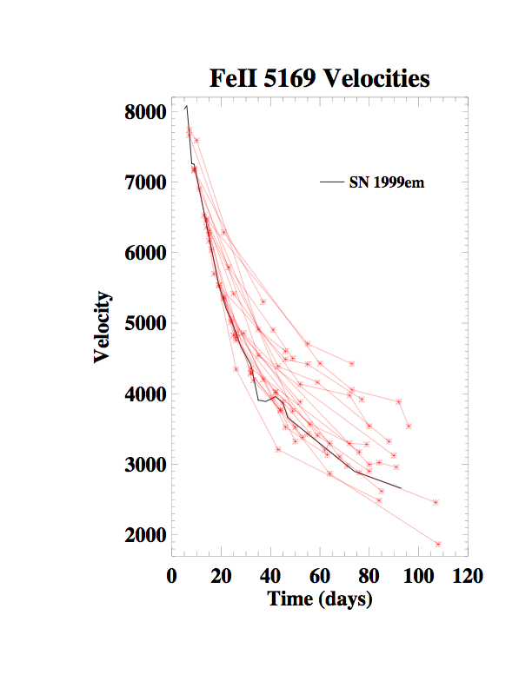
Velocity Correlations
Doug Leonard has shown that the FeII(5169) velocities decline monotonically as a function of time. They actually have an e-folding time of 89days which we can exploit since not all our observations are at day 50 and we need to extrapolate.

Slide 16
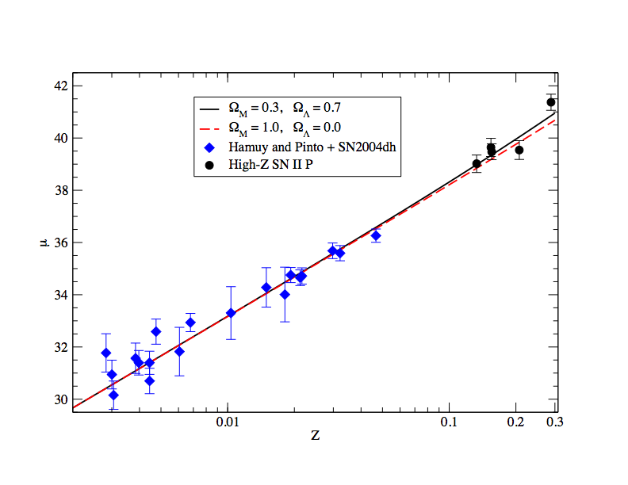
Hubble Diagram
With all uncertainties factored in:
Extinction
Explosion date
Photometry
Velocity
Large MC to handle all the correlations.

Slide 17
Conclusions
A very good high-z program for SNII-P underway.
We do need to improve the low-z component, this is underway at Caltech/Palomar.
Dispersion is 0.24 mag, this will certainly improve as we get better low-z data and figure out how to take advantage of the quality of the high-redshift data. And…

Slide 18
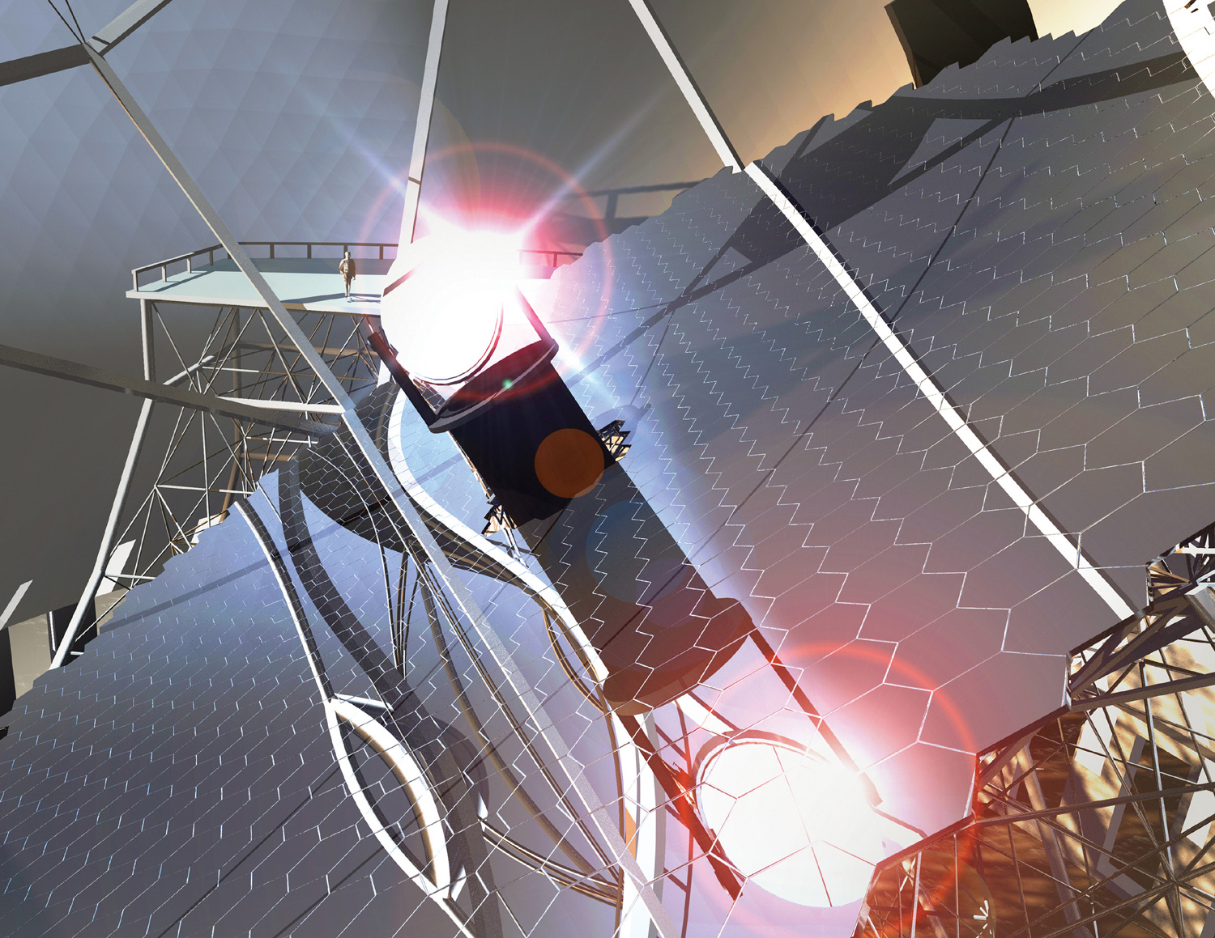
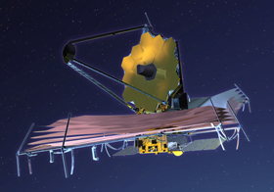
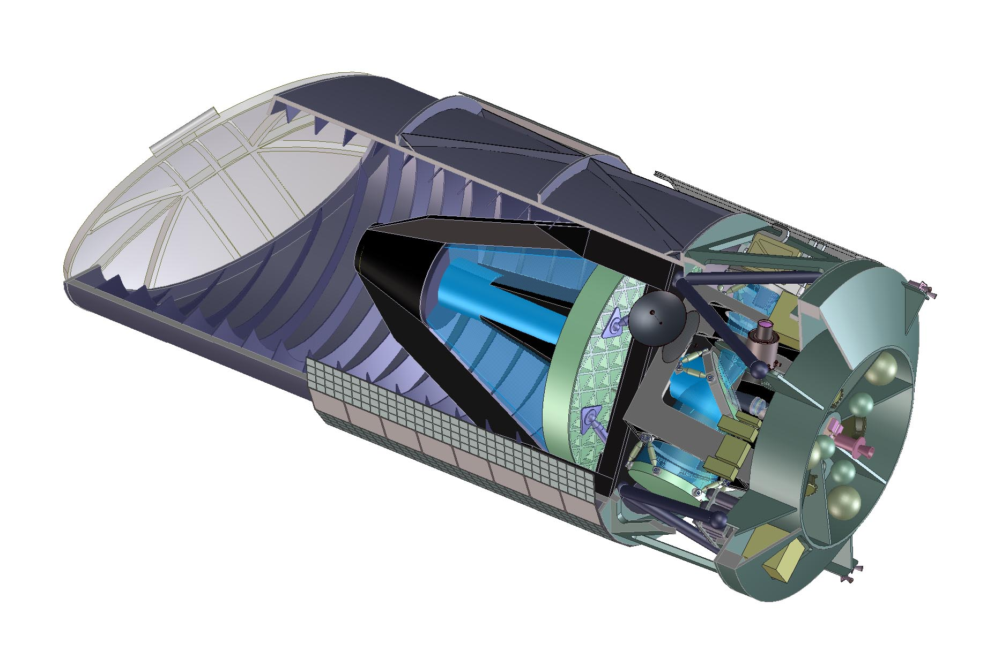
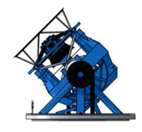
Future
TMT - JWST - JDEM - LSST…..

