Slide 1
Drug Development for Diabetic Foot Infections: Lessons Learned
Anti-Infective Drug Advisory Committee Meeting
October 28, 2003
Alfred F. Sorbello, DO, FACOI
Medical Officer, CDER/DAIDP

Slide 2
Introduction
Defining Diabetic Foot Infections
Classifying Diabetic Foot Infections and Foot Ulcers
Characterization of Study Population
Adjunctive Treatment Measures
Microbiologic Considerations

Slide 3
Definition of a Diabetic Foot Infection
No generally-accepted definition
Foot infections in diabetics can be ulcer- or non-ulcer related
  ~15% of diabetics develop chronic non-healing foot ulcers
  Not all chronic foot ulcers are infected
Clinical trials
  Broad studies of cSSSIs with supplemental studies involving diabetic foot infections
  Eligibility criteria
    Specific disease entities
    Discrete clinical findings
    Presence/absence of a foot ulcer

Slide 4
Common Lower Extremity
Problems in Diabetics
Developmental foot deformities
    hammer toes, valgus deformities
Soft tissue changes
    chronic lower extremity edema
    dependent rubor
    stasis dermatitis
    chronic ulcers colonized with bacteria
Decreased peripheral pulses
Sensory peripheral neuropathy
Charcot (neuropathic) joints

Slide 5
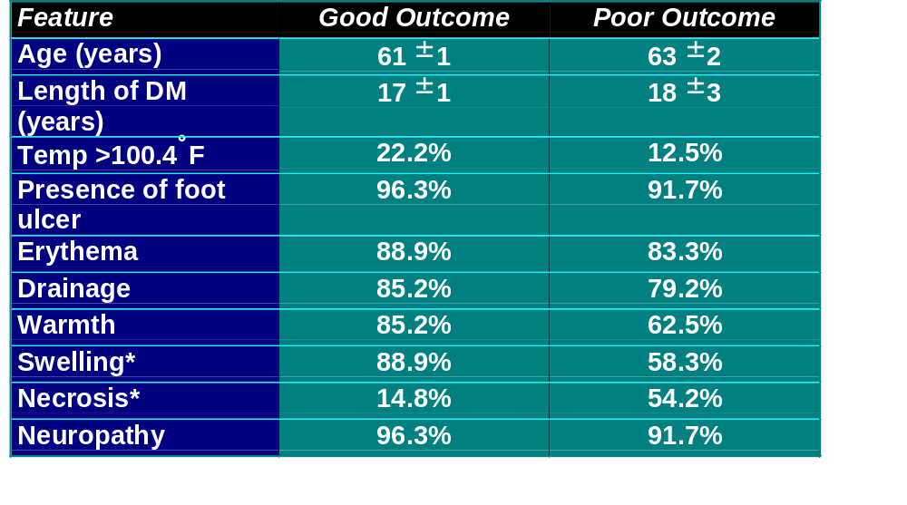
Comparative Prognostic Factors in Diabetics with Osteomyelitis of the Foot
* statistically significant
Bamberger et al. Am J Med 1987;83:653-660

Slide 6
Clinical Trials: Framework for a Definition for a Diabetic Foot Infection
Presence or absence of:
  open wound, foot ulcer, break in skin
  clinical findings
Anatomic location of primary site
Depth of infection
(skin/soft tissue vs. bone/joint)
Isolation of pathogenic bacteria from an appropriate culture specimen

Slide 7
Classification Systems for Diabetic Foot Infections
Classification systems
  Severity of Infection
  Foot Ulcer (Wound)
  No generally-accepted classification
  Differ in criteria & complexity
  Require validation for clinical trials

Slide 8
Classification Systems for Severity of Diabetic Foot Infections
Limb-threatening vs. non-limb threatening
Mild, moderate, severe

Slide 9
Classification Systems for
Diabetic Foot Ulcers
  •Wagner
  •Univ of Texas
  •S(AD) SAD
  •Simple staging

Slide 10
Clinical Trials: Framework to Classify
Diabetic Foot Infections
Standardize definitions
  clinical disease entities
  assessments of ischemia, neuropathy
Correlate with extent, natural history, and prognosis of the infection
Distinguish skin/soft tissue from bone/joint infections
Would need validation

Slide 11
Characterization of Study Population
Demographics
Co-morbidities
Baseline Assessments
Clinical Diagnoses

Slide 12
Demographics and Co-morbidities
Age
Gender
Race
Weight
Country of Origin
Study Center/Site
Type 1 vs type 2 DM
Peripheral neuropathy
Peripheral vascular disease
Renal insufficiency
History of osteomyelitis
History of lower extremity surgery
  podiatric, orthopedic, vascular

Slide 13
Baseline Assessments
Laboratory
  hematology
  chemistry
  HgbA₁C
  C-Reactive Protein
  Wound, tissue, and blood cultures
Radiologic imaging
Vascular evaluation
Neurologic exam
Pulse oxygenation measurement (toe)
Wound or ulcer dimensions

Slide 14
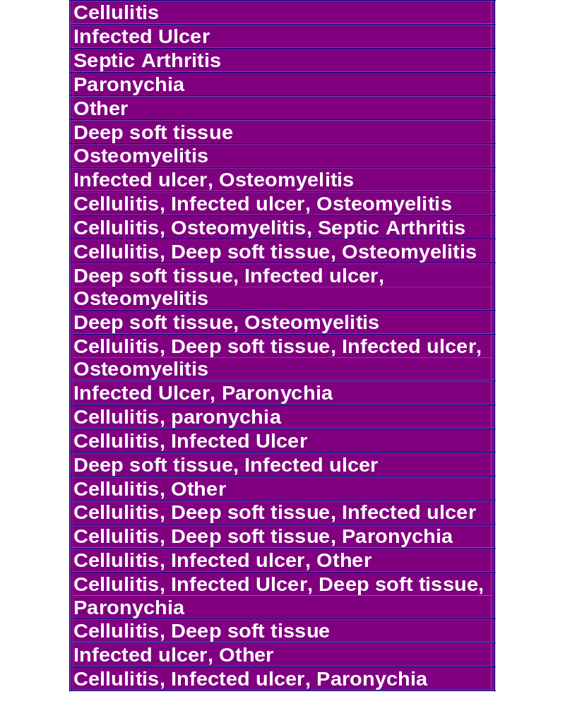
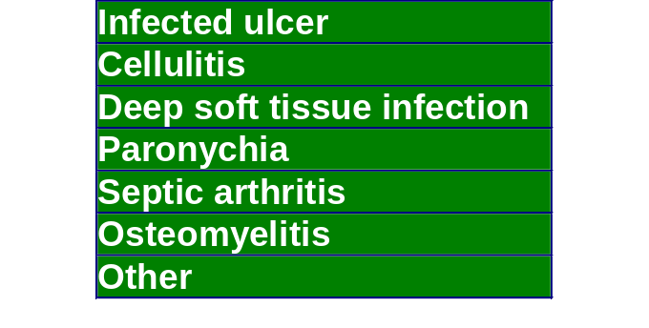
Heterogeneity of Baseline Clinical Diagnoses:
CRF Tabulation
FDA
CRF Tabulation

Slide 15
Adjunctive Treatment Measures
Adjunctive treatments permitted per protocol to augment wound healing
Are they utilized equally in all subjects in both treatment groups?
Could adjunctive treatments make two dissimilar drugs appear indistinguishable?

Slide 16
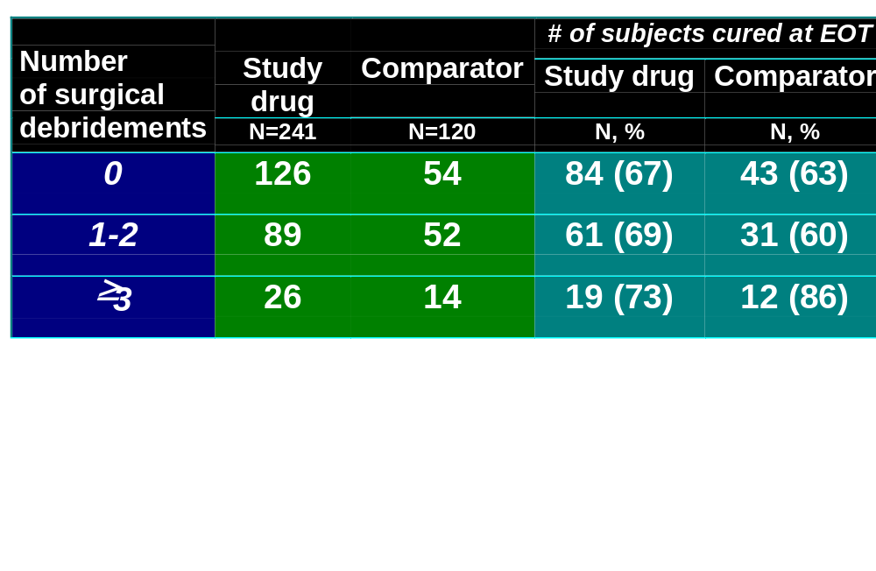
Adjunctive Treatments and Clinical Outcome
EOT = end of therapy; N = number of subjects
Trend indicative of improved cure rate associated with increasing number of debridements.

Slide 17
Microbiologic Considerations
Identify pathogens
  among polymicrobial infections
Standardize culture methodology
  swabs, curettage, biopsy
Microbiological outcome
  Presumed pathogen eradications predominate due to healing of pre-therapy wounds/ulcers
  outcome endpoints are clinically-driven
  follow-up cultures should be performed in treatment failures

Slide 18
Guidance Development for DFIs
Define and classify diabetic foot infections and foot ulcers
Characterize study population
Primary focus is on clinical outcome
Standardize microbiologic methodology
Effect of adjunctive treatment(s) on clinical outcome
Separate clinical trials to assess drug development for bone and joint infections

