Slide 1
National Institute of Diabetes and Digestive and Kidney Diseases Network of Minority Research Investigators Workshop
Molecular Mechanisms in Diabetic Nephropathy
Mario B. Marrero
Medical College of Georgia

Slide 2
INTRODUCTION
Renal failure is a common and serious complication of longstanding diabetes mellitus.
Diabetes is now the most common cause of end-stage renal failure requiring dialysis.
Diabetes accounts for almost 40% of all new dialysis patients.

Slide 3
INTRODUCTION (continuation)
The incidence of renal failure caused by diabetes is rising dramatically in the United States especially in minorities (e.g. African Americans, Hispanics and Native Americans).
This tragedy is compounded by the grim reality that the survival of patients with renal failure caused by diabetes is much worse than that of patients with renal failure resulting from other causes.

Slide 4
DIABETIC NEPHROPATHY
Diabetic nephropathy refers to a characteristic set of structural and functional kidney abnormalities that occur in patients with diabetes which leads to End Stage Renal Disease (ESRD).

Slide 5
Structural abnormalities include :
hypertrophy of the kidney
Increase in the thickness of glomerular basement membranes
Accumulation of extracellular matrix components in the glomerulus
Tubular atrophy and interstitial fibrosis.

Slide 6
Thus, excessive cellular growth in the glomeruli is a major contributor to pathological changes associated with diabetic nephropathy.
Furthermore, high glucose-induced growth of glomerular mesangial cells is a characteristic feature of diabetes-induced renal complications.

Slide 7
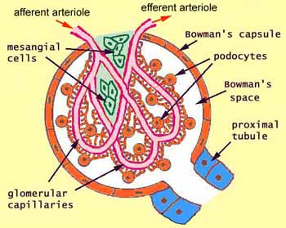
Glomerular mesangial cells are inconspicuous and rather non-descript cells concentrated toward the vascular pole of the glomerulus. These cells produce the mesangial matrix which contributes to the maintenance of the filtration membrane.
Kidney Glomeruli

Slide 8
Glomerular mesangial cells are responsive to traditional growth factors.
However, in diabetes this occurs in the context of an environment enriched in both circulating vasoactive mediators and high glucose.

Slide 9
The vasoactive peptide Angiotensin II (ANG II) has been implicated in the pathogenesis of diabetic renal disease.
Recent findings suggest that both high glucose and ANG II activate intracellular signaling processes leading to growth which include the JAK/STAT Pathway

Slide 10
For the last few years we have been actively investigating the importance of the JAK/STAT cell-signaling cascade in the progression of Diabetic Nephropathy.

Slide 11
Members of the JAK/STAT family
JAKs
JAK1
JAK2
JAK3
Tyk2
STATs
STAT1
STAT3
STAT5 A/B
STAT6
STAT2
STAT4

Slide 12
There are four members of the JAK family in mammals, Jak1, Jak2, Jak3 and Tyk2.
They are over 1000 amino acids in length, ranging in molecular weight from 120 to 130 kDa.
Jak1, Jak2 and Tyk2 are expressed ubiquitously, whereas the expression of Jak3 is restricted to cells of the myeloid and lymphoid lineages

Slide 13
Activators
KGTGYIKTEL
750
IFN-, , IFN , EGF, PDGF, Insulin, Ang II, VEGF
STAT 1
Helix
DNA
SH2
701
ERRKYLKHRL
851
STAT 2
Helix
SH2
IFN-α, β, Ang II
690
SAAPYLKTKF
IL-6, LIF, CNTF, ET-1,
serotonin, GM-CSF, IL-10,
Leptin, EGF, PDGF,
Ang II, FGF, VEGF
770
STAT 3
Helix
DNA
SH2
705
GDKGYVPSVF
748
STAT 4
Helix
DNA
SH2
IL-4 and IL- 12
693
AVDGYVKPQI
Prolactin, GH, IL-3, Epo, IL- 5, Ang II, Insulin, GM-CSF
734
STAT 5
Helix
DNA
SH2
694
KDGRGYVPAT
848
IL- 4, IL-13, Ang II, PDGF, FGF
STAT 6
Helix
DNA
SH2
641

Slide 14
JAK/STAT Activation
Upon ligand stimulation, receptors undergo conformational changes.
These changes attract JAKs which subsequently are activated by trans-phosphorylation.
Phosphorylated JAKs once activated phosphorylate downstream signaling molecules such as STATs.

Slide 15
Several studies have suggested that JAK’s associate with growth factor (e.g. Insulin, EGF and PDGF) and with G-protein coupled (e.g. Angiotensin II) receptors.
These associations and JAK’s activation enables these receptors to activate the STAT’s.

Slide 16

NH₂
Ang II
JAK2-STAT1 activation
Fyn
+
SHP-2
Fyn
P
YIPP
COOH
P
SHP-2
P
P
SHP-2
JAK2
Fyn
+
JAK2
NUCLEUS
P
P
STAT1 ^{α}/_{β}
STAT1 ^{α}/_{β}
P
P
STAT1 ^{α}/_{β}
P
P
STAT1 ^{α}/_{β}
P
STAT 1 ^{α}/_{β}
STAT 1 ^{α}/_{β}
c-fos
MKP-1
STAT 1 ^{α}/_{β}

Slide 17
THE JAK/STAT PATHWAY IS NECESSARY FOR THE ANGIOTENSIN II-MEDIATED KIDNEY MESANGIAL CELL GROWTH

Slide 18
Hypothesis
Activation of the JAK/STAT signaling cascade by Angiotensin II is altered by hyperglycemia in glomerular mesangial cells.

Slide 19
Methods
GMC were isolated by collagenase digestion of the rat glomeruli.
Cells from passages 1-6 were grown in DMEM:
    Normal Glucose (5.5 mM) (NG)
    High Glucose (25.0 mM) (HG)
    Normal Glucose + High Mannitol (19.5 mM)
Stimulated with 100 nM Ang II for various times

Slide 20




HG effects on Ang II-induced JAK2 activation in mesangial cells
Tyr-P-JAK2
NG
HG
0 1 5 10 30 60 min
JAK2
NG
HG
0 1 5 10 30 60
Ang II incubation time (minutes)
Notes:
Figure 1

Slide 21














HG effects on Ang II-induced STAT activation in mesangial cells
Normal Glucose High Glucose
Tyr-P-STAT1
Ser-P-STAT1
STAT1
Tyr-P-STAT3
Ser-P-STAT3
STAT3
Tyr-P-STAT5
Ser-P-STAT5
STAT5
0 10 30 60 90
0 10 30 60 90
Ang II incubation time (minutes)

Slide 22


JAK2
sense
antisense
0 1 3 6 12 24
Time, hours

Slide 23
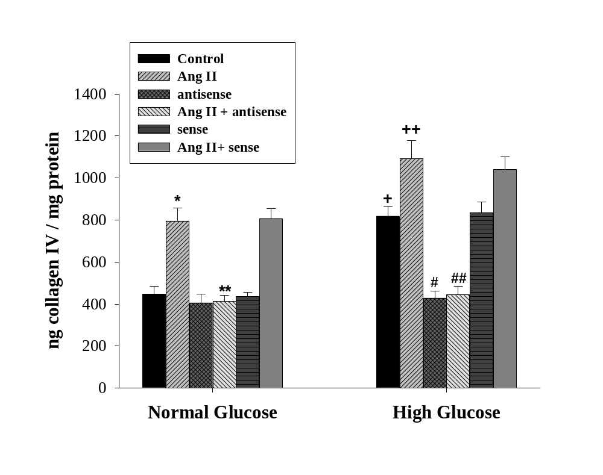

Slide 24
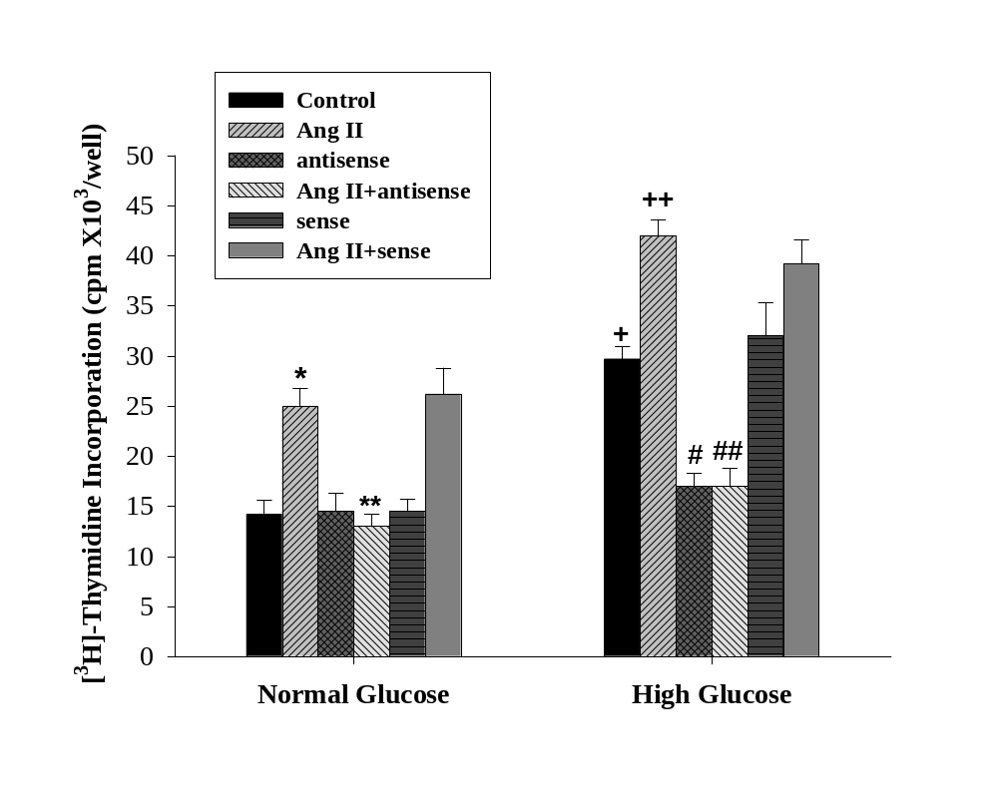

Slide 25
Diabetes-induced changes
Altered regulation of the vasoactive peptide angiotensin II receptor and its early growth signaling pathways ( e.g. JAK/STAT).
Increased growth (accumulation of extracellular matrix proteins (e.g., collagen) and proliferation of kidney mesangial cells.

Slide 26
Conclusion.
Angiotensin II-induced activation of the JAK/STAT pathway
1. Enhanced under HG conditions in vitro.
2. HG-induced growth (DNA and collagen IV synthesis) are blocked by JAK2 antisense.
These results provide evidence that activation of the JAK/STAT pathway by HG or/and Ang II may be of importance in the increased growth in the matrix proteins, collagen IV synthesis and cell proliferation that is seen in diabetic nephropathy.

Slide 27
What are the Molecular Mechanisms by which high glucose augments the Angiotensin II-induced activation of the JAK/STAT pathway?

Slide 28
Effects of High Glucose
High Glucose
AGE
(S100B)
Increases
NADH:NAD
Ratio
Aldose Reductase
Pathway
DAG synthesis
RAGE
PKC
ROS

Slide 29









Normal Glucose
High Glucose
S100B
pJAK2
no zopolrestat
JAK2
no zopolrestat
pJAK2
with zopolrestat
JAK2
with zopolrestat
0 5 10
0 5 10
0 5 10
Ang II incubation time (minutes)
Effects of zopolrestat on the HG or S100B augmentation on the Ang II-induced JAK2 tyrosine phosphorylation

Slide 30











Normal Glucose
High Glucose
S100B
pJAK2
anti-IgG
JAK2
anti-IgG
pJAK2
anti-p47phox
JAK2
anti-p47phox
0 5 10
0 5 10
0 5 10
Ang II incubation time (minutes)
Effects of electroporating rabbit IgG or anti-p47phox antibodies on the HG or S100B augmentation on the Ang II-induced JAK2 tyrosine phosphorylation

Slide 31

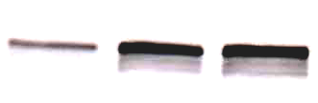


pJAK2
Control
JAK2
Control
pJAK2
S100B (5ug/ml)
JAK2
S100B (5ug/ml)
pJAK2
S100B (5ug/ml) + rabbit IgG (100 ug/ml)
JAK2
S100B (5ug/ml) + rabbit IgG (100 ug/ml)
pJAK2
S100B (5ug/ml) + anti-RAGE (70 ug/ml)
JAK2
S100B (5ug/ml) + anti-RAGE (70 ug/ml)
0 5 10
Ang II incubation time (minutes)
Effects of anti-RAGE on the S100B effects on the Ang II-induced tyrosine phosphorylation of JAK2.

Slide 32



pJAK2
Control
JAK2
Control
pJAK2
S100B (5ug/ml)
JAK2
S100B (5ug/ml)
pJAK2
S100B (5ug/ml) + 0.2% 1-Butanol
JAK2
S100B (5ug/ml) + 0.2% 1-Butanol
pJAK2
S100B (5ug/ml) + 0.2% 2-Butanol
JAK2
S100B (5ug/ml) + 0.2% 2-Butanol
0 5 10
Ang II incubation time (minutes)
Effects of 1-Butanol or 2-Butanol on the S100B effects on the Ang II-induced tyrosine phosphorylation of JAK2.

Slide 33


PLD2
sense
antisense
0 2 6 12 24
Time, hours

Slide 34





pJAK2
Control
JAK2
Control
pJAK2
S100B (5ug/ml)
JAK2
S100B (5ug/ml)
pJAK2
S100B (5ug/ml) + PLD2 antisense
JAK2
S100B (5ug/ml) + PLD2 antisense
pJAK2
S100B (5ug/ml) + PLD2 sense
JAK2
S100B (5ug/ml) + PLD2 sense
0 5 10
Ang II incubation time (minutes)
Effects of PLD2 antisense on the S100B effects on the Ang II-induced tyrosine phosphorylation of JAK2.

Slide 35
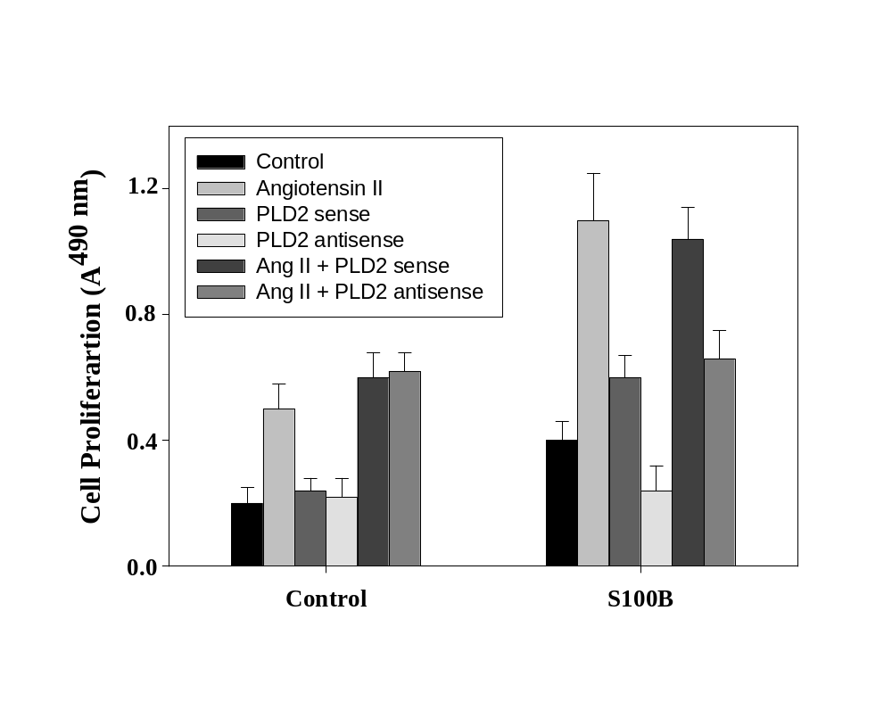
+
#
Effects of PLD2 antisense on the S100B and Ang II-induced cell proliferation.

Slide 36
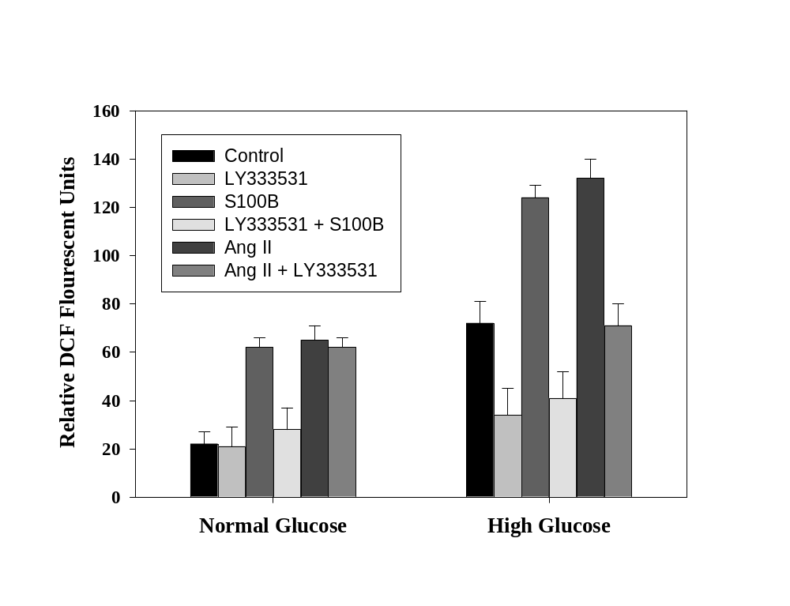
Effects of PKC-beta inhibitor LY379196 on the Ang II-, HG- and S100B-induced H₂O₂ production.

Slide 37







Normal Glucose
High Glucose
pJAK2
no inhibitor
JAK2
no inhibitor
pJAK2
with LY379196
JAK2
with LY379196
0 5 10
0 5 10
Ang II incubation time (minutes)
Effects of PKC-beta inhibitor LY379196 on the Ang II-, HG-induced JAK2 activation.

Slide 38
S100B
Angiotensin II
High Glucose
RAGE
AT₁
High Glucose
PLC-gamma1
Aldose
Reductase
O₂
PLD2
ROS
NADPH oxidase
Polyol Pathway
DAG
SHP-1 and SHP-2
PKC-beta
JAK2 and STATs
Cell Growth
High Glucose and S100B augmentation of the Ang II-induced JAK/STAT pathway in kidney mesangial cell growth.

Slide 39
Activation of the JAK/STAT pathway by Ang II is also altered by High Glucose in vivo.

Slide 40
Material and Methods (in vivo)
Male Sprague-Dawley rats (225-250g)
STZ (60mg/kg) rats were considered hyperglycemic if blood glucose > 15.0 mM 48 hrs after injection
Seven groups:
STZ
STZ + high insulin
STZ + AG-490
STZ + Candesartan (10 mg/kg/day)
Candesartan (10 mg/kg/day)
AG-490
Control (Sham)
Animals were treated for 7, 14 and 28 days

Slide 41
Effects of Candesartan on the STZ-induced JAKs activation in the rat kidney glomeruli after 14 days of hyperglycemia
pJAK2
JAK2
pJAK1
JAK1
pTYK2
TYK2
C Can STZ STZ + Can

Slide 42




Effects of Candesartan on the STZ-induced STATs phosphorylation in the rat kidney glomeruli after 14 days of hyperglycemia
pTyr-STAT1
STAT1
pTyr-STAT3
STAT3
pTyr-STAT5
STAT5
pTyr-STAT6
STAT6
C Can STZ STZ+Can

Slide 43
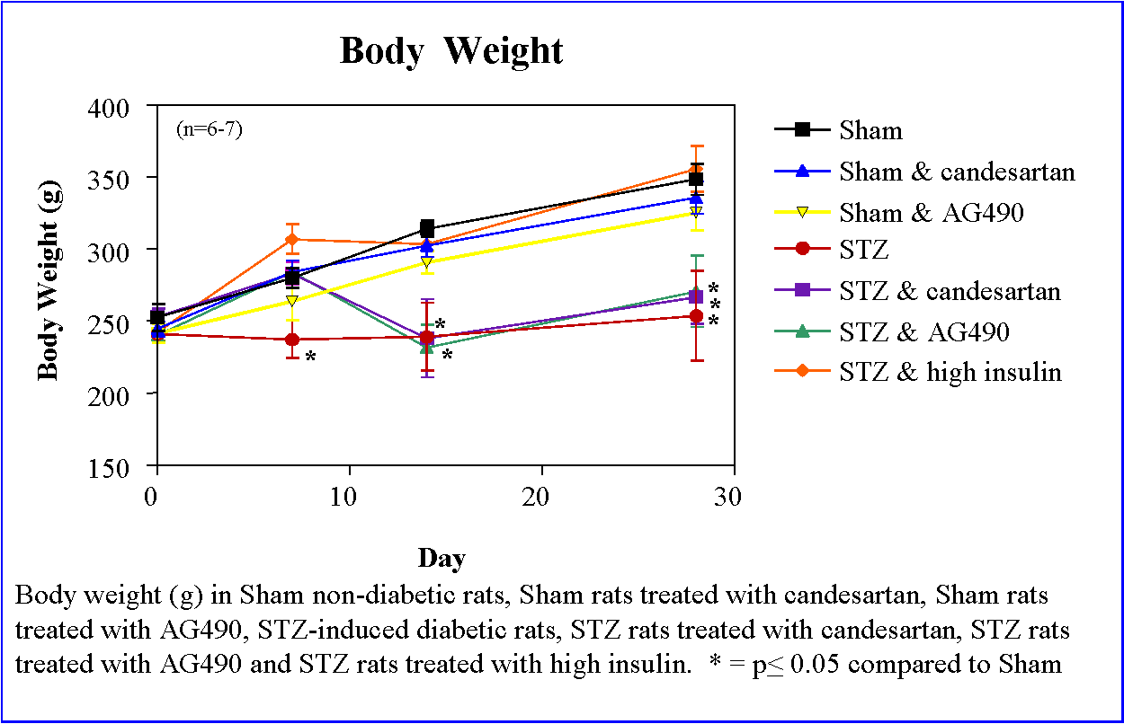

Slide 44
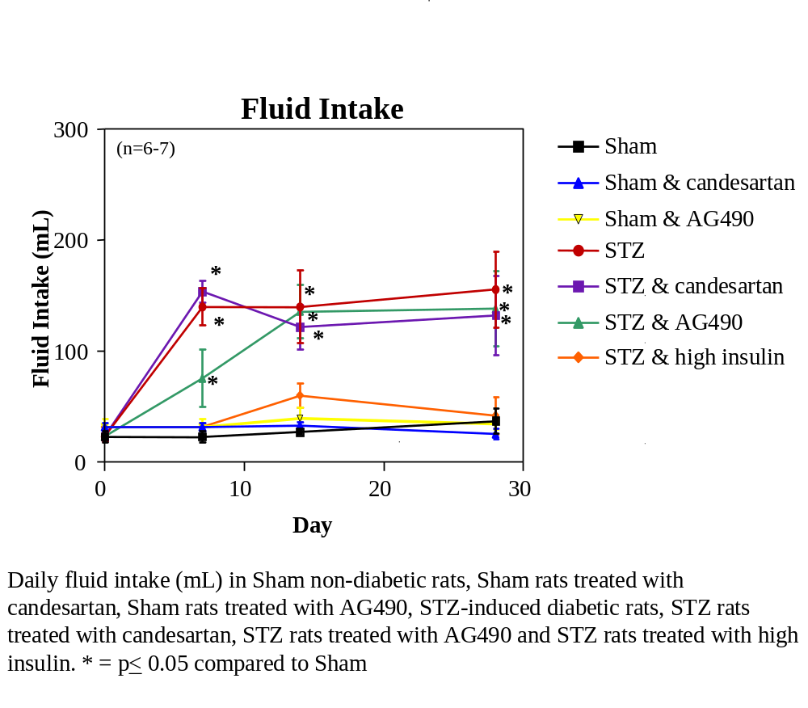

Slide 45
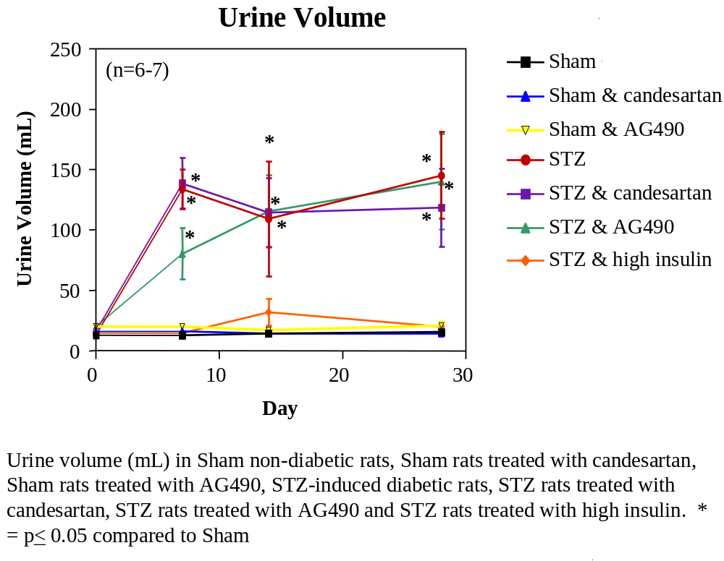

Slide 46
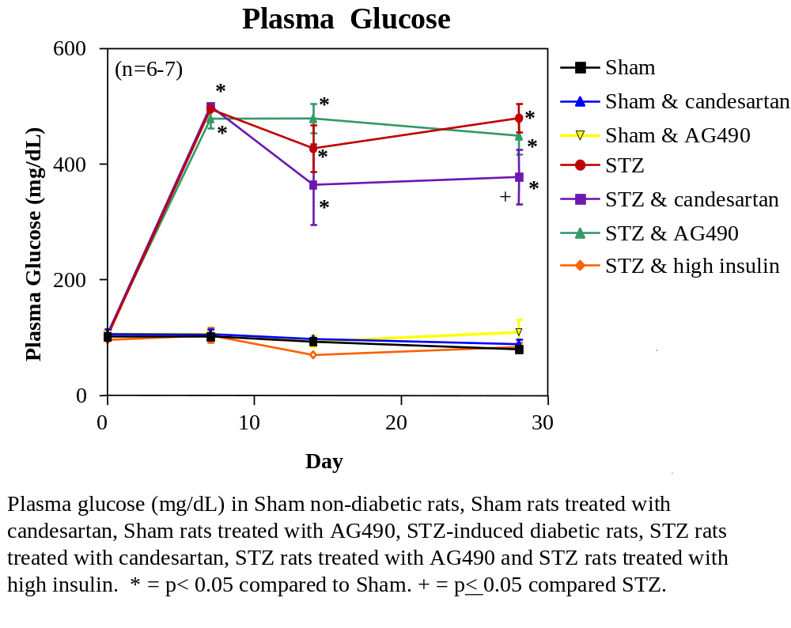

Slide 47
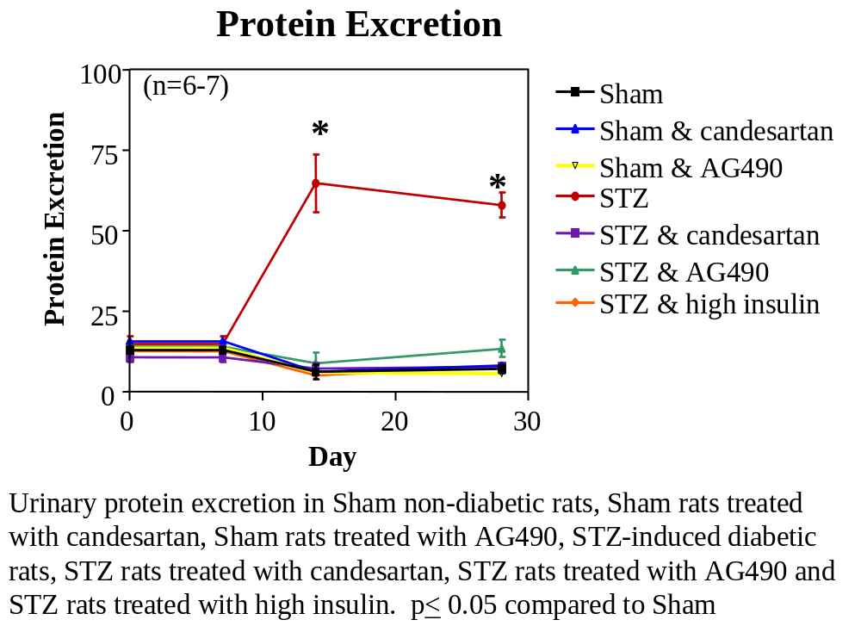

Slide 48
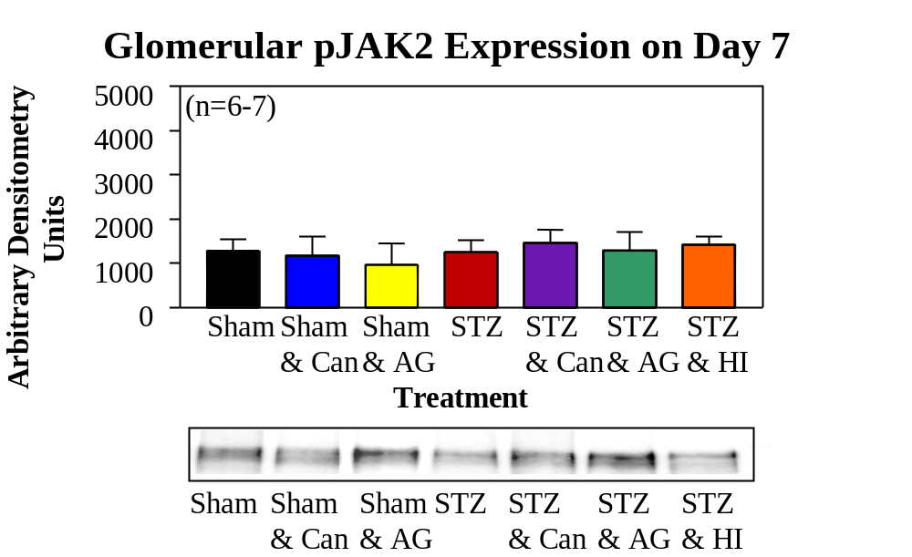

Slide 49
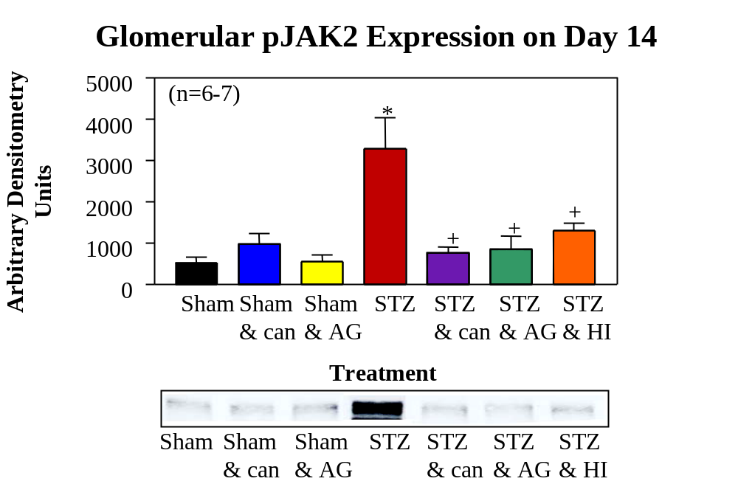

Slide 50
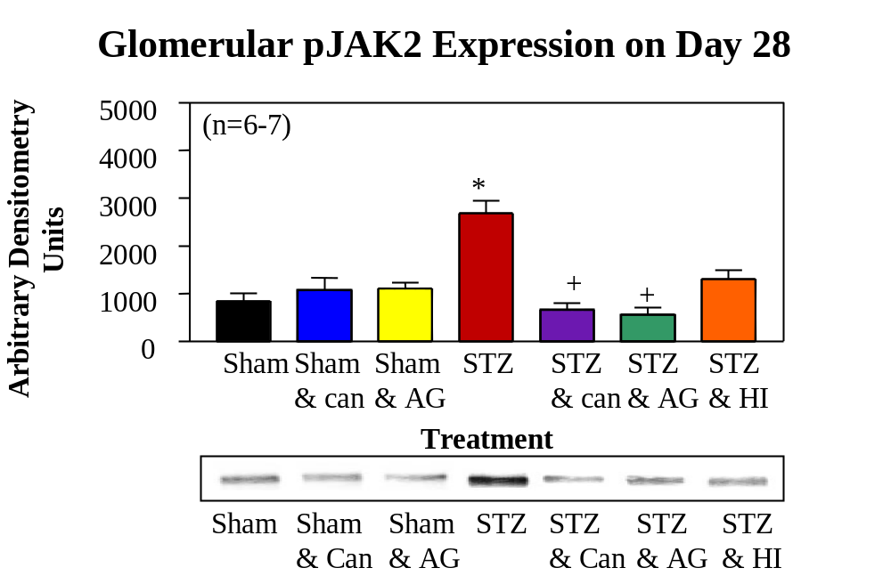

Slide 51
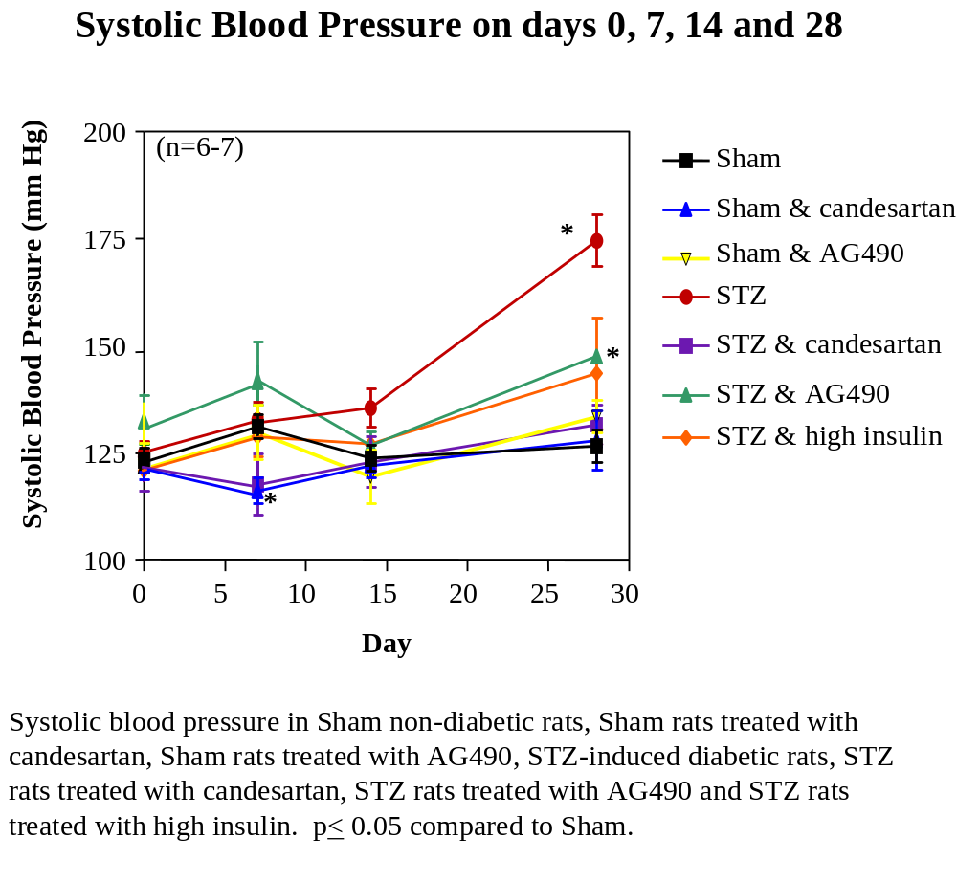

Slide 52
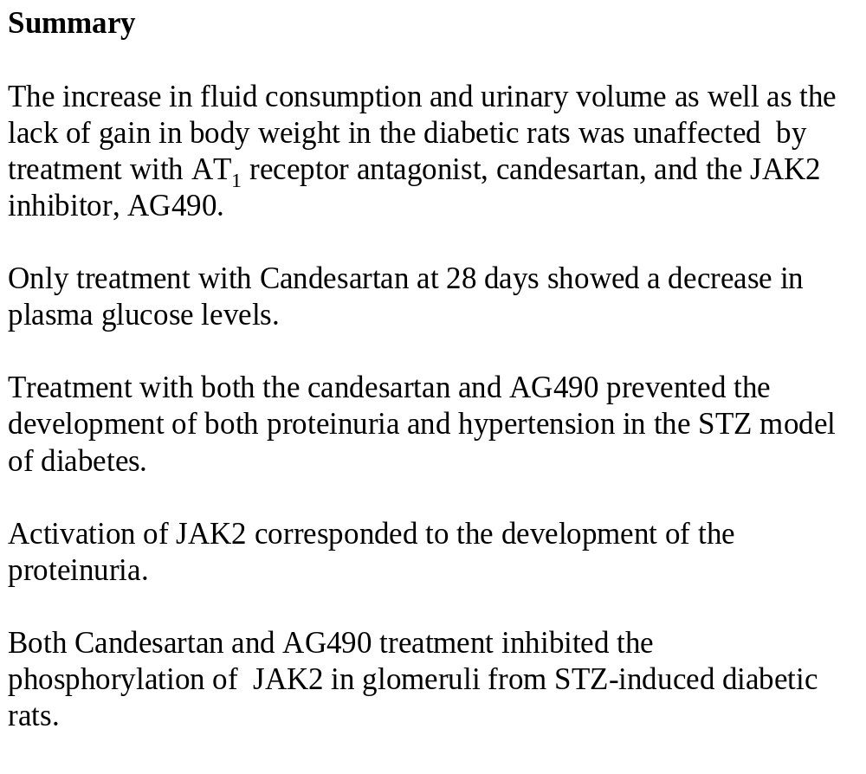

Slide 53
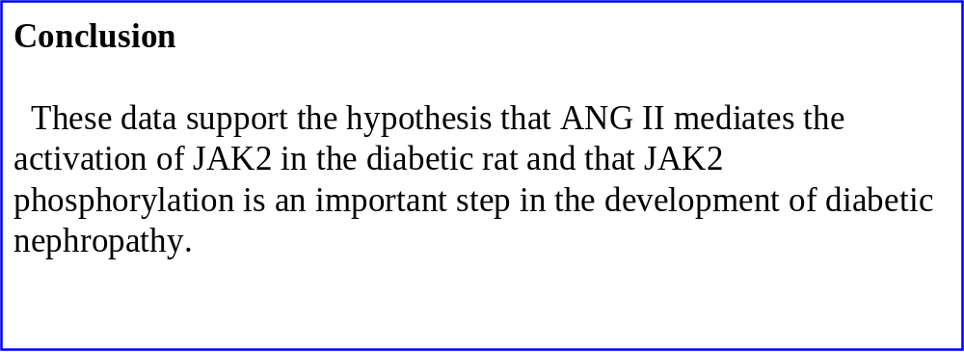

Slide 54
Acknowledgments
Dr. Douglas C. Eaton
Dr. David Fulton
Dr. Carlos Isales
Dr. David Pollock
Dr. R. Dan Rudic
Dr. Ann Marie Schmidt
Dr. David Stepp
Dr. David Stern
Dr. Marrero’s Laboratory
Dr. Gwen Alexander
Dr. Farhad Amiri
Dr. Amy Banes
Dr. Sean Shaw
Mr. Kenjiro Muta
Ms. Amanda Shirley
Ms. Xiaodan Wang

