Slide 1
Ways to live healthy while being Diabetic
Project produced by: Erica V., Jessica W.,
Shaniqua B., and
Donta G.

Slide 2
Introduction:
What Is Nutrition?
Nutrition is what you eat each day in order to gain energy throughout the day. We will guide you through a healthy diet for a 16 year old diabetic.

Slide 3
Sample Diabetic Menu
Lunch
Snack
Dinner
Breakfast

Slide 4

Breakfast
1 pack Regular oatmeal (1/2 cup-72 cal.)
Low- fat milk(1 cup-120 cal.)
Sliced canned peaches(1/2 cup-100 cal.)
Orange juice (1 cup-105 cal.)
Butter (1tablespoon-cal.300)
Total caloric intake:697

Slide 5
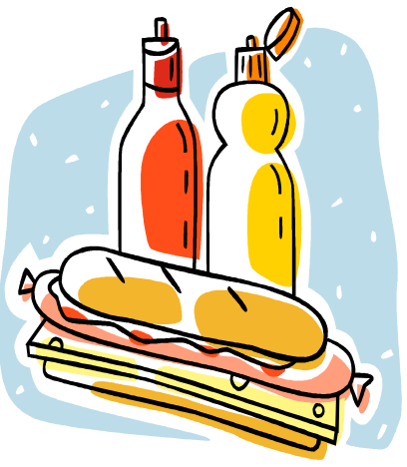
Lunch
Two slices of wheat bread
(140 cal.)
Sliced turkey without skin(2 ounces)
Reduced fat mayo(2 table spoons-200 cal.)
Two Slices of tomato (30 cal.)
A cup of skim milk (120 cal.)
Total caloric intake:490

Slide 6
Mid Day Snack
1 rice cake (40 cal.)
One tablespoon of peanut butter (95 cal.)
Total caloric intake:135

Slide 7
Dinner
1 Chicken Breast, roasted (without skin- 193 cal.)
Macaroni and cheese(cal.320)
Rice, brown (cooked)- (120 cal.)
Cooked green beans(1/2 cup-22 cal.)
1 diet coke(2 cal.)
Total caloric intake:555

Slide 8
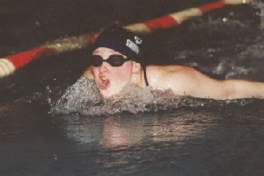
Introduction 2:
An Exercise Plan
The exercise plan is designed to keep a 16 year old diabetic in good health. It is also designed to work around her school schedule. This plan will give her time to relax in between school and becoming fit.

Slide 9
Morning Exercise Plan
Starting time: 7:00 am ;Ending Time: 7:35 am
Dance Exercise (10 minutes) Cal. 105
Walking (15 minutes) Cal. 61
Weight lifting (muscular strength) Cal. 60
Total caloric lost:226

Slide 10
After School Exercise Plan
Starting Time: 5:00 pm Ending Time: 5:30 pm
Swimming Practice (20 minutes ) Cal. 255
Break (5 min. Drink water) Cal. 28
Total caloric lost:283

Slide 11
Credits
www.bddiabetes.com
www.coolnurse.com
Microsoft Clip Art

Slide 12
Acknowledgments
We would like to thank Ms. Amanda Morris, Ms. Erika Johnson, Mr. Enrique Seale, Mrs. Greene for making this project possible.

