Slide 1
American Optometric Association
White House Conference on Aging Solutions Forum
Dorothy L. Hitchmoth OD, FAAO
Chief of Optometry
Department of Veterans Affairs
White River Junction, Vermont

Slide 2
Health and Long-term Living
Eye Care Access: Eliminating Barriers for Seniors and Baby Boomers

Slide 3

What we know……
There are a whole lotta’ people developing obesity……..who are developing Type II diabetes and impaired glucose tolerance…...............costing a whole lotta’ $$$$$.

Slide 4
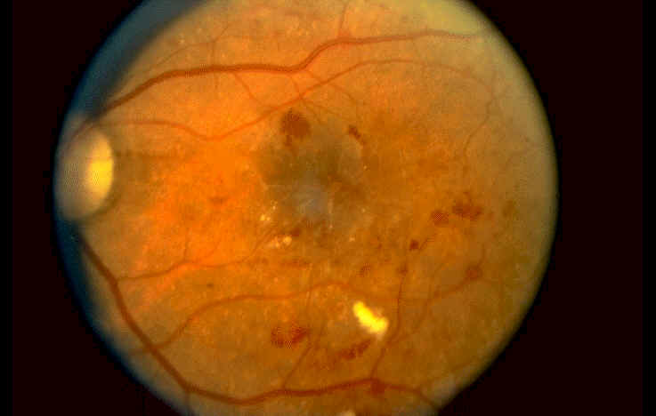
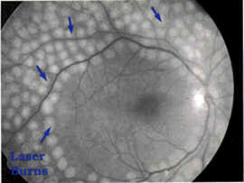
What we know………
Research has clearly shown that early detection and treatment of diabetic retinopathy is the best method we have for preventing vision loss in the absence of cure or prevention.

Slide 5
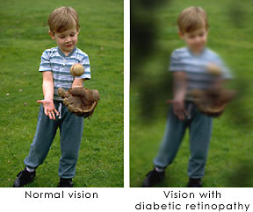
What we know………
The number of people who are visually impaired or blind as a result of diabetes is growing rapidly.
Direct and indirect costs associated with loss of vision are very high.

Slide 6
Barrier: Standards of Care
Statement of Problem
Resource-constrained health care systems, such as the Department of Veterans Affairs Medical Administration, Medicare, Medicaid, and other capitated health insurance programs, cannot bear the cost burden of the rapidly increasing diabetic population in need of eye care in the U.S. Access to care is, therefore, often limited or delayed.
Current standards of care are too general and do no stratify patients into risk groups. High-risk patients may receive no care, while low-risk patients may receive more care than needed. There are no evidence-based outcome studies linking annual or biannual dilated fundus exams to improved morbidity (eyesight) in the elderly, Type II diabetic population. Standards of care should be based on actual patient outcomes.

Slide 7

Solution
Utilize electronic medical records to identify patients at risk for developing diabetic retinopathy. Define those risk groups and increase [NOTE: Should this be “DECREASE”?? Check on this with Dorothy.] the intervals between eye examinations in order to increase the overall number of patients receiving eye examinations.

Slide 8
What data can we use to profile patients?
Research has shown that there are clear laboratory and clinical measures for predicting what patients are most likely to suffer complications of diabetes, to include diabetic retinopathy.
  Tight Glycemic control i.e. HGA1C
  Blood Pressure control
  Blood Lipid control

Slide 9
Context
This concept requires a baseline eye examination
Computer-extrapolated data (HGA1C) may be used to create a hypothetical risk pool
Computer-extrapolated data could be used to examine retrospective outcomes and create a model for safe, prospective studies
Eye examination intervals could be increased in low-risk patients and decreased in high-risk patients
Individual trend analyses of HGA1C may help define risk for patients with variable control and length of diagnosis
These profiles may create increased access to limited resources, e.g. providers and/or $$

Slide 10
Context
Utilization of digital retinal imaging technology in combination with computer risk profiles may increase the overall number of patients receiving initial and ongoing care.
Research has clearly indicated that digital retinal imaging is a powerful tool for retinal screenings.
The most sophisticated patient record system in the world is currently being used by the Department of Veterans Affairs. This system can be effectively modeled for larger-scale patient population profiling.

Slide 11
Threats
Other sight-threatening eye disease may require more regular examinations to improve morbidity (save vision) in the diabetic population. There are no evidence-based outcomes studies demonstrating these risks.
Opportunities for patient education may be reduced.
Risk profiling could be used to assign higher health care premiums to certain populations.
Vision care may be necessitated at greater intervals than medical eye care.
Data collection is only useful if gathered correctly.

Slide 12
Conclusions
Computer patient records and digital retinal imaging can save resources.
Research dollars should be directed to projects utilizing these technologies.
Research dollars should be directed to projects looking at patient outcomes rather than overall disease incidence in a population.

Slide 13
Conclusions
Optometry is well poised to provide front-line medical eye care for the diabetic population, using technology.
Optometry currently provides 2/3 of all eye care in the U.S.
The American Optometric Association is almost 30,000 members strong.

Slide 14


