Slide 1
Cardiac Structure and Function, Diabetes and Cardiovascular Disease Risk: The Strong Heart Study
Richard B. Devereux, M.D.
Weill Medical College of Cornell University

Slide 2
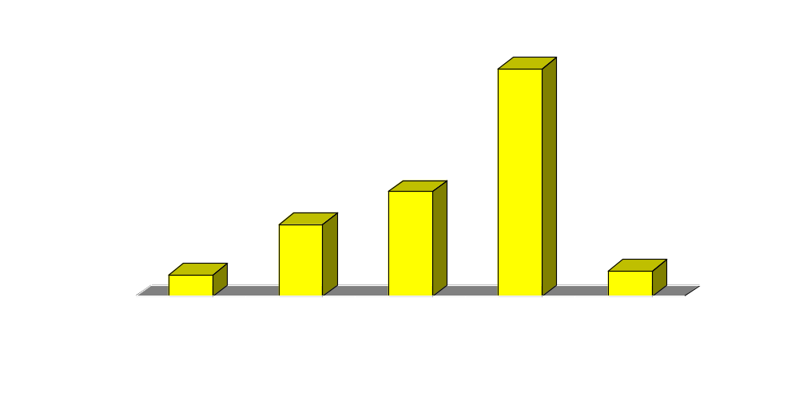
Diabetes Prevalence Differs by Ethnicity
p<0.001
p<0.001
Diabetes Prevalence (%)
p<0.001
Mean BMI ~27 ~32 ~32.5 ~31.5 ~27.5
Galderisi et al.: Am J Cardiol 1991; Palmieri et al.: Circulation 2001;103:102-109; Devereux et al.: Circulation 2000;101:2271-2276; Carter et al.: Diabetologia 2006;49:29-35. .

Slide 3

The Strong Heart Study: A Partnership of Investigators with American Indian Communities
NHLBI funded 1988-2010...

Slide 4
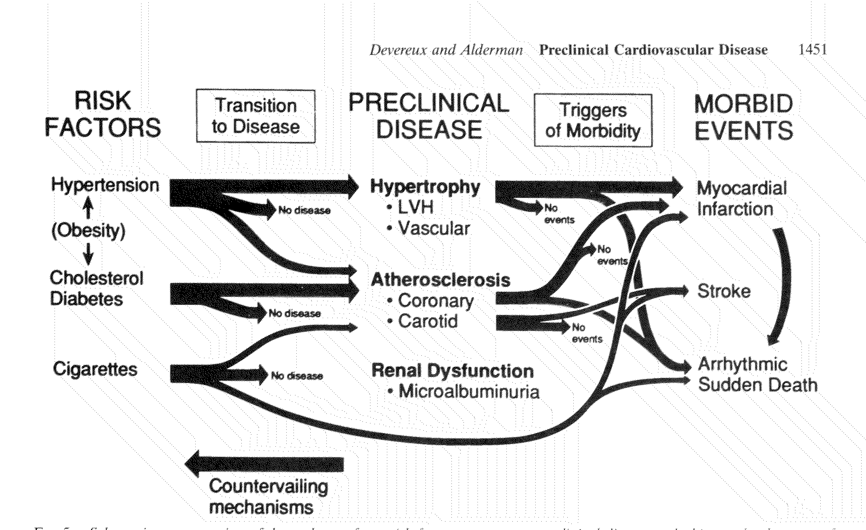
Pathways to Cardiovascular Morbid Events
LV Dysfunction
Devereux and Alderman: Circulation 1993;88:1444-1455.

Slide 5
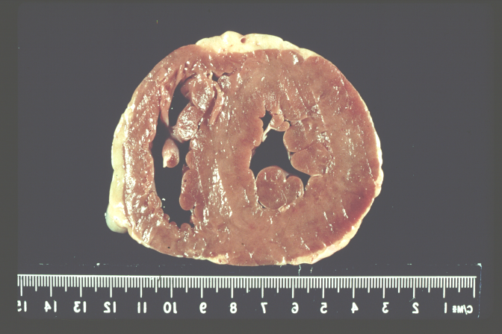
LEFT VENTRICULAR HYPERTROPHY: ANATOMY

Slide 6
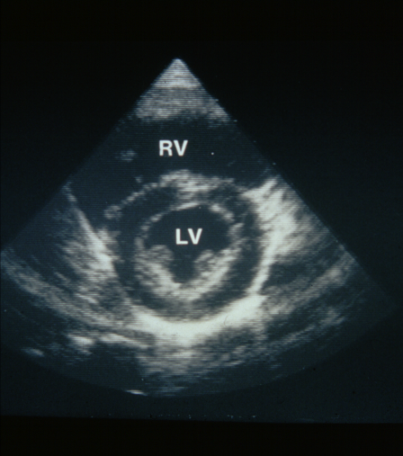
LEFT VENTRICULAR HYPERTROPHY: ECHO

Slide 7
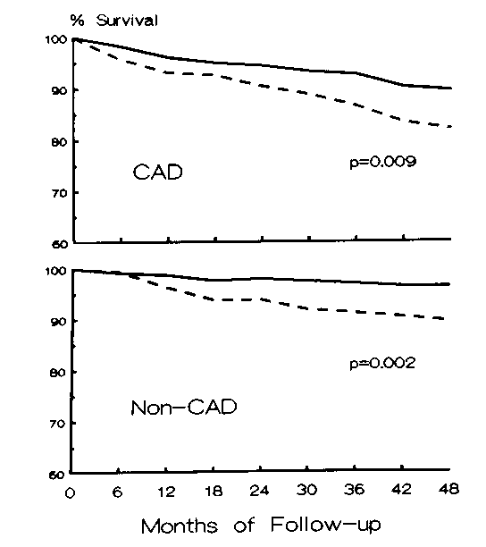
Echo LVH Predicts Death with and Without CAD
In catheterized black patients with or without angiographic CAD, echo LVH predicts all-cause mortality, more strongly than EF or # of diseased vessels
Ghali et al: Ann Intern Med 1992; Liao et al: JAMA 1995

Slide 8
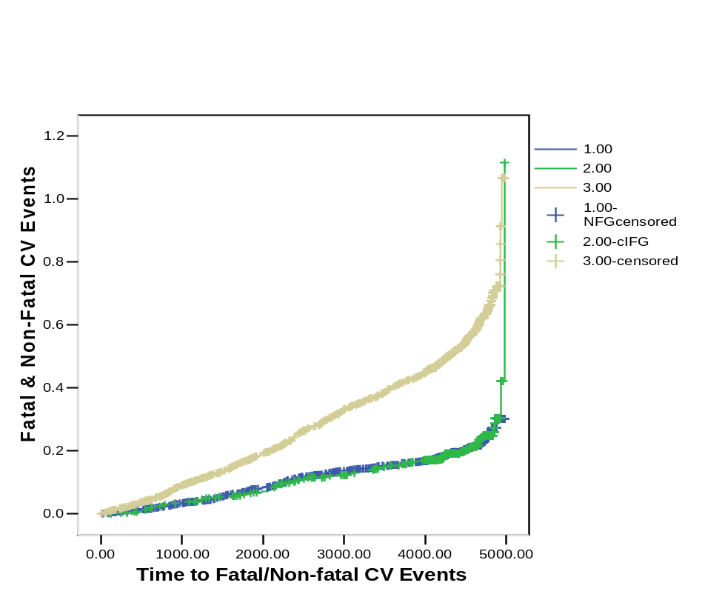
12-Year CV Event Rate with Diabetes vs. Normal or Impaired Fasting Glucose:
The Strong Heart Study
Diabetes
60
40
20
0
CV Events (%)
NFG & IFG
Devereux et al.: unpublished data 3/2006.

Slide 9
Do Measures of Preclinical CV Disease Stratify Risk in Diabetes?
I: Left Ventricular Hypertrophy

Slide 10
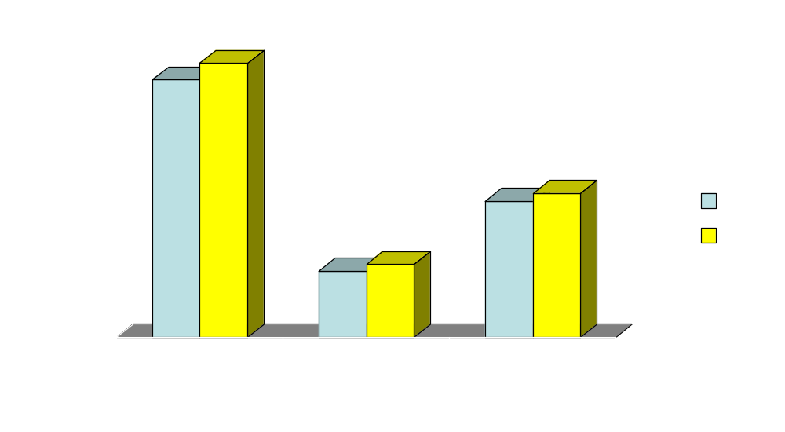
LV Mass in Glucose Tolerant vs Diabetic American Indians: The Strong Heart Study
P<0.001
P<0.001
P<0.001
P, adjusted for age,
gender, height, weight, SBP,
HTN Rx and center.
Devereux et al: Circulation 2000; 101:2271-2276.

Slide 11
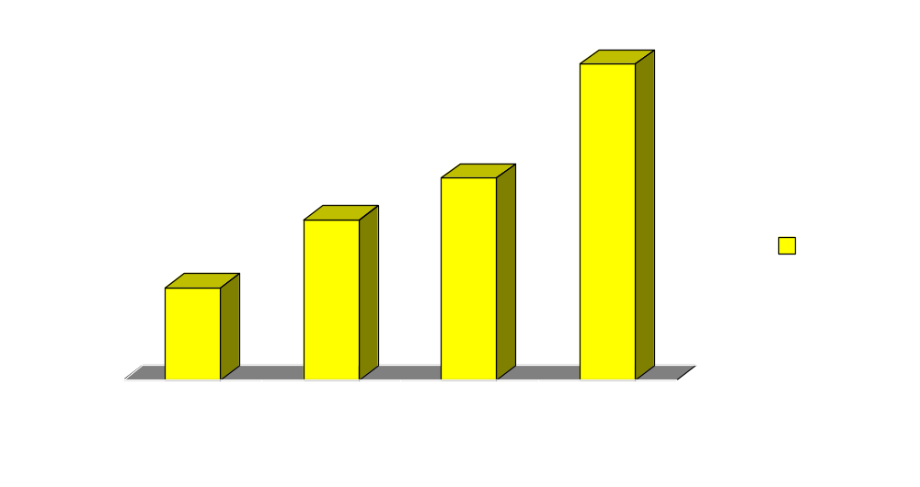
Prevalence of LVH in SHS Participants Grouped by Diabetes & Hypertension Status
P, adjusted for
age, gender,
height, weight,
SBP, HTN Rx
and center.
All p<0.001
LVH Prevalence (%)
From Bella et al: Am J Cardiol 2001;87:1260-1265.

Slide 12
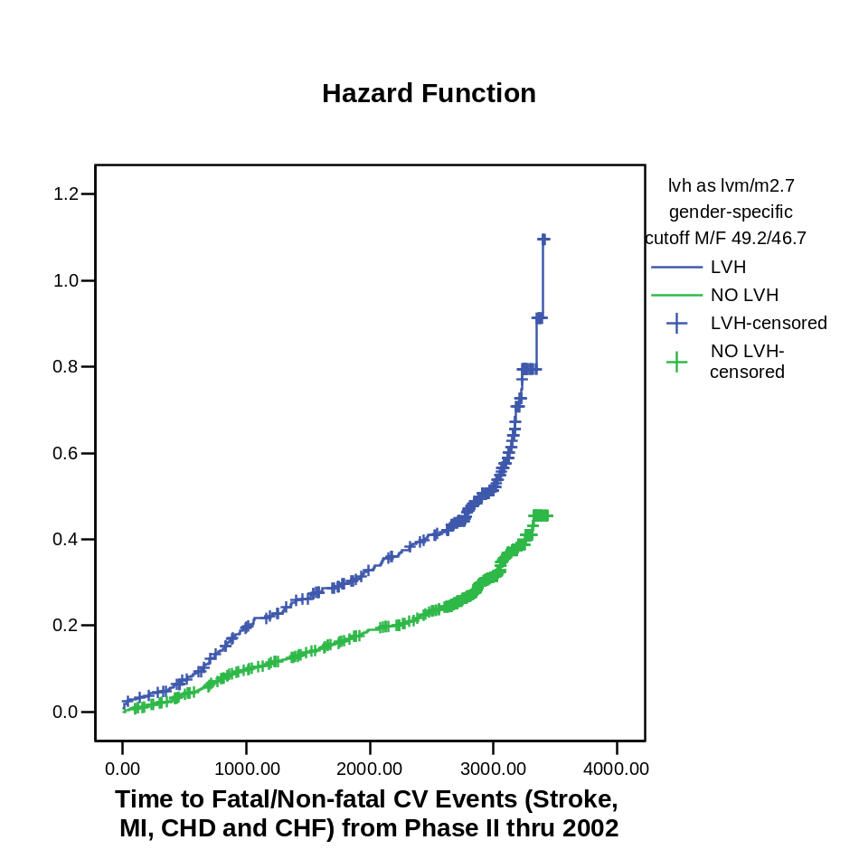
Association of LV Hypertrophy with CV Events in Diabetic American Indians: The Strong Heart Study
P<0.0001, adjusted
for age, gender, BP,
BMI, LDL, HDL,
smoking and plasma
creatinine.
Hazard ratio =
1.58 (95% CI =
1.27-1.97)
Proportion Suffering CV Events
Devereux et al.: unpublished data 3/2006.

Slide 13
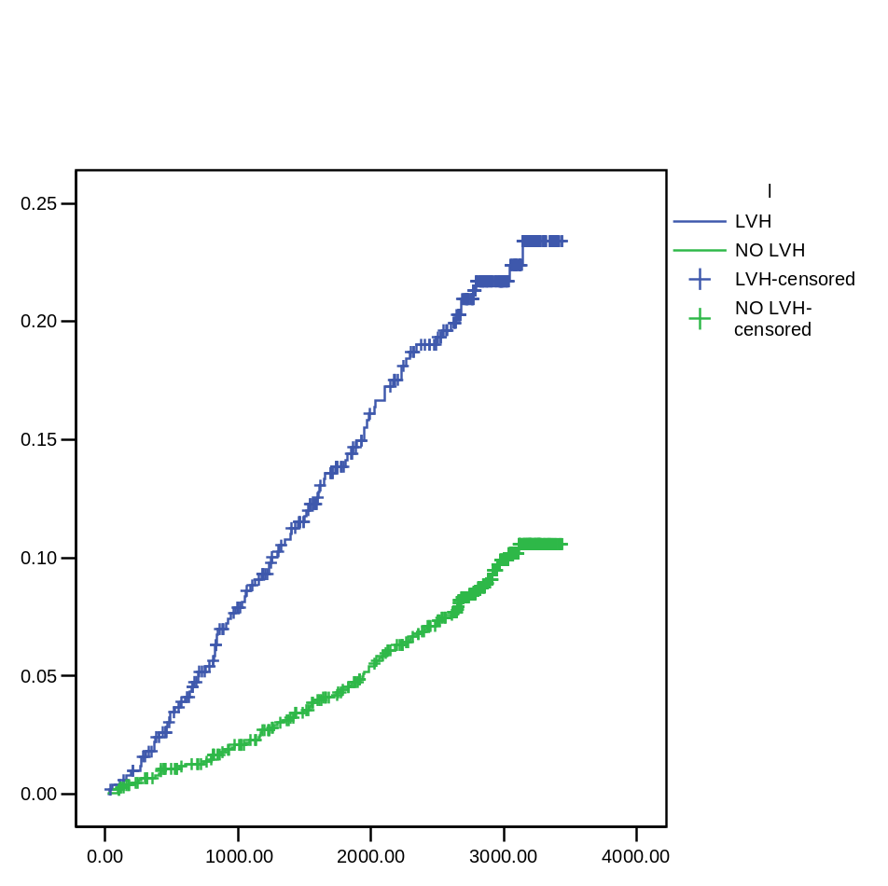
Association of LV Hypertrophy with CV Death in Diabetic American Indians: The Strong Heart Study
P<0.0001, adjusted
for age, gender, BP,
BMI, LDL, HDL,
smoking and plasma
creatinine.
Hazard ratio =
1.90 (95% CI =
1.33-2.71)
Proportion Suffering CV Death
Proportion Suffering CV Events
Days after Echocardiogram
Devereux et al.: unpublished data 3/2006.

Slide 14
Do Measures of Preclinical CV Disease Stratify Risk in Diabetes?
II: LV Systolic Function

Slide 15
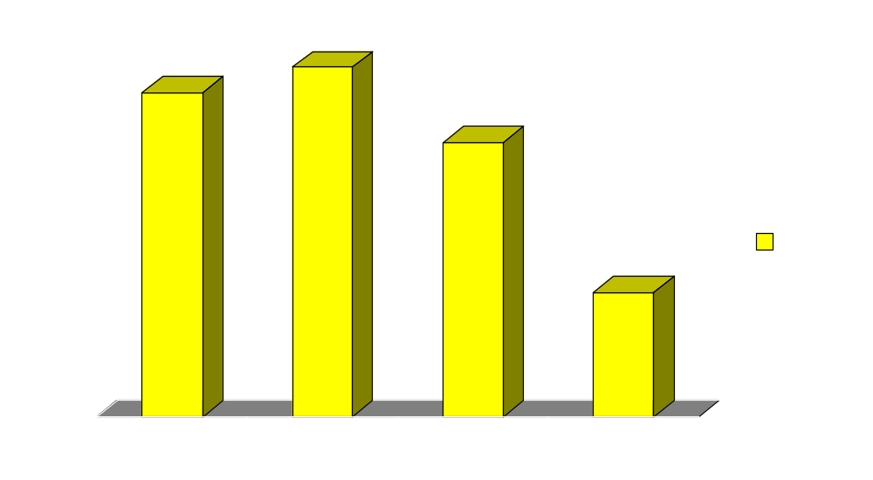
Fractional Shortening in SHS Participants Grouped by Diabetes & Hypertension Status
NS
P, adjusted for age,
gender, height,
weight, SBP,
HTN Rx and center.
NS
Fractional Shortening (%)
P<.001
From Bella et al: Am J Cardiol 2001;87:1260-1265.

Slide 16
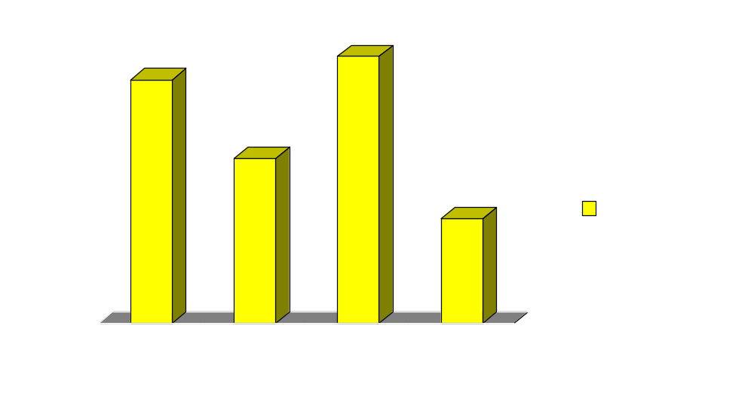
Left Ventricular Contractility in SHS Participants Grouped by Diabetes & Hypertension Status
P, adjusted for age,
gender, height,
weight, SBP,
HTN Rx and center.
P<.01
P<.001
Stress-Corrected MWS (%)
From Bella et al: Am J Cardiol 2001;87:1260-1265.

Slide 17
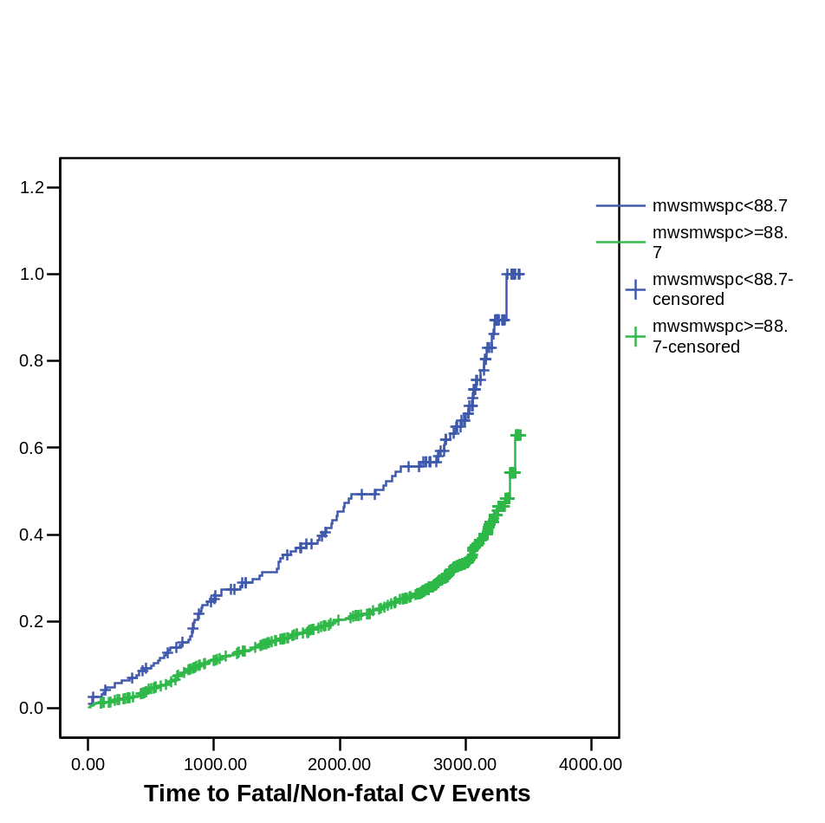
Stress-Corrected Midwall Shortening & CV Events in Diabetes: The Strong Heart Study
P=0.002, adjusted
For age, gender,
BP, BMI, LDL, HDL,
smoking and urine
albumin/creatinine.
OR = 1.51, 95% CI =
1.16-1.97

Slide 18
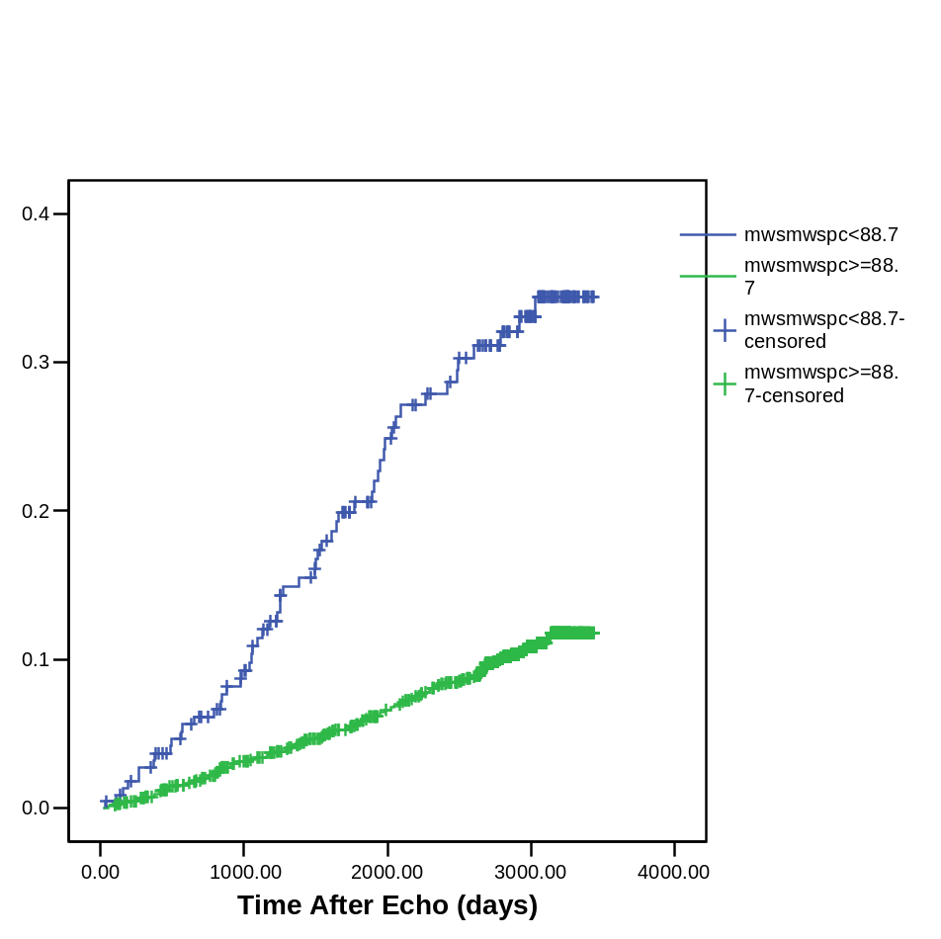
Stress-Corrected Midwall Shortening & CV Death in Diabetes: The Strong Heart Study
P=0.008, adjusted
For age, gender,
BP, BMI, LDL, HDL,
smoking and urine
albumin/creatinine.
OR = 1.75, 95% CI =
1.15-2.52

Slide 19
Do Measures of Preclinical CV Disease Stratify Risk in Diabetes?
III: LV Diastolic Filling

Slide 20
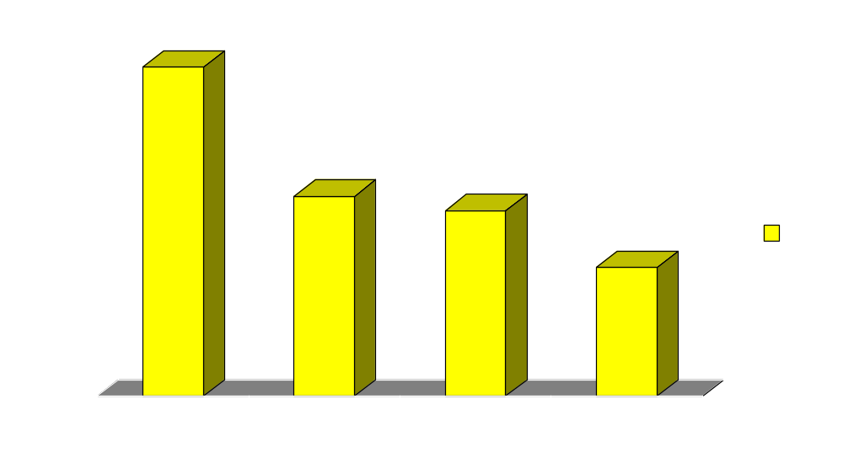
Mitral E/A Ratio in SHS Participants Grouped by Diabetes & Hypertension Status
*P, adjusted for age, gender, heart rate,
SBP and center.
P<0.001 adjusted for covariates*
From Liu et al: J Am Coll Cardiol 2001;37:1943-1949.

Slide 21
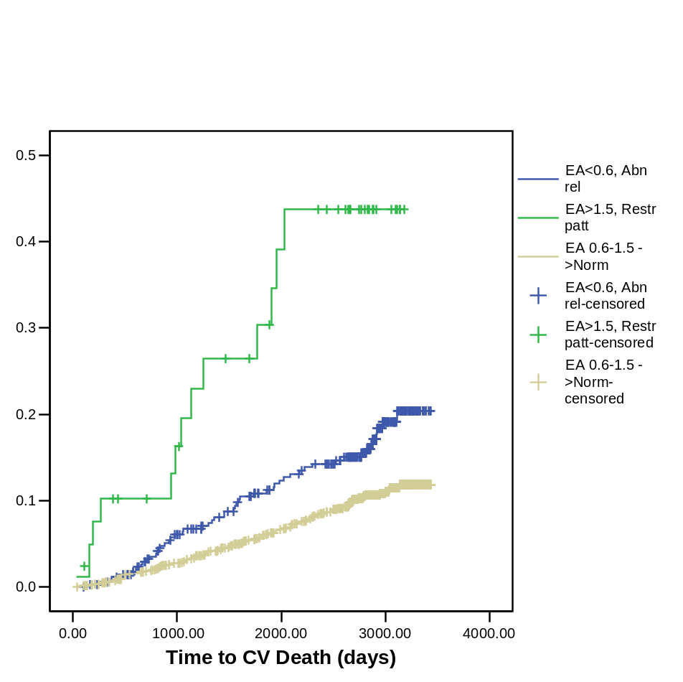
Diastolic Filling Pattern & Cardiovascular Death in Diabetes: The Strong Heart Study
P<0.011, adjusted
For age, gender, BP,
BMI, LDL, HDL &
smoking.
Restrictive Pattern:
OR = 2.37, 95% CI =
1.22-4.63
Proportion Suffering CV Death
Devereux et al.:
3/2006

Slide 22
Do Measures of Preclinical CV Disease Stratify Risk in Diabetes?
IV: Arterial Hypertrophy & Plaque

Slide 23
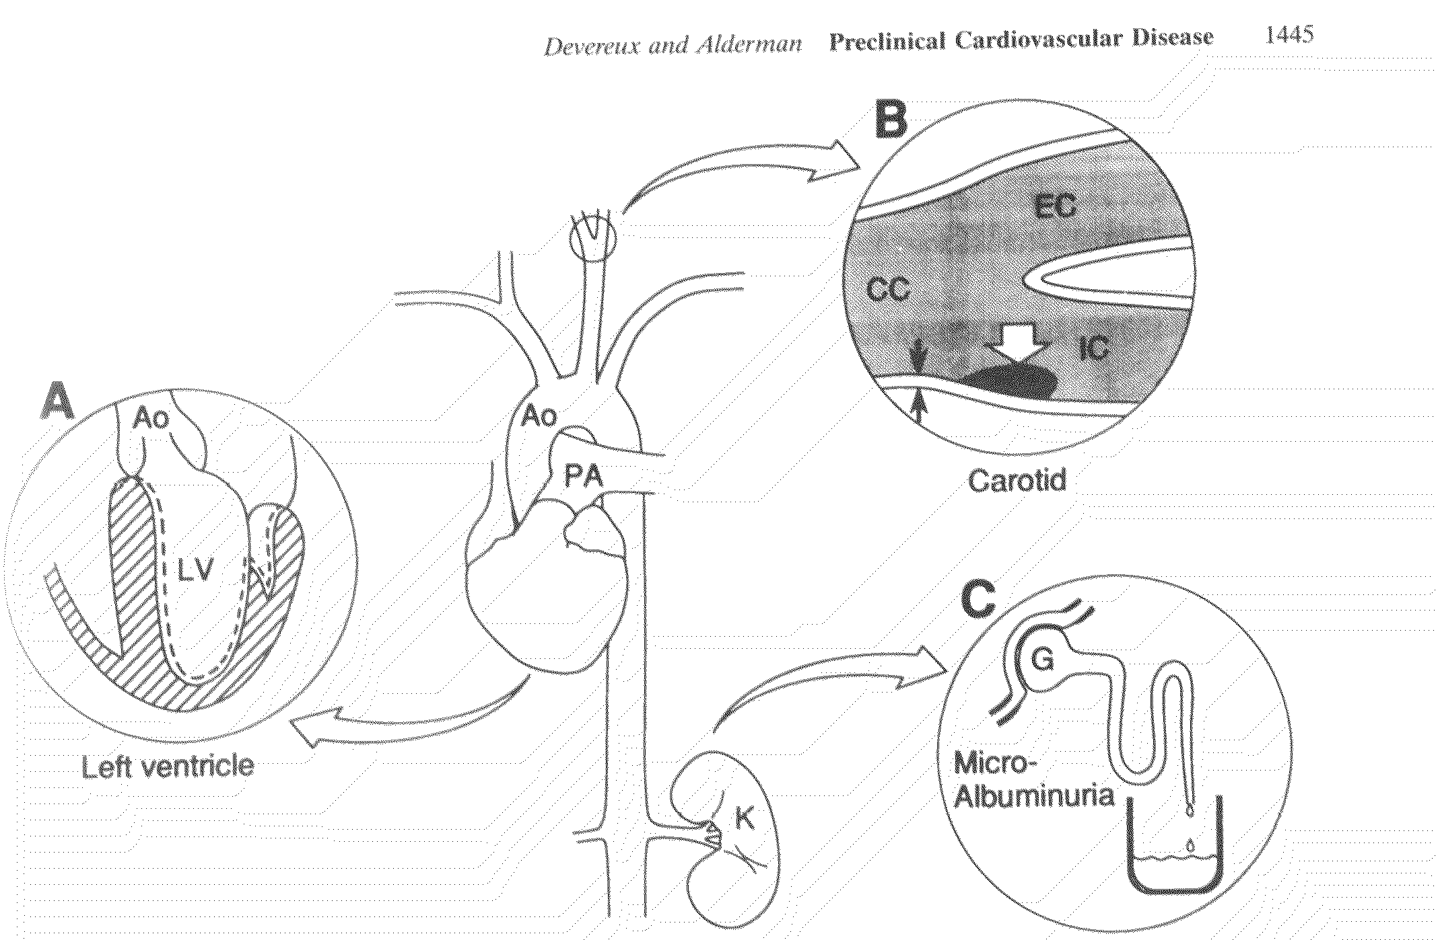
Noninvasively Measurable Manifestations
of Preclinical Cardiovascular Disease
Devereux and Alderman: Circulation 1993;88:1444-1455.

Slide 24
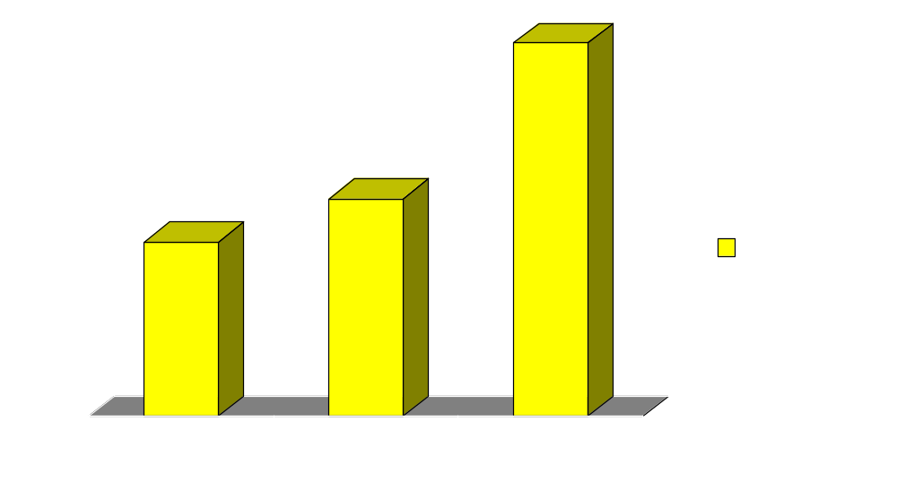
Prevalence of Discrete Carotid Plaque in
IGT & Diabetes: The Strong Heart Study
P<0.001, adjusted
for age, gender, BP, smoking &
cholesterol
Plaque Prevalence (%)
Roman et al: JACC 1999;33:274A.

Slide 25
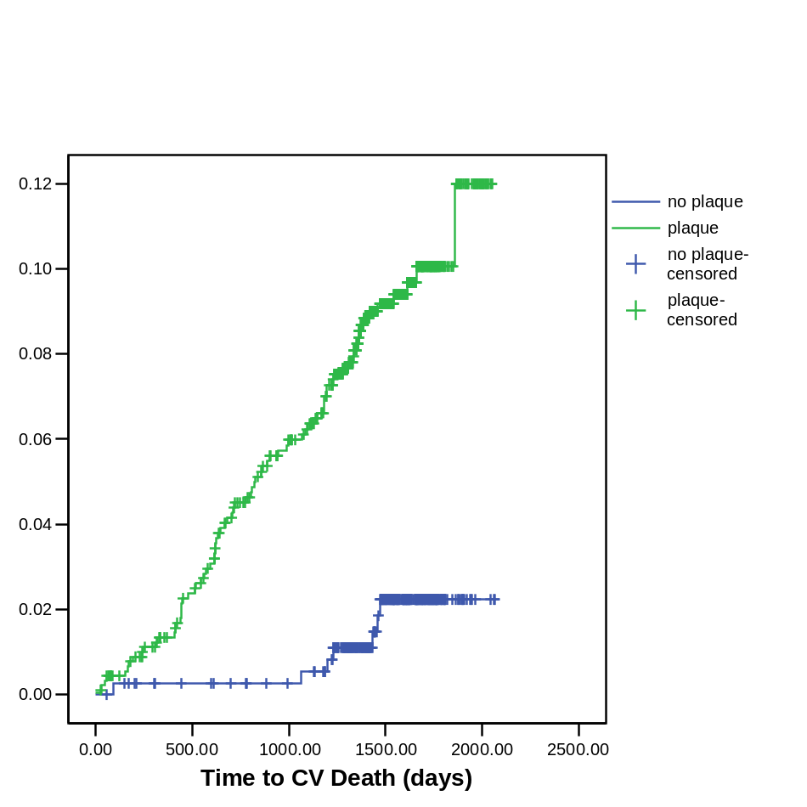
Discrete Carotid Plaque & Cardiovascular Death in Diabetes: The Strong Heart Study
P<0.006, adjusted
For age, gender, BP,
BMI, LDL, HDL &
smoking.
Restrictive Pattern:
OR = 3.71, 95% CI =
1.46-9.39
Proportion Suffering CV Death
Devereux et al.:
3/2006

Slide 26
Adverse Cardiovascular Effects of Diabetes: Conclusions
As the US population becomes more obese & older, diabetes is becoming ‘epidemic’
In SHS participants, diabetes is associated, independent of covariates & CHD manifested clinically or by echo or ECG, with:
  LV hypertrophy & dysfunction, impaired LV filling and systemic atherosclerosis
In diabetic adults, these abnormalities independently predict CV events and death, with HRs 1.5 to 3.7.
Thus, assessment of preclinical CV disease improves prediction of risk in diabetic adults and may identify individuals who will especially benefit from therapy that is more intensive or targeted to reversal of cardiac abnormalities.

Slide 27
Pathways to Cardiovascular Events in Diabetes: Lessons from the Strong Heart Study
CV Events
CV Death
{
LV Dysfunction
Adapted from Devereux and Alderman: Circulation 1993;88:1444-1455.

Slide 28
Prevention of Cardiovascular Events in Diabetes: Future Challenges for SANDS and Beyond
CV Events
CV Death
{
LV Dysfunction
Optimal control of glycemia, BP, lipids, regimens
optimized to reverse LVH, dysfunction & plaque
Adapted from Devereux and Alderman: Circulation 1993;88:1444-1455.

