Slide 1
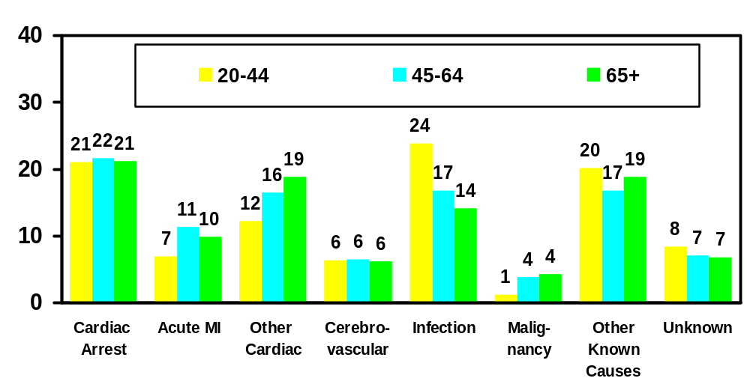
Distribution of Causes of Death for All Dialysis Patients by Age, 1994-96
% of Deaths
Rate=95* Rate=173* Rate=341*
*Total deaths/1000 pt yrs;
includes missing cause
Cause of Death

Slide 2
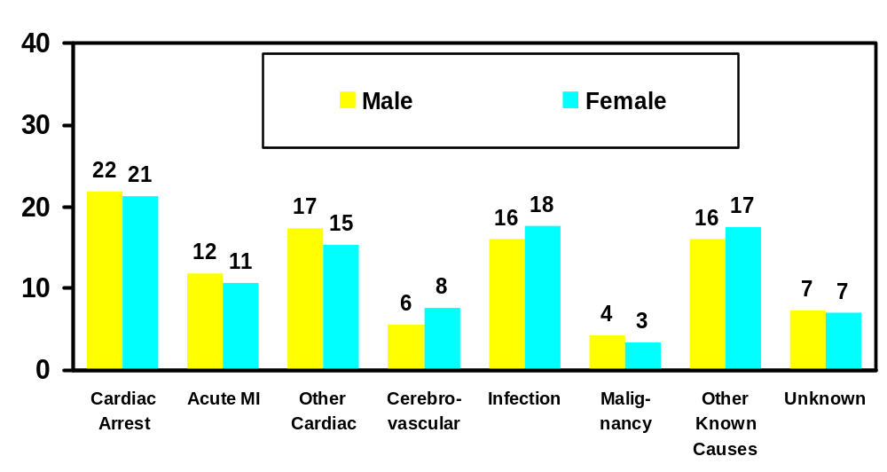
Distribution of Causes of Death for Dialysis Patients, Ages 45-64, by Sex, 1994-96
% of Deaths
Rate=175* Rate=171*
*Total deaths/1000 pt yrs;
includes missing cause
Cause of Death

Slide 3
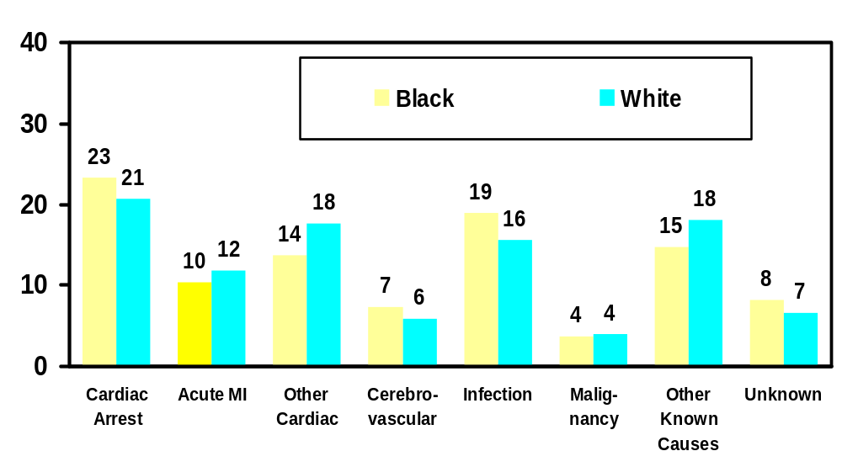
Distribution of Causes of Death for Dialysis Patients, Ages 45-64, by Race, 1994-96
% of Deaths
Rate=141* Rate=206*
*Total deaths/1000 pt yrs;
includes missing cause
Cause of Death

Slide 4
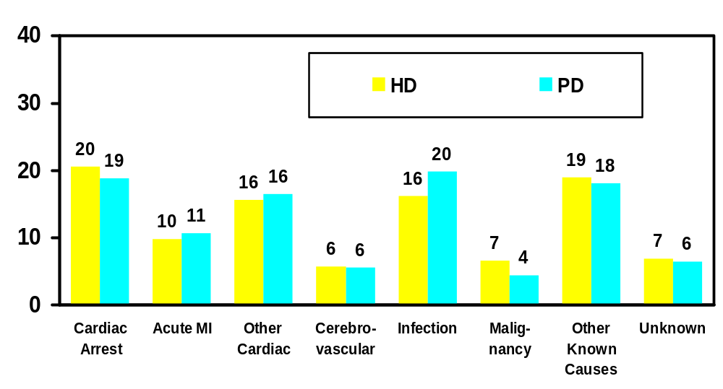
Distribution of Causes of Death for Nondiabetic Dialysis Patients, Ages 45-64, by Modality, 1994-96
% of Deaths
Rate=135* Rate=142*
*Total deaths/1000 pt yrs;
includes missing cause
Cause of Death

Slide 5
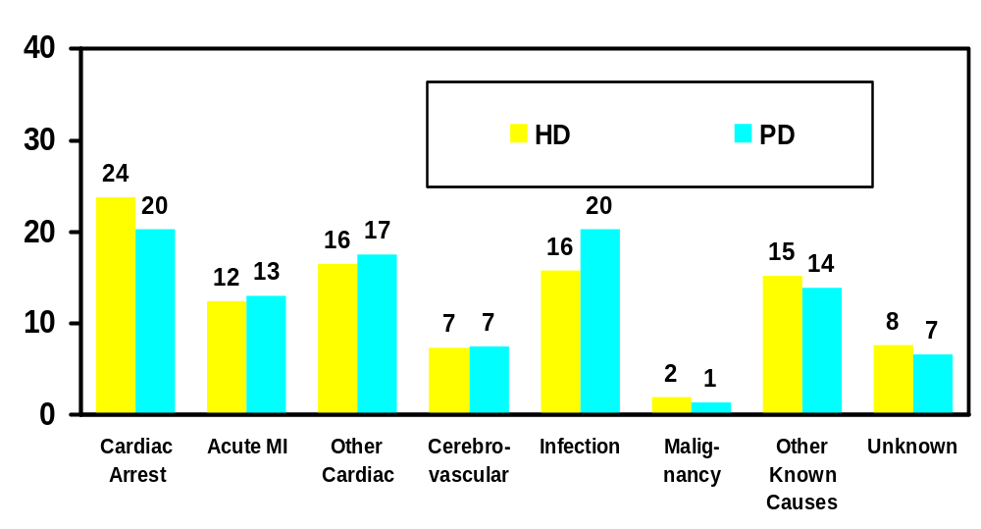
Distribution of Causes of Death for Diabetic Dialysis Patients, Ages 45-64, by Modality, 1994-96
% of Deaths
Rate=202* Rate=278*
*Total deaths/1000 pt yrs;
includes missing cause
Cause of Death

Slide 6
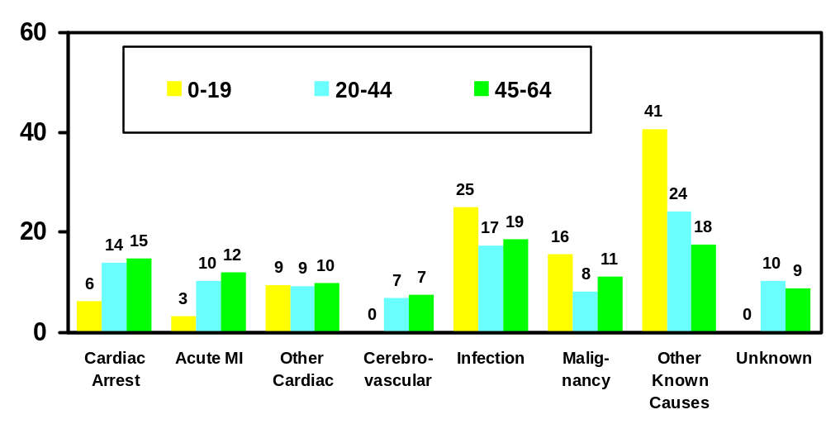
Distribution of Causes of Death for All Transplant Patients by Age, 1994-96
% of Deaths
Rate=6* Rate=16* Rate=44*
*Total deaths/1000 pt yrs;
includes missing cause
Cause of Death

Slide 7
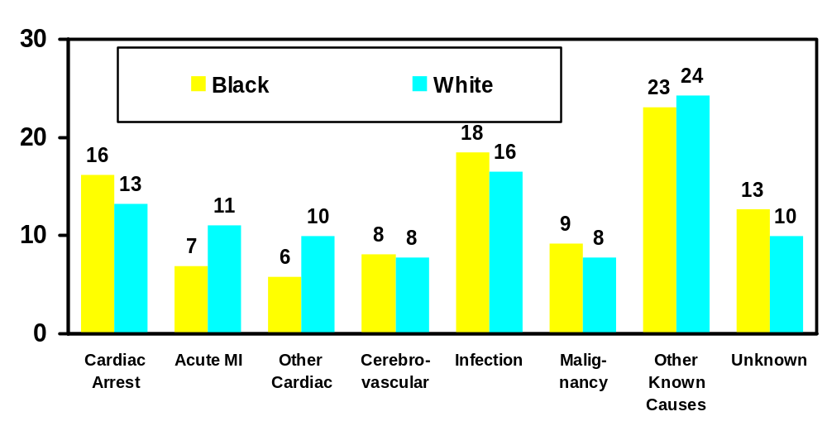
Distribution of Causes of Death for Transplant Patients, Ages 20-44, by Race, 1994-96
% of Deaths
Rate=16* Rate=17*
*Total deaths/1000 pt yrs;
includes missing cause
Cause of Death

Slide 8
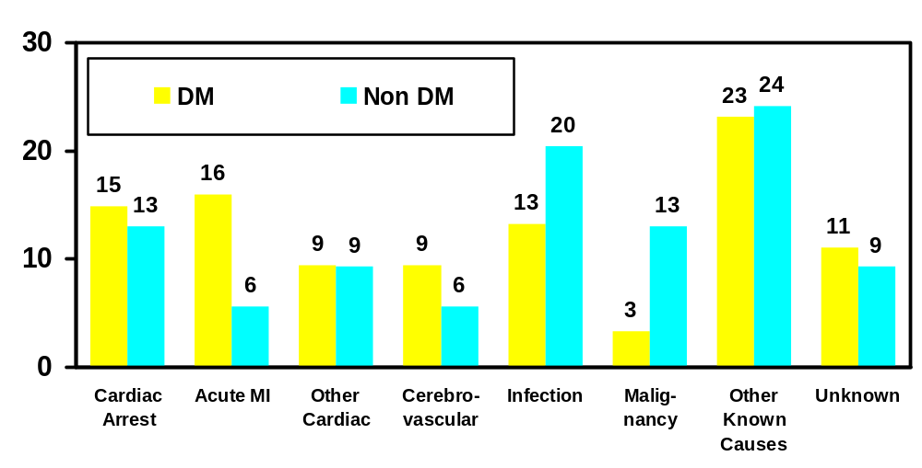
Distribution of Causes of Death for Transplant Patients, Ages 20-44, by Diabetic Status, 1994-96
% of Deaths
Rate=33* Rate=11*
*Total deaths/1000 pt yrs;
includes missing cause
Cause of Death

Slide 9
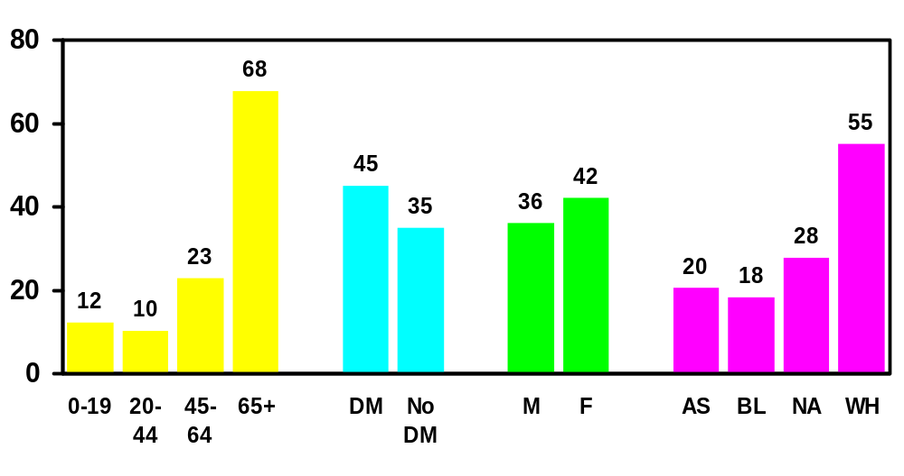
Rate of Withdrawal from Dialysis
by Age, Diabetes, Sex, and Race, 1994-96
Deaths / 1000 Dialysis Pt. Yrs.
Overall Withdrawal Rate=39

Slide 10
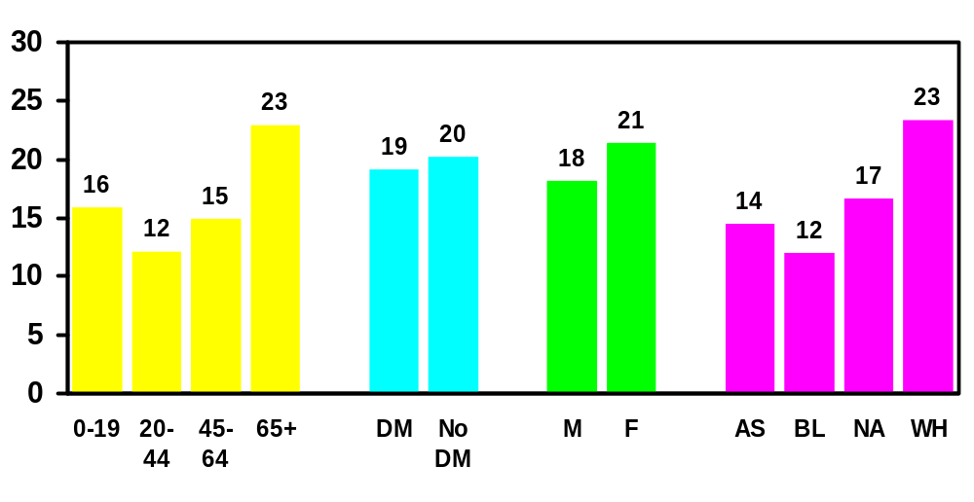
Percentage of Deaths* with Prior Withdrawal by Age, Diabetic Status, Sex, and Race, 1994-96
Withdrawal as a % of Deaths
Overall 20% Withdraw
*HD and PD patients

Slide 11
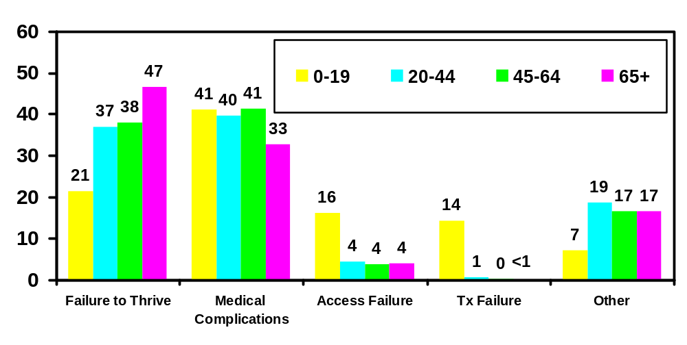
Reasons for Withdrawal from Dialysis
by Age, 1994-96
% of Withdrawal Deaths
Rate=12* Rate=10* Rate=23* Rate=68*
*Overall withdrawal
deaths/1000 pt yrs
Reason

