Slide 1
Comments heard about it
Where do they come up with these things? Do they just pick them out of the air?
Does anyone back there know what they are doing?
It’s another top down mess
I can’t believe that they think that they can tell us how to practice medicine
They don’t know what they are talking about
They want me to do what?
Is there any money?

Slide 2
Our Response:
GPRA BUSTERS

Slide 3
GPRA BUSTERS
Where do they come up with these things?
  We make them up ( no.. They are based on goals)
Does anyone back there know what they are doing?
  Well…
I can’t believe that they think that they can tell us how to practice medicine
  No, we know that we can’t
They don’t know what they are talking about
  Sometimes, but sometimes, we do
They want me to do what?
  Don’t worry. We’ll tell you
Is there any money?
  Mike Lincoln will answer that!

Slide 4


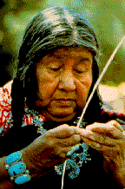

Clinical Quality Initiatives
Impact on AI/AN health status
February 2004

Slide 5
We Can Change The World
The Indian Health Service is committed to improving clinical outcomes by improving clinical quality

Slide 6
Improving Quality of
Health Care for AI/AN
Objectives
  What affects clinical quality
  How do we measure clinical quality
  Quality of care indicators

Slide 7
What affects Clinical Quality in the I/T/U setting?
Limited resources ( human, fiscal, administrative)
Increasing User population
Increasing disease burden ( obesity, diabetes, CVD, cancer, suicide, violence, alcohol and substance abuse)
Budget increases do not keep pace with medical inflation
Recruitment and retention issues (e.g. dental)

Slide 8
What affects Clinical Quality in the I/T/U setting?
Concerned communities
Caring and compassionate staff
A sense of support
Creating possibilities
Embracing prevention and innovation
Knowing the guidelines
Knowing where the best practices are

Slide 9
How do we measure clinical quality?
Outcomes
Content quality
  Technical and clinical expertise (guidelines)
  Standards of care
Delivery quality
  Interpersonal components of care
Service quality
  Patients requirements and needs are met

Slide 10
What interferes with our measurements?
Kubler-Ross Stages of Performance Improvement
“The data are wrong.”
“The data are right, but it’s not a
problem.”
“The data are right; it is a problem;
but it is not my problem.”
“I accept the burden of
improvement.”

Slide 11
So, what do we do?
Recognize that the local facility( and staff) is where clinical quality begins
Measure what is important to our communities in as passively as way as possible ( see indicators)
Feedback information to the local level, as well as the regional and national level
Use this information to assess and report performance at these different levels, including Congress
Link performance to the budget process
( show how the I/T/U health care system
is a good investment)

Slide 12
Clinical Quality Indicators
    indicator name
    how long has it been an indicator
    why is it an indicator
    what is the impact of achieving this indicator goal
    what is the likelihood that we can achieve this goal at a national level
    What is the likelihood that YOU can achieve this goal at your facility

Slide 13
Diabetes Group
Ideal control (FY 97 )
Poor Control (FY 04)
Blood Pressure Control ( FY 97 )
Nephropathy Screening (FY 97 )
LDL screening (FY 97 )
Retinopathy ( FY 03)

Slide 14
Why are they indicators/ Impact of achieving- diabetes group
  Rationale:
    Diabetes is a major problem in AI/AN communities
    These indicators, as well as others in the diabetic audit, are standards of care
    Achievable goals
  Impact of Achieving:
    Reduce health disparities
    Improving diabetic blood sugar control will
      Save patients feet, kidneys, eyes, hearts, and lives
      Save money

Slide 15
Cancer Screening Group
PAP ( FY 99 )
Mammogram ( FY 99 )

Slide 16
Why are they indicators/ Impact of Achieving- Cancer Screening
Rationale
  Higher rates of late diagnosis of breast and cervical cancer in AI/AN communities
  Later diagnosis means higher mortality
Impact of Achieving
  Prevent cervical cancer
  Reduce the mortality and morbidity of cervical cancer and breast cancer

Slide 17
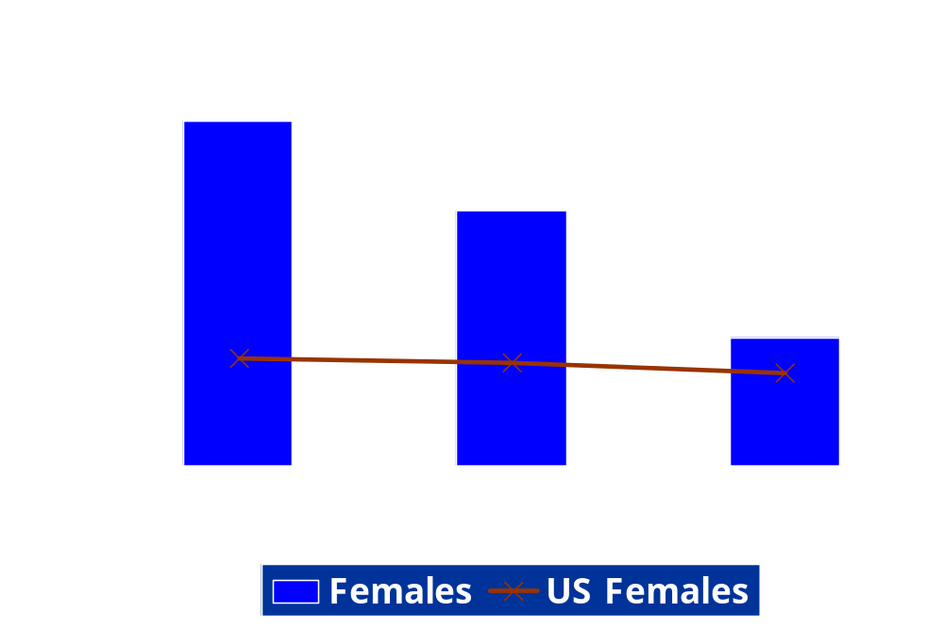
AI/AN Age-Adjusted Cervical Cancer Mortality
Rates, Compared to U.S. All Races, 1984-1998

Slide 18
Oral Health Group
Access to care ( FY 97))
Diabetic access to care (FY 99)
Dental Sealants (FY 01; changed in FY 02 to count numbers of sealants)
Fluoridation ( FY ’99)

Slide 19
Rationale / impact of achieving- dental group
Rational
  High incidence of dental caries, which increases risk for other diseases
  Diabetes increases risk for periodontal disease
  Many communities without fluoridation
  Adequate teeth are essential for proper nutrition
Impact of Achieving
  Prevent caries and teeth loss
  Improve nutritional status
  Decrease morbidity and mortality

Slide 20
Behavioral Group
FAS Screening ( since FY 99; changes in FY 04 to screening women for alcohol use)
Intimate Partner Violence ( since FY 99; changes in FY 04 to screening for DV in women)
Suicide Prevention ( since FY 00; changes in FY 04 to implementation of national suicide prevention initiative)
BH Data system utilization ( since FY 98)
YRTC ( since FY 99; changes in FY 05 to accreditation)

Slide 21
Rationale / impact of achieving- BH group
Rationale
  FAS- high incidence
  IPV – every AI/AN female homicide in NM in CY 02 was a victim of IPV
  Suicide prevention – highest rate
  BH data system – limited BH data up to now for advocacy
  YRTC – ensure ongoing support
Impact of Achieving
  Reduce health disparities
  Prevent FAS , IPV, suicide
  Improve outcomes for youth who are clients at YRTS
  Improve access to care as well as data

Slide 22
Potpourri’
Urban data ( FY 99)
Accreditation ( FY 98)
Consumer Satisfaction (FY 99)
Medication Errors (FY 02)
PHN Nursing Visits ( FY 00)
GPRA Passive Data Extraction- GPRA+
( FY 01)

Slide 23
Rationale/ Impact of Achieving- Potpourri
Rationale
  Desire to ensure comprehensive and quality care
  Morbidity and mortality associated with medication errors
  Desire for passive way to provide data to local facilities in a timely manner
Impact of Achieving
  Improved quality of care
  Improved consumer and provider satisfaction

Slide 24
Immunizations
Childhood ( FY 99)
Influenza ( FY 00)
Pneumovax ( FY 03)

Slide 25
Rationale/ Impact of Achieving – Immunizations
Rationale
  Childhood- reduce childood illness
  Influenza- reduce incidence of influenza
  Pneumovax- reduce pneumonia and other pneumococcal disease
Impact of Achieving
  Reduction morbidity and mortality of specific communicable diseases

Slide 26
Prevention Group
Obesity ( FY 99; changed in FY 04 to BMI measurement)
CVD ( FY 01 pilot projects; changes in FY 05 to LDL screening in adults)
Tobacco Cessation ( FY 00; FY 04 assess baseline screening rates)
HIV ( FY 05- baseline screening in pregnancy)
High Risk STD patients receive risk reduction counseling ( FY 04; no indicator in FY 05)

Slide 27
Rationale/ Impact of Achieving – Prevention
Rationale
  Obesity, CVD , and tobacco use are major and increasing problems
  Identification of high risk patients with STD’s, and care of HIV patients is critical to ensuring adequate treatment and decreased tranmission
Impact of Achieving
  Potentially reduce the rate of increase of these 3 major problems
  Impact on health disparities
  Increase utilization of cost- effective care ( for example, medical nutrition therapy)

Slide 28
Increasing the likelihood of your facility achieving clinical quality goals
Adopt an integrated approach to meeting the quality indicators
Integrate guidelines into your practice via PCC+ or health maintenance reminders
Use the clinical quality software to monitor your performance
Check out the ‘toolbox’ on the web site
Look for the best practices on the web site
Celebrate ( and publish) your successes

Slide 29
We Change the World
No one else can take your place
We can change the world
Re-arrange the world
Open up the door
We can change the world…
Nash 1970

