Slide 1
Deriving Quality Measures from EHRs:
Realizing the Benefits
Paul Tang, MD
VP, Chief Medical Information Officer
Palo Alto Medical Foundation

Slide 2
Outline
Accuracy of claims-based quality measures
NQF expert panel on use of EHR data elements in AQA and HQA quality measures
Recommendations to HITSP, CCHIT, NQF (AQA/HQA)

Slide 3
Deriving Quality Measures
What data are available?
Are they standardized and combinable?
What important quality questions can we answer with the data we have?
What quality goals can we set based on the data?

Slide 4
Impact of Using Administrative Data for Clinical Quality Reporting
Comparing Claims-Based Methods with EHR-Based Methods
Funded by CMS
Tang PC, et al. J Am Med Inform Assoc. 2007;14:10 –15.
http://www.jamia.org/cgi/reprint/14/1/10

Slide 5
Methods
Compared calculation of quality measures using administrative data vs. clinical data from an EHR for 125 diabetics identified through gold-standard chart review
  Claims-based definitions used in CMS DOQ project
  (2 visits with encounter diagnosis of diabetes)
  Query of coded information in EHR
    Problem list, medication list, lab results (and not progress notes)

Slide 6
Results
97% of gold-standard diabetics identified using EHR coded data
  94% identified using problem list alone
25% of gold-standard confirmed diabetics “missed” by administrative claims-based definition
Statistically significant difference for 50% of diabetic performance measures when comparing those identified using administrative definition vs. those missed by administrative definition

Slide 7
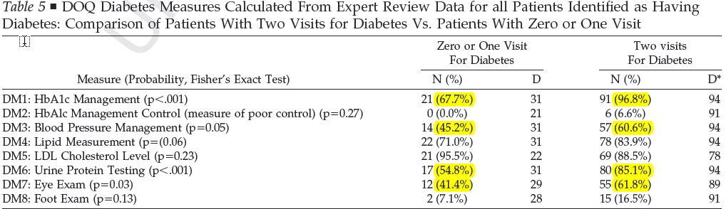
Results
Performance Measure Differences in Subgroups
Notes:
Performance measures for management of HbA1c may differ significantly between those patients identified by the DOQ rule (compliance = 97%) and those patients missed by the DOQ rule (compliance = 68%).

Slide 8
Implications
Claims-Based Measures
Underestimates target population (denominator)
Biased toward spuriously higher scores (self-fulfilling prophesy)
Subject to “gaming” (no clinical downside)
Potential to misdirect quality-improvement efforts
EHR-Based Measures
Accurately identifies target population (subject to policies)
More accurate, though lower scores may disincent EHR adoption
Clinical record less subject to “gaming” due to clinical reuse
More accurate tool to manage clinical QI initiatives

Slide 9
Deriving Quality Measures
What are the important quality goals?
What data do we need to answer the important quality questions?
Are they standardized and combinable?
Can we make them exist in EHRs?

Slide 10
NQF HIT Expert Panel
Use of EHRs to Support Quality Measures
Charge: To convene an expert panel to develop a set of common data elements and healthcare workflow changes to enable automation of performance measures through electronic health records (EHRs) and health information exchange.

Slide 11
NQF HIT Expert Panel
Members
Paul C. Tang, MD, MS (Chair)
Patricia A. Abbott, PhD, RN
Andrew Amster, MSPH
David W. Bates, MD
Paul Biondich, MD, MS
Sarah Corley, MD, FACP
Floyd P. Eisenberg, MD, MPH
John D. Halamka, MD, MS
Robert E. Kaplan, MHA
Karen Kmetik, PhD
Michael Lieberman, MD, MS
W. Paul Nichol, MD
Janette A. Orton, MS, BSN
Alisa Ray
Sharon Sprenger, MPA
Jack Starmer, MD
Charlene S. Underwood, MBA
James W. Walker, MD

Slide 12
NQF HIT Expert Panel
Federal Liaisons and NQF Staff
Federal Liaisons
Karen M. Bell, MD, MMS
Alicia Bradford, MS, RN
Kelly Cronin
Theresa A. Cullen, MD, MS
Tammy Czarnecki, MSN, RN
Marybeth Farquhar, RN, MSN
Latousha D. Leslie, RN, MS
John W. Loonsk, MD
Michael Rapp, MD, JD
Jonathan White, MD
NQF Staff
Janet M. Corrigan, PhD, MBA
Helen Burstin, MD, MPH
Kate Blenner
Lisa McGonigal, MD, MPH
Carol Ostrowski

Slide 13
NQF HITEP
Prioritization Framework
Clinical importance of health conditions
  Used IOM priority condition method
    Clinical impact
    Improvability
    Inclusiveness
Quality of data in EHR
Diversity of clinical data

Slide 14
NQF HITEP
Method
Prioritize AQA/HQA measures by IOM priority condition → high priority (chose 4 conditions as initial set to prioritize)
Extract data elements from AQA/HQA measures
Develop EHR data quality metric
Analyze quality of EHR data used in quality measures
Recommend changes to increase reliability/accuracy of quality measure
  Substitute higher quality or more accurate EHR data element
  Recommend HITSP action to standardize required coded data
  Recommend new or enhanced EHR functionality to ensure reliable capture of necessary data elements for quality measures

Slide 15
EHR Data Quality
Data Quality Attribute
Weight (1-5)
Use of data standards
5
Authoritative source (Accuracy)
5
Feasible Workflow
4
Version control
2
Available in EHRs
4

Slide 16
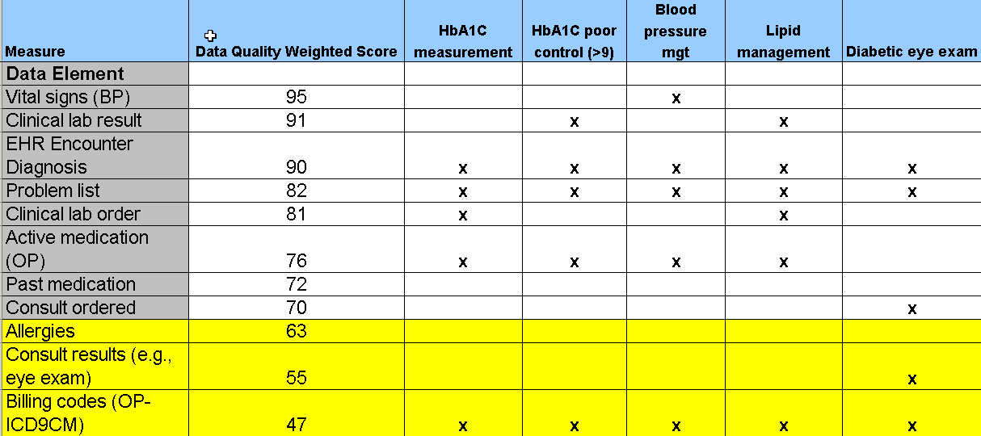
Diabetes Cluster
Quality Measures

Slide 17
NQF HITEP Recommendation
Identification of Target Population
“The Expert Panel recommends that a coded interdisciplinary problem list in the EHR be used in place of billing codes to identify patient conditions for quality measurement.”

Slide 18
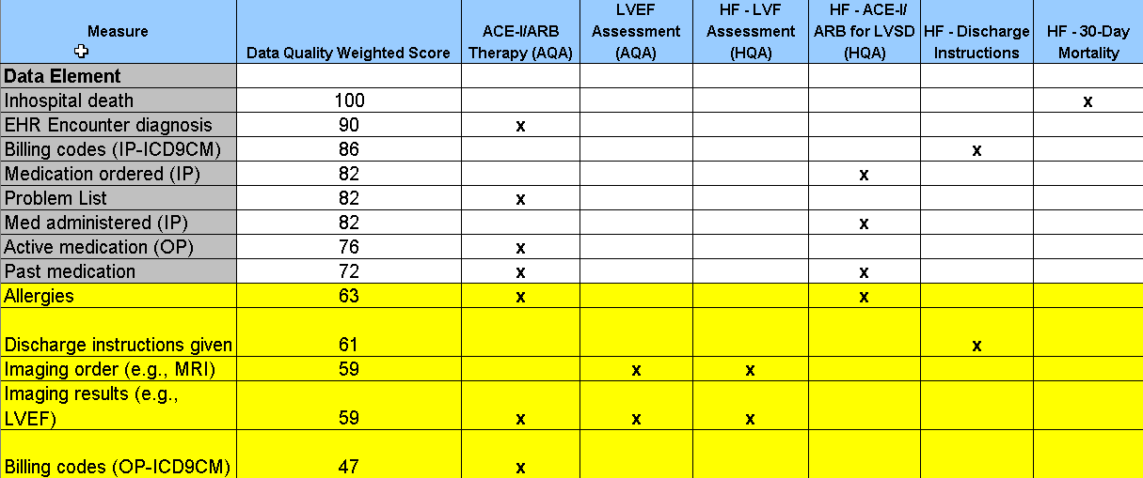
Heart Failure Cluster
Quality Measures

Slide 19
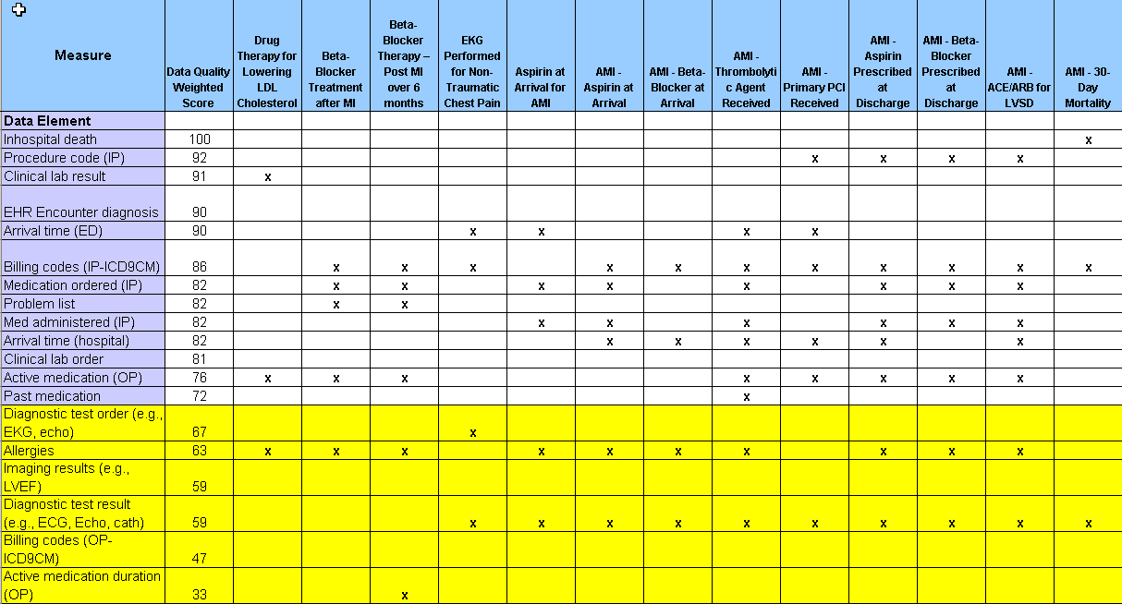
Coronary Artery Disease Cluster
Quality Measures

Slide 20
NQF HITEP Recommendations
To HITSP
Identify standardized code sets (e.g., ICD10-CM, SNOMED) that accurately represent patient diagnoses/conditions
Identify standards to encode medication allergies and side effects
Identify standards to encode results of diagnostic tests (e.g., LVEF, radiology results)
Identify standards to encode results of consults (e.g., diabetic retinal eye exam)

Slide 21
NQF HITEP Recommendations
To EHR Vendors and CCHIT
Develop functionality to efficiently capture distinctions between true hypersensitivity allergic responses to a drug vs. drug intolerance or side effects
Develop functionality to efficiently code results of diagnostic tests (e.g., LVEF)
Develop functionality to automatically capture the issuance of discharge instructions regarding specific conditions
Develop methods of using pharmacy data to determine duration of medication usage

Slide 22
NQF HITEP Recommendations
To NQF
Adopt problem list method of identifying target population for clinical quality measures going forward
Promote use of EHR data quality attribute to development of clinical quality measures going forward (e.g., AQA, HQA) and use as part of NQF endorsement criteria
Re-evaluate measures that use low-quality data elements

Slide 23
Next Steps
Apply EHR data quality metric to remainder of AQA/HQA measures and analyze results
Formulate a quality measure strategy to encourage development and use of quality measures derived from EHRs
Develop strategy to migrate from administrative claims data to EHR data

