Slide 1
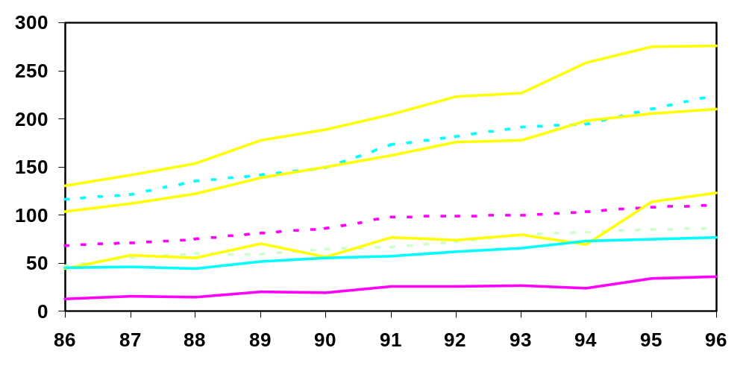
Treated ESRD Incidence Rate for Selected Countries, 1986-96
New Patients/Million Pop.
USA (All)
JPN
USA (White)
FRA
CAN
NL
AUS
POL
Year of ESRD Incidence

Slide 2
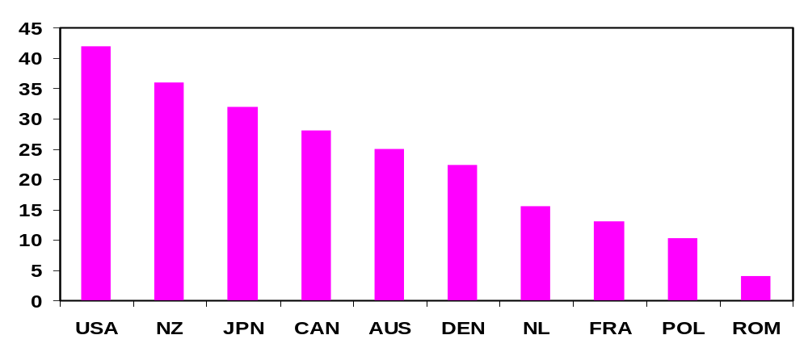
Percent of Incident ESRD Patients
with Diabetic Nephropathy
for Selected Countries, 1996
% of ESRD Patients
*
*
Country
* Data are from 1995

Slide 3
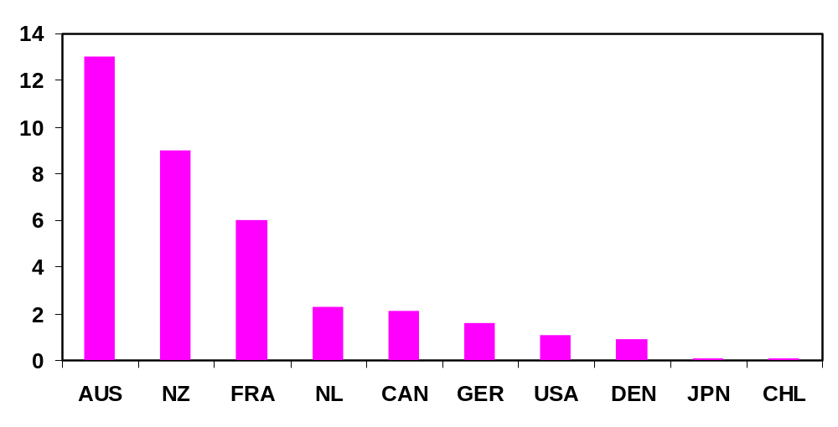
Percent of Prevalent Dialysis Patients Receiving
Home Hemodialysis for Selected Countries, 1996
% of Dialysis Patients
*
*
* Data are from 1995
Country

Slide 4
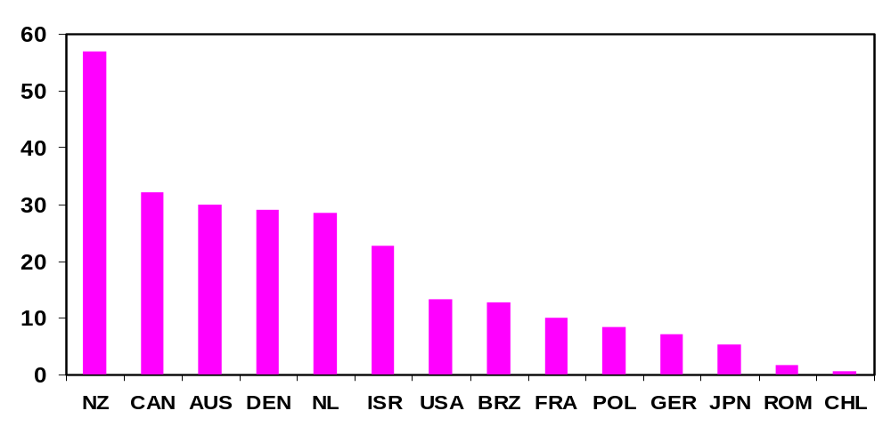
Percent of Prevalent Dialysis Patients Receiving
CAPD or CCPD for Selected Countries, 1996
% of Dialysis Patients
*
* Data are from 1995
Country

Slide 5
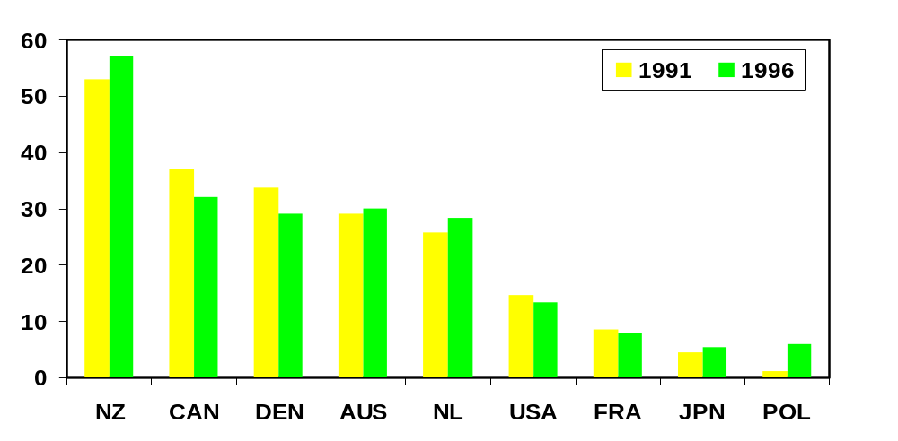
Utilization of CAPD/CCPD
for Selected Countries, 1991 versus 1996
% of Dialysis Patients Receiving CAPD/CCPD
*
*
*
Country
* Data are for 1990 versus 1995

Slide 6
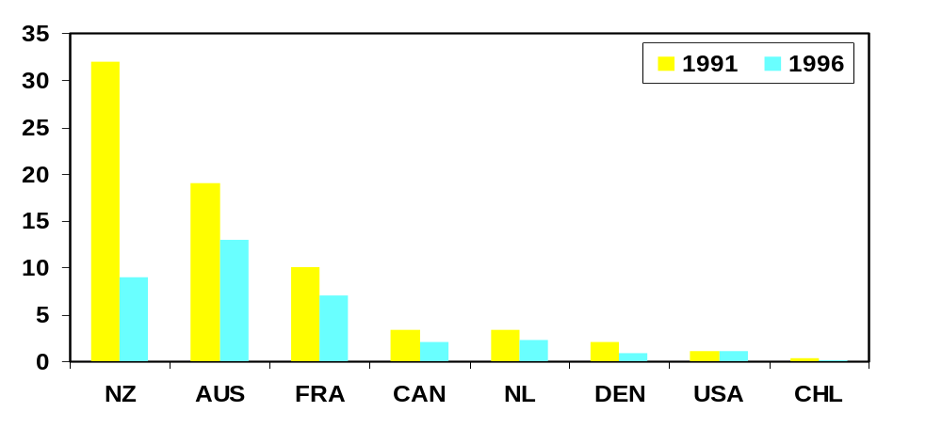
Utilization of Home Hemodialysis
for Selected Countries, 1991 versus 1996
% of Dialysis Patients Receiving Home Hemodialysis
*
*
Country
* Data are for 1990 versus 1995

Slide 7
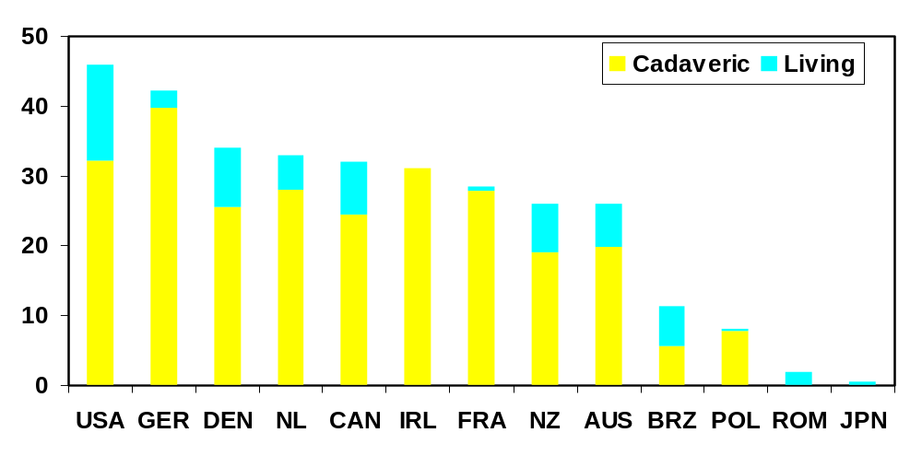
Transplantation Rates for Selected
Countries, 1996
New Transplants/Million Pop.
*
*
Country
* Data are from 1995

Slide 8
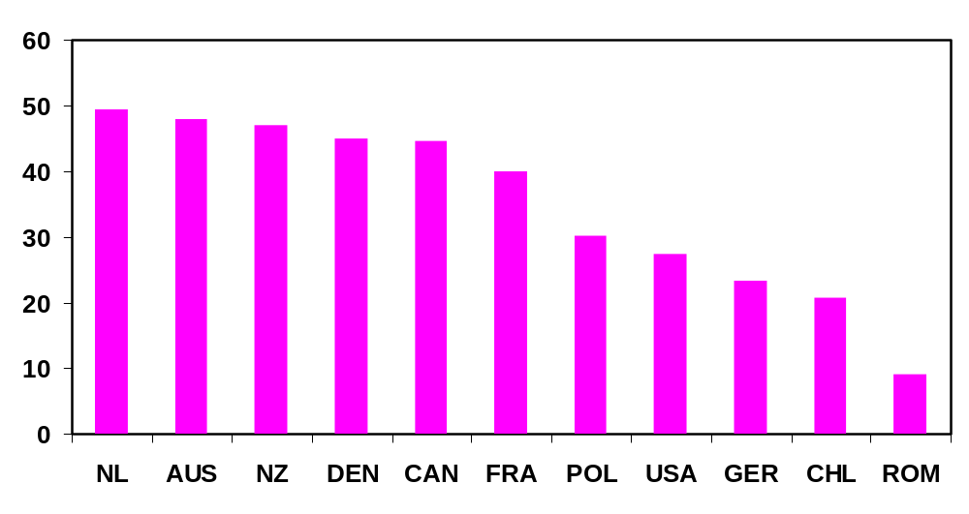
Percent of Prevalent ESRD Patients with
a Functioning Transplant, 1996
% of ESRD Patients
*
*
* Data are from 1995
Country

Slide 9
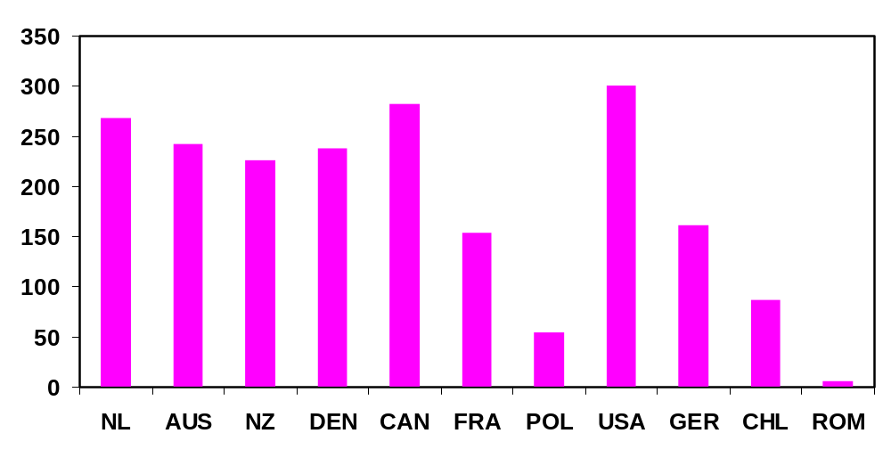
Patients with a Functioning Transplant
per Million Population, 1996
Functioning Transplants/ Million Pop.
*
*
* Data are from 1995
Country

Slide 10
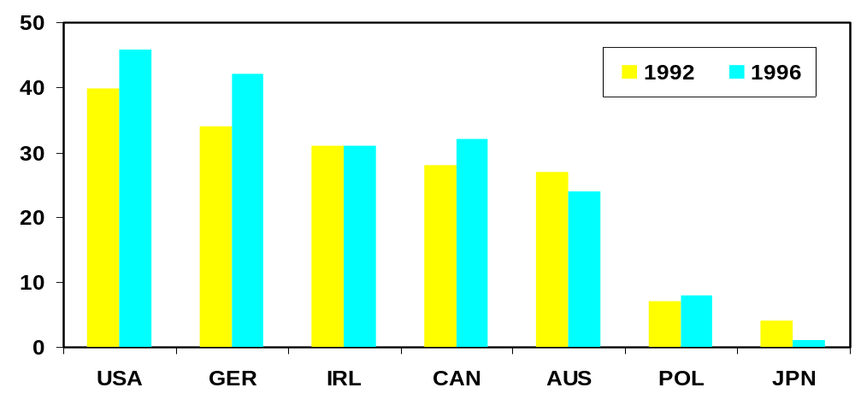
Utilization of Transplantation
for Selected Countries, 1992 versus 1996
New transplants/ Year/ Million pop.
*
* Data are from 1993 versus 1996
Country

